Slide 1
Deep Learning
(Yann LeCun, Yoshua Bengio & Geoffrey Hinton)
Representation learning methods
composed of simple non-linear modules
Moving to higher levels of abstraction.

Slide 2
Supervised Learning
Mapping inputs to outputs.
Steps (images)
  Categorize images
  Present images to algorithms
  Rank categories on each image
  Reward / punish on accuracy

Slide 3
Supervised Learning: Accuracy
Use Gradient Vector
  Each weight, tells us the change in error if incremented.
Objective Function
  Averaged over all training examples
  “Hilly landscape” in high-dimensional space of weight values
  Negative gradient vector indicates movement towards minimal error

Slide 4
Supervised Learning: Obj. Function
[In Practice]
Stochastic Gradient Descent
  Works quickly vs more optimized solutions
Performance measured on test set after training.
** Many current applications use:
  Linear classifiers + Hand-engineered features
  2-Class Linear Classifier computes a weighted of feature vector components
    When above threshold → Input is classified

Slide 5
Supervised Learning: Linear Classifiers
Linear Classifiers can only carve input space into simple 'half spaces' (separated by hyper plane)
  Not good for detailed features:
    Wolf vs Samoyed (wolf like dog)

Slide 6
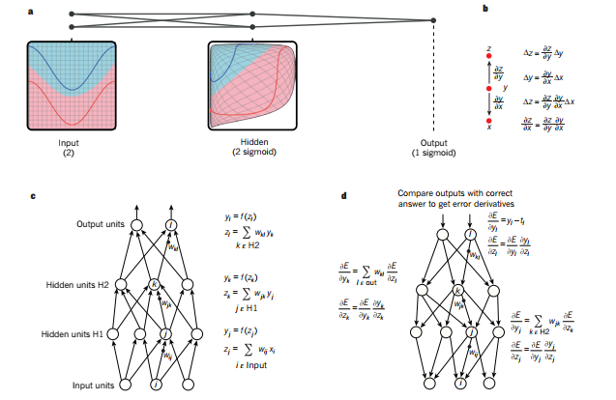
Multilayer Neural Networks and Backpropagation
a. Distortion of inputs to makes classes of the data (many choices on function: sigmoid here)

Slide 7
Multilayer Neural Networks and Backpropagation
Chain rule of derivatives
Small change of x on y and that of y on z
We select a continuous/differentiable function.

Slide 8
Multilayer Neural Networks and Backpropagation

