Slide 1
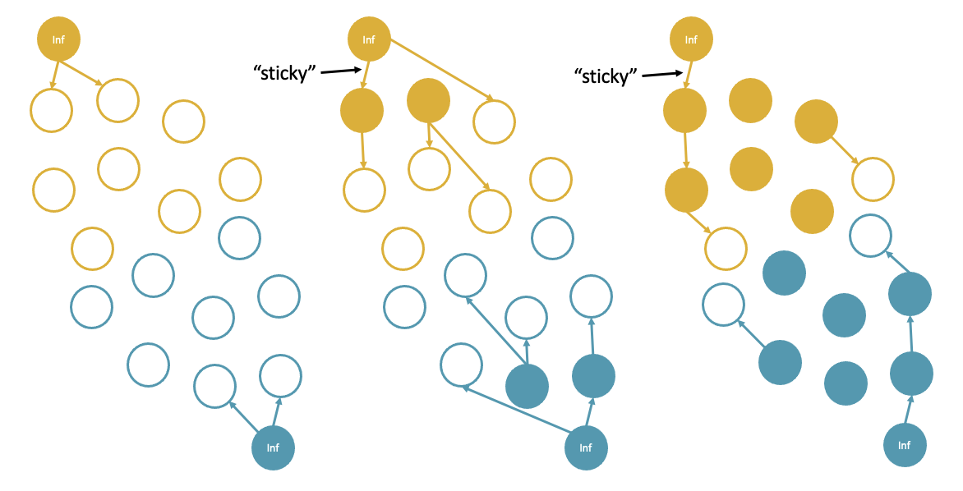



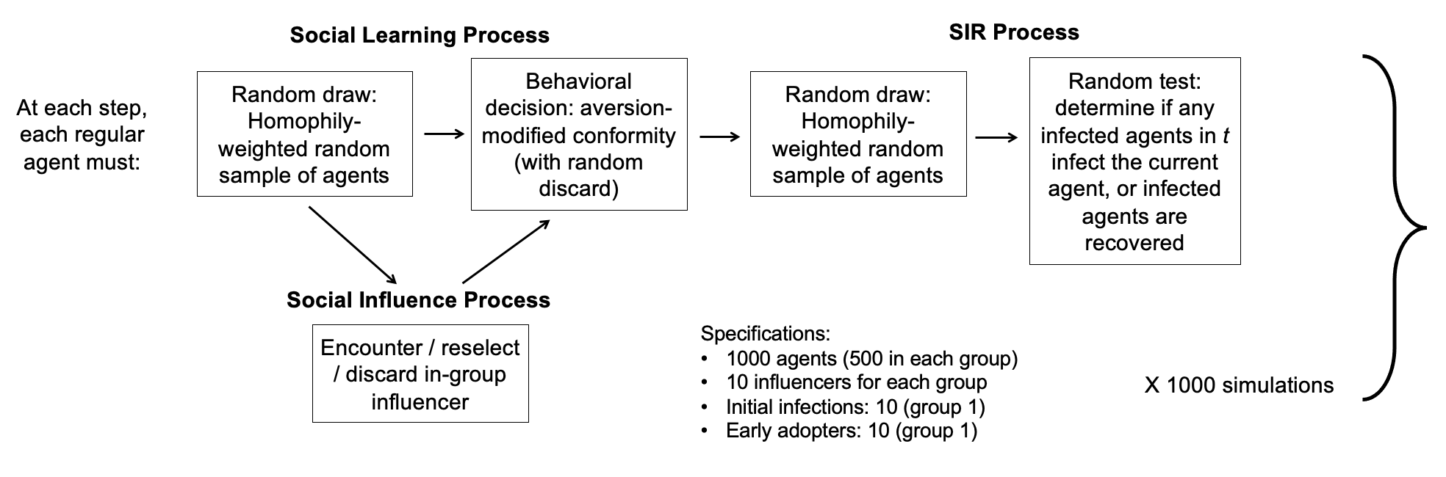
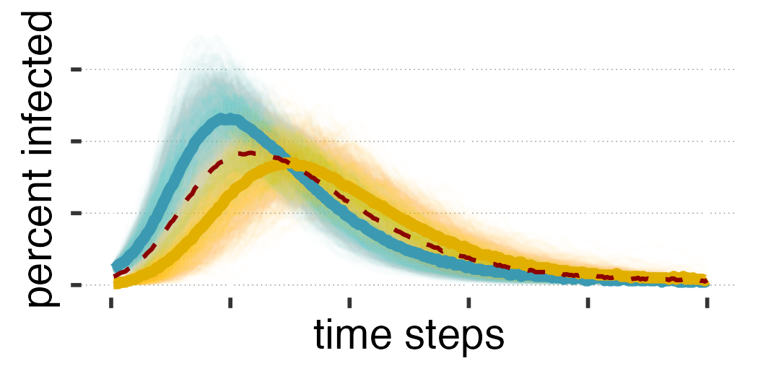
a)
b)
c)
Susceptible → Infected → Recovered
5% chance
per time step, t
(long recovery)
R₀ = 1.23
behaviour ✗
behaviour ✔️
VS.
85% efficacy
d)
Specifications:
1000 agents (500 in each group)
10 influencers for each group
Initial infections: 10 (early-infected)
Early adopters: 10 (early-infected)

