Slide 1

Geometry Guided Generalizable-FER
Jin Ho Kwak, Amsyar Hakimi, Chew Glenn
phseo@korea.ac.kr
Korea University

Slide 2

Facial Emotion Recognition(FER)
Computer Vision--ECCV 2024
Datasets : RAF-DB, FERPlus, AffectNet, SFEW2.0, MMA

Slide 3

Facial Expression Recognition(FER)
What is the task
  Classify image input into 7 expression
    Input: an image of a human face
    Output: label from 7 expression
(happy, surprise, anger, sad, fear, disgust, neutral)

Slide 4
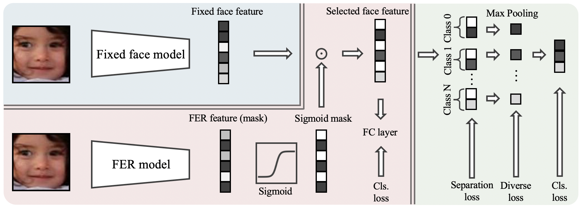
Generalizable-FER
Step 1: Extract fixed face features via large pre-trained models (CLIP).
Step 2: Learn a Sigmoid Mask to select only expression-relevant channels.
Step 3: Classify based only on selected features to avoid noise.

Slide 5
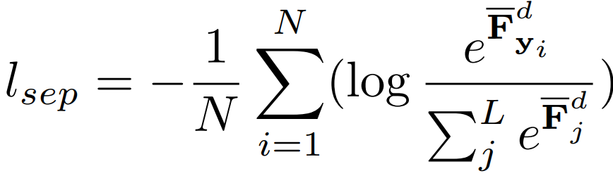
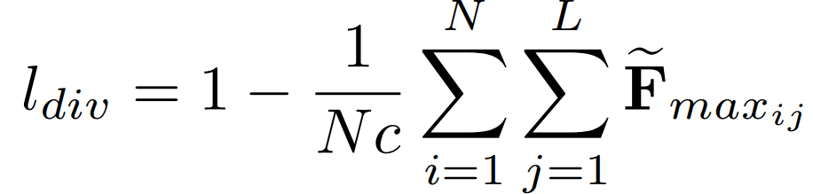
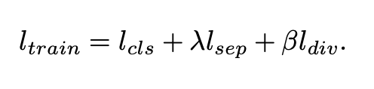
Original Loss
Separate 512 channels into 7 group, where each group of channels have 1 class they really focusing on
make sure in each group, every channels are diverse and not learn the same thing

Slide 6
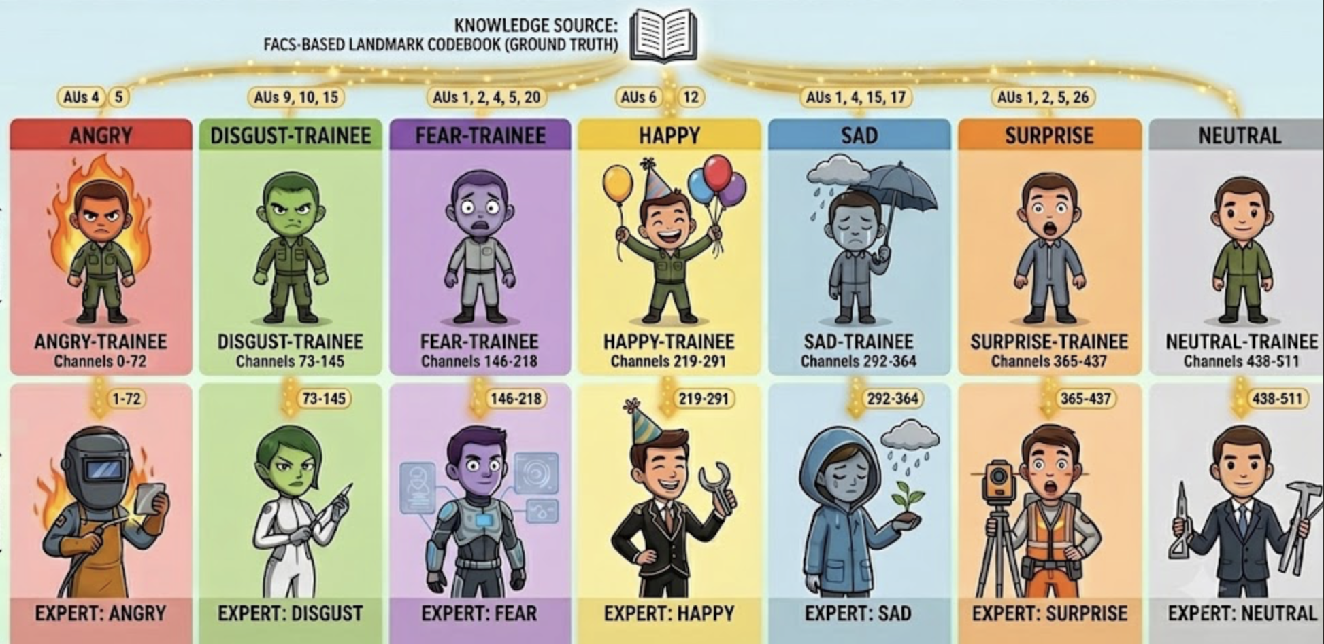
Generalizable-FER

Slide 7
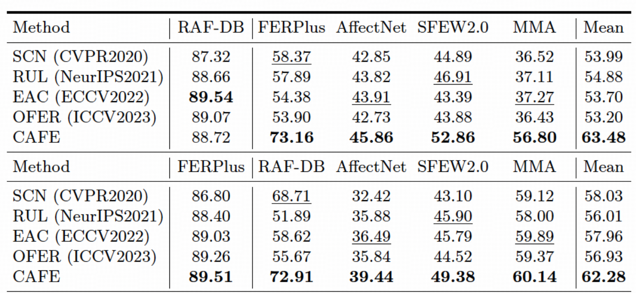
Generalizable-FER
more generalized but not enough to capture fully generalizable facial expressions

Slide 8
Facial Landmarks
Geometric Blindness
Vision encoders struggle to capture fine-grained facial structure information (landmarks) and precise spatial relationships essential for subtle expressions.
(Multimodal Prompt Alignment for Facial Expression Recognition, IEEE, 2025)
Identity Entanglement
Facial Expression Analysis (FEA) suffers from severe identity bias, where expressions are entangled with task-irrelevant factors like identity and head pose.
(Norface: Improving Facial Expression Analysis by Identity Normalization, ECCV, 2024)
Need a specific facial
expression reference!

Slide 9
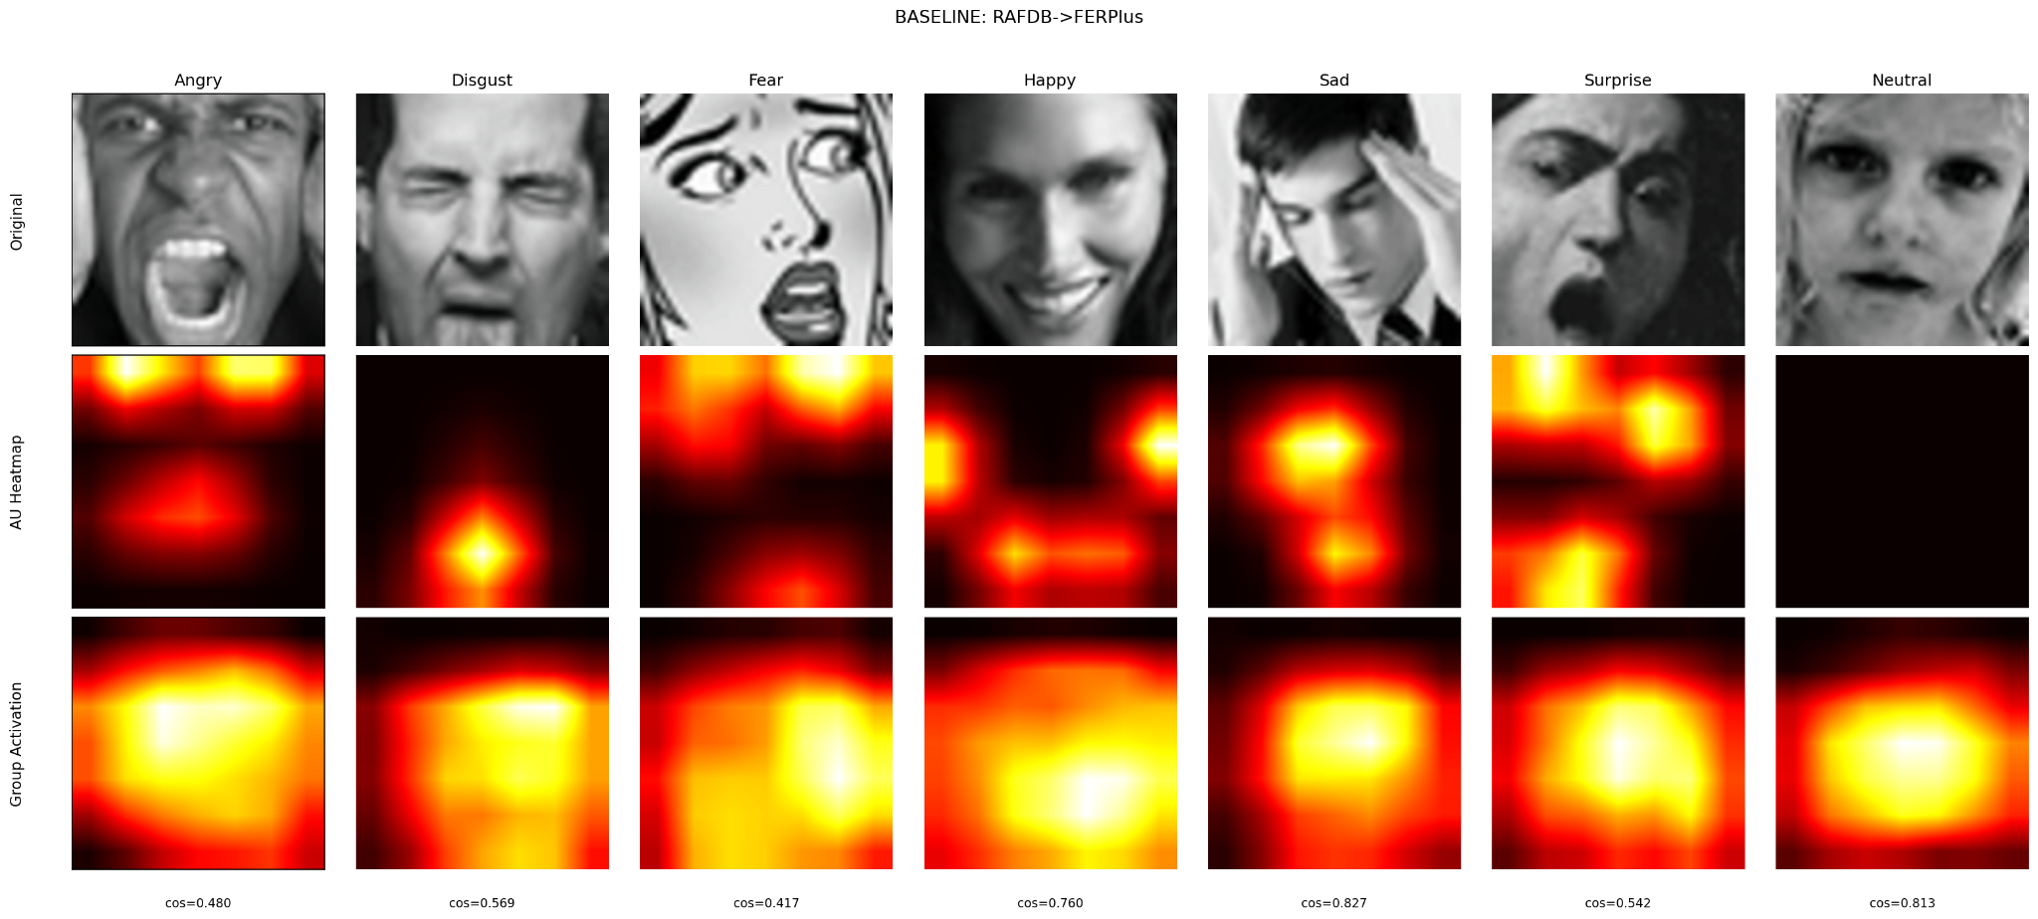
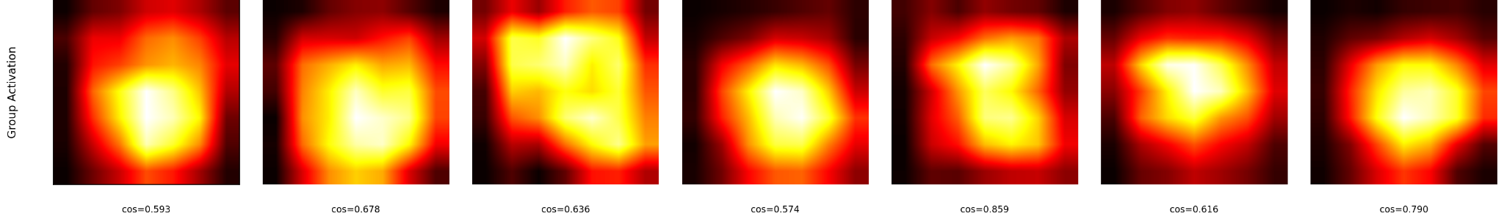
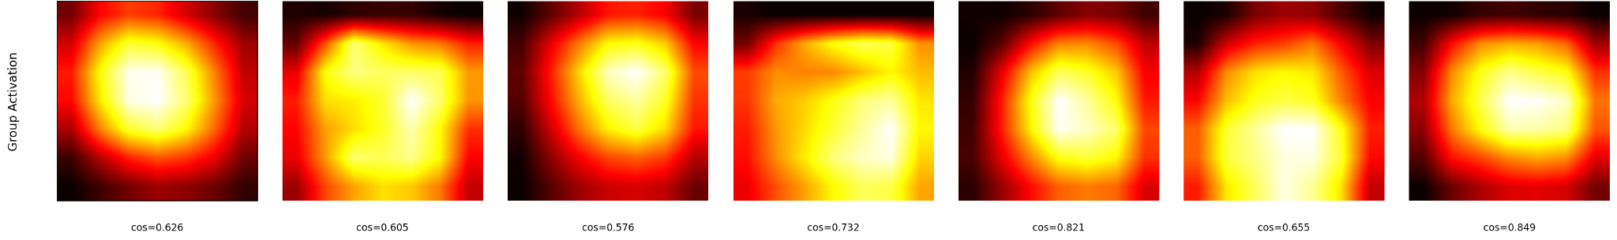
About the Datasets
The baseline group activations are broad and diffuse over the whole face(average cosine similarity=0.63)

Slide 10
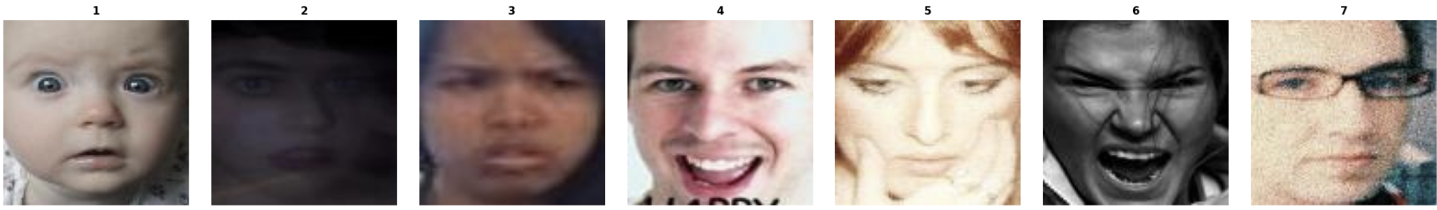
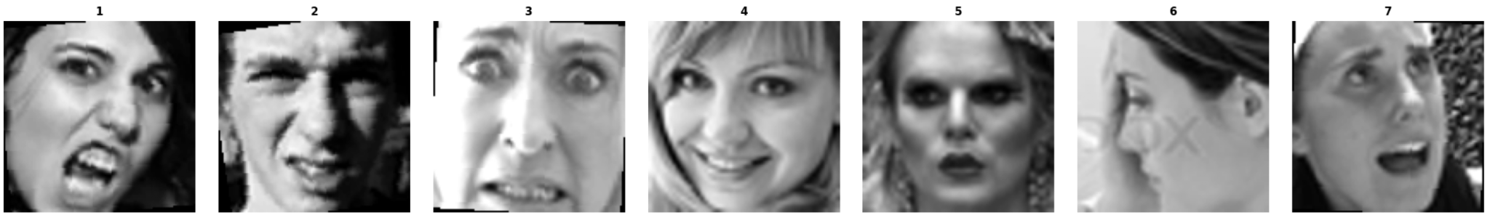
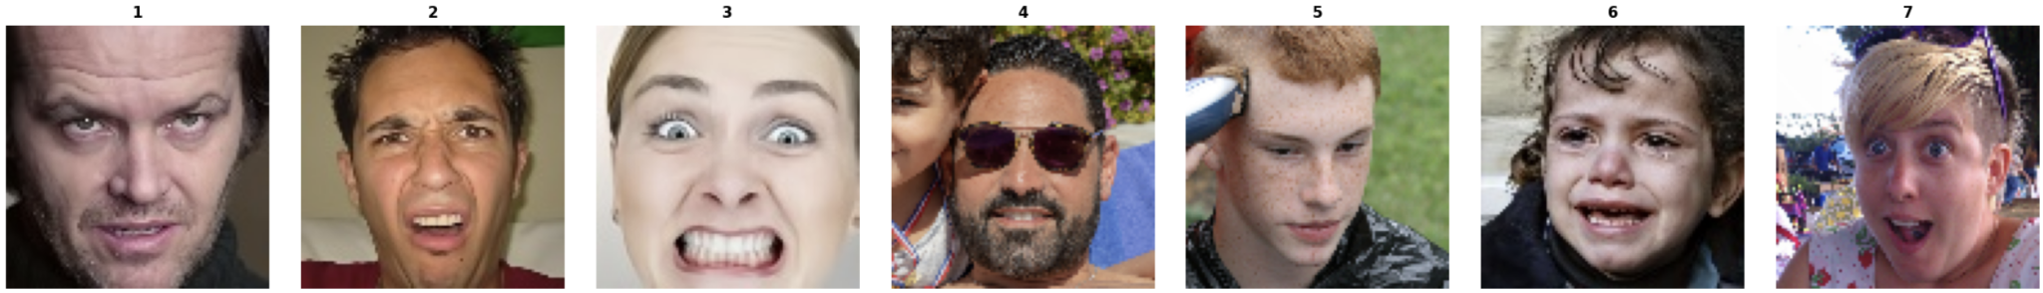
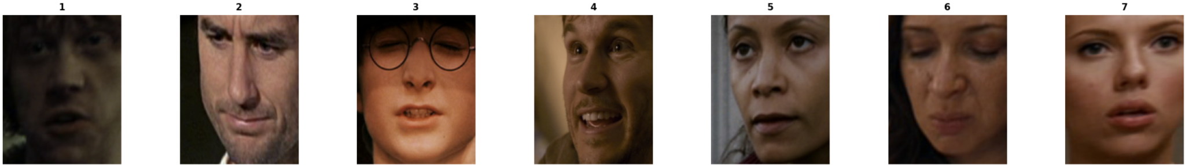
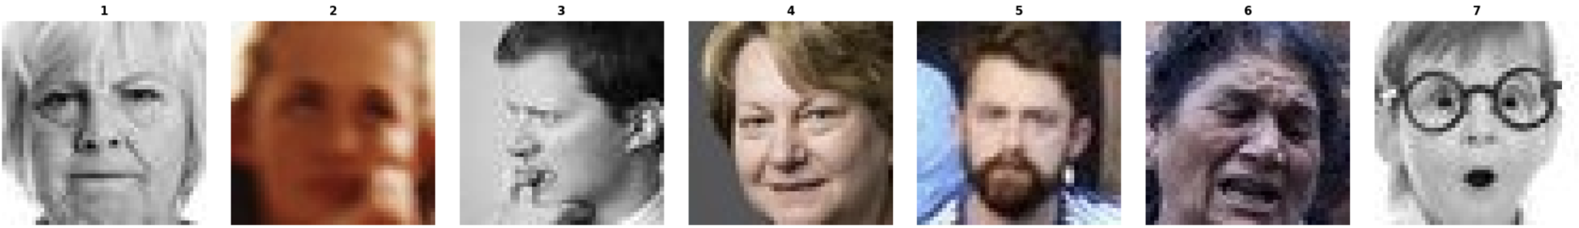
About the Datasets
Dataset | Image Input | Description
RAF-DB |  | 7 basic expressions by 40 trained human coders.
FERPlus |  | FER2013 with cleaner labels collected by the Google search engine.
AffectNet |  | Contains 8 expressions (7 basic + contempt).
SFEW2.0 |  | Real-world dataset collected from movie frames
MMA |  | Majority of expressions from individuals of European and American descent

Slide 11
Limitation
Lacks emotion-specific localization
CAFE's ResNet learns spatial patterns from the full face without anatomical guidance. Channels could activate on background, hair, or lighting rather than facial muscles.
Domain gap between datasets
CAFE has no domain-robustness mechanism
→ features transfer poorly across datasets (87% → ~52%).
AU muscle geometry is relatively more domain-stable

Slide 12
Goal
Goal: Improve cross-dataset generalization of the CAFE model
Hypotheses
H1 · Per-Group FACS Attention guide each emotion group toward its respective AU region
→ relies on facial geometry( a relatively more domain-stable cue than appearance)
→ better transfer
H2 · Data Augmentation simulate unseen-domain variation
→ less overfitting to source appearance
→ better transfer
Validation: Ablation study to analyze individual and combined effects
(Mean Accuracy) across multiple datasets

Slide 13
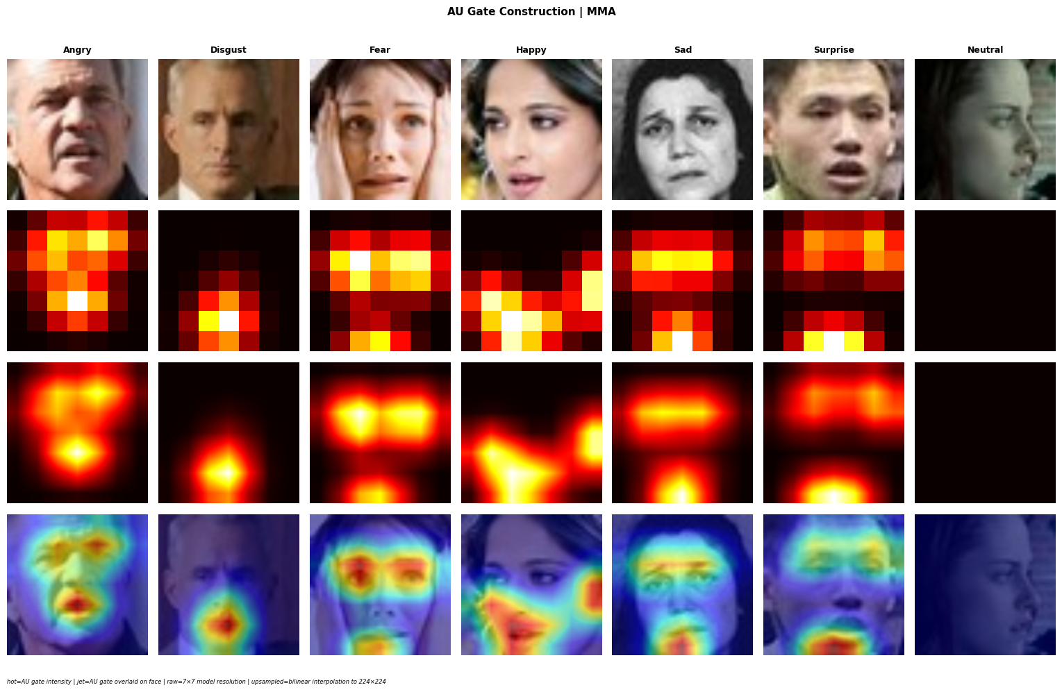
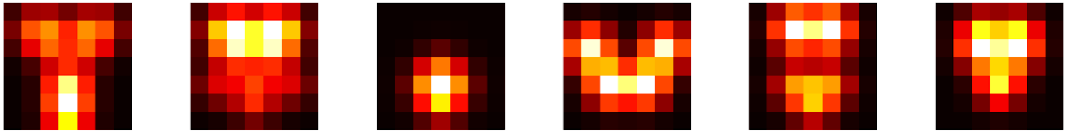
Generalizable-FER
Action Units (AU)
From the Facial Action Coding System (FACS) by Ekman & Friesen (1978)
Each AU represents a specific facial muscle movement
“Every facial expression is a combination of specific AUs“
Belharbi et al. [FG 2024]
7x7 AU Spatial Heatmap
Surprise
Fear
Disgust
Happy
Sad
Angry
Neutral
Brows
+
Jaw Dropping
Brows
+
Eyes + Mouth
Nose
+
Mouth
Cheeks
+
Lip corners
Brows
+
Lip + Chin
Brows lowered
+
Lip pressed
No focus

Slide 14
Method : Per Group Facial Attention
. Build AU heatmaps (FACS prior)
FACS codebook: expression → active AUs → 68 landmark points
Detect landmarks per input image via face_alignment (re-detected after augmentation, so the map stays aligned)
→ one 7×7 AU heatmap per emotion
Gate each group with its own emotion's heatmap
group_k × AU-heatmap_k
→ each group is aligned to its expression's AU region

Slide 15
Generalizable-FER

Slide 16
Generalizable-FER
Fixed Landmarks (ours)
✓
Learnable Landmarks
✘
Detected from face anatomy
→ Good for cross generalization
Optimized by gradient descent
→ Adapts to trained dataset only
Area showing mouth will always be mouth after cross-dataset test
→ Spatial constraint transfer
Landmark position overfit to trained dataset
→ Focused landmark can drift away for cross-dataset test
Suits this model’s cross-dataset generalizable goal
Similar to Belharbi et al. [FG 2024], we use fixed AU-based spatial heatmaps built from detected landmarks and then use it as a soft spatial filter that suppresses non-expression relevant regions

Slide 17





Generalizable-FER
Proposed Pipeline
Class 1
Input Image
CLIP
Image Features
×
Masked Features
224×224×3
ViT-B/32
Frozen
N × 512
N × 512
Class 2
ResNet-18
AVG
Pool
Input Image
Layer 4
×
AU_attention
FC Layer
. . .
. . .
224×224×3
MS-Celeb
pretrained
N×512×7×7
N x512x7x7
Class N
Sigmoid Mask
Output
(7 Expression Class)
Input Image
FAN
Facial Landmarks
AU Heatmap
224×224×3
Facial Landmark Pretrained
68 Landmarks per image
FACS landmark changed into 7x7 map per group
Pre-cached
Separation Loss
Diverse Loss
Cls
Loss

Slide 18
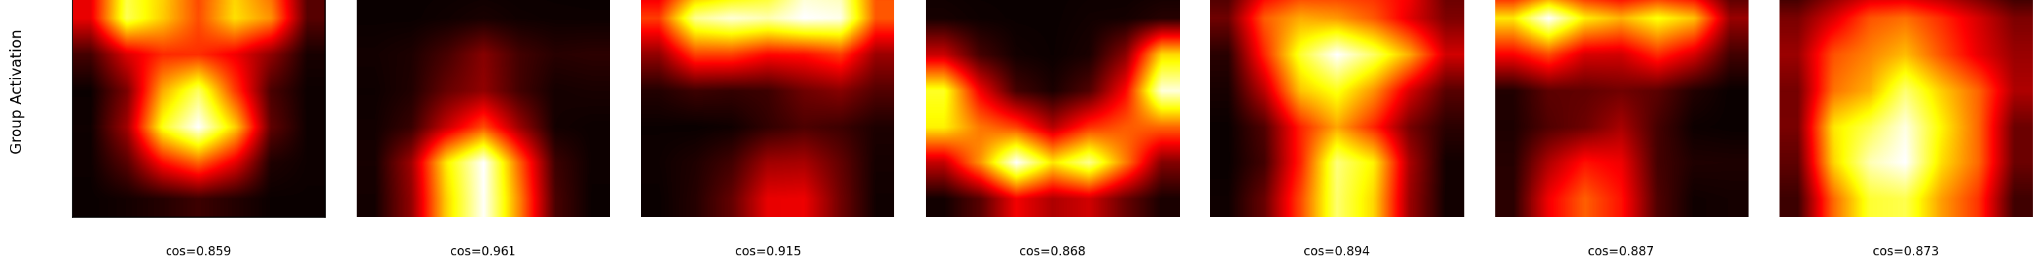
Generalizable-FER
How Does It Work ?
Initial image input (SFEW)
AU map
- Tells each group which are the facial
anatomy they need to focus on
Resnet activation + baseline l_sep
- Activation just based on pretrained
ms-celeb face
Activation x AU_Attention
- Activation in each group become
more focused on expression-specific
facial muscles, removing other unnecessary facial part
REF : [1] Belharbi et al., "Guided Interpretable FER via Spatial AU Cues", IEEE FG 2024

Slide 19
Data Augmentation
Motivations:
Simulate variations in real world data
Prevents the model from overfitting to the training data
Helps the training distribution to be more similar to the unseen test data distribution
(Gattermayr, 2025)

Slide 20
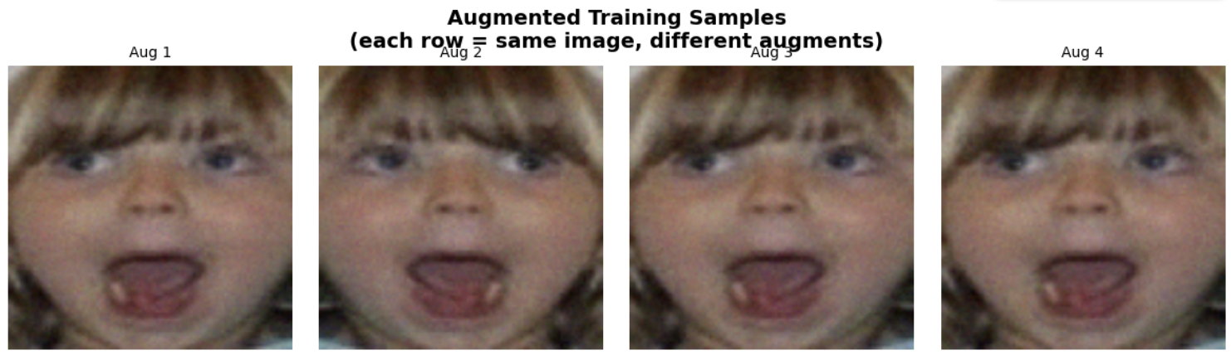
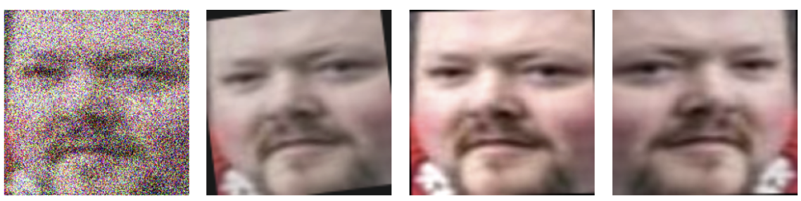
Data Augmentation
Baseline augmentation
composition:
Horizontal Flipping,
Random Erasing,
Gaussian Noise
Proposed augmentation
composition:
Horizontal Flipping,
Rotation,
Gaussian Noise,
Color Jittering,
Cropping
(Gattermayr, 2025)
Notes:
“[A] well-balanced combination of different augmentation techniques yields better performance than solely focusing on the most promising single augmentation techniques or applying excessive augmentation”

Slide 21
Generalizable-FER
Experimental Design
Method Group | Spatial Attention | Augmentation
BASELINE | None | Basic
BASELINE_Aug | None | Albumentations
PerGroup_FA | FACS (Landmarks) | Basic
PerGroup_FA_Aug | FACS (Landmarks) | Albumentations

Slide 22
Ablation table (Accuracy)
Index | Method |  | Training Dataset | Dataset only used for evaluation |  |  |  | Mean
 | (1) | (2) | RAF-DB | FERPlus | AffectNet | MMA | SFEW
1 | ✖ | ✖ | 86.7% | 61.9% | 48.6% | 57.1% | 42.2% | 59.3%
2 | ✔ | ✖ | 87.0% | 72.1% | 49.90% | 60.2% | 47.1% | 63.3%
3 | ✖ | ✔ | 85.8% | 63.8% | 47.4% | 58.4% | 44.5% | 60.0%
4 | ✔ | ✔ | 85.9% | 71.0% | 48.5% | 60.7% | 45.7% | 62.4%
(1) Data Augmentation
(2) Per Group Face Attention

Slide 23
Ablation table (Accuracy)
Index | Method |  | Training Dataset | Dataset only used for evaluation |  |  |  | Mean
 | (1) | (2) | FERPlus | RAF-DB | AffectNet | MMA | SFEW
1 | ✖ | ✖ | 82.8% | 64.7% | 51.7% | 56.0% | 40.6% | 59.2%
2 | ✔ | ✖ | 83.5% | 70.6% | 51.8% | 58.6% | 40.8% | 61.1%
3 | ✖ | ✔ | 82.2% | 57.7% | 49.9% | 54.8% | 32.0% | 55.3%
4 | ✔ | ✔ | 83.9% | 72.4% | 53.0% | 58.4% | 46.9% | 62.9%
(1) Data Augmentation
(2) Per Group Face Attention

Slide 24
Ablation table (Accuracy)
Index | Method |  | Training Dataset | Dataset only used for evaluation |  |  |  | Mean
 | (1) | (2) | AffectNet | RAF-DB | FERPlus | MMA | SFEW
1 | ✖ | ✖ | 72.1% | 38.8% | 49.8% | 33.9% | 18.8% | 42.7%
2 | ✔ | ✖ | 72.1% | 43.4% | 52.9% | 38.4% | 21.4% | 45.6%
3 | ✖ | ✔ | 70.2% | 43.8% | 52.9% | 34.8% | 20.6% | 44.5%
4 | ✔ | ✔ | 69.7% | 46.9% | 56.1% | 40.0% | 21.1% | 46.8%
(1) Data Augmentation
(2) Per Group Face Attention

Slide 25
Ablation table (Accuracy)
Index | Method |  | Training Dataset | Dataset only used for evaluation |  |  |  | Mean
 | (1) | (2) | MMA | RAF-DB | FERPlus | AffectNet | SFEW
1 | ✖ | ✖ | 64.1% | 75.0% | 73.3% | 49.1% | 43.9% | 61.0%
2 | ✔ | ✖ | 66.0% | 77.4% | 70.1% | 54.2% | 48.3% | 63.2%
3 | ✖ | ✔ | 63.7% | 74.4% | 73.1% | 47.9% | 44.3% | 60.7%
4 | ✔ | ✔ | 65.6% | 73.4% | 70.5% | 53.6% | 48.3% | 62.3%
(1) Data Augmentation
(2) Per Group Face Attention

Slide 26
Ablation table (Accuracy)
Index | Method |  | Training Dataset | Dataset only used for evaluation |  |  |  | Mean
 | (1) | (2) | SFEW | RAF-DB | FERPlus | AffectNet | MMA
1 | ✖ | ✖ | 43.2% | 38.7% | 34.2% | 20.7% | 36.2% | 34.6%
2 | ✔ | ✖ | 45.5% | 45.9% | 37.9% | 24.4% | 37.2% | 38.2%
3 | ✖ | ✔ | 43.2% | 41.2% | 36.4% | 22.4% | 37.1% | 36.0%
4 | ✔ | ✔ | 44.8% | 43.7% | 36.9% | 23.6.% | 37.5% | 37.3%
(1) Data Augmentation
(2) Per Group Face Attention

Slide 27
Ablation table (Accuracy)
Index | Method |  | Means for each training dataset |  |  |  |  | Mean
 | (1) | (2) | RAF-DB | FERPlus | AffectNet | MMA | SFEW
1 | ✖ | ✖ | 59.3% | 59.2% | 42.7% | 61.0% | 34.6% | 51.36%
2 | ✔ | ✖ | 63.3% | 61.1% | 45.6% | 63.2% | 38.2% | 54.28%
3 | ✖ | ✔ | 60.0% | 55.3% | 44.5% | 60.7% | 36.0% | 51.30%
4 | ✔ | ✔ | 62.4% | 62.9% | 46.8% | 62.3% | 37.3% | 54.34%
(1) Data Augmentation
(2) Per Group Face Attention

Slide 28
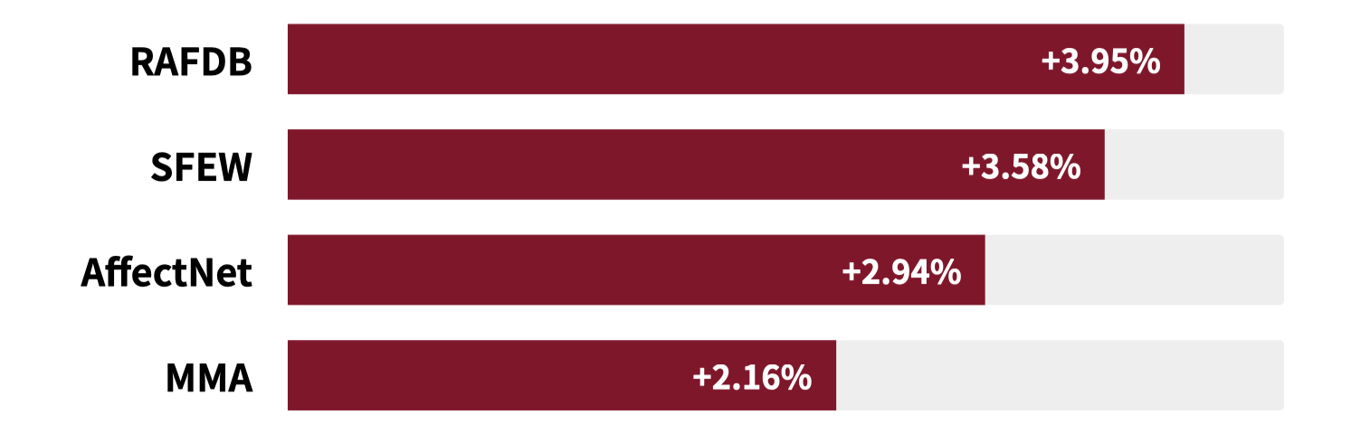
Results
Augmentation Is the Consistent Driver(+2.9%p Avg)
BASELINE → BASELINE_Aug improves every single train domain

Slide 29
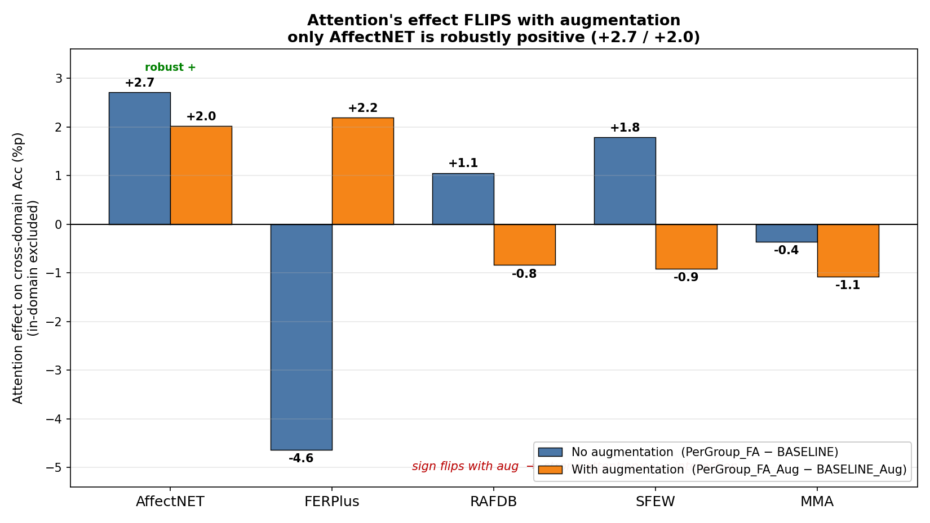
Results
Attention effects flips with augmentation

Slide 30
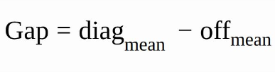
Results
The Mechanism Clearly Worked
Train Set | BASELINE Gap | PerGroup Gap
RAFDB | -0.003 | 0.229
FERPlus | 0.004 | 0.217
AffectNet | 0.002 | 0.195
MMA | -0.001 | 0.217
SFEW | 0.000 | 0.077
M[i,j] = cosine(group i's ResNet activation, emotion j's AU heatmap)
diag = alignment to own emotion,
off = alignment to others, gap = diag − off = degree of per-emotion specialization.

Slide 31
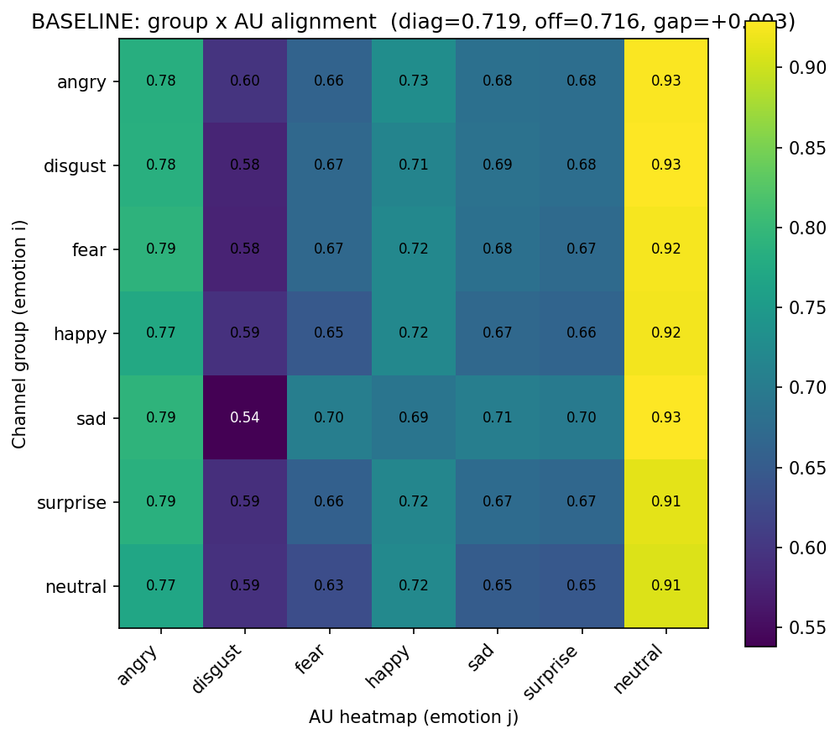
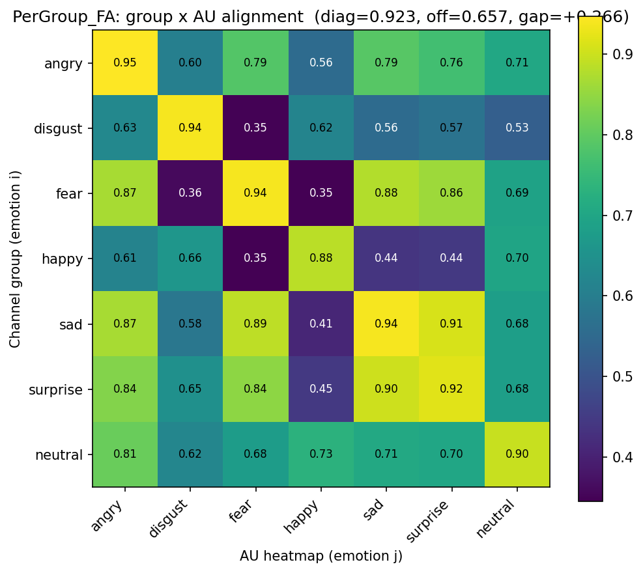
Results
specialization succeeded — does it help accuracy?

Slide 32
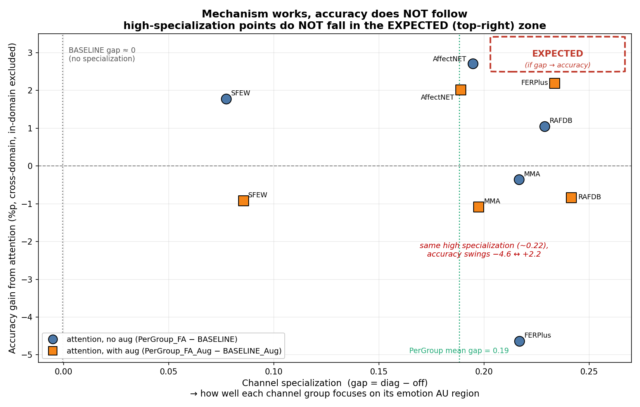
Results

Slide 33
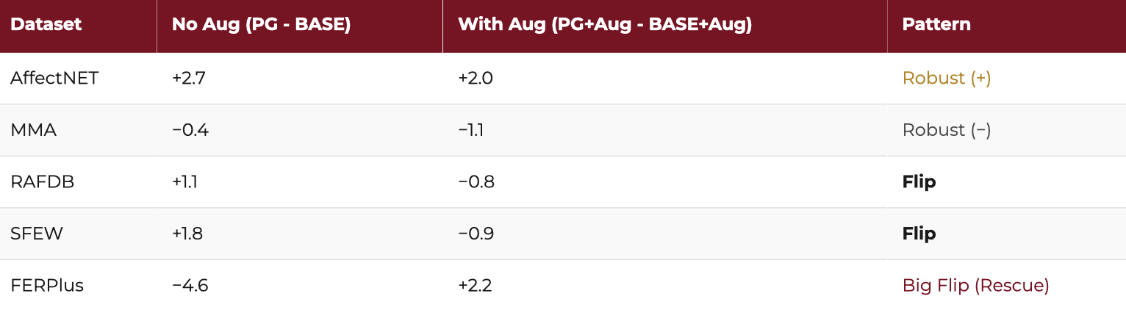
Discussions
Effect FLIPS with Augmentation
Rescue (FERPlus): attention alone is harmful (−4.6); augmentation turns it beneficial (+2.2).
Redundancy (RAFDB, SFEW): attention alone helps; once augmentation is present it becomes redundant/slightly harmful.

Slide 34
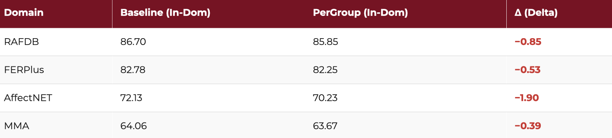
Discussions
Attention Sacrifices Fit (Over-Regularization)
Over-Regularization Mechanism: The fixed AU gate pushes non-AU cells toward 0. Without a trainable recovery layer, the model discards discriminative non-AU facial cues, leading to mild underfitting

Slide 35
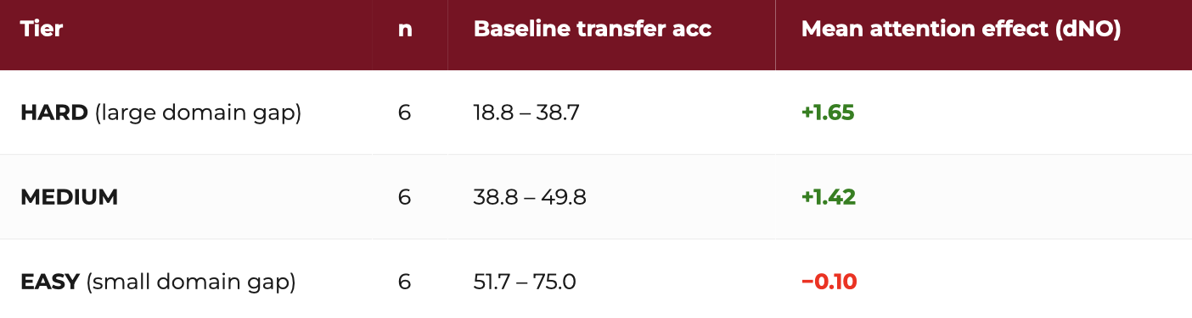
Discussions
Attention effect by transfer difficulty — no augmentation
net value = robustness benefit − capacity cost.
Correlation: r = −0.43, p = 0.078 (n = 18)
2 over-specialization outliers excluded: FERPlus→SFEW (−8.58) and FERPlus→RAFDB (−6.98)

Slide 36
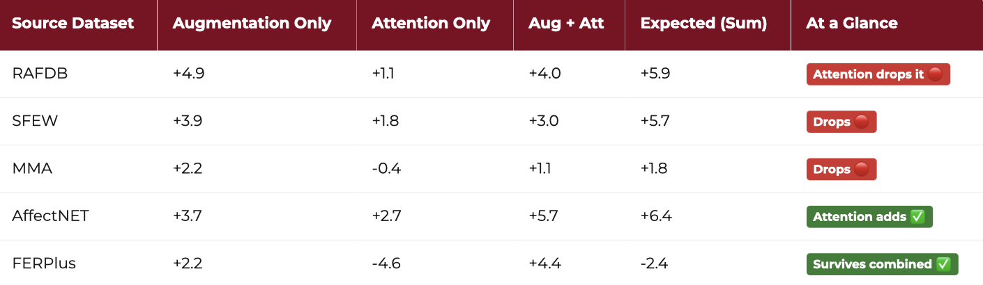
Discussions
Attention is Redundant with Augmentation
4 / 5 sources are sub-additive (combined < expected sum) → Attention, Augmentation overlap.
RAFDB, SFEW, MMA: combined < augmentation alone → adding attention actively lowers accuracy
→ Once augmentation is present, attention has nothing left to add — only its capacity cost remains = redundant.
Exceptions: AffectNET (attention contributes a residual gain), FERPlus (harmful alone, augmentation is a prerequisite → rescue).

Slide 37
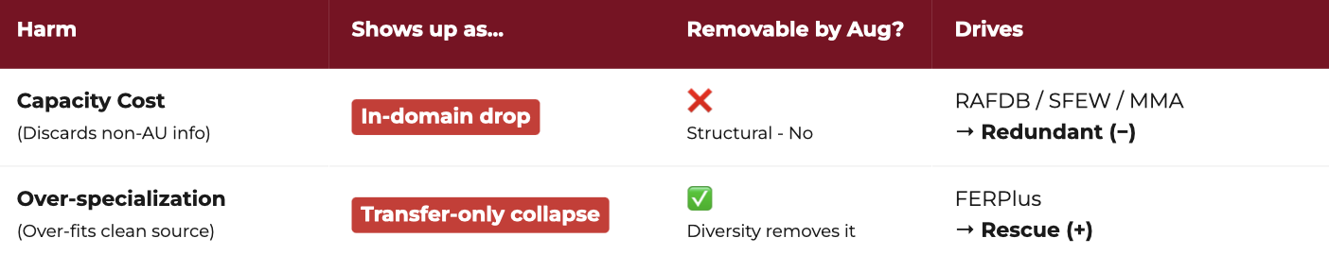
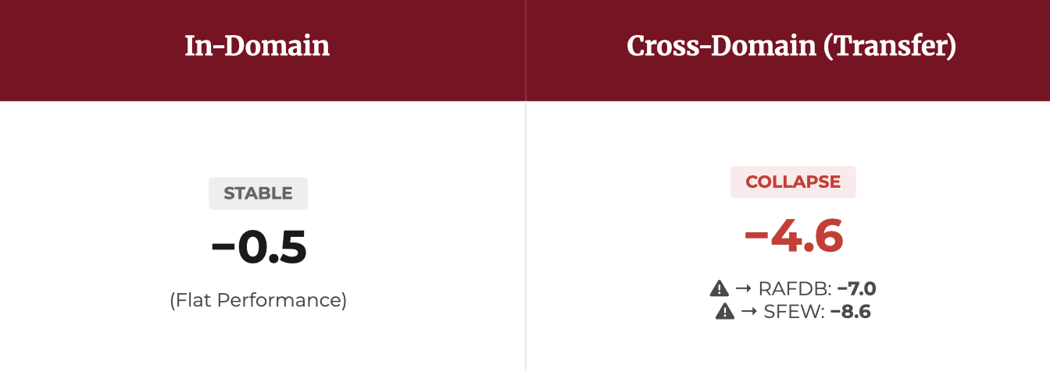
Discussions
Attention on FERPlus
Augmentation removes the over-specialization (over-specialization on a grayscale / low-res).
Once the brittleness is gone, attention's hidden robustness benefit appears → −4.6 → +2.2.

Slide 38
Summary
① Best configuration = Augmentation + Attention — but barely.
Mean cross-domain accuracy: BASELINE 46.8 → +Aug 50.1 → +Aug+Attn 50.4 (attention-only: 46.9).
→ Attention adds just +0.3%p over augmentation alone.
② Augmentation is the reliable, cost-free driver.
Improves cross-domain on all 5 sources (+3.4%p avg) and even raises in-domain (+1.1) — pure benefit.
③The mechanism works, but doesn't translate to all.
Specialization gap 0 → ~0.19 as designed, yet uncorrelated with accuracy (mechanism ≠ performance).
④Attention is redundant with augmentation.
On RAFDB/SFEW/MMA, attention on top of aug drops below aug alone (sub-additive). It only adds value where augmentation leaves room (AffectNet +2.0).
⑤One exception is two harms.
FERPlus: attention is harmful alone (cross-domain −4.6, but in-domain flat −0.5) = over-specialization, not capacity cost → augmentation removes it → rescued to +2.2.

Slide 39
Conclusion
Thesis:
A fixed FACS attention prior in CAFE works as a mechanism but barely as a performance gain. Augmentation is the reliable driver; attention adds only a small, conditional benefit on top.

Slide 40
Q&A
Thank You

