Slide 1




INTELLIGENT VIDEO PROCESSING AND KNOWLEDGE ENRICHMENT SYSTEM
Soumya Ranajan Nayak
PRN: 23070243063
Internal Guide: Mr. Sahil Shah
External Guide: Mr. Prashant Mane

Slide 2

BACKGROUND OF THE RESEARCH PROJECT
Explosion of AI research post-2025 created an overwhelming volume of video content explaining cutting-edge papers.
Manual tracking and knowledge consolidation from these sources is tedious and non-scalable.
Need for a system that can process, summarize, and semantically integrate insights from research paper explanation videos into structured, queryable knowledge.

Slide 3

PROBLEM STATEMENT
Lack of automation in extracting structured knowledge from AI research videos.
Difficulty in semantic linking and contextual understanding across multiple video sources.
No existing framework unifies transcription, summarization, and knowledge graph creation with enrichment capabilities.

Slide 4
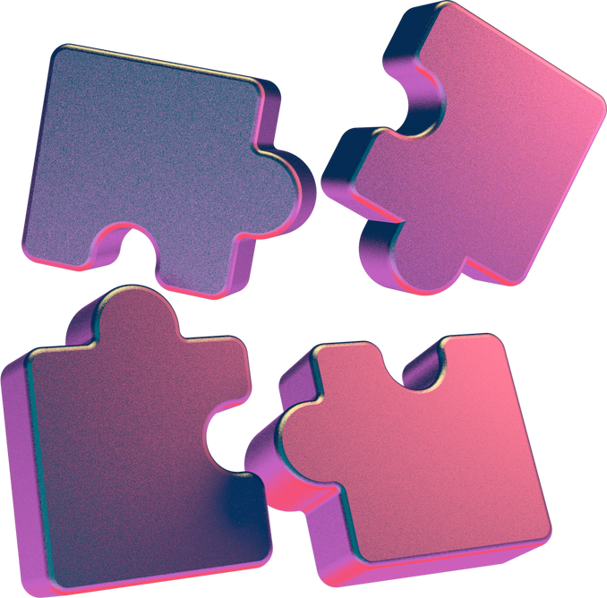
OBJECTIVE
To develop a modular system that:
Processes AI-focused research videos from YouTube.
Transcribes, summarizes, and converts into structured formats using Gemini 2.0 Flash.
Builds and enriches a knowledge graph via LangChain and Neo4j for semantic querying and validation.

Slide 5
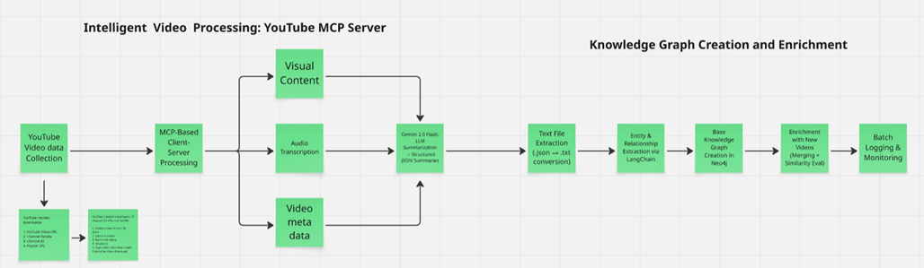
METHODOLOGY FLOW
Main stages:
Video Collection (YouTube)
MCP-based multimodal processing
LLM-based transcription & summarization
Text-to-Graph transformation
Enrichment using semantic similarity

Slide 6
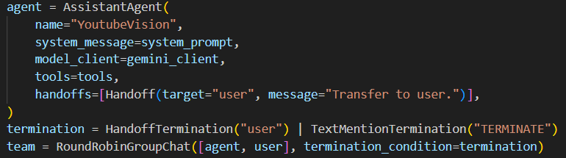
TOOLS AND TECHNOLOGIES USED
YouTube Downloader + Autogen(0.5.2) based MCP Server for YouTube Video Processing.
Gemini 2.0 Flash (via API) for transcription and summarization
LangChain for prompt-based entity and relation extraction
Neo4j for knowledge graph storage and querying. (AuraDB)
Python for (Autogen Assistant agent ) based orchestration, batching, logging

Slide 7
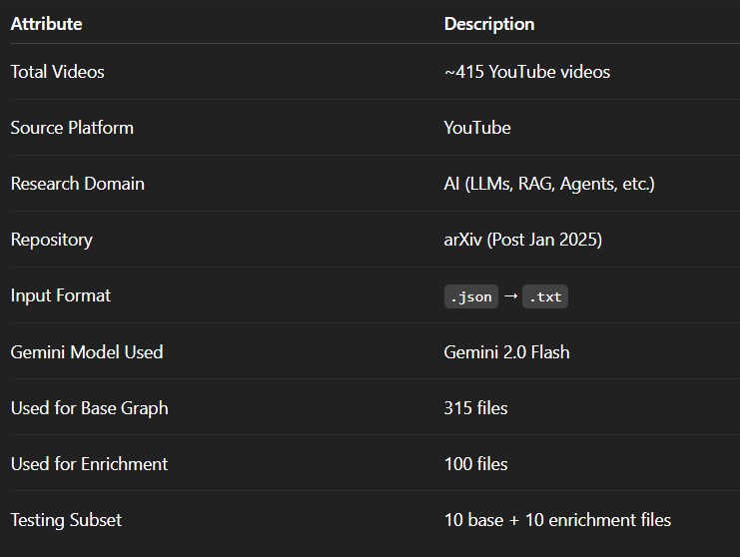
DATASET DESCRIPTION

Slide 8


PROCESSING
Video Source: AI research explainers (YouTube)
MCP Framework:
Client-server architecture
Downloading: video.mkv, transcript.txt, metadata.json, summary.json
LLM Summarization:
Gemini 2.0 Flash used via API
Outputs structured JSON summaries
Knowledge Graph Enrichment
Additional 100 files used to enrich the initial 315-node graph
Entity matching via cosine similarity using sentence embeddings
LangChain-driven relationship generation for matched nodes
Graph merging and duplication avoidance handled automatically
Knowledge Graph Construction
Text summaries converted to .txt
LangChain prompts used for:
Named entity extraction
Relationship building
Nodes and relations pushed to Neo4j
Generic, reusable framework with batch handling

Slide 9
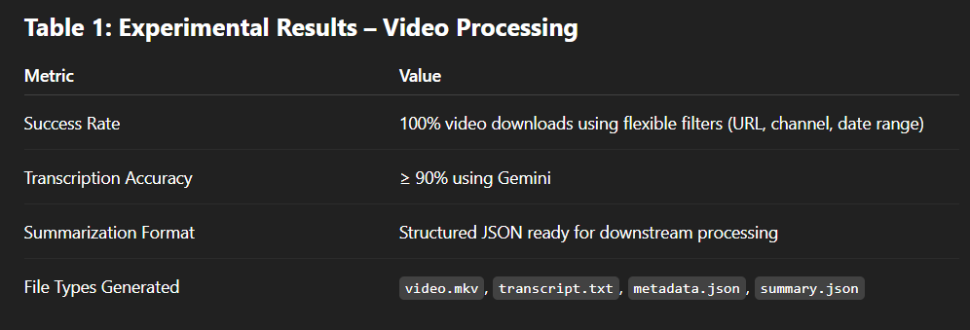

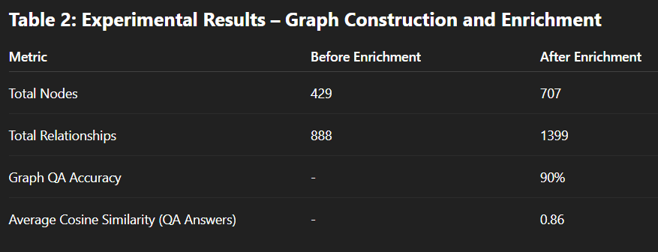
RESULT

Slide 10
DISCUSSION
Modular design enables plug-and-play functionality.
Gemini 2.0 Flash provided structured and topic-aligned summaries.
LangChain and Neo4j enabled semantic query and enrichment.
Challenges:
Ambiguous prompts affecting LLM output
Irregular transcript formatting
Minor graph duplication handled with similarity checks

Slide 11
CONCLUSION
Successfully developed an end-to-end framework to automate extraction of structured knowledge from AI video content.
The system performs robustly in both base and enrichment scenarios.
Future scope: integrate visual slide understanding, improve QA feedback loops, support real-time video streams.

Slide 12
REFERENCES
ZHANG, Z., MA, X., & WANG, Y. (2024). KARMA: A MULTI-AGENT FRAMEWORK FOR VIDEO UNDERSTANDING AND RAG. ARXIV:2405.08426
WU, S. ET AL. (2024). GRAPHRAG: INTEGRATING GRAPH DBS IN RETRIEVAL-AUGMENTed Generation. arXiv:2403.12345
Lyu, Y. et al. (2024). Hybrid RAG with Comprehensive Enhancements. arXiv:2403.09876
MA, X. ET AL. (2024). UNIFIED MODEL FOR VIDEO UNDERSTANDING. ARXIV:2402.11223

Slide 13
THANK YOU!
FOR YOUR ATTENTION

