Slide 1
Workshop on Workshops

Slide 2
Plan
Frame next assignment
Discuss concept behind it
Share and work through Brandon's example lesson
Start thinking through your own workshop ideas
(probably next time)

Slide 3
Workshop Assignment
Due week of October 20th
Use it as an opportunity to teach to learn.
Develop a low-tech, pencil and paper (ish) digital humanities workshop you could give soon based on your research interests.
Be thinking of connections to the project.
Work with others to workshop your individual workshop materials.
Outcome will be a blog post
Pedagogy discussions with staff and students at W&L and Yale
Notes:
Other questions that should be asked?

Slide 4
Buttonology
"Knowing how to upload texts into a tool like Voyant does not help researchers think about what texts should be uploaded, how selecting data relates to a research question, or even what constitutes an effective research question."
"Beyond Buttonology: Digital Humanities, Digital Pedagogy, and the ACRL Framework" – John E. Russell and Merinda Kaye Hensley
That's the provocation for this unit.
Notes:
Reactions to the buttonology reading?
What are the worst teaching/learning experiences they've ever had?
What scares them about teaching digital humanities?
Things you want them to get to – it's ok not to know everything. The technology can get in the way; it's not always necessary; you only need to know a little bit. They're all good teachers.
Buttonology certainly has its place, but there are other ways to teach.

Slide 5
Example Workshop – Five Ways to Read a Text
One-shot workshop that I can use for variable amounts of time
Uses basically no technology but powerpoint
Basically it's text analysis with pen and paper
In what follows, we'll move back and forth between student and teacher perspective

Slide 6
Slidessssss
Slides start here!

Slide 7
Sentiment Analysis
How does a text feel?
Is it happy? Sad?
Complicated questions!
Let’s try to tell…
Notes:
One last type of reading. How do you tell if a text is happy or sad?

Slide 8
Sentiment Analysis
“I am very happy.”
“She is so sad.”
Notes:
Are these sentences happy or sad? How do you tell?

Slide 9
Sentiment Analysis
"It was the best of times, it was the worst of times…”
Notes:
Happy? Sad? How do you tell? Maybe there’s some other kind of measure?

Slide 10
Sentiment Analysis
"It was the best of times, it was the worst of times…”
Not a clear answer overall. We need a better way to register this. Let’s go word by word.
Notes:
Happy? Sad? How do you tell? Maybe there’s some other kind of measure?

Slide 11
Sentiment Analysis
"It
was
the
best happy!
of
times,
it
was
the
worst sad!
of
times…"

Slide 12
Sentiment Analysis
"It
was
the
best happy! / positive
of
times,
it
was
the
worst sad! / negative
of
times…"
Notes:
But remember computers like numbers. How might we register this?

Slide 13
Sentiment Analysis
"It
was
the
best happy! / positive / 1
of
times,
it
was
the
worst sad! / negative / -1
of
times…"

Slide 14
Sentiment Analysis
"It was the best of times, it was the worst of times…”
1 -1
Total = 0
Overall neutral sentiment
Notes:
If we add up the numbers for the sentence, we can get a sense of the feelings in it.

Slide 15
Sentiment Analysis
Chart the sentiment for each of the three excerpts on your handout.
Which is happier? Sadder?
Happiest? Saddest?
Any problems or questions that this raises?
In breakout rooms or pairs
Notes:
Note in particular that Fahrenheit 451 appears to be the happiest.
Key concepts to point them towards:
How do they move from individual words to whole paragraphs' sentiment?
How do they compare or not the sentiment of each others? They need to have the same common number system
They need a dictionary of words that have sentiments
Does every word have a polarity associated with it?
What about context? How would you account for context?
Anything else?

Slide 16
Sentiment Analysis
Can imagine a range of emotions: good, better, best.
So you could use a range of numbers: good = +1, better= +3, best = +5
Say, assign any emotion-laden word a number between -5 and +5.
Keep in mind that you’re not reading for context. Simply on a word-by-word basis.
So “yes” would be positive. “no” would be negative

Slide 17
Sentiment Analysis
How do we account for context?
How do we make sure our results are comparable?
How can we make sure everyone is getting the same results so that we could compare readings?
How do you account for longer texts?

Slide 18
Sentiment Analysis
Declaration: Negative
Kafka: Negative
Bradbury: Positive, right?
Notes:
What numbers did you get? Do some people have different numbers?
Note in particular that Fahrenheit 451 appears to be the happiest.
What do you make of this form of measure? What can you imagine it used for.
Can you imagine any way to make it work better? (have humans validate the results and tweak them)

Slide 19
Sentiment Analysis
Pretty Vexed
But intellectually interesting in itself
High stakes for businesses

Slide 20
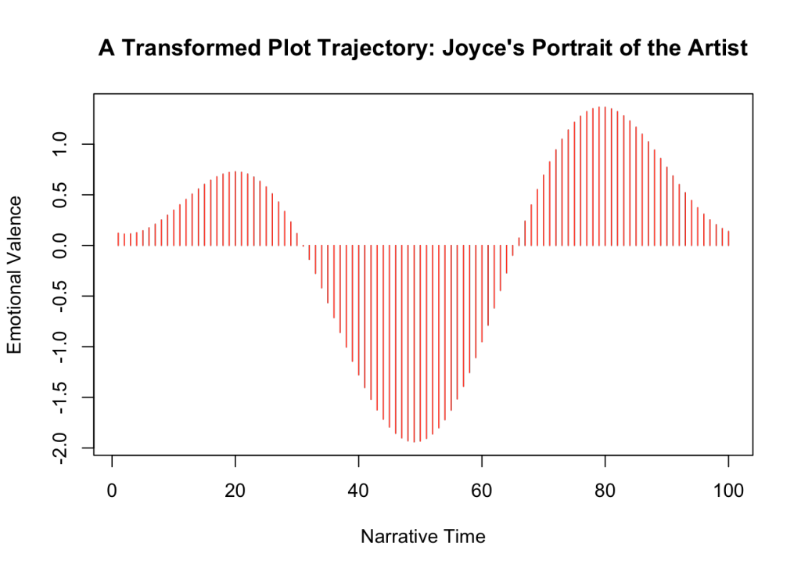
Sentiment Analysis
http://www.matthewjockers.net/2015/02/02/syuzhet/
Notes:
What can you do with sentiment analysis?
From a humanities perspective, you can say that by registering moments of happiness or sadness over time, you can measure a plot’s tension. You could get a sense of the plot arc in a text. Jockers claims there are really only six shapes if you do this kind of math.

Slide 21
Reflect on the Activity
General thoughts on what we did.
Thoughts on other technical workshops they've been in.
Thoughts on the readings.

Slide 22
Reflect on the Activity
No risk of technical problems going wrong
Students don't need any programming to participate
Gets concepts across but the students arrive at them on their own
Now they'll know what the tools are doing
Show them where to go next

Slide 23
Workshop Assignment
Due Week of October 20th
Develop a low-tech, pencil and paper (ish) digital humanities workshop you could give soon based on your research interests.
Use it as an opportunity to teach to learn.
Be thinking of the how this connects to the project.
Work with others on your ideas
Outcome is a blog post

Slide 24
Begin to Jam on Your Interests a Bit
Notes:
What were their reactions to digital pedagogy in the humanities? What did they read about there? Anything they noticed that was particular compelling?
How does this kind of teaching relate to teaching they have done?
What might some goals be that they could have when designing an assignment or workshop? What would some challenges be?
Anything feel scary?
Feel empowering? Let's talk about those risks!
If time allows…
What are their research interests?
Does anyone have any first ideas?
Anyone totally stumped as to how to get started? Think through some constraints

Slide 25
Reading / Homework
Think about what kind of method or concept you want as part of your profile
Think through how it might relate to your own…
Research
Workshop
DH Education project
Start brainstorming workshop ideas.
Talk to me – I can poke you in a direction

Slide 26
Resources to Get You Started
Disciplinary DH assignment
Come in with 3-5 DH projects from your discipline (broadly construed!), some of which connect to your interests for discussion.
Digital Pedagogy in the Humanities can be a way in for those projects
I can also help you find things – ping me
Be prepared to chat about what you find.
Readings Assigned
Explore 2-3 things in Digital Pedagogy in the Humanities: Concepts, Models, and Experiments that are useful for your interests.

Slide 27
Resources
Some other ways to start your thinking…
Keep exploring Digital Pedagogy in the Humanities
Pick a lesson from programminghistorian.org to work through that looks interesting
Shoot me a slack message or meet with me for five minutes!
Goal is to have one or two topics in mind about a dh method/concept that might relate to interests in some way for next time.

