Slide 1
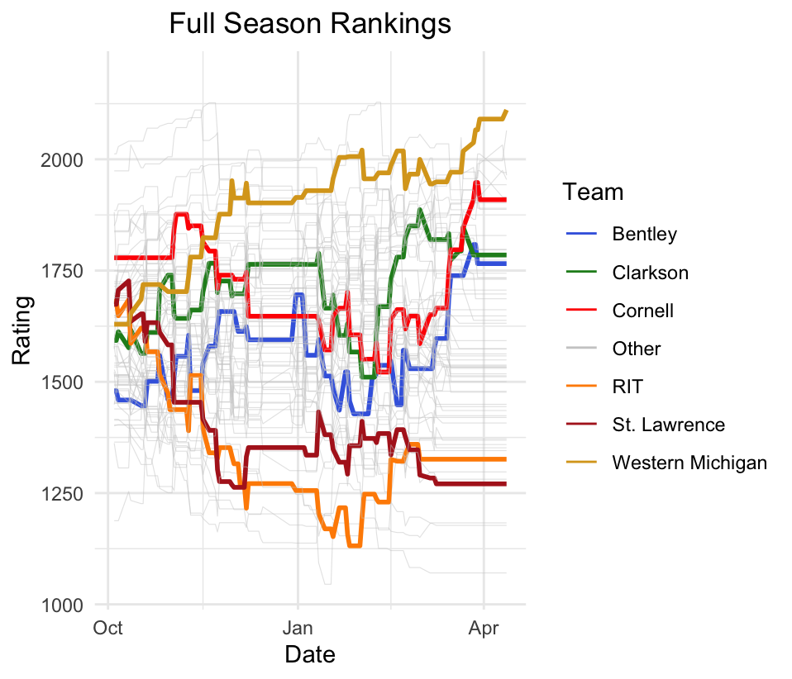
Analyzing Elo Ratings for NCAA Men’s Division 1 Hockey Alex Tidd ’25 (Statistics) Advisors: Dr. Matt Higham and Dr. Robin Lock
Using an Elo ratings model to quantitatively rank NCAA Men’s Division 1 Hockey

