Slide 1
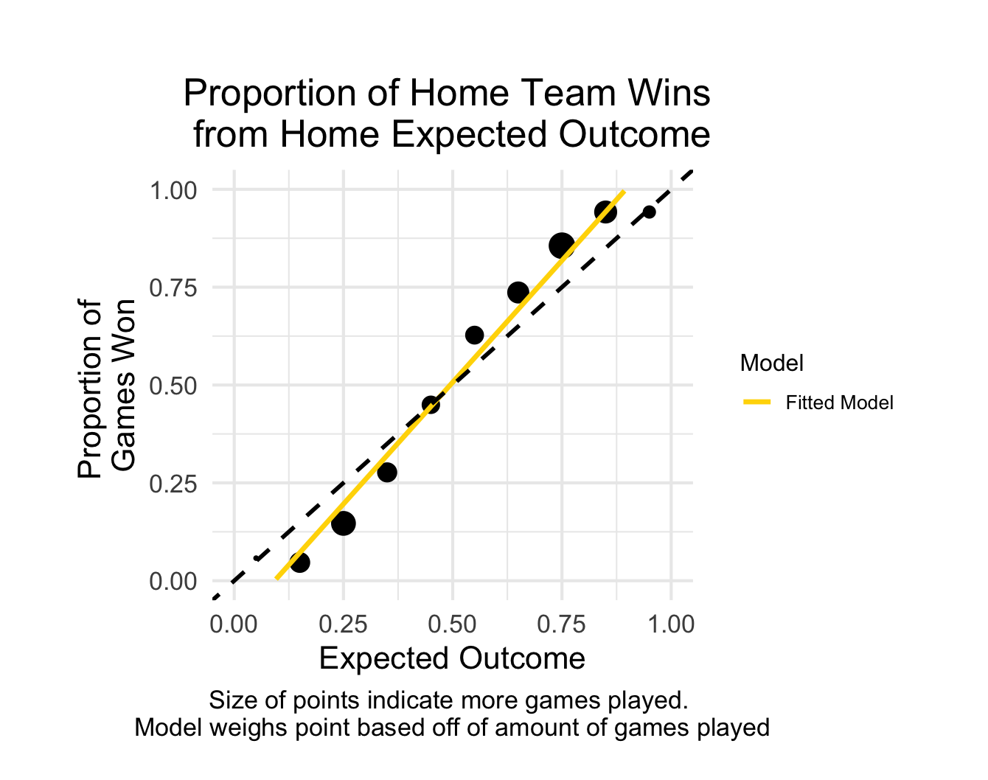
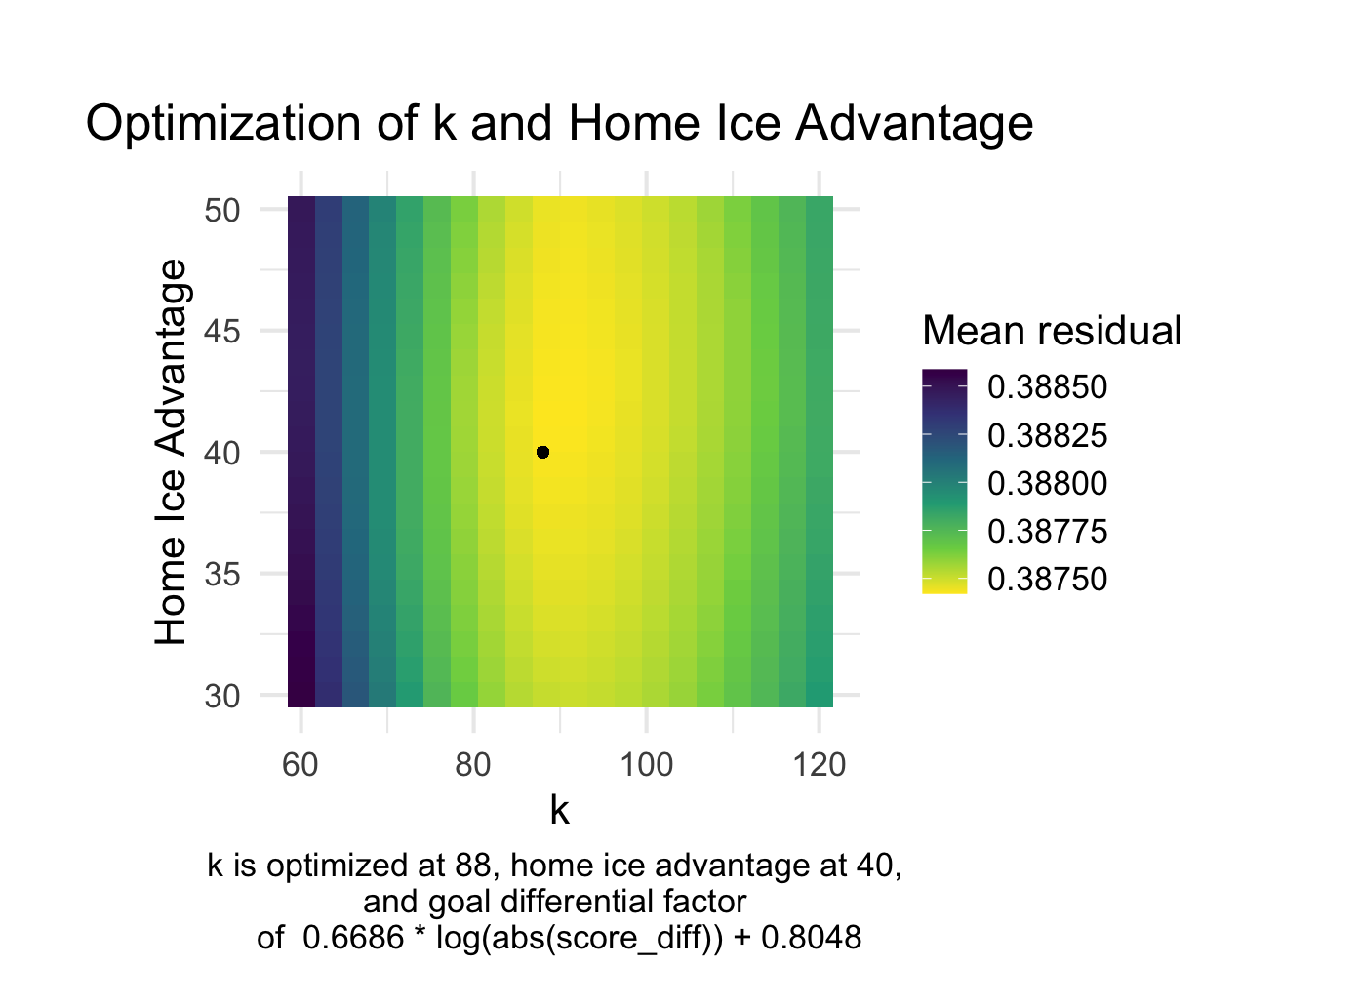
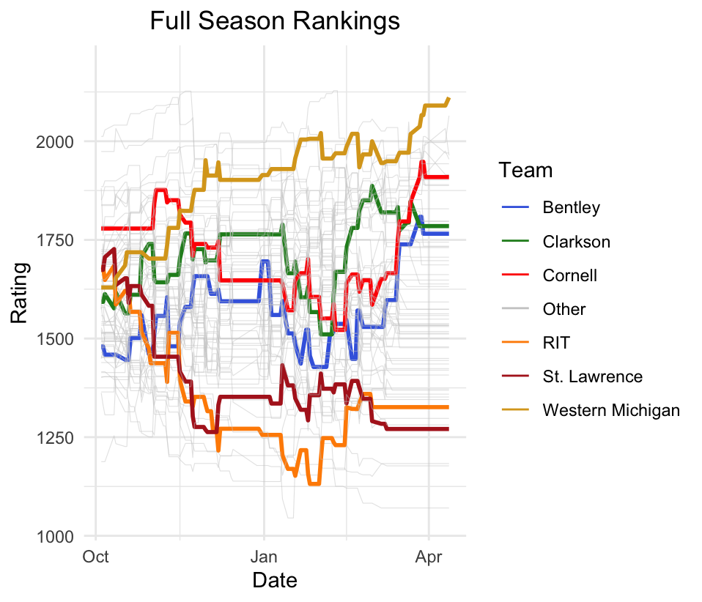

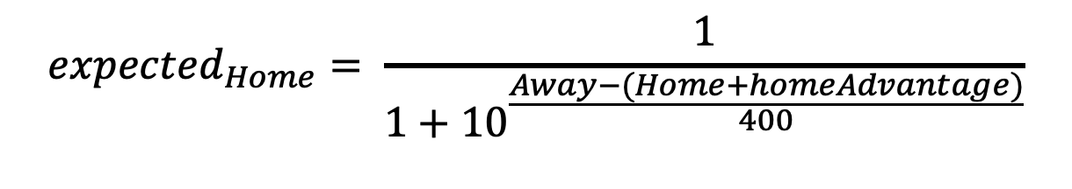
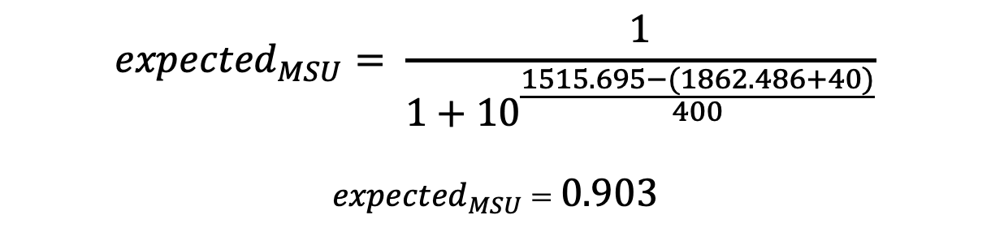
Analyzing Elo Ratings for NCAA Men’s Division 1 Hockey
Alex Tidd ’25 (Statistics)
Advisors: Dr. Matt Higham and Dr. Robin Lock
Background
Optimizing Parameters
Findings
64 Men’s Division 1 hockey teams.
Weekly rankings via “expert vote” system. by US College Hockey Online.
Rankings use no formal quantitative. calculation/analysis.
Grid search to find combination of k, d, and home ice advantage that yields the lowest mean difference between expected outcome and actual outcome.
Elo Rating
New teams historically set at 1500.
Continuously updates after every match.
Uses an expected outcome parameter based on players pre-game rating.
Uses an “update” factor, k, to scale how much rating increases/decreases for wins/losses.
Expected slope to be equal to 1, shown by dashed line
$${expected}_{Home}= \frac{1}{1+{10}^{\frac{Away−(Home+homeAdvantage)}{400}}}$$
Example
$${rating}_{post}={rating}_{pre}+k\left(scoreMultiplier\left(goalDiff\right)(outcome−expectedOutcome)\right)$$
Michigan State vs Lake Superior State, October 4th , 2024:
Michigan State wins 2 – 1.
Michigan State new Elo rating = 1870.956.
Goal:
Use a modified Elo rating system to rank Men’s Division 1 Hockey.
Optimize update factor, k, for NCAA Men’s Division 1 Hockey.
Account for home ice advantage.
Account for blowouts and closely contested games using goal differential.
Rankings of all 64 NCAA Division 1 Men’s Ice Hockey teams. Select teams Highlighted.
$${expected}_{MSU}= \frac{1}{1+{10}^{\frac{1515.695−(1862.486+40)}{400}}}$$
${expected}_{MSU}$ = 0.903
Acknowledgements
$${rating}_{MSU}=1862.486+88\left(((0.669\log_{e}{1)+0.805)}(1−\text{0.90}3)\right)$$
$${rating}_{MSU}=1870.956$$
$$\left|residual\right|=\left|1 −\text{0.90}3\right|$$
$$\left|residual\right|=0.097$$
College Hockey News. (2024). Men’s Division I Hockey Schedule – 2023–2024 Season. https://www.collegehockeynews.com/schedules/
College Hockey News. (2025). Men’s Division I Hockey Schedule – 2024–2025 Season. https://www.collegehockeynews.com/schedules/
Silver, N. (n.d.). How our NHL predictions work. FiveThirtyEight. https://fivethirtyeight.com/methodology/how-our-nhl-predictions-work/

