Slide 1



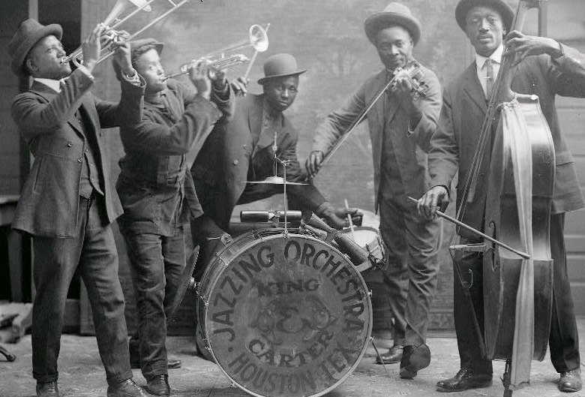
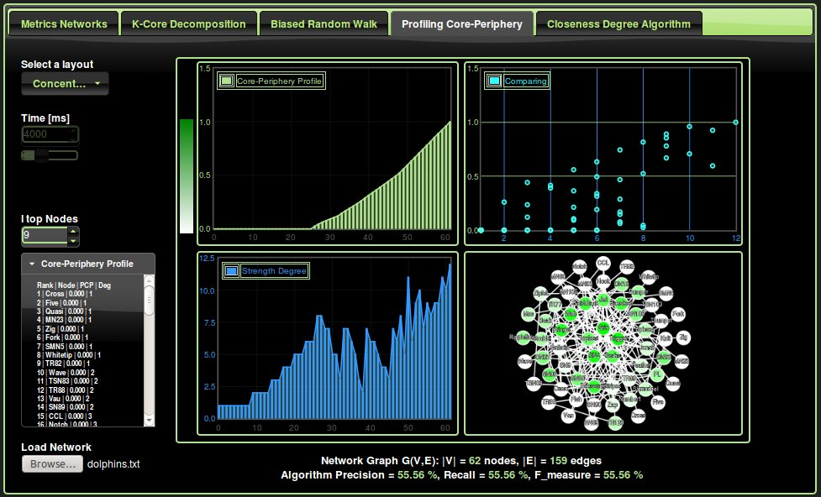
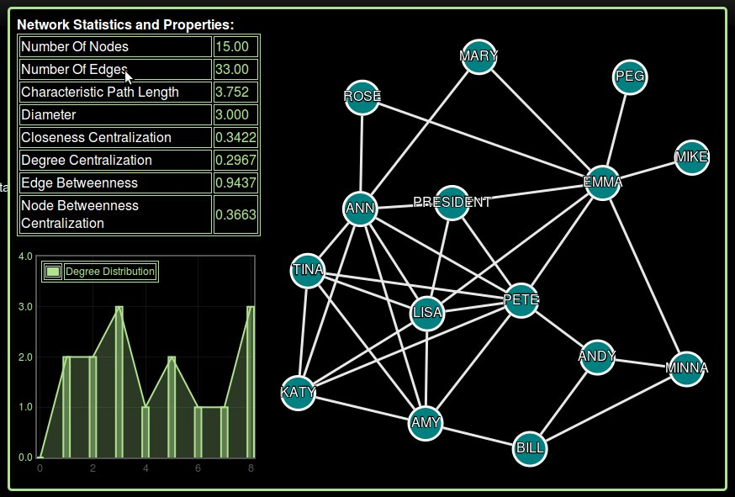
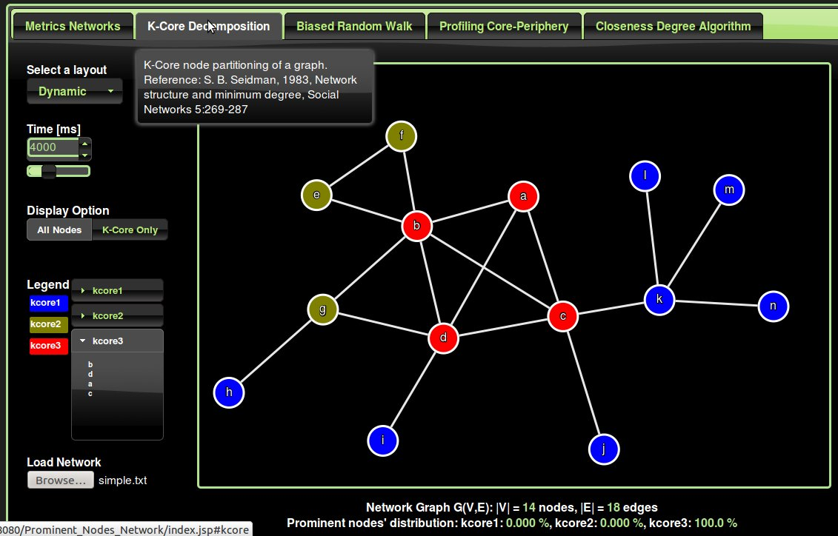
Network Analysis and Visualization
Identifying most prominent nodes
Master Project in Computer Science
Student ID: 1402590
Akram M'Tir
Supervisor: Dr Shan He
Notes:
The four upper pictures represent different networks that we have use to evaluate the algorithms implemented.
For instance, the dolphin picture is an undirected social network of frequent associations between 62 dolphins in a community living in New Zealand, The bottlenose dolphin community of Doubtful Sound features
Zachary karate club

Slide 2

Table of contents
Introduction and background of the problem
Objectives and motivations
Methodology and Algorithms
Technology and Architecture
Experiments/Results/achievements/challenges
Conclusion and Improvement

Slide 3

Introduction
What is a Network?
Why are they important?
What is the focus of this thesis?
Type of project?
A network is the outcome of interactions between a large number of entities such as humans, businesses, molecules, cells, proteins, stocks etc. A network is represented by a graph: a set of nodes or vertices connected by links.
Networks are important because they allow us to model, detect and extract significant patterns or structures and useful information about the system.
The aim of this thesis is to tackle and address the problem of identifying most prominent nodes in different networks.
The project type is a combination of Software and Research project.
Notes:
It is the result of the interaction between a large number of entities.
It really represents a quite wide large number of systems.
The way we represent a network is in a graph form: a set of nodes connected by edges. The edges or links could directed an weighted.

Slide 4
Introduction
What is a prominent node?
What is the difference between regular and prominent nodes?
Properties of prominent nodes:
Have a large number of connections. (on average 3 to 4 times as many friend as regular nodes)
The degree of a node plays a great role in determining the importance of a node.
May be nodes in the network with many connections, that are not prominent, or vice versa, prominent node with a smaller number of connections.
Notes:
Indeed, we can cite the example of a star network connected to the rest of the network by just on edge. Isolated and does not have friends.

Slide 5

Objectives and motivations
Devise a web application, a multi-tier client-server, using the skills required by employers in the IT and offering an online service to users interested in visualizing, analysing and characterizing their networks. (Software project)
Tackle and address the problem of identifying most prominent nodes in different networks by implementing highly technical and complex algorithms. (Research project)

Slide 6

Methodology and Algorithms
Algorithms implemented:
K-Core decomposition
Prominent nodes using biased random walks
Profiling Core-Periphery by random walkers
Statistics and metrics of a network
Baseline algorithm based on closeness and degree measure.
Method adopted:
Consider various existing methods of determining the importance of a node. Apply these algorithms to four different Networks where the prominent nodes are known.
Compare the performance of the discussed methods.
Notes:
Baseline algorithm. The degree is a good indicator of the importance of a node, but does not take into account indirect ties. Therefore, we retrieve the l top nodes of the network based on their closeness, which emphasizes the distance of a node to all others. If two nodes have the same closeness measure, then we sort them based on their degree.
Degree centrality is the number of connections an actor (node) has
When ties are directed, we calculate total number of ties sent (out-degree) and ties received (in-degree)
Degree centrality measures one’s local position, while closeness centrality measures position globally
Farness is the sum of the geodesic distances from each ego to all others in the network “Closeness" is the reciprocal of farness = 1/farness
Geodesic distance - the number of relations in the shortest possible walk from one actor to another
The geodesic path (or paths, as there can be more than one) is often the "optimal" or most "efficient" connection between two actors
Diameter - the largest geodesic distance in the (connected) network

Slide 7
Network Statistics and Metrics
Network size: Number of nodes and edges
Average path length
Diameter, Density
Centralization measures at the network level
  closeness, degree, edge, betweeness
Degree distribution
Reference: Google code: Flexigraph, A Java graph algorithms library, https://code.google.com/p/flexigraph/
Introduction to social network methods, Department of Sociology, University of California
Notes:
Degree centrality is the number of connections an actor (node) has
When ties are directed, we calculate total number of ties sent (out-degree) and ties received (in-degree)
Degree centrality measures one’s local position, while closeness centrality measures position globally
Farness is the sum of the geodesic distances from each ego to all others in the network “Closeness" is the reciprocal of farness = 1/farness
Geodesic distance - the number of relations in the shortest possible walk from one actor to another
The geodesic path (or paths, as there can be more than one) is often the "optimal" or most "efficient" connection between two actors
Diameter - the largest geodesic distance in the (connected) network

Slide 8
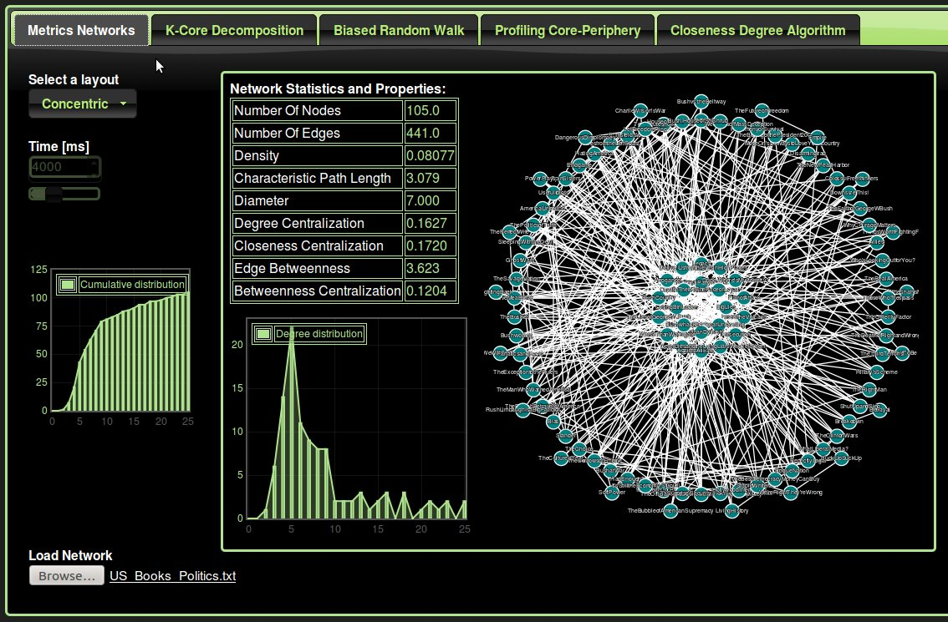
Network Statistics and Metrics
Notes:
Tooltip, when you hover the element with our mouse, the title attribute is displayed in a little box next to the element.
Degree centrality is the number of connections an actor (node) has
When ties are directed, we calculate total number of ties sent (out-degree) and ties received (in-degree)
Degree centrality measures one’s local position, while closeness centrality measures position globally
Farness is the sum of the geodesic distances from each ego to all others in the network “Closeness" is the reciprocal of farness = 1/farness
Geodesic distance - the number of relations in the shortest possible walk from one actor to another
The geodesic path (or paths, as there can be more than one) is often the "optimal" or most "efficient" connection between two actors
Diameter - the largest geodesic distance in the (connected) network

Slide 9

BRW Biased Random Walks
Network Graph G(V,E)
Node's neighborhood:
Degree centrality:
Node's neighborhood density:
Probability of selecting a node:
Reference: Identifying Prominent Actors in Online Social Networks using Biased Random Walks. Frank Takes, Walter Kosters, Leiden University, The Netherlands.
Notes:
A good first indication of importance could be the degree centrality
Takes and Kosters argue that the friends of prominent nodes have more connections in common than regular nodes.
They call this concept a node's neighborhood density.
The numerator defines the number of common connections, whereas the denominator normalizes the result so that it is independent of the degree of v or the degree of w.
Alpha [0,1] to balance the weight between the two indicators or metrics.

Slide 10
Pseudo-Code BRW
1: Input: Graph G(V,E), N, p,
2: Output f[ ], containing the importance value f[v] for each node
3: for do
4: f[v] ← 0
5: end for
6: i ← 0
7: v ← RandomNodeFrom(V)
8: While ( i < N ) do
9: f[v] ← f[v] + 1/N
10: if( rand(0,1) > p ) then
11: v ← BiasedSelectFrom( N(v), )
12: else
13: v ← RandomNodeFrom( V )
14: enf if
15: i ← i + 1
16: end While
17: return f[ ]
Reference: Identifying Prominent Actors in Online Social Networks using Biased Random Walks. Frank Takes, Walter Kosters, Leiden University, The Netherlands.
Notes:
How we select N number of iteration ?
P ? Alpha?
N >> n the number of nodes in the network at least 10 to 100 times.
P Probability to select either a completely random node
or select a node with a biased
In my experiment I have followed the recommendation given in the article
Alpha = 0.5 and P = 0.15
Special case Social network.

Slide 11
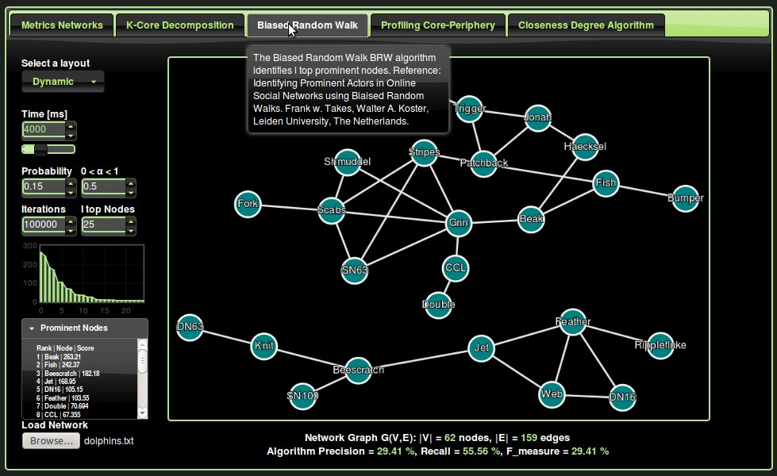
BRW Demo Software
Notes:
Link analysis algorithm:
PageRank algorithm counts the number and quality (weight) links to a page, to determine an estimate of how important the website is. Assumption: that more important website are likely to receive more links from other websites.
The page rank of a page is defined recursively and depends on the number and PageRank metric of all pages that link to it (“incoming links”). A page that is linked to by many pages with high PageRank receives a high rank itself.
Directed network : incoming links

Slide 12
K-Core Decomposition
Core of order K decomposition
partitions the network into layers, from the external to the more central ones.
revealing the structure of the different k-shells.
identifies progressively internal cores.
cohesion increases as k increases, and are used to define the core collapse.
A subgraph H=(C,E|C) induced by the set is a k-core if and only if the degree of every node induced in H is greater or equal than k ( ), and H is the maximum subgraph with this property.
A vertex i has shell index k if it belongs to the k-core but not to (k+1)-core.
A k-shell is composed by all the vertices whose shell index is k. The maximum value k such that is not empty is denoted kmax.
The k-core is thus the union of all shells with . Each connected set of vertices having the same shell index c is a cluster , where the corresponding set of edges are those connecting vertices of the cluster. Each shell is thus composed by cluster , such that , where is the number of clusters in .
Reference: K-Core decomposition: a tool for the visualization of large scale network, Asta, Barrat, Hamelin, Indiana University, USA.
Notes:
K-core: A subgraph H where the degree of every node induced in H is greater or equal than k.
A vertex i has shell index k if it belongs to the k-core but not to (k+1)-core.
A k-shell is composed by all the vertices whose shell index is k.
The k-core is thus the union of all shells Sc with c>=k.
cluster Qc: Each connected set of vertices having the same shell index c is a cluster Qc.
Each shell Sc is thus composed by union of these cluster Qcm. .

Slide 13
K-Core Software Demo

Slide 14
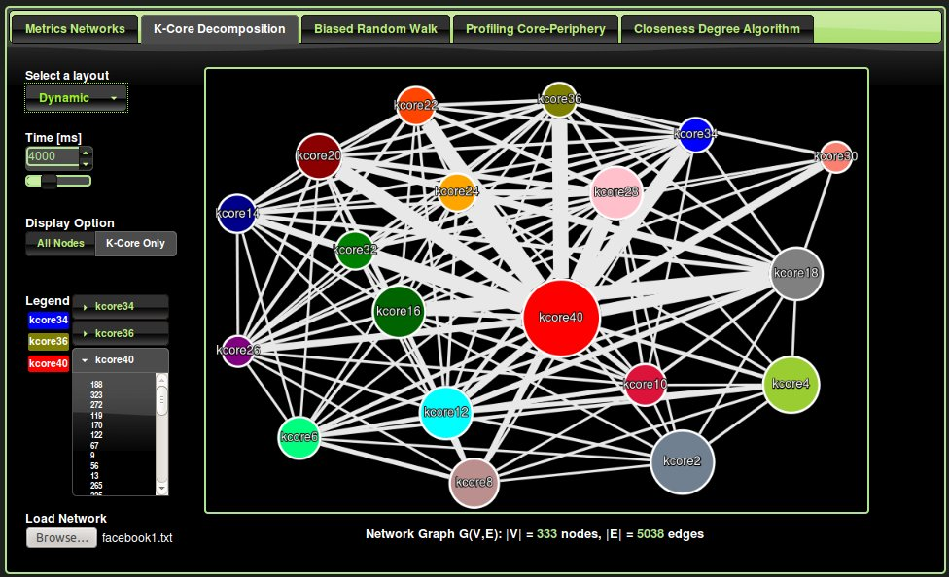
K-Core Software Demo

Slide 15

PCP Profiling Core-Periphery
A global topological portrait of a network and individual characterization.
A numerical indicator, the coreness, is attributed to each node, highlighting its rank and role.
Quantify to what extent an actual centralization exists.
Method aimed at revealing whether there exists a central core through which most of the network flow passes. Adapted to identify and model networks with dense cores and a sparsely connected periphery.
Notion of alpha periphery by grouping all nodes with coreness below a prescribed threshold aplha.
For undirected network, the Strength of a node i :
Persistence probability:
Step1: Select a random node i among those with minimal strength
Step2: k = 2,3, …, n: Select the node that minimize the persistence probability. If not unique, select one randomly among those attaining the minimum..
Reference: Profiling core-periphery network structure by random walkers, Fabio Rossa, Dercole, Piccardi, Scientific Reports, article, nature.com, March 2013

Slide 16
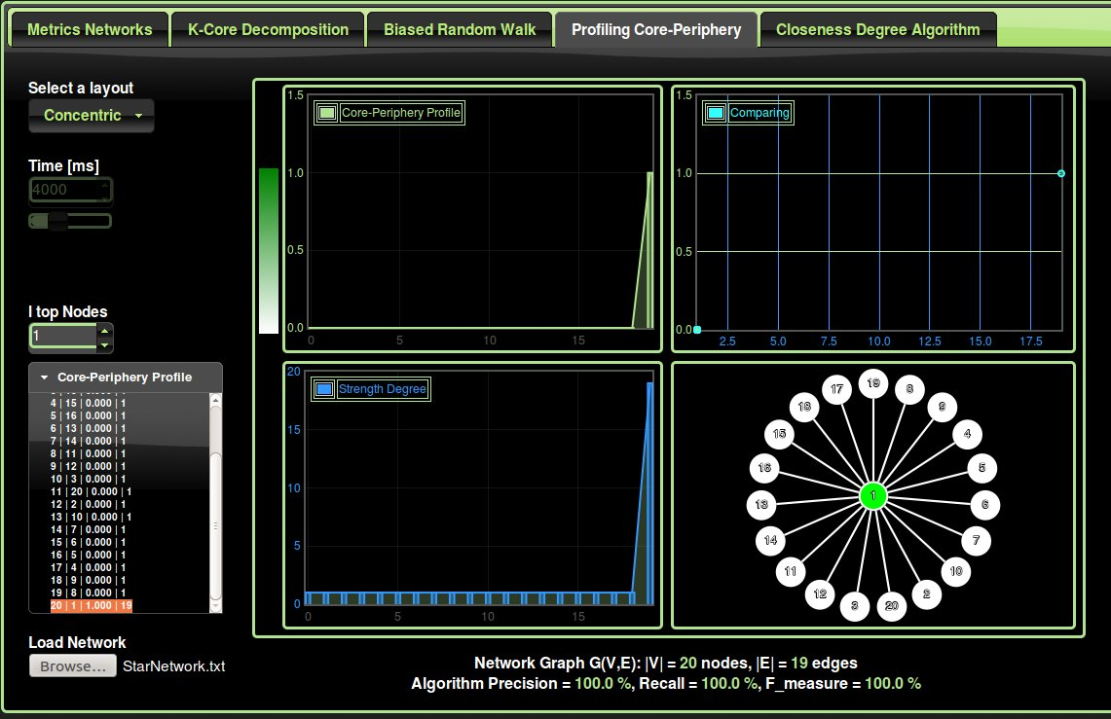
PCP Star Network

Slide 17
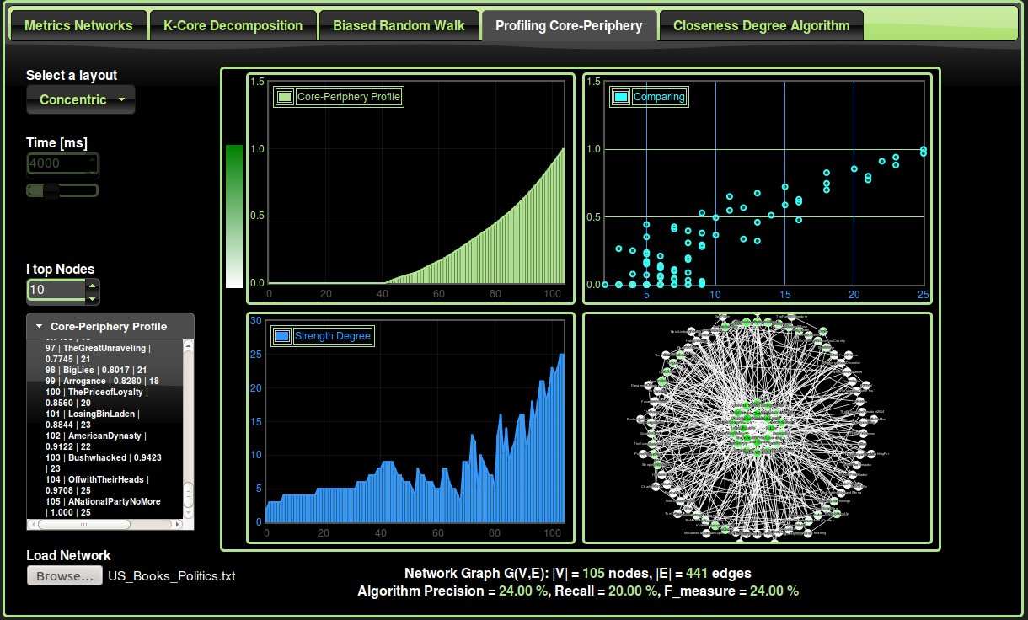
PCP Complete Network

Slide 18














Technology and Architecture
Front Client Side
Server Side
AJAX, JSON Objects
AJAX = Asynchronous JavaScript and XML
JSON = JavaScript Object Notation
MVC pattern, JSP, Servlet
Notes:
Reasons for using Java language
Extensive standardized APIs (Application Programming Interfaces)
Better portability than other languages across operating systems
Supports web based applications (Servlet, JSP), distributed applications(sockets, RMI, EJB, JDBC ) And network protocols (HTTP, …)
Object Oriented OO
Built-in support for multi-threading, socket communication, and memory management (automatic garbage collection).
Basics of AJAX
1 – A JSP page to produce the initial display
2 - A JavaScript to produce the Ajax request of the server
3 - A server-side program to receive the request and data and produce the requested data
4 - A Javascript to receive the new data and integrate it into the original document being displayed.
JSON: JavaScript Object Notation
Syntax for storing and exchanging data.
An alternative to XML.
Self-describing and easy to use, text format that can be read by any programming language.

Slide 19
Evaluation and criteria
How performant and efficient are these algorithms?
How to evaluate? Criteria?
Network G(V,E)
Subset W of known prominent nodes
Subset of the top prominent nodes from each algorithm
Precision:
Recall:
F-measure:

Slide 20

Experiments and Results
Test and evaluation of the algorithms on four datasets where the prominent nodes are known Ground-Truth
First network: Zachary's karate club: A social network of friendships between 34 members of a karate club, as described by Wayne Zachary in the 1970s. At the beginning of the study there was an incident conflict between the club president, John A., and Mr. Hi over the price of karate lessons.
Second network: Thurman office: Thurman spent 16 months observing the interactions among employees in the overseas office of a large international corporation. During this time, two major disputes erupted in a subgroup of fifteen people.
Third dataset: Social network of bottlenose dolphin living in Doubtful Sound, New Zealand. This dolphin dataset was collected by DL, Olivier J. Boisseau for the long-term research program of the University of Otago-Marine Mamma Research Group.
Fourth network: Jazz musicians bands network: The data was obtained from the Red Hot Archive digital database. The network dataset include 198 bands that performed between 1912 and 1940, with most of the band in 1920's.
Notes:
Trying to identify these leaders.
The dolphin network, (high betweenness) Brokers between communities who are influential of individuals in a network over the flow of information between others.
Betweenness (Freeman 1979) is a measure of the influence of individuals in a network over the flow of information between others. The betweenness of a vertex i is defined as the number of shortest paths between other pairs of vertices that pass through i. In the dolphin network, the vertices with highest betweenness fall, not surprisingly, on the boundary between the communities in the network (Fig. 2). The communities were defined
by looking for edges with high betweenness, not vertices, but edge and vertex betweennesses tend to be correlated. The betweenness centrality thus tends to pick out boundary individuals who play the role of brokers between communities.

Slide 21
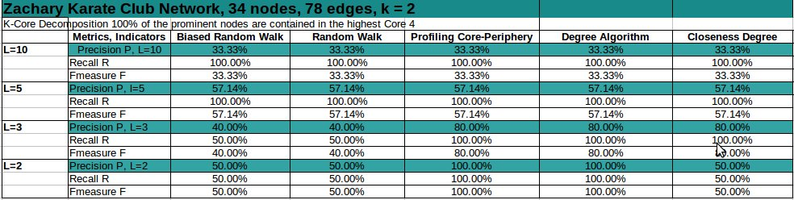
Results Zachary Karate Club

Slide 22
Results Zachary Karate Club

Slide 23
Results Zachary Karate Club

Slide 24
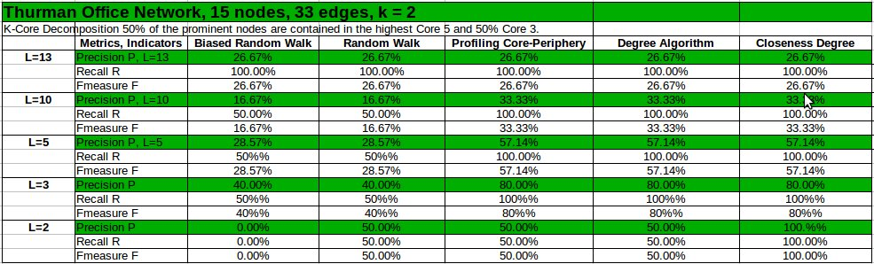
Results Thurman Office

Slide 25
Results Thurman Office

Slide 26
Results Thurman Office

Slide 27
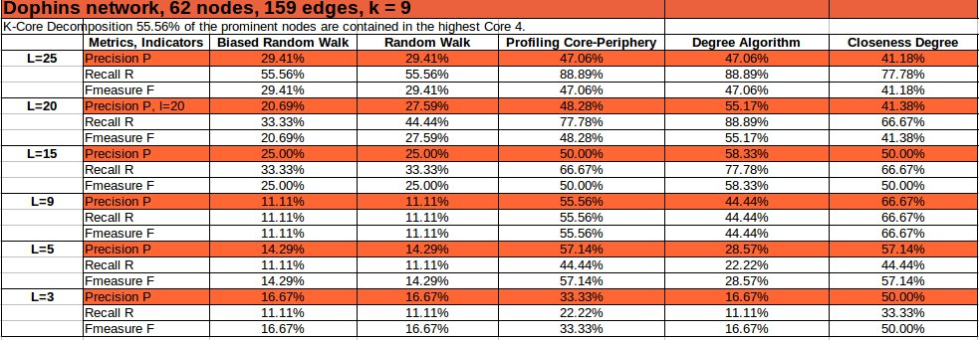
Results Dolphins Networks

Slide 28
Results Dolphins Networks

Slide 29
Results Dolphins Networks

Slide 30
Results Books US politics 2004
Reference: http://www.orgnet.com, Books about politics 2004 presidential election and sold by the online bookseller Amazon.com.
Notes:
Books about US politics: A network of books about US politics published around the time of the 2004 presidential election and sold by the online bookseller Amazon.com. Edges between books represent frequent copurchasing of books by the same buyers.
The network was compiled by V. Krebs and is unpublished, but can found on Krebs' web site. Thanks to Valdis Krebs for permission to post these data on this web site.

Slide 31
Conclusion and Improvement
From the few data sets tested so far, in detecting most prominent nodes, It seems that the algorithms do not add a significant value to the simple closeness and degree selection algorithm.
We obtain almost the same results between the Profiling Core-Periphery and a simple closeness degree algorithm. However the PCP outperforms the Biased Random Walk.
Possible Improvements:
Gather and test other datasets to obtain more accurate and significant statistical results.
Extend the algorithms to other type of network such as directed and unweighted networks.
Increase the network's size handled by the application: upload directly the dataset into the server.

