Slide 1

Housing Inspection Explorer: A Tool for Viewing Inspection Scores Among Public and Multihousing Units
Christopher Phillips and Amtul Nazneen
Team #1
CS 6315
November 18, 2020

Slide 2
Introduction
HIE (Housing Inspection Explorer)
Graphical reporting interface
Leverages inspection scores - multifamily & public housing
Many use cases
Ranking top states, counties
Cities with acceptable inspection scores
Inspections performed in a year

Slide 3
Target Audience
Government agents
Compiling statistics for reports
Determining funding for housing projects
Independent citizens
Observing safety/sanitation/upkeep of properties/neighborhoods
Assessing properties for rental/purchase

Slide 4
Data Sources
Dataset 1258
Public Housing Physical Inspection Scores
# triples: 1278872
Dataset 1259
Multifamily Housing Physical Inspection Scores
# triples: 1455325
Property ID: Unique Property Identification Number
Triple Ontological Form
[Property ID] -> [Attribute] -> [Value]

Slide 5
Data Integration
Integrate Dataset 1258 & 1259
"State_name" attribute
Common to both Datasets
Lists State associated with a housing property
Ex: “CA”, “TX”, etc.
Apache Jena Fuseki
SPARQL endpoint on the LOGD website non-functional (more on this later)
Raw N-Triples uploaded to Fuseki server

Slide 6
Data Product Results
SPARQL Queries
Average Scores by State
Average Scores by County
Inspection Information for State, Year
Average Scores, Latest Inspection Dates by Property
Top/Bottom 5 Scoring States

Slide 7
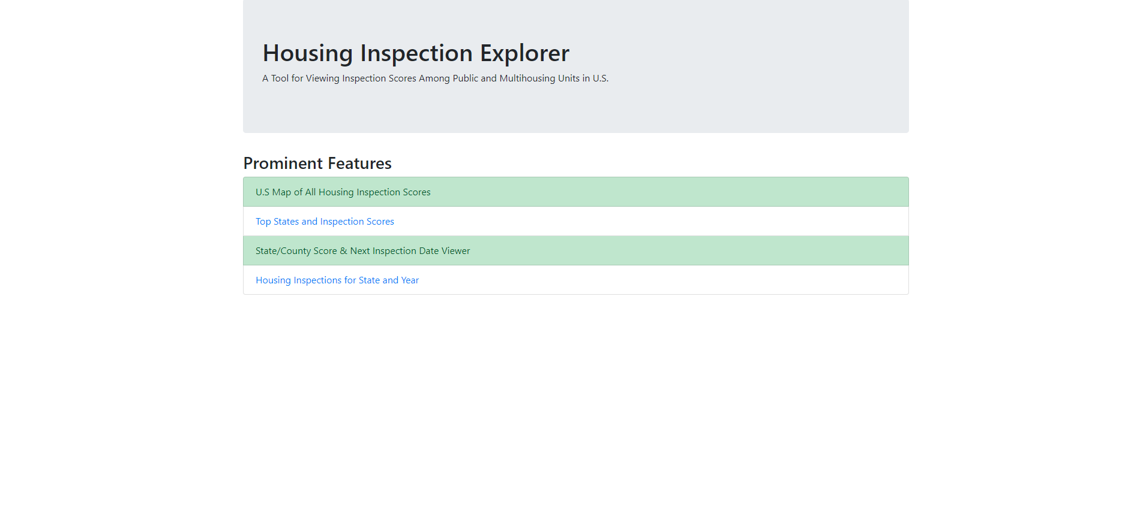
Housing Inspection Explorer

Slide 8
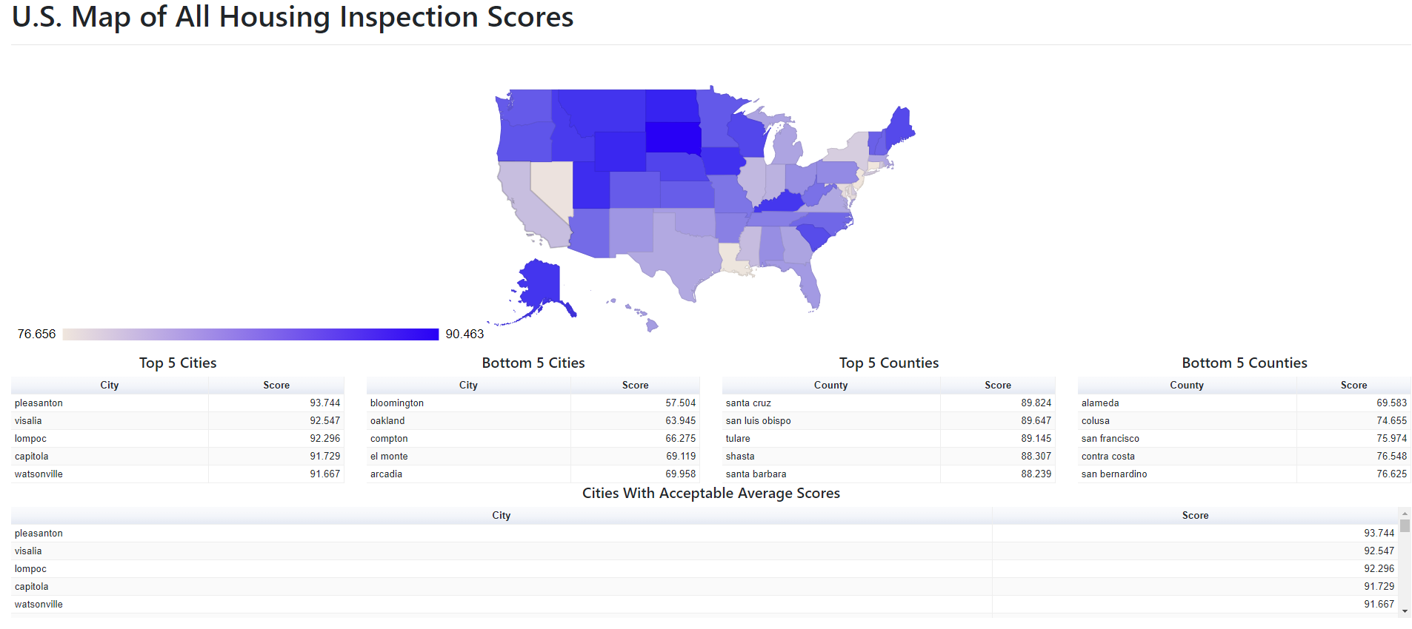
U.S. Map of all Housing Inspection Scores

Slide 9
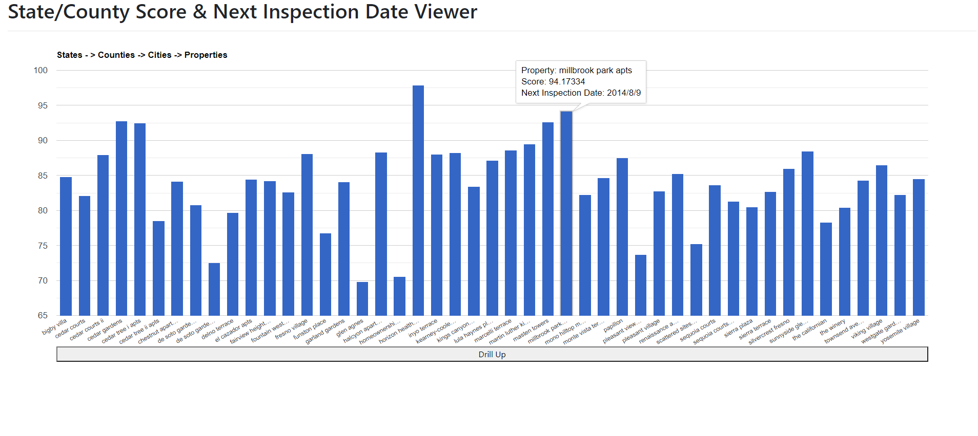
State/Inspection Score & Next Inspection Date Viewer

Slide 10
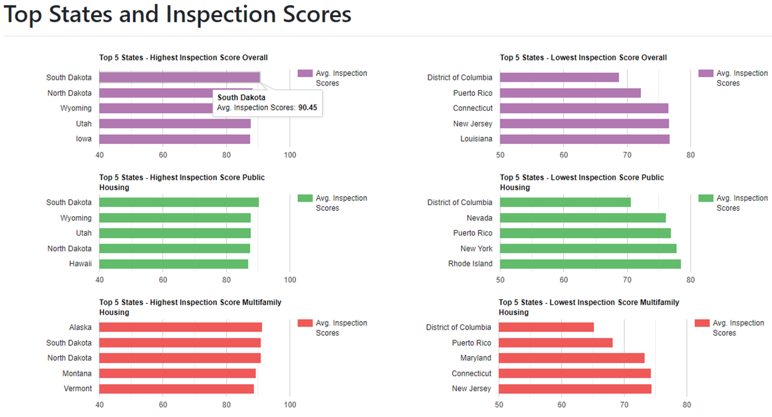
Top States and Inspection Scores

Slide 11
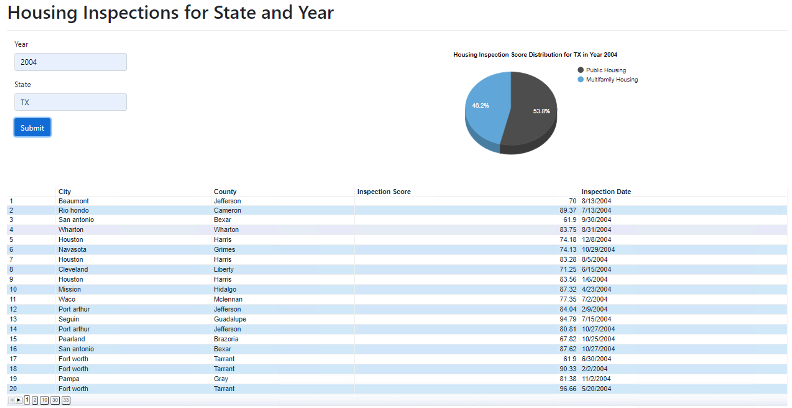
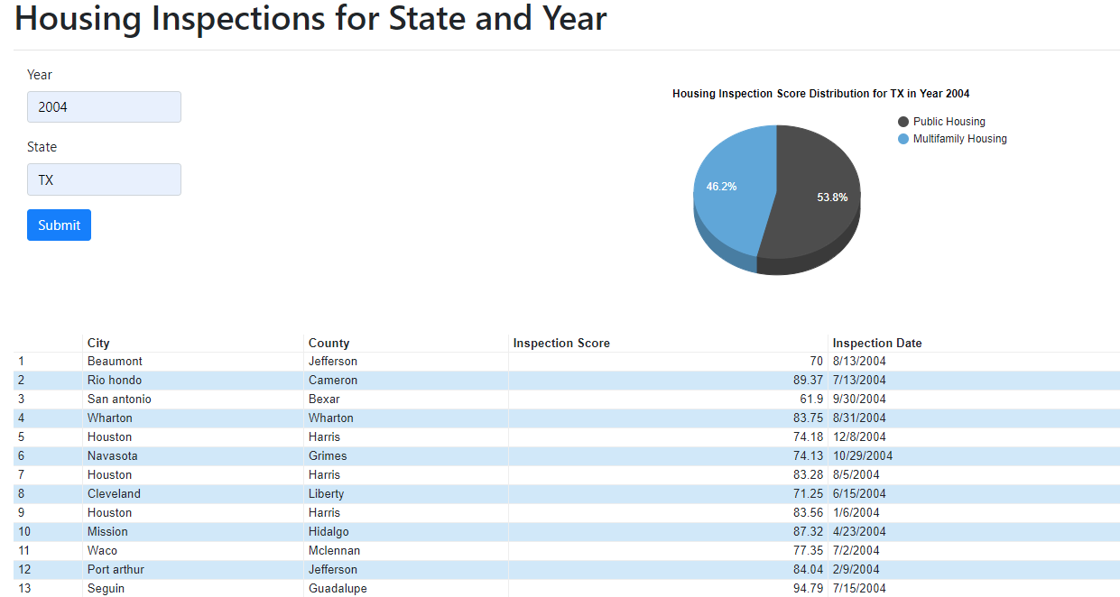
Housing Inspections for State and Year

Slide 12
Difficulties Encountered
Loss of functioning LOGD SPARQL endpoint
Occurred halfway through project
Necessitated use of Fuseki
Both datasets no longer listed on Data.gov
Gathering metadata was thus more challenging
Internet Archive utilized to get data catalogs

Slide 13
Successes
Leveraging Fuseki benefited project overall
Supported SPARQL 1.1 (aggregations, subqueries)
Greatly simplified client-side code
Extended functionality of Google Charts
Drilldown implemented manually
Ability to dynamically filter, query on demand

Slide 14
Summary
Resulting application (HIE) a success
Reports information effectively, intuitively
Would be of significant value to target audience
Knowledge gained
Hands-on experience with SPARQL 1.1
Experience creating a Semantic Web application

Slide 15

Thank you
Contact information or summary
More details concerning the brand standards for UT Dallas can be found online at utdallas.edu/brand.

