Slide 1
Hashing

Slide 2
Abstract Data Types
Set + Operations define an ADT.
  A set + insert, delete, find
  A set + ordering
  Multiple sets + union, insert, delete
  Multiple sets + merge
  Etc.
Depending on type of members and choice of operations, different implementations can have different asymptotic complexity.

Slide 3
Dictionary ADTs
Data structure with just 3 basic operations:
  find (i): find item with key (identifier) i
  insert (i): insert i into the dictionary
  remove (i): delete i
  Just like words in a Dictionary
Where do we use them:
  Symbol tables for compiler
  Customer records (access by name)
  Games (positions, configurations)
  Spell checkers
  P2P systems (access songs by name), etc.

Slide 4
Naïve Method 1: Linked List
Keep a linked list of the keys
  insert (i): add to the head of list. Easy and fast O(1)
  find (i): worst-case, search the whole list (linear)
  remove (i): also linear in worst-case

Slide 5
Naïve Method 2: Direct Mapping
Perm #
An array for all possible keys
Map key i to location i
  insert (i): set A[i] = 1
  find (i): return A[i]
  remove (i): set A[i] = 0
1
2
3
8
9
13
14
Student Records
Graduates

Slide 6
Naïve Method 2: Direct Mapping
Maintain an array (bit vector) for all possible keys
  insert (i): set A[i] = 1
  find (i): return A[i]
  remove (i): set A[i] = 0
All operations easy and fast O(1)
What’s the drawback?
Too much memory/space, and wasteful!
The space of all possible IP addresses, variable names in a compiler is enormous!

Slide 7
Shortcomings of Naïve Implementations
Linked list space-efficient, but search-inefficient.
  Insert is O(1) but find and delete are O(n).
  A sorted search structure (array) also no good. The search becomes fast, but insert/delete take O(n).
Bit Vector search-efficient but space-inefficient.
Balanced search trees work but take O(log n) time per operation, and complicated.

Slide 8
Towards an Efficient Data Structure: Hash Table
Formal Setup
Assume keys are integers {0, 1, …, |U|}
  Non-numeric keys (strings, webpages) converted to numbers: Sum of ASCII values, first three characters
  The keys come from a known but very large set, called universe U (e.g. IP addresses, program states)
The set of keys to be managed is S is a subset of U.
  The size of S is much smaller than U, namely, |S| << |U|
  We use n for |S|.

Slide 9
Hash Table
Key idea is that instead of direct mapping, Hash Tables use a Hash Function h to map each input key to a unique location in table of size M
  h : U -> {0, 1, …, M-1}
  hash function determines the hash table size.
Desiderata:
  M should be small, O(n)
  h should be easy to compute
  Typical example: h(i) = i mod M

Slide 10
Hashing : the basic idea
9
10
20
39
4
14
8
Student Records
Perm # (mod 9)
Graduates

Slide 11
Hash Tables: Intuition
Hash function lets us find an item in O(1) time.
  Each item is uniquely identified by a key
  Just check the location h(key) to find the item
Suppose we expect to have at most 100 keys in S
  91, 2048, 329, 17, 689345, ….
We create a table of size 100 and use the hash function h(key) = key mod 100
It is both fast and uses the ideal size table.
What can go wrong?

Slide 12
Hashing:
But what if all keys end with 00?
  All keys will map to the same location
  This is called a Collision in Hashing
This motivates the 3rd important property of hashing
  A good hash function should evenly spread the keys to foil any special structure of input
  Hashing with mod 100 works fine if keys random
  Most data (e.g. program variables) are not random

Slide 13
Hashing:
A good hash function should evenly spread the keys to foil any special structure of input
Key idea behind hashing is to “simulate” the randomness through the hash function
A good choice is h(x) = x mod p, for prime p
h(x) = (ax + b) mod p called pseudo-random hash functions

Slide 14
Hashing: The Basic Setup
Choose a pseudo-random hash function h
  this automatically determines the hash table size.
An item with key k is put at location h(k).
To find an item with key k, check location h(k).
What to do if more than one keys hash to the same value. This is called collision.
We will discuss two methods to handle collision:
  Separate chaining
  Open addressing

Slide 15
Separate chaining
0
1
2
3
4
5
6
7
8
9
10
23
1
56
Maintain a list of all elements that hash to the same value
Search using the hash function to determine which list to traverse
Collisions can be resolved by creating a list of keys that map to the same value
Insert/deletion–once the “bucket” is found through Hash, insert and delete are list operations
24
36
14
16
17
7
29
31
20
42
Notes:
Hash function is x mod 11

Slide 16
Insertion: insert 53
53 = 4 x 11 + 9
53 mod 11 = 9
0
1
2
3
4
5
6
7
8
9
10
0
1
2
3
4
5
6
7
8
9
10
23
1
56
23
1
56
24
24
36
14
36
14
16
16
17
17
7
29
7
29
31
20
42
53
20
42
31

Slide 17
Analysis of Hashing with Chaining
Worst case
  All keys hash into the same bucket
  a single linked list.
  insert, delete, find take O(n) time.
  A worst-case Theorem later
Average case
  Keys are uniformly distributed into buckets
  Load Factor L = InputSize/HashTableSize
  In a failed search, avg cost is L
  In a successful search, avg cost is 1 + L/2

Slide 18
Separate Chaining
Use an array of linked lists
  LinkedList Table[];
  Table = malloc (LinkedList(N)), where N is the table size
Define Load Factor of Table as
  λ = number of keys/size of the table
  (λ can be more than 1)
Still need a good hash function to distribute keys evenly
  For search and updates

Slide 19
Open addressing
0
1
2
3
4
5
6
7
8
9
10
42
If collision happens, alternative cells are tried until an empty cell is found.
Different probing strategies
  Linear
  Quadratic
  Double Hashing
1
24
14
16
28
7
31
9

Slide 20
Linear Probing
The idea:
  Table remains a simple array of size N
  On insert(x), compute f(x) mod N, if the cell is full, find another by sequentially searching for the next available slot
    Go to f(x)+1, f(x)+2 etc..
  On find(x), compute f(x) mod N, if the cell doesn’t match, look elsewhere.
  Linear probing function can be given by
    h(x, i) = (f(x) + i) mod N (i=1,2,….)

Slide 21
Linear Probing (insert 12)
12 = 1 x 11 + 1
12 mod 11 = 1
0
1
2
3
4
5
6
7
8
9
10
42
0
1
2
3
4
5
6
7
8
9
10
42
1
1
24
24
14
14
12
16
16
28
28
7
7
31
31
9
9

Slide 22
Search with linear probing (Search 15)
15 = 1 x 11 + 4
15 mod 11 = 4
0
1
2
3
4
5
6
7
8
9
10
42
1
24
14
12
16
28
7
NOT FOUND !
31
9

Slide 23
Deletion with linear probing: LAZY (Delete 9)
9 = 0 x 11 + 9
9 mod 11 = 9
0
1
2
3
4
5
6
7
8
9
10
42
0
1
2
3
4
5
6
7
8
9
10
42
1
1
24
24
14
14
12
12
16
16
28
28
7
7
31
31
FOUND !
D
9

Slide 24
Deletion in Hashing with Linear Probing
Since empty buckets are used to terminate search, standard deletion does not work.
One simple idea is to not delete, but mark.
  Insert: put item in first empty or marked bucket.
  Search: Continue past marked buckets.
  Delete: just mark the bucket as deleted.

Slide 25
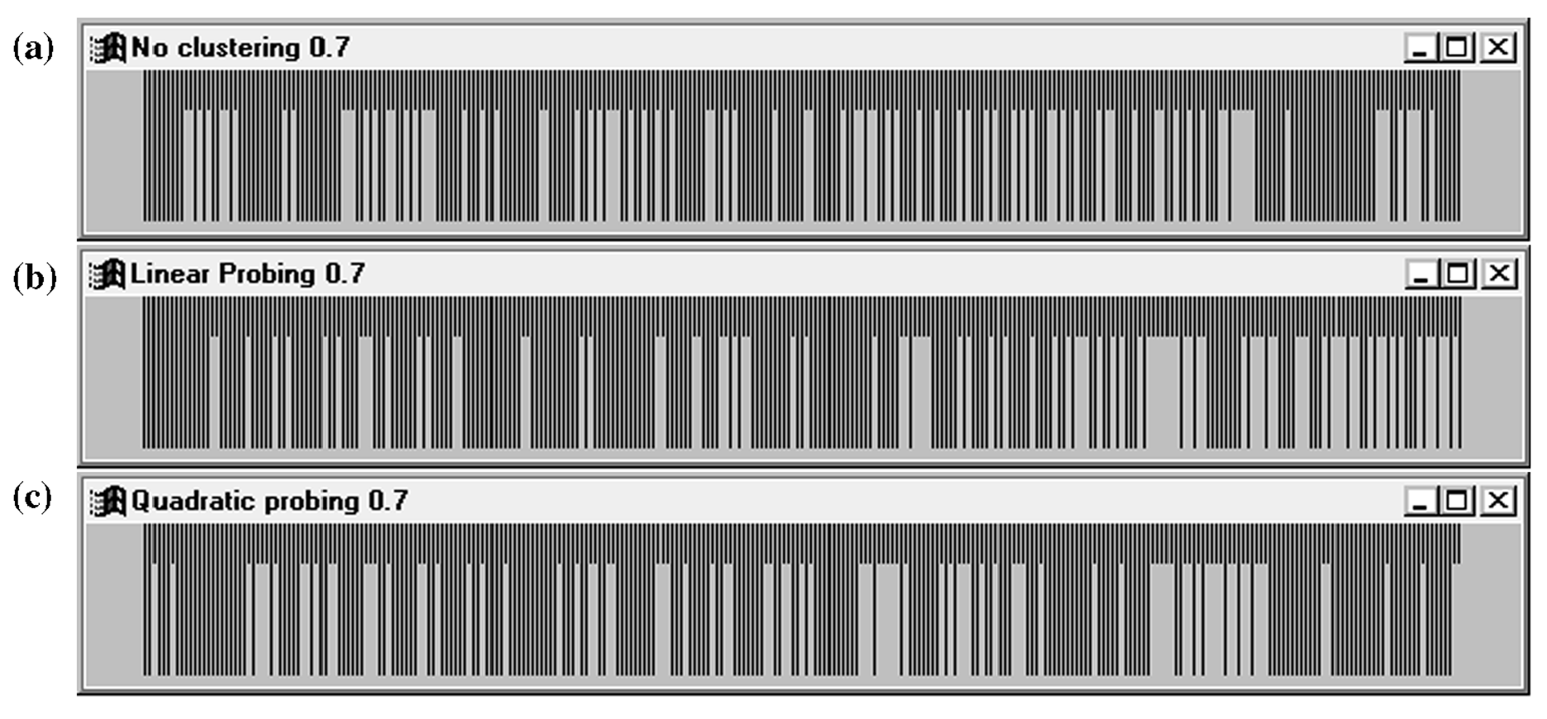
Clustering Problem
Clustering is a significant problem in linear probing. Why?
Illustration of primary clustering in linear probing (b) versus no clustering (a) and the less significant secondary clustering in quadratic probing (c). Long lines represent occupied cells, and the load factor is 0.7.
Data Structures & Problem Solving using JAVA/2E Mark Allen Weiss © 2002 Addison Wesley

Slide 26
Hashing with Linear Probing
Avg. cost for successful searches ½ (1 + 1/(1 – L))
Failed search avg. cost more ½ (1 + 1/(1 – L)²)

Slide 27
Load Factor (open addressing)
definition: The load factor λ of a probing hash table is the fraction of the table
that is full. The load factor ranges from 0 (empty) to 1 (completely full).
It is better to keep the load factor under 0.7
Double the table size and rehash if load factor gets high
Cost of Hash function f(x) must be minimized
When collisions occur, linear probing can always find an empty cell
  But clustering can be a problem

Slide 28
Quadratic Probing
Solves the clustering problem in Linear Probing
  Check H(x)
  If collision occurs check H(x) + 1
  If collision occurs check H(x) + 4
  If collision occurs check H(x) + 9
  If collision occurs check H(x) + 16
  ...
  H(x) + i²

Slide 29
Quadratic Probing (insert 12)
12 = 1 x 11 + 1
12 mod 11 = 1
0
1
2
3
4
5
6
7
8
9
10
42
0
1
2
3
4
5
6
7
8
9
10
42
1
1
24
24
14
14
12
16
16
28
28
7
7
31
31
9
9

Slide 30
Double Hashing
When collision occurs use a second hash function
  Hash₂ (x) = R – (x mod R)
  R: greatest prime number smaller than table-size
Inserting 12
  H₂(x) = 7 – (x mod 7) = 7 – (12 mod 7) = 2
  Check H(x)
  If collision occurs check H(x) + 2
  If collision occurs check H(x) + 4
  If collision occurs check H(x) + 6
  If collision occurs check H(x) + 8
  H(x) + i * H₂(x)

Slide 31
Double Hashing (insert 12)
12 = 1 x 11 + 1
12 mod 11 = 1
7 –12 mod 7 = 2
0
1
2
3
4
5
6
7
8
9
10
42
0
1
2
3
4
5
6
7
8
9
10
42
1
1
24
24
14
14
12
16
16
28
28
7
7
31
31
9
9

Slide 32
Rehashing
If table gets too full, operations will take too long.
Build another table, twice as big (and prime).
  Next prime number after 11 x 2 is 23
Insert every element again to this table
Rehash after a percentage of the table becomes full (70% for example)

Slide 33
Collision Functions
H_{i}(x)= (H(x)+i) mod B
  Linear pobing
H_{i}(x)= (H(x)+c*i) mod B (c > 1)
  Linear probing with step-size = c
H_{i}(x)= (H(x)+i²) mod B
  Quadratic probing
H_{i}(x)= (H(x)+ i * H₂(x)) mod B

Slide 34
Analysis of Open Hashing
Effort of one Insert?
  Intuitively – that depends on how full the hash is
Effort of an average Insert?
Effort to fill the Bucket to a certain capacity?
  Intuitively – accumulated efforts in inserts
Effort to search an item (both successful and unsuccessful)?
Effort to delete an item (both successful and unsuccessful)?
  Same effort for successful search and delete?
  Same effort for unsuccessful search and delete?

Slide 35
Issues:
What do we lose?
  Operations that require ordering are inefficient
  FindMax: O(n) O(log n) Balanced binary tree
  FindMin: O(n) O(log n) Balanced binary tree
  PrintSorted: O(n log n) O(n) Balanced binary tree
What do we gain?
  Insert: O(1) O(log n) Balanced binary tree
  Delete: O(1) O(log n) Balanced binary tree
  Find: O(1) O(log n) Balanced binary tree
How to handle Collision?
  Separate chaining
  Open addressing

Slide 36


