Slide 1

Data Structures
Ramesh Naidu Laveti/RS Patil
C-DAC, Bangalore

Slide 2

Trees

Slide 3
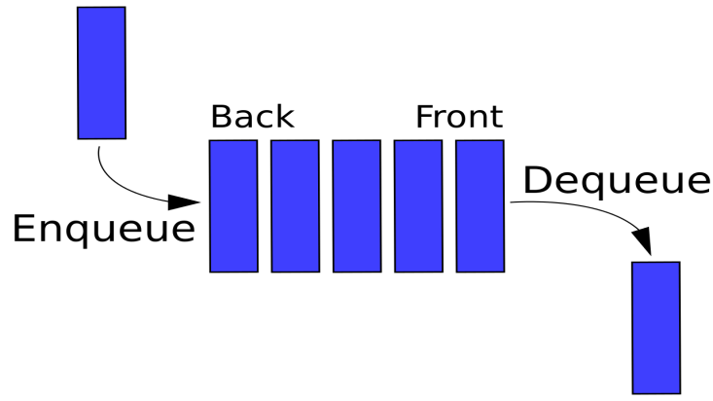
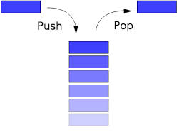
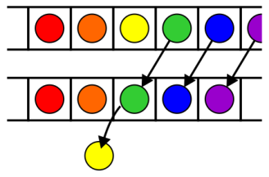
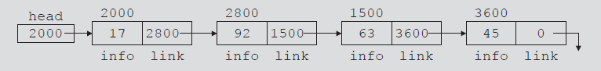
Introduction
Till now, we have seen linear data structures
Queue
Stack
List (Arrays)
Linked List
Now, we will learn about a hierarchical data structure - Tree

Slide 4
A View Of Natural Tree
leaves
branches
root

Slide 5

Computer Scientist’s View
root
leaves
branches
nodes
Notes:
Branches meet at nodes.

Slide 6


Definition1
Tree: A tree is a hierarchical data structure with a root value and subtrees of children, represented as a set of linked nodes.
A tree can be empty with no nodes called thenull or empty tree or a tree is a structure consisting of one node called the root and one or more subtrees.
A tree is recursive in nature
A tree should not be cyclic
Links are unidirectional
There are many types of trees ( we will discuss later)

Slide 7
Definition2
Definition: A rooted tree is a graph G such that:
G is connected
G has no cycles
G has exactly one vertex called the root of the tree
Consequences
The depth of a vertex v is the length of the unique path from root to v
G can be arranged so that the root is at the top, its neighboring vertices are vertices of depth 1, and so on…
The set of all vertices of depth k is called level k of the tree

Slide 8
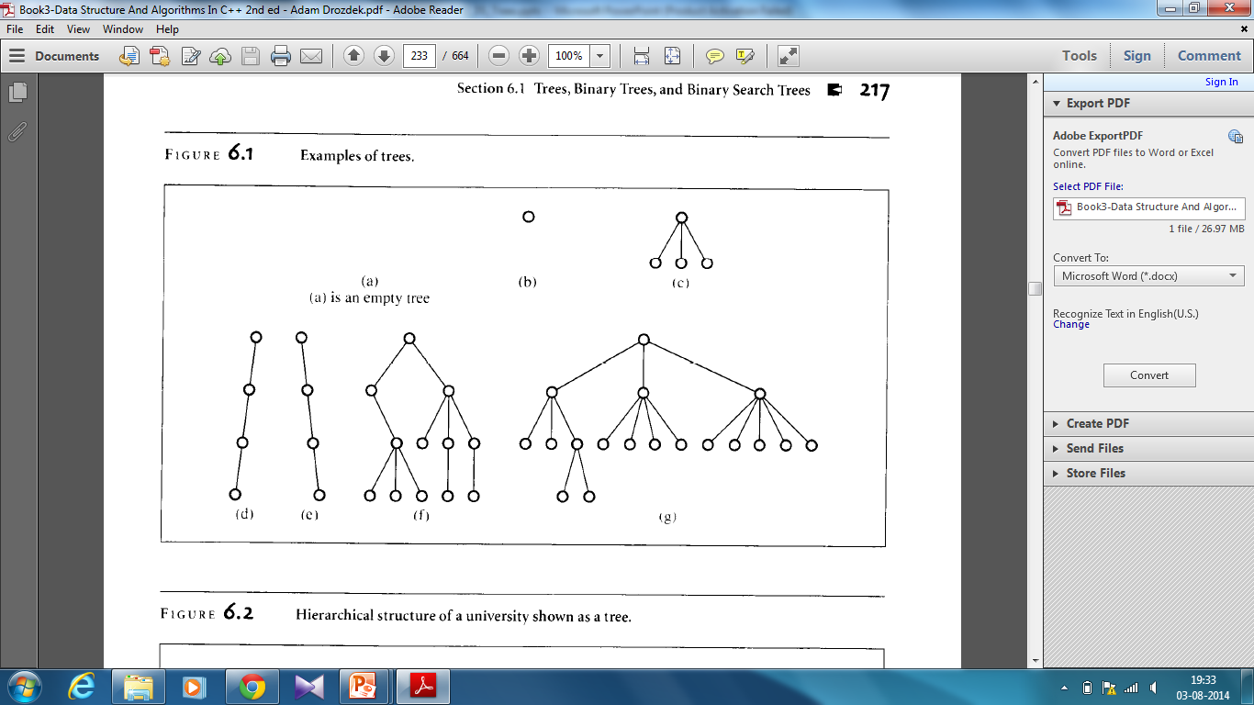
Definition2

Slide 9
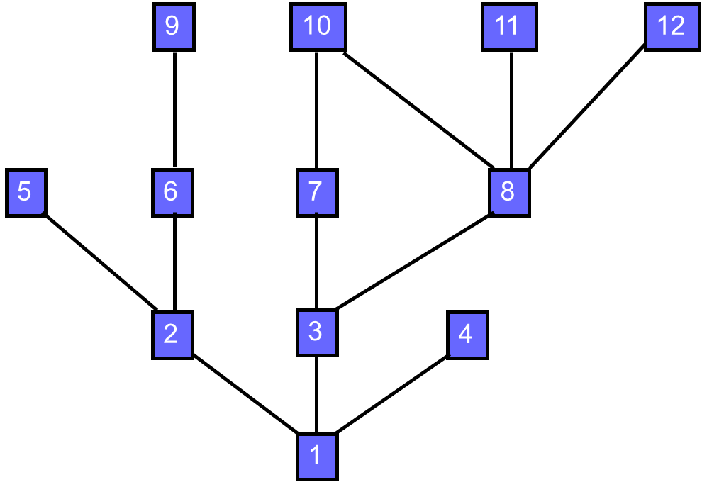
Is it a Tree?
Cyclic

Slide 10
Example Tree
President
root
children of root
VP1
VP2
VP3
Manager1
Manager2
Manager
Manager
grand children of root
Worker Bee
great grand child of root

Slide 11
Terminology - Subtrees
President
root
VP1
VP2
VP3
Manager1
Manager2
Manager
Manager
Worker Bee

Slide 12
Terminology - Leaves
President
VP1
VP2
VP3
Manager1
Manager2
Manager
Manager
Leaves in Green Color
Worker Bee

Slide 13
Parent, Grandparent, Siblings, Ancestors, Descendants1
President
VP1
VP2
VP3
Manager1
Manager2
Manager
Manager
Worker Bee

Slide 14
Levels
President
Level 1
Level 2
VP1
VP2
VP3
Manager1
Manager2
Manager
Manager
Level 3
Worker Bee
Level 4

Slide 15
Caution
Some texts start level numbers at 0 rather than at 1.
Root is at level 0.
Its children are at level 1.
The grand children of the root are at level 2.
And so on.
We shall number levels with the root at level 1.

Slide 16
Height Depth and Number of Levels
President
Level 1
Level 2
VP1
VP2
VP3
Manager1
Manager2
Manager
Manager
Level 3
Worker Bee
Level 4

Slide 17
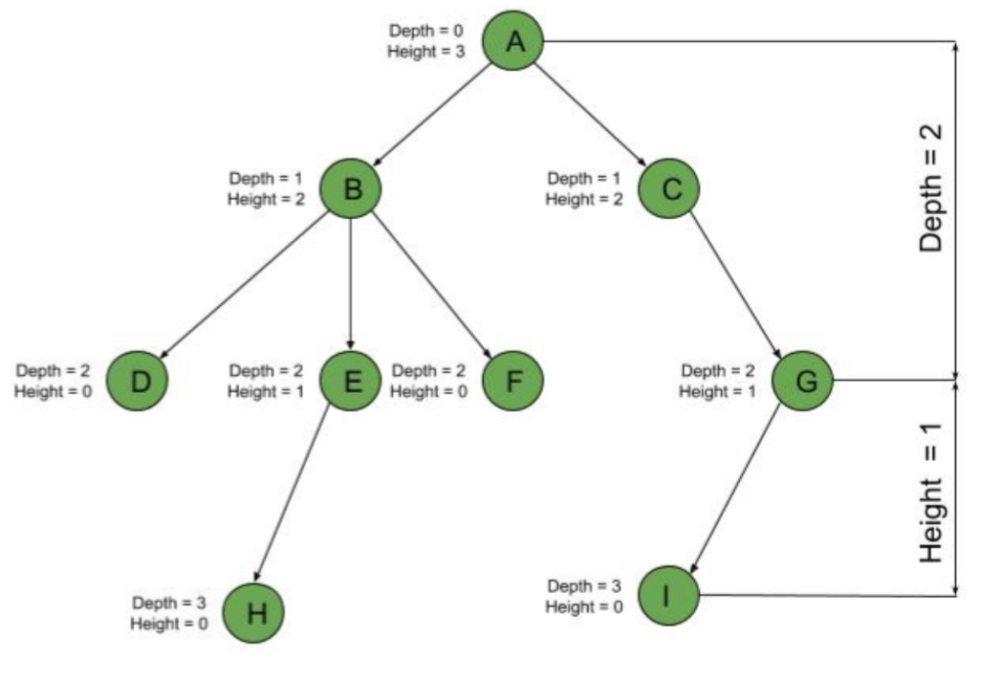
Height and Depth of Nodes
The depth of a node is the number of edges present in path from the root node of a tree to that node.
The height of a node is the number of edges present in the longest path connecting that node to a leaf node.

Slide 18
Node Degree = Number Of Children
President
3
2
VP1
1
VP2
1
VP3
0
0
1
0
Manager1
Manager2
Manager
Manager
Worker Bee
0

Slide 19
Tree Degree = Max Node Degree
President
3
2
VP1
1
VP2
1
VP3
0
0
1
0
Manager1
Manager2
Manager
Manager
Worker Bee
0
Degree of tree = 3.
Notes:
Note that it is possible to have a tree whose degree is (say) 3 and whose root has a
degree that is < 3.

Slide 20
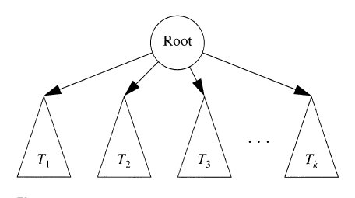
Trees – A recursive View

Slide 21
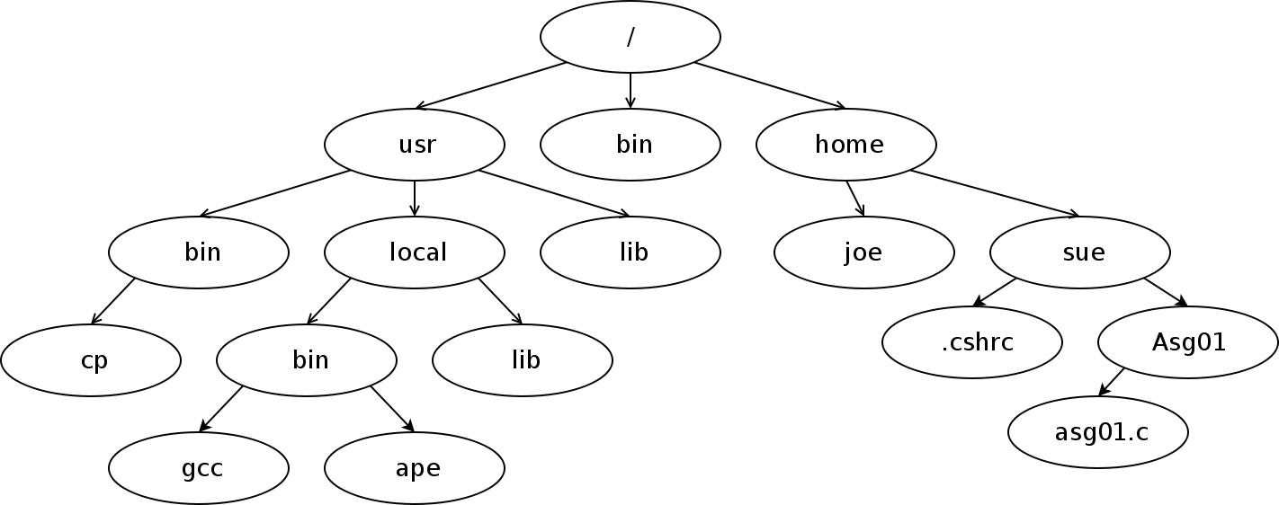
Trees – Applications
Unix File System

Slide 22
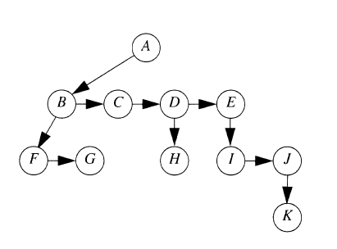
Trees – Implementation
First Child Next Sibling Method:
Keep the children of each node in a linked list of tree nodes, with each node keeping two pointers, one to its leftmost child (if it is not a leaf) and one to its right sibling (if it is not the rightmost sibling).
Arrows that point downward are first child pointers
Arrows that point left to right are Next sibling pointers.
We did not draw NULL pointers because there are too many of them.

Slide 23
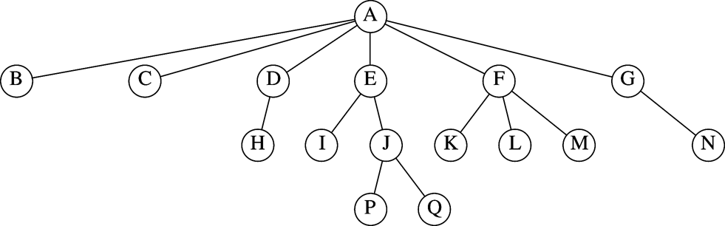
Recap
Which are the parent nodes?
Which are the child nodes?
Which are the leaves?
What is the height and depth of the tree?
What is the height and depth of node E? Node F?

Slide 24
Types of Trees
Traditional Binary Trees
Binary Search Tree
AVL Trees
Threaded Trees
Red-Black Trees
B-Tree
2-3 Tree & 2-3-4 Tree
Heap
Many More……

Slide 25
Binary Trees

Slide 26
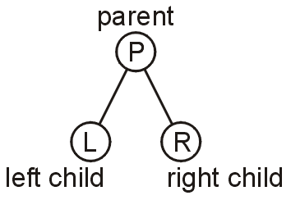
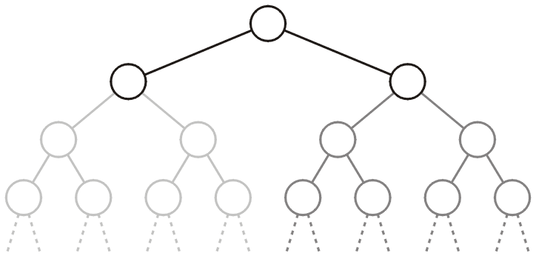
Definition
5.1.1
A binary tree is a tree in which no node can have more than two children. Because there are only two children, we can name them left and right.
Each child is either empty or another binary tree
This restriction allows us to label the children as left and right subtrees

Slide 27
Definition…
5.1.1
Recursively, a binary tree is either empty or consists of a root, a left tree, and a right tree.
A node with one child could have either a left or right child.

Slide 28
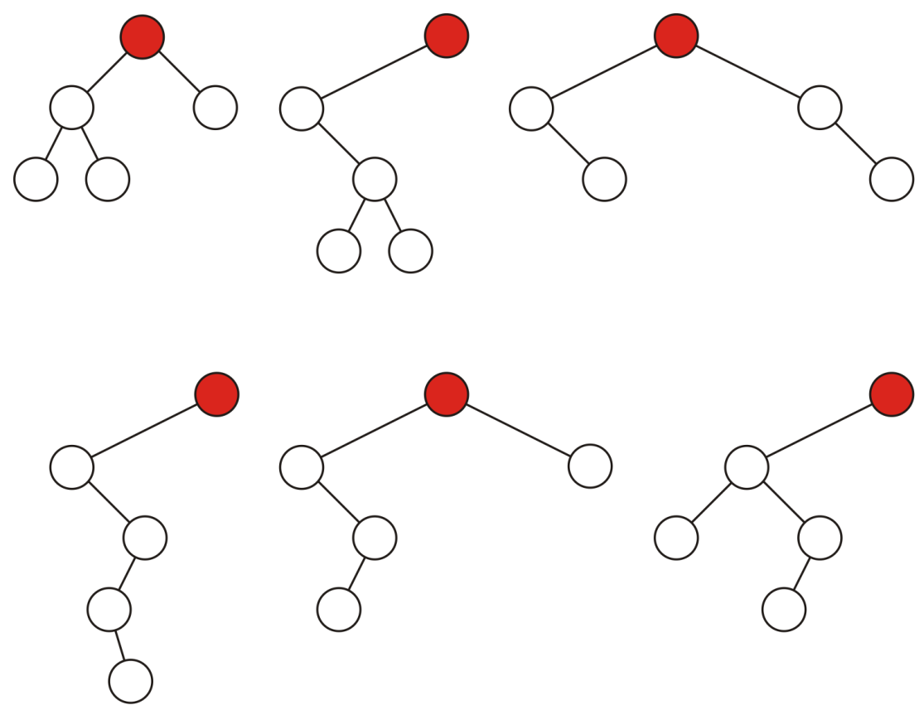
Variations of binary tree
5.1.1
Sample variations on binary trees with five nodes:

Slide 29
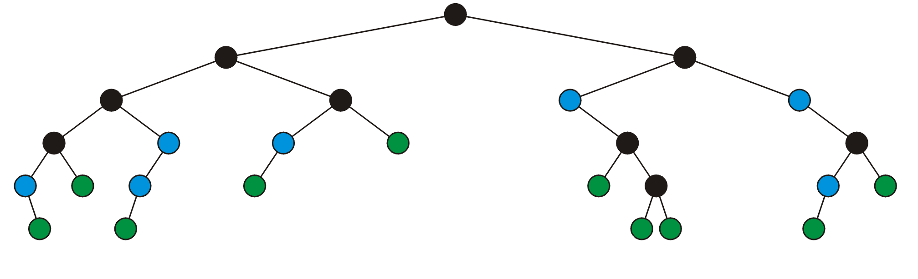
Full Node
5.1.1
A full node is a node where both the left and right sub-trees are non-empty trees
Legend:
full nodes neither leaf nodes

Slide 30
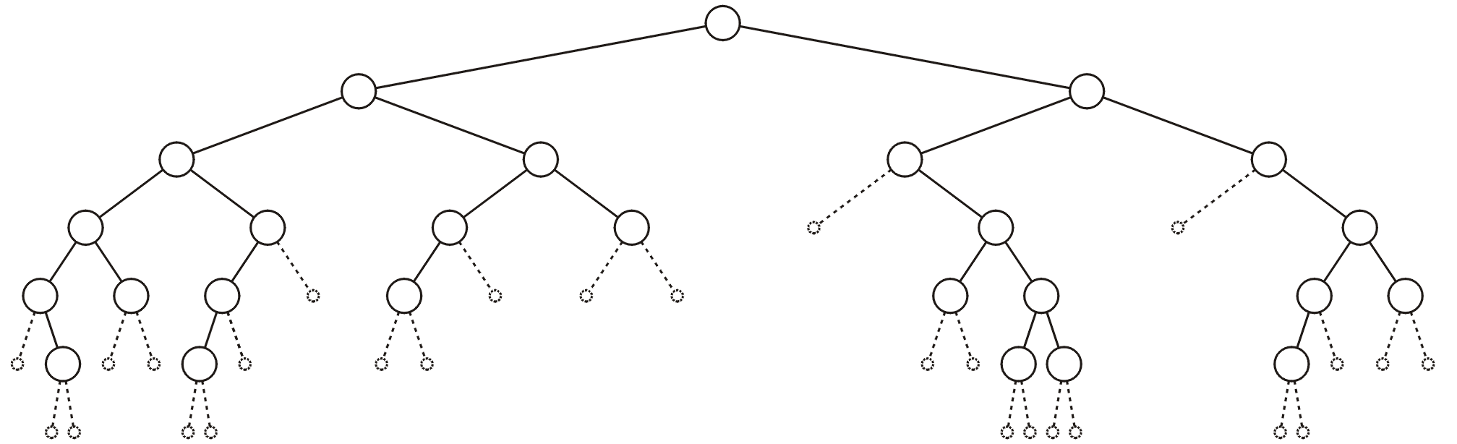
Empty Node
5.1.1
An empty node or a null sub-tree is any location where a new leaf node could be appended

Slide 31
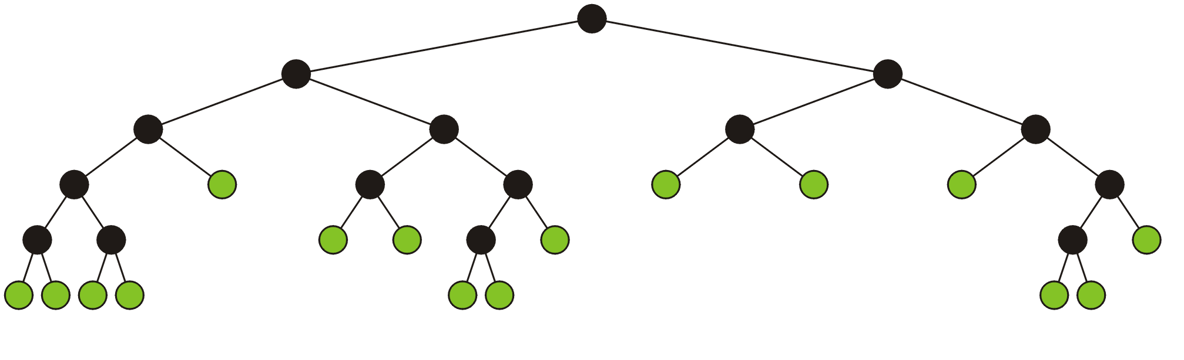
Full Binary Tree
5.1.1
A full binary tree is where each node is:
A full node, or
A leaf node
These have applications in
Expression trees
Huffman encoding

Slide 32
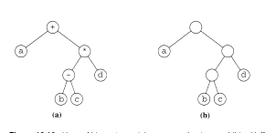
Applications
5.1.1
Expression Tree (a)
Huffman Coding Tree (b)
Binary Search Tress
and so on…..

Slide 33
Tree Traversals
5.1.1
Three types of traversals:
Preorder
PostOrder
Inorder
A special type
Level Order
Notes:
http://en.wikibooks.org/wiki/A-level_Computing/AQA/Problem_Solving,_Programming,_Operating_Systems,_Databases_and_Networking/Programming_Concepts/Tree_traversal_algorithms_for_a_binary_tree

Slide 34
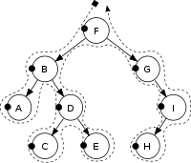
Tree Traversals - Preorder
5.1.1
Preorder Traversal: In a preorder traversal, the node is processed and then its children are processed recursively.
Procedure:
Visit the root node (generally output this) → N (Node)
Traverse to left subtree → L (Left)
Traverse to right subtree → R (Right)
Output:
F, B, A, D, C, E, G, I, H

Slide 35
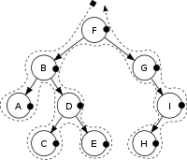
Tree Traversals - Postorder
5.1.1
Postorder Traversal: In a postorder traversal, the children are processed first and then its node is processed recursively.
Procedure:
Traverse to left subtree → L (Left)
Traverse to right subtree → R (Right)
Visit the root node (generally output this) → N (Node)
Output:
A, C, E, D, B, H, I, G, F

Slide 36
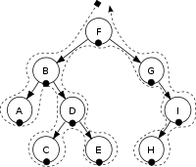
Tree Traversals - Inorder
5.1.1
Inorder Traversal: In a inorder traversal, the left child is recursively processed, the current node is processed, and the right child is recursively processed.
Procedure:
Traverse to left subtree → L (Left)
Visit the root node (generally output this) → N (Node)
Traverse to right subtree → R (Right)
Output:
A, B, C, D, E, F, G, H, I

Slide 37
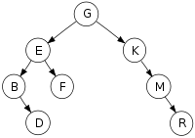
Class Room Work
5.1.1
Perform Pre-Order, In-Order and Post-Order traversals for the following tree
Pre-Order: GEBDFKMR
In-Order: BDEFGKMR
Post-Order: DBFERMKG
Notes:
Rule of thumb[edit]
There is an easier way to remember how to do this and if you are struggling for time in the exam you can try this way:
Check that the code is left traversal followed by right traversal
Check the position of the output line
draw the dots on the nodes
draw a line around the tree
follow the line and write down each node where you meet a dot
So let's take a look at what that all means. First of all take a look at the code. If the code has the left tree traversal before the right tree traversal we can proceed (this is true in all cases above and below). How we need to find out where the output line is.
Depending on where the line to output the node value is this will tell you what sort of tree order traversal they are asking you to do. NOTE: If you have In order traversal don't jump too soon, the tree may not be sorted!
But how does this help? The next thing you need to do is put a little mark on each node of the tree as follows:

Slide 38
Binary Search Trees

