Slide 1
Affective Computing Project
CS616

Slide 2
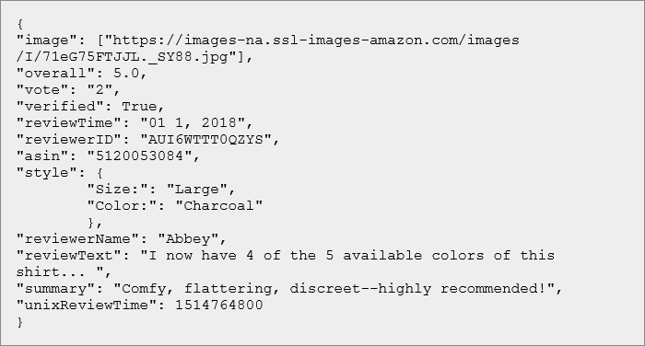
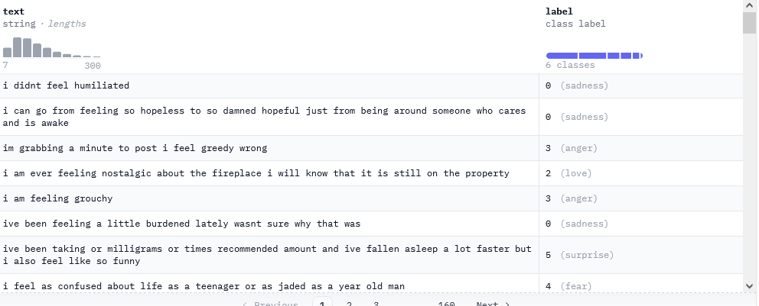
Project Resources
No code shared this time either
I am sharing the Amazon reviews dataset
200+ million reviews of products on Amazon
I am also sharing HuggingFace’s Emotion dataset
18k tweets annotated with emotion information

Slide 3
Project Ideas
You can apply any of the sentiment analysis algorithms we will discuss in class in the next couple of weeks (or your own) to predict user ratings from review text in the Amazon dataset
Doing this for a small sample (****)
Doing this for the whole dataset (*****)
You can apply any of the emotion prediction algorithms we will discuss in class in the next couple of weeks to predict emotions from text in the Emotion dataset (****)
BYOP (*****)

Slide 4
Timelines
Submission deadline is Monday, 30th October noon
With multiplicative discounts as before for delays
Teams are the same. Changes are possible but you have to tell me first.
Feel free to discuss what you want to do with me before executing
We will cover the algorithms in the next couple of weeks, but you can get a head-start via the sentiment analysis and opinion mining monograph I have shared

Slide 5
Reality mining
Bonus project

Slide 6
Dataset
The Reality Mining dataset
100 Nokia 6600 phones equipped with custom apps to track
Call logs
Nearby phones
Nearby cell towers
App usage
Participants were also surveyed about their social life halfway through the tracking period (one semester)

Slide 7
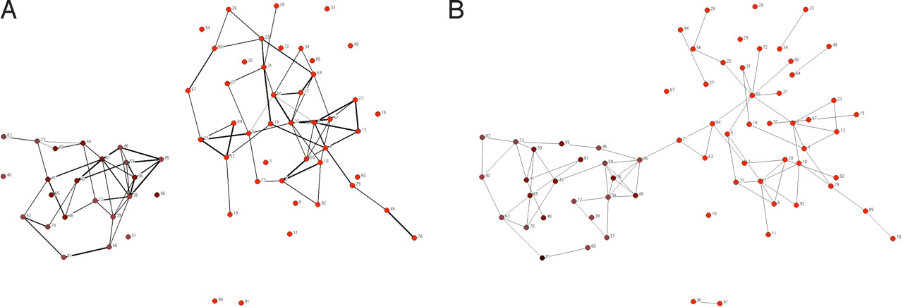
Inferring friendship structure
Inferred
Self-reported

Slide 8
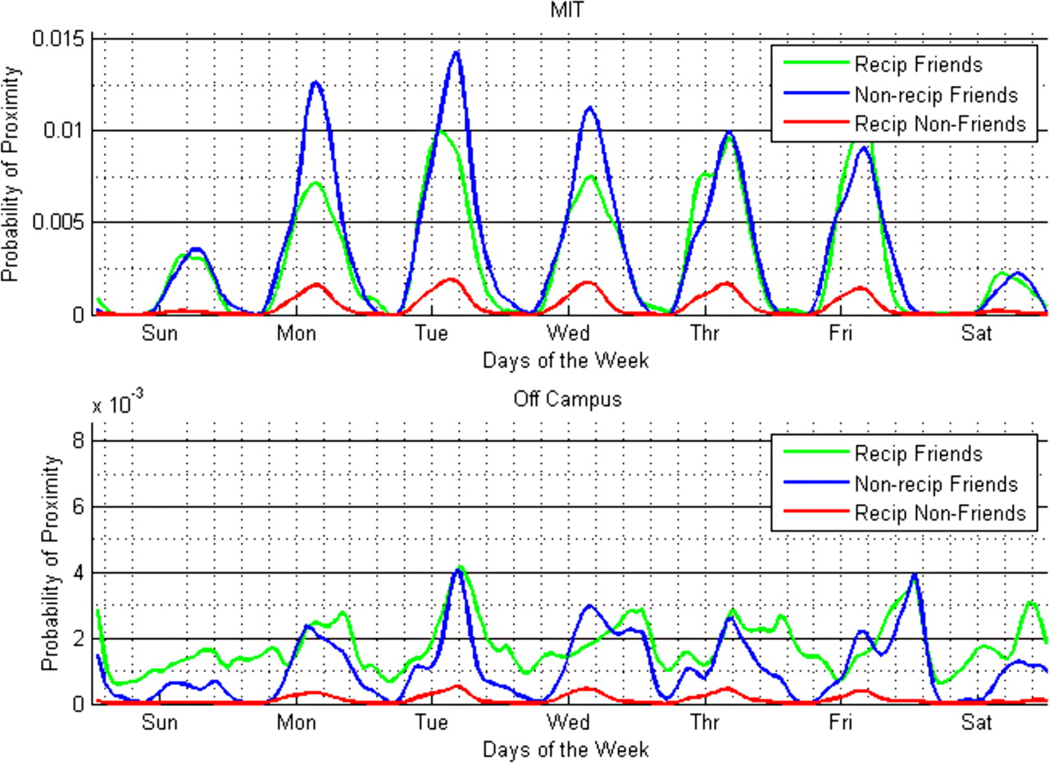
Dynamics of proximity and relationship

Slide 9
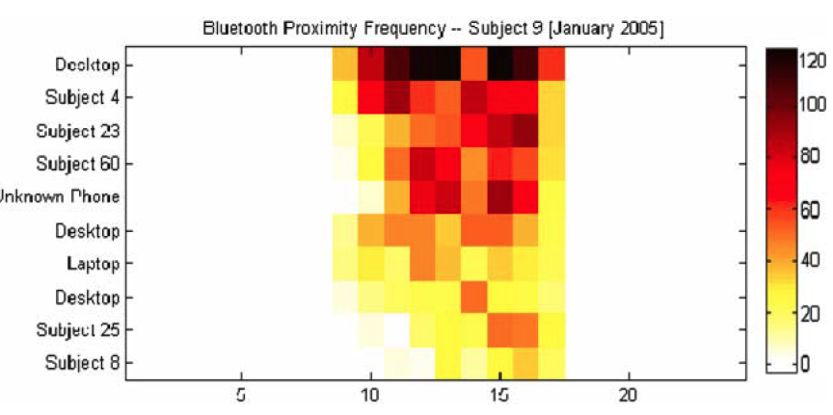
Localization

Slide 10
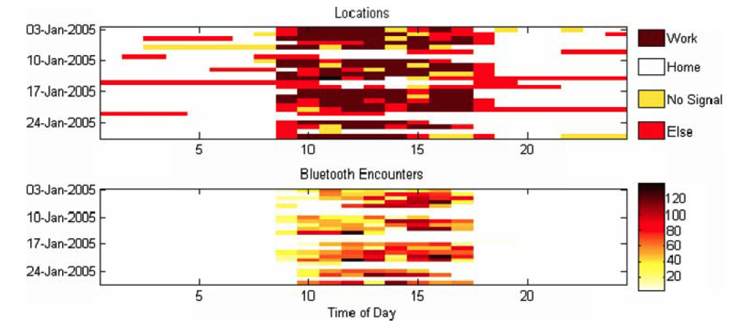
Entropy

Slide 11
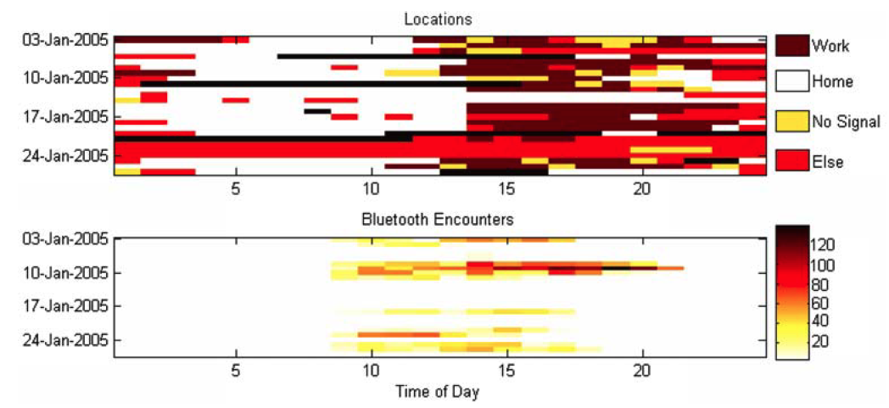
Entropy

Slide 12
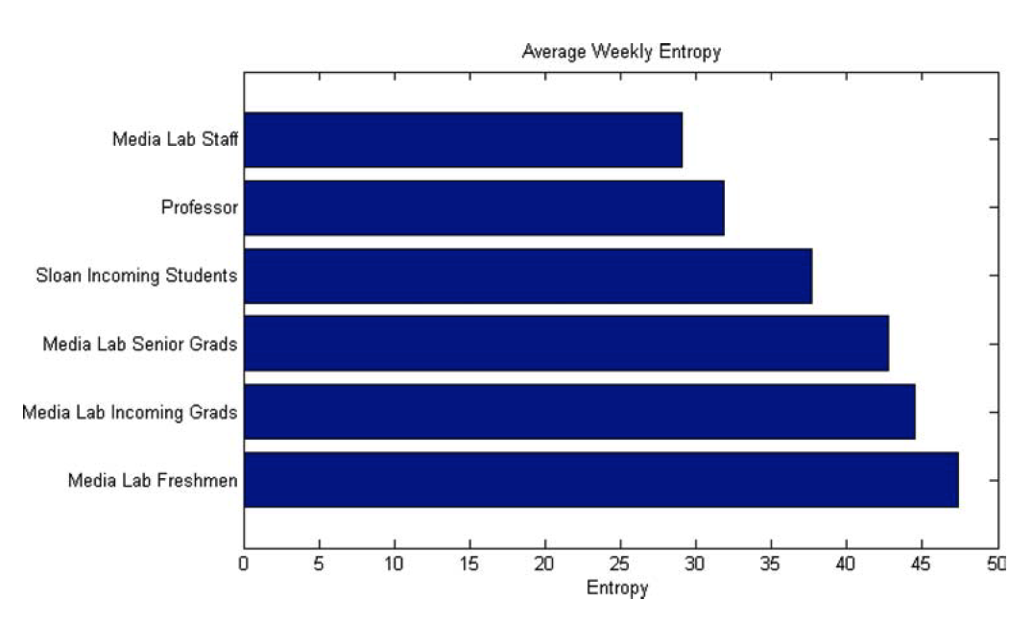
Entropy

Slide 13
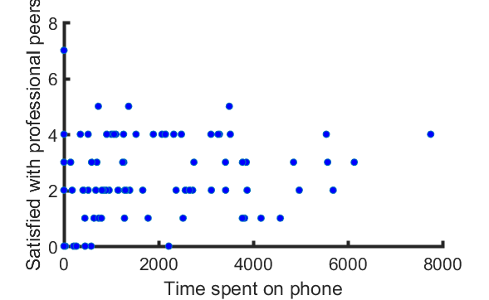
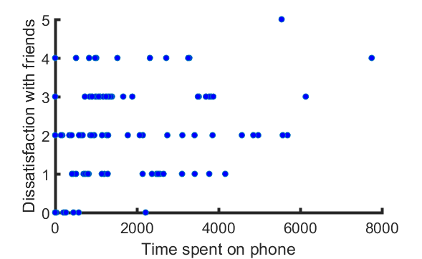
Low-hanging fruit

Slide 14
Value of the original study
Showed that regular phones could be used to infer location using cell tower ID pretty well
Showed that Bluetooth could be used to detect interpersonal proximity fairly well
Showed that interpersonal relationships could be predicted quite well using physical proximity off work

Slide 15
Possible projects
What can we infer from the call logs themselves?
Can we infer location? (***)
Can we infer physical proximity? (***)
Can we infer relationship structure? (****)
I’m looking for
creative theories of how call patterns might correlate with these factors, and
competent operationalization of these theories in your formal models
Due 30th October noon

