Slide 1
W4995 Applied Machine Learning
Working with Imbalanced Data
03/20/17
Andreas Müller

Slide 2
Recap on imbalanced data

Slide 3
Two sources of imbalance
Asymmetric cost
Asymmetric data

Slide 4
Why do we care?
Why should cost be symmetric?
Detect rare events

Slide 5
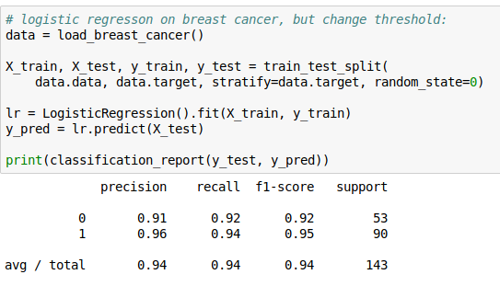
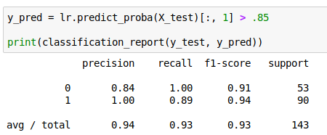
Changing Thresholds

Slide 6
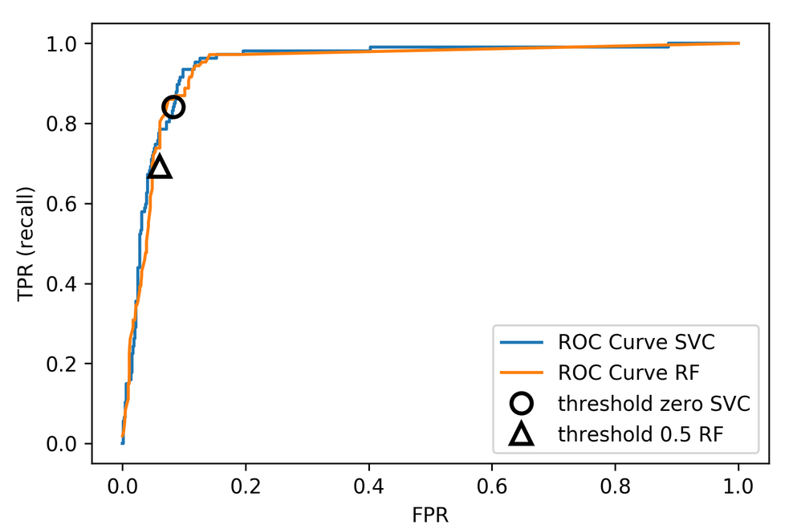
Roc Curve

Slide 7
Remedies for the model

Slide 8
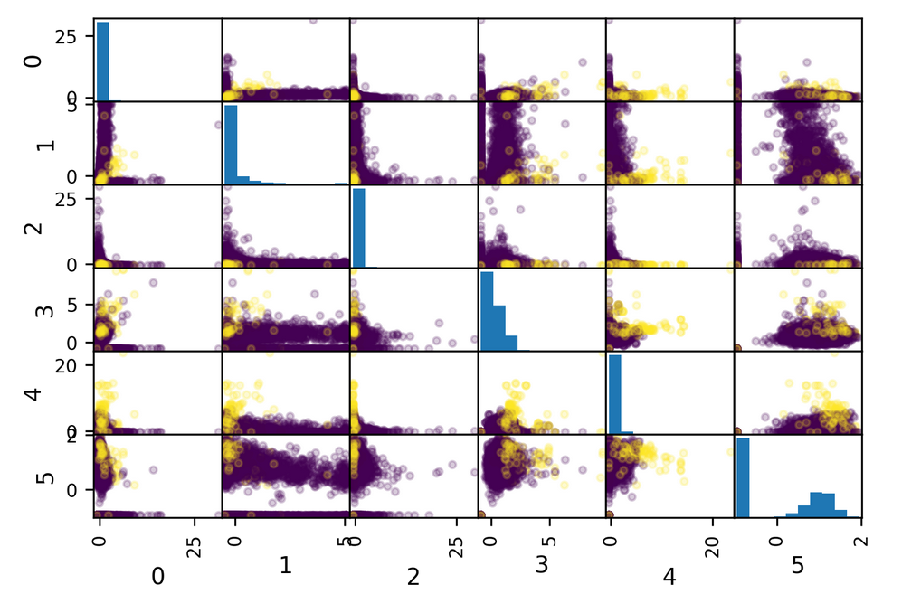
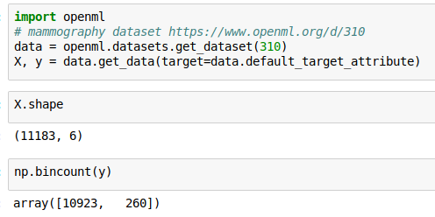
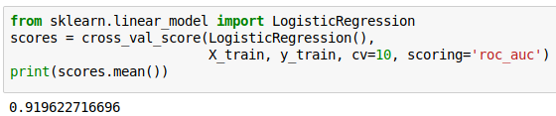
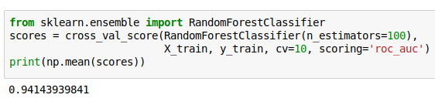
Mammography data

Slide 9
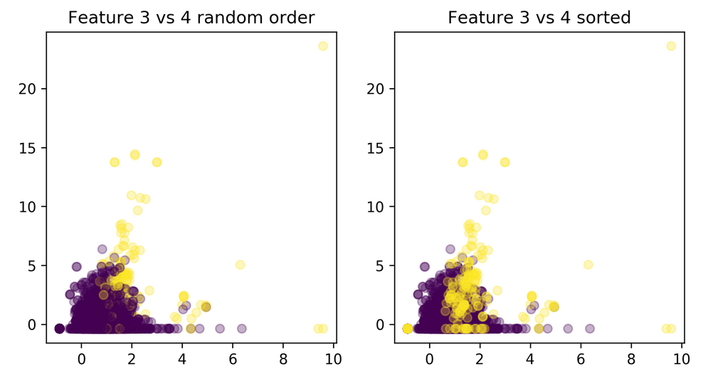
Mammography data

Slide 10
Basic Approaches
Change the data
Change the training procedure
Add samples
Remove Samples
Both

Slide 11
Scikit-learn vs resampling
The transform method only transforms X
Pipelines work by chaining transforms
To resample the data, we need to also change y
Imbalance-learn extends scikit-learn interface with a “sample” method.
Imbalance-learn has a custom pipeline that allows resampling.
Imbalance-learn: resampling is only performed during fitting
Warning: not everything in imbalance-learn is multiclass!

Slide 12
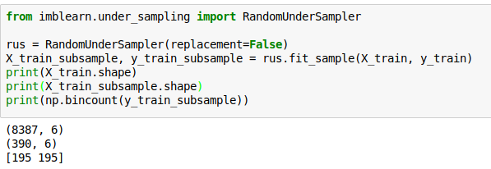
Random Undersampling
Drop data from the majority class randomly
Often until balanced
Very fast training (data shrinks to 2x minority)
Loses data!

Slide 13
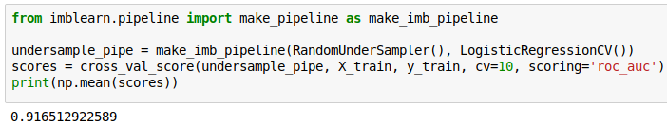
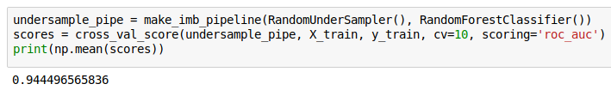
Random Undersampling
As accurate with fraction of samples!
Really good for large datasets!

Slide 14
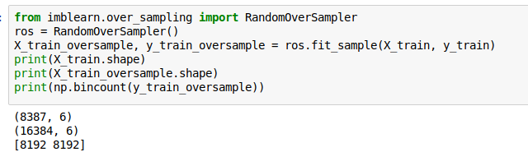
Random Oversampling
Repeat samples from the minority class randomly.
Often until balanced.
Much slower (dataset grows to 2x majority)

Slide 15
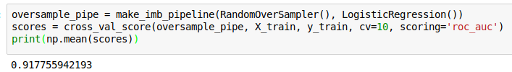
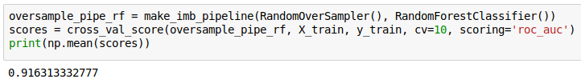
Random Oversampling
Logreg the same, Random Forest much worse than before

Slide 16
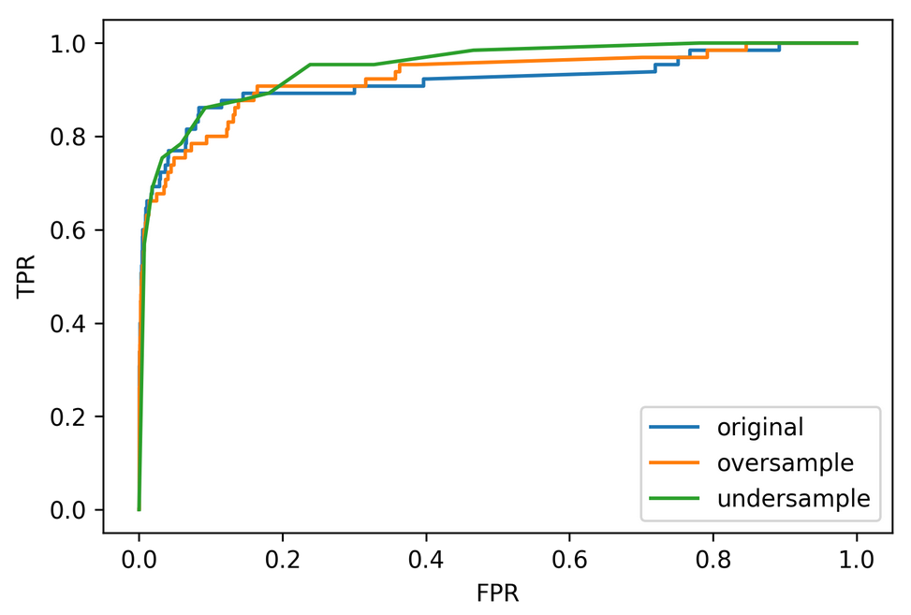
ROC Curves for LogReg

Slide 17
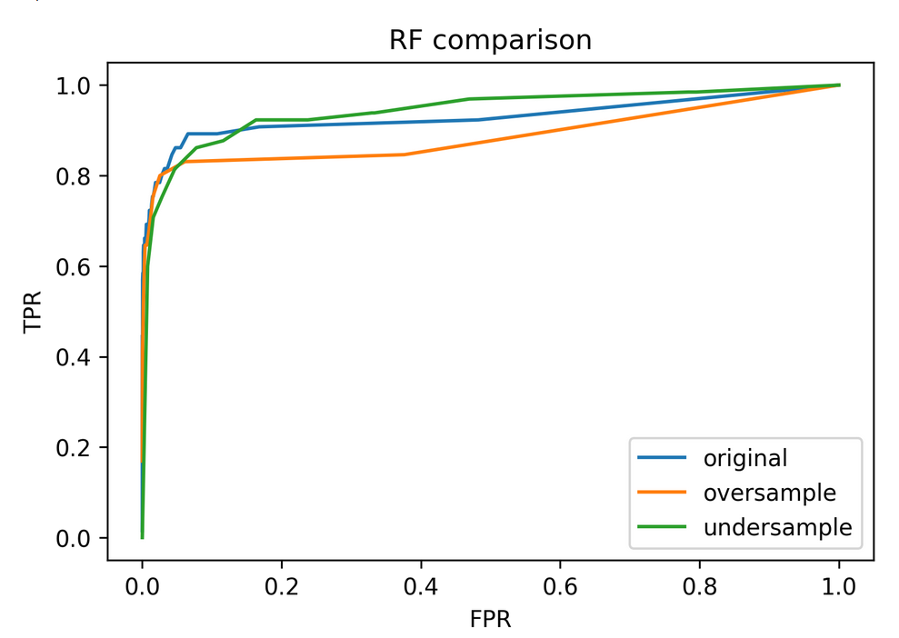
ROC Curves for Random Forest

Slide 18
Class-weights
Instead of repeating samples, re-weight the loss function.
Works for most models!
Same effect as over-sampling (though not random), but not as expensive (dataset size the same).

Slide 19
Class-weights in linear models
Similar for linear and non-linear SVM

Slide 20
Class weights in trees

Slide 21
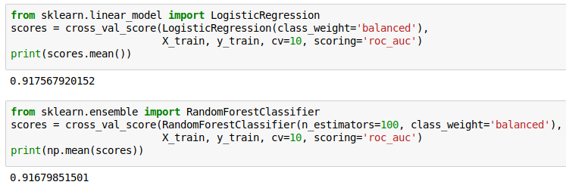
Using Class-Weights

Slide 22
Ensemble Resampling
Random resampling separate for each instance in an ensemble!
Paper: “Exploratory Undersampling for Class-Imbalance Learning”
Not in sklearn (yet), not totally easy with imbalance-learn (but soon).

Slide 23
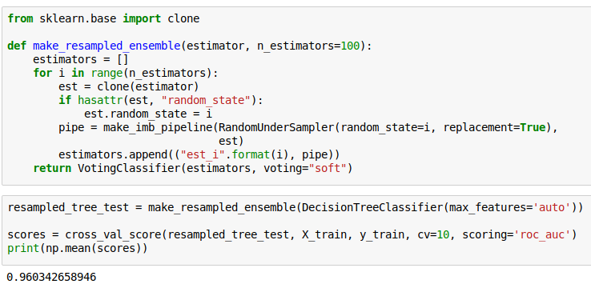
Quick & Dirty Easy Ensemble
As cheap as undersampling, but much better results than anything else!
Didn’t do anything for Logistic Regression.

Slide 24
Smart resampling
(based on nearest neighbor heuristics from the 70’s

Slide 25
Edited Nearest Neighbors
Originally as heuristic for reducing dataset for KNN
Remove all samples that are misclassified by KNN from training data (mode) or that have any point from other class as neighbor (all).
“Cleans up” outliers and boundaries.

Slide 26
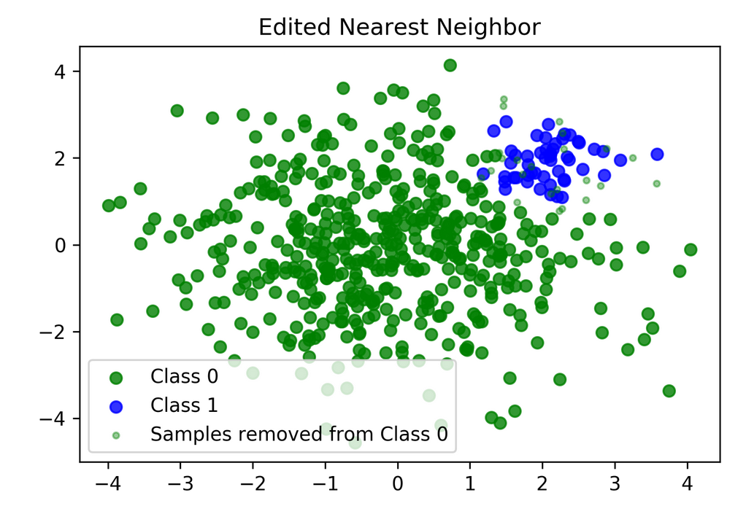

Slide 27
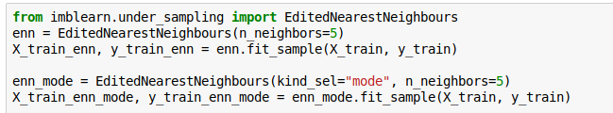
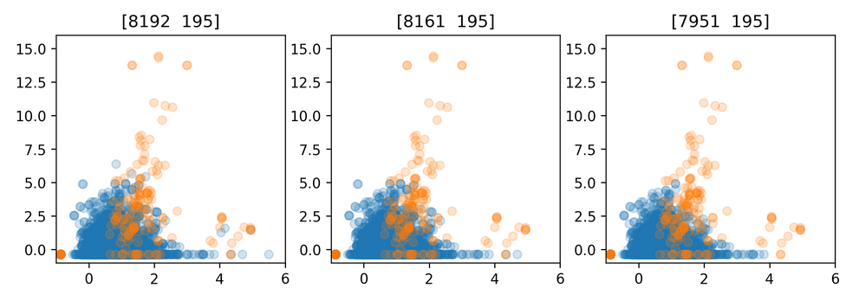
Edited Nearest Neighbors
original
mode
all

Slide 28
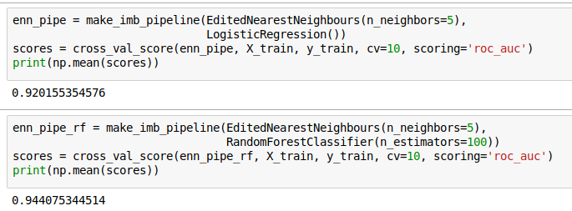

Slide 29
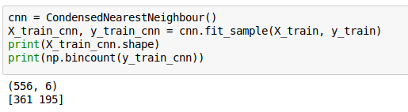
Condensed Nearest Neighbors
Iteratively adds points to the data that are misclassified by KNN
Focuses on the boundaries
Usually removes many

Slide 30
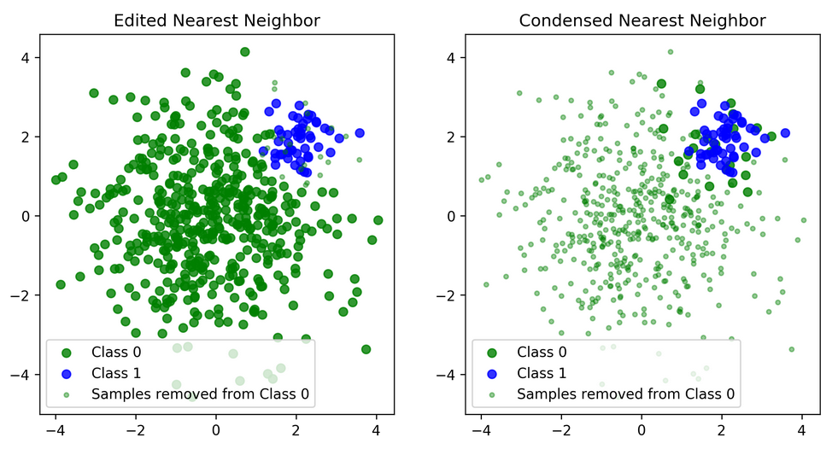

Slide 31
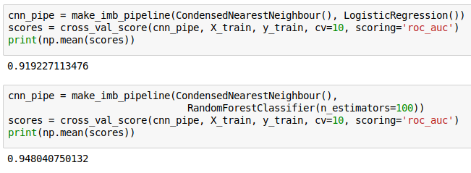

Slide 32
Synthetic Sample Generation

Slide 33
Synthetic
Minority Oversampling Technique (SMOTE)
Adds synthetic interpolated data to smaller class
For each sample in minority class:
  Pick random neighbor from k neighbors.
  Pick point on line connecting the two uniformly
  Repeat.
Leads to very large datasets (oversampling)
Can be combined with undersampling strategies

Slide 34
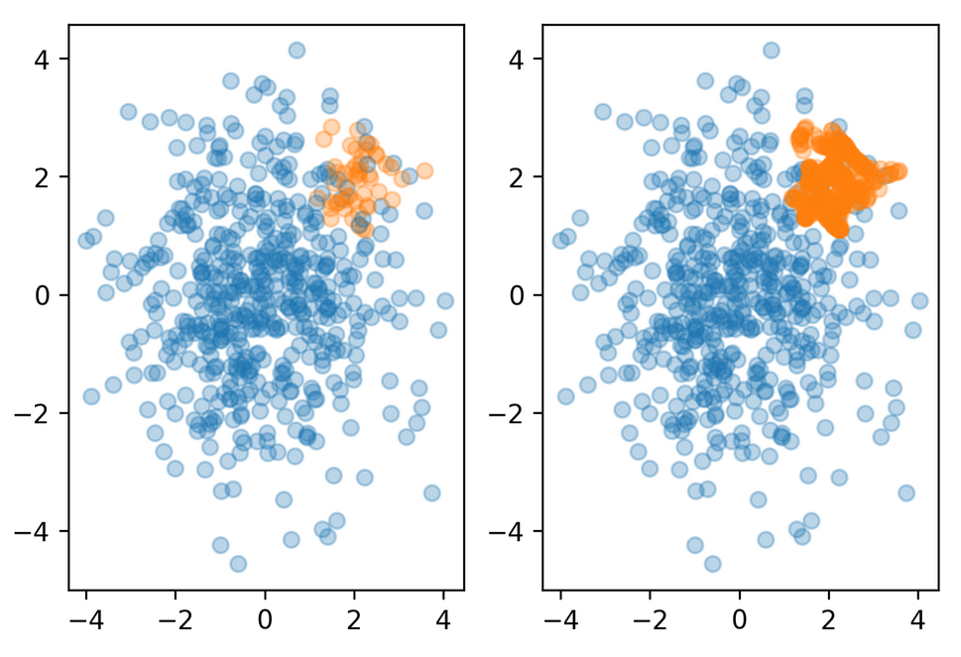
smo

Slide 35
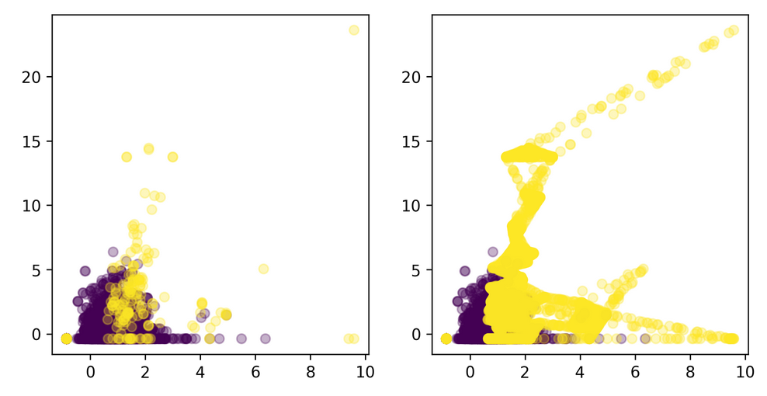
original
smote

Slide 36
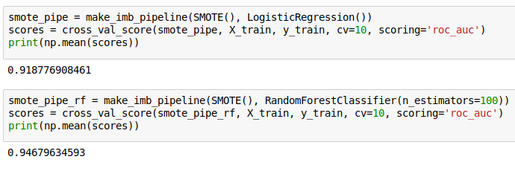


Slide 37
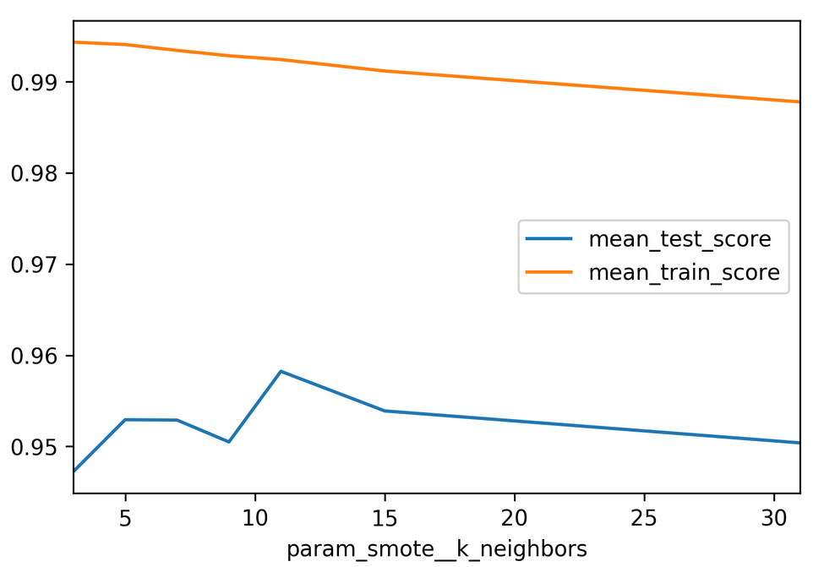

Slide 38
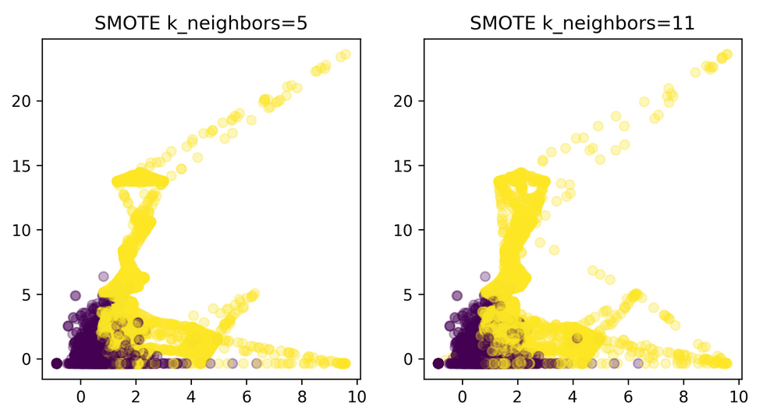

Slide 39
Summary
Always check roc_auc, look at curve
Undersampling is very fast and can help!
Undersampling + Ensembles is very powerful!
Many smart sampling strategies, mixed outcomes
SMOTE allows adding new interpolated samples,
works well in practice
More advanced variants of SMOTE available

