Slide 1


Advanced Scikit-Learn
Andreas Mueller (NYU Center for Data Science, scikit-learn)

Slide 2



Me

Slide 3







Slide 4
Representing Data
one sample
1.1 | 2.2 | 3.4 | 5.6 | 1.0
6.7 | 0.5 | 0.4 | 2.6 | 1.6
2.4 | 9.3 | 7.3 | 6.4 | 2.8
1.5 | 0.0 | 4.3 | 8.3 | 3.4
0.5 | 3.5 | 8.1 | 3.6 | 4.6
5.1 | 9.7 | 3.5 | 7.9 | 5.1
3.7 | 7.8 | 2.6 | 3.2 | 6.3
1.6
2.7
4.4
0.5
0.2
5.6
6.7
X =
y =
one feature
outputs / labels

Slide 5
Basic API
estimator.fit(X, [y])
estimator.predict | estimator.transform
Classification | Preprocessing
Regression | Dimensionality reduction
Clustering | Feature selection
 | Feature extraction

Slide 6
Model selection and model complexity
(aka bias-variance tradeoff)

Slide 7
Overfitting and Underfitting
Training
Sweet spot
Accuracy
Generalization
Underfitting
Overfitting
Model complexity

Slide 8
Cross-Validation
from sklearn.cross_validation import cross_val_score
scores = cross_val_score(SVC(), X, y, cv=5)
print(scores)
>> [ 0.92 1. 1. 1. 1. ]
cv_ss = ShuffleSplit(len(X_train), test_size=.3,
n_iter=10)
scores_shuffle_split = cross_val_score(SVC(), X, y,
cv=cv_ss)
cv_labels = LabelKFold(labels, n_folds=5)
scores_pout = cross_val_score(SVC(), X, y, cv=cv_labels)

Slide 9
All Data
Training data
Test data
Fold 1
Fold 2
Fold 3
Fold 4
Fold 5
Split 1
Fold 1
Fold 2
Fold 3
Fold 4
Fold 5
Split 2
Fold 1
Fold 2
Fold 3
Fold 4
Fold 5
Finding Parameters
Split 3
Fold 1
Fold 2
Fold 3
Fold 4
Fold 5
Split 4
Fold 1
Fold 2
Fold 3
Fold 4
Fold 5
Split 5
Fold 1
Fold 2
Fold 3
Fold 4
Fold 5
Final evaluation
Test data

Slide 10
Cross -Validated Grid Search
from sklearn.grid_search import GridSearchCV
from sklearn.cross_validation import train_test_split
X_train, X_test, y_train, y_test = train_test_split(X, y)
param_grid = {'C': 10. ** np.arange(-3, 3),
'gamma': 10. ** np.arange(-3, 3)}
grid = GridSearchCV(SVC(), param_grid=param_grid)
grid.fit(X_train, y_train)
grid.predict(X_test)
grid.score(X_test, y_test)

Slide 11
Sample application: Sentiment Analysis

Slide 12
IMDB Movie Reviews Data
Review:
One of the worst movies I've ever rented. Sorry it had one of my favorite actors on it (Travolta) in a nonsense role. In fact, anything made sense in this movie.
Who can say there was true love between Eddy and Maureen? Don't you remember the beginning of the movie ?
Is she so lovely? Ask her daughters. I don't think so.
Label: negative
Training data: 12500 positive, 12500 negative

Slide 13
Bag Of Word Representations
CountVectorizer / TfidfVectorizer
“This is how you get ants.”
tokenizer
['this', 'is', 'how', 'you', 'get', 'ants']
Build a vocabulary over all documents
['aardvak', 'amsterdam', 'ants', ... 'you', 'your', 'zyxst']
Sparse matrix encoding
aardvak
ants
get
you
zyxst
[0, …, 0, 1, 0, … , 0, 1 , 0, …, 0, 1, 0, …., 0 ]

Slide 14
N-grams (unigrams and bigrams)
CountVectorizer / TfidfVectorizer
“This is how you get ants.”
Unigram tokenizer
['this', 'is', 'how', 'you', 'get', 'ants']
“This is how you get ants.”
Bigram tokenizer
['this is', 'is how', 'how you', 'you get', 'get ants']

Slide 15
Notebook Working With Text Data

Slide 16
Pipelines

Slide 17
Training Labels
Training Data
Model

Slide 18
Training Labels
Training Data
Feature
Extraction
Scaling
Feature
Selection
Model
Cross Validation

Slide 19

Pipelines

Slide 20
Pipelines
from sklearn.pipeline import make_pipeline
pipe = make_pipeline(StandardScaler(), SVC())
pipe.fit(X_train, y_train)
pipe.predict(X_test)

Slide 21
Randomized Parameter Search

Slide 22

Randomized Parameter Search
Step-size free for continuous parameters
Decouples runtime from search-space size
Robust against irrelevant parameters
Source: Bergstra and Bengio

Slide 23
Randomized Parameter Search
params = {'featureunion__countvectorizer-1__ngram_range':
[(1, 3), (1, 5), (2, 5)],
'featureunion__countvectorizer-2__ngram_range':
[(1, 1), (1, 2), (2, 2)],
'linearsvc__C': 10. ** np.arange(-3, 3)}

Slide 24
Randomized Parameter Search
params = {'featureunion__countvectorizer-1__ngram_range':
[(1, 3), (1, 5), (2, 5)],
'featureunion__countvectorizer-2__ngram_range':
[(1, 1), (1, 2), (2, 2)],
'linearsvc__C': expon()}

Slide 25

Randomized Parameter Search
params = {'featureunion__countvectorizer-1__ngram_range':
[(1, 3), (1, 5), (2, 5)],
'featureunion__countvectorizer-2__ngram_range':
[(1, 1), (1, 2), (2, 2)],
'linearsvc__C': expon()}
rs = RandomizedSearchCV(text_pipe,
param_distributions=param_distributins, n_iter=50)

Slide 26
Randomized Parameter Search
Always use distributions for continuous variables.
Don't use for low dimensional spaces.

Slide 27
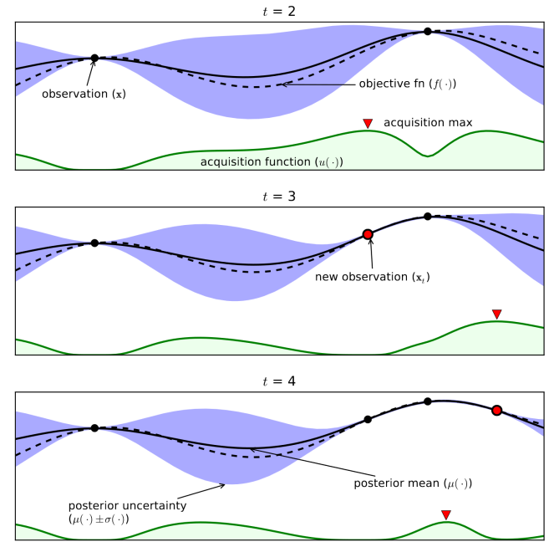
GP based parameter optimization
(coming soon)
From Eric Brochu, Vlad M. Cora and Nando de Freitas

Slide 28
Scoring Functions

Slide 29
GridSeachCV
RandomizedSearchCV
cross_val_score
...CV
Default:
Accuracy (classification)
R2 (regression)
For GridSeachCV
cross_val_score
validation_curve
Typical: accuracy

Slide 30
Notebook scoring metrics

Slide 31
Out of Core Learning

Slide 32
Three regimes of data
Fits in RAM
Fits on a Hard Drive
Doesn't fit on a single PC

Slide 33


Slide 34
HDD
Your for-loop / polling
estimator.partial_fit(X_batch, y_batch)
Trained
Scikit-learn
estimator
Network

Slide 35
Supported Algorithms
All SGDClassifier derivatives
Naive Bayes
MinibatchKMeans
IncrementalPCA
MiniBatchDictionaryLearning
MultilayerPerceptron (dev branch)
Scalers

Slide 36
Out of Core Learning
sgd = SGDClassifier()
for i in range(9):
X_batch, y_batch = cPickle.load(open("batch_%02d" % i))
sgd.partial_fit(X_batch, y_batch, classes=range(10))
Possibly go over the data multiple times.

Slide 37
The hashing trick for text data

Slide 38
Text Classification: Bag Of Word
“This is how you get ants.”
tokenizer
['this', 'is', 'how', 'you', 'get', 'ants']
Build a vocabulary over all documents
['aardvak', 'amsterdam', 'ants', ... 'you', 'your', 'zyxst']
Sparse matrix encoding
aardvak
ants
get
you
zyxst
[0, …, 0, 1, 0, … , 0, 1 , 0, …, 0, 1, 0, …., 0 ]

Slide 39
Text Classification: Hashing Trick
“This is how you get ants.”
tokenizer
['this', 'is', 'how', 'you', 'get', 'ants']
hashing
[hash('this'), hash('is'), hash('how'), hash('you'), hash('get'), hash('ants')]
= [832412, 223788, 366226, 81185, 835749, 173092]
Sparse matrix encoding
[0, …, 0, 1, 0, … , 0, 1 , 0, …, 0, 1, 0, …., 0 ]

Slide 40
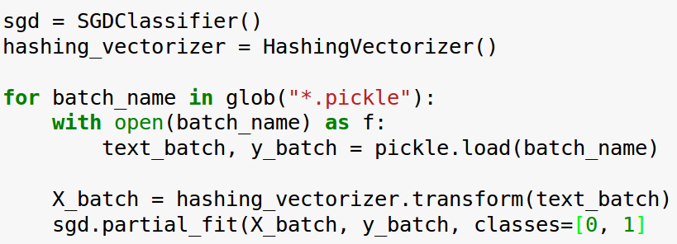
Text Classification: Hashing Trick

Slide 41
How (and why) to build your own estimator

Slide 42
Why?
GridSearchCV
cross_val_score
Pipeline

Slide 43
How
“fit” method
set_params and get_params (or inherit)
Run check_estimator
See the “build your own estimator” docs!

Slide 44
Notebook Building your own estimator

Slide 45
What's new in 0.17

Slide 46
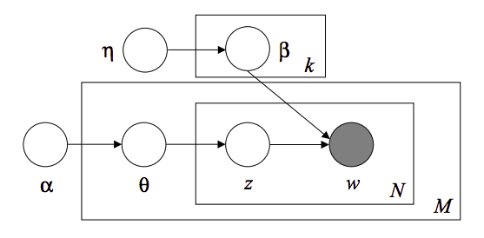
Latent Dirichlet Allocation
using online variational inference
Topic #0:
government people mr law gun state president states public use right rights national new control american security encryption health united
Topic #1:
drive card disk bit scsi use mac memory thanks pc does video hard speed apple problem used data monitor software
Topic #2:
said people armenian armenians turkish did saw went came women killed children turkey told dead didn left started greek war
Topic #3:
year good just time game car team years like think don got new play games ago did season better ll
Topic #4:
10 00 15 25 12 11 20 14 17 16 db 13 18 24 30 19 27 50 21 40
Topic #5:
windows window program version file dos use files available display server using application set edu motif package code ms software
Topic #6:
edu file space com information mail data send available program ftp email entry info list output nasa address anonymous internet
Topic #7:
ax max b8f g9v a86 pl 145 1d9 0t 34u 1t 3t giz bhj wm 2di 75u 2tm bxn 7ey
Topic #8:
god people jesus believe does say think israel christian true life jews did bible don just know world way church
Topic #9:
don know like just think ve want does use good people key time way make problem really work say need
By Chyi-Kwei Yau, based on code by Matt Hoffman

Slide 47
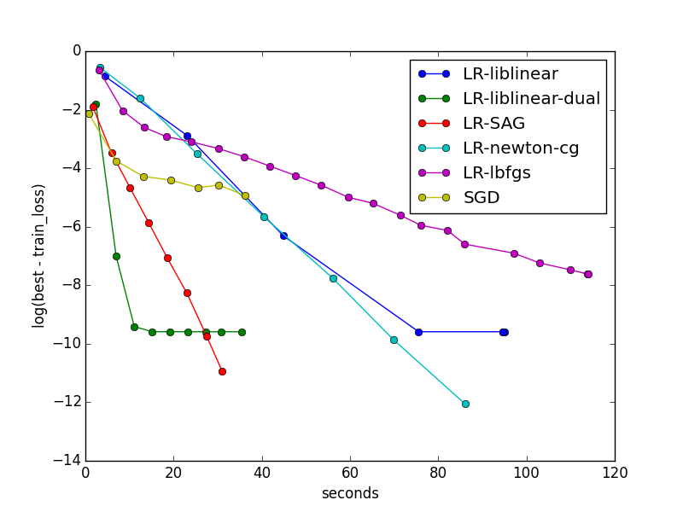
SAG for Logistic Regression and Ridge Regression
By Danny Sullivan and Tom Dupre la Tour

Slide 48
Coordinate Descent Solver for Non-Negative Matrix Factorization
Topics in NMF model:
Topic #0:
don people just like think know time good right ve make say want did really way new use going said
Topic #1:
windows file dos files window program use running using version ms problem server pc screen ftp run application os software
Topic #2:
god jesus bible christ faith believe christians christian heaven sin hell life church truth lord say belief does existence man
Topic #3:
geb dsl n3jxp chastity cadre shameful pitt intellect skepticism surrender gordon banks soon edu lyme blood weight patients medical probably
Topic #4:
key chip encryption clipper keys escrow government algorithm secure security encrypted public des nsa enforcement bit privacy law secret use
Topic #5:
drive scsi ide drives disk hard controller floppy hd cd mac boot rom cable internal tape bus seagate bios quantum
Topic #6:
game team games players year hockey season play win league teams nhl baseball player detroit toronto runs pitching best playoffs
Topic #7:
thanks mail does know advance hi info looking anybody address appreciated help email information send ftp post interested list appreciate
Topic #8:
card video monitor vga bus drivers cards color driver ram ati mode memory isa graphics vesa pc vlb diamond bit
Topic #9:
00 sale 50 shipping 20 10 price 15 new 25 30 dos offer condition 40 cover asking 75 interested 01
By Tom Dupre la Tour and Mathieu Blondel

Slide 49
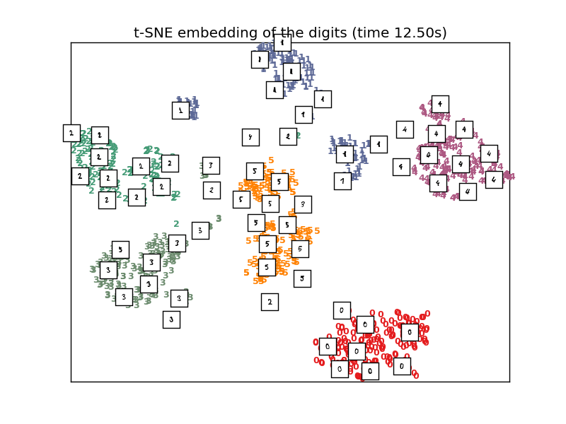
Barnes-Hut Approximation for
T-SNE manifold learning

Slide 50
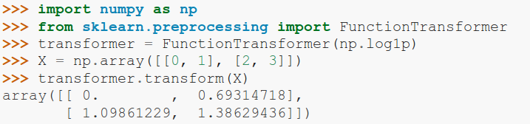
FunctionTransformer

Slide 51
VotingClassifier
clf1 = LogisticRegression()
clf2 = RandomForestClassifier()
clf3 = GaussianNB()
eclf = VotingClassifier(
estimators=[('lr', clf1), ('rf', clf2), ('gbn', clf3)],
voting=”hard”)

Slide 52
What the future will bring (0.18)

Slide 53

Gaussian Process Rewrite
34.4**2 * RBF(length_scale=41.8)
+ 3.27**2 * RBF(length_scale=180)
* ExpSineSquared(length_scale=1.44, periodicity=1)
+ 0.446**2 * RationalQuadratic(alpha=17.7, length_scale=0.957)
+ 0.197**2 * RBF(length_scale=0.138) + WhiteKernel(noise_level=0.0336)
By Jan Hendrik Metzen.

Slide 54
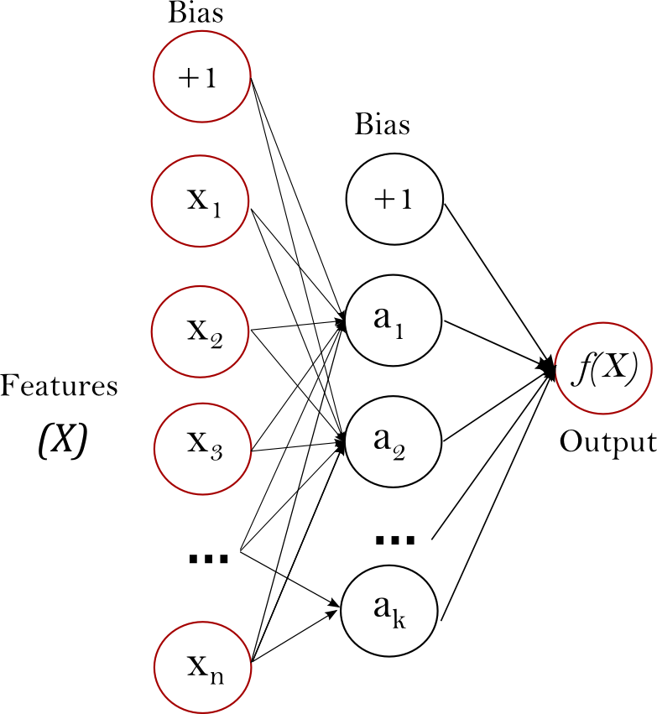
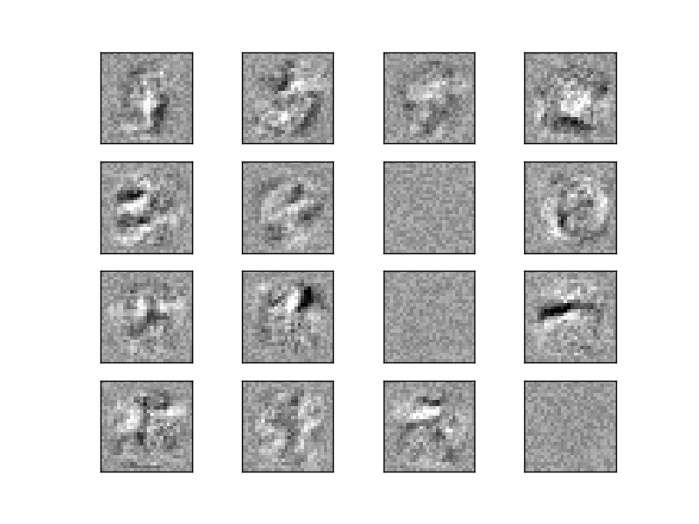
Neural Networks
By Jiyuan Qian and Issam Laradji

Slide 55
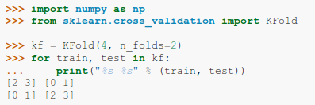
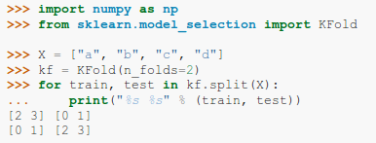

Improved Cross-Validation
current
future
By Raghav RV

Slide 56
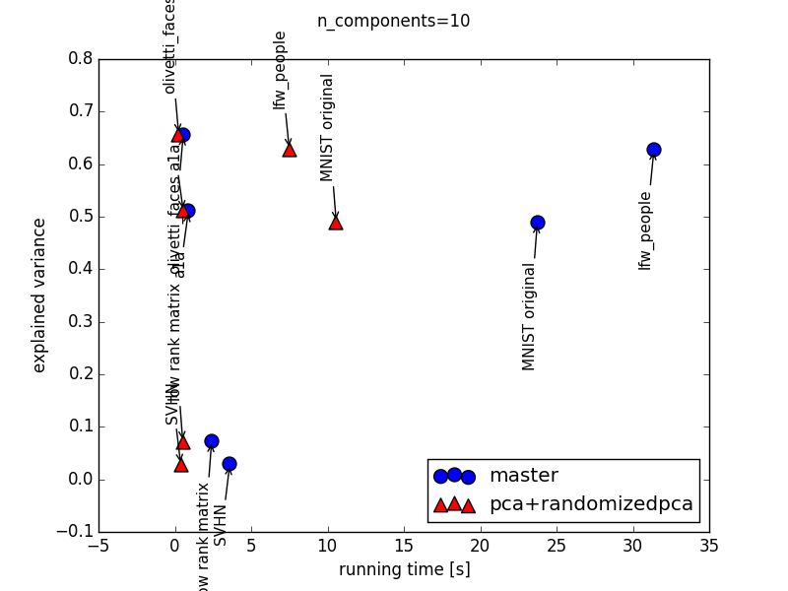
Faster PCA
By Giorgio Patrini

Slide 57

Hellbender
Release June 2016

Slide 58




Thank you!
@amuellerml
@amueller
importamueller@gmail.com
http://amueller.github.io

