Slide 1

Advanced Scikit-Learn
Andreas Mueller (NYU Center for Data Science, scikit-learn)

Slide 2



Me

Slide 3
Classification
Regression
Clustering
Semi-Supervised Learning
Feature Selection
Feature Extraction
Manifold Learning
Dimensionality Reduction
Kernel Approximation
Hyperparameter Optimization
Evaluation Metrics
Out-of-core learning
…...

Slide 4







Slide 5
Overview
Reminder: Basic sklearn concepts
Model building and evaluation:
  Pipelines and Feature Unions
  Randomized Parameter Search
  Scoring Interface
Out of Core learning
  Feature Hashing
  Kernel Approximation
New stuff in 0.16.0
  Overview
  Calibration

Slide 6
Supervised Machine Learning
clf = RandomForestClassifier()
clf.fit(X_train, y_train)
y_pred = clf.predict(X_test)
Training Data
Model
Training Labels
Test Data
Prediction
Test Labels
Evaluation
clf.score(X_test, y_test)

Slide 7
Unsupervised Transformations
pca = PCA(n_components=3)
pca.fit(X_train)
X_new = pca.transform(X_test)
Training Data
Model
Test Data
Transformation

Slide 8
Basic API
estimator.fit(X, [y])
estimator.predict | estimator.transform
Classification | Preprocessing
Regression | Dimensionality reduction
Clustering | Feature selection
 | Feature extraction

Slide 9
Cross-Validation
from sklearn.cross_validation import cross_val_score
scores = cross_val_score(SVC(), X, y, cv=5)
print(scores)
>> [ 0.92 1. 1. 1. 1. ]

Slide 10
Cross-Validation
from sklearn.cross_validation import cross_val_score
scores = cross_val_score(SVC(), X, y, cv=5)
print(scores)
>> [ 0.92 1. 1. 1. 1. ]
cv_ss = ShuffleSplit(len(X_train), test_size=.3,
n_iter=10)
scores_shuffle_split = cross_val_score(SVC(), X, y,
cv=cv_ss)

Slide 11
Cross-Validation
from sklearn.cross_validation import cross_val_score
scores = cross_val_score(SVC(), X, y, cv=5)
print(scores)
>> [ 0.92 1. 1. 1. 1. ]
cv_ss = ShuffleSplit(len(X_train), test_size=.3,
n_iter=10)
scores_shuffle_split = cross_val_score(SVC(), X, y,
cv=cv_ss)
cv_labels = LeaveOneLabelOut(labels)
scores_pout = cross_val_score(SVC(), X, y, cv=cv_labels)

Slide 12
Notebook cross-validation?

Slide 13

Cross -Validated Grid Search

Slide 14
All Data
Training data
Test data
Fold 1
Fold 2
Fold 3
Fold 4
Fold 5
Split 1
Fold 1
Fold 2
Fold 3
Fold 4
Fold 5
Split 2
Fold 1
Fold 2
Fold 3
Fold 4
Fold 5
Finding Parameters
Split 3
Fold 1
Fold 2
Fold 3
Fold 4
Fold 5
Split 4
Fold 1
Fold 2
Fold 3
Fold 4
Fold 5
Split 5
Fold 1
Fold 2
Fold 3
Fold 4
Fold 5
Final evaluation
Test data

Slide 15
Cross -Validated Grid Search
from sklearn.grid_search import GridSearchCV
from sklearn.cross_validation import train_test_split
X_train, X_test, y_train, y_test = train_test_split(X, y)
param_grid = {'C': 10. ** np.arange(-3, 3),
'gamma': 10. ** np.arange(-3, 3)}
grid = GridSearchCV(SVC(), param_grid=param_grid)
grid.fit(X_train, y_train)
grid.predict(X_test)
grid.score(X_test, y_test)

Slide 16
Notebook GridSearchCV

Slide 17
Working with Text Data

Slide 19
Training Labels
Training Data
Model

Slide 20
Training Labels
Training Data
Feature
Extraction
Scaling
Feature
Selection
Model
Cross Validation

Slide 21

Pipelines

Slide 22
Pipelines
from sklearn.pipeline import make_pipeline
pipe = make_pipeline(StandardScaler(), SVC())
pipe.fit(X_train, y_train)
pipe.predict(X_test)

Slide 23
Notebooks Pipelines

Slide 24
Combining Pipelines and
Grid Search
Proper cross-validation
param_grid = {'svc__C': 10. ** np.arange(-3, 3),
'svc__gamma': 10. ** np.arange(-3, 3)}
scaler_pipe = make_pipeline(StandardScaler(), SVC())
grid = GridSearchCV(scaler_pipe, param_grid=param_grid, cv=5)
grid.fit(X_train, y_train)

Slide 25
Combining Pipelines and
Grid Search II
Searching over parameters of the preprocessing step
param_grid = {'selectkbest__k': [1, 2, 3, 4],
'svc__C': 10. ** np.arange(-3, 3),
'svc__gamma': 10. ** np.arange(-3, 3)}
scaler_pipe = make_pipeline(SelectKBest(), SVC())
grid = GridSearchCV(scaler_pipe, param_grid=param_grid, cv=5)
grid.fit(X_train, y_train)

Slide 26
Feature Union
Training Labels
Training Data
Feature
Extraction I
Feature
Extraction II
Model

Slide 27
Feature Union
char_and_word = make_union(CountVectorizer(analyzer="char"), CountVectorizer(analyzer="word"))
text_pipe = make_pipeline(char_and_word, LinearSVC(dual=False))
param_grid = {'linearsvc__C': 10. ** np.arange(-3, 3)}
grid = GridSearchCV(text_pipe, param_grid=param_grid, cv=5)
param_grid2 = {'featureunion__countvectorizer-1__ngram_range': [(1, 3), (1, 5), (2, 5)],
'featureunion__countvectorizer-2__ngram_range': [(1, 1), (1, 2), (2, 2)],
'linearsvc__C': 10. ** np.arange(-3, 3)}

Slide 28
Randomized Parameter Search

Slide 29

Randomized Parameter Search
Step-size free for continuous parameters
Decouples runtime from search-space size
Robust against irrelevant parameters
Source: Bergstra and Bengio

Slide 30
Randomized Parameter Search
params = {'featureunion__countvectorizer-1__ngram_range':
[(1, 3), (1, 5), (2, 5)],
'featureunion__countvectorizer-2__ngram_range':
[(1, 1), (1, 2), (2, 2)],
'linearsvc__C': 10. ** np.arange(-3, 3)}

Slide 31
Randomized Parameter Search
params = {'featureunion__countvectorizer-1__ngram_range':
[(1, 3), (1, 5), (2, 5)],
'featureunion__countvectorizer-2__ngram_range':
[(1, 1), (1, 2), (2, 2)],
'linearsvc__C': expon()}

Slide 32

Randomized Parameter Search
params = {'featureunion__countvectorizer-1__ngram_range':
[(1, 3), (1, 5), (2, 5)],
'featureunion__countvectorizer-2__ngram_range':
[(1, 1), (1, 2), (2, 2)],
'linearsvc__C': expon()}
rs = RandomizedSearchCV(text_pipe,
param_distributions=param_distributins, n_iter=50)

Slide 33
Randomized Parameter Search
Always use distributions for continuous variables.
Don't use for low dimensional spaces.
Future: Bayesian optimization based search.

Slide 34
Efficient Parameter Search and Path Algorithms

Slide 35
rfe = RFE(LogisticRegression())
param_grid = {'n_features_to_select': range(1, n_features)}
gridsearch = GridSearchCV(rfe, param_grid)
grid.fit(X, y)
rfecv = RFECV(LogisticRegression())
rfecv.fit(X, y)

Slide 36
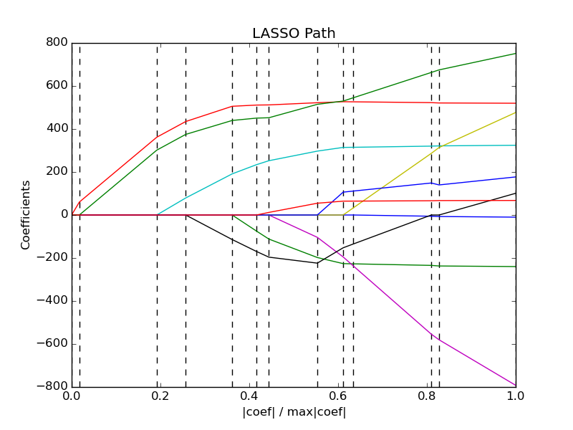

Slide 37
Linear Models | Feature Selection | Tree-Based models [possible]
LogisticRegressionCV [new] | RFECV | [DecisionTreeCV]
RidgeCV |  | [RandomForestClassifierCV]
RidgeClassifierCV |  | [GradientBoostingClassifierCV]
LarsCV
ElasticNetCV ...

Slide 38
Notebook Efficient Parameter Search

Slide 39
Scoring Functions

Slide 40
GridSeachCV
RandomizedSearchCV
cross_val_score
...CV
Default:
Accuracy (classification)
R2 (regression)
For GridSeachCV
cross_val_score
validation_curve
Typical: accuracy

Slide 41

Scoring with imbalanced data
cross_val_score(SVC(), X_train, y_train)
>>> array([ 0.9, 0.9, 0.9])
cross_val_score(DummyClassifier("most_frequent"), X_train, y_train)
>>> array([ 0.9, 0.9, 0.9])
cross_val_score(SVC(), X_train, y_train, scoring="roc_auc")
array([ 0.99961591, 0.99983498, 0.99966247])

Slide 42
Available metrics
print(SCORERS.keys())
>> ['adjusted_rand_score',
'f1',
'mean_absolute_error',
'r2',
'recall',
'median_absolute_error',
'precision',
'log_loss',
'mean_squared_error',
'roc_auc',
'average_precision',
'accuracy']

Slide 43
Defining your own scoring
def my_super_scoring(est, X, y):
return accuracy_scorer(est, X, y) - np.sum(est.coef_ != 0)

Slide 44
Notebook scoring metrics

Slide 45
Out of Core Learning

Slide 46

Or: save ourself the effort

Slide 47
Think twice!
Old laptop: 4GB Ram
1073741824 float32
Or 1mio data points with 1000 features
EC2 : 256 GB Ram
68719476736 float32
Or 68mio data points with 1000 features

Slide 48
Supported Algorithms
All SGDClassifier derivatives
Naive Bayes
MinibatchKMeans
IncrementalPCA
MiniBatchDictionaryLearning
MultilayerPerceptron (dev branch)
Scalers

Slide 49
Out of Core Learning
sgd = SGDClassifier()
for i in range(9):
X_batch, y_batch = cPickle.load(open("batch_%02d" % i))
sgd.partial_fit(X_batch, y_batch, classes=range(10))
Possibly go over the data multiple times.

Slide 50
Stateless Transformers
Normalizer
HashingVectorizer
RBFSampler (and other kernel approx)

Slide 51
Text data and the hashing trick

Slide 52
Bag Of Word Representations
CountVectorizer / TfidfVectorizer
“You better call Kenny Loggins”

Slide 53
Bag Of Word Representations
CountVectorizer / TfidfVectorizer
“You better call Kenny Loggins”
tokenizer
['you', 'better', 'call', 'kenny', 'loggins']

Slide 54
Bag Of Word Representations
CountVectorizer / TfidfVectorizer
“You better call Kenny Loggins”
tokenizer
['you', 'better', 'call', 'kenny', 'loggins']
Sparse matrix encoding
aardvak
better
call
you
zyxst
[0, …, 0, 1, 0, … , 0, 1 , 0, …, 0, 1, 0, …., 0 ]

Slide 55
Hashing Trick
HashingVectorizer
“You better call Kenny Loggins”
tokenizer
['you', 'better', 'call', 'kenny', 'loggins']
hashing
[hash('you'), hash('better'), hash('call'), hash('kenny'), hash('loggins')]
= [832412, 223788, 366226, 81185, 835749]
Sparse matrix encoding
[0, …, 0, 1, 0, … , 0, 1 , 0, …, 0, 1, 0, ... 0 ]

Slide 56
Out of Core Text Classification
sgd = SGDClassifier()
hashing_vectorizer = HashingVectorizer()
for i in range(9):
text_batch, y_batch = cPickle.load(open("text_%02d" % I))
X_batch = hashing_vectorizer.transform(text_batch)
sgd.partial_fit(X_batch, y_batch, classes=range(10))

Slide 57
Kernel Approximations

Slide 58

Reminder: Kernel Trick
x

Slide 59

Reminder: Kernel Trick

Slide 60
Reminder: Kernel Trick
Classifier linear → need only

Slide 61
Reminder: Kernel Trick
Classifier linear → need only
Linear:
Polynomial:
RBF:
Sigmoid:

Slide 62
Complexity
Solving kernelized SVM:
~O(n_samples ** 3)
Solving linear (primal) SVM:
~O(n_samples * n_features)
n_samples large? Go primal!

Slide 63
Undoing the Kernel Trick
Kernel approximation:
k =
= RBFSampler

Slide 64
Usage
sgd = SGDClassifier()
kernel_approximation = RBFSampler(gamma=.001, n_components=400)
for i in range(9):
X_batch, y_batch = cPickle.load(open("batch_%02d" % i))
if i == 0:
kernel_approximation.fit(X_batch)
X_transformed = kernel_approximation.transform(X_batch)
sgd.partial_fit(X_transformed, y_batch, classes=range(10))

Slide 65
Highlights from 0.16.0

Slide 66
Highlights from 0.16.0
Multinomial Logistic Regression, LogisticRegressionCV.
IncrementalPCA.
Probability callibration of classifiers.
Birch clustering.
LSHForest.
More robust integration with pandas.

Slide 67
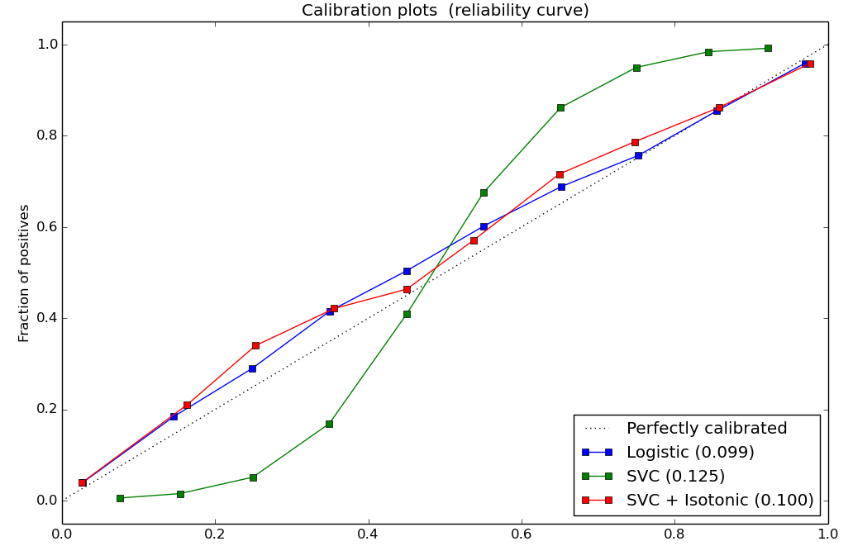
Probability Calibration
SVC().decision_function()
→ CalibratedClassifierCV(SVC()).predict_proba()
RandomForestClassifier().predict_proba()
→ CalibratedClassifierCV(RandomForestClassifier()).predict_proba()

Slide 68


Slide 69

Hellbender

Slide 70



Thank you!
@amuellerml
@amueller
importamueller@gmail.com

Slide 71
Bias Variance Tradeoff
(why we do cross validation and grid searches)

Slide 72
Overfitting and Underfitting
Training
Sweet spot
Accuracy
Generalization
Underfitting
Overfitting
Model complexity

Slide 73

Linear SVM

Slide 74


(RBF) Kernel SVM

Slide 75











Decision Trees

Slide 76




Random Forests

Slide 77
Know where you are on the bias-variance tradeoff

Slide 78

Validation Curves
train_scores, test_scores = validation_curve(SVC(), X, y, param_name="gamma", param_range=param_range)

Slide 79

Learning Curves
train_sizes, train_scores, test_scores = learning_curve(
estimator, X, y,train_sizes=train_sizes)

