Slide 1
W4995 Applied Machine Learning
PCA, Discriminants, Manifold Learning
03/06/17
Andreas Müller

Slide 2
Principal Component Analysis

Slide 3
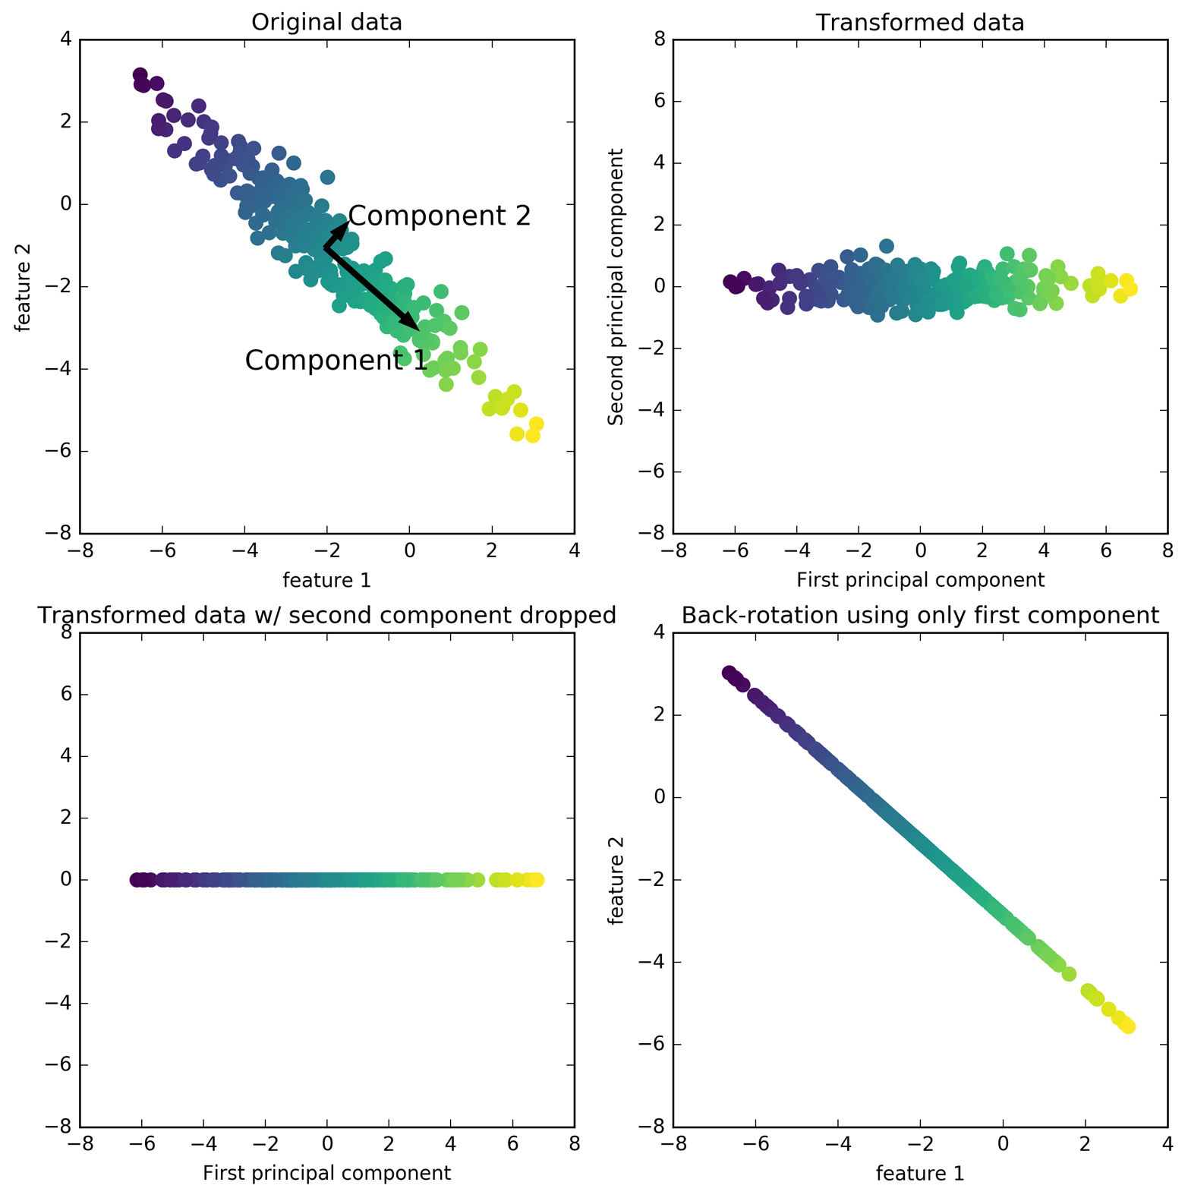

Slide 4
PCA Objective(s)
Restricted rank reconstruction

Slide 5
PCA Objective(s)
Find directions of maximum variance:
Find projection (onto one vector) that maximizes the variance observed in the data.
Subtract projection onto u1, iterate to find more components.
Only well-defined up to sign / direction of arrow!

Slide 6
PCA Computation
Center X (subtract mean)
In practice: Also scale to unit variance.
Compute singular value decomposition:
Diagonal (containing singular values)
n_samples x n_samples orthogonal matrix
(not necessarily computed in practice)
n_features x n_features
orthogonal matrix
Contains component vectors.
Drop rows (of V^T) for dimensionality reduction.

Slide 7
Back to intuition

Slide 8
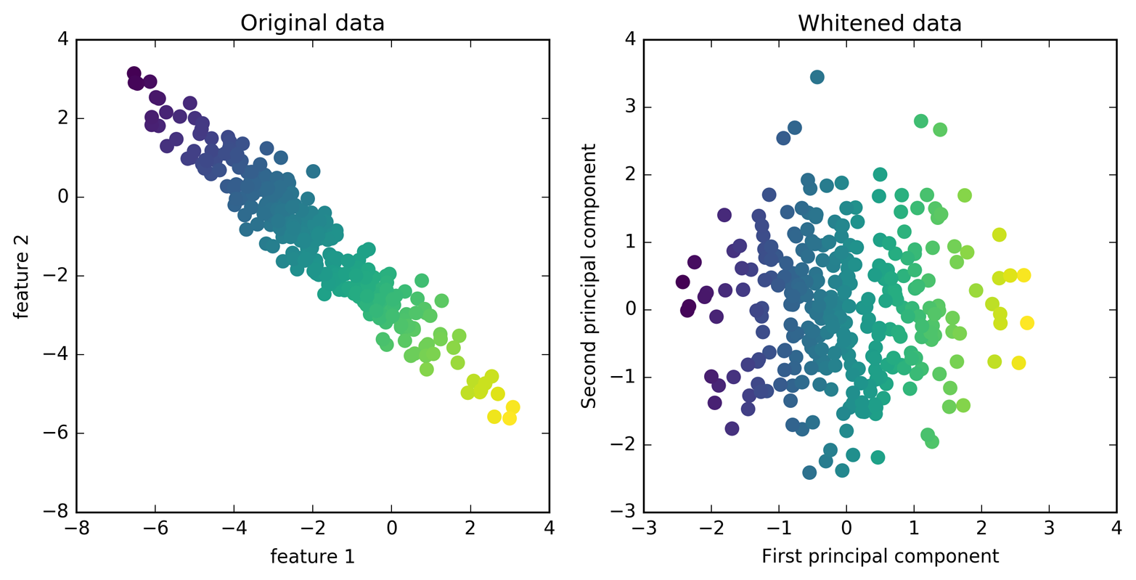
Whitening
Same as using PCA without whitening, then doing StandardScaler

Slide 9
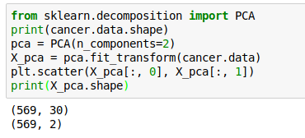
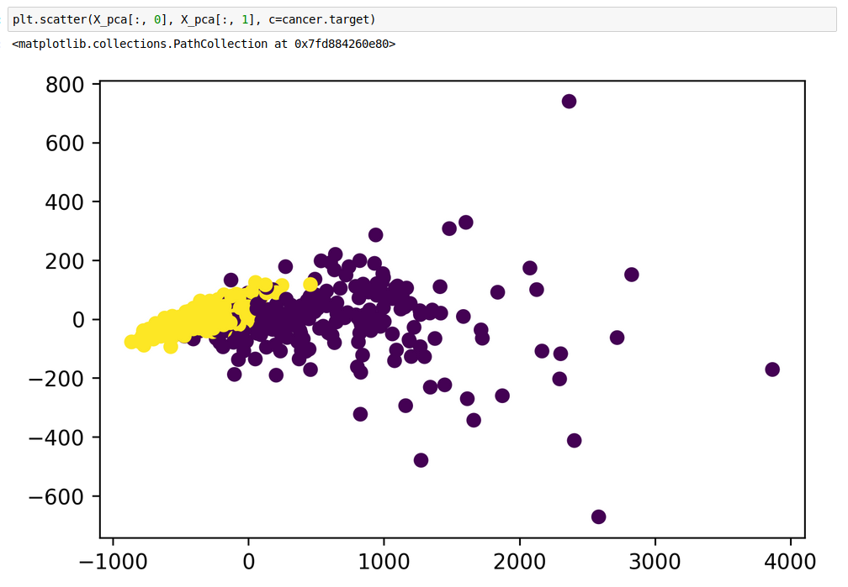
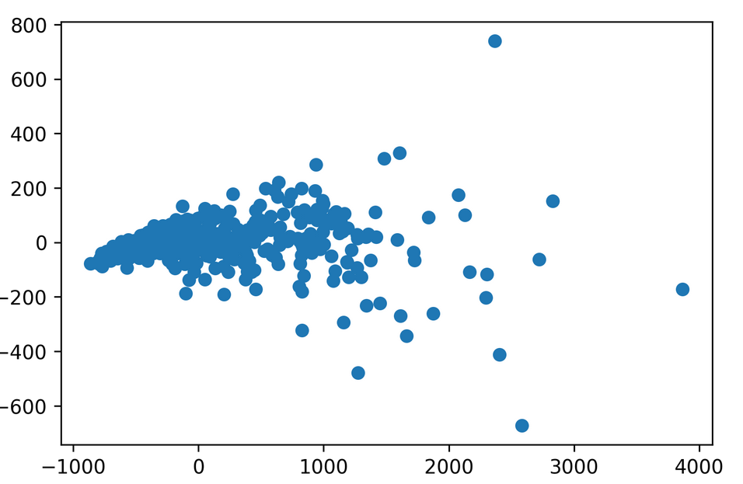
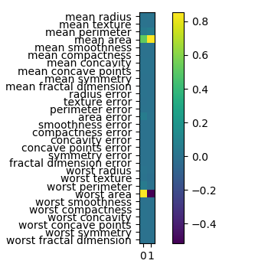
PCA for visualization

Slide 10
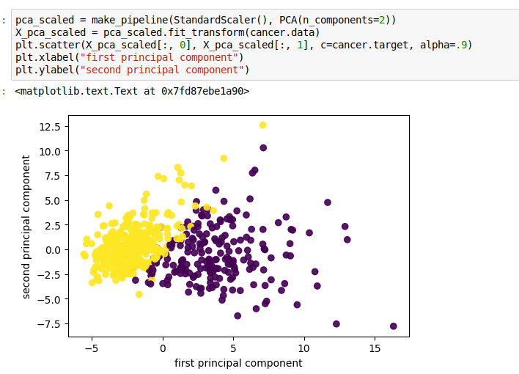
Scaling!
Imagine one feature with very large scale. Without scaling, it’s guaranteed to be the first principal component!

Slide 11
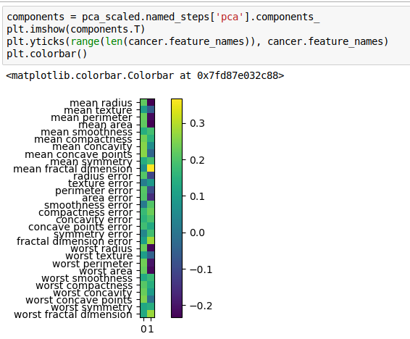
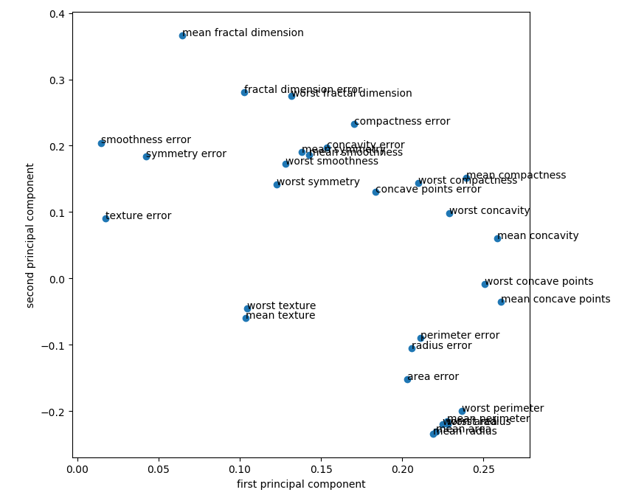
Inspecting Components
Direction (sign) of component is meaningless!

Slide 12
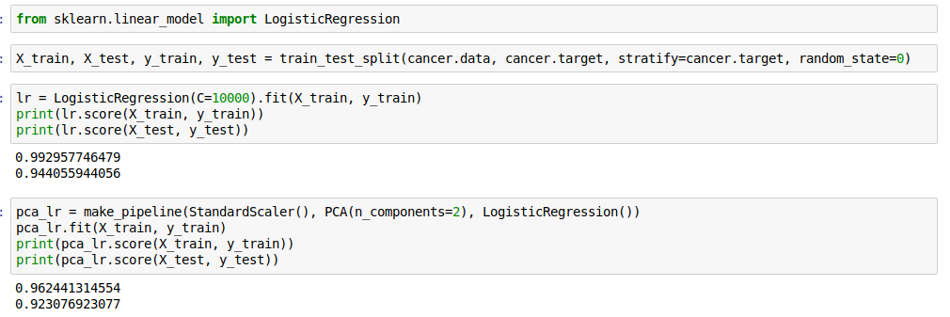
PCA for regularization

Slide 13
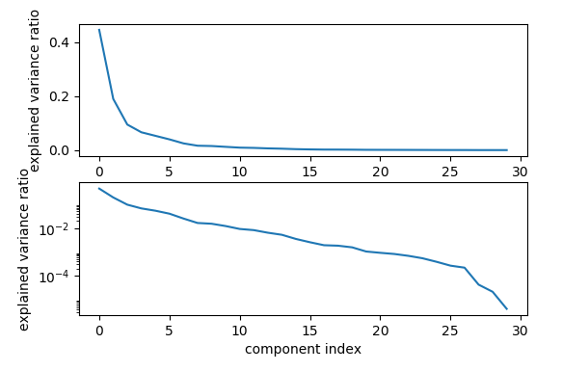
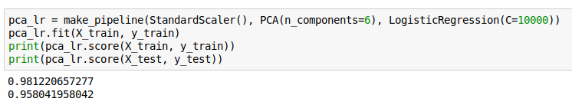
Variance covered

Slide 14
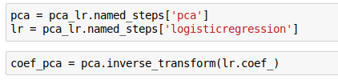
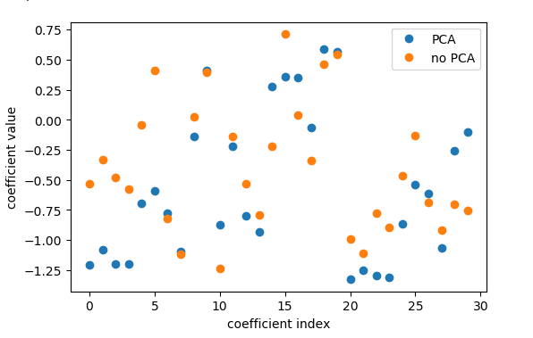
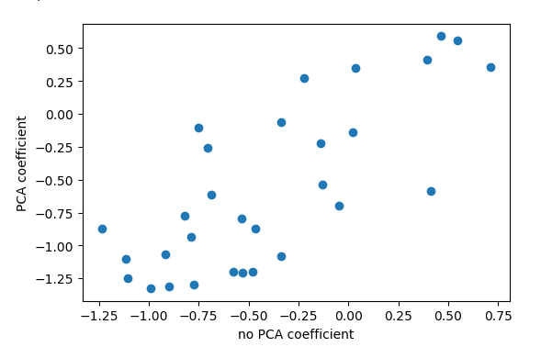
Interpreting coefficients
Rotating coefficients back into input space.
Makes sense because model is linear!
Otherwise more tricky.
Comparing PCA + Logreg vs plain Logreg:

Slide 15
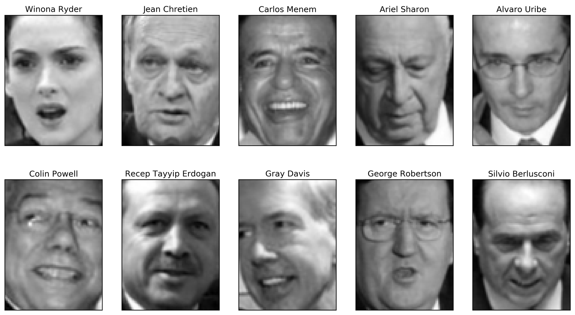
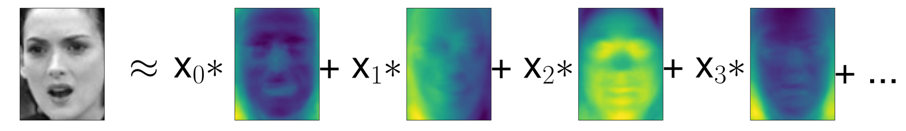
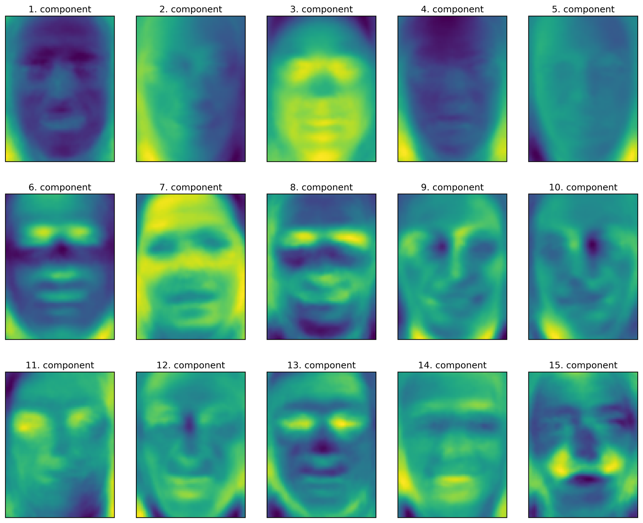
PCA for feature extraction
Remember:
Signs don’t mean anything!

Slide 16
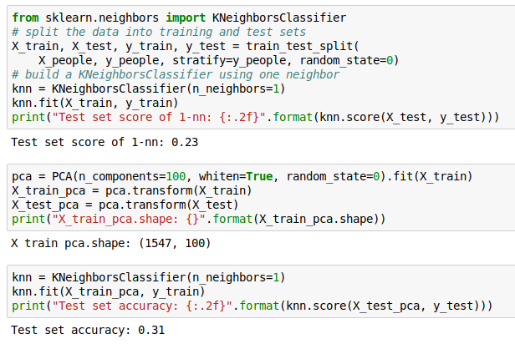
1-NN and Eigenfaces

Slide 17
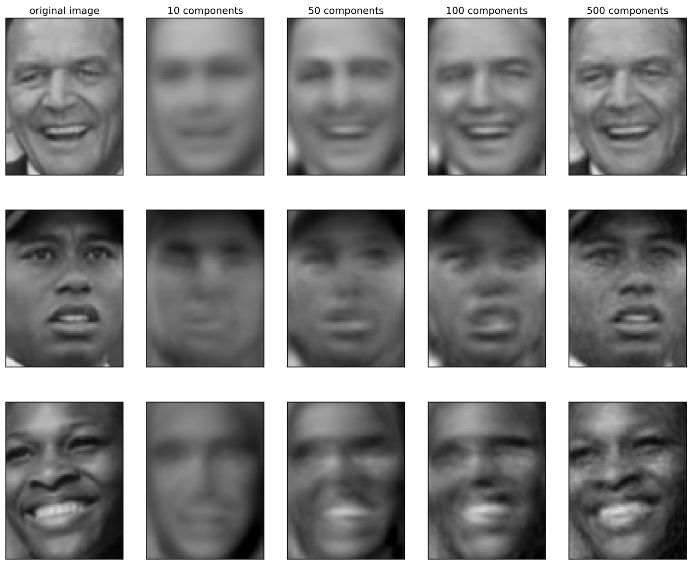
Reconstruction

Slide 18
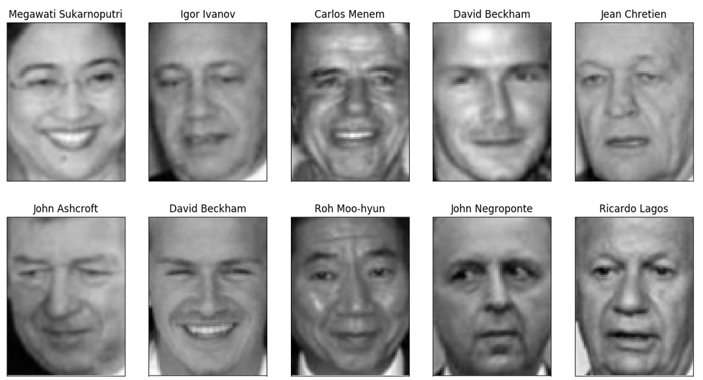
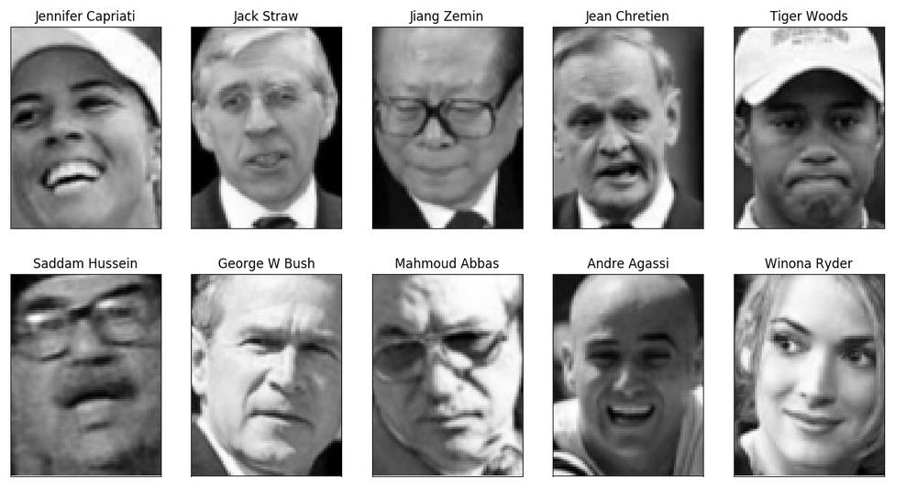
PCA for outlier detection
Best reconstructions
Worst reconstructions

Slide 19
Manifold Learning

Slide 20
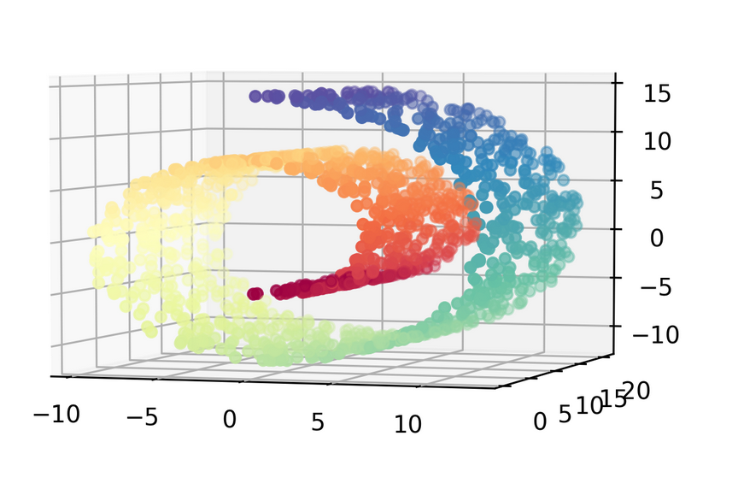
Learn underlying “manifold” structure, use for dimensionality reduction

Slide 21
Pros and Cons
For visualization only
Axes don’t correspond to anything in the input space.
Often can’t transform new data.
Pretty pictures!

Slide 22
Algorithms in sklearn
KernelPCA – does PCA, but with kernels!
Eigenvalues of kernel-matrix
Spectral embedding (Laplacian Eigenmaps)
Uses eigenvalues of graph laplacian
Locally Linear Embedding
Isomap “kernel PCA on manifold”
t-SNE (t-distributed stochastic neighbor embedding)

Slide 23
t-SNE
Starts with a random embedding
Iteratively updates points to make “close” points close.
Global distances are less important, neighborhood counts.
Good for getting coarse view of topology.
Can be good for finding interesting data points.

Slide 24
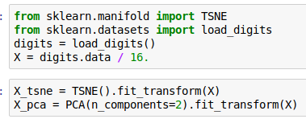
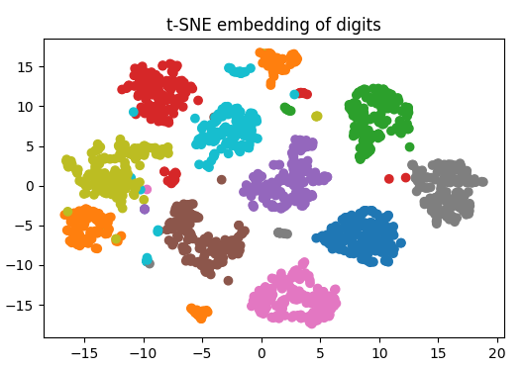
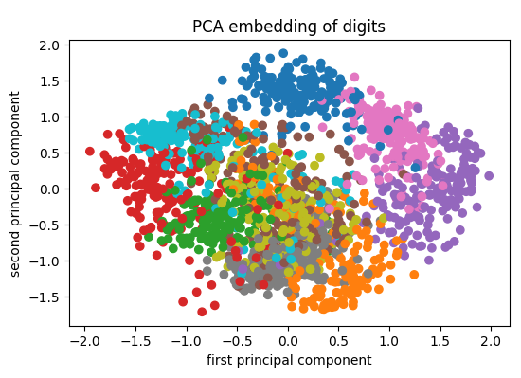

Slide 25
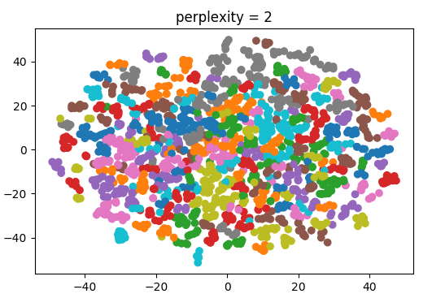
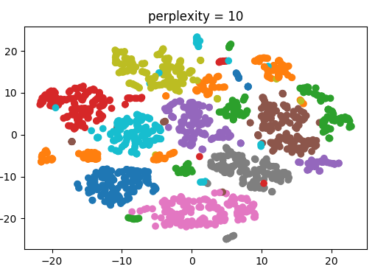
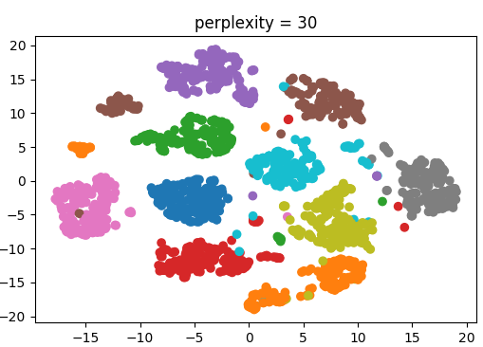
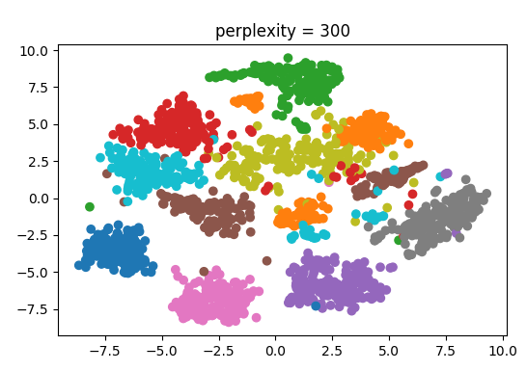
Tuning t-SNE
http://distill.pub/2016/misread-tsne/
Important parameter: perplexity
Intuitively: bandwidth of neighbors to consider
(low perplexity: only close neighbors)

Slide 26
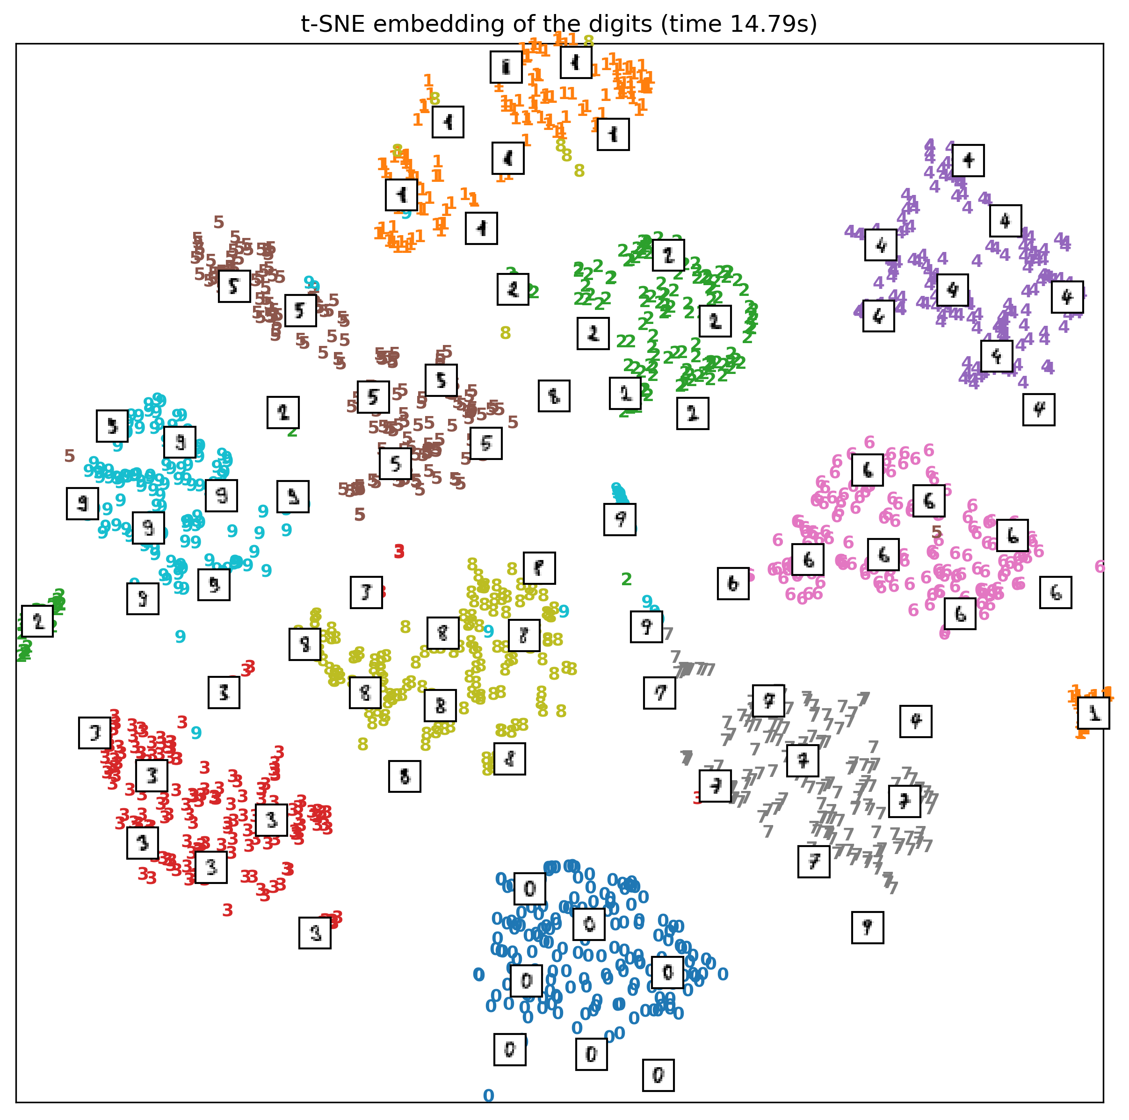

Slide 27
Discriminant Analysis

