Slide 1
W4995 Applied Machine Learning
Boosting, Stacking, Calibration
02/22/17
Andreas Müller

Slide 2
Gradient Boosting

Slide 3



Gradient Boosting Algorithm
0.1 *
+ 0.1 *
+ 0.1 *
Iteratively add regression trees to model
Use log loss for classification
Discount update by learning rate

Slide 4
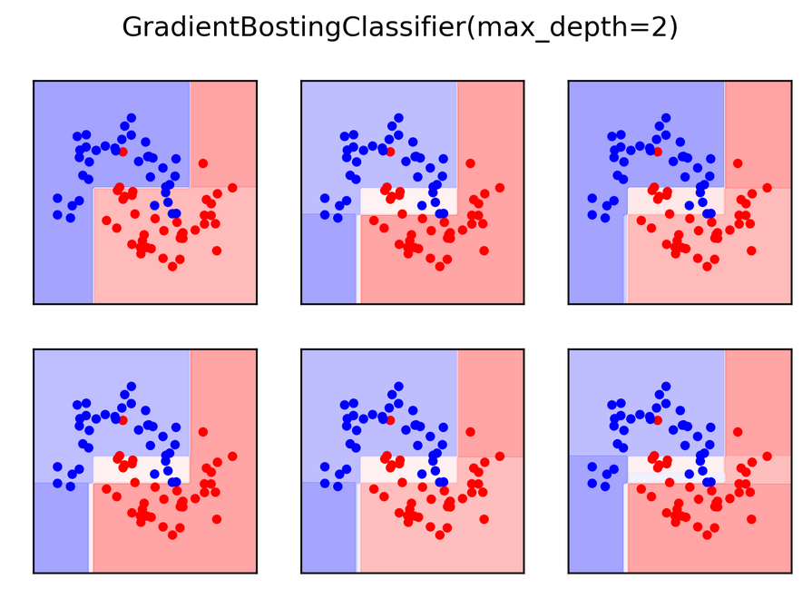

Slide 5
Gradient Boosting
Many shallow trees
learning_rate ↔ n_estimators
Slower to train than RF (serial), but much faster to predict
Small model size
Uses one-vs-rest for multi-class!

Slide 6
Tuning Gradient Boosting
Pick n_estimators, tune learning rate
Can also tune max_features
Typically strong pruning via max_depth

Slide 7
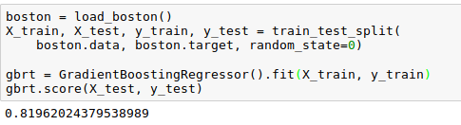
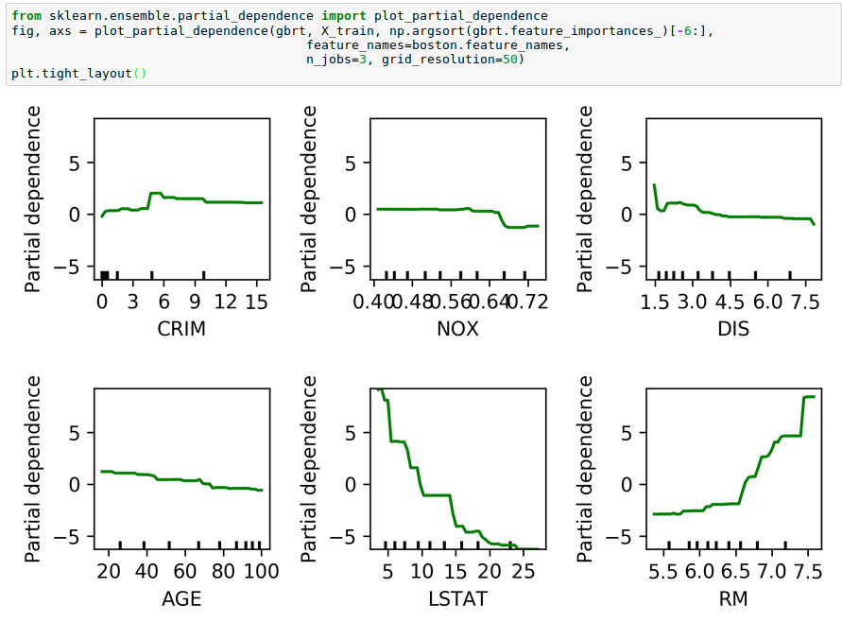
Partial Dependence Plots
Marginal dependence of prediction on one or two features

Slide 8
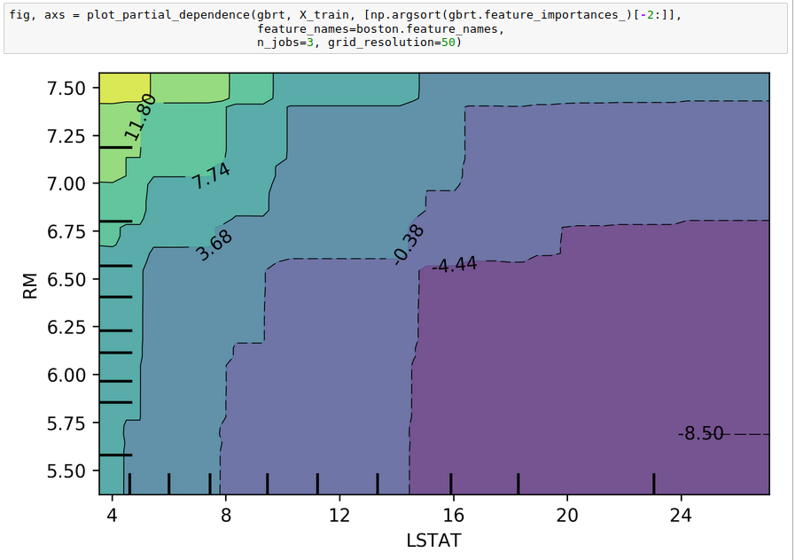

Slide 9
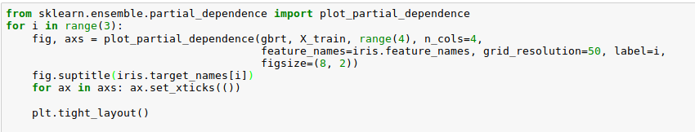
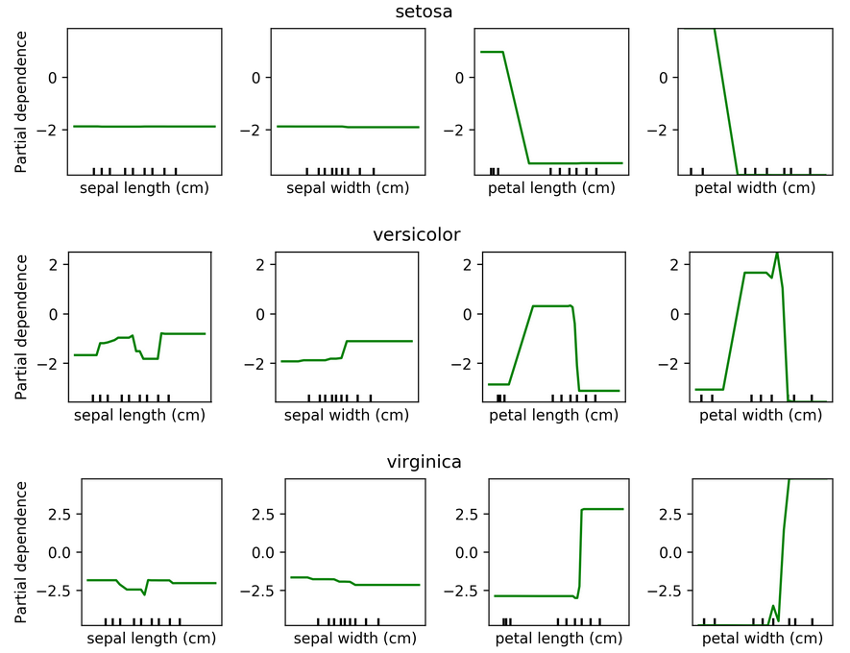
Partial Dependence for Classification

Slide 10
XGBoost
Efficient implementation of gradient boosting
Improvements on original algorithm
https://arxiv.org/abs/1603.02754
Adds l1 and l2 penalty on leaf-weights
Fast approximate split finding
Can pip-install
Scikit-learn compatible interface

Slide 11
Boosting in General
“Meta-algorithm” to create strong learners from weak learners.
AdaBoost, GentleBoost, …
Trees or stumps work best
Gradient Boosting often the best of the bunch
Many specialized algorithms (ranking etc)

Slide 12
When to use tree-based models
Model non-linear relationships
Single tree: very interpretable (if small)
Random forests very robust, good benchmark
Gradient boosting often best performance with careful tuning
Doesn’t care about scaling, no need for feature engineering!

Slide 13
More ensembles: Stacking

Slide 14
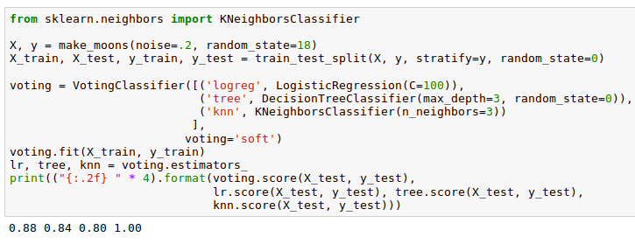
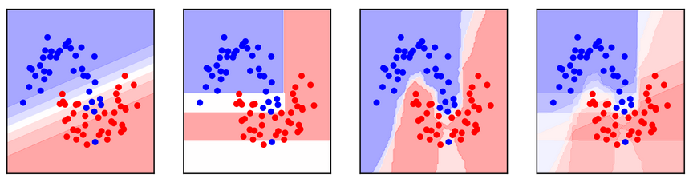
Poor man’s Stacking
Build multiple models
Train model on probabilities / scores produced

Slide 15
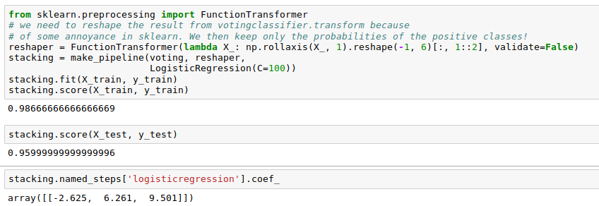
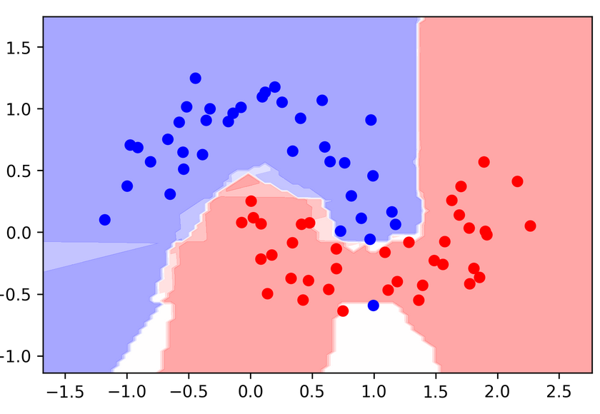
Poor man’s Stacking
Problem: Overfitting!

Slide 16
Stacking
Use cross-validation (even LOO!) to produce probability estimates on training set.
Train second step estimator on held-out estimates
No overfitting of second step!
For testing: as usual

Slide 17

Hold-out estimates of probabilities
Split 1 produces probabilities for Fold 1, split2 for Fold 2 etc.
Get a probability estimate for each data point!
Unbiased estimates (like on the test set) for the whole training set!
Without it: The best estimator is the one that memorized the training set.

Slide 18
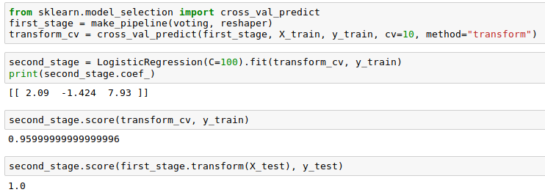
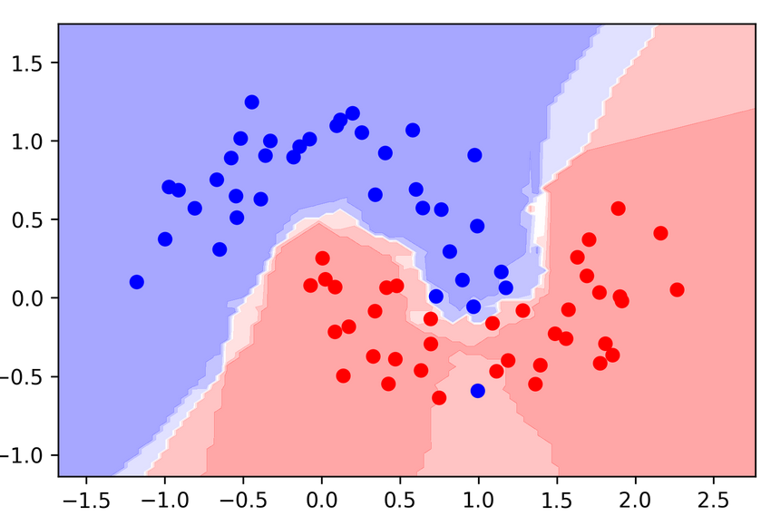
Stacking with Scikit-learn
Hold-out stacking
Naive stacking

Slide 19
Calibration

