Slide 1
W4995 Applied Machine Learning
Neural Networks
04/12/17
Andreas Müller

Slide 2
History
Nearly everything we talk about today existed ~1990
What changed?
  More data
  Faster computers (GPUs)
  Some improvements:
    relu
    Drop-out
    adam
    batch-normalization

Slide 3
Supervised Neural Networks
Non-linear models for classification and regression
Work well for very large datasets
Non-convex optimization
Notoriously slow to train – need for GPUs
Use dot products etc → require preprocessing, similar to SVM or linear models, unlike trees
MANY variants (Convolutional nets, Gated Recurrent neural networks, Long-Short-Term Memory, recursive neural networks, variational autoencoders, general adverserial networks, neural turing machines...)

Slide 4
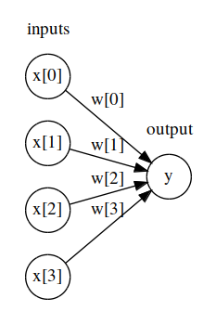
Logistic regression drawn as neural net

Slide 5
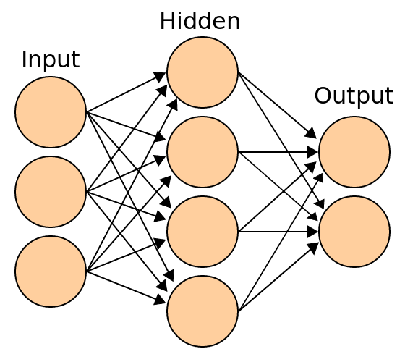
Basic Architecture
(for making predictions)
x
h(x) = f(Wx + b)
o(x) = g(W’h(x) + b’)
Notes:
First let’s describe how to make a prediction given a model.
Input denotes single sample, here three input features.
Hidden layer here 4 units is matrix multiply with W, b added (size of b is 4 here), followed by the univariate non-linear function f – sigmoid, tanh, rectifying linear function.
Output is a matrix multiplication with different weight matrix W’, b’ added (size 2 here), followed by another non-linear function g. The function g for the output layer is often different: identity for regression, soft-max for classification.
We want to learn W (3x4) W’ (4x2), b (4,), b’ (2,).
Can think of it as logistic regression with learning a non-linear basis transformation.

Slide 6
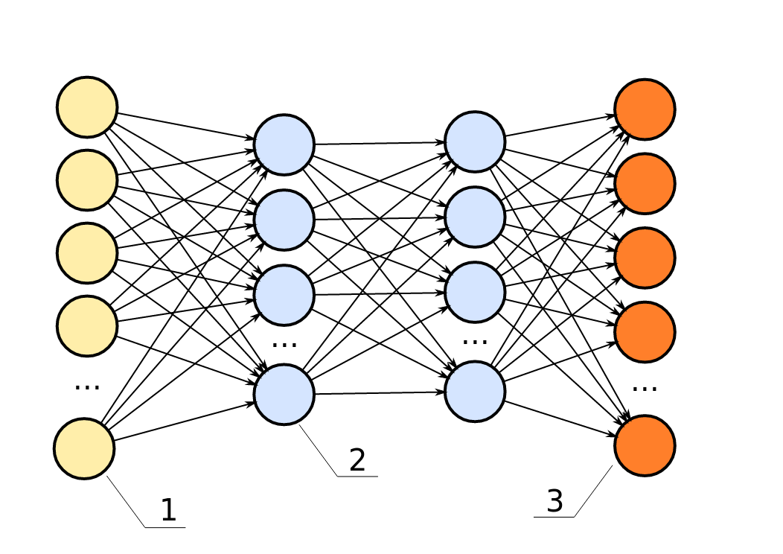
Can have arbitrary many layers
Notes:
Hidden layers usually all have the same non-linear function, weights are different for each layer.
Many layers → “deep learning”.
This is called a multilayer perceptron, feed-forward neural network, vanilla feed-forward neural network.
For regression usually single output neuron with linear activation.
For classification one-hot-encoding of classes, n_classes many output variables with softmax.

Slide 7
Nonlinear activation function
Notes:
Choices for activation function f of hidden layers.
Traditional tanh (or logistic sigmoid, not shown, but similar).
Tanh squashes to open interval (-1, 1).
Relu – recent trend, linear function x=y for positive, constant for negative values. Bias allows shifting the cut-off (~ linear splines)

Slide 8
Training objective
Could add regularization
squared loss for regression
cross-entropy loss (multi-class log-loss) for classification

Slide 9
Backpropagation
For gradient based-method need
backpropagation of gradient of layer above.
Gradient of
Non-linearity f
Input to 1st layer x
Backpropagation = Chain Rule + Dynamic Programming
Notes:
Easy to write down for last layer
Example for squared loss (g is identity for regression)
Can use the chain rule to compute other gradients
Bottom layers require partial derivatives of upper layers → reuse results
Backpropagation:
dynamic programming + chain rule
“backward pass” compute partial derivatives starting at the last layer.
You should try to go through that yourself once

Slide 10
But wait!
Notes:
relu is not differentiable.
But it’s differentiable almost anywhere.
“subgradient descent” - little issues in practice

Slide 11
Optimizing W, b
batch
minibatch
Online / stochastic
Notes:
Standard solvers: l-bfgs, newton, cg
Problem: Hessian too expensive, can to l-bfgs
Computing gradients over whole dataset expensive
Stochastic Gradient Descent to rescue
Actually use mini-batches

Slide 12
Learning Heuristics
Constant not good
Can decrease
Better: adaptive for each entry if Wi
State-of-the-art: adam (with magic numbers)
https://arxiv.org/pdf/1412.6980.pdf
http://sebastianruder.com/optimizing-gradient-descent/

Slide 13
Picking optimization algorithms
Small dataset: off the shelf like l-bfgs
Big dataset: adam
Have time & nerve: tune the schedule

Slide 14
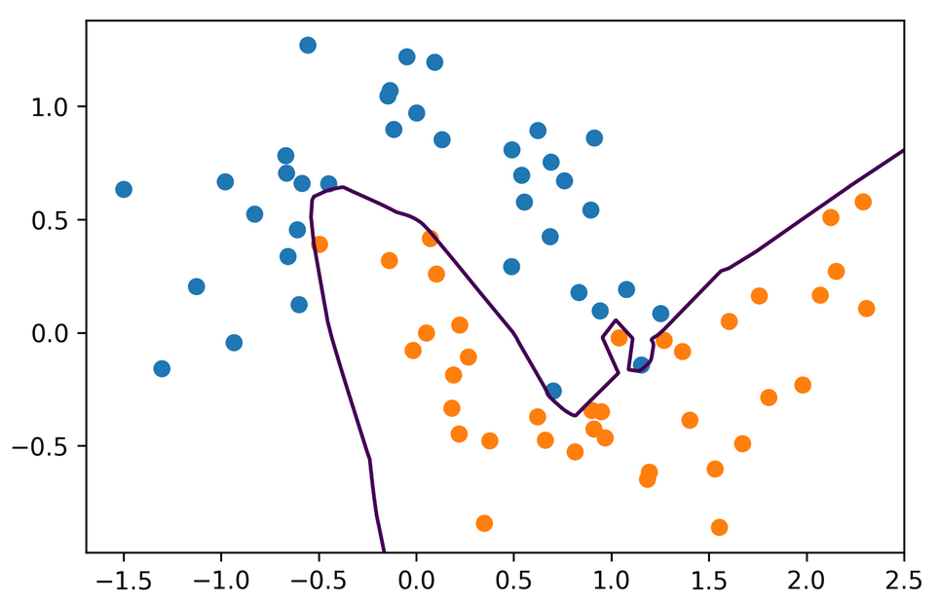
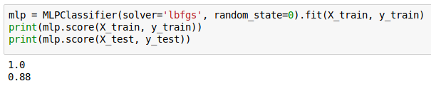
Neural Nets with sklearn
Notes:
Don’t user sklearn for anything but toy problems in neural nets.

Slide 15
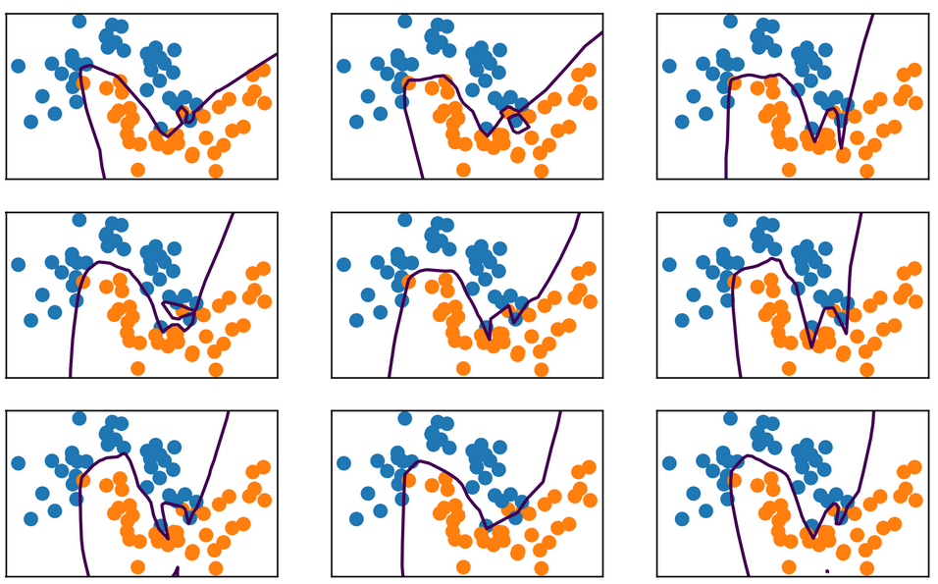
Random State
Notes:
This net is also way over capacity and can overfit in many ways.
Regularization might make it less dependent on initialization.

Slide 16
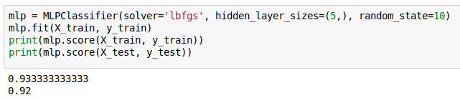
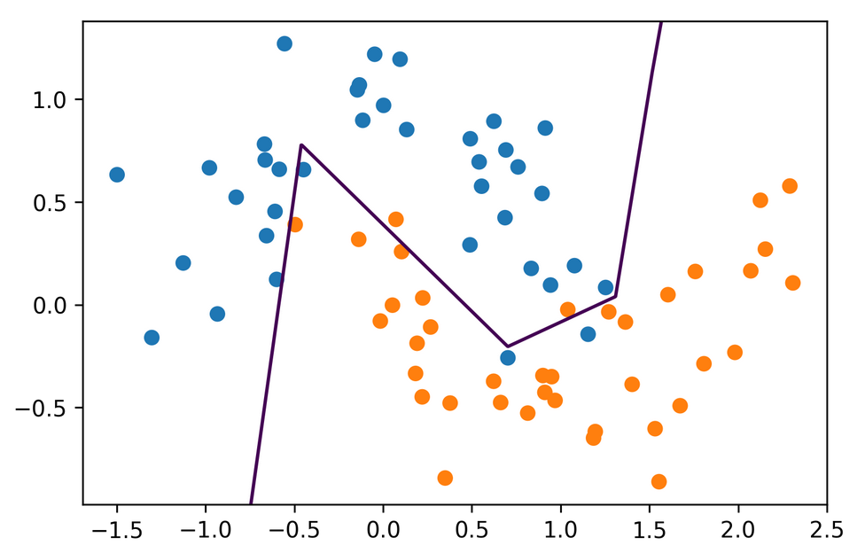
Hidden Layer Size

Slide 17
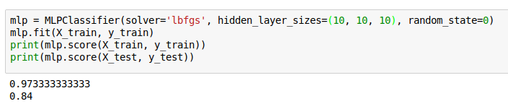
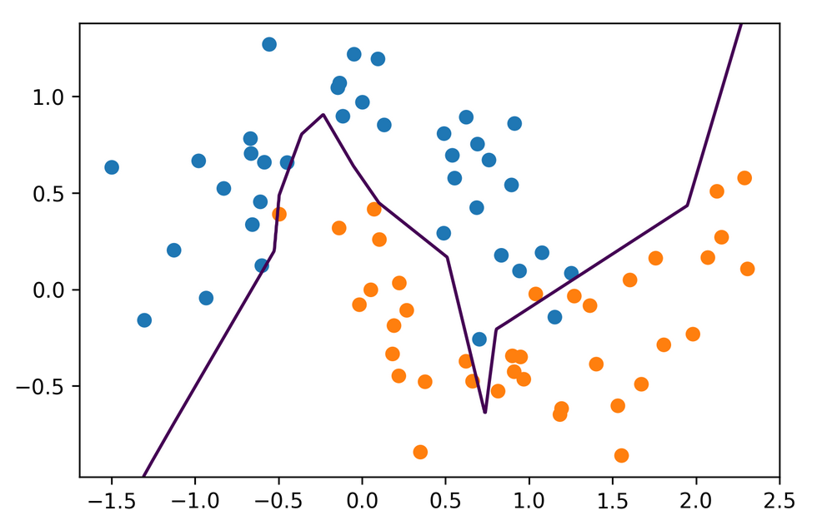
Hidden Layer Size

Slide 18
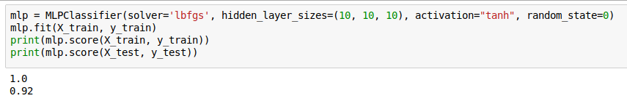
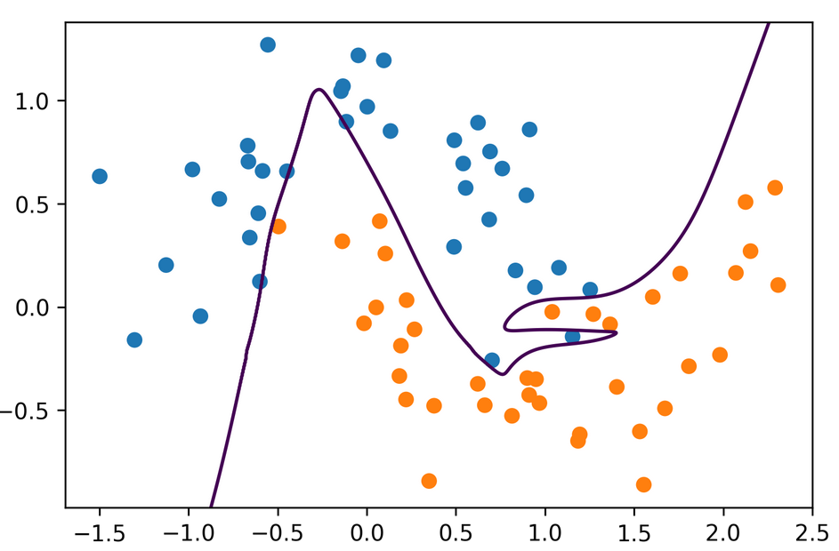
Activation Functions
Notes:
Using tanh we get smoother boundaries
Here actually it fits the data better.
It might be that relu doesn’t work that well with l-bfgs or with using these very small hidden layer sizes.
For large networks, relu is definitely preferred.

Slide 19
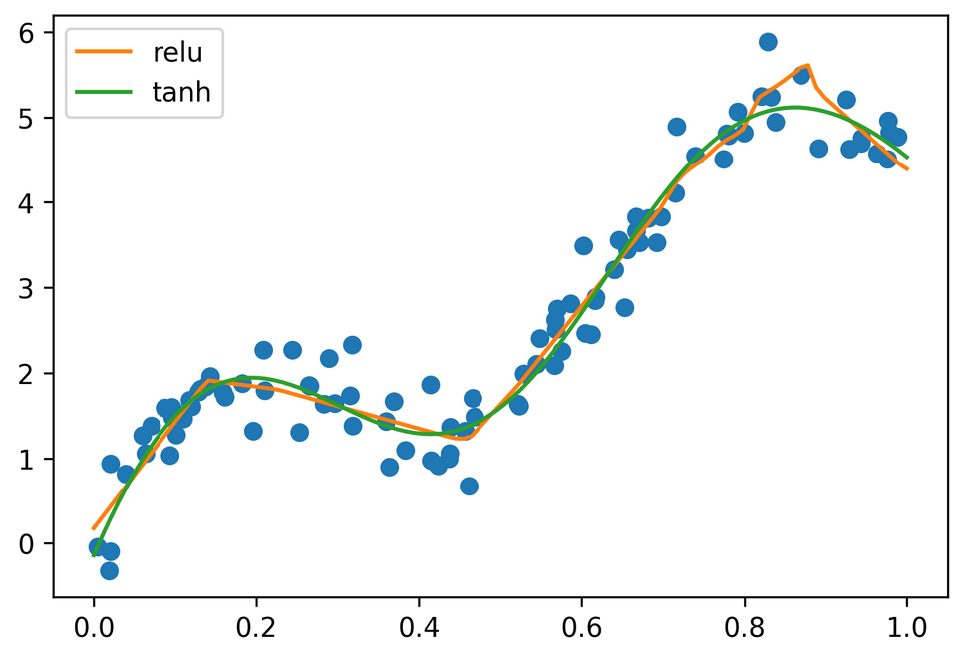

Regression

Slide 20
Complexity Control
Number of parameters
Regularization
Early stopping
(drop-out)

Slide 21
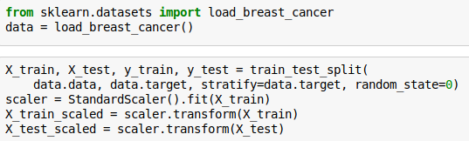

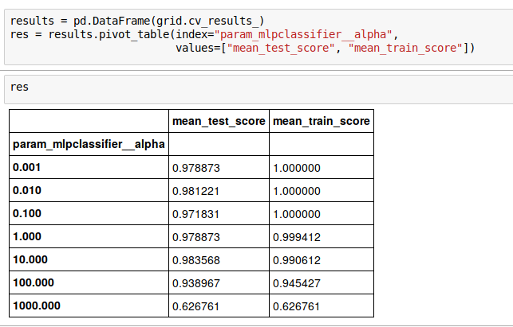
Grid-Searching Neural Nets

Slide 22
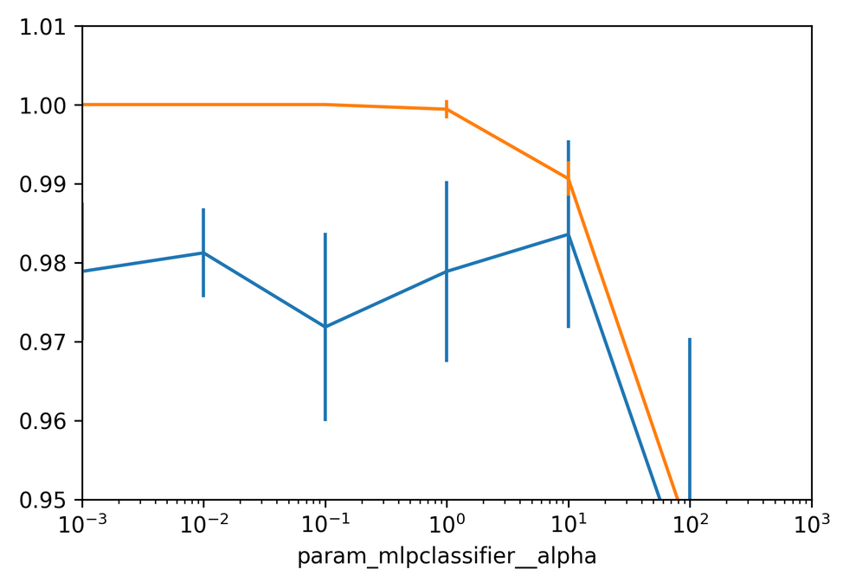

Slide 23
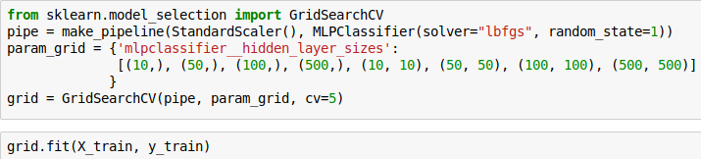
Searching hidden layer sizes

Slide 24
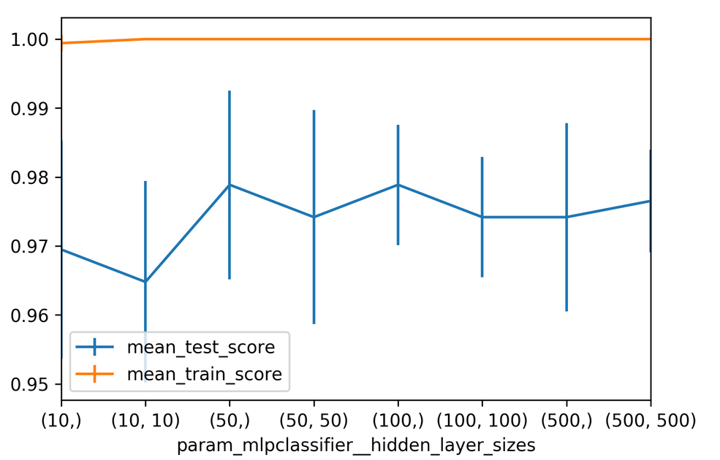

Slide 25
Getting flexible & Scaling up

Slide 26
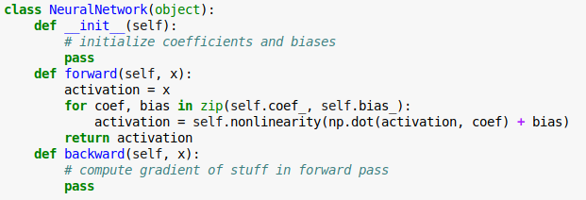
Write your own neural networks

Slide 27
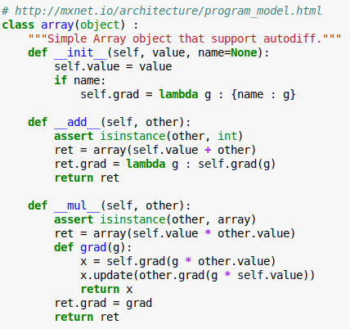
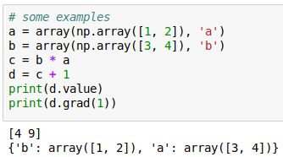
Autodiff

Slide 28
GPU Support

Slide 29
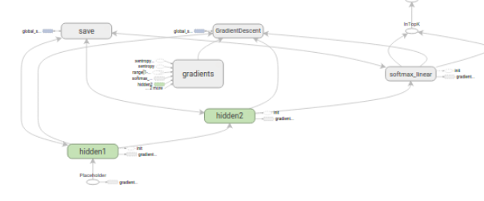
Computation Graph

Slide 30
All I want from a deep learning framework
Autodiff
GPU support
Optimization and inspection of computation graph
on-the-fly generation of the graph?
distribution over cluster?
Choices:
  TensorFlow
  Theano
  Torch (lua)

Slide 31
Deep Learning Libraries
tf.learn (Tensorflow)
Keras (Tensorflow, Theano)
Lasagna (Theano)
Torch.nn / PyTorch (torch)
Chainer (chainer)
MXNet (MXNet)
Also see: http://mxnet.io/architecture/program_model.html

Slide 32
Introduction to tf.learn

Slide 34
Drop-out

Slide 35
Implementing Drop-Out

Slide 36
Experiments

Slide 37
Batch Normalization

