Slide 1
W4995 Applied Machine Learning
Support Vector Machines
02/15/17
Andreas Müller

Slide 2
Motivation
Go from linear models to more powerful non-linear ones.
Keep convexity (ease of optimization).
Generalize the concept of feature engineering.

Slide 3
Reformulate linear models
FIXME support vector image here!

Slide 4
Reformulate linear models
Optimization Theory:
(alpha are dual coefficients,
Non-zero for support vectors only)
Can formulate learning as optimization over alpha, only involves x via dot-products (x_i^T, x_j)

Slide 5
Introducing Kernels
Dimensionality of \phi “doesn’t matter”. We only ever need to compute dot-product!
As long as k is positive definite, symmetric, there exists a phi! (might be infinite-dimensional)
Can now design k instead of \phi – which might be easier, more flexible!

Slide 6
Examples of Kernels
If k, k’ are kernels, so are

Slide 7
Polynomial Kernel vs Polynomial Features
SVM with poly kernel equivalent to linear SVM with polynomial features!
Single Number! No matter what degree!
Primal vs dual optimization:
Explicit polynomials => compute on n_features ^ d * n_samples
Kernel trick => compute on kernel matrix of shape n_samples * n_samples
For a single feature, easy to see:

Slide 8
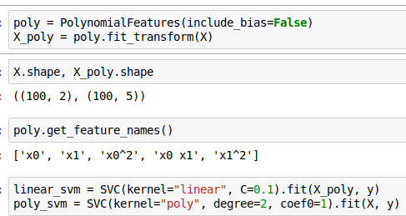
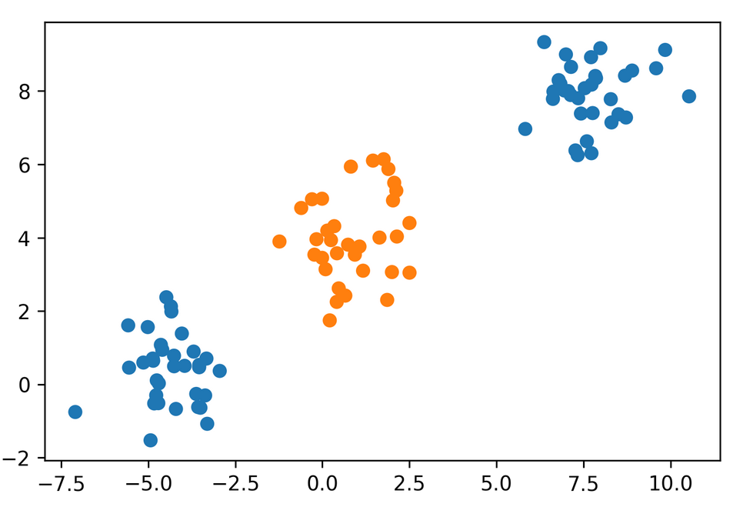
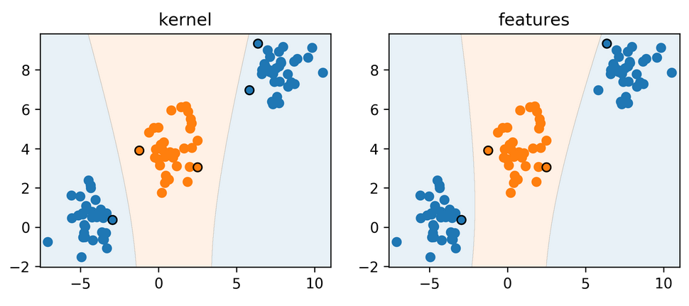
Poly kernels with sklearn

Slide 10

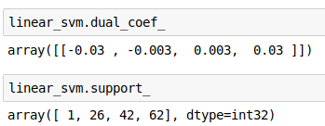
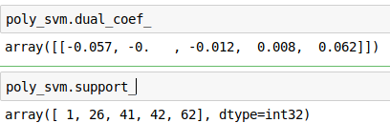
Understanding Dual Coefficients
y = sign( 0.139 * x[0] + 0.06 * x[1] – 0.201 * x[0] ** 2 + 0.048 * x[0] * x[1] + 0.019 x[1] ** 2)
y = sign(-0.03 * np.inner(poly(X[1]), poly(x)) – 0.003 * np.inner(poly(X[26]), poly(x))
+0.003 * np.inner(poly(X[42]), poly(x)) + 0.03 * np.inner(poly(X[63]), poly(x))
y = sign(-0.057 * (np.inner(X[1], x) + 1) ** 2 – 0.012 * (np.inner(X[41], x) + 1) ** 2
+0.008 * (np.inner(X[42], x) + 1) ** 2 + 0.062 * (np.inner(X[63], x) + 1) ** 2

Slide 11
Runtime Considerations

Slide 12
Kernels in Practice

Slide 13
Preprocessing?

Slide 14
Parameters for RBF Kernels

Slide 15
Grid-Searching Parameters

Slide 16
Max-Margin and Support Vectors

Slide 17
Support Vector Regression

Slide 18
SVR in sklearn

Slide 19
Undoing the Kernel-Trick

Slide 20
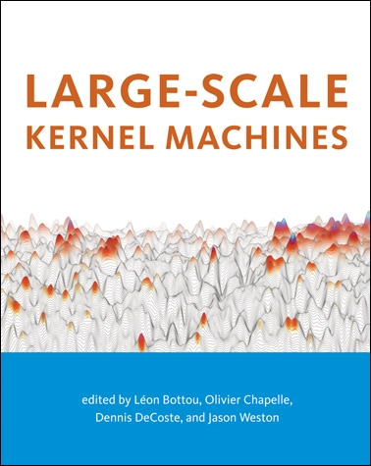
Why undo the kernel trick?
There are no

Slide 21
RKHS vs RKS
(Reproducing Kernel Hilbert-Spaces vs Random Kitchen Sinks)
https://www.microsoft.com/en-us/research/video/random-kitchen-sinks-replacing-optimization-with-randomization-in-learning/

Slide 22
Nyström Approximation

Slide 23
Fast Food etc

Slide 24
Relation to Random Neural Nets

Slide 25
Extreme Learning Machine Hoax

Slide 26
Kernel Approximation in Practice

