Slide 1
W4995 Applied Machine Learning
Visualization and Matplotlib
01/25/17
Andreas Müller
Notes:
Hey. Welcome to the second lecture on applied machine learning. Last week we talked a bit about very general and high-level issues in machine learning. Today, we’ll go right down to the metal. Actually, things we will talk about today are more generally about software engineering. If you want to build real-world systems, software engineering practices are really incredibly important.
For those of you from CS, I hope this is a repetition, for those of you from DSI, this is probably new.
We’ll talk about version control, in particular git, about some basic python, about testing, continuous integration and about documentation.
Also, I apologize in advance for the slides. There’s a lot of bullet points and few diagrams and I don’t like that, but I didn’t have a lot of time.

Slide 2
Principles of data visualization
Chart types and using matplotlib
Good chart, bad chart

Slide 3
Principles of data visualization

Slide 4
Why?
Explore
Communicate

Slide 5
Above else, show the data.
Maximize the data-ink ratio.

Slide 6
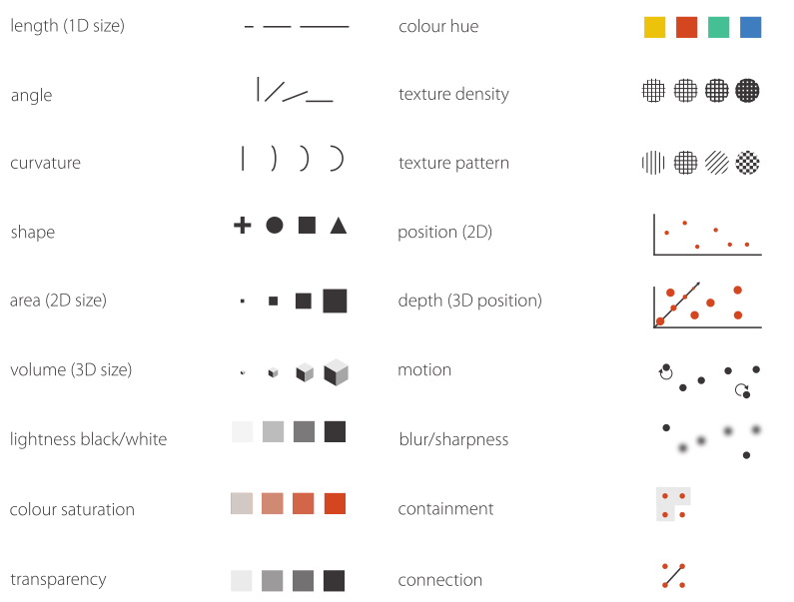
Visual Channels

Slide 7
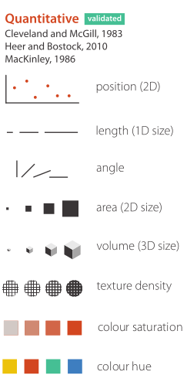
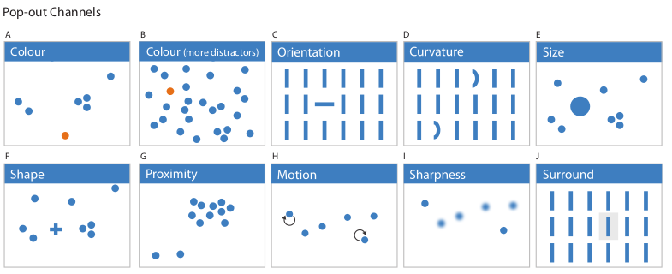
Picking Channels

Slide 8
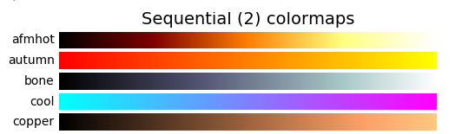
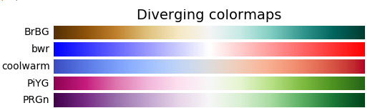
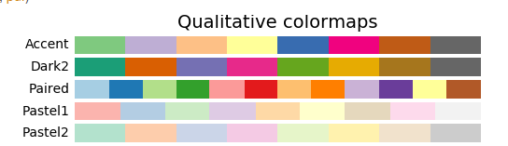
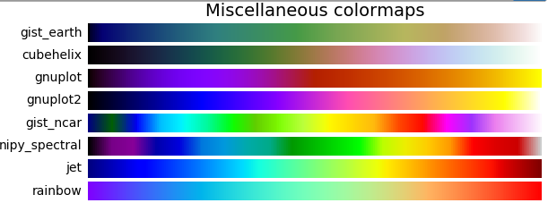
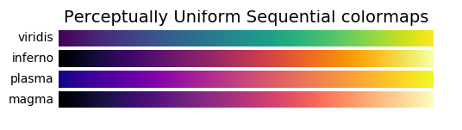
Colormaps

Slide 9
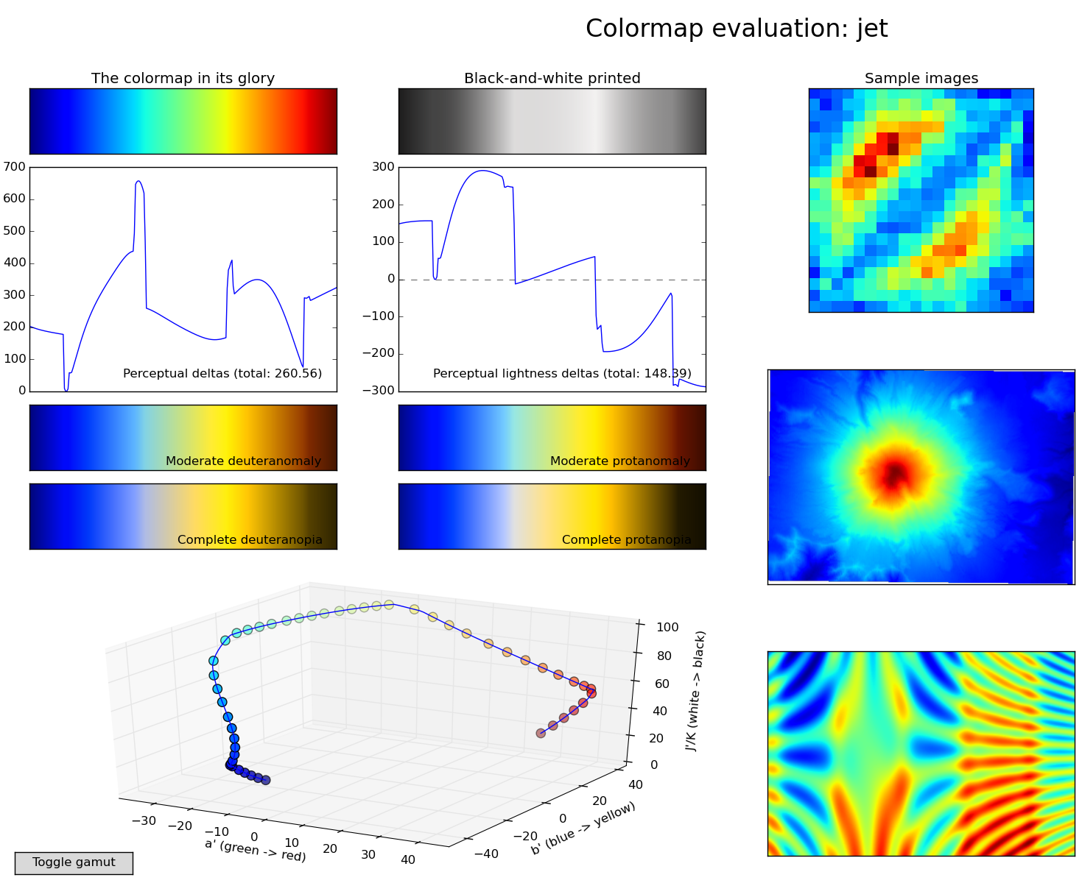
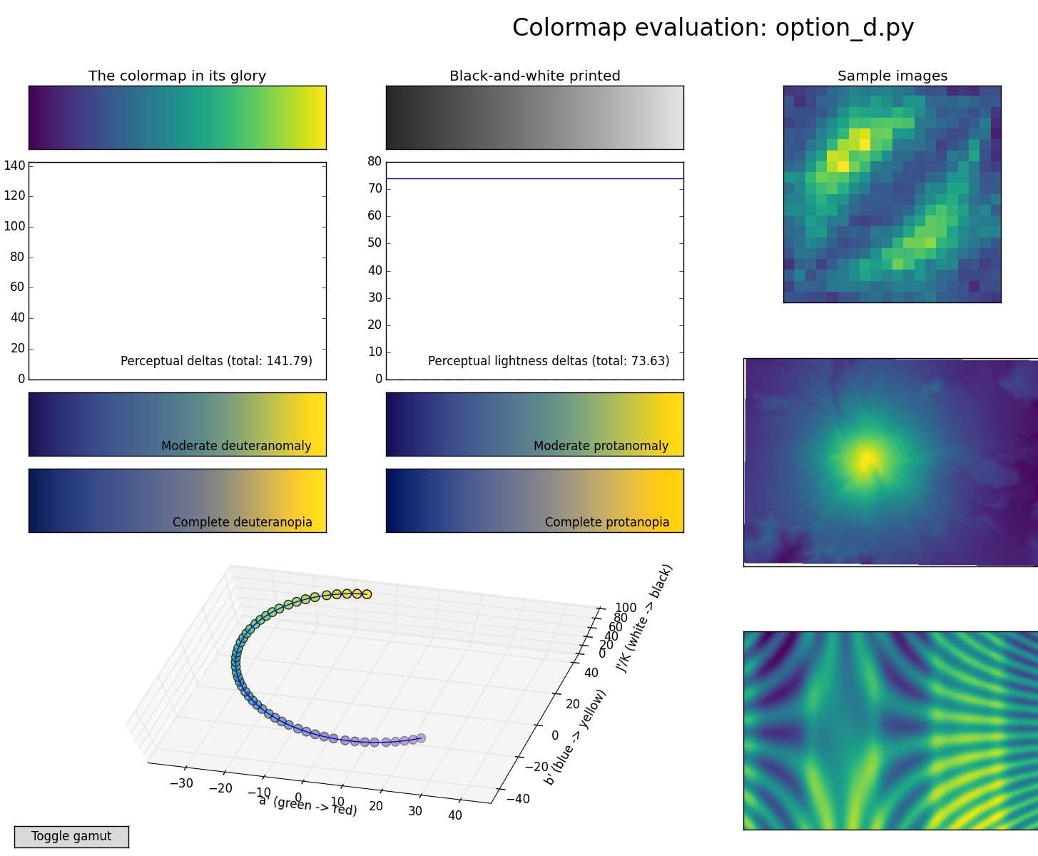
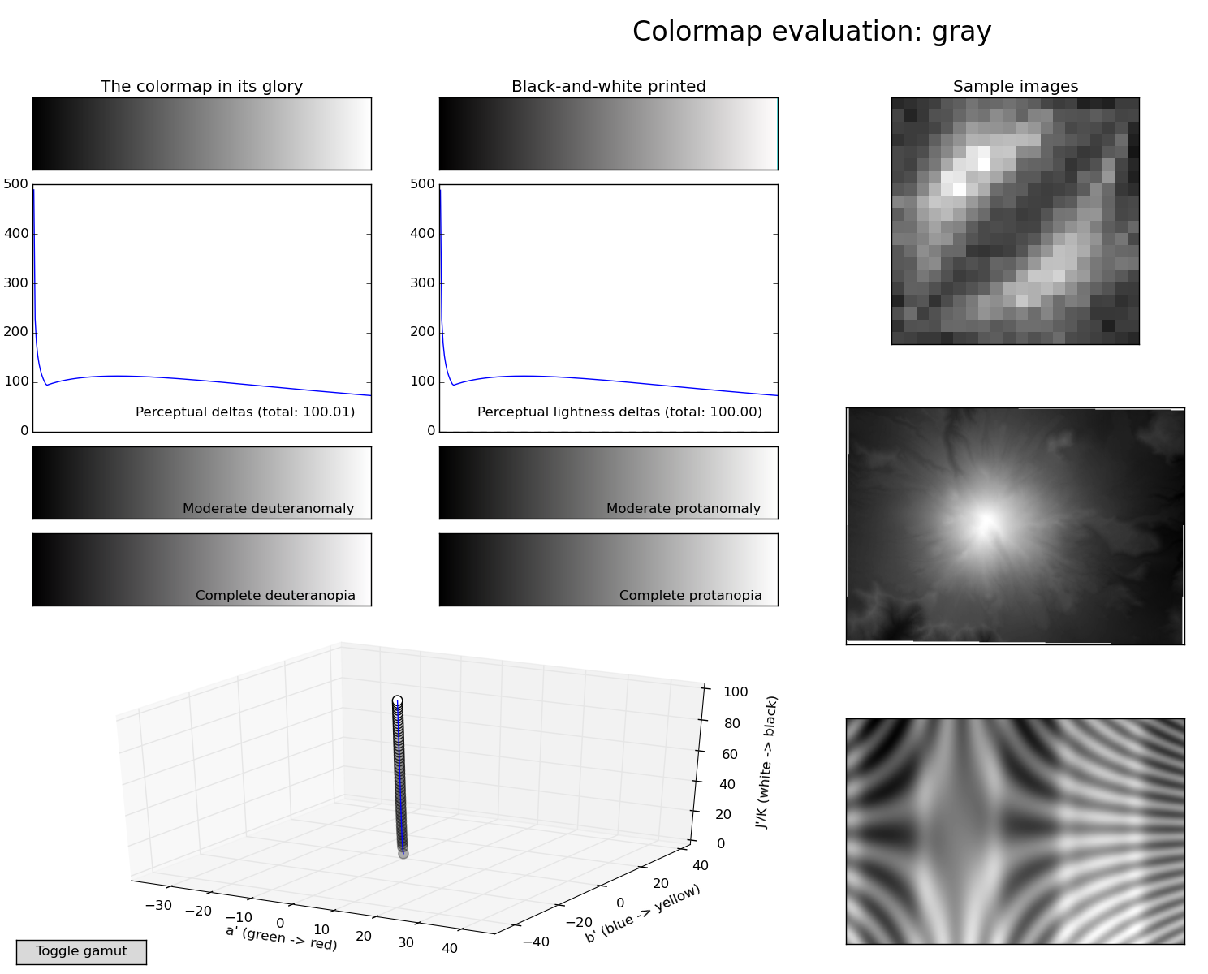

Slide 10
matplotlib v2
update now!
(you can enable classic style if your really want)

Slide 11
Matplotlib and chart types

Slide 12
Imports
from matplotlib.pyplot import *
from pylab import *
from numpy import *
import matplotlib.pyplot as plt
import numpy as np

Slide 13
matplotlib & Jupyter
% matplotlib inline
sends png to browser
no panning or zooming
new figure for each cell
no changes to previous figures
% matplotlib notebook
interactive widget
all figure features
need to create figures explicitly
ability to update figures
Notes:
I highly recommend that you use jupyter to play around with matplotlib figures and visualizations.
To show matplotlib figures embedded in jupyter, you have to call one of two magics. Jupyter magics are those that start with a percentage.
There’s matplotlib inline and matplotlib notebook, and you should run one of them, and only one of them, at the very start of the notebook.
Both will allow you to show the figures inside the the browser, but they are quite different. [read/explain table]

Slide 14
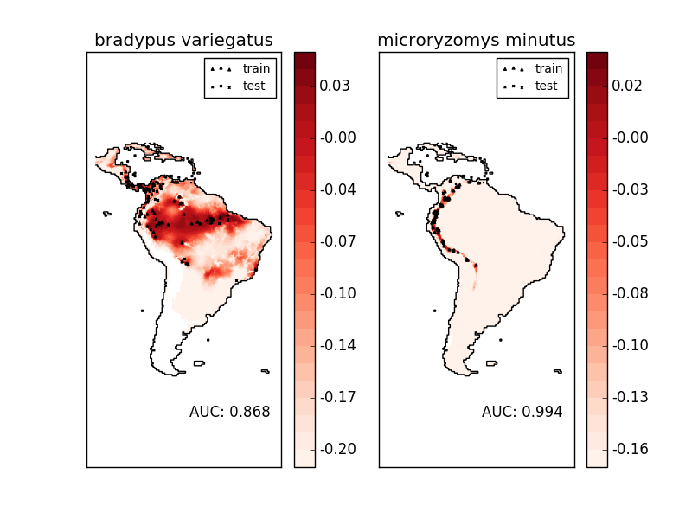
Figures and axes
figure = one window or one image file
axes = one drawing area with coordinate system
figure
axes
by default: each figure has one axis
There is a “current figure” and “current axes”

Slide 15
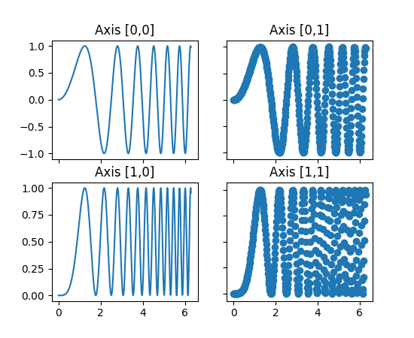
Creating Figures and axes
1st way: don’t.
Creates figure with axes on plot command
2nd way: fig = plt.figure()
Creates a figure with axes, sets current figure.
Can add more / different axes later.
3rd way: fig, ax = plt.subplots(n, m)
Creates a figure with a regular grid
of n x m axes.

Slide 16
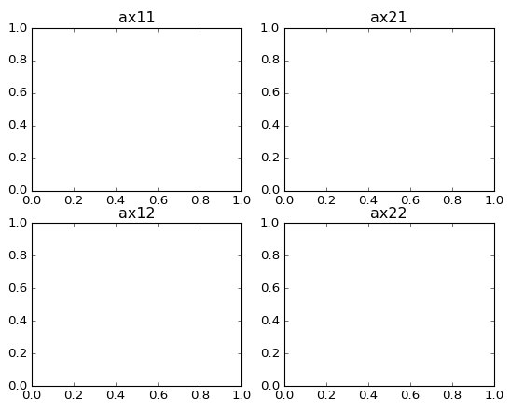
More axes via subplots
ax = plt.subplot(n, m, i) # or plt.subplot(nmi)
places ax at position “i” in n x m grid (1-based index)
ax11 = plt.subplot(2, 2, 1)
ax21 = plt.subplot(2, 2, 2)
ax12 = plt.subplot(2, 2, 3)
ax22 = plt.subplot(2, 2, 4)
equivalent:
fig, axes = plt.subplots(2, 2)
ax11, ax21, ax12, ax22 = axes.ravel()

Slide 17
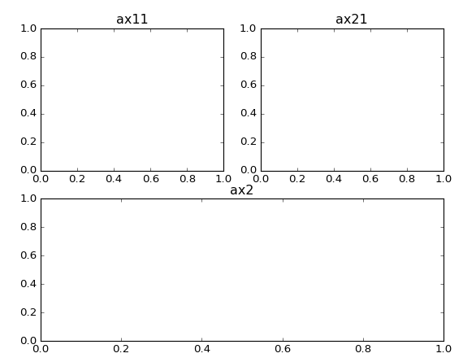
More axes via subplots
ax = plt.subplot(n, m, i) # or plt.subplot(nmi)
places ax at position “i” in n x m grid (1-based index)
ax11 = plt.subplot(2, 2, 1)
ax21 = plt.subplot(2, 2, 2)
ax2 = plt.subplot(2, 1, 2)

Slide 18
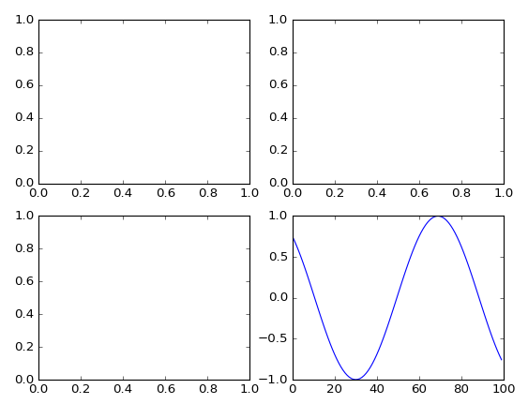
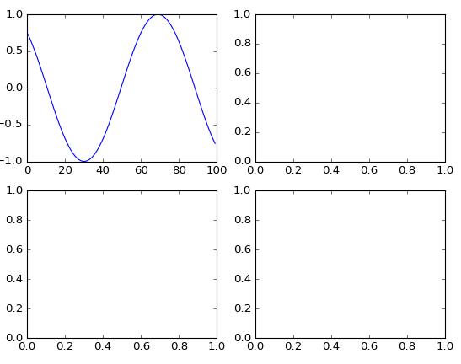
Two interfaces
Stateful interface - applies to current figure and axes
object interface - explicitly use object
sin = np.sin(np.linspace(-4, 4, 100))
fig, axes = plt.subplots(2, 2)
plt.plot(sin)
fig, axes = plt.subplots(2, 2)
axes[0, 0].plot(sin)

Slide 19
Differences between interfaces
plt.title | ax.set_title
plt.xlim, plt.ylim | ax.set_xlim, ax.set_ylim
plt.xlabel, plt.ylabel | ax.set_xlabel, ax.set_ylabel
plt.xticks, plt.yticks | ax.set_xticks, ax.set_yticks
(& ax.set_xtick_labels)
ax = plt.gca() # get current axes
fig = plt.gcf() # get current figure

Slide 20
Plotting commands
Gallery:
http://matplotlib.org/gallery.html
Plotting commands summary
http://matplotlib.org/api/pyplot_summary.html

Slide 21
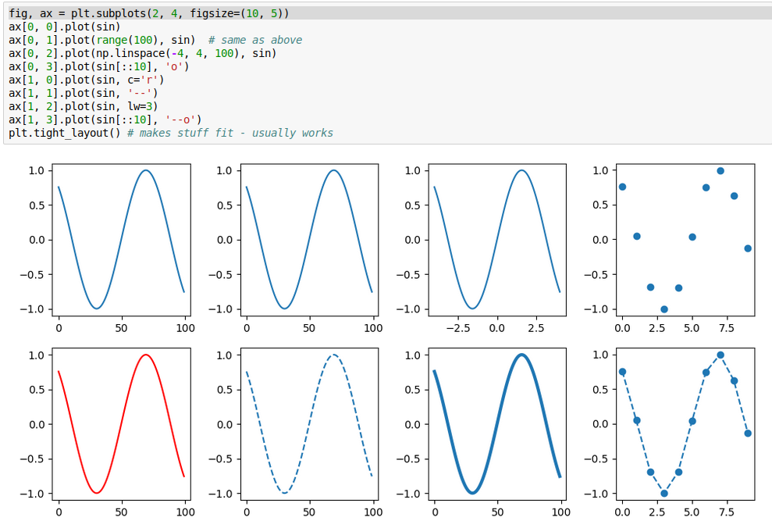
plot
why?

Slide 22
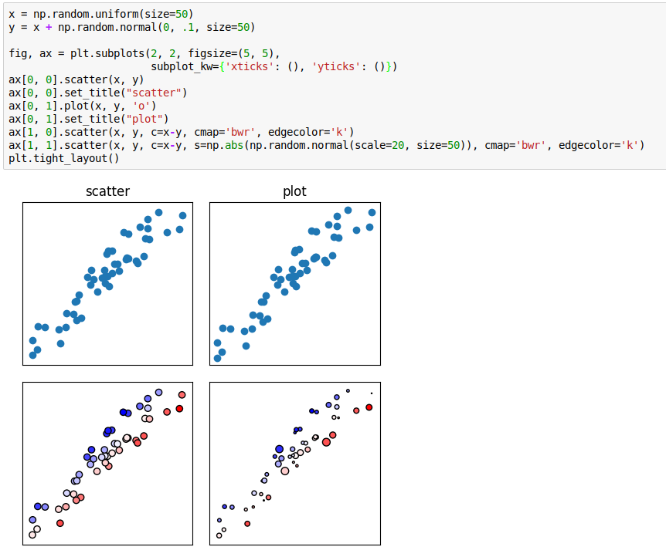
scatter

Slide 23
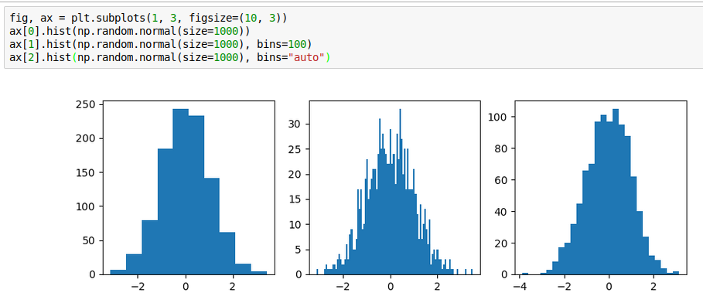
histogram

Slide 24
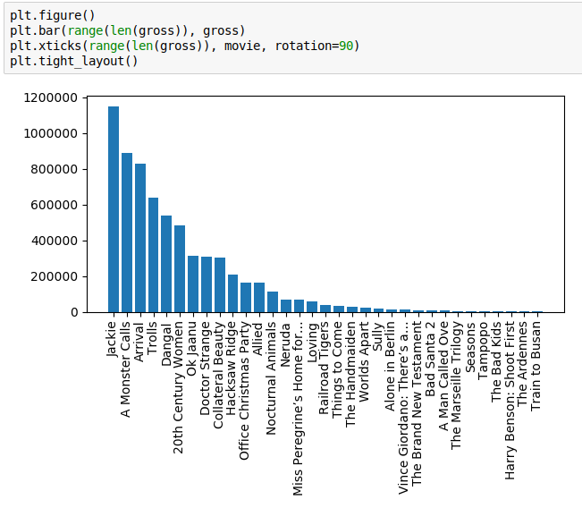
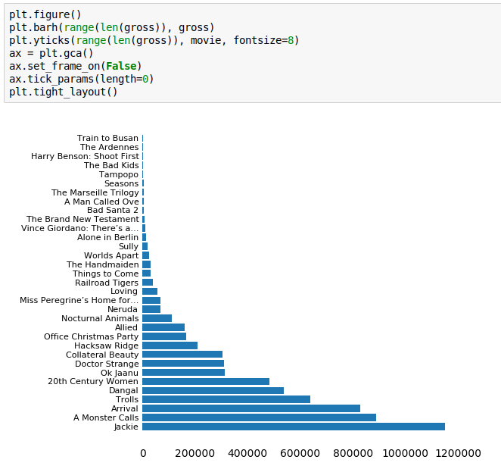
bars

Slide 25
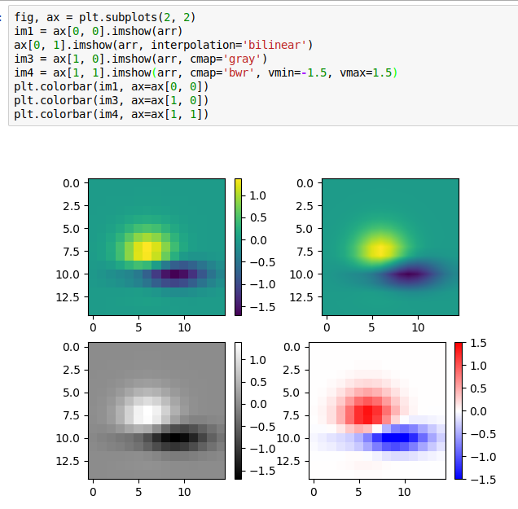
heatmaps

Slide 26
hexgrids

Slide 27
Twin x / twiny

Slide 28
Other libs
pandas plotting - convenience
seaborn - ready-made stats plots
bokeh - alternative to matplotlib for in-browser

