Slide 1
W4995 Applied Machine Learning
Linear Models for Classification
02/13/17
Andreas Müller

Slide 2
Linear models for binary classfiication

Slide 3


Slide 4
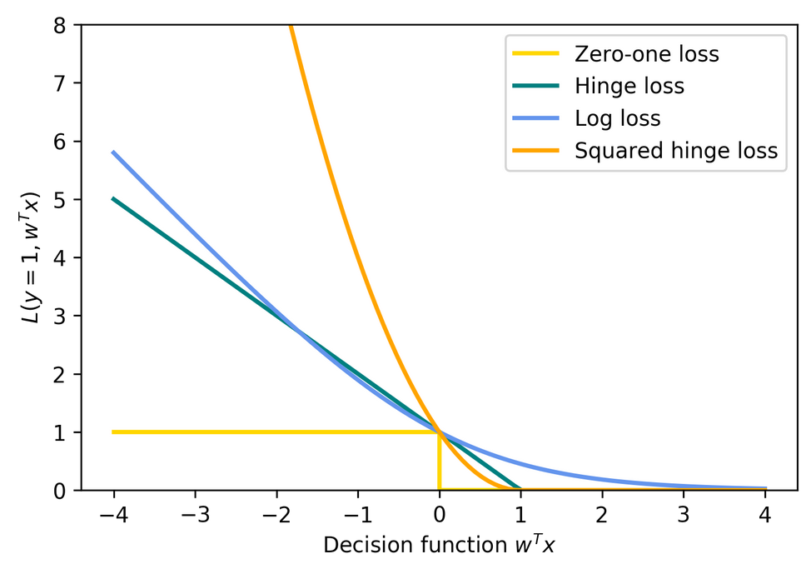
Picking a loss?
Obvious idea:
Minimize number of misclassifications aka 0-1 loss.
But: non-convex, not continuous => Relax

Slide 5

Logistic Regression

Slide 6
Penalized Logistic Regression
C is inverse to alpha (or alpha / n_samples)
Both versions strongly convex, l2 version smooth (differentiable).
All points contribute to w (dense solution to dual).

Slide 7
(soft margin) linear SVM
Both versions strongly convex, neither smooth.
Only some points contribute (the support vectors) to w (sparse solution to dual).

Slide 8
SVM or LogReg?
Do you need probability estimates?
ou
yes
It doesn’t matter
- try either / both
Logistic Regression
Need compact model or believe solution is sparse? Use L1.

Slide 9
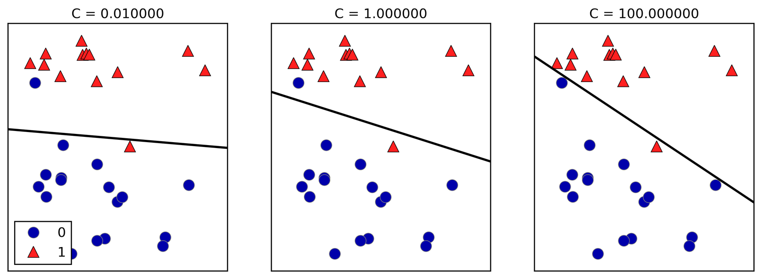
Effect of regularization
Small C (little regularization) limits the influence of individual points!

Slide 10
Multiclass classification

Slide 11
Reduction to Binary classification
For 4 classes
One vs Rest
1v{2, 3, 4}, 2v{1, 3, 4}, 3v{1, 2, 4}, 4v{1, 2, 3}
n binary classifiers - each on all data
One vs One
1v1, 1v2, 1v3, 1v4, 2v3, 2v4, 3v4
n * (n-1) / 2 binary classifiers - each on a fraction of the data
Standard

Slide 12
Prediction with One Vs Rest
“Class with highest score”
Unclear why it even works, but work well.

Slide 13
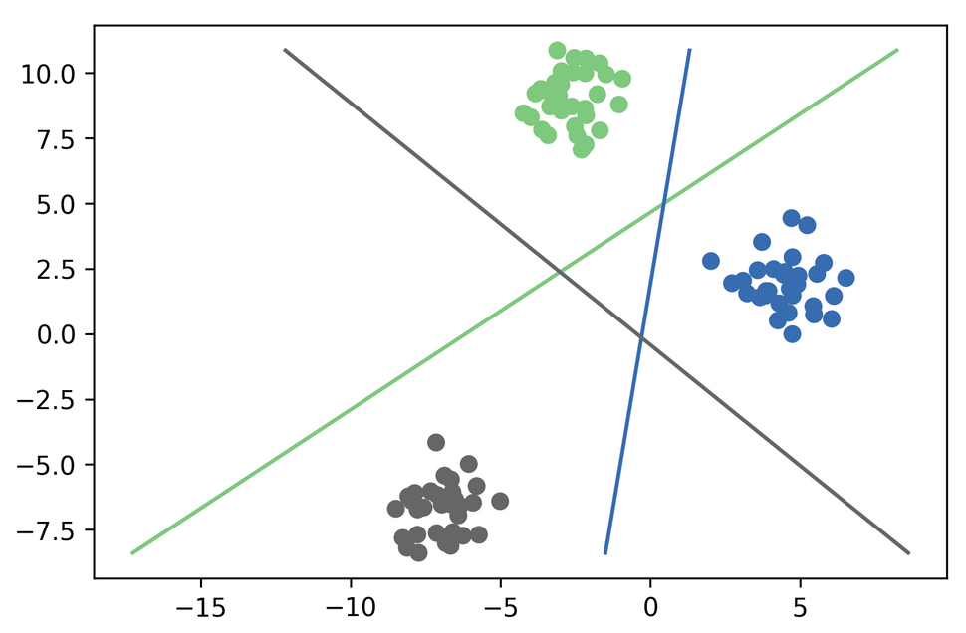
One vs Rest Prediction

Slide 14
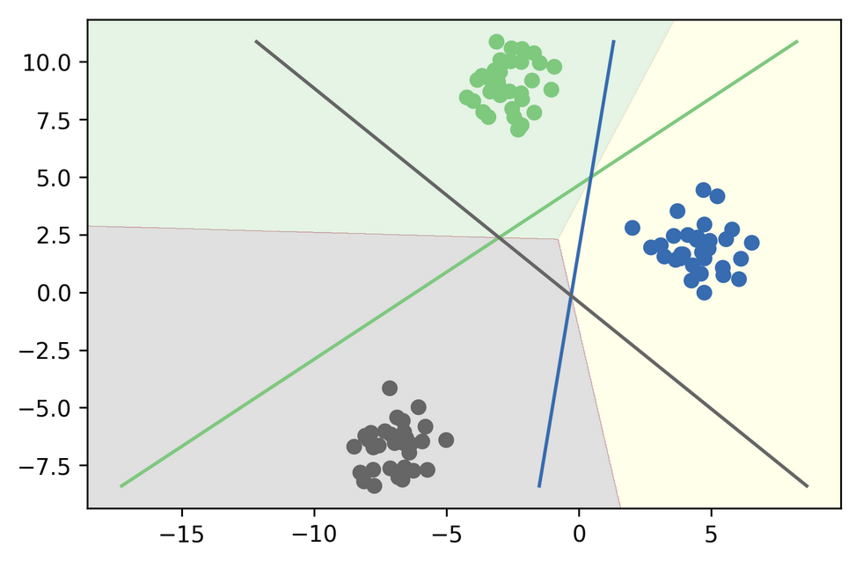
One vs Rest Prediction

Slide 15
Prediction with One Vs One
“Vote for highest positives”
Classify by all classifiers.
Count how often each class was predicted.
Return most commonly predicted class.
Again – just a heuristic.

Slide 16
Multinomial Logistic Regression
Probabilistic multi-class model:
Same prediction rule as OvR!

Slide 17
In scikit-learn
OvO: only SVC
OvR: default for all linear models, even LogisticRegression
LogisticRegression(multinomial=True)
clf.decision_function = w^Tx
logreg.predict_proba
SVC(probability=True) not great

Slide 18
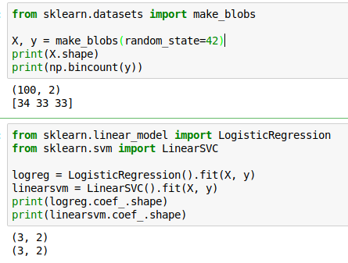
Multi-Class in Practice
OvR and multinomial LogReg produce one coef per class:

Slide 19
Computational Considerations

