Slide 1
W4995 Applied Machine Learning
Imputation and Feature Selection
02/13/17
Andreas Müller

Slide 2
Dealing with missing values
Missing values can be encoded in many ways
Numpy has no standard format for it (often np.NaN)
Sometimes: 999, ???, ?, np.inf, “N/A”, “Unknown“ …
Not discussing “missing output” - that’s semi-supervised learning.
Add feature that encodes that data was missing!
Often missingness is informative!

Slide 3
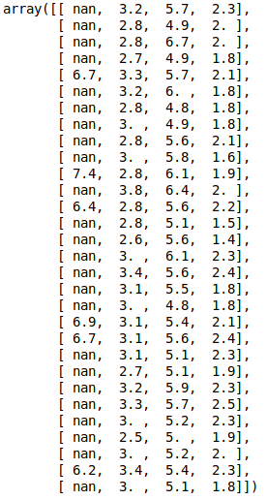
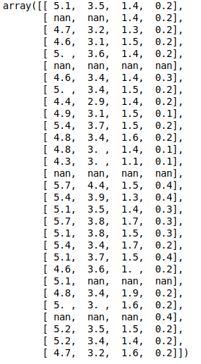
Problem:
prediction not for all samples! Accuracy might be biased!

Slide 4
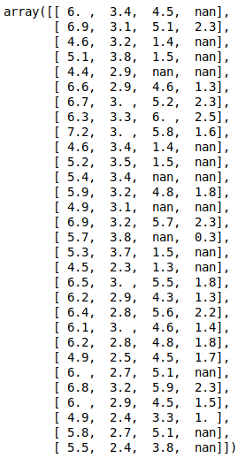
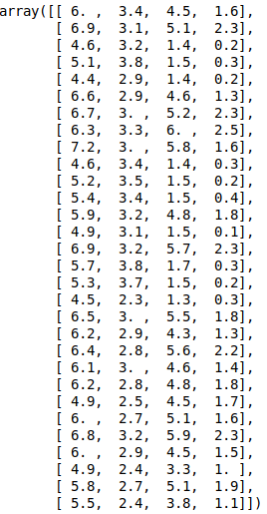
Imputation

Slide 5
Imputation methods
Mean / median
KNN
Model-driven
Iterative

Slide 6
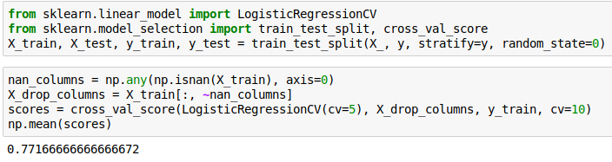

Slide 7
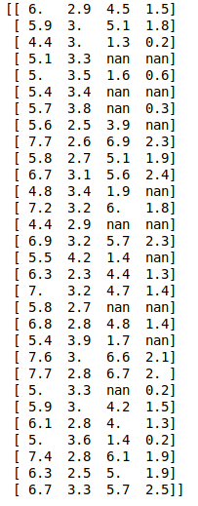
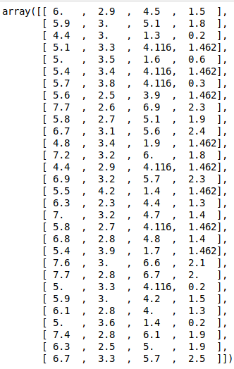

Mean and Median
Imputation

Slide 8
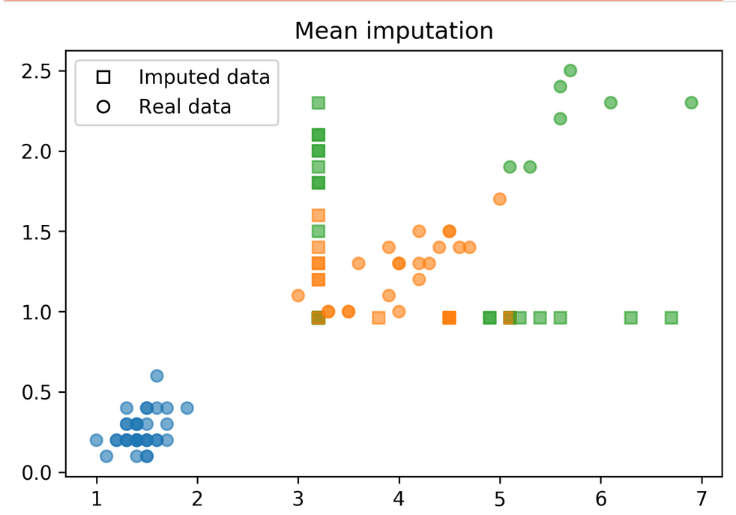

Slide 9
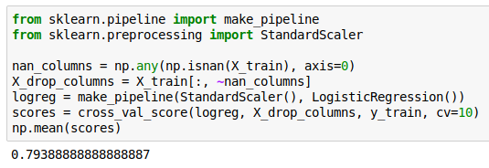
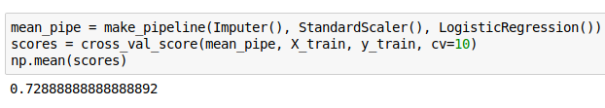

Slide 10
KNN imputation
Find k nearest neighbors that have non-missing values.
Fill in all missing values using the average of the neighbors.
Different strategies possible for finding neighbors that have missing values.
Tricky if there is no feature that is always non-missing.
PR in scikit-learn: https://github.com/scikit-learn/scikit-learn/pull/4844

Slide 11
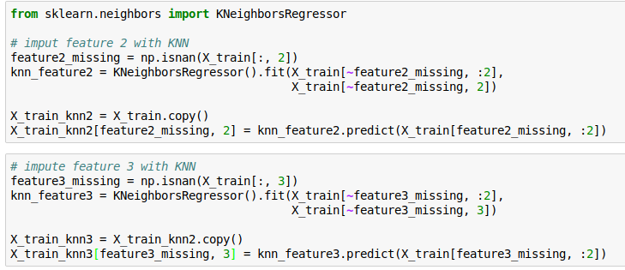
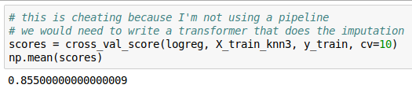
KNN imputation
An efficient implementation would find nearest neighbors only once!
This approach is quite naive as is requires the first two features to always be present!

Slide 12
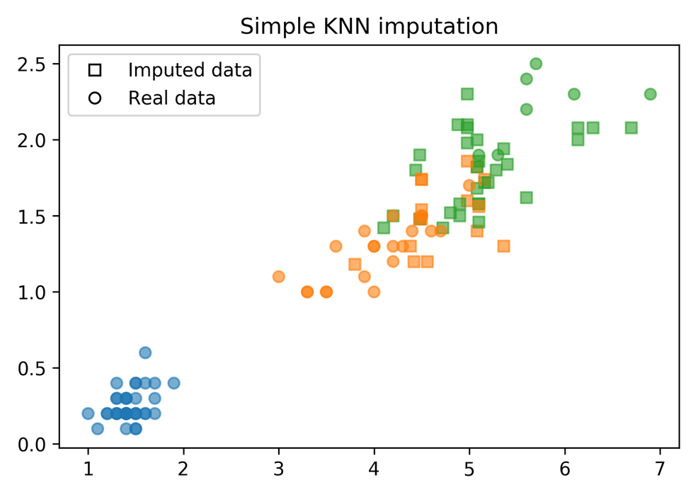

Slide 13
Model-Driven Imputation
Train regression model for missing values
Possibly iterate: retrain after filling in
Very flexible!

Slide 14
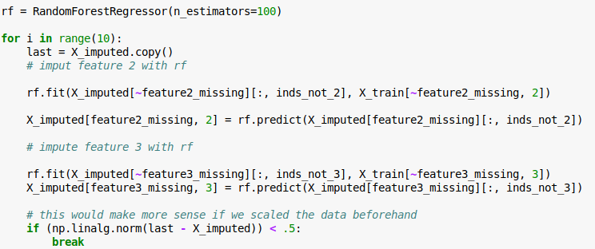

Model-driven Imputation w RF

Slide 15
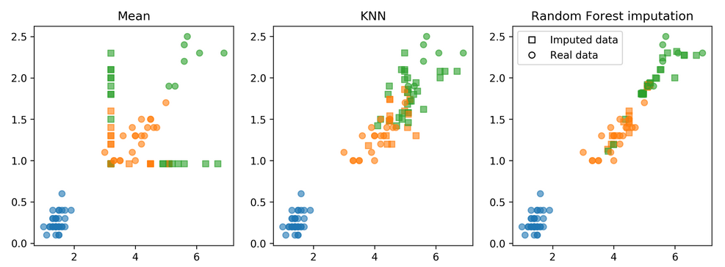
Comparison of Imputation Methods

Slide 16
Fanyimpute
pip install fancyimpute
Has many methods – but no fit-transform paradigm
MICE is iterative and works well often
Try different things in practice, MICE might be best

Slide 17
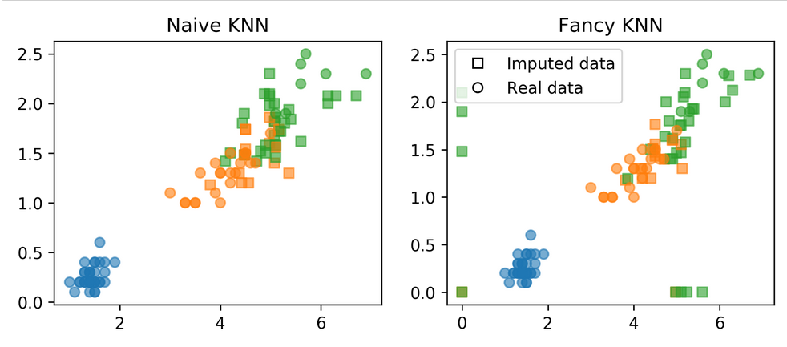

Slide 18
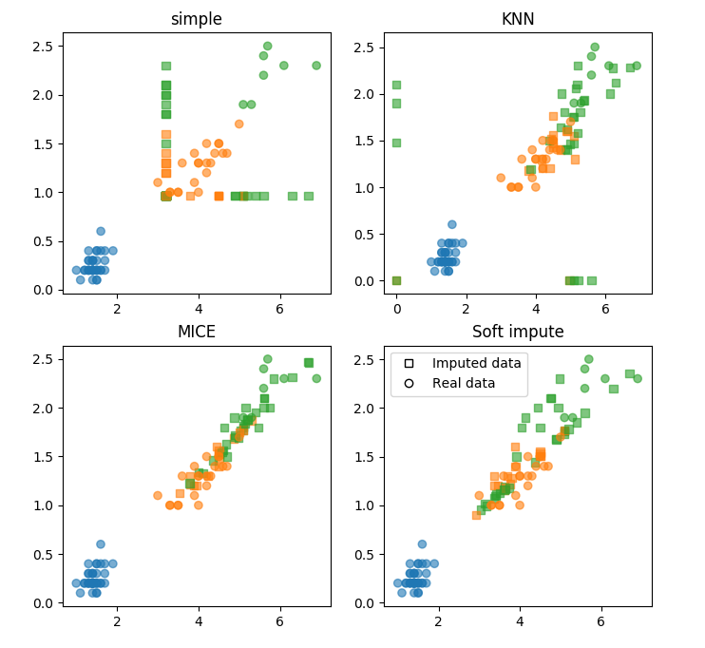

Slide 19
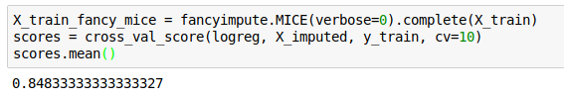
Applying fancyimpute
Again, cheating with the imputation :(
This is allowed for the homework because the current tools make it hard to do the right thing.

Slide 20
Feature Selection

Slide 21
Why Select Features?
Avoid overfitting
Faster prediction and training
Less storage for model and dataset

Slide 22
Types of Feature Selection
Unsupervised vs Supervised
Univariate vs Multivariate
Model-based or not

Slide 23
Unsupervised feature selection
May discard important information
Variance-based: 0 variance or few unique values
Covariance-based: remove correlated features
PCA: remove linear subspaces

Slide 24
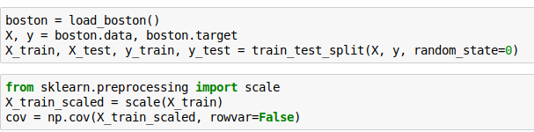
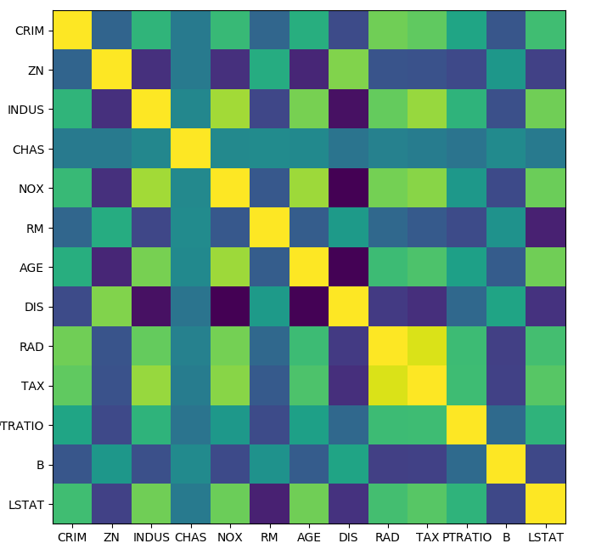
Covariance

Slide 25
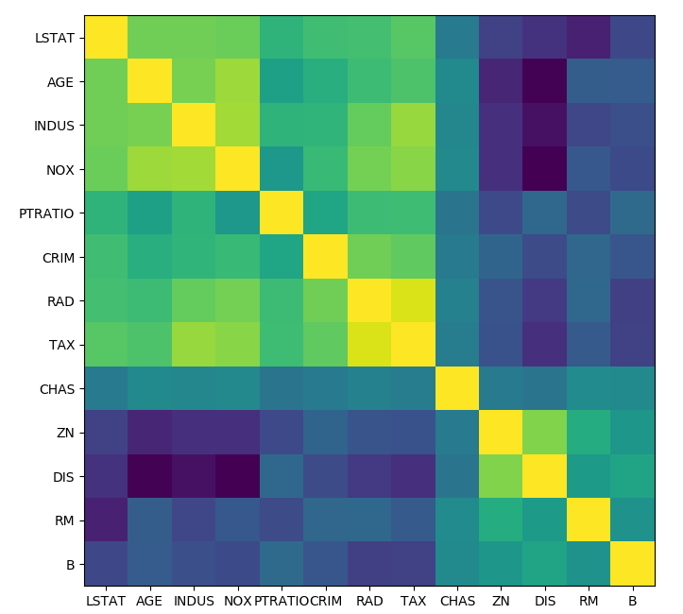
Can use this to iteratively remove most correlated pairs.
Beware: might discard important information!

Slide 26
Supervised Feature Selection

Slide 27

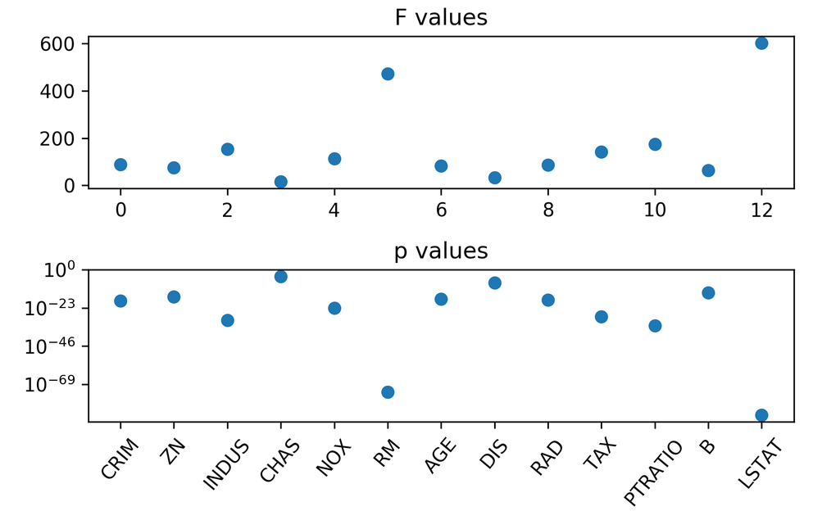
Simple univariate selection
Pick statistic, check p-values!
f_regression, f_classif, chi2 in scikit-learn

Slide 28
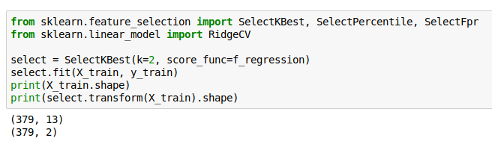
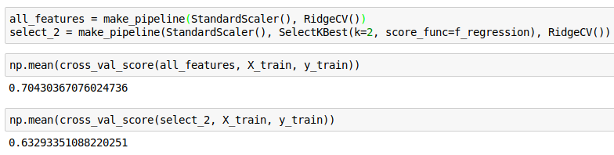

Slide 29
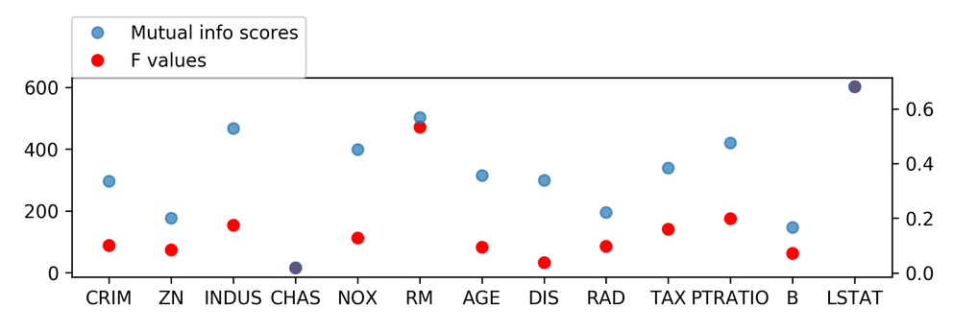
Mutual Information
Mutual information (as implemented here) is also univariate,
but doesn’t assume a linear model (like the F statistics do)
Can be used with SelectKBest etc

Slide 30
Model-Based Feature selection
Get best fit for a particular model
Ideally: exhaustive search over all possible combinations
Exhaustive is infeasible (and has multiple testing issues)
Use heuristics in practice.

Slide 31
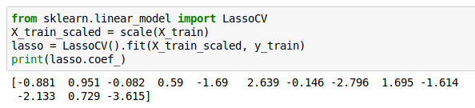
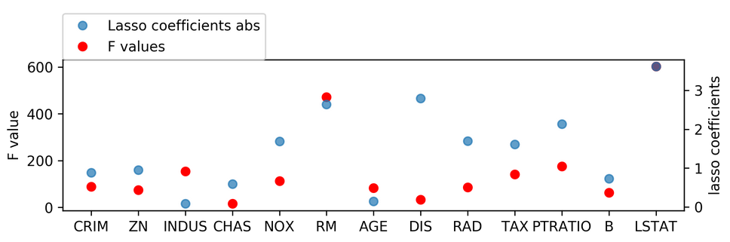
Model based (single fit)
Build a model, select features most important to model.
Lasso, other linear models, tree-based models
Multivariate – linear models assume linear relation

Slide 32
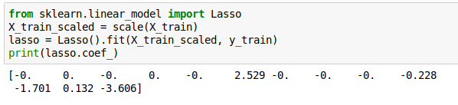
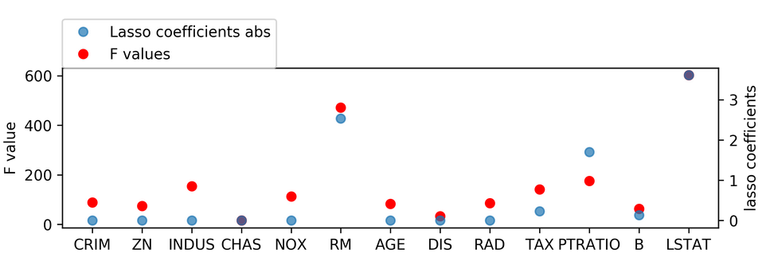
Changing Lasso alpha

Slide 33
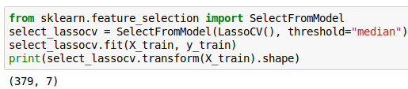
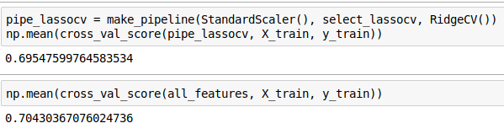
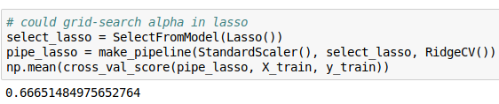
SelectFromModel

Slide 34
Iterative Model-Based Selection
Fit model, find least important feature, remove, iterate.
Or: Start with single feature, find most important feature, add, iterate.

Slide 35
Recursive Feature Elimination
Uses feature importances / coefficients, similar to “SelectFromModel”
Iteratively removes features (one by one or in groups)
Runtime:
(n_features - n_feature_to_keep) / stepsize

Slide 36
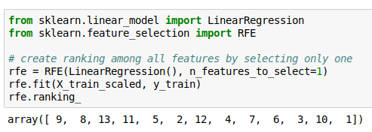
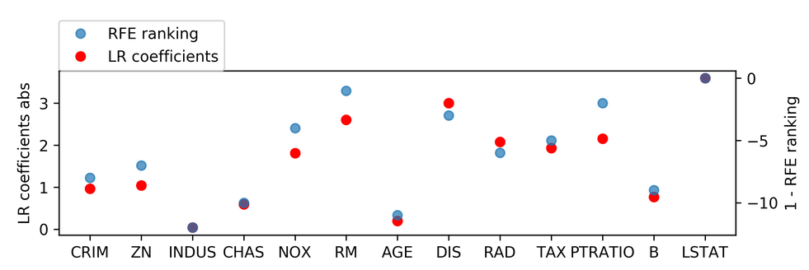

Slide 37
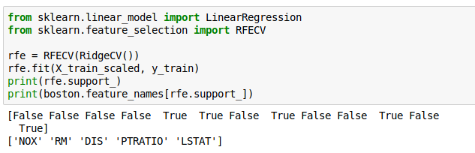

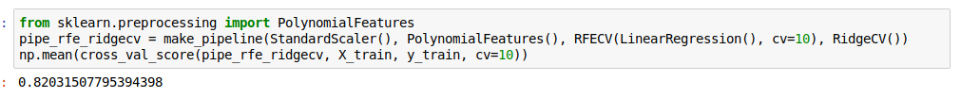
RFECV
Efficient CV for n_features_to_keep
If we want to predict with the same model as used for selection, RFECV can be used as the prediction step.
Could also use RFECV as transformer and use any other model!

Slide 38
Wrapper Methods
Can be applied for ANY model!
Shrink / grow feature set by greedy search
Called Forward or Backward selection
Complexity: n_features * (n_features + 1) / 2
Implemented in mlxtend

Slide 39
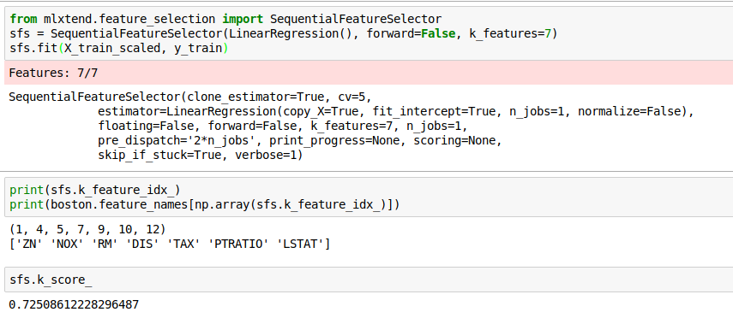
SequentialFeatureSelector

