Slide 1
W4995 Applied Machine Learning
Trees & Forests
02/20/17
Andreas Müller

Slide 2
Why trees?
Very powerful modeling method – non-linear!
Doesn’t care about scaling of distribution of data!
“Interpretable”
Basis of very powerful models!

Slide 3
Decision Trees for Classification

Slide 4
Idea: series of binary questions

Slide 5



Building trees
Continuous features:
“questions” are thresholds on single features.
[Other methods are possible but not as common]
For each split:
exhaustive search over all features and thresholds!
Minimize “impurity”
Notes:
The second family of models I want to talk about is decision-tree based models.
A decision tree is basically the same as a sequence of if-else branches, that ultimately lead to a decision. The point is that the question that are asked are learned, though.
A decision tree is build recursively by asking a series of questions of the form “is feature “i” greater than threshold t”. In each iteration, the question is chosen that yields the most information about the target variable. Then, the data is split according to this question, and we start again. This yields a hierarchical partitioning of the data, where each section of the partitioning becomes more and more “pure”, that is their content becomes more and more the same.
After you build the tree, you can make a prediction by checking which part of the partition a new point lies in and assigning the mean of the datapoints in this part.

Slide 6
Criteria (for classification)
Gini index:
Cross-entropy:
observations in node m
classes
distribution over classes in node m

Slide 7
Prediction
y=0
Traverse tree based on feature tests
Predict most common class in leaf

Slide 8
Regression trees
Impurity Criteria:
Mean Squared Error
Mean Absolute Error
Prediction:
Predict mean.
Without regularization / pruning:
Each leaf often contains a single point to be “pure”

Slide 9
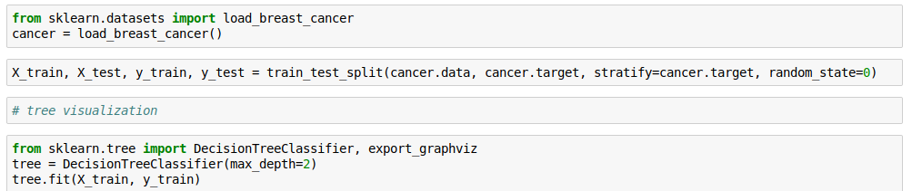
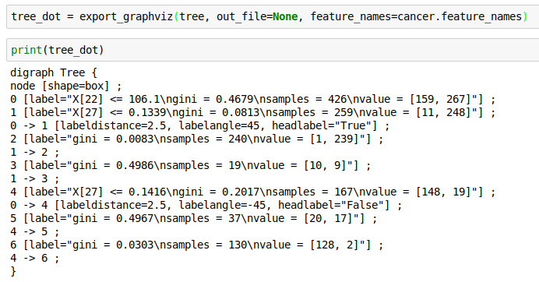
Visualizing trees with sklearn

Slide 10
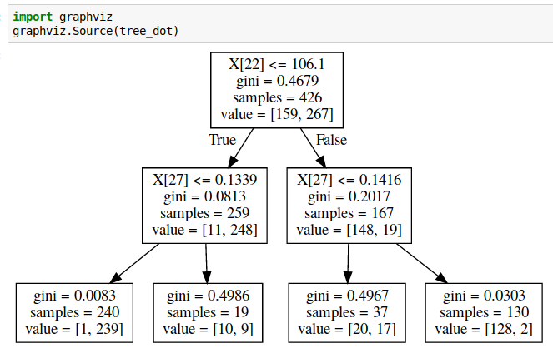
Showing dot files in Jupyter
First install graphvis C library:
conda install graphviz
Then install graphviz python library:
pip install graphviz

Slide 11
Parameter tuning
Pre-pruning and post-pruning (not in sklearn yet)
Limit tree size (pick one):
max_depth
max_leaf_nodes
min_samples_split
(and more)

Slide 12
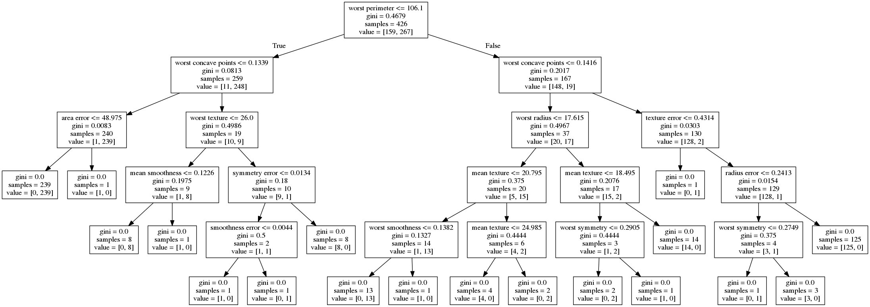
No pruning

Slide 13
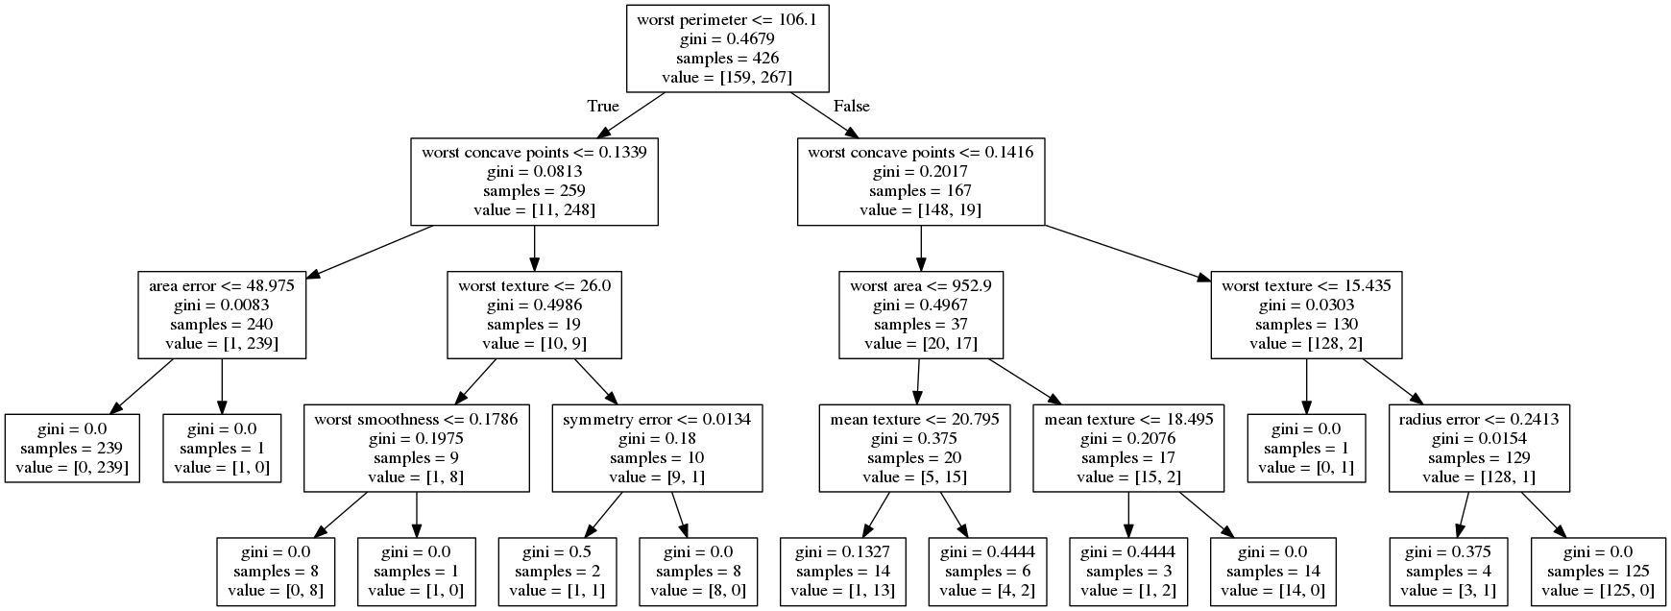
max_depth=4

Slide 14
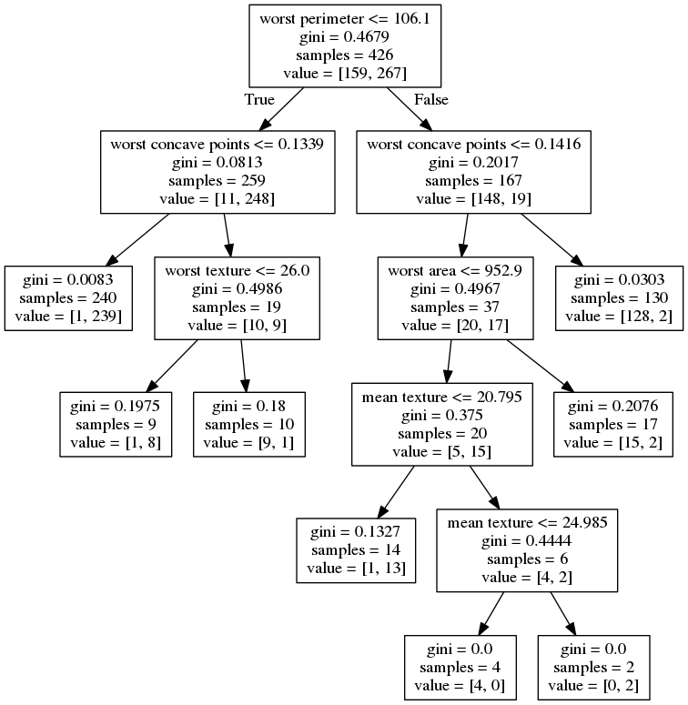
max_leaf_nodes=8

Slide 15
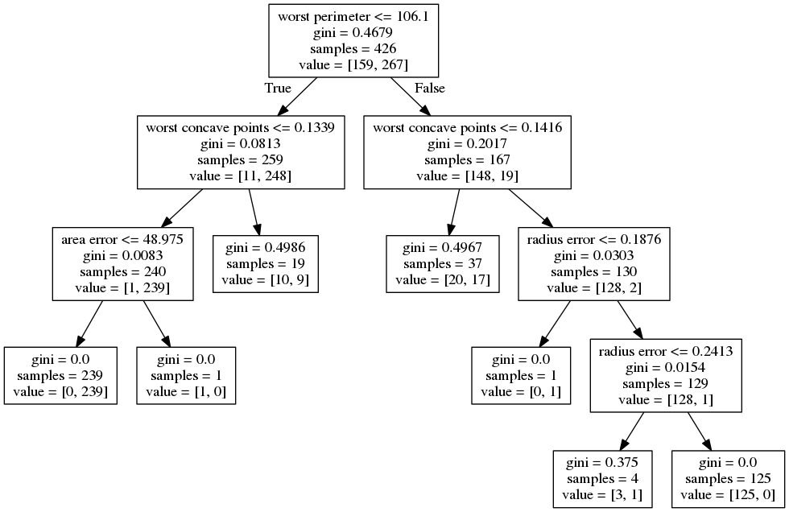
min_samples_split=50

Slide 16

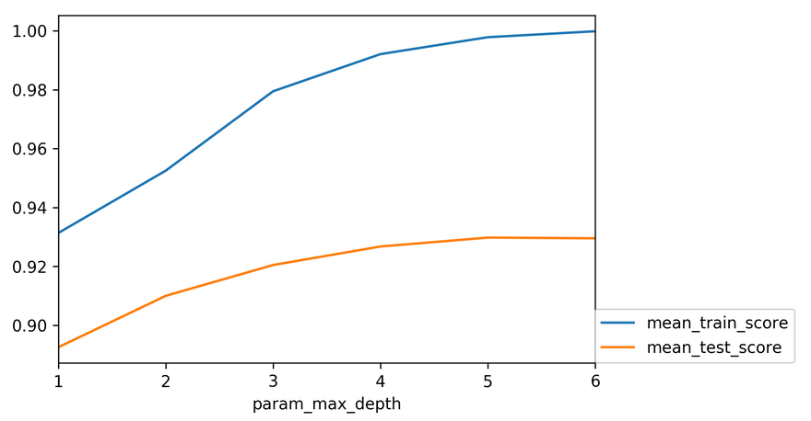

Slide 17
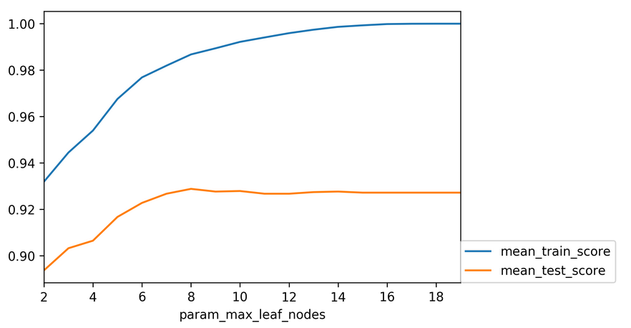

Slide 18
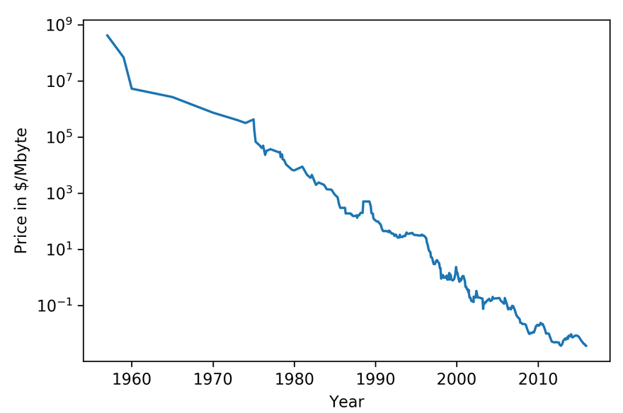

Slide 19
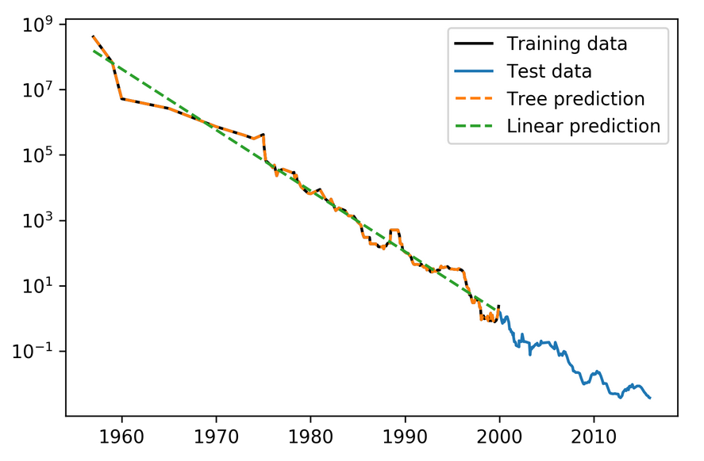

Slide 20
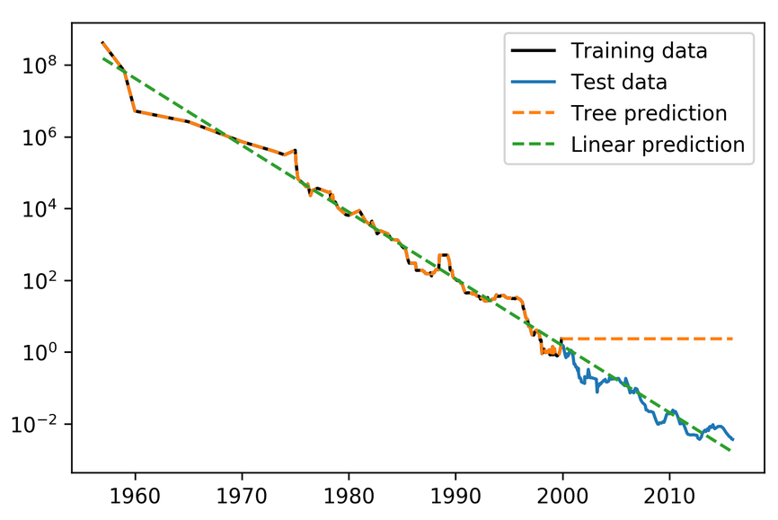
Extrapolation
Would be the same for nearest neighbor regression!

Slide 21
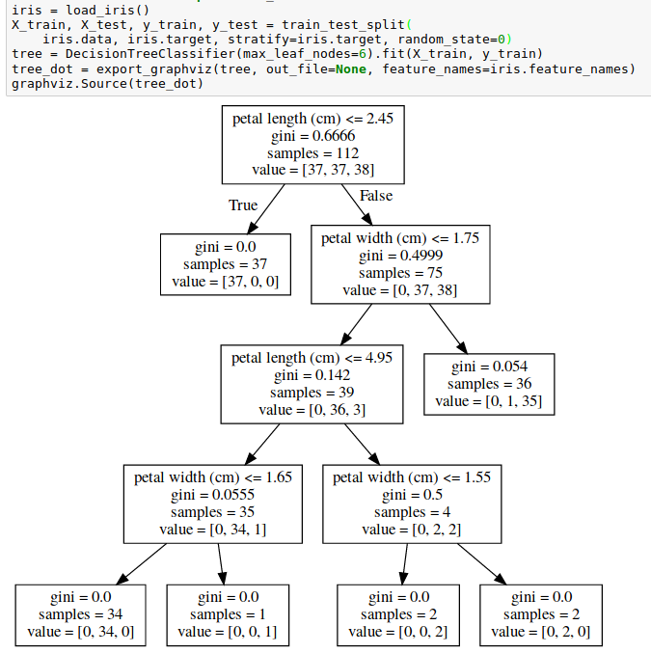
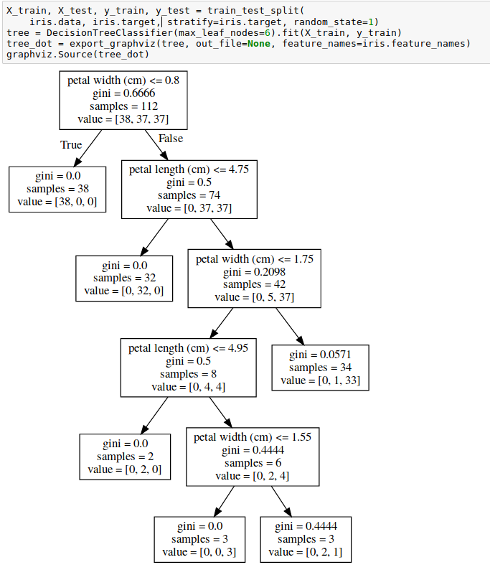
Instability

Slide 22

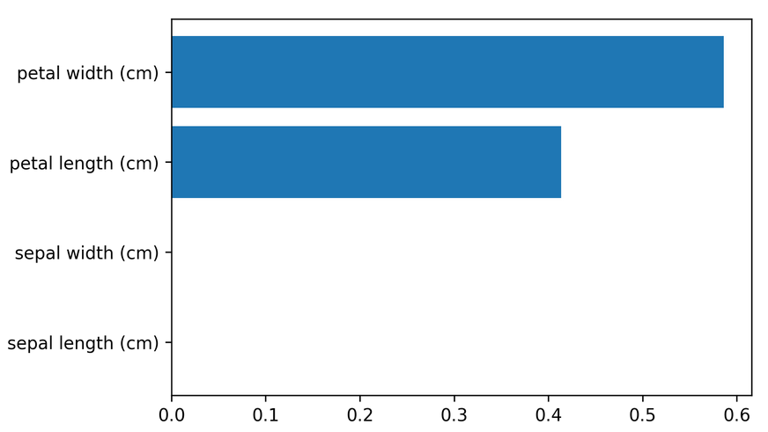
Feature importance
Unstable tree → unstable feature importances.
Might take one or multiple from a group of correlated features.

Slide 23
Categorical Data
Can split on categorical data directly
Intuitive way to split: split in two subsets
2 ^ n_values many possibilities
Possible to do in linear time exactly for gini index and binary classification.
Heuristics done in practice for multi-class.
Not in sklearn release version :(

Slide 24
Predicting probabilities
Fraction of class in leaf.
Without pruning: Always 100% certain!
Even with pruning might be too certain.

Slide 25
Conditional Inference Trees
Select “best” split with correcting for multiple-hypothesis testing.
More “fair” to categorical variables.
Only in R so far (party)

Slide 26
Relation to Nearest Neighbors
Predict average of neighbors – either by k, by epsilon ball or by leaf.
Trees are much faster to predict.
Both can’t extrapolate

Slide 27
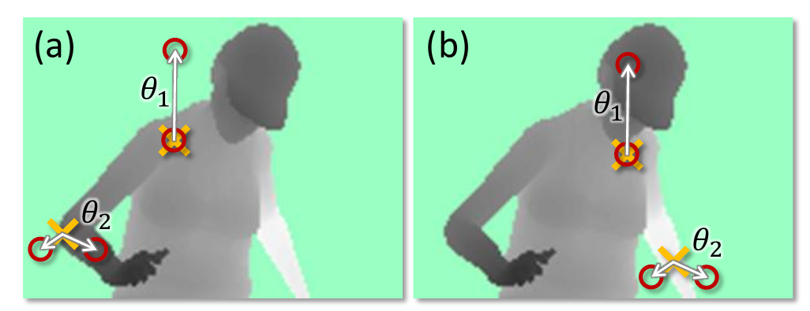
Different Splitting Methods
Could use anything as split candidate!
Linear models used if extrapolation is needed.
Computer vision: pixel comparisons
Kinect (first generation): depth comparison
(taken from Shotton et. al. Real-Time Human Pose Recognition ..)

Slide 28
Ensemble Models

Slide 29
Poor man’s ensembles
Build different models
Average the result
Owen Zhang (long time kaggle 1st): build XGBoosting models with different random seeds.
More models are better – if they are not correlated.
Also works with neural networks
You can average any models as long as they provide calibrated (“good”) probabilities.
Scikit-learn: VotingClassifier
hard and soft voting

Slide 30
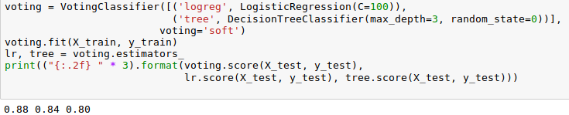
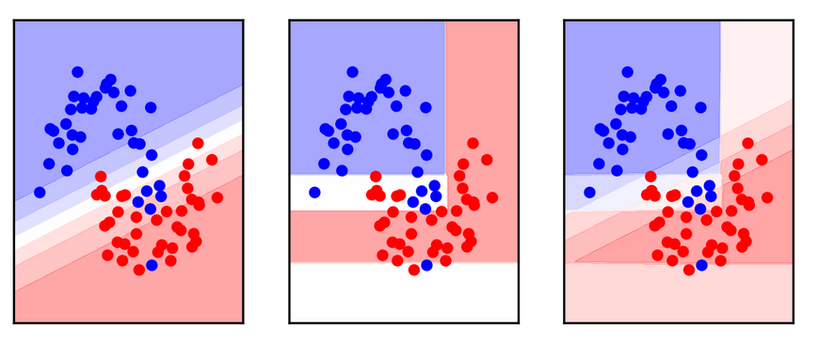
VotingClassifier

Slide 31
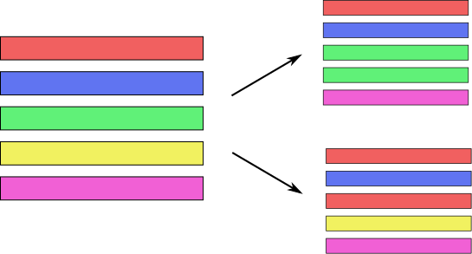
Bagging (Bootstrap AGGregation)
Generic way to build “slightly different” models
Draw bootstrap samples from dataset
(as many as there are in the dataset, with repetition)
Implemented in BaggingClassifier, BaggingRegressor

Slide 32
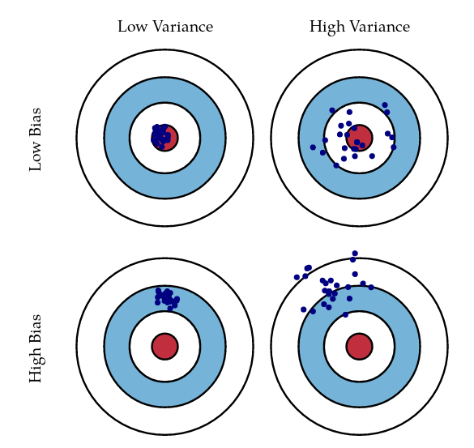
Bias and Variance
http://scott.fortmann-roe.com/docs/BiasVariance.html

Slide 33
Bias and Variance in Ensembles
Breiman showed that generalization depends on strength of the individual classifiers and (inversely) on their correlation
Uncorrelating them might help, even at the expense of strength

Slide 34

Random Forests
Smarter bagging for trees!
Notes:
So decision trees are a great idea, but unfortunately they don’t work that well in practice. However, there is a modification of the algorithm that works very well, called random forest.
The idea behind random forest is that we build many decision trees, but we inject some randomness into each tree, so that they are all different.
Then, to make a prediction, we look at the prediction of all the decision trees and take the average.

Slide 35
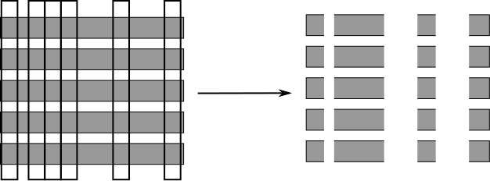
Randomize in two ways
For each tree:
Pick bootstrap sample of data
For each split:
Pick random sample of features
More tree are always better

Slide 36
Tuning Random Forests
Main parameter: max_features
  around sqrt(n_features) for classification
  Around n_features for regression
n_estimators > 100
Prepruning might help, definitely helps with model size!
max_depth, max_leaf_nodes, min_samples_split again

Slide 37
Extremely Randomized Trees
More randomness!
Randomly draw threshold for each feature!
Doesn’t use bootstrap
Faster because no sorting / searching
Can have smoother boundaries

Slide 38
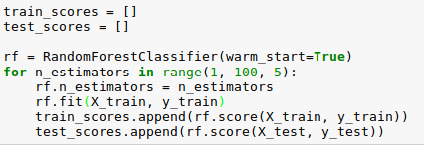
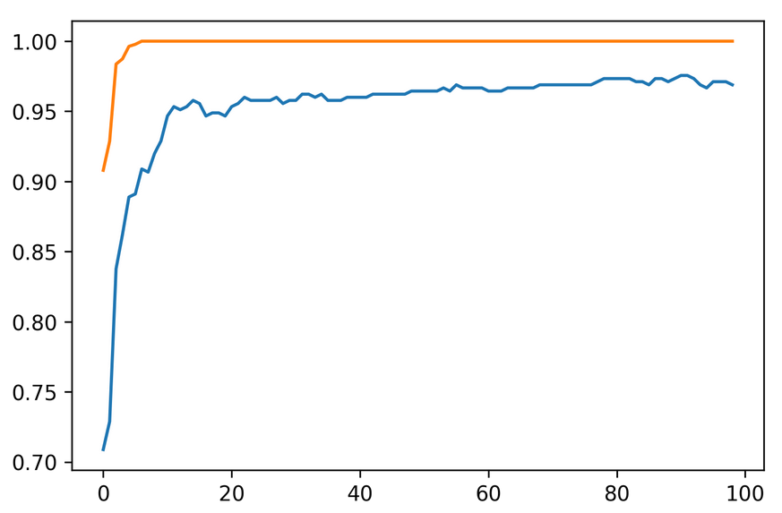
Warm-Starts

Slide 39
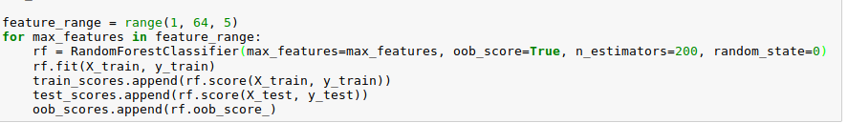
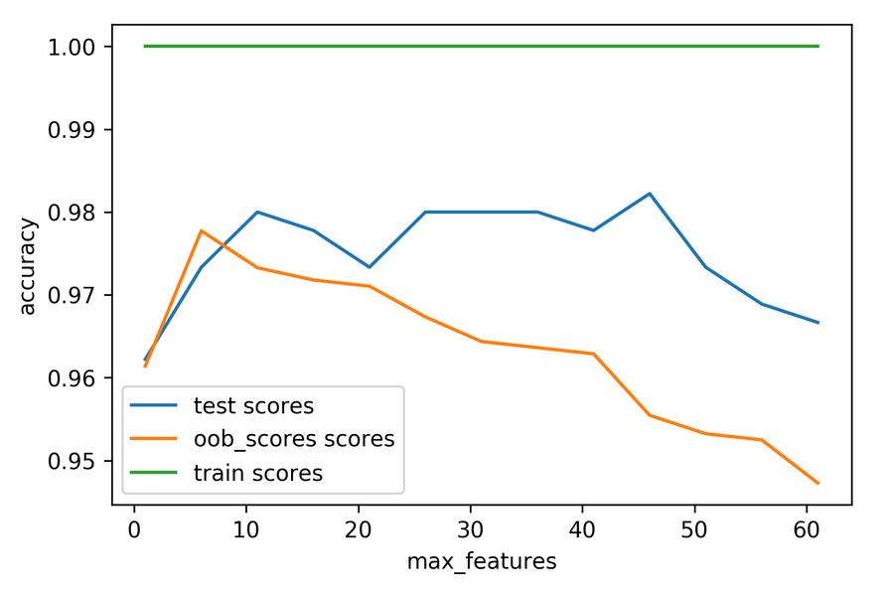
Out-of-bag estimates
Each tree only uses ~66% of data
Can evaluate it on the rest!
Make predictions for out-of-bag, average, score.
Each prediction is an average over different subset of trees

Slide 40
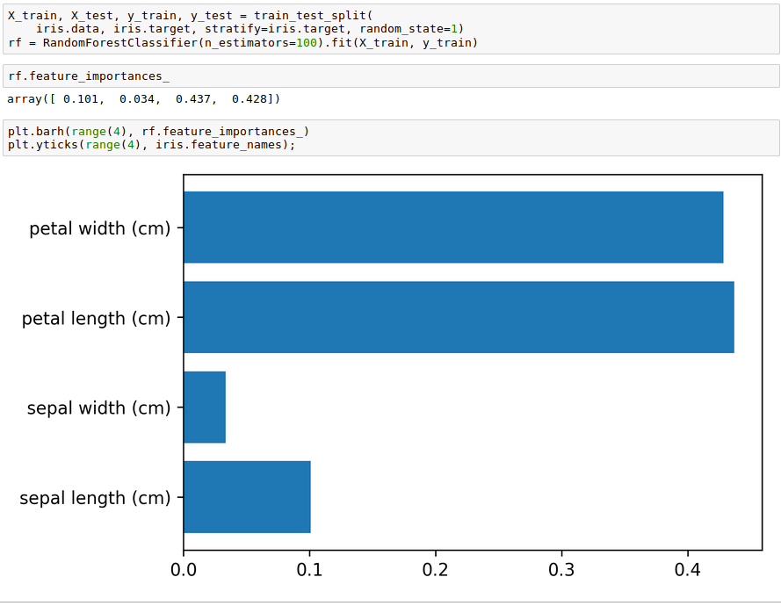
Variable Importance

