Slide 1
W4995 Applied Machine Learning
PCA, Discriminants, Manifold Learning
03/06/17
Andreas Müller

Slide 2
Principal Component Analysis

Slide 3
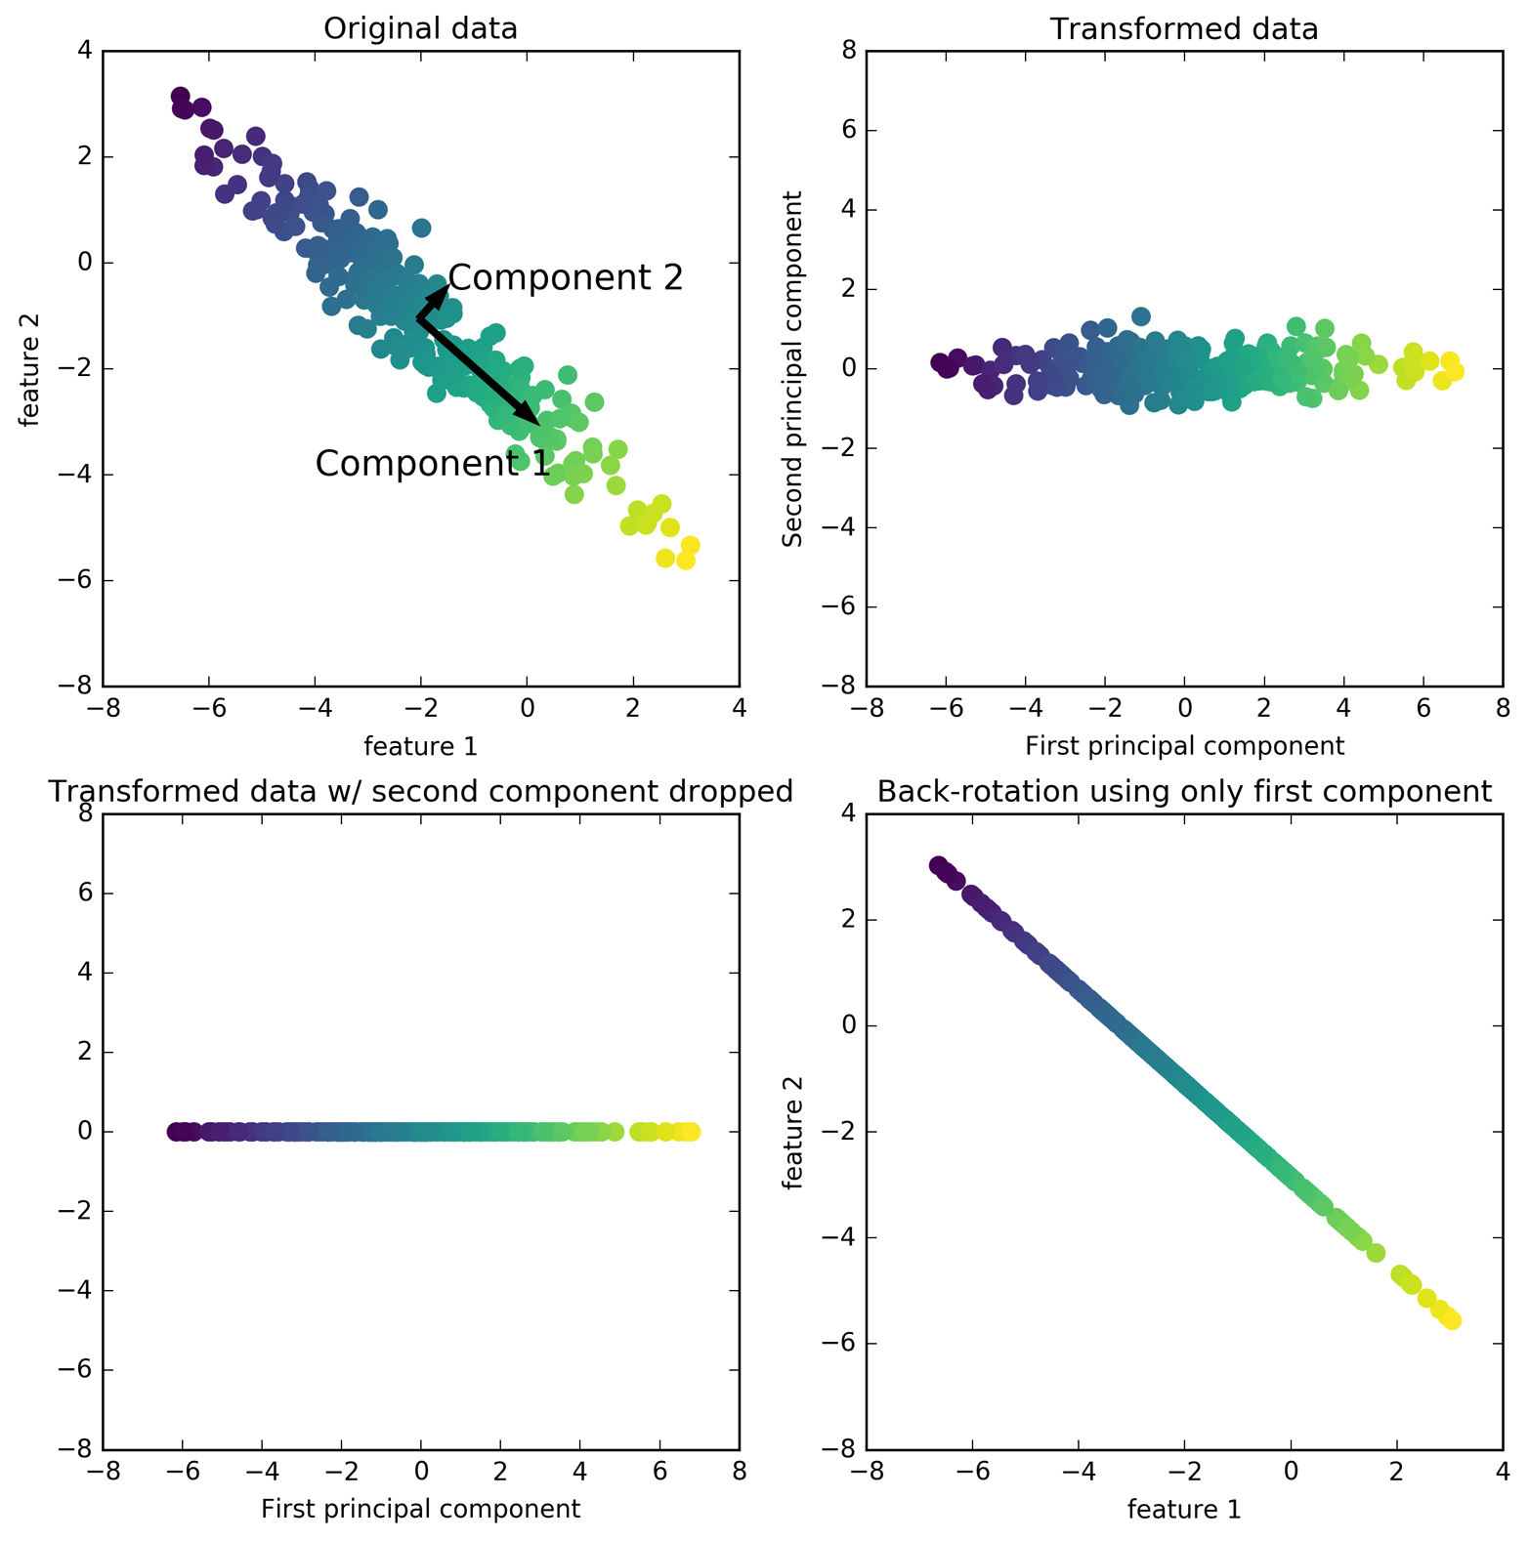

Slide 4
PCA Objective(s)
Restricted rank reconstruction

Slide 5
PCA Objective(s)
Find directions of maximum variance:
Find projection (onto one vector) that maximizes the variance observed in the data.
Subtract projection onto u1, iterate to find more components.
Only well-defined up to sign / direction of arrow!

Slide 6
PCA Computation
Center X (subtract mean)
In practice: Also scale to unit variance.
Compute singular value decomposition:
Diagonal (containing singular values)
n_samples x n_samples orthogonal matrix
(not necessarily computed in practice)
n_features x n_features
orthogonal matrix
Contains component vectors.
Drop rows (of V^T) for dimensionality reduction.

Slide 7
Back to intuition

Slide 8
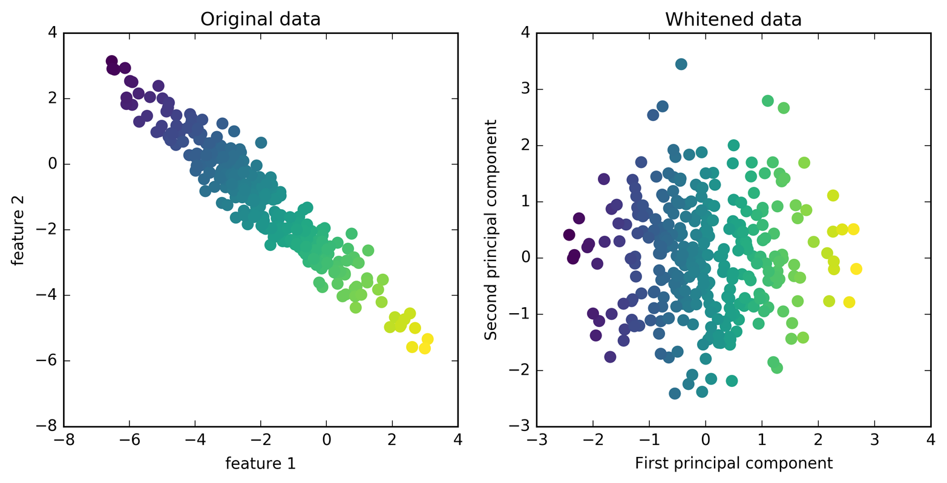
Whitening
Same as using PCA without whitening, then doing StandardScaler

Slide 9
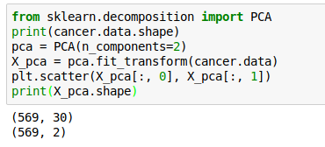
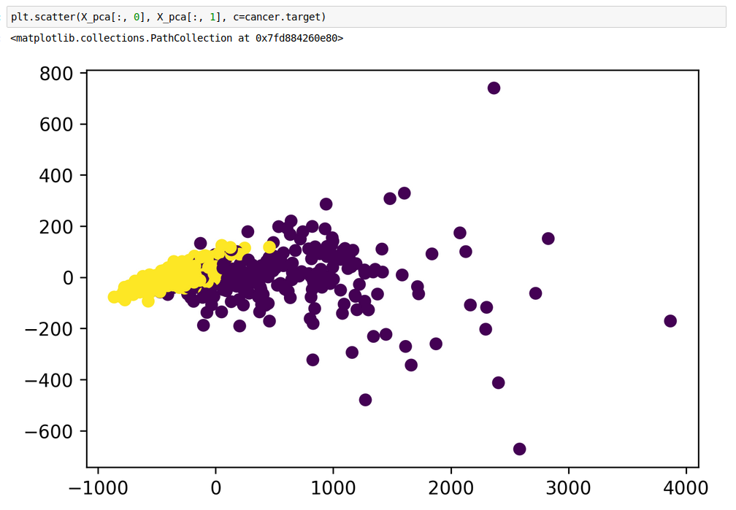
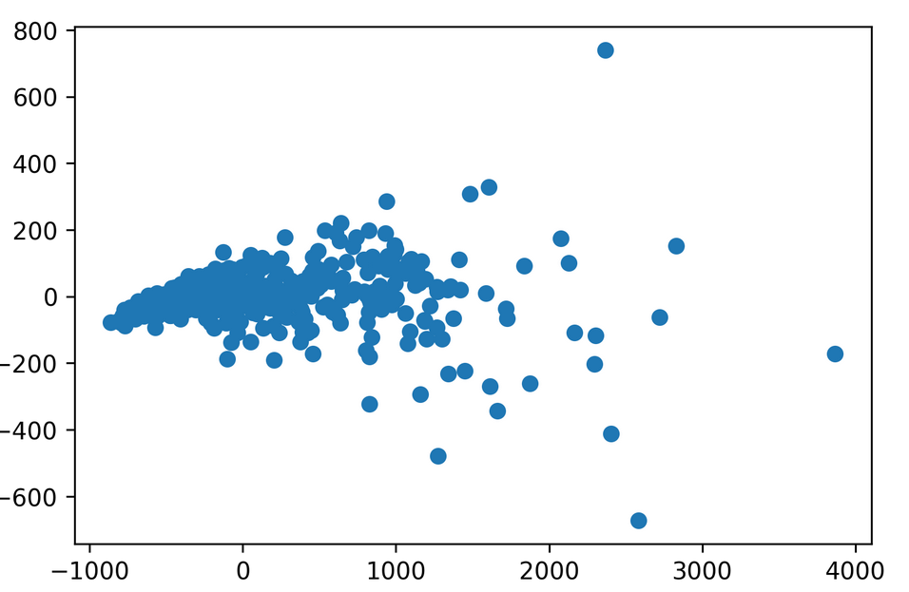
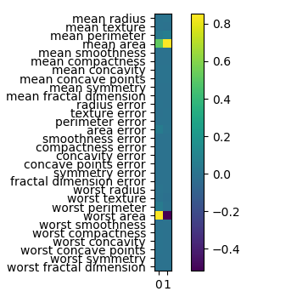
PCA for visualization

Slide 10
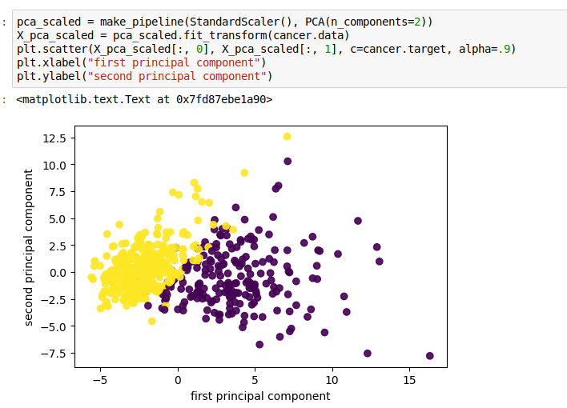
Scaling!
Imagine one feature with very large scale. Without scaling, it’s guaranteed to be the first principal component!

Slide 11
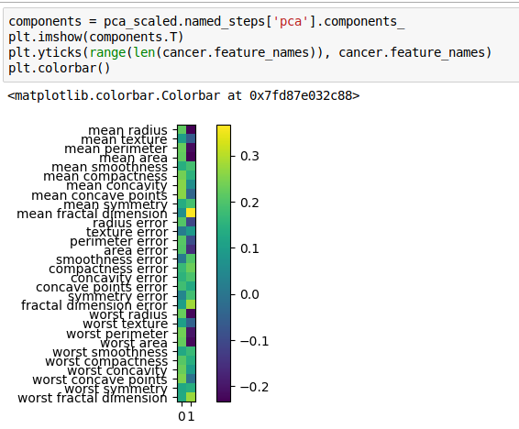
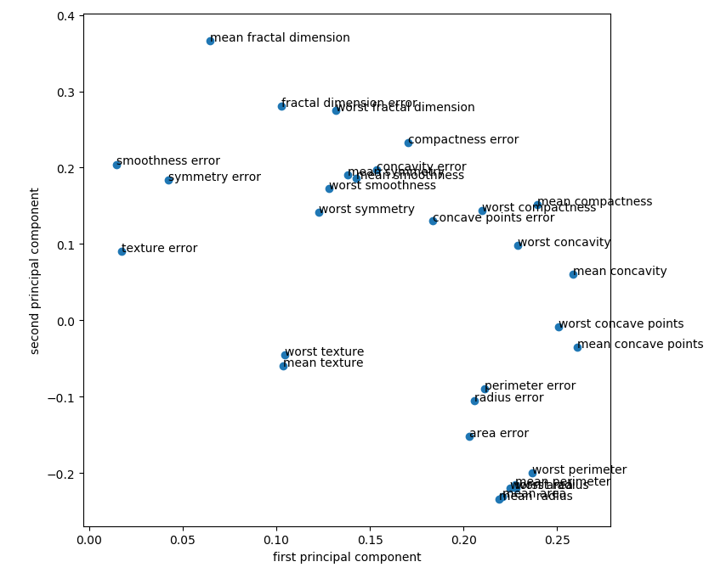
Inspecting Components
Direction (sign) of component is meaningless!

Slide 12
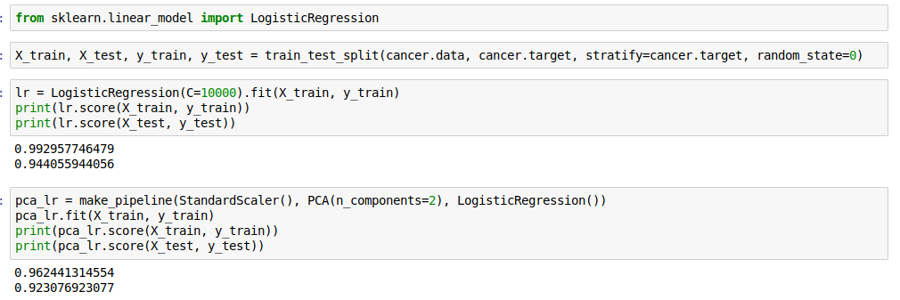
PCA for regularization

Slide 13
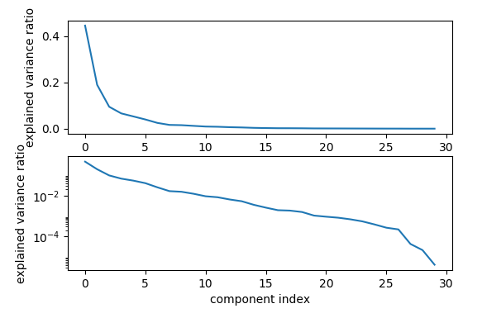
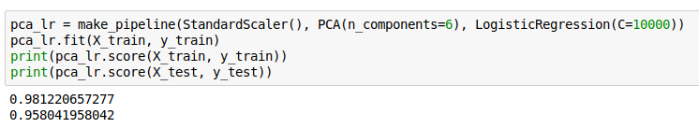
Variance covered

Slide 14
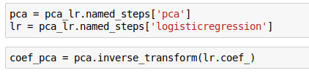
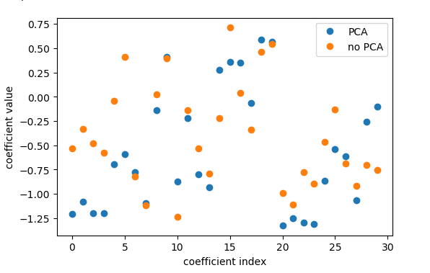
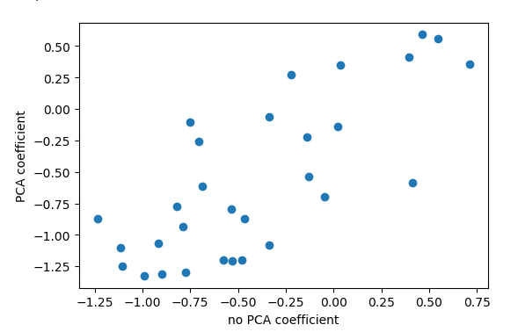
Interpreting coefficients
Rotating coefficients back into input space.
Makes sense because model is linear!
Otherwise more tricky.
Comparing PCA + Logreg vs plain Logreg:

Slide 15
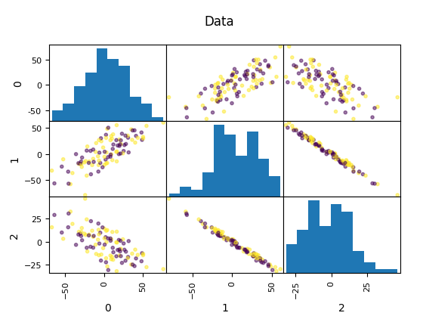
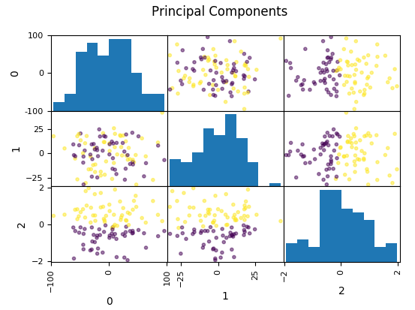
PCA is Unsupervised!
Dropping the first two principal components will result in random model!
All information is in the smallest principal component!

Slide 16
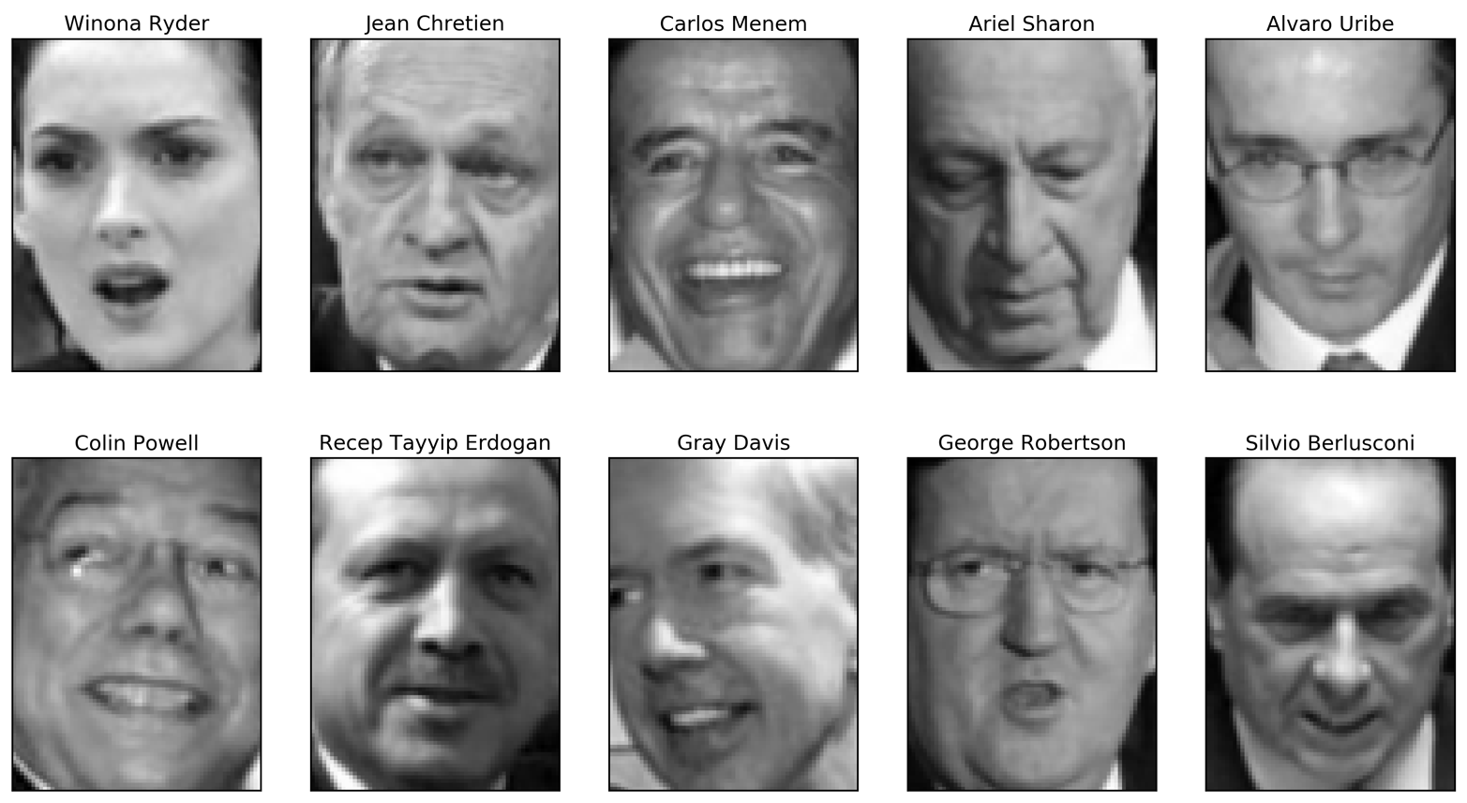
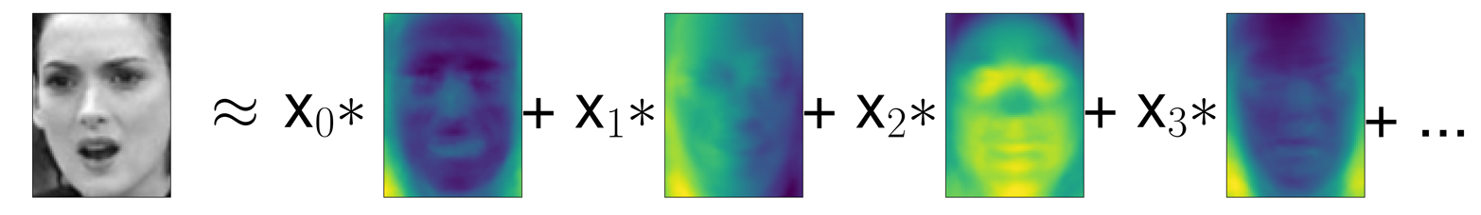
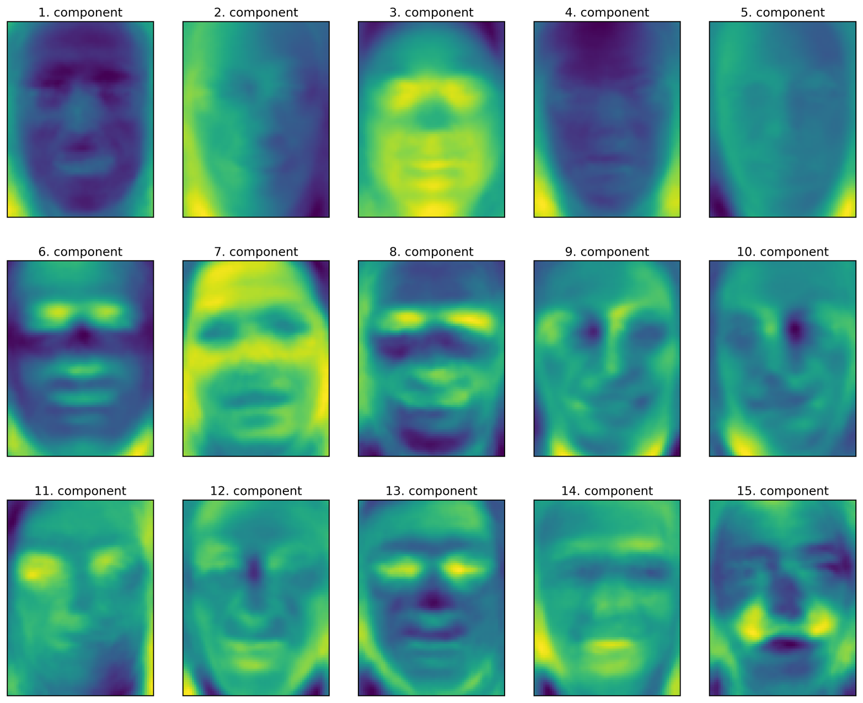
PCA for feature extraction
Remember:
Signs don’t mean anything!

Slide 17
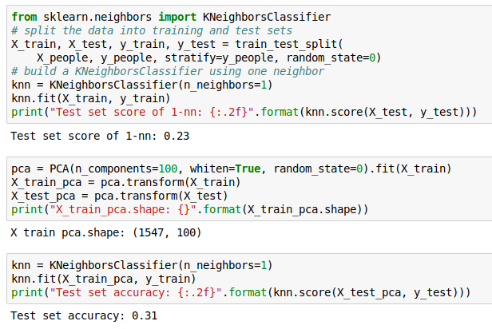
1-NN and Eigenfaces

Slide 18
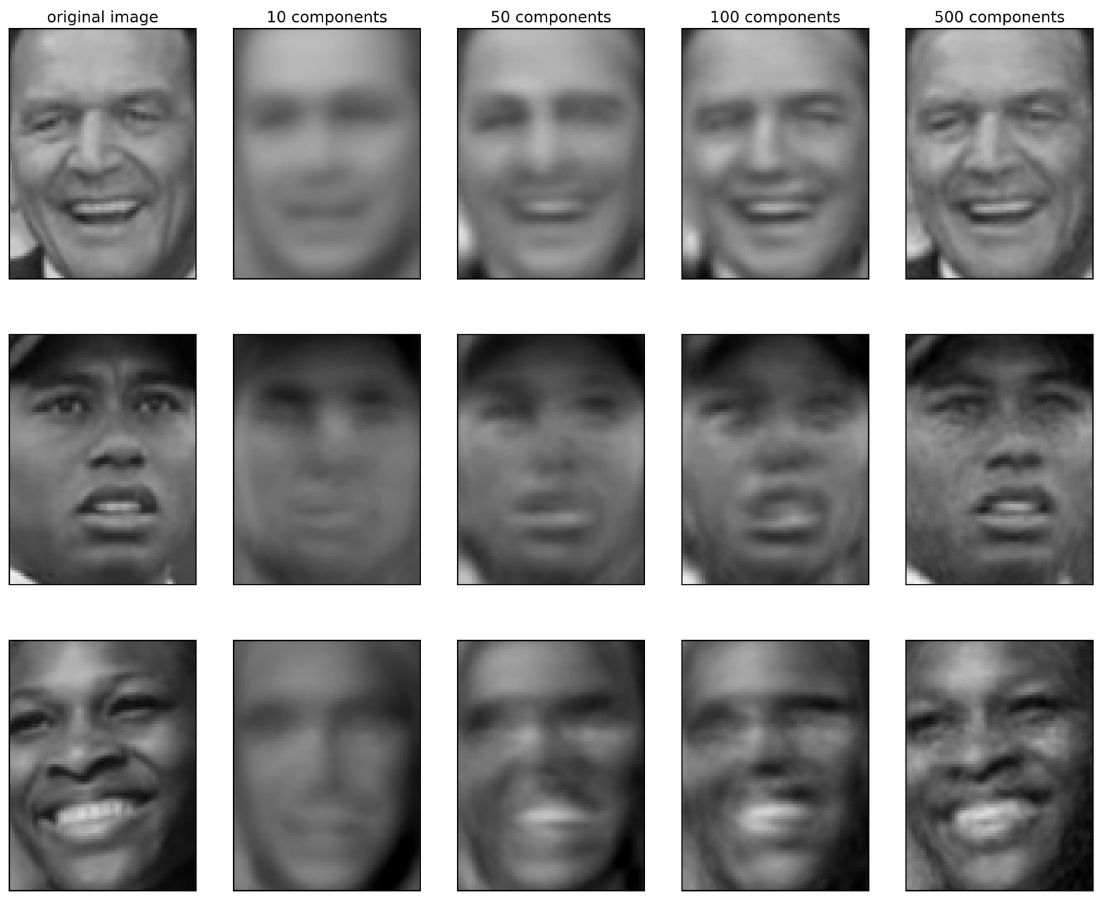
Reconstruction

Slide 19
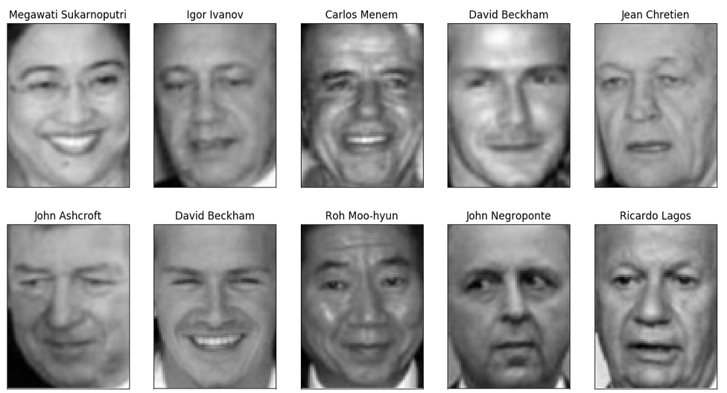
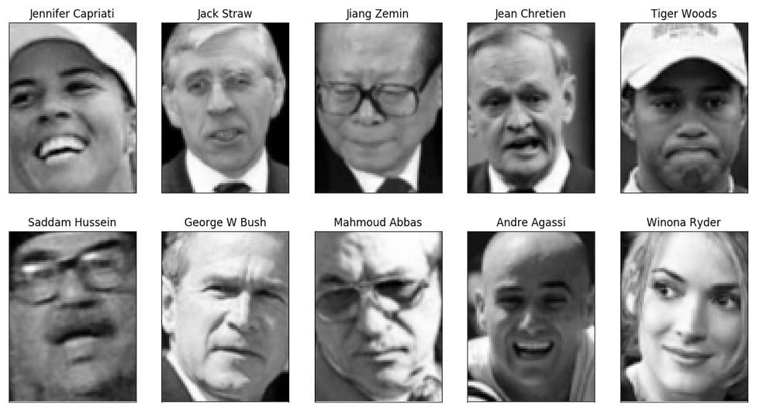
PCA for outlier detection
Best reconstructions
Worst reconstructions

Slide 20
Manifold Learning

Slide 21
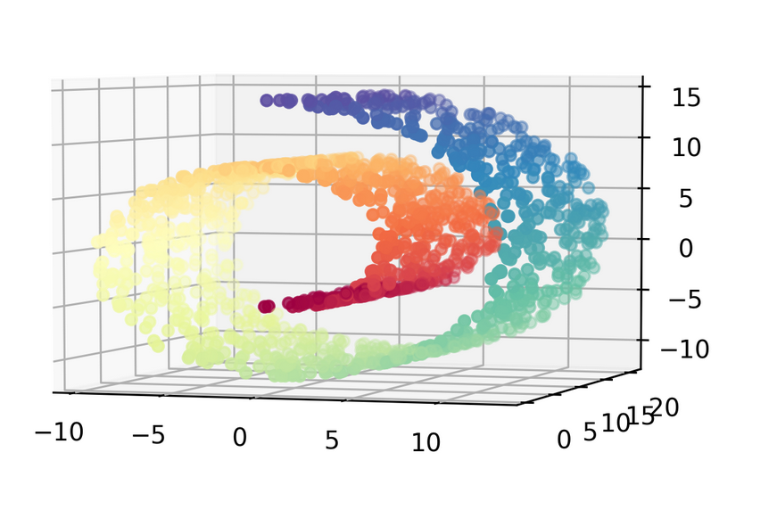
Learn underlying “manifold” structure, use for dimensionality reduction

Slide 22
Pros and Cons
For visualization only
Axes don’t correspond to anything in the input space.
Often can’t transform new data.
Pretty pictures!

Slide 23
Algorithms in sklearn
KernelPCA – does PCA, but with kernels!
Eigenvalues of kernel-matrix
Spectral embedding (Laplacian Eigenmaps)
Uses eigenvalues of graph laplacian
Locally Linear Embedding
Isomap “kernel PCA on manifold”
t-SNE (t-distributed stochastic neighbor embedding)

Slide 24
t-SNE
Starts with a random embedding
Iteratively updates points to make “close” points close.
Global distances are less important, neighborhood counts.
Good for getting coarse view of topology.
Can be good for finding interesting data points.

Slide 25
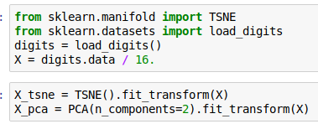
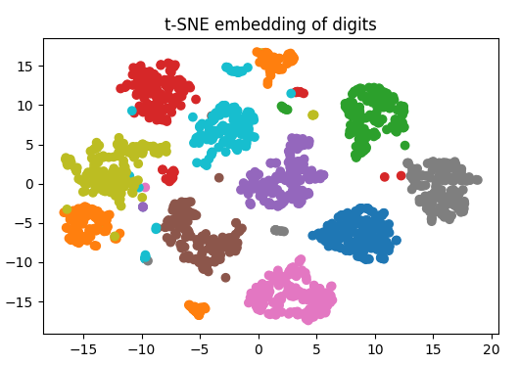
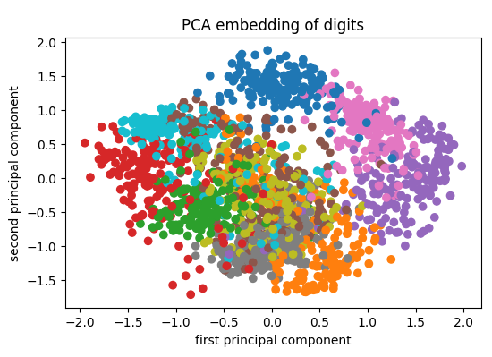

Slide 26
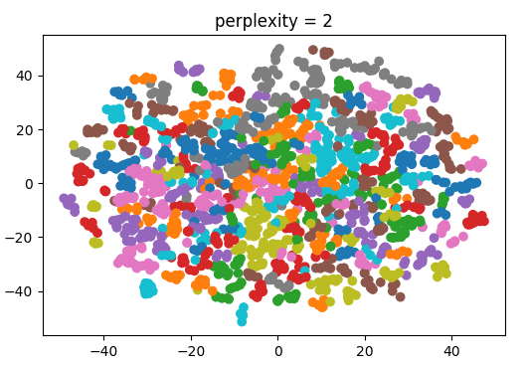
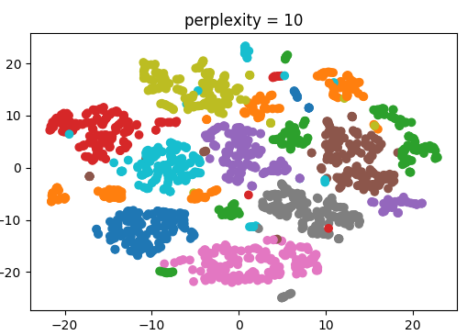
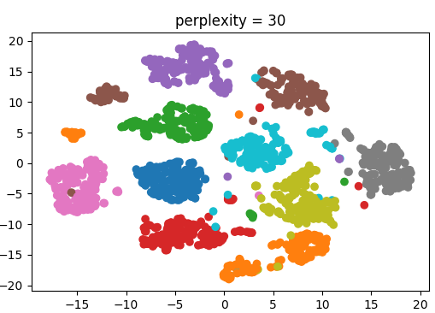
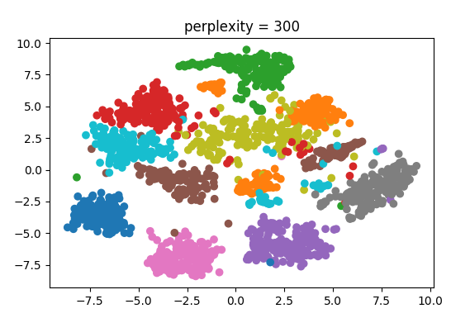
Tuning t-SNE
http://distill.pub/2016/misread-tsne/
Important parameter: perplexity
Intuitively: bandwidth of neighbors to consider
(low perplexity: only close neighbors)

Slide 27
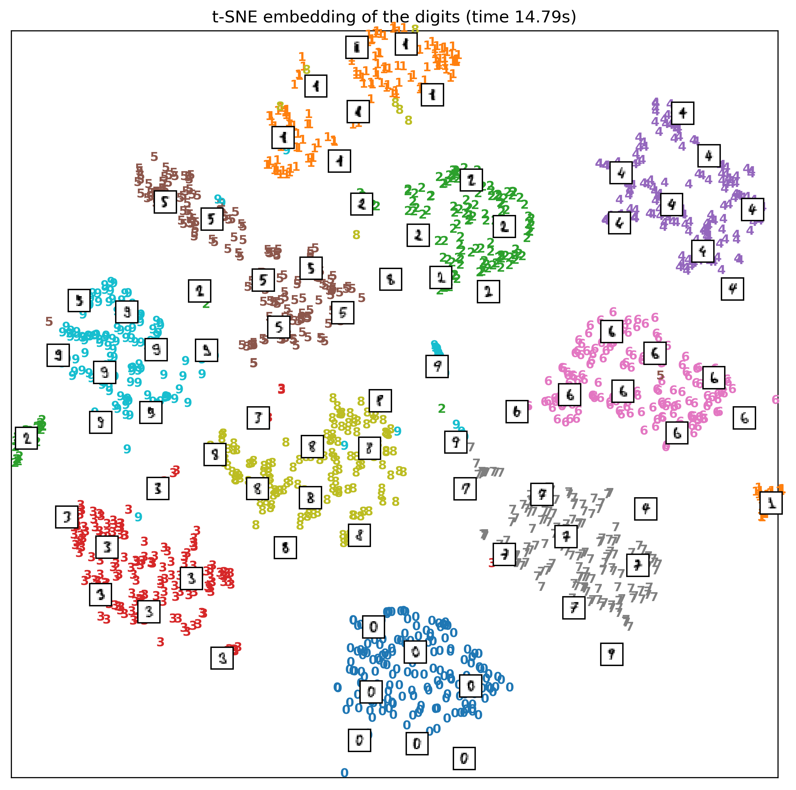

Slide 28
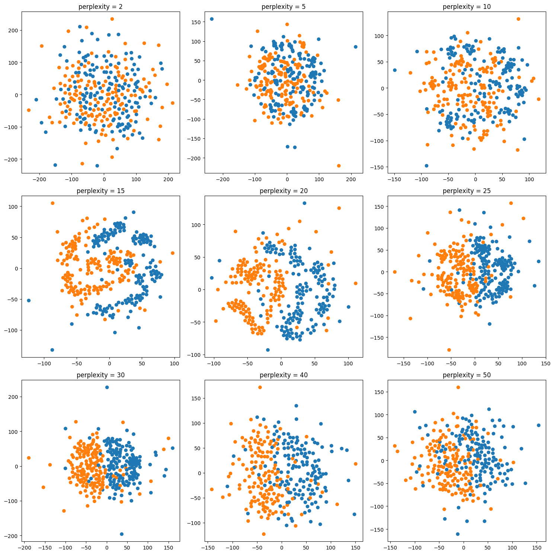
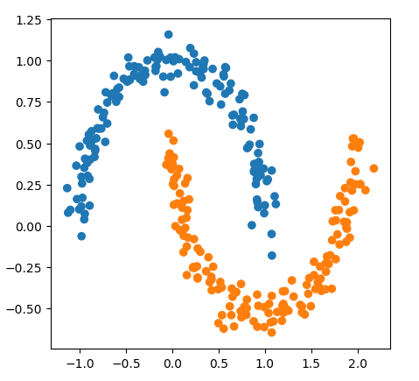

Slide 29
Discriminant Analysis

Slide 30
Linear Discriminant Analysis aka Fisher Discriminant
Generative model: assumes each class has Gaussian distribution
Covariances are the same for all classes.
Very fast: only compute means and invert covariance matrix (works well if n_features << n_samples)
Leads to linear decision boundary.
Imagine: transform space by covariance matrix, then nearest centroid.
No parameters to tune!
Don’t confuse with Latent Dirichlet Allocation (LDA)

Slide 31
Quadratic Discriminant Analysis
Each class is Gaussian, but separate covariance matrices!
More flexible (quadratic decision boundary), but less robust: have less points per covariance matrix.
Can’t think of it as transformation of the space.

Slide 32
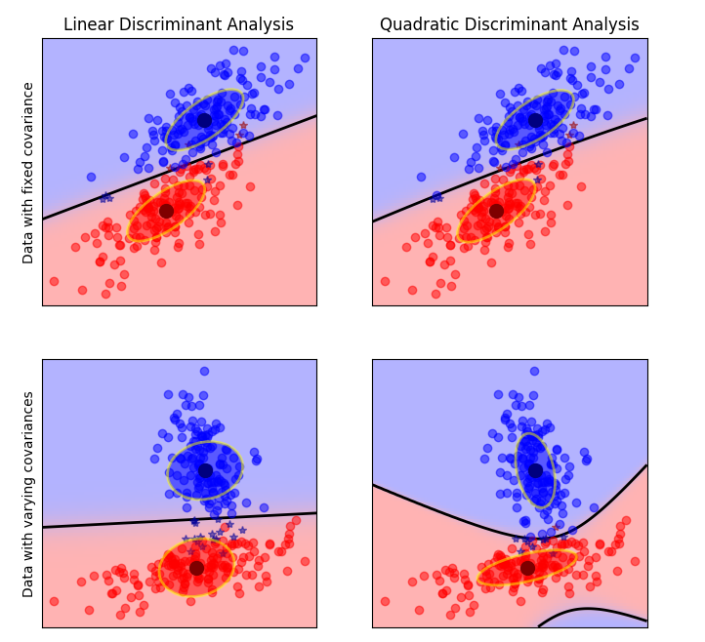

Slide 33
Discriminants and PCA
Both fit Gaussian model
PCA for the whole data
LDA multiple Gaussians with shared covariance
Can use LDA to transform space!
At most as many components as there are classes (needs between class variance)

Slide 34
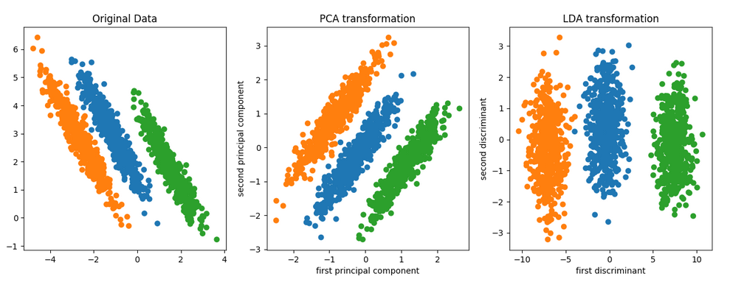

Slide 35
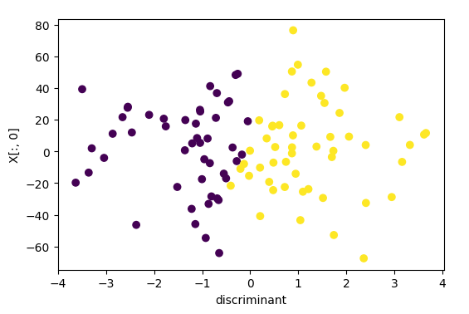
Data where PCA failed

Slide 36
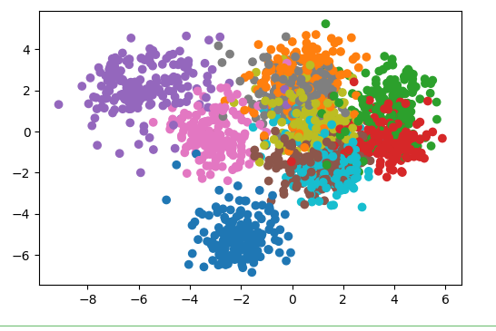

Slide 37
Summary
PCA good for visualization, exploring correlations
PCA can sometimes help with classification as regularization or for feature extraction.
Manifold learning makes nice pictures.
LDA is a handy supervised alternative to PCA that also yields a rotation of the input space.

