Slide 1
W4995 Applied Machine Learning
Evaluating Clustering
03/27/17
Andreas Müller

Slide 2
Evaluation Measures

Slide 3
Supervised evaluation
Compare clustering against “ground truth”.
Usually classification datasets.
Often used for papers on clustering algorithms.
Unclear what the assumptions are.
Impossible to do in practice.
Compare partitions, not labels!

Slide 4
Thinking in Partitions
Partition: set expressed as union of disjoint sets.
Y=[0, 0, 0, 1, 1, 1] → C={{0, 1, 2}, {3, 4, 5}}
Y=[0, 1, 0, 1, 2, 2] → C={{0, 2}, {1, 3}, {4, 5}}
Partition given by [1, 0, 1, 0] and [0, 1, 0, 1] are the same!

Slide 5
Contingency matrix
Same as confusion matrix – but different!
Rows correspond to one partition, columns the other.
Doesn’t need to be square.
Both of these mean identical partitions:
10 | 0
0 | 10
0 | 10
10 | 0

Slide 6
Rand Index
Computed of partitions C1, C2 over the same elements (say {0, …, n-1})
Number of pairs of points in the same set in C1 and in C2
Number of pairs of points in different sets in C1 and in C2
Number of possible pairs
Between 0 and 1

Slide 7
Rand Index Example

Slide 8
Adjusted Rand Index (ARI)
Maximum of 1, 0 on expectation (can become negative!)
[Don’t learn the formula]

Slide 9
Mutual Information
Between 0 and 1 but not normalized or adjusted.
If V is subpartition of U still = 1

Slide 10
NMI and AMI
Penalizes overpartitioning (via entropy)
Adjusts for chance – any two random partitions have expected AMI of 0

Slide 11
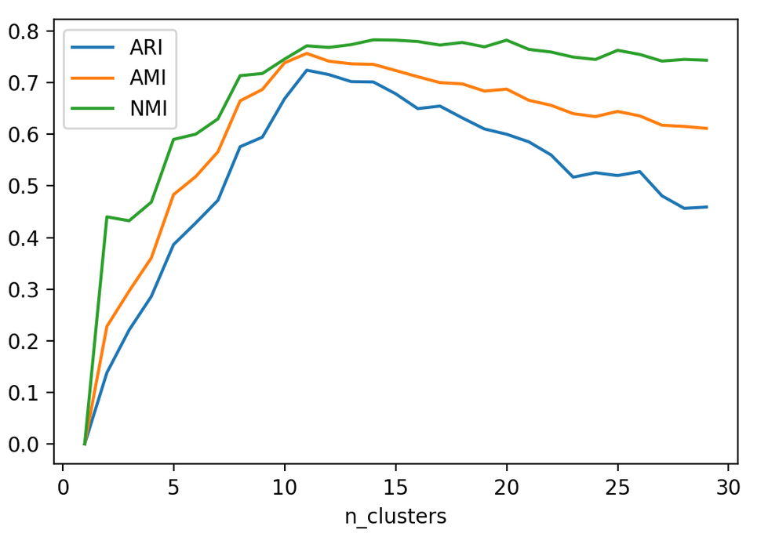
ARI, AMI and NMI for k-Means on “digits” dataset. ARI and AMI penalize too many clusters.

Slide 12
Unsupervised Evaluation

Slide 13
Silhouette Score
For each sample:
a is mean distance to samples in same cluster
b is mean distance to samples in nearest cluster
For whole clustering: average over all samples
Prefers compact clusters (like k-means)

Slide 14
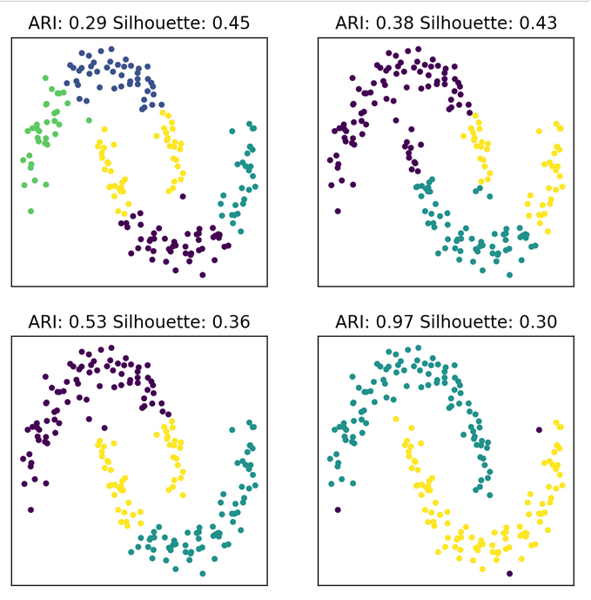

Slide 15
Picking the number of clusters

Slide 16
With metrics
Either cross-validation or evaluated on whole dataset.
If you have the label, why are your doing clustering?

Slide 17
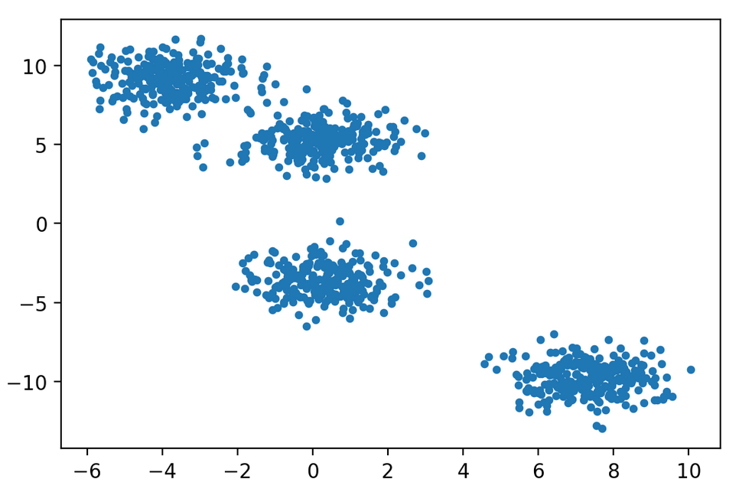
What’s the right number of clusters?

Slide 18
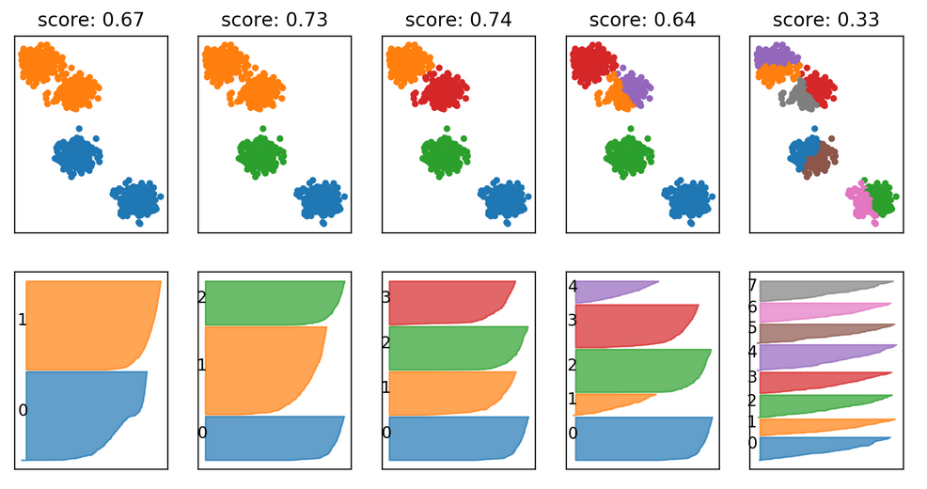
Silhouette Plots
Plot sorted silhouette score for each sample in each cluster
http://scikit-learn.org/stable/auto_examples/cluster/plot_kmeans_silhouette_analysis.html

Slide 19
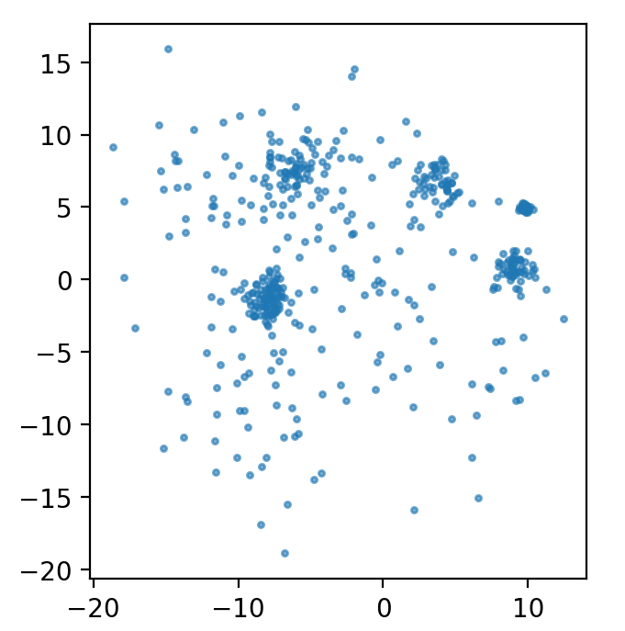
What’s the right number of clusters?
Generated as mixture of 10 Gaussians.
So what?

Slide 20
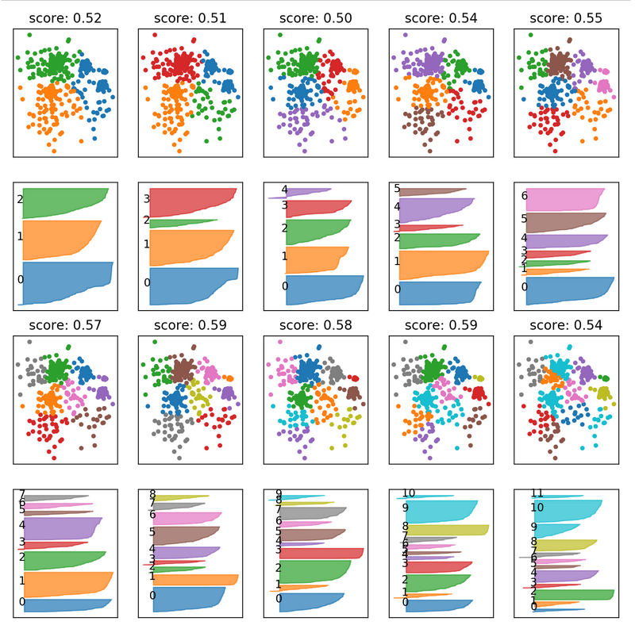

Slide 21
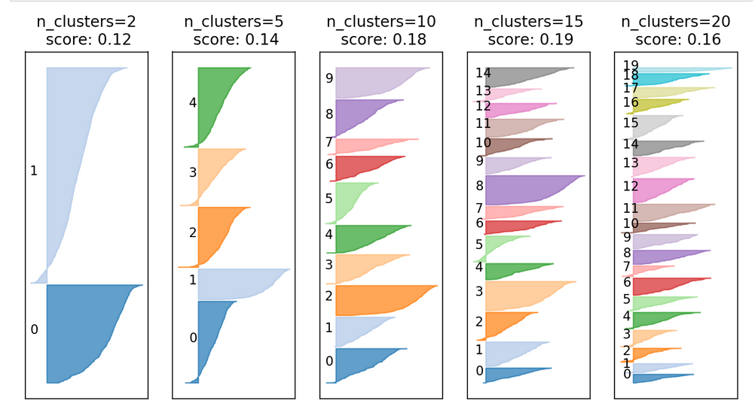
Digits dataset

Slide 22
Custer Stability
For comparing clustering algorithms / parameters (with different number of clusters for example)
Clustering stability: an overview (U. v. Luxburg)
https://arxiv.org/abs/1007.1075
Try multiple random samplings / perturbations
The configuration that yields the most consistent result among perturbations is best.

Slide 23
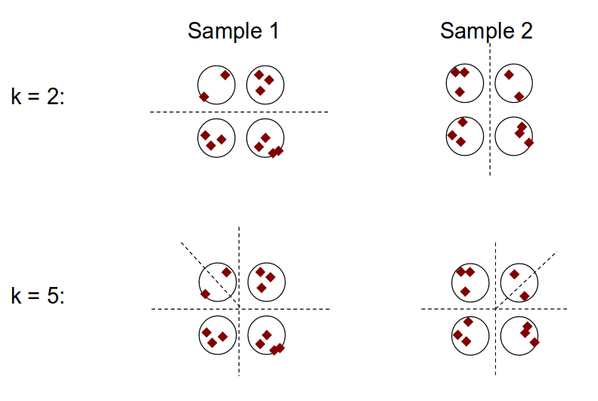
Stability Intuition

Slide 24
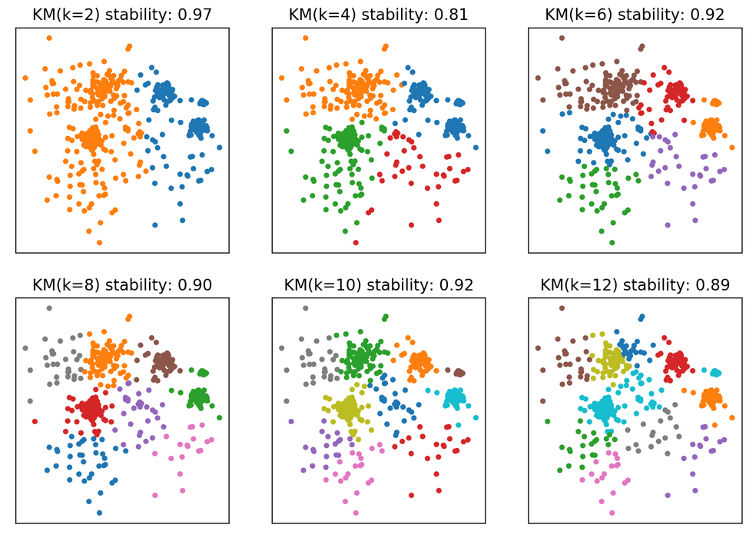

Slide 25
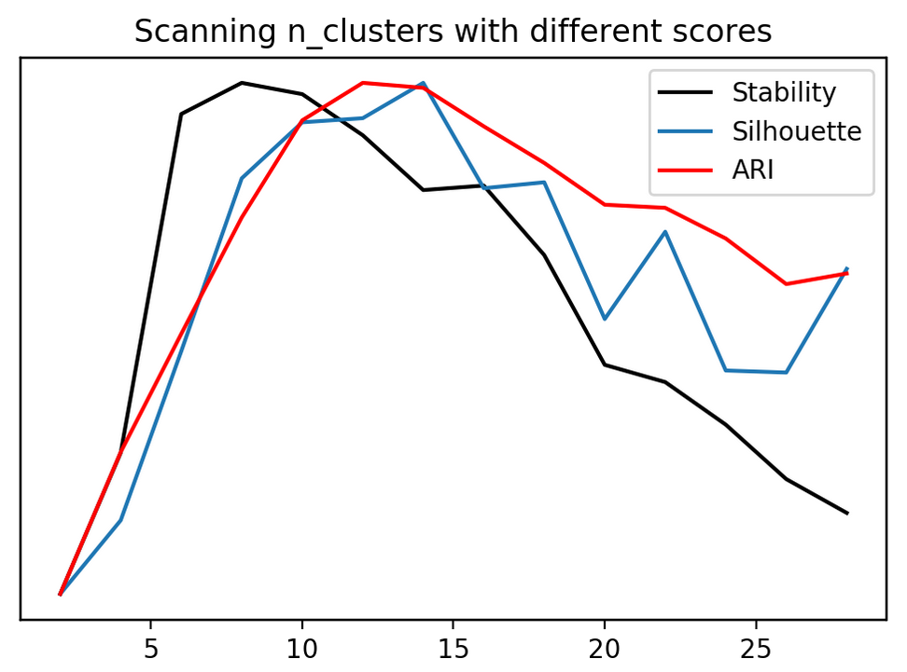
digits dataset

Slide 26
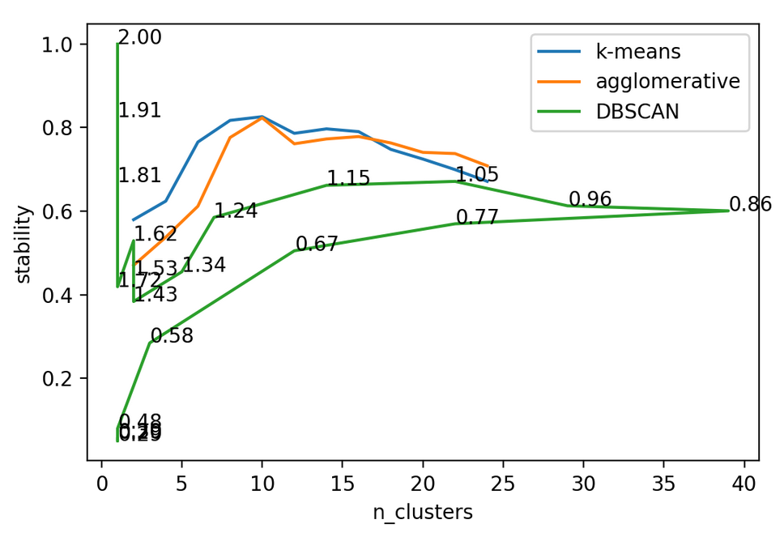
Stability of different algorithms
Digits dataset

Slide 27
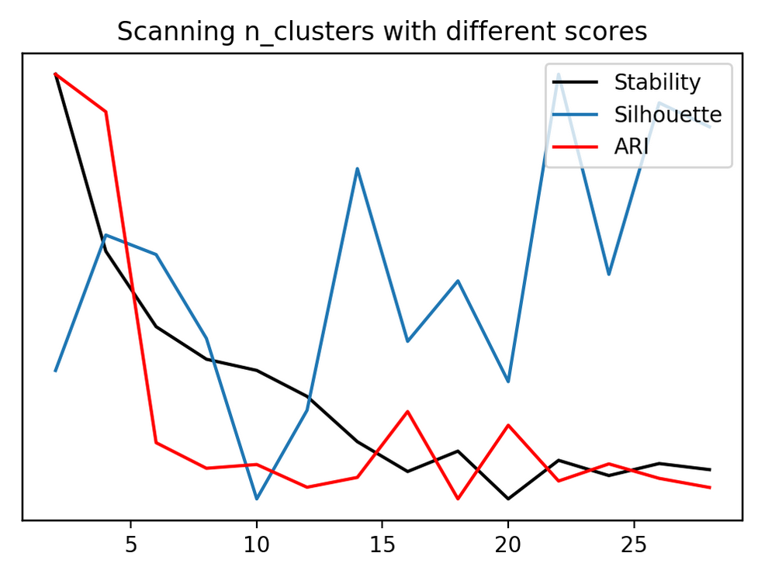
Adult Dataset

Slide 28
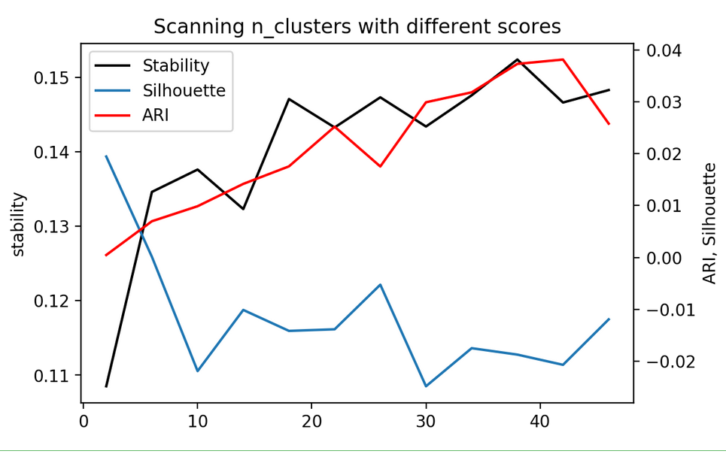
Labeled Faces in the Wild
With PCA, 100 components. Without whitening: no stable clusters!

Slide 29
Qualitative Evaluation
(aka eyeballing)
Look at low-dim visualization
Look at individual points
Look at cluster centers (if available)

Slide 30
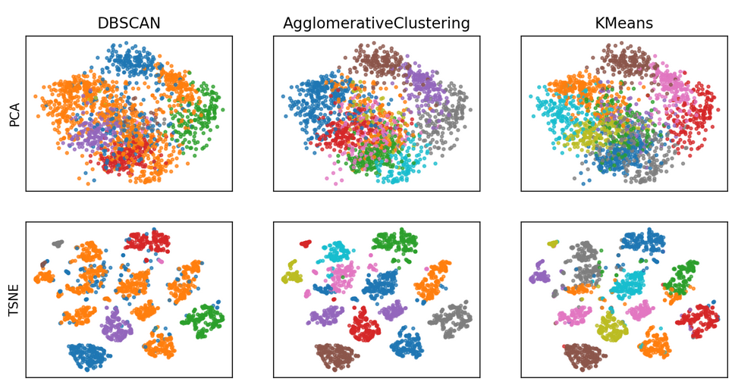
Digits

Slide 31
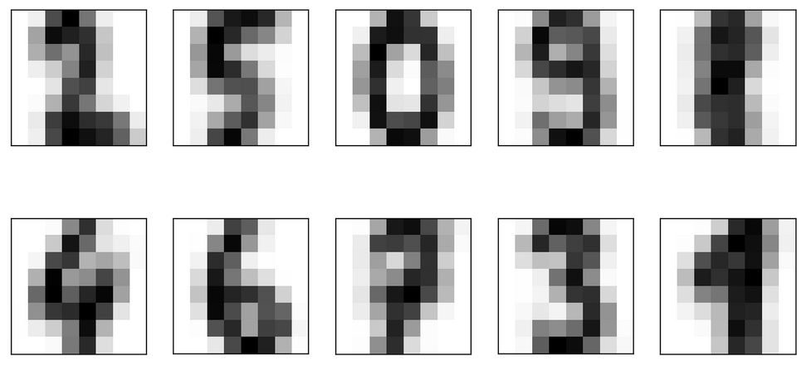
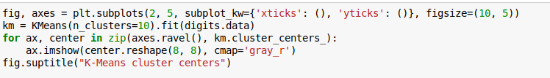
K-Means cluster centers

Slide 32
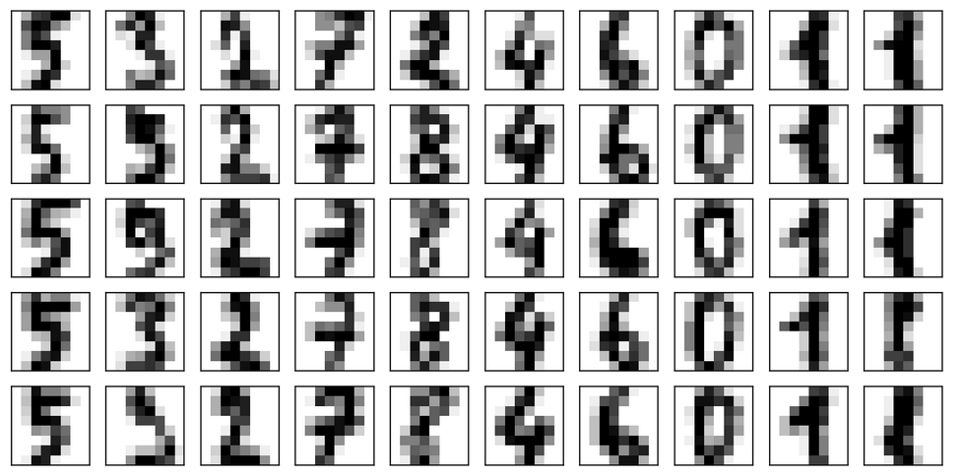
Agglomerative Clusters
Each column corresponds to one of 10 clusters, “first” 5 samples are shown.

Slide 33
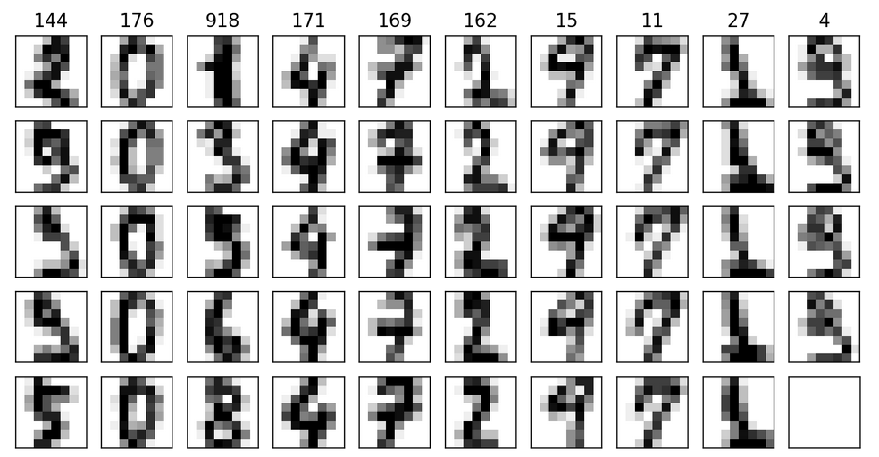
DBSCAN Clusters
Outliers!
Each column corresponds to one of 10 clusters, “first” 5 samples are shown.
Number on top gives clusters size

Slide 34
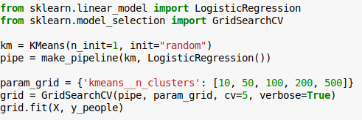
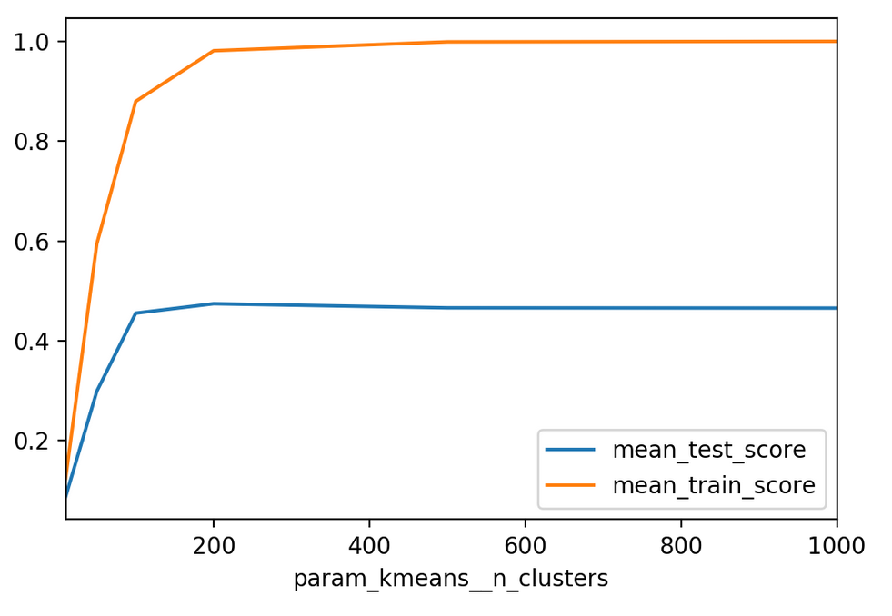
For feature extraction

Slide 35
So what is n_clusters?
As preprocessing
  The one that makes the whole pipeline work best.
  Larger is often better.
For exploratory analysis:
  The one that tells you the most about the data.
For most datasets, there is no “correct” number of clusters.

Slide 36
If you want semantics from clustering,
you need manual confirmation.
Clustering might not pick up
on what you thought it would.

