Slide 1
W4995 Applied Machine Learning
Word Embeddings
04/10/17
Andreas Müller

Slide 2
Beyond Bags of Words
Limitations of bag of words:
Semantics of words not captured
Synonymous words not represented
Very distributed representation of documents

Slide 3
Last Time
Latent Semantic Analysis
Non-negative Matrix Factorization
Latent Dirichlet Allocation
All embed documents into a continuous, corpus-specific space.
Today: Embed words in a “general” space.

Slide 4
Idea
Unsupervised extraction of semantics using large corpus (wikipedia etc)
Input: one-hot representation of word (as in BoW).
Use auxiliary task to learn continuous representation.

Slide 5
Skip-Gram models
Given a word, predict surrounding word
Supervised task, each document yields many examples
Not interested in performance for this task, just want to learn representations.

Slide 6
[“What is my purpose?”
“You pass the butter.”]
Using context windows of size 1 (in practice 5 or 10):
word | context
“is” | [“what”, “my”]
“my” | [“is”, “purpose”]
“pass” | [“you”, “the”]
“the” | [“pass”, “butter”]

Slide 7
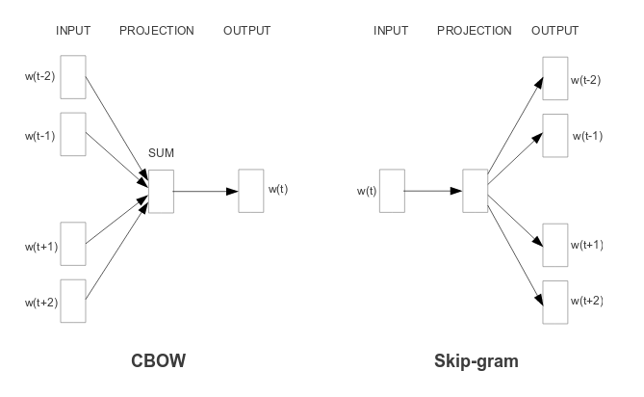
CBOW vs Skip-gram
Word embedding
Softmax weights
Efficient Estimation of Word Representations in Vector Space https://arxiv.org/pdf/1301.3781.pdf

Slide 8
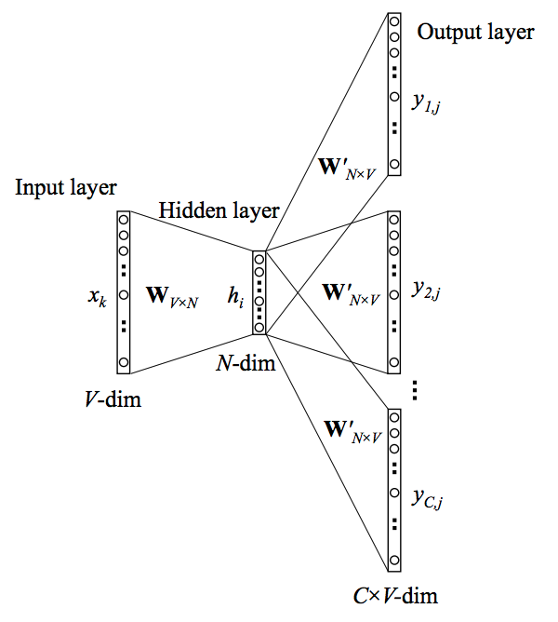

Slide 9
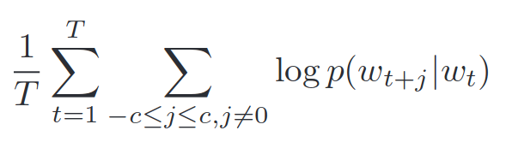
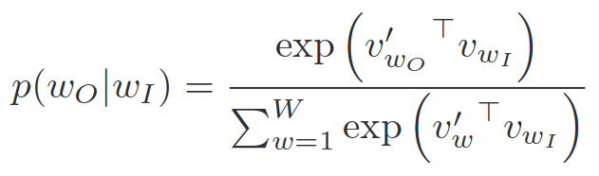
Softmax Training
Output weights
Word embedding
Normalize over whole vocabulary!
[We want to do stochastic gradient descent / minibatch learning]
Monte-Carlo estimate: use some “noise words”
http://papers.nips.cc/paper/5021-distributed-representations-of-words-and-phrases-and-their-compositionality.pdf

Slide 10
Implementations
Gensim
Word2vec
Tensorflow
For small applications don’t train yourself

Slide 11
Gensim – topic models for humans
Multiple LDA implementations
Wrappers for Mallet and vopal wabbit
Tools for analyzing topic models
No supervised learning
Uses list-of-tuples instead of sparse matrices to store documents.

Slide 12
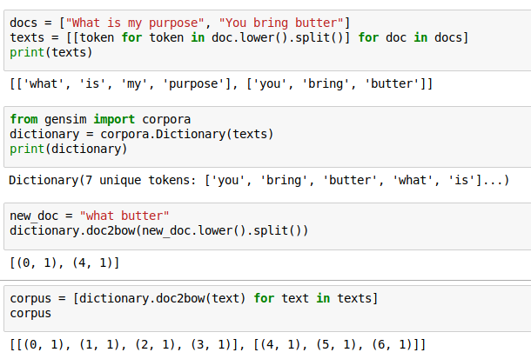
Introduction to gensim
Notes:
Use NLTK or spacy or a regexp for tokenization in real applications. This method here doesn’t even handle punctuation.
In gensim, a document is represented as list of tuples (index, frequency), corpus is a list of these.

Slide 13
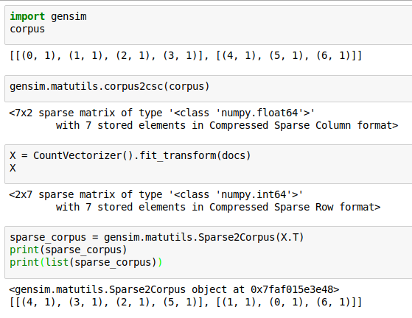
Converting to/from sparse matrix
Transposed!
Notes:
most transformations is gensim are lazy:
They yield a generator (like Sparse2Corpus) which can be converted to a list.

Slide 14
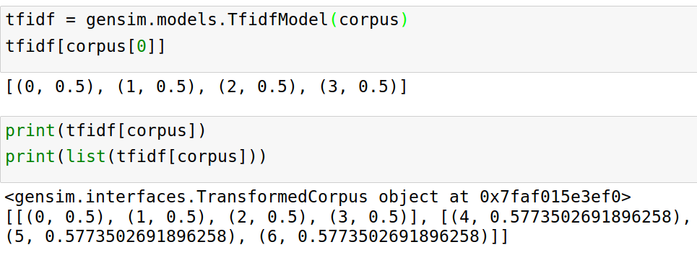
Corpus Transformations

Slide 15
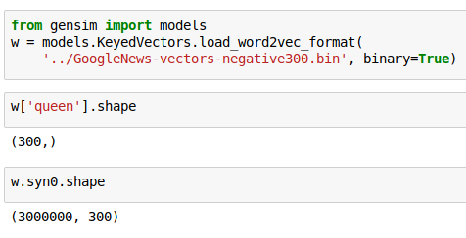
Word2Vec in Gensim

Slide 16
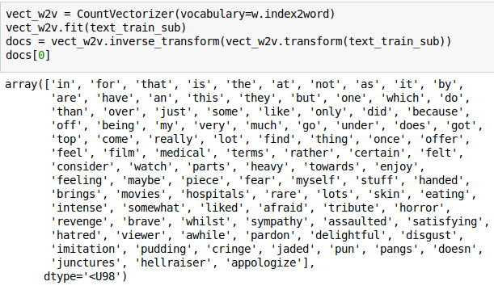
Prepare document
Notes:
This is a silly way to tokenize the input and using only words that appear in the vocabulary used in the pre-trained model.

Slide 17
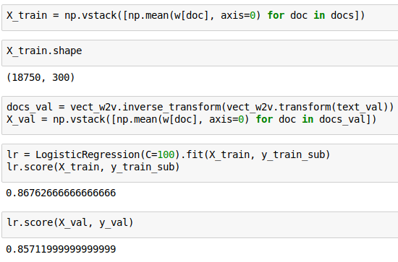
Represent doc by average

Slide 18
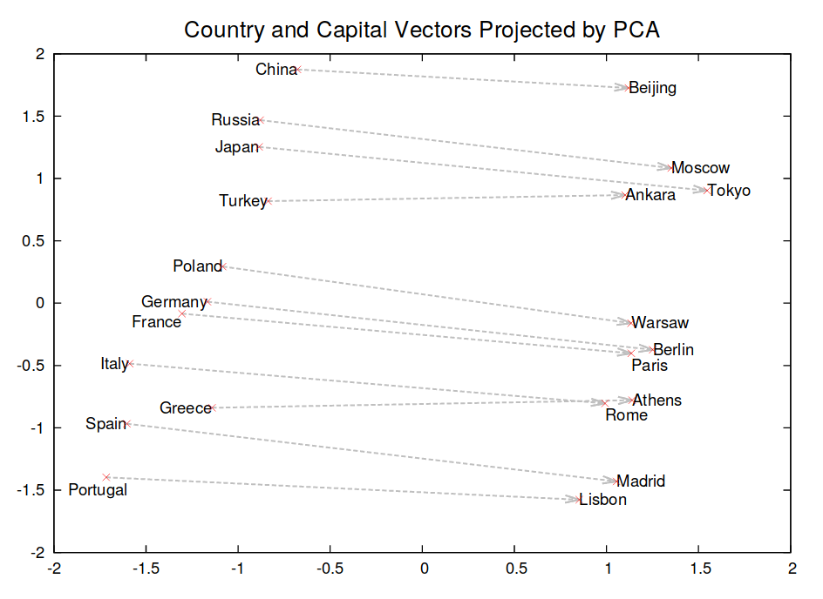
Analogues and Relationships
http://papers.nips.cc/paper/5021-distributed-representations-of-words-and-phrases-and-their-compositionality.pdf

Slide 19
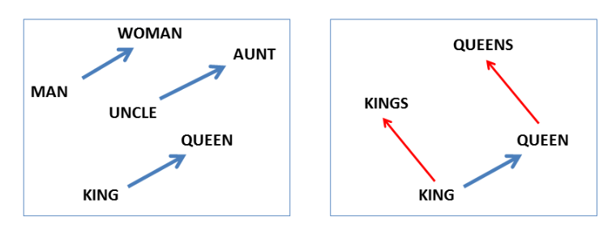
Answer “King is to Kings as Queen is to ?”:
Find closest vector to vec(“Queen”) + (vect(“Kings”) - vec(“King”))
http://www.aclweb.org/anthology/N13-1090

Slide 20
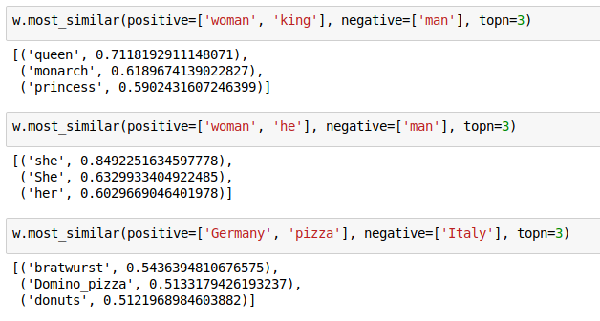
Examples with Gensim

Slide 21
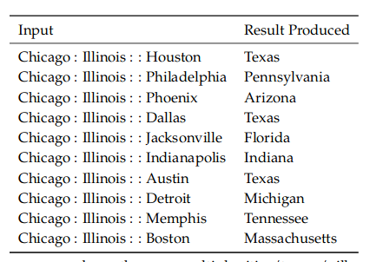

Slide 22
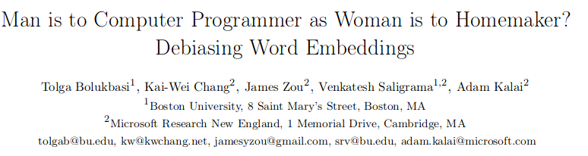


Slide 23
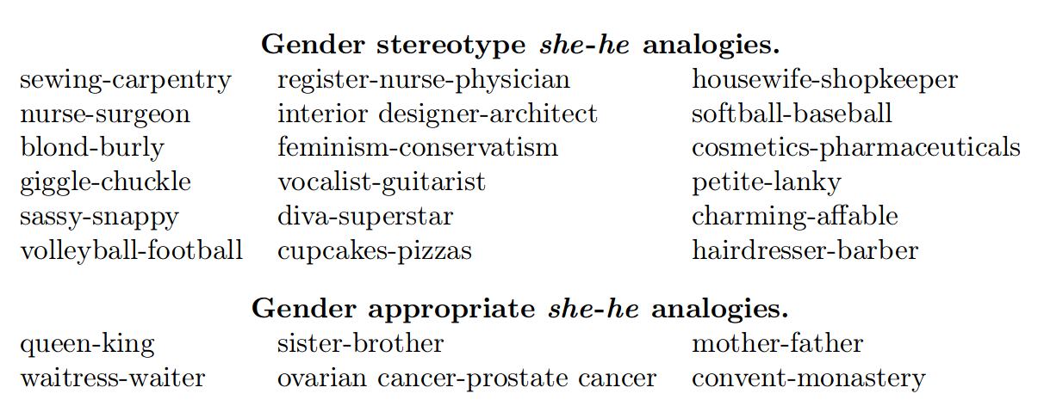
Going along he-she direction:

Slide 24
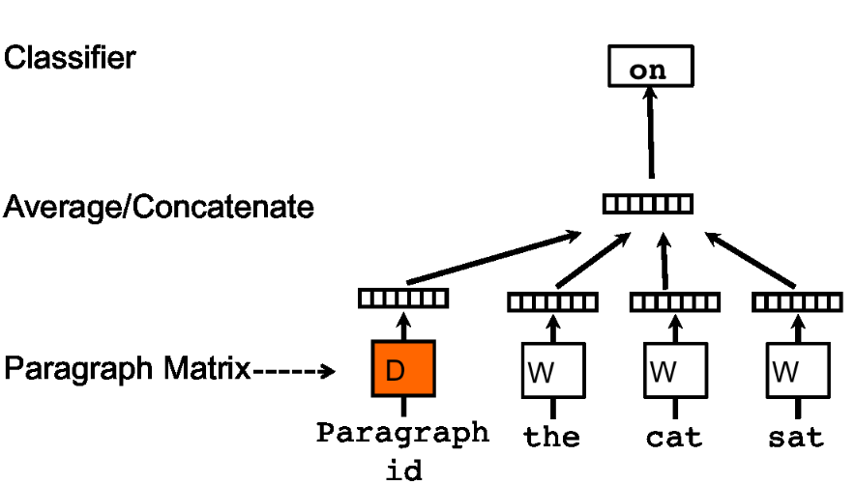
Paragraph Vectors - Doc2Vec
https://arxiv.org/pdf/1405.4053v2.pdf
Notes:
Add a vector for each paragraph / document, also randomly initialized.
To infer for new paragraph: keep weights fixed, do stochastic gradient descent on the representation D, sampling context examples from this paragraph.

Slide 25
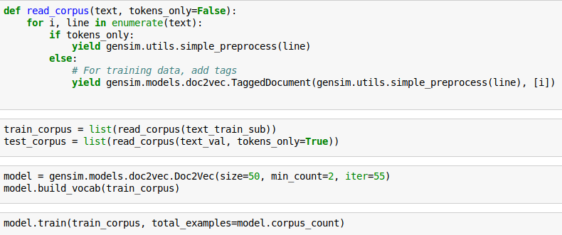
Doc2Vec with gensim
https://github.com/RaRe-Technologies/gensim/blob/develop/docs/notebooks/doc2vec-lee.ipynb

Slide 26
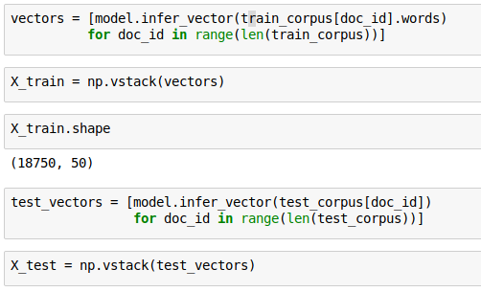
Encoding using doc2vec

Slide 27
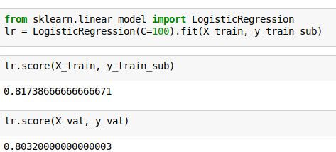
Notes:
Not working well here. Either not enough training data, sgd didn’t converge yet, or too low dimension.

Slide 28


GloVe: Global Vectors for Word Representation
https://nlp.stanford.edu/projects/glove/
Co-occurence not prediction
Notes:
Here X_ij is the coocurrance count matrix, counting how often word I and j appear in the same context – say a 5 word window.
We are learning a factorization of log(X_ij) into w_i and ~w_j, where w_i are the word-vectors we want to extract.
Very infrequent word-pairs are less important to get right, and are down-weighted using f(X_ij).

Slide 29
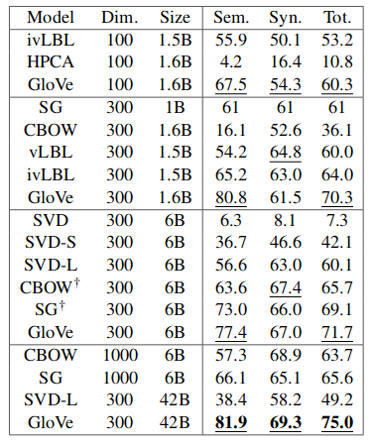
Word analogies
https://nlp.stanford.edu/pubs/glove.pdf
Notes:
Comparison of CBOW, SGD, skip-gram and Glove on the semantic (ie. state→capital) and syntactic (ie singular→ plural) word analogy tasks

