Slide 1
W4995 Applied Machine Learning
Time Series and Forecasting
04/24/17
Andreas Müller

Slide 2
What’s different?
Not iid

Slide 3
Equally spaced & not equally spaced
Equally spaced:
Unevenly spaced:
1 second, 1 day, 1 year
Event time series
(earthquake, trade, ...)

Slide 4
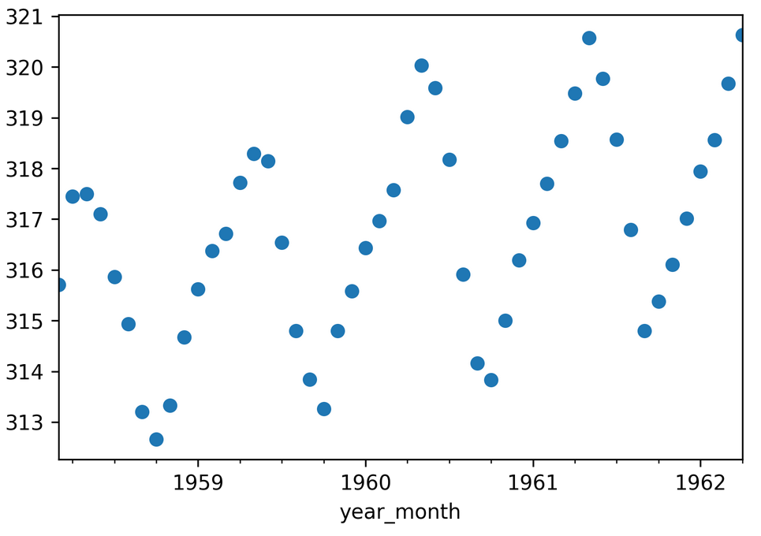
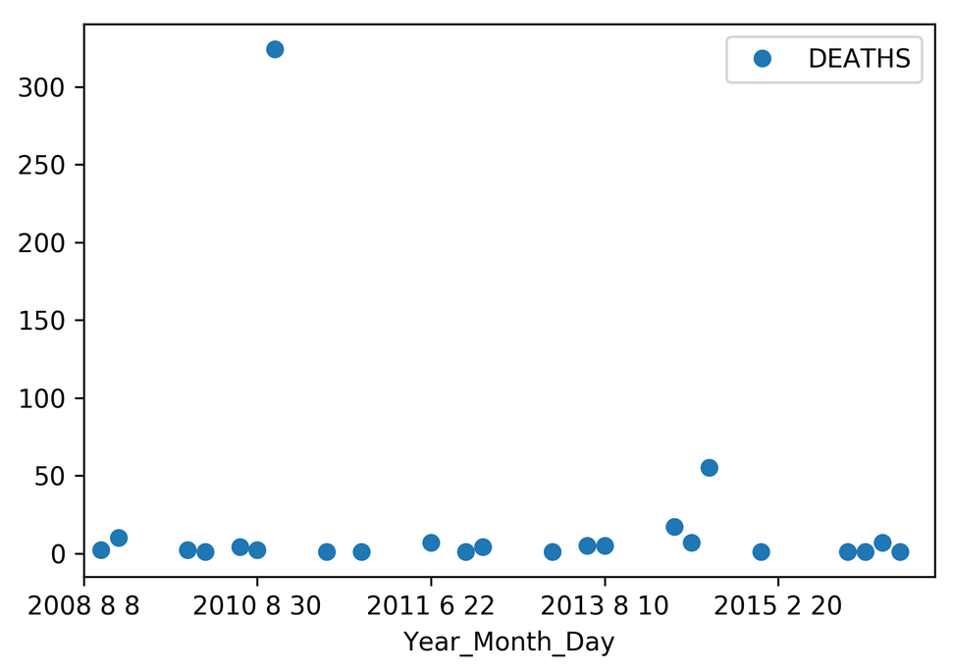
Evenly spaced
Unevenly spaced
CO2 Measurements
Volcanic eruption deaths
Today: Only evenly spaced.
For uneven: sometimes aggregates over fixed periods make sense.

Slide 5
Tasks

Slide 6
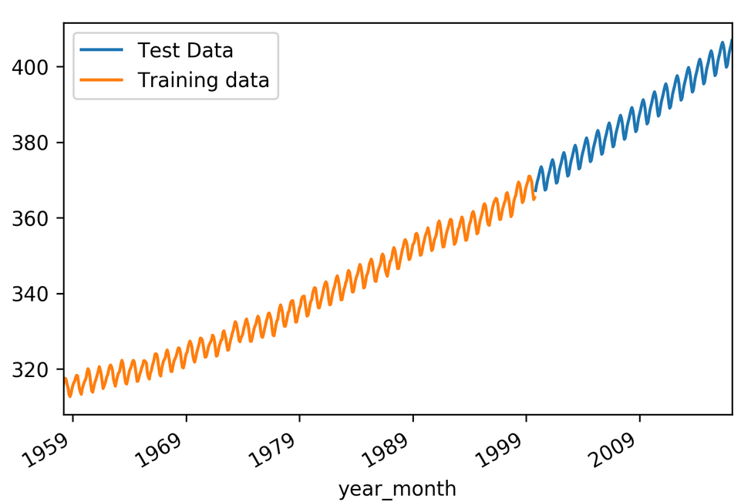
1d Forecasting

Slide 7
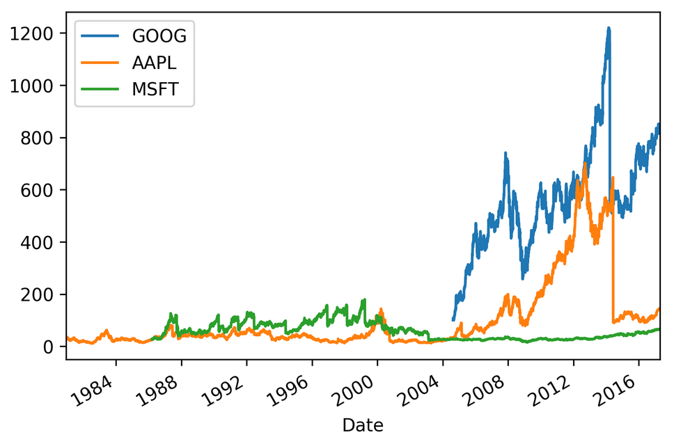
Nd forecasting

Slide 8
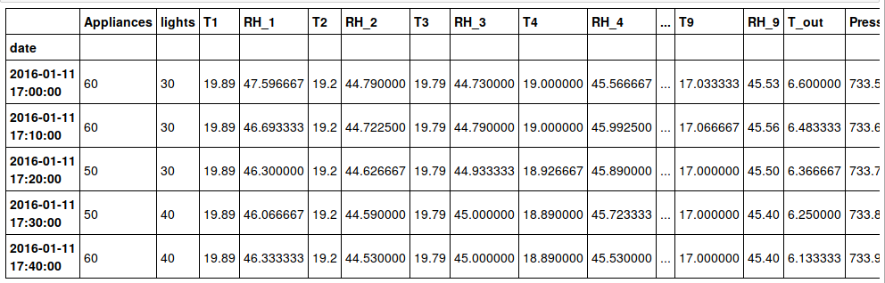
Feature-based forecasting
(explanatory variables)

Slide 9
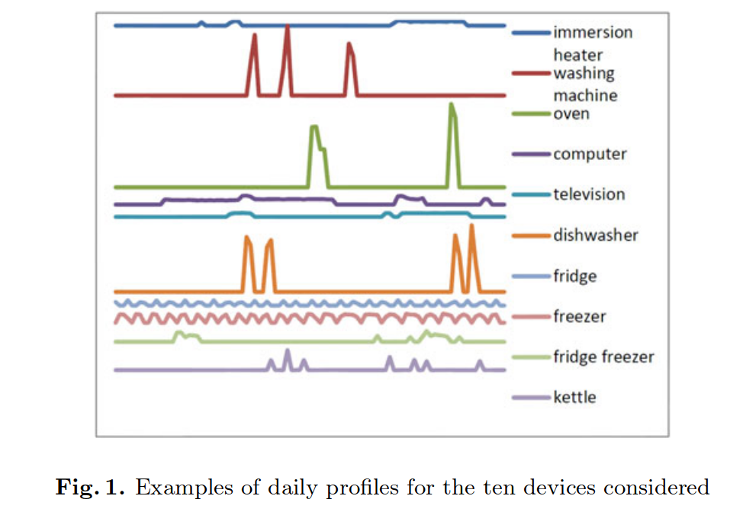
Time Series Classification
From: Classification of Household Devices byElectricity Usage Profiles

Slide 10
Tasks
1d time-series forecasting
  Number of customers (naive)
Multivariate time-series – forecast all
  Stock market
Multivariate time-series – forecast one
  Number of customers (with features)
Time-series classification (1d or nd)
  Activity from smart phone sensors

Slide 11
Data reading / munging with Pandas

Slide 12
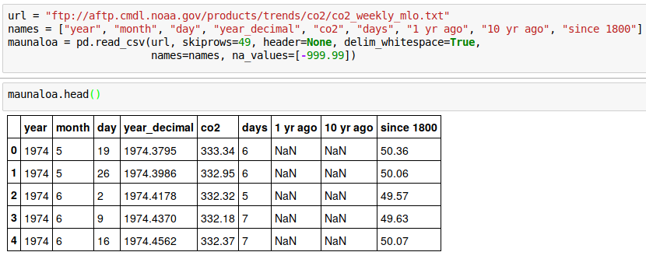
Parse Dates

Slide 13
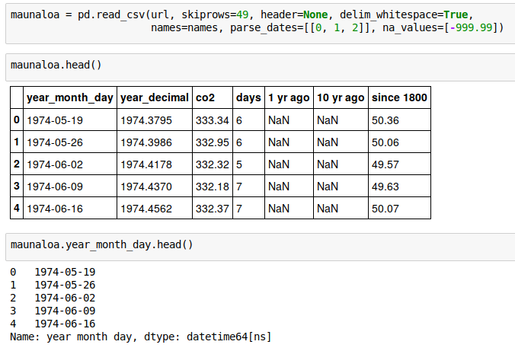
Parse dates
Multiple columns combined to a single date!

Slide 14
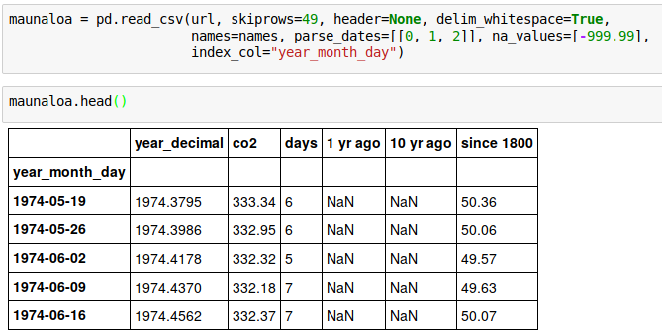
Time Series Index
Can also use set_index if we already read the data it.

Slide 15

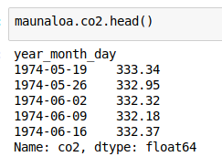
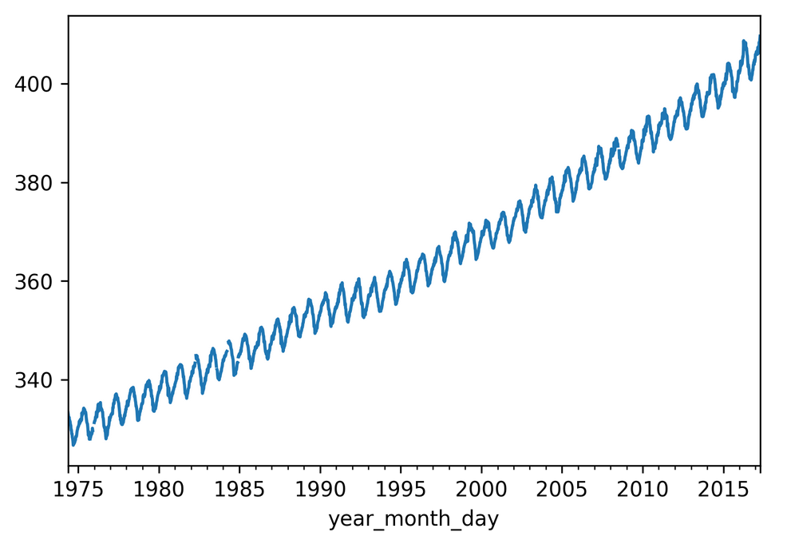

Slide 16
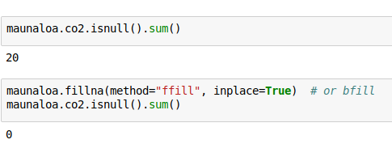
Backfill and Forward Fill
Simple “imputation” method
If we resample later, we could also just drop

Slide 17
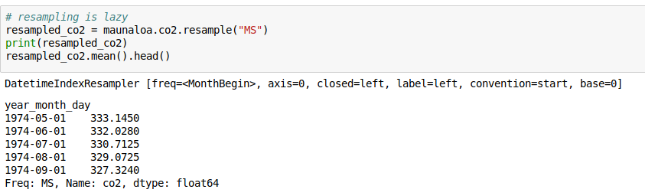
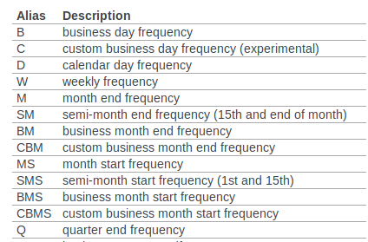
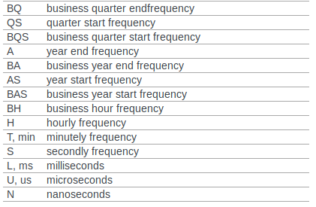
Resampling
http://pandas.pydata.org/pandas-docs/stable/timeseries.html#timeseries-offset-aliases

Slide 18
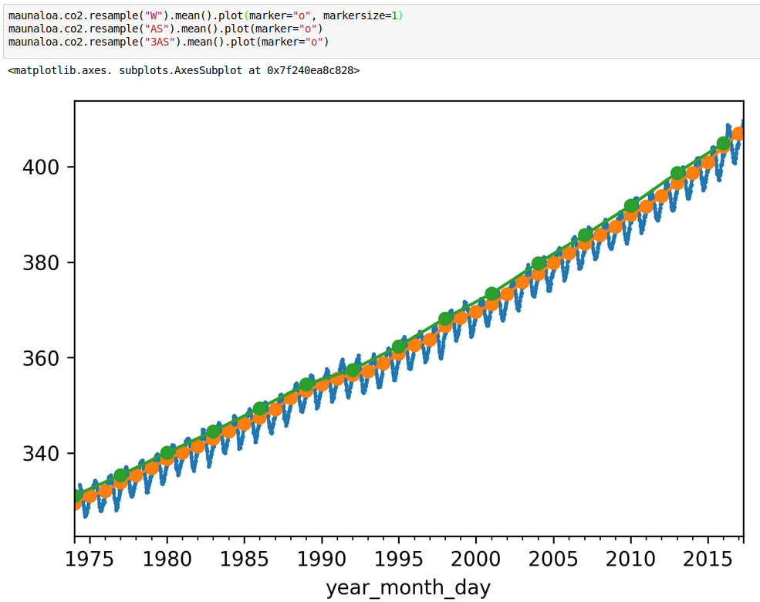

Slide 19
Basic Analysis

Slide 20
Stationarity
Required for some classical statistics methods
Mean independent of time
Variance independent of time
Covariance of two observations k steps apart independent of time

Slide 21
Mean changes → not stationary
“there is a trend”

Slide 22
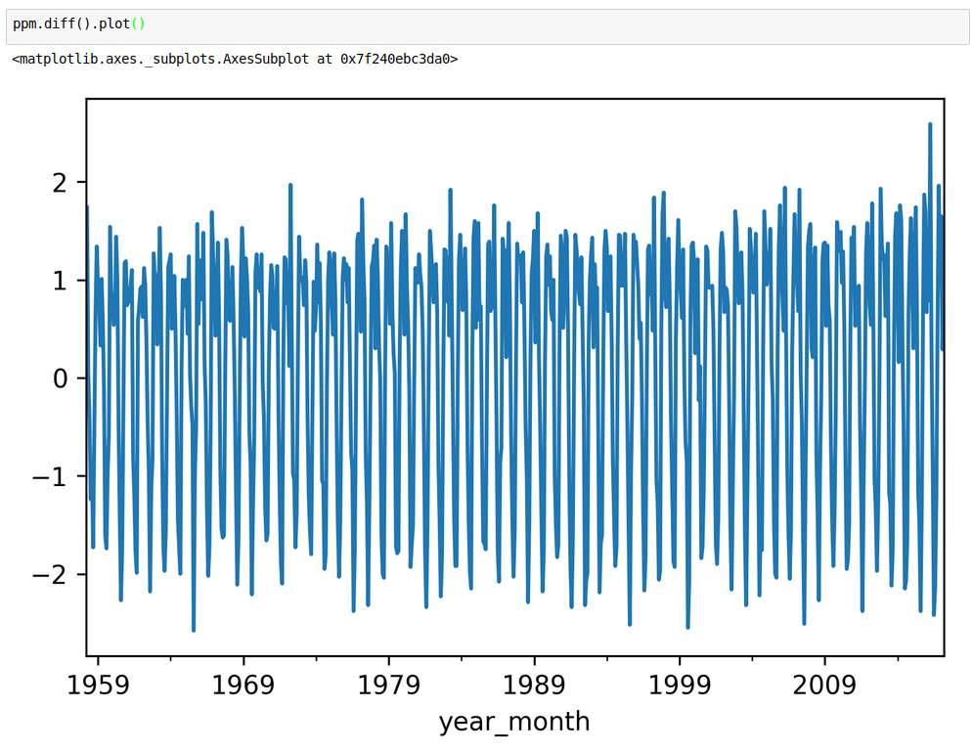
De-trending
Model trend
Or: differencing (compute new series )

Slide 23
Autocorrelation

Slide 24
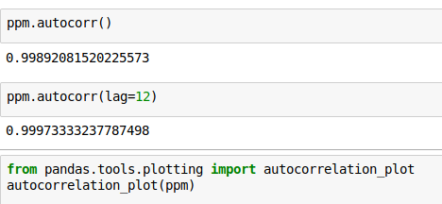
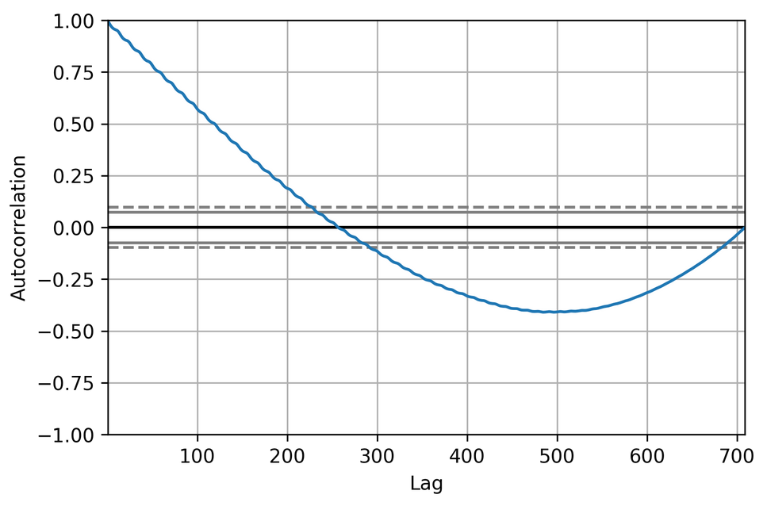

Slide 25

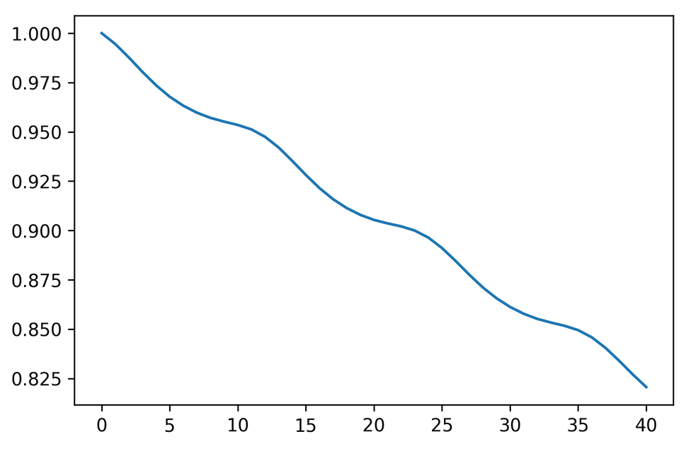
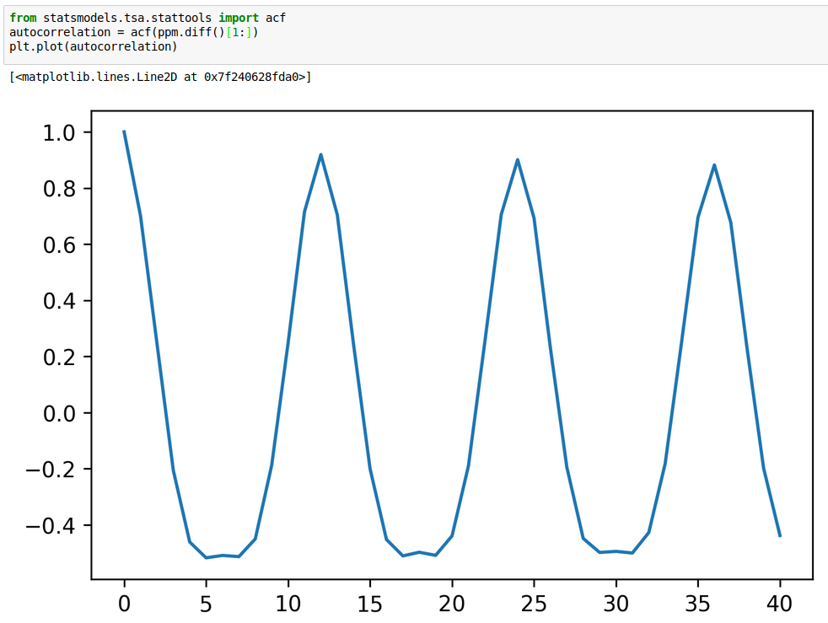
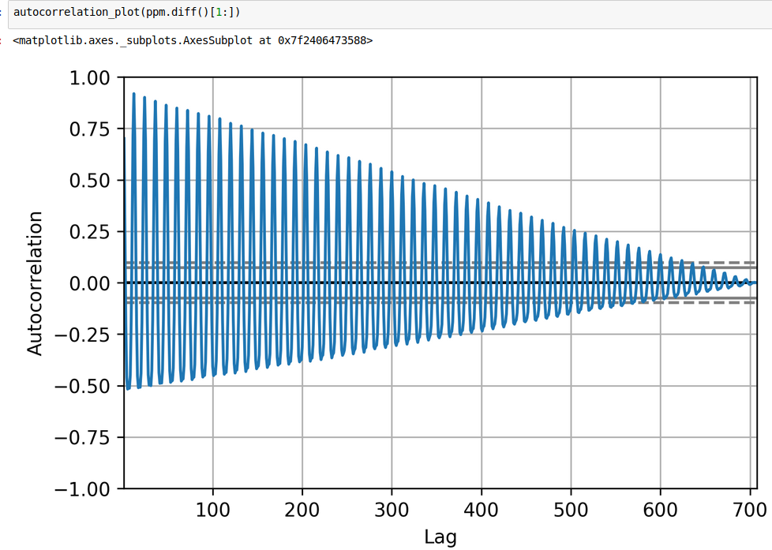

Slide 26
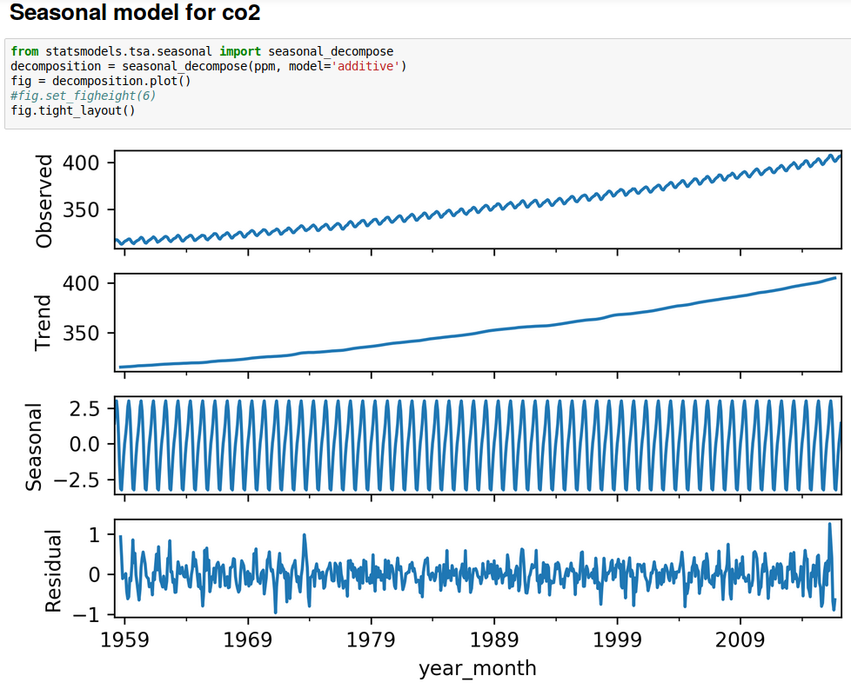
Autoregressive Models
Naive model using averages (so no parametric form)

Slide 27
Autoregressive (linear) model
Order k AR model (can include trend and offset):
learn c_i (i.e. using least squares)

Slide 28
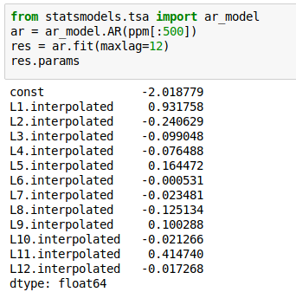
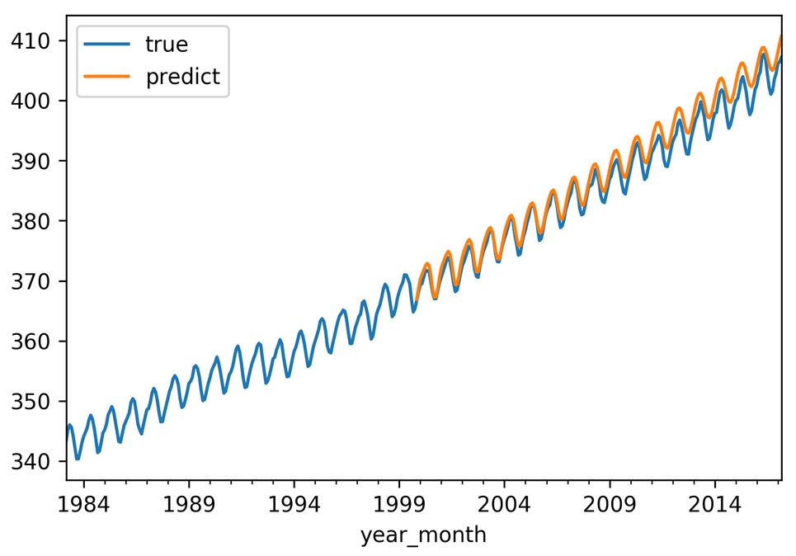
AR model with statsmodels

Slide 29
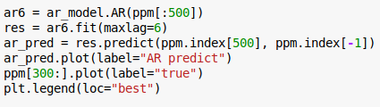
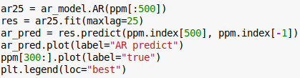
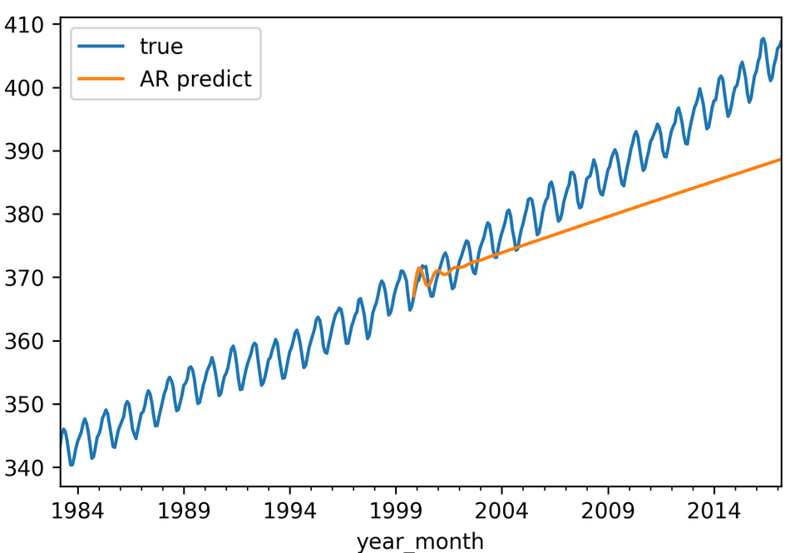
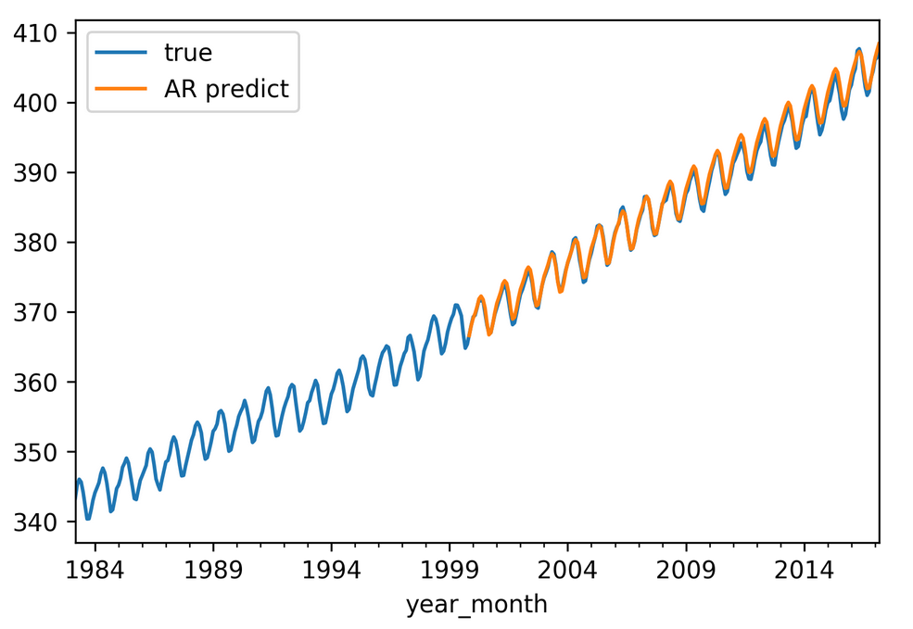
Impact of order

Slide 30
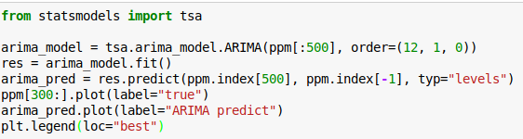
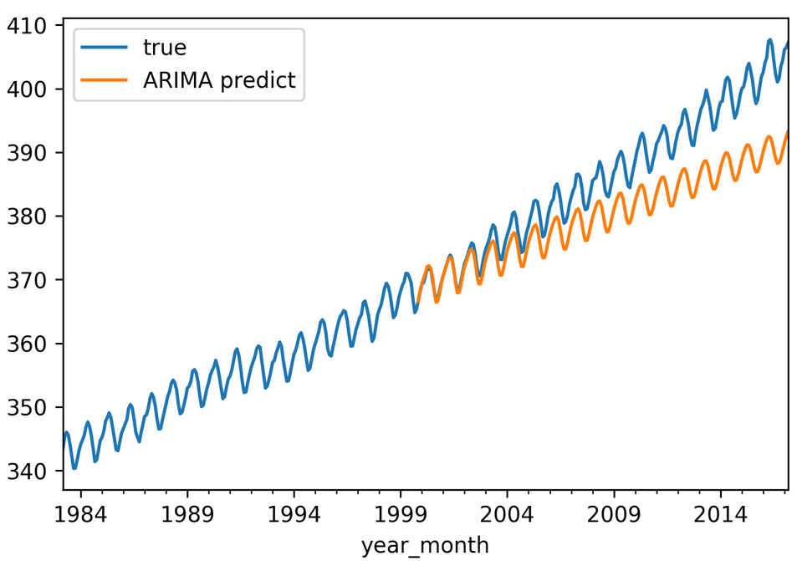
ARIMA
More complicated process model.
Internally uses differencing.
Also check out
SARIMAX
(state space model)

Slide 31
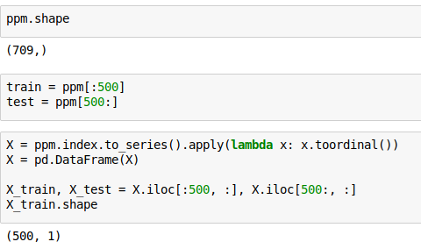
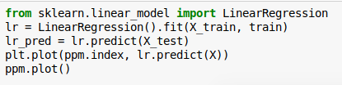
1d with sklearn

Slide 32
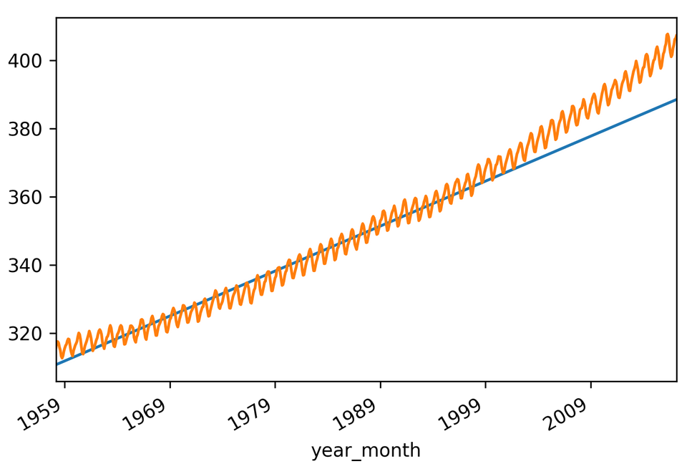
Linear model for trend

Slide 33
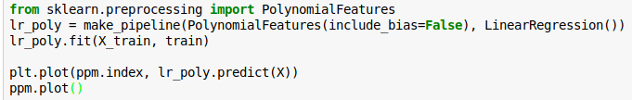
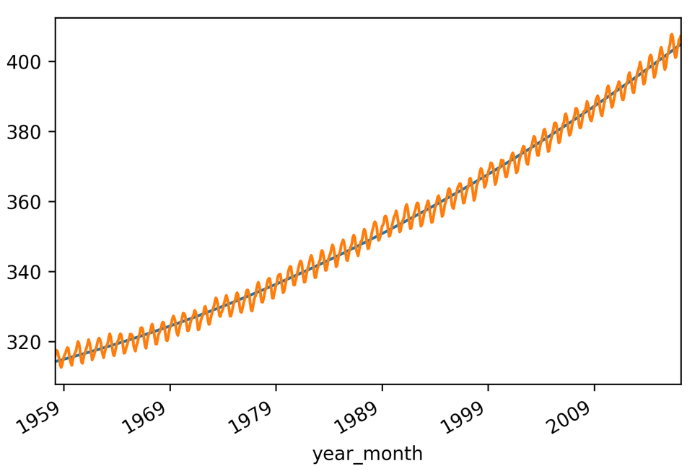
Quadratic Model

Slide 34

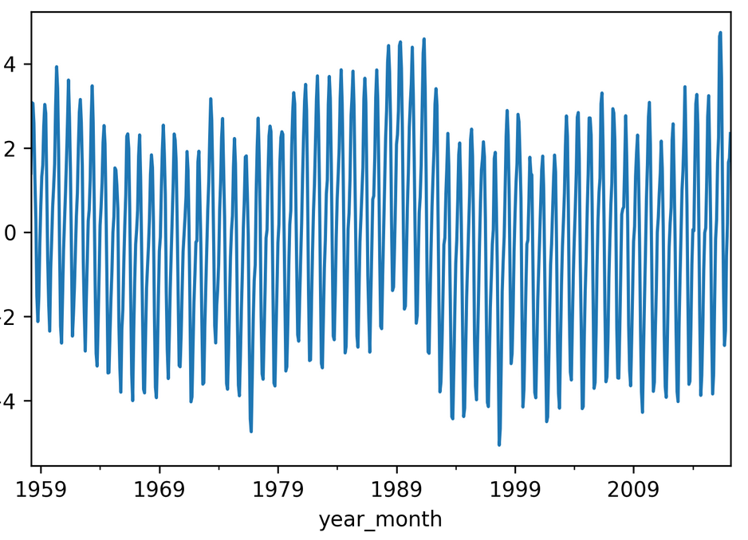
Detrending with trend model

Slide 35
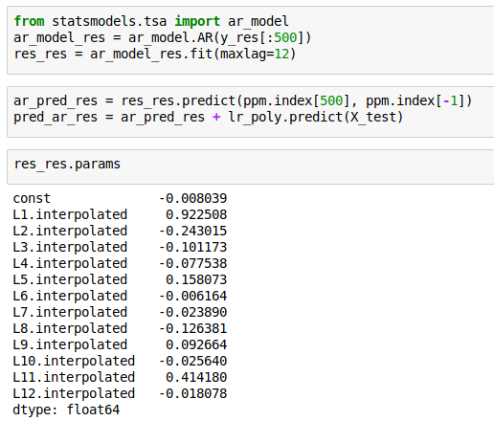
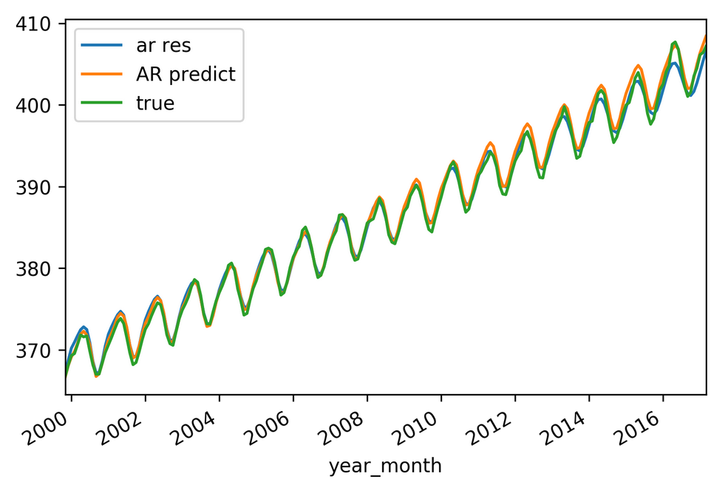
AR model on residuals

Slide 36
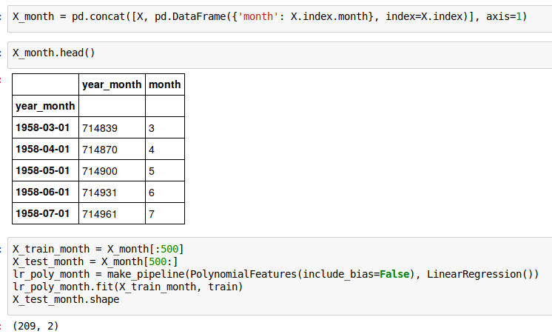
Just Linear Regression

Slide 37
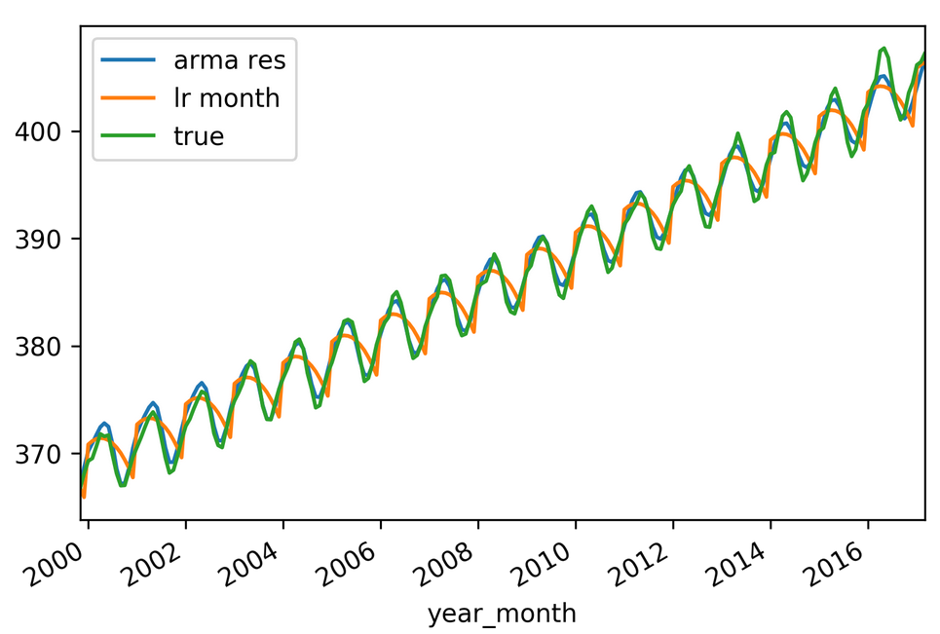

Slide 38

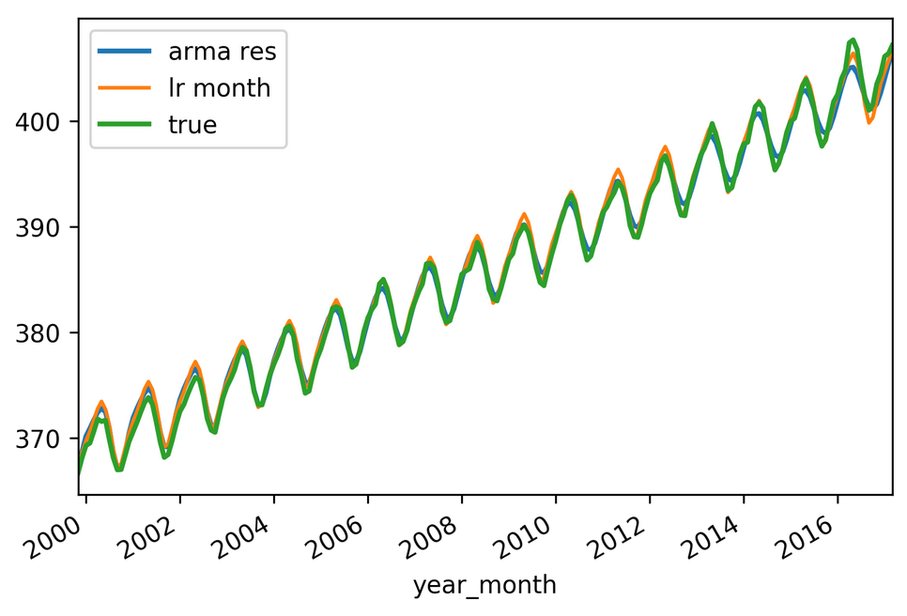
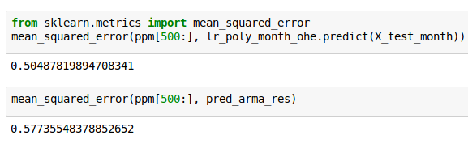

Slide 39
General Autoregressors
https://github.com/scikit-learn/scikit-learn/pull/6029
Trees work well (as always)
Can take explanatory variables

Slide 40
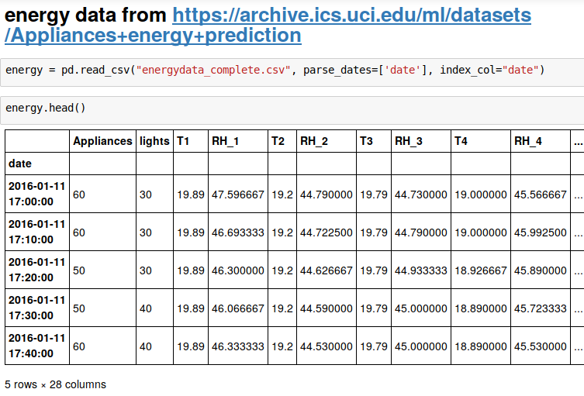
Multivariate Timeseries

Slide 41
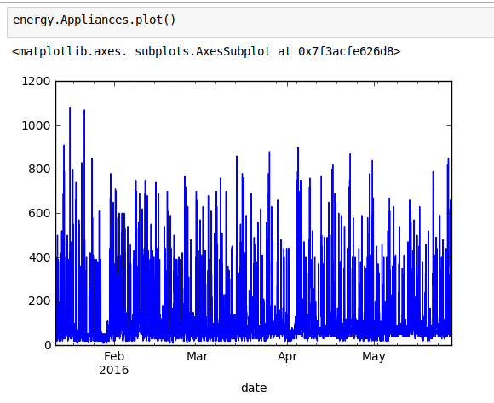
Exploration

Slide 42
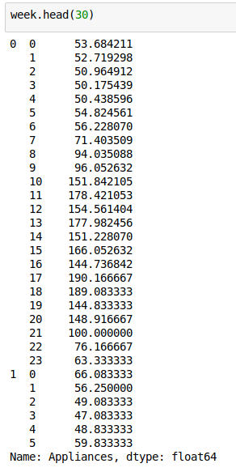
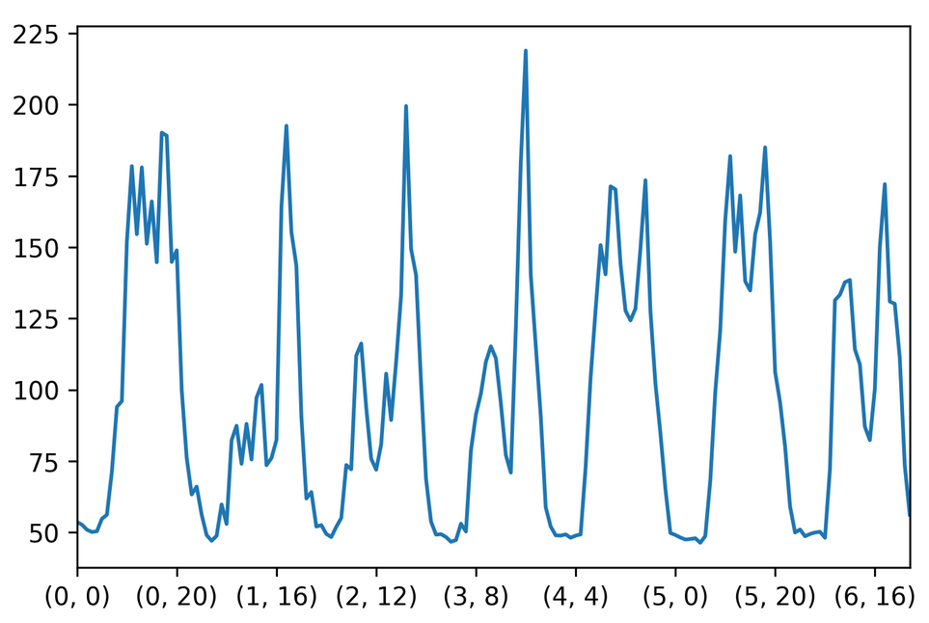
Weekly trends

