Slide 1
W4995 Applied Machine Learning
More Neural Networks
04/17/17
Andreas Müller

Slide 2
Getting flexible & Scaling up
Notes:
So today we’ll talk about using neural nets beyond scikit-learn.
There are two main motivations for this: scaling to larger datasets and larger networks using GPUs, and having more flexible ways to create the neural network architectures.
If you want to get serious about neural nets, you are likely to include some modifications to the standard network. So how could you go about doing that?

Slide 3
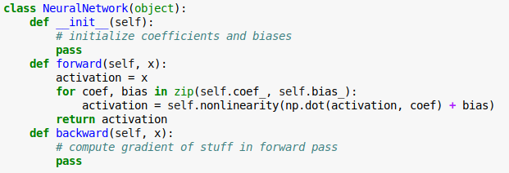
Write your own neural networks
Notes:
It’s actually pretty straight-forward to write the prediction functions, or forward pass of a neural network. There is matrix multiplications and nonlinearities. It quickly becomes more complicated when you use some of the tricks we’ll discuss today, but even for this writing down the gradient can be a bit tricky and something people used to get wrong all the time.
So they came up with a trick that avoided having to write down the gradients yourself, also known as the backward pass.
That trick is autodiff.

Slide 4
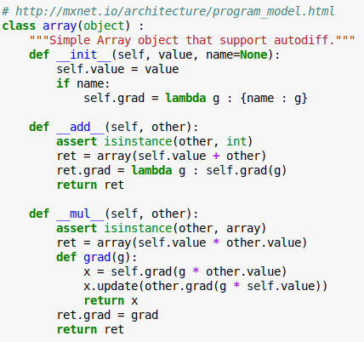
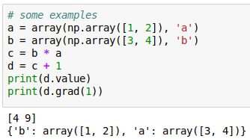
Autodiff
Notes:
Here is a toy implementation of the idea behind autodiff. It’s a class called array with some operations such as addition of integer and multiplication with other arrays.
It also has a method that returns the gradient called grad. The gradient of the array is just the identity function.
The trick is what happens with the addition and multiplication. If you add something to an array or you multiply two arrays, the result again is an array, and has again a gradient. The product actually has two gradients, one for each array involved.
The magic here is that while we are doing some computation, we are keep track of that computation and building up a graph of how to compute the gradient of it.

Slide 5
Autodiff
Notes:
On the right you can see the result of adding two arrays and then computing the gradient at a particular location.
FIXME the gradient of multiplication?
Any computation in the neural network is a simple operation like a matrix multiplication, addition or non-linearity. If we write down the derivative of each of these, we can keep track of our computation and automatically get the derivative.
It’s really easy to implement but really helpful.
Keep in mind that we actually hard-code the derivative for each operation, there is no symbolic differentiation involved.

Slide 6
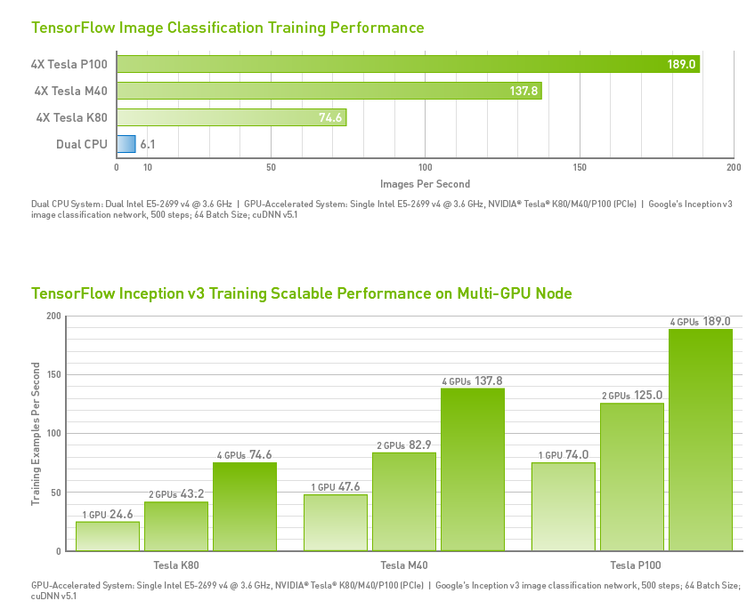
GPU Support
Notes:
From http://www.nvidia.com/object/gpu-accelerated-applications-tensorflow-benchmarks.html
Take with a grain of salt.
An important limitation of GPUs is that they usually have much less memory than the RAM, and memory copies between RAM and GPU are somewhat expensive.

Slide 7
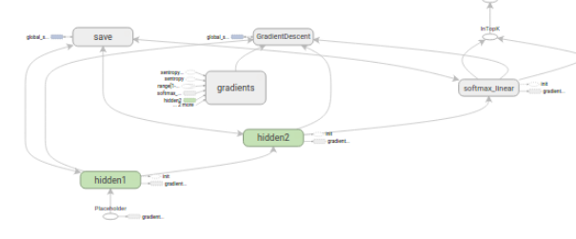
Computation Graph
Notes:
Autodiff doesn’t solve all of the problems, though. Depending on which derivations you need to compute, you need to store different intermediate results (the net activation in backprob for example).
Given the limited amount of memory available, it’s important to know what to store and what can be discarded. That requires an end-to-end view of the computation, which can be summarized as a graph.
Then you can use knowledge about the computation graph to decide what results to cache, what results to throw away and when to communicate between CPU and GPU.
Having a representation of the graph also helps with visual debugging and understanding your network structure. The computation graph is more complex than the network graph because it includes intermediate results and gradient computations.

Slide 8
All I want from a deep learning framework
Autodiff
GPU support
Optimization and inspection of computation graph
on-the-fly generation of the graph?
distribution over cluster?
Choices:
  TensorFlow
  Theano
  Torch (lua)
Notes:
So create deep learning model efficiently, I need support for auto diff, computation on a GPGPU, and optimization and inspection of the computation graph.
There is some more advanced features that can come in handy for research, like on-the-fly generation of computation graphs, and distributing the network over multiple GPUs or over a cluster.
At least the first three are all provided by the TensorFlow, Theano and Torch frameworks, which are the most established deep learning frameworks.
These don’t provide deep learning models, they are infrastructure, more like numpy on steroids than sklearn.
Theano was an early deep learning library for python, but I think it has become less relevant since tensorflow got released.

Slide 9
Deep Learning Libraries
tf.learn (Tensorflow)
Keras (Tensorflow, Theano)
Lasagna (Theano)
Torch.nn / PyTorch (torch)
Chainer (chainer)
MXNet (MXNet)
Also see: http://mxnet.io/architecture/program_model.html
Notes:
Then there are actual deep learning libraries that provide higher level interfaces built on top of this infrastructure.
There are a lot of these right now given the deep learning hype, I want to point out a couple.
There is tf.learn, a high-level interface to tensorflow, including a scikit-learn compatible API.
There’s keras, which supports both Tensorflow and theano, there’s lasagna, which I think has seen less activity recently, and torch.nn (lua) and pytorch building on top of the torch framework.
Then there are two projects that are deep learning libraries but that also come with their own framework underneath, chainer and mxnet.
I think right now Keras with tensorflow is the most commonly used one, and I want to go into those two a bit more. But these all have their pros and cons.

Slide 10
Quick look at TensorFlow
“down to the metal” - don’t use for everyday tasks
Three steps for learning:
  Build the computation graph (using array operations and functions etc)
  Create an Optimizer (gradient descent, adam, …) attached to the graph.
  Run the actual computation.

Slide 11
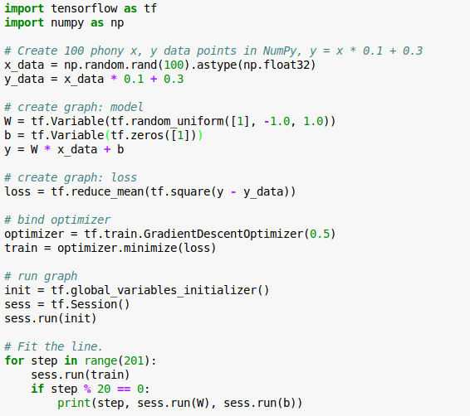
No computation
Allocate variables
All the work / computation
https://www.tensorflow.org/versions/r0.10/get_started/

Slide 12
A little more tf
Everything passed to the graph is a “tensor”
Either “variable”, “constant”, “placeholder”
Learned parameters: variables
Data: placeholders (data is assigned using “feed”)

Slide 13
Great Resources!
https://www.tensorflow.org/versions/r0.10/tutorials/
http://playground.tensorflow.org
https://www.tensorflow.org/versions/r0.10/get_started/basic_usage
https://www.tensorflow.org/versions/r0.10/tutorials/mnist/beginners/
Note: tf.learn is now officially tf.contrib.learn
Tensorboard web interface

Slide 14
Introduction to Keras

Slide 15
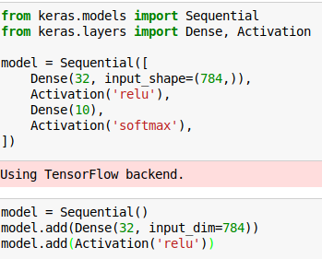

Keras Sequential
Notes:
There are two interfaces to keras, sequential and the functional, but we’ll only discuss sequential.
Sequential is for feed-forward neural networks where one layer follows the other. You specify the layers as a list, similar to a sklearn pipeline.
Dense layers are just matrix multiplications. Here we have a neural net with 32 hidden units for the mnist dataset with 10 outputs. The hidden layer non-linearity is relu, the output if softmax for multi-class classification.
You can also instantiate an empty sequential model and then add steps to it.
For the first layer we need to specify the input shape so the model knows the sizes of all the matrices. The following layers can infer the sizes from the previous layers.

Slide 16
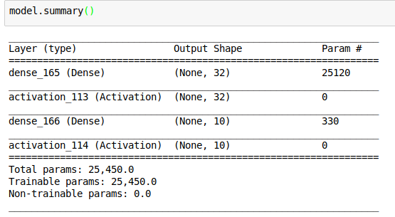

Slide 17
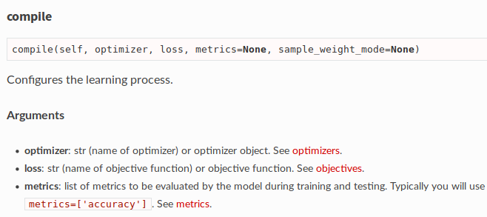
Setting optimizer
Notes:
Compile method picks optimization procedure and loss

Slide 18
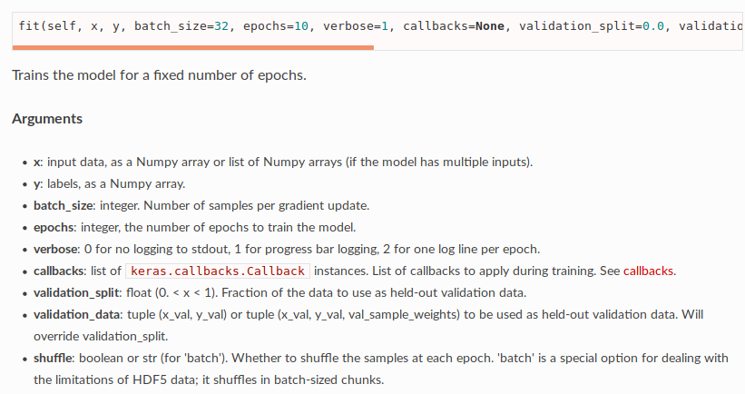
Training the model

Slide 19
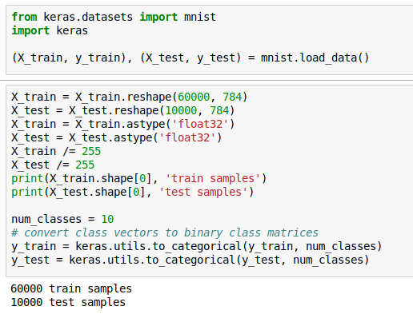
Preparing MNIST data

Slide 20
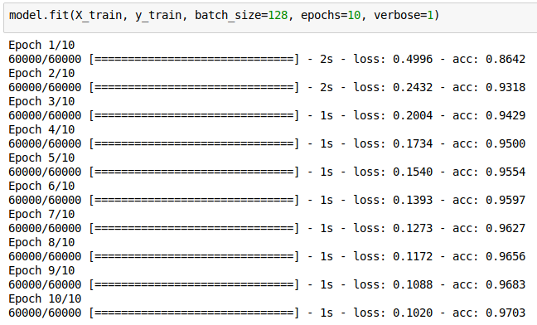
Fit model

Slide 21
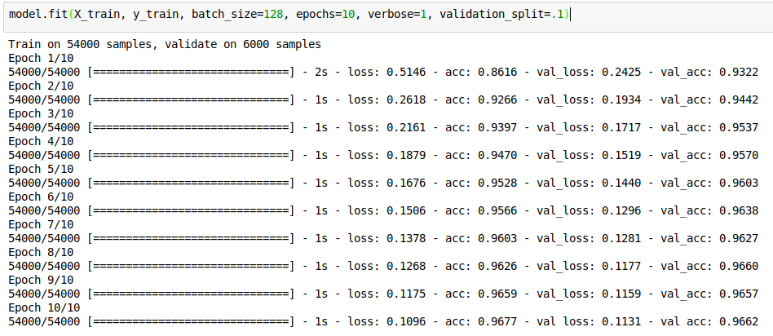
Fit with Validation

Slide 22
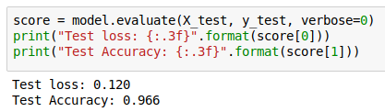
Evaluating on Test Set

Slide 23
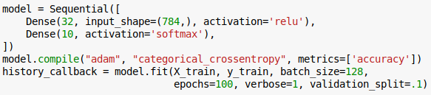
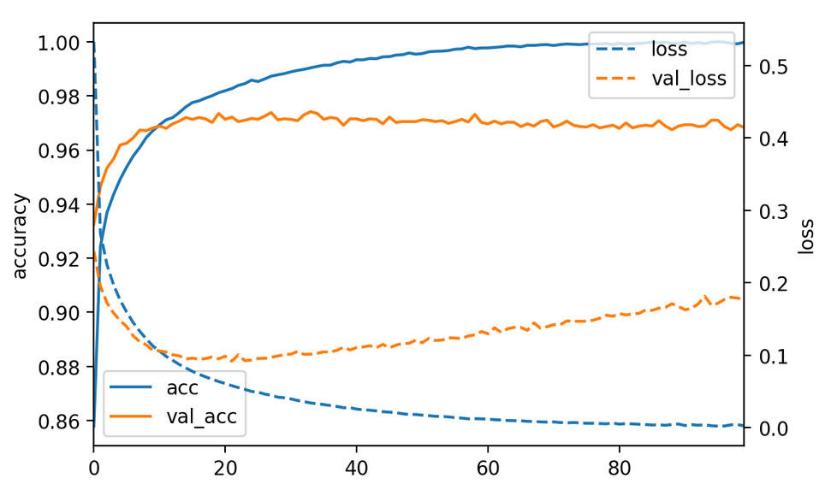
Loggers and Callbacks

Slide 24
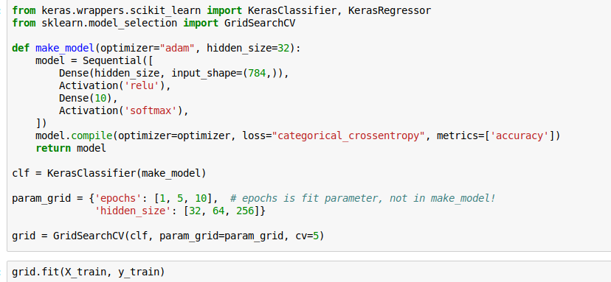
Wrappers for sklearn
See https://keras.io/scikit-learn-api/
Notes:
Useful for grid-search.
You need to define a callable that returns a compiled model.
You can search parameters that in Keras would be passed to “fit” like the number of epochs.

Slide 25
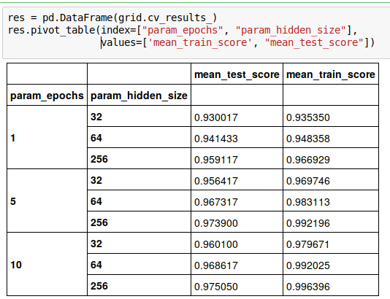
Notes:
Training longer overfits more and more units overfit more, but both also lead to better results.
We should probably train much longer actually.
Setting the number of epochs via cross-validation is a bit silly since it means starting from scratch again each time. Using early stopping would be better.

Slide 26
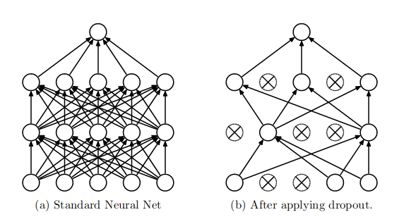
Drop-out Regularization
Randomly set activations to zero:
https://www.cs.toronto.edu/~hinton/absps/JMLRdropout.pdf
Rate often as high as .5, i.e. 50% of units set to zero!
Predictions: use all weights, down-weight by rate
Notes:
Drop out is a very successful regularization technique developed in 2014. It is an extreme case of adding noise to the input, a previously established method to avoid overfitting.
Instead of adding noise, we actually set given inputs to 0. And not only on the input layer, also the intermediate layer.
For each sample, and each iteration we pick different nodes. Randomization avoids overfitting to particular examples.

Slide 27
Ensemble Interpretation
Every possible configuration represents different network.
With p=.5 we jointly learn networks
Networks share weights
For last layer dropout: prediction is approximate geometric mean of predictions of sub-networks.

Slide 28
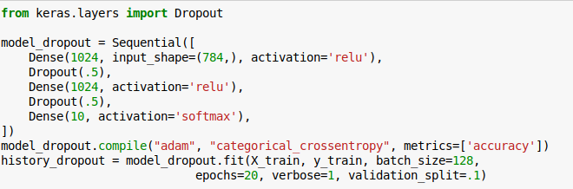
Implementing Drop-Out

Slide 29
When to use drop-out
Avoids overfitting
Allows using much deeper and larger models
Slows down training somewhat
Wasn’t able to produce better results on MNIST (I don’t have a GPU) but should be possible

Slide 30
Convolutional neural networks

Slide 31
Idea
Translation invariance
Weight sharing

Slide 32
Definition of Convolution
0 1 2 0 1 1 0 0 1 0
-1 2 -1
-1 2 -1
-1 2 -1
0 3 -3 ...
Notes:
The definition is symmetric in f, but usually one is the input signal, say f, and g is a fixed “filter” that is applied to it.
You can imagine the convolution as g sliding over f.
If the support of g is smaller than the support of f (it’s a shorter non-zero sequence) then you can think of it as each entry in f * g depending on all entries of g multiplied with a local window in f.
Not that the output is shorter than the input by half the size of g. this is called a valid convolution.
We could also extend f with zeros, and get a result that is larger than f by half the size of g, that’s called a full convolution. We can also just pad a little bit and get something that is of the same size as f.
Also not that the filter g is flipped as it’s indexed with -m

Slide 33
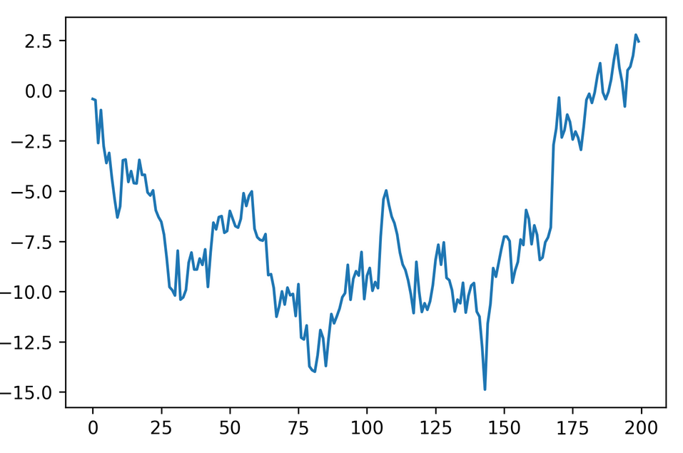
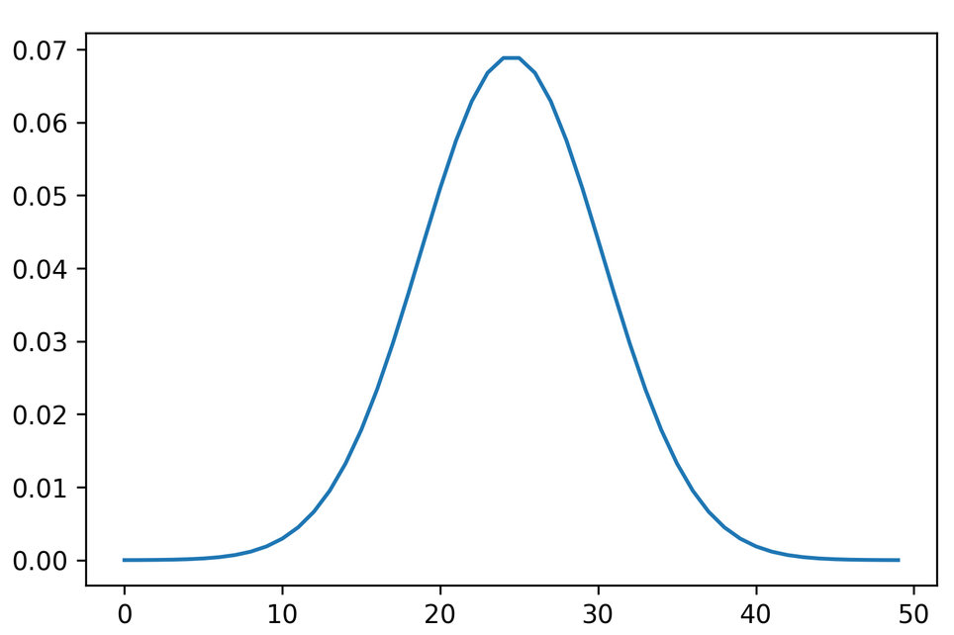
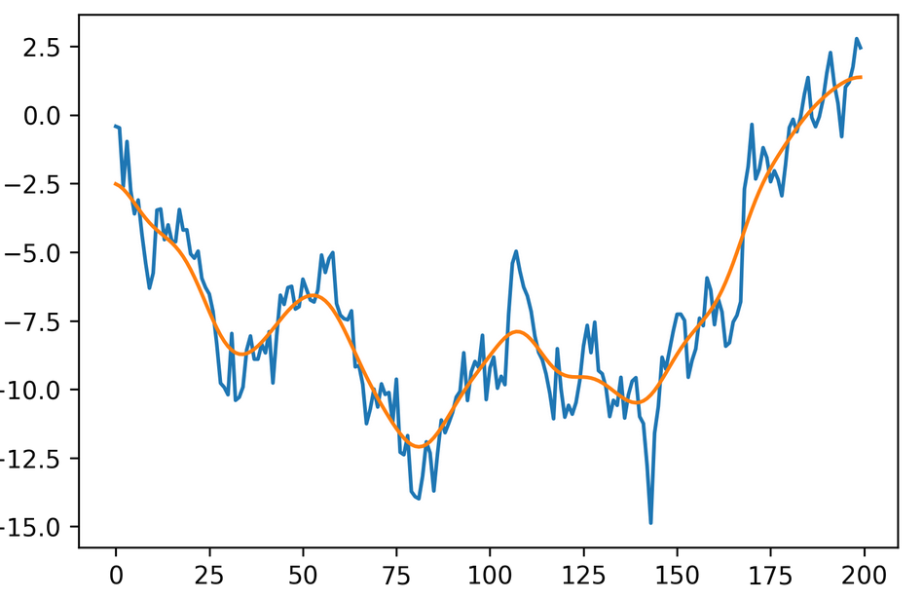
1d example: Gaussian smoothing
*
=

Slide 34
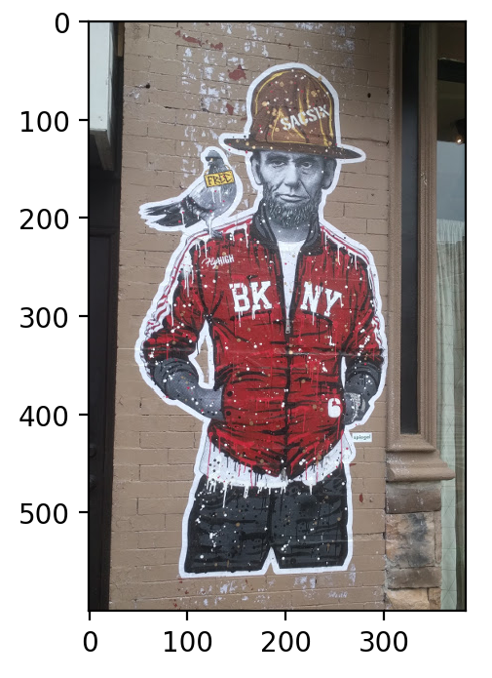
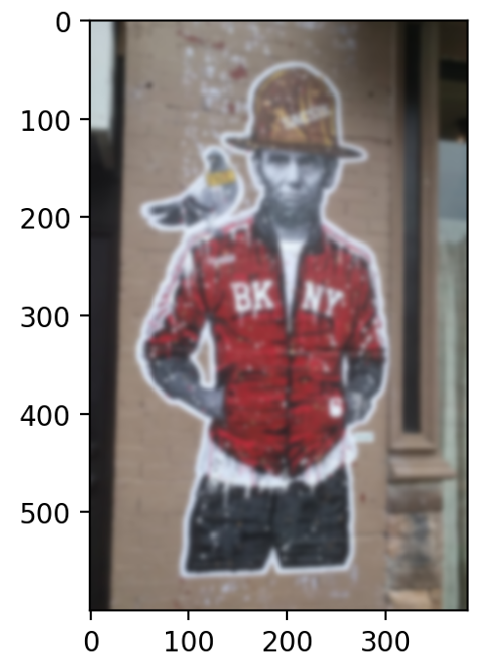
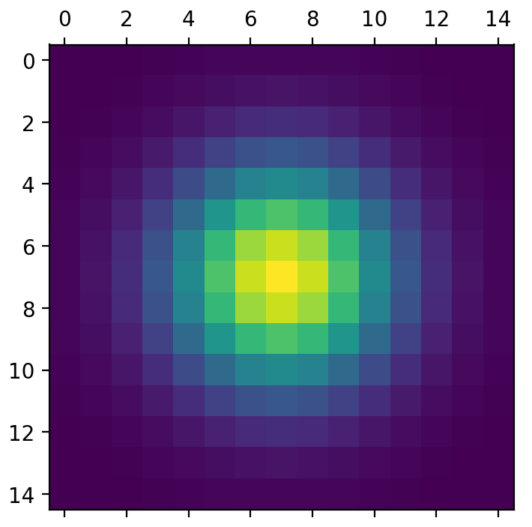
2d smoothing

Slide 35
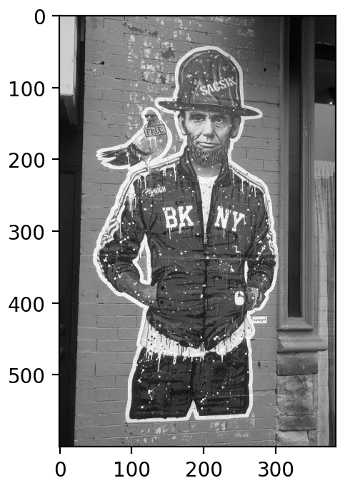
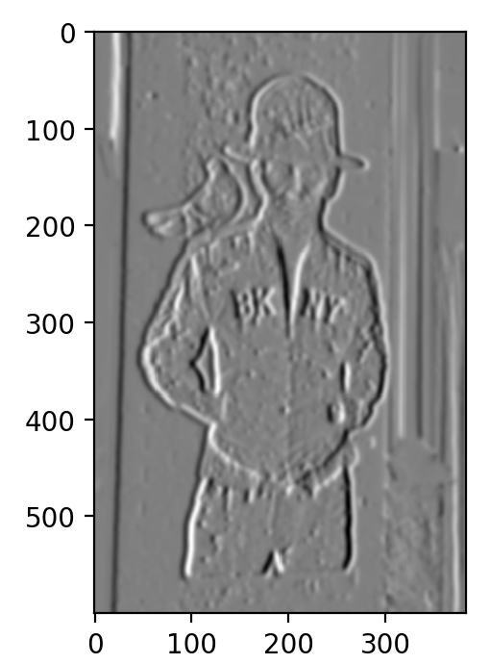
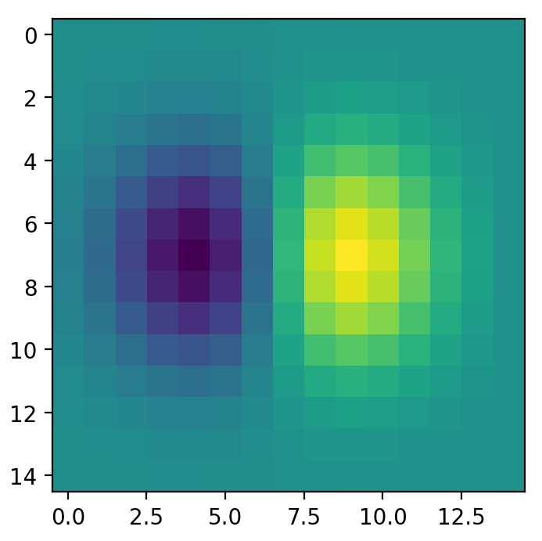
2d Gradients

Slide 36
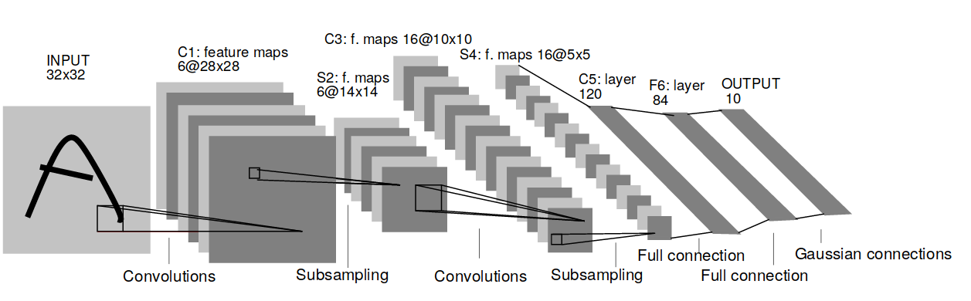
Convolutional Neural Networks
Y. LeCun, L. Bottou, Y. Bengio, and P. Haffner.
Gradient-based learning applied to document recognition
Notes:
Here is the architecture of an early convolutional net form 1998. The basic architecture in current networks is still the same.
You can multiple layers of convolutions and resampling operations. You start convolving the image, which extracts local features. Each convolutions creates new “feature maps” that serve as input to later convolutions.
To allow more global operations, after the convolutions the image resolution is changed. Back then it was subsampling, today it is max-pooling.
So you end up with more and more feature maps with lower and lower resolution.
At the end, you have some fully connected layers to do the classificattion.

Slide 37
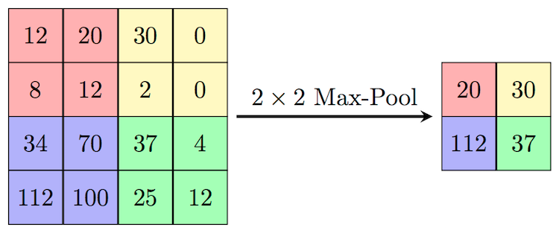
Max pooling
Need to remember position of maximum for back-propagation.
Again not differentiable → subgradient descent

Slide 38
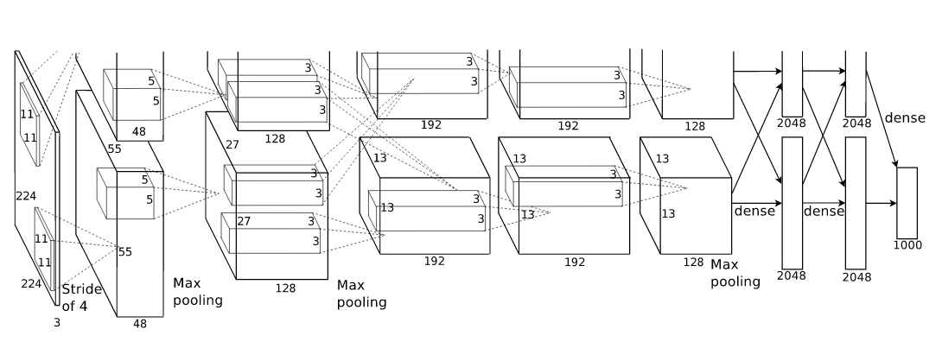
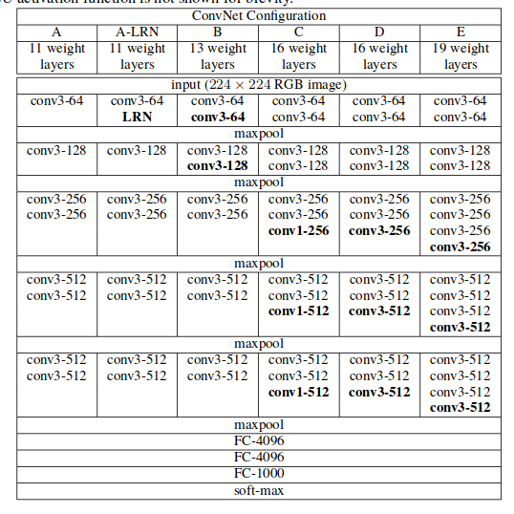

Alex Net
VGG 16
conv <receptive field size>-<number of channels>
Notes:
Here are two more recent architectures, AlexNet from 2012 and VGG net from 2015.
These nets are typically very deep, but often have very small convolutions. In VGG there are 3x3 convolutions and even 1x1 convolutions which serve to summarize multiple feature maps into one.
There is often multiple convolutions without pooling in between but pooling is definitely essential.

