Slide 1
W4995 Applied Machine Learning
Clustering and Mixture Models
03/22/17
Andreas Müller

Slide 2
Clustering

Slide 5
3
1
2

Slide 6
Group into 4 clusters
4
3
2
1

Slide 7
Clustering
Group data into a partitioning:
Identify groups by assigning “cluster labels” to each data point.
Points within a cluster should be “similar”.
Points in different cluster should be “different”.
Number of clusters might be pre-specified.
Notations of “similar” and “different” depend on algorithm or user specified metrics.

Slide 8
Goals of Clustering
Data exploration
  are there coherent groups?
  How many groups are there?
Data partitioning
  divide data by group before further processing.
Unsupervised feature extraction
  Derive features from clusters or cluster distances

Slide 9
Clustering Algorithms

Slide 10
K-Means

Slide 11
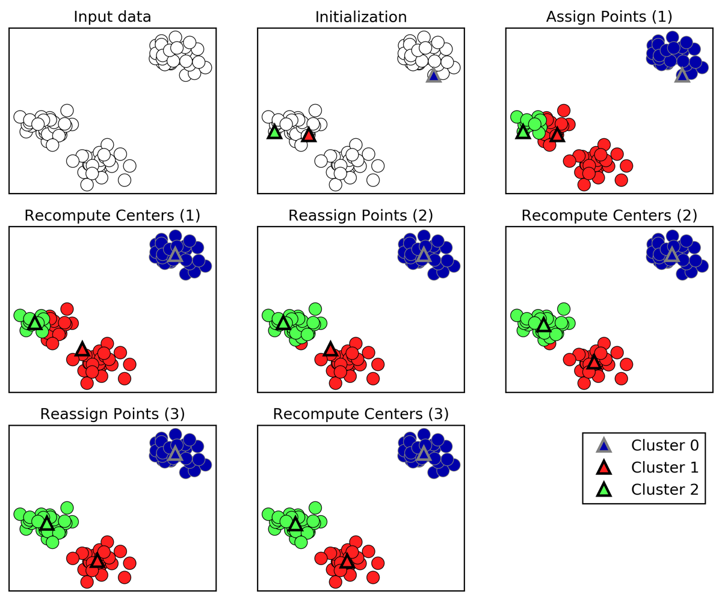
K-Means algorithm
Pick number of clusters k.
Pick k random points as “cluster center”
While cluster centers change:
  Assign each data point to it’s closest cluster center
  Recompute cluster centers as the mean of the assigned points.

Slide 12
Objective function for K-Means
Finds a local minimum of minimizing squared distances (exact solution is NP hard):
New data points can be assigned cluster-membership based on existing clusters.
Is the cluster center c_j closest to x_i.

Slide 13
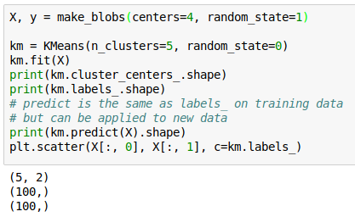
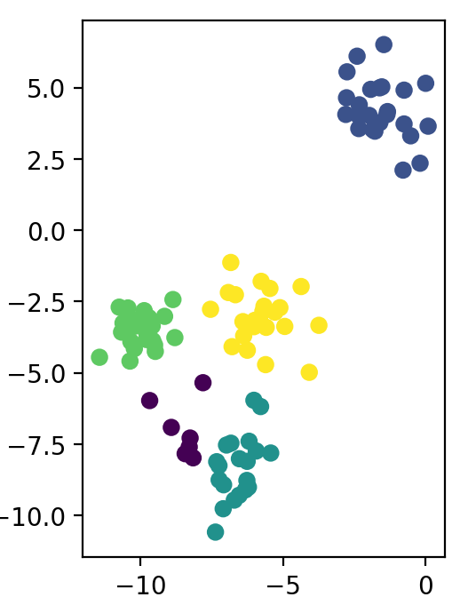
K-Means API

Slide 14
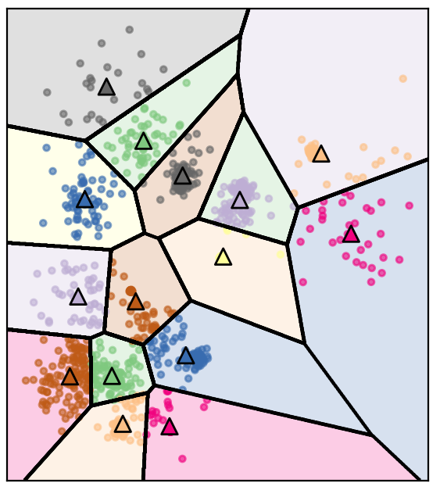
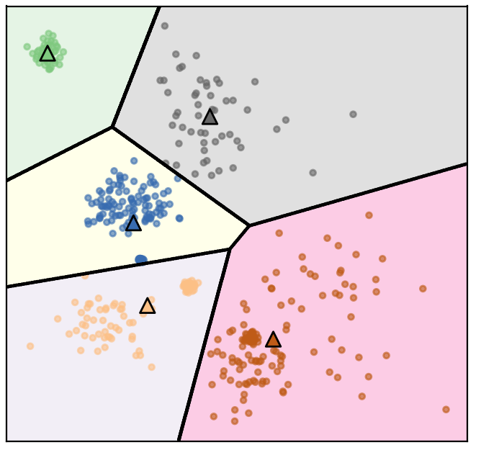
Restriction of Cluster Shapes
Clusters are Voronoi-diagrams of centers.
Clusters are always convex in space:

Slide 15
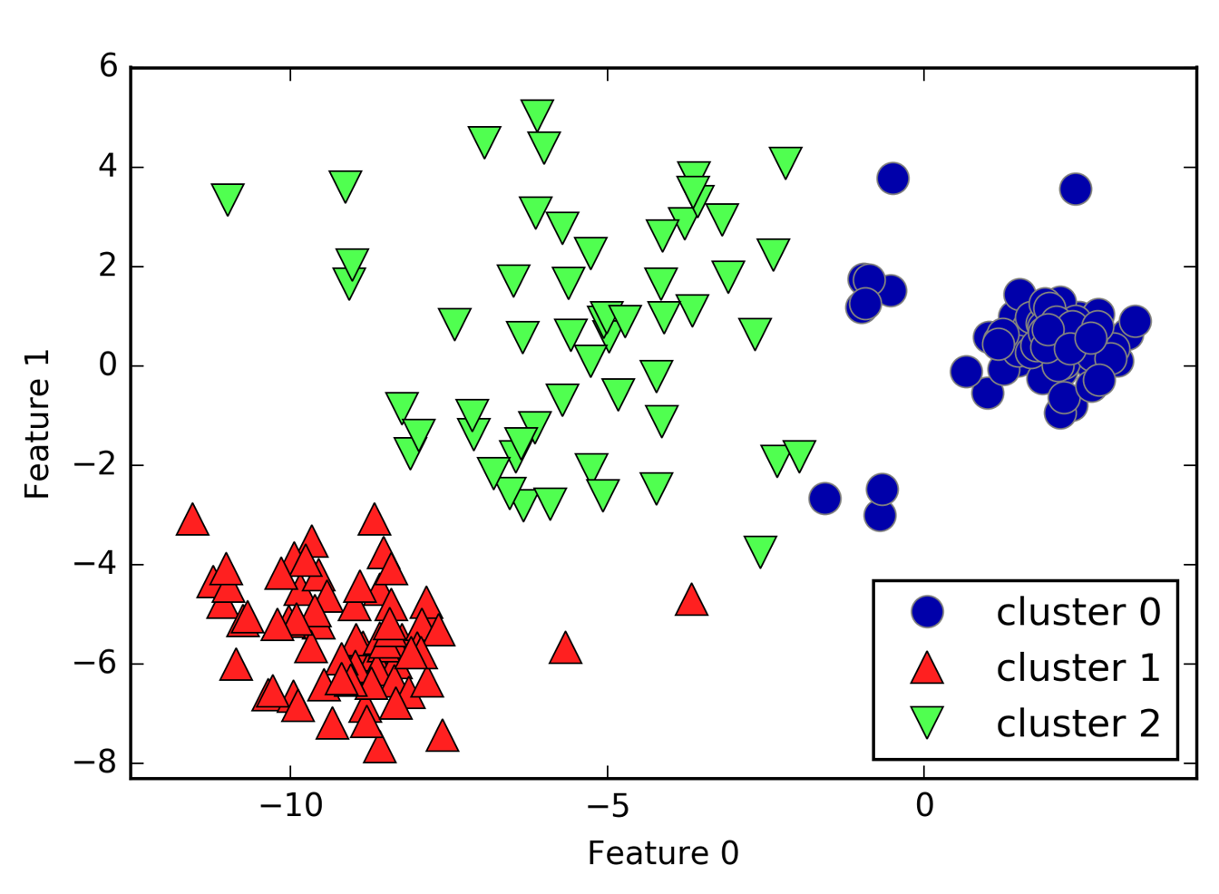
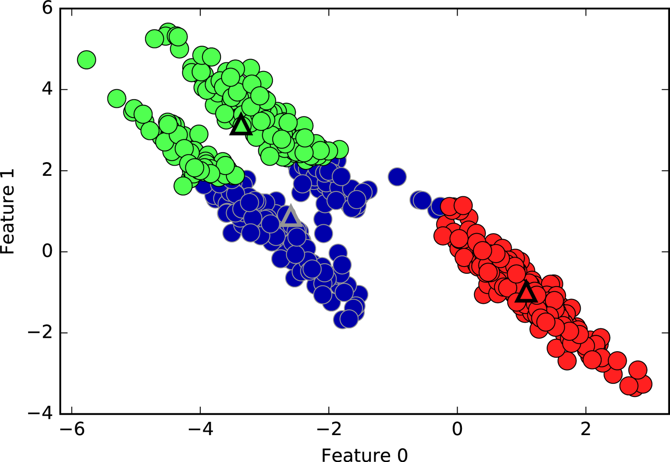
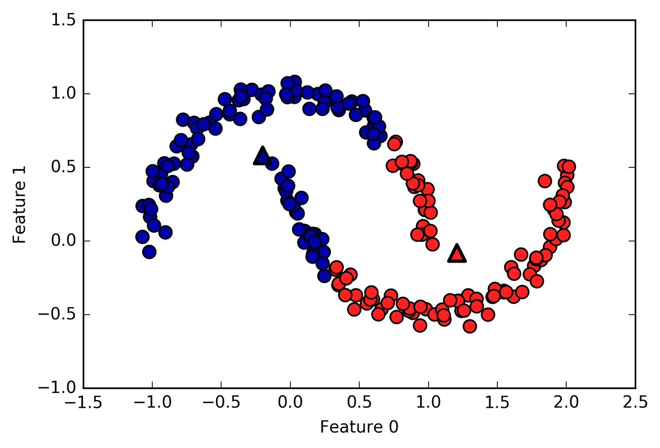
Limitations of k-means
Cluster boundaries are always in the middle of the centers.
Can’t model covariances well
Only simple cluster shapes

Slide 16
Computational properties
Naive implementation:
Each iteration computes n_cluster * n_samples distances.
Fast exact algorithms:
Elkans, Ying-Yang (compute cluster distances and use triangle inequality)
Many approximate algorithms, in particular mini-batch K-Means: Much faster, online version (partial_fit)

Slide 17
Initialization
Random centers fast but not great.
K-means++ (default):
Greedily add “furthest way” point
By default K-means in sklearn does 10 random restarts with different initializations.
For large datasets, K-means++ initialization may take much longer than clustering.
Consider using random, in particular for MiniBatchKMeans

Slide 18
Feature Extraction using k-Means
Cluster membership → categorical feature
Cluster distanced → continuous feature
Examples:
  partitioning low-dimensional space (similar to using basis functions)
  Extracting features from high-dimensional spaces, for image patches, see http://ai.stanford.edu/~acoates/papers/coatesleeng_aistats_2011.pdf

Slide 19
Agglomerative Clustering

Slide 20
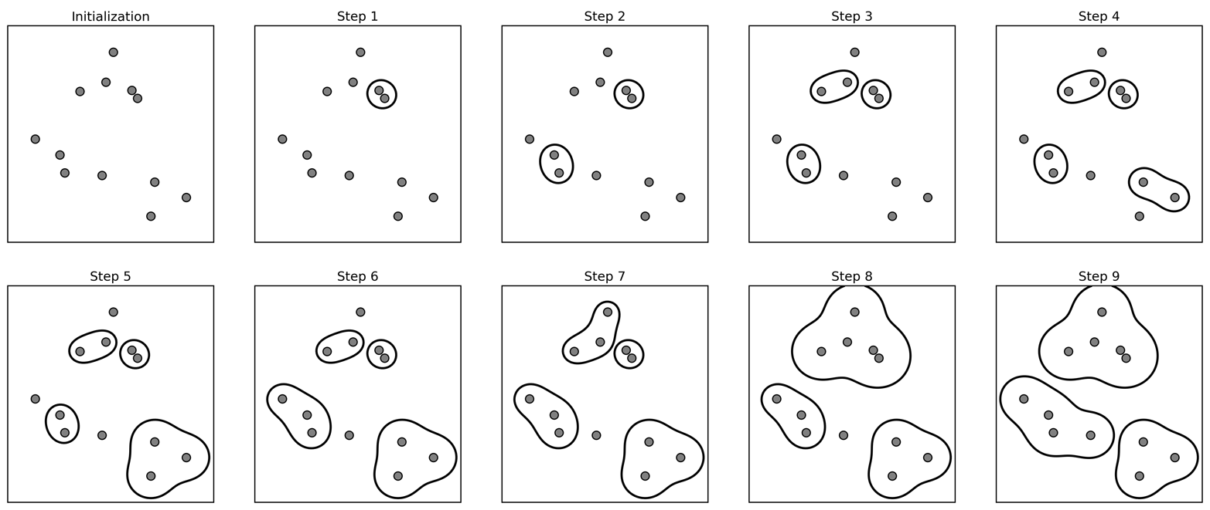
Agglomerative Clustering
Start with all points in their own cluster.
Greedily merge the two most similar clusters.
Creates a hierarchical clustering from with cluster sizes from n_samples to single cluster.

Slide 21
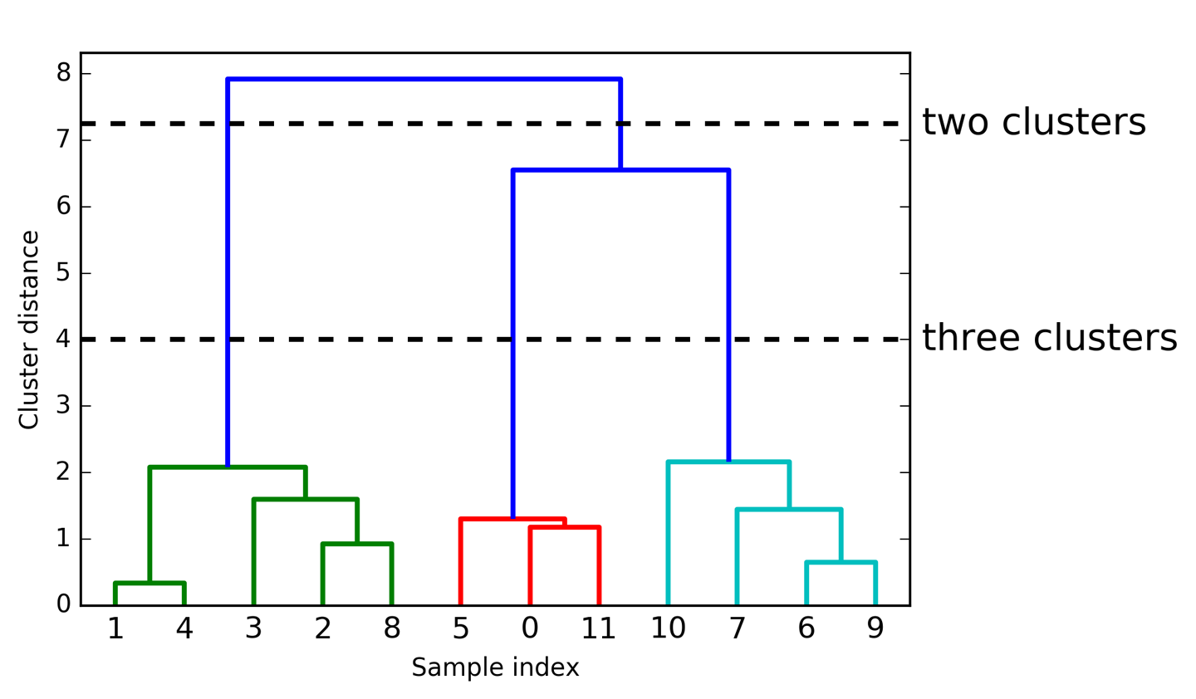
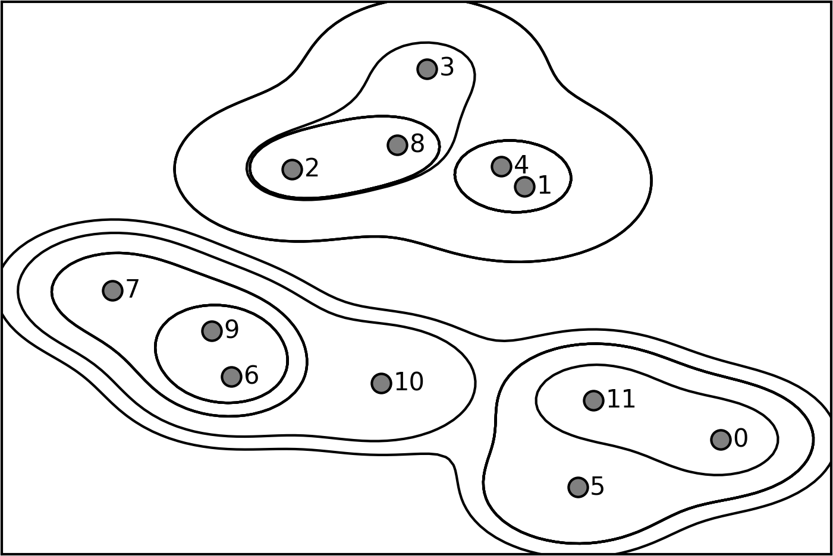
Dendograms

Slide 22
Merging Criteria
Complete Link
  Smallest maximum distance
Average linkage
  Smallest average distance between all pairs in the clusters.
Single Link
  Smallest minimum distance
Ward (default in sklearn)
  Smallest increase in within-cluster variance
  Leads to more equally sized clusters.

Slide 23
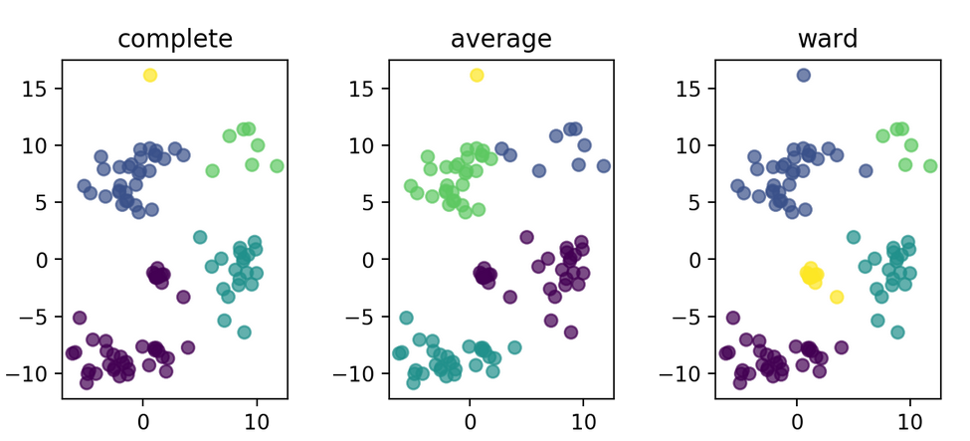


Slide 24
Pros and Cons
Can restrict to input “topology” given by any graph, for example neighborhood graph.
Fast with sparse connectivity, otherwise O(log(n) n ** 2 )
Some linkage criteria an lead to very imbalanced cluster sized (can be pro or con)
Hierarchical clustering gives more holistic view, can help with picking the number of clusters.

Slide 25
DBSCAN

Slide 26
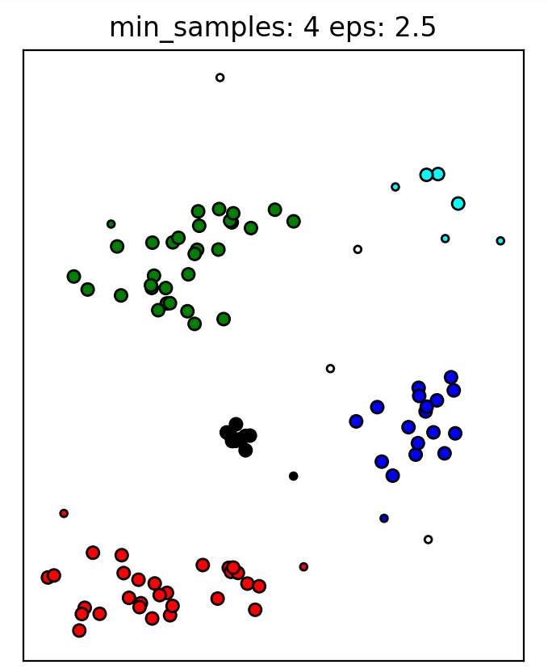
Algorithm
Clusters are formed by “core samples”
Sample is “core sample” if more than min_samples is within epsilon - “dense region”
Start with a core sample
Recursively walk neighbors that are core-samples and add to cluster.
Also add samples within epsilon that are not core samples (but don’t recurse)
If can’t reach any more points, pick another core sample, start new cluster.
Remaining points are labeled outliers

Slide 27
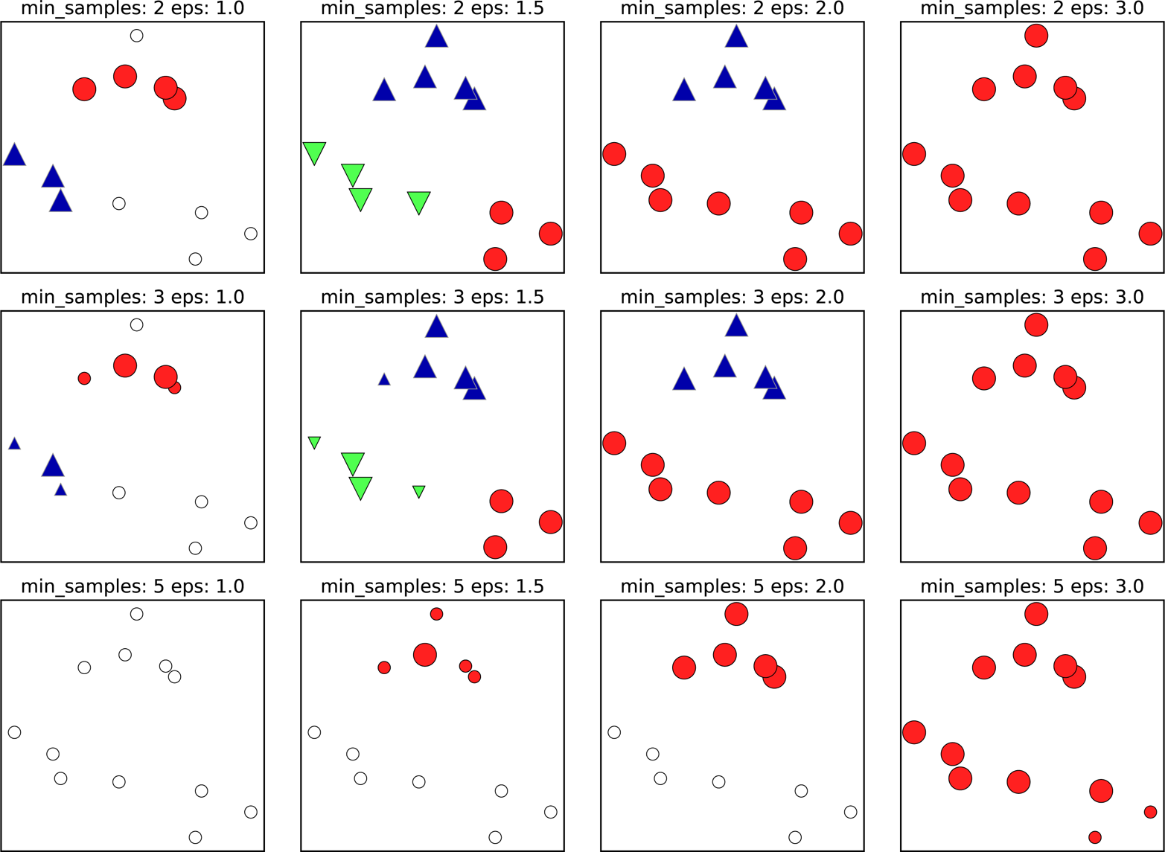
Illustration

Slide 28
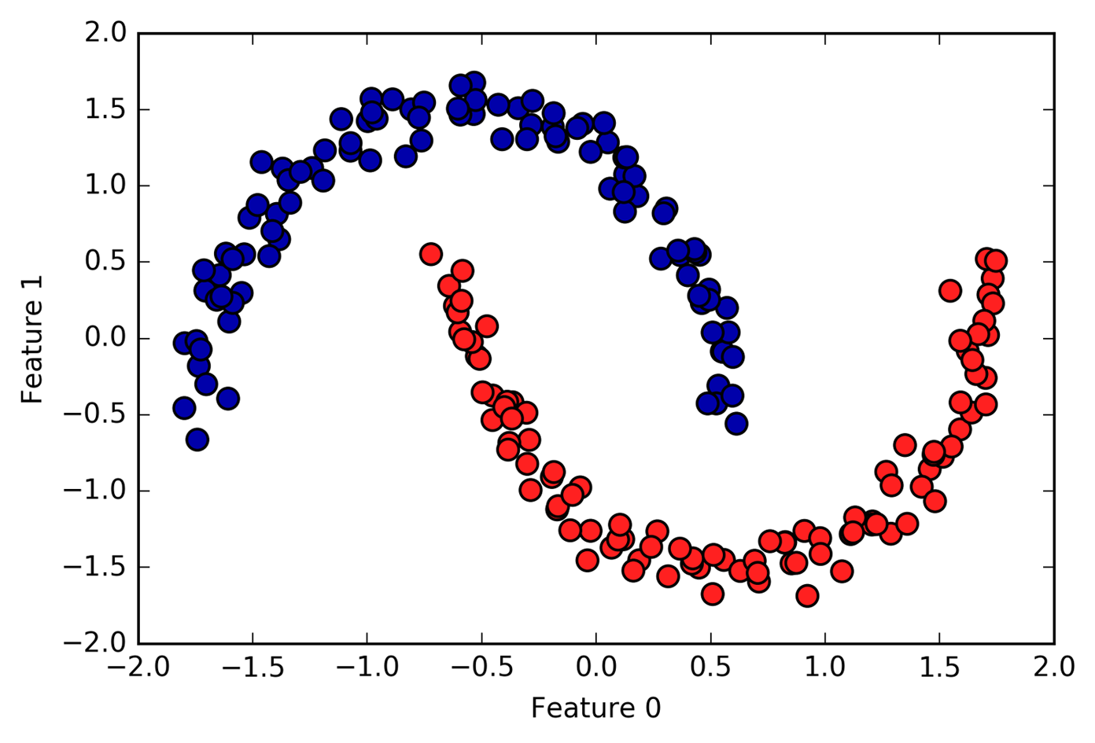
Pros and Cons
Allows complex cluster shapes
Can detect outliers
Needs two parameters to adjust, eps is hard to pick (can be done based on number of clusters though).
Can learn arbitrary cluster shapes

Slide 29
(Gaussian) Mixture Models

Slide 30
Mixture models
Generative model – find p(X).
Assume form of data generating process
Mixture model assumption:
  Data is mixture of small number of known distributions.
  Each mixture component distribution can be learned “simply”
  Each point comes from one particular component
We learn the component parameters and weights of components

Slide 31
Gaussian Mixture Models
Each component is created by a Gaussian distribution.
There is a multinomial distribution over the components.
Non-convex optimization.
Alternately assign points to components and compute mean and variance (EM algorithm).
Initialized with K-means, random restarts.

Slide 32
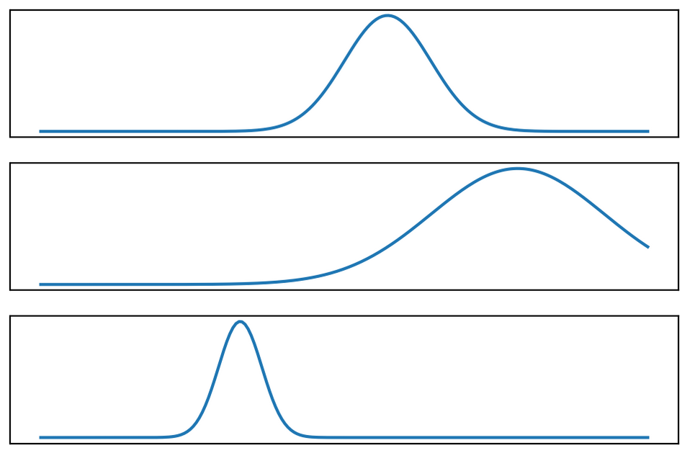
.5 *
.3 *
.2 *

Slide 33
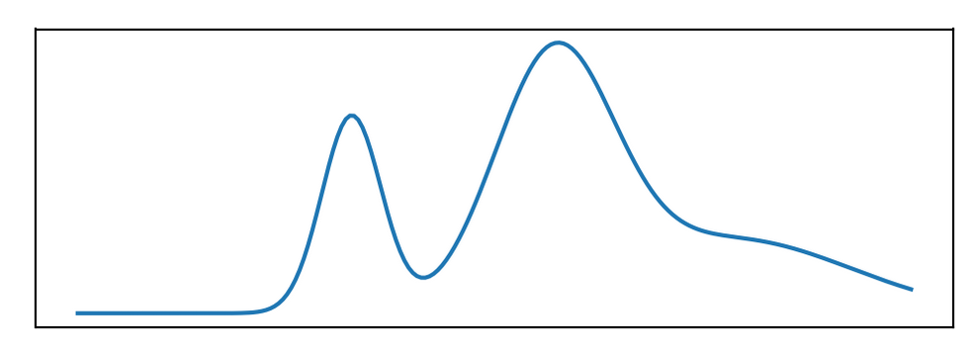
Goals of Mixture Models
Create parametric density model.
Allows for testing how “likely” a new point is.
Clustering (each components is one cluster).
Feature Extraction

Slide 34
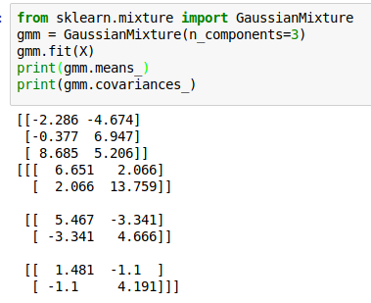
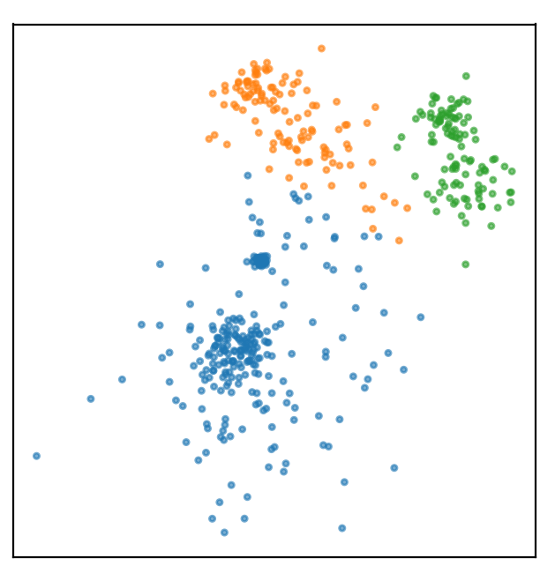
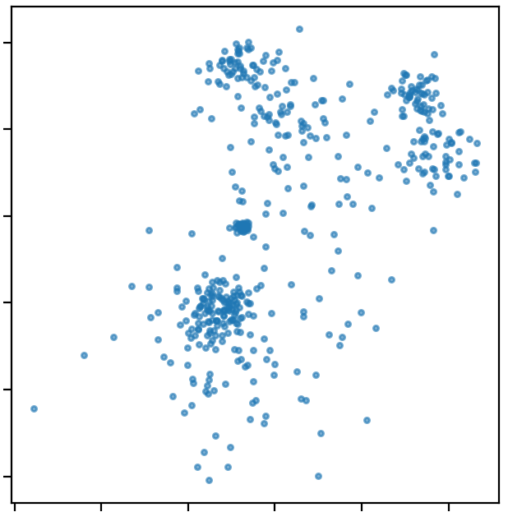
Examples

Slide 35
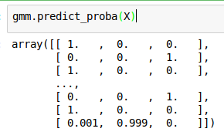
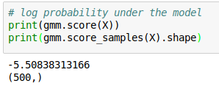
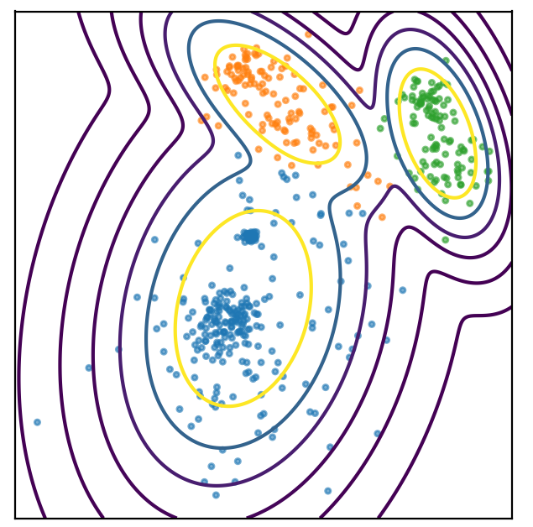
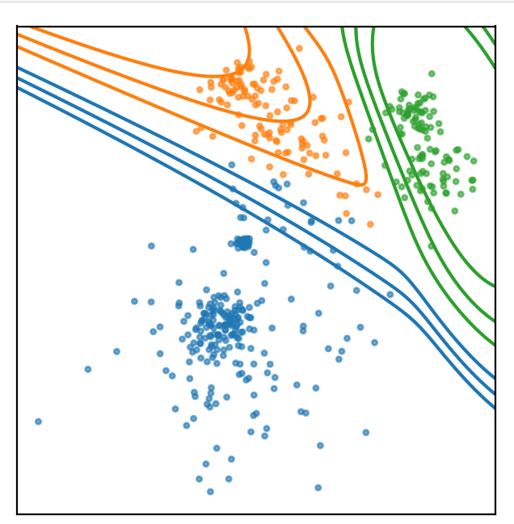
Probability estimates

Slide 36
Notes
In high dimensions, covariance=”full” might not work.
Try covariance=”diagonal”, covariance=”tied”.
Restart with different initializations (default=1)

Slide 37
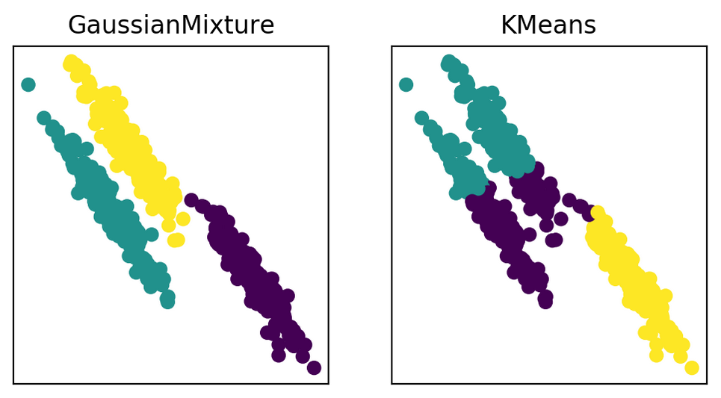
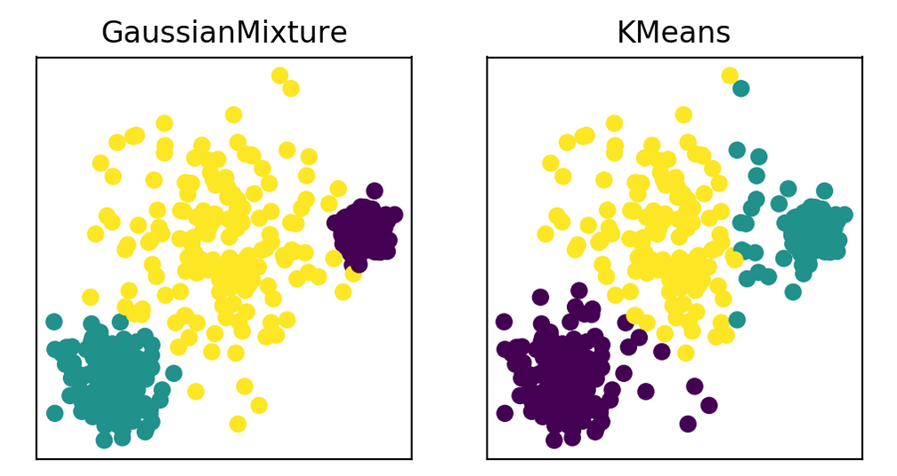
GMM vs KMeans
GMM can be more unstable, is more expensive to compute.

Slide 38
Bayesian Infinite Mixtures
Bayesian treatment:
  Add priors on mixture coefficients and Gaussians.
  Can “unselect” components if they don’t contribute.
  Possibly more robust
Infinite Mixtures:
  Replace Dirichlet Prior over mixture coefficients by Dirichlet Process.
  “automatically” finds number of components (based on parameter of the prior).
Both implemented in BayesianGaussianMixture
Use variational inference (as opposed to gibbs sampling)
In practice: need to specify

Slide 39
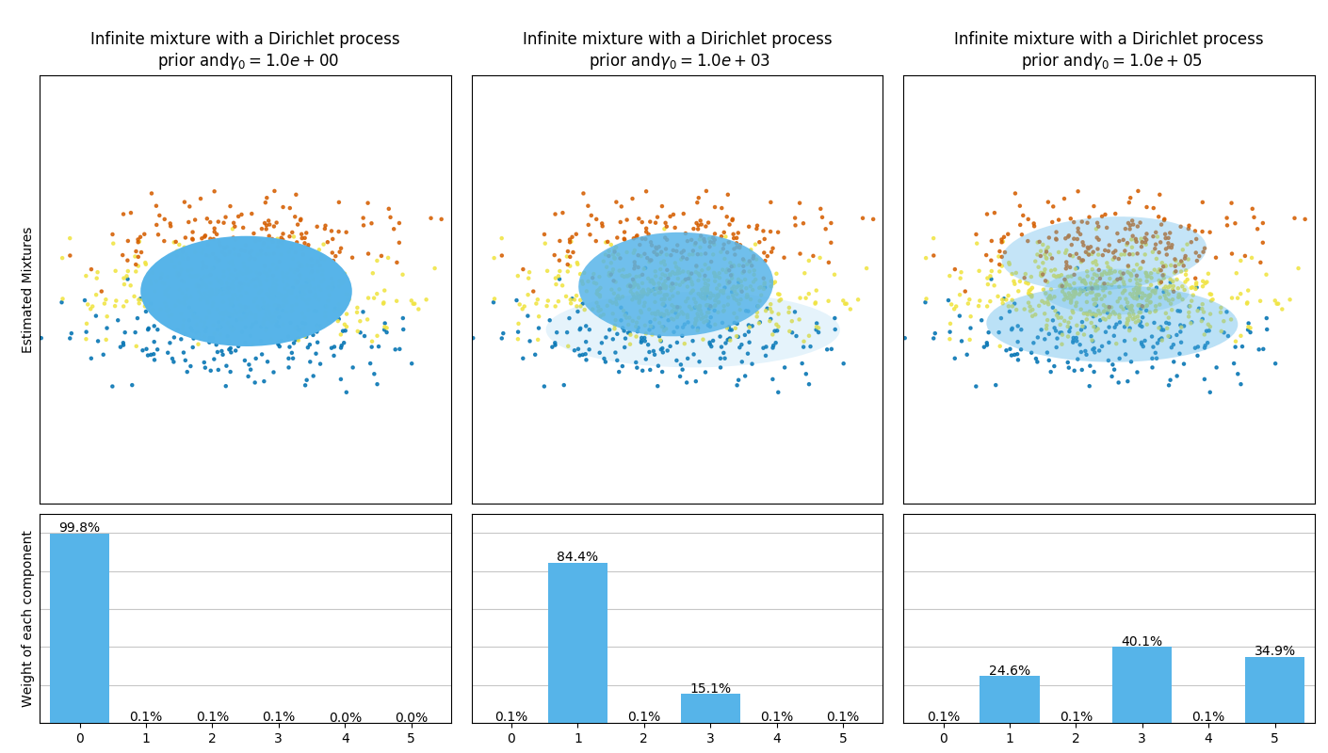

Slide 40
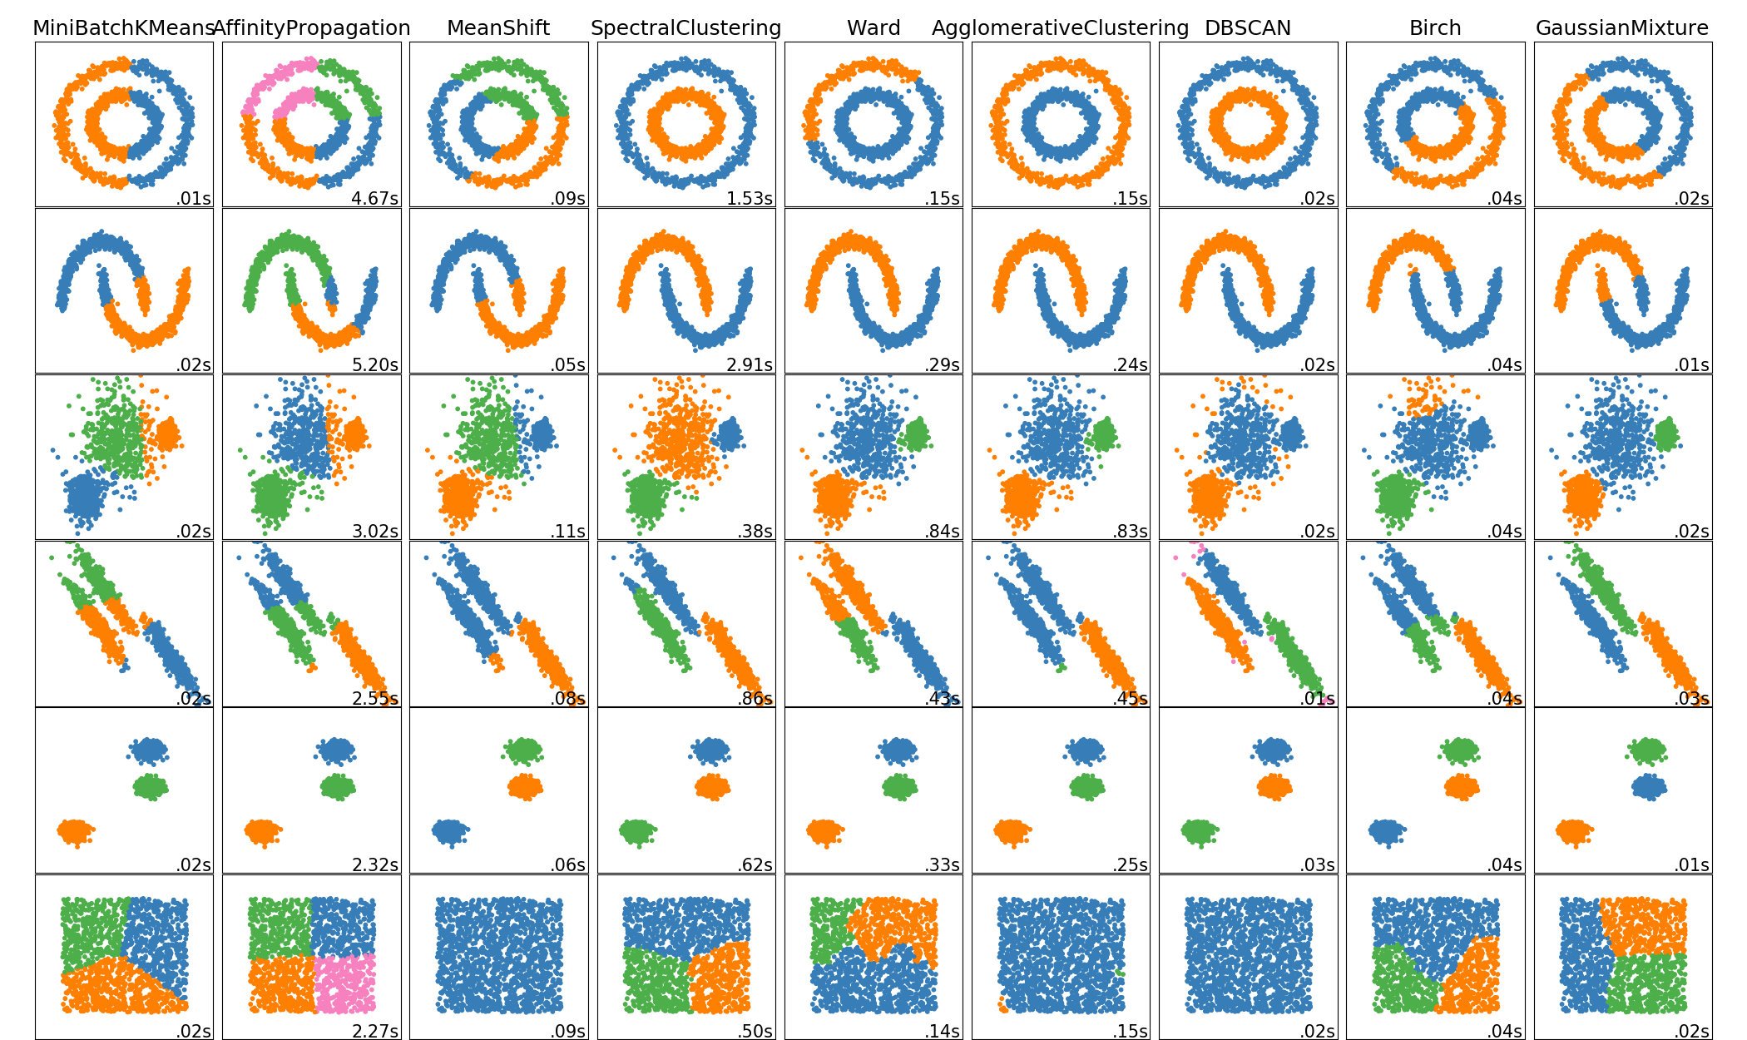
http://scikit-learn.org/dev/auto_examples/cluster/plot_cluster_comparison.html

Slide 41
Evaluation of Clustering

Slide 42
Qualitative Evaluation
(aka eyeballing)

Slide 43
Supervised evaluation

Slide 44
Unsupervised Evalution

Slide 45
Comparison on Toy Data

Slide 46
Comparison using Supervised Evaluation

