Slide 1
W4995 Applied Machine Learning
Even More Neural Networks
04/19/17
Andreas Müller

Slide 2
Convolutional neural networks

Slide 3
Idea
Translation invariance
Weight sharing

Slide 4
Definition of Convolution
0 1 2 0 1 1 0 0 1 0
-1 2 -1
-1 2 -1
-1 2 -1
0 3 -3 ...
Notes:
The definition is symmetric in f, but usually one is the input signal, say f, and g is a fixed “filter” that is applied to it.
You can imagine the convolution as g sliding over f.
If the support of g is smaller than the support of f (it’s a shorter non-zero sequence) then you can think of it as each entry in f * g depending on all entries of g multiplied with a local window in f.
Not that the output is shorter than the input by half the size of g. this is called a valid convolution.
We could also extend f with zeros, and get a result that is larger than f by half the size of g, that’s called a full convolution. We can also just pad a little bit and get something that is of the same size as f.
Also not that the filter g is flipped as it’s indexed with -m

Slide 5
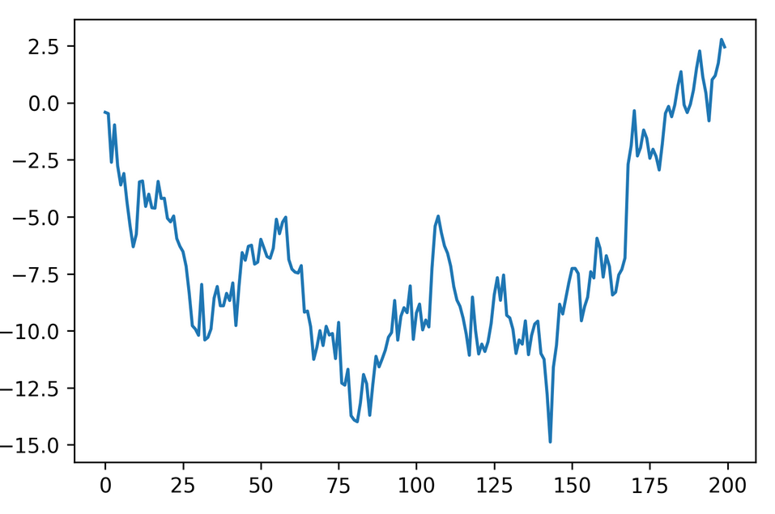
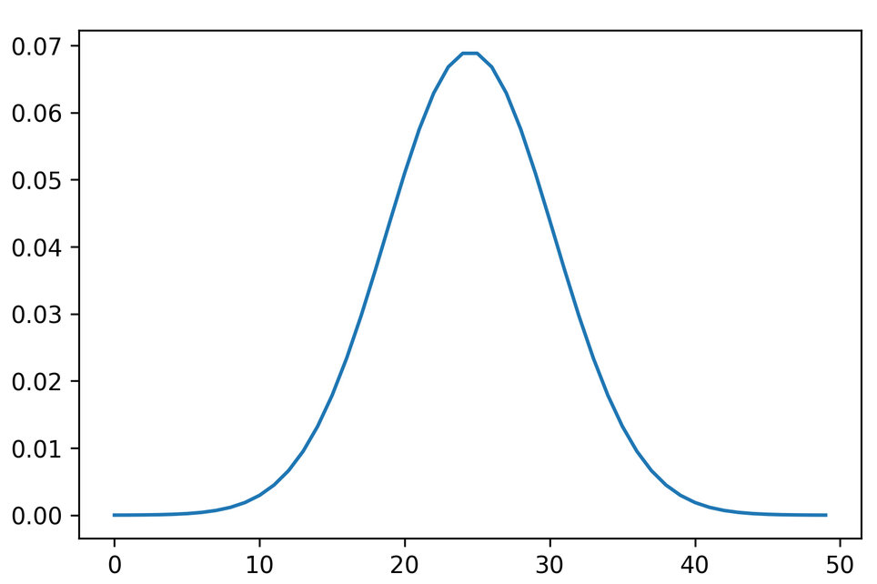
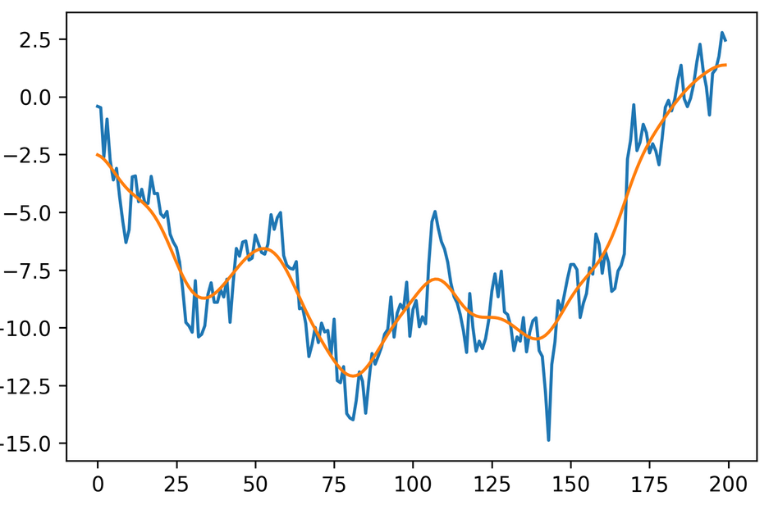
1d example: Gaussian smoothing
*
=

Slide 6
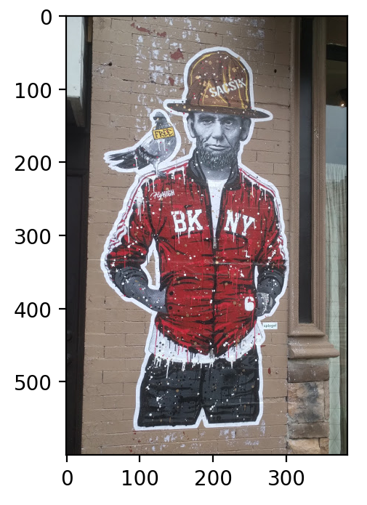
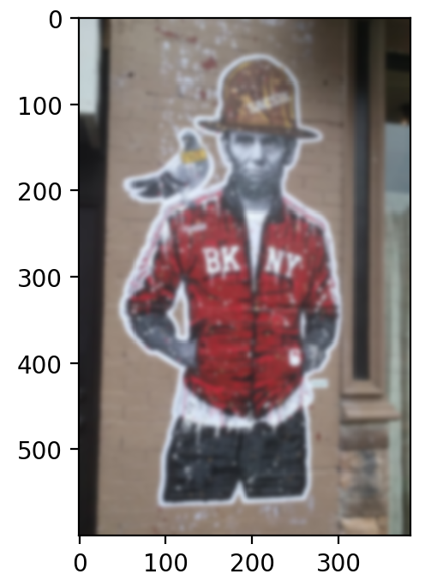
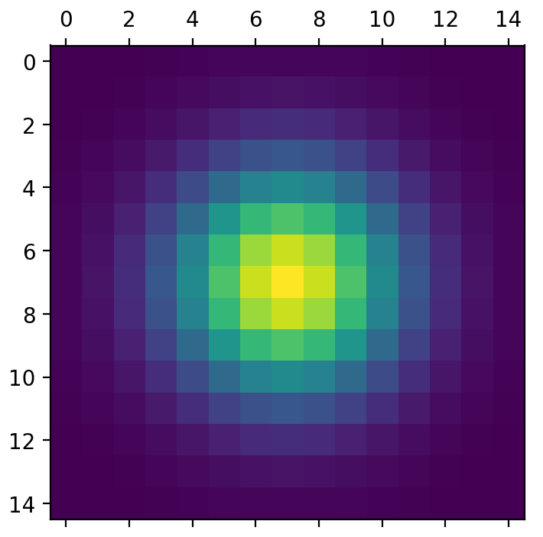
2d smoothing

Slide 7
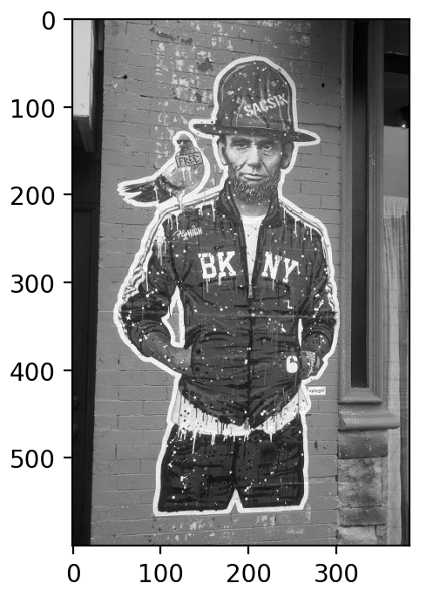
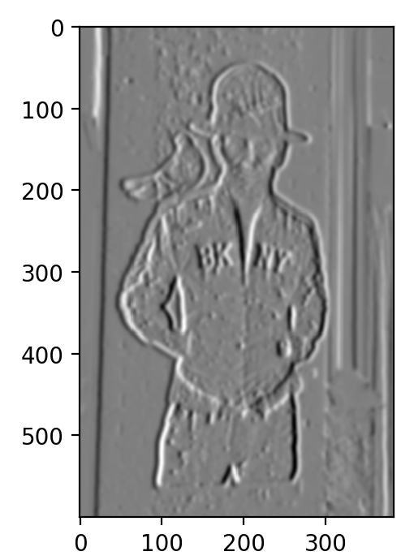
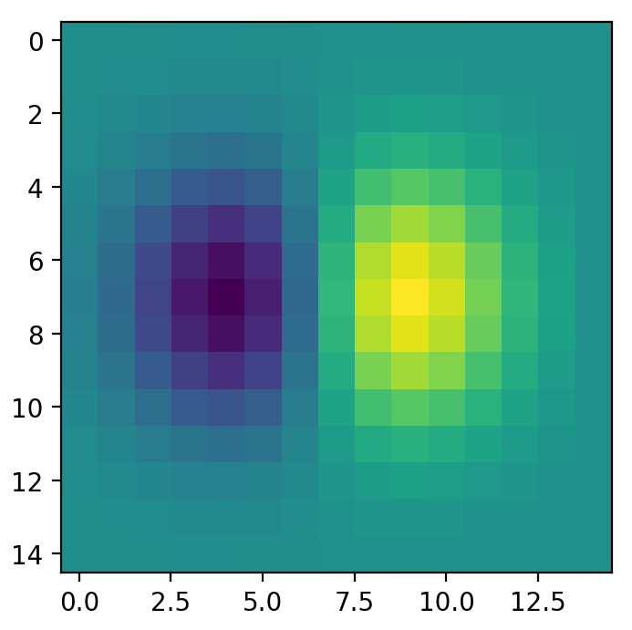
2d Gradients

Slide 8
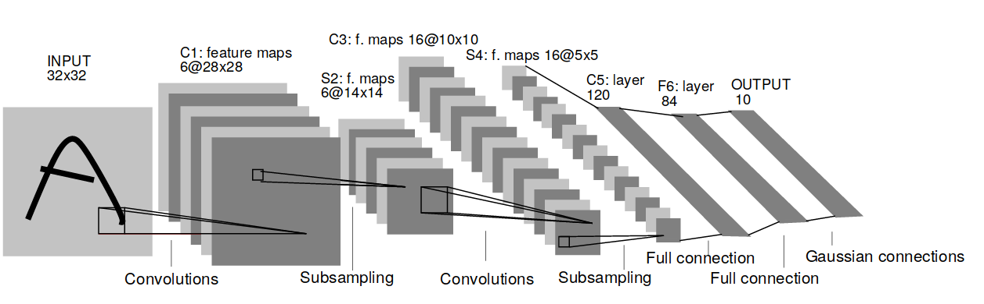
Convolutional Neural Networks
Y. LeCun, L. Bottou, Y. Bengio, and P. Haffner.
Gradient-based learning applied to document recognition
Notes:
Here is the architecture of an early convolutional net form 1998. The basic architecture in current networks is still the same.
You can multiple layers of convolutions and resampling operations. You start convolving the image, which extracts local features. Each convolutions creates new “feature maps” that serve as input to later convolutions.
To allow more global operations, after the convolutions the image resolution is changed. Back then it was subsampling, today it is max-pooling.
So you end up with more and more feature maps with lower and lower resolution.
At the end, you have some fully connected layers to do the classificattion.

Slide 9
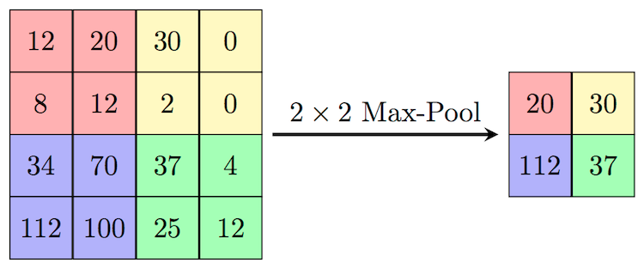
Max pooling
Need to remember position of maximum for back-propagation.
Again not differentiable → subgradient descent

Slide 10
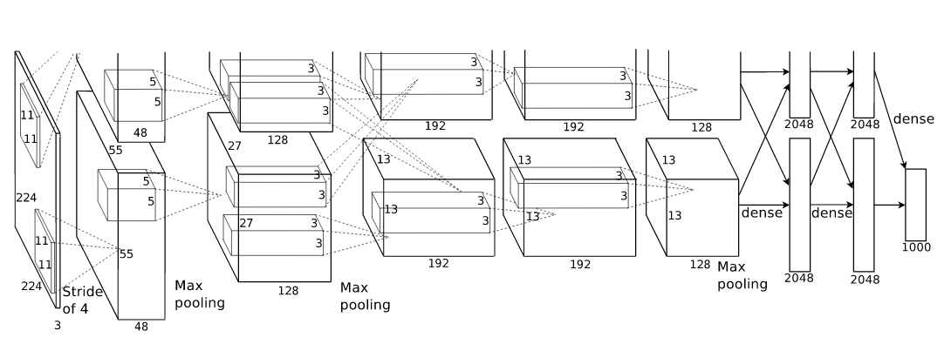
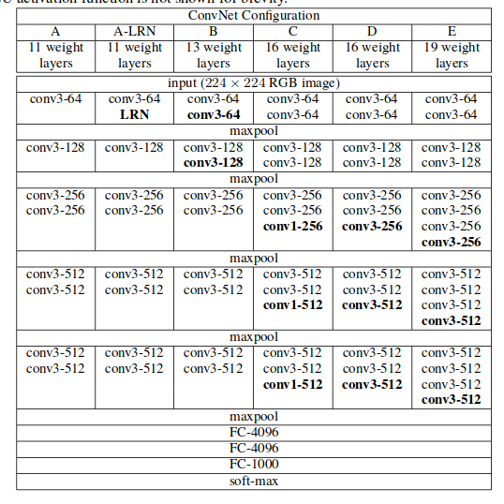

Alex Net
VGG 16
conv <receptive field size>-<number of channels>
Notes:
Here are two more recent architectures, AlexNet from 2012 and VGG net from 2015.
These nets are typically very deep, but often have very small convolutions. In VGG there are 3x3 convolutions and even 1x1 convolutions which serve to summarize multiple feature maps into one.
There is often multiple convolutions without pooling in between but pooling is definitely essential.

Slide 11
Conv-nets with keras

Slide 12
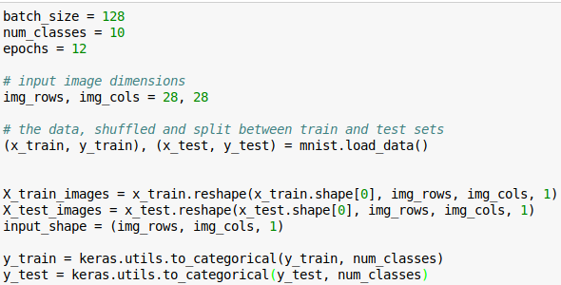
Preparing data
Channels
Notes:
For convolutional nets the data is n_samples, width, height, channels.
MNIST has one channel because it’s grayscale. Often you have RGB channels or possibly Lab.
The position of the channels is configurable, using the “channels_first” and “channels_last” options – but you shouldn’t have to worry about that.

Slide 13
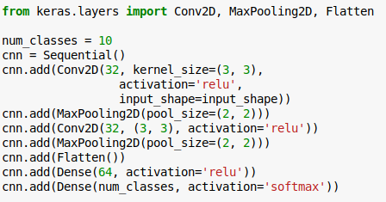
Notes:
For convolutional nets we need 3 new layer types: Conv2d for 2d convolutions, MaxPooling2d for max pooling and Flatten go reshape the input for a dense layer.
There are many other options but these are the most commonly used ones.

Slide 14
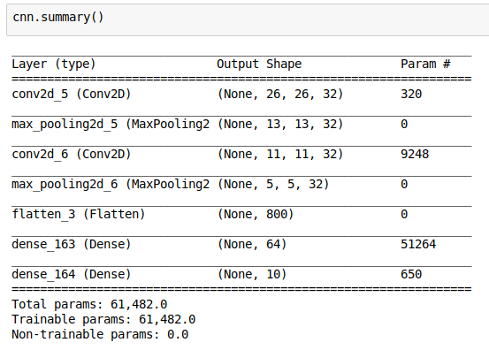
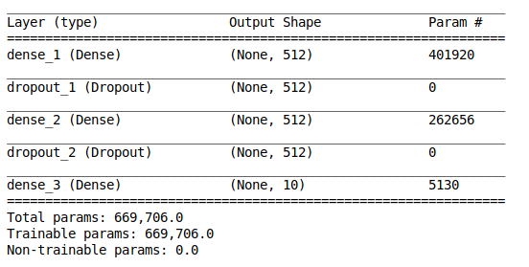
Number of Parameters
Convolutional network for MNIST
Dense network for MNIST

Slide 15
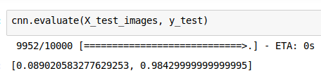
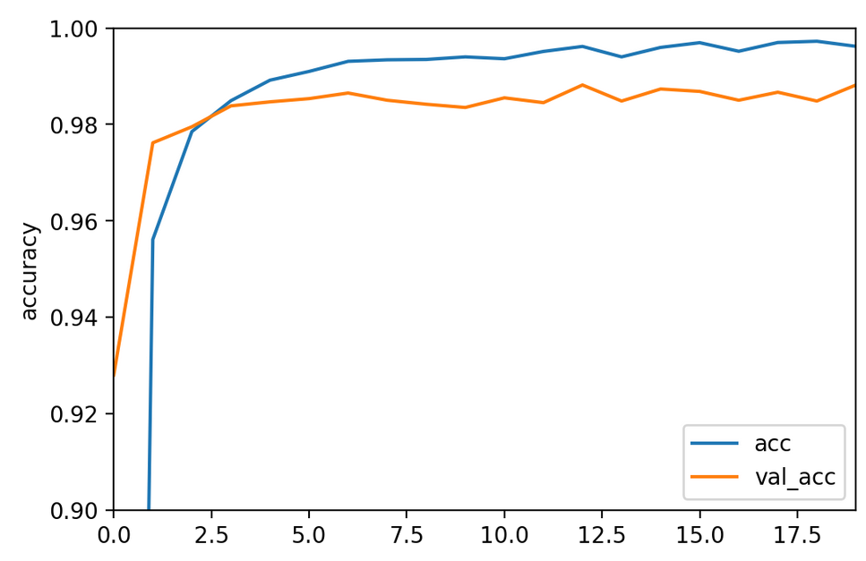
Train and Evaluate

Slide 17
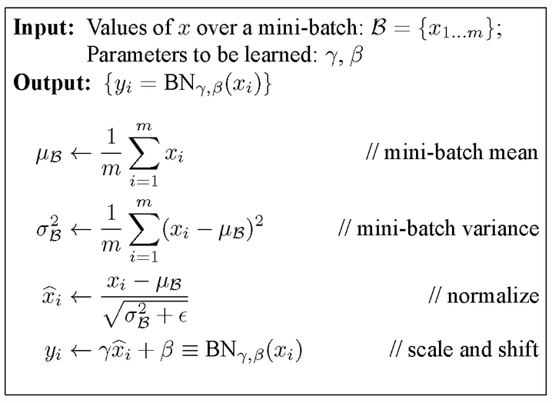
Batch Normalization
https://arxiv.org/abs/1502.03167
Notes:
Another relatively recent advance in neural networks is batch normalization. The idea is that neural networks learn best when the input is zero mean and unit variance. We can scale the data to get that.
But each layer inside a neural network is itself a neural network with inputs given by the previous layer. And that output might have much larger or smaller scale (depending on the activation function).
Batch normalization re-normalizes the activations for a layer for each batch during training (as the distribution over activation changes). The avoids saturation when using saturating functions.
To keep the expressive power of the model, additional scale and shift parameters are learned that are applied after the per-batch normalization.

Slide 19
Inspecting Conv-Nets

Slide 20
Tensorboard?

Slide 21
Deconvolution?

Slide 22
Filters learned in neural networks

Slide 23
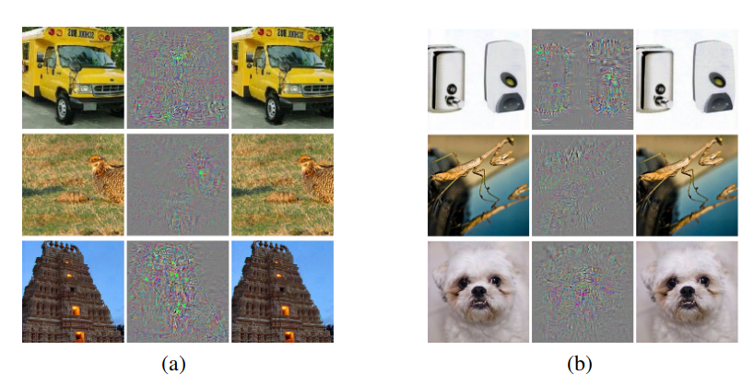
Adverserial Samples
Right column: correctly classified image, left column classified as Ostrich.
Center: difference.
Intriguing properties of neural networks https://arxiv.org/abs/1312.6199
Notes:
Since convolutional neural nets are so good at image recognition, some people think they are pretty infallible. But they are not. There is this interesting paper about intriguing properties of neural networks, that introduces adverserial samples.
Adverserial samples are samples that were created by an adversary or attacker to fool your model. Here, they changed images to be classified as Ostrich by AlexNet trained on imagenet.
The picture on the left is change just slightly, and went from correctly classified to classified as Ostrich.
This technique uses gradient descent on the input and requires access to all the weights in the network to create the samples.
Given how high-dimensional the input space is, this is not very surprising from a mathematical perspective, but it might be somewhat unexpected.

Slide 24
Using pre-trained networks
Train on “large enough” data.
Apply to new “small” dataset.
Take activations of last or second to last fully connected layer.
Notes:
Often we have a small but specific image dataset for a particular application. Training a neural net is not feasible unless we have tens of thousands or hundreds of thousands of images.
However, if we have a convolutional neural net that was already trained on a large dataset that is similar enough, we can hope that the features it learned are also helpful for our task.
The easiest way to adapt a trained network to a new task is to just apply it to our dataset and take the activations of the second to last or last layer.
If the original task was rich enough – say 10000 different classes as in imagenet – these layers contain a lot of information about the image.
We can then use these activations as features for another classifier like a linear model or smaller dense neural network.

Slide 25
Using pre-trained networks
Train on “large enough” data.
Apply to new “small” dataset.
Take activations of last or second to last fully connected layer.
Notes:
The main point is that we don’t need to retrain all the weights in the network. You can think of it as retraining only the last layer – the classification layer – of the network, while holding all the convolutional filters fixed. If they learned generic patterns like edges and patterns, these will still be useful for your task.
You can download pre-trained neural networks for many architectures online.
Using a pre-trained network is sometimes also known as transfer learning.
This potentially doesn’t work with images from a very different domain, like medical images.

Slide 26
Finetuning
Start with pre-trained net
Back-propagate error through all layers
“tune” filters to new data.
Notes:
A more complicated variant of this is to load a network trained on some other dataset, and replace the last layer with your classification task.
Instead of training only the last layer, we can also keep training all the previous layers, backpropagating the gradient through the network and adjusting the previously learned filters for our task.
You can think of this as warm-starting a neural network from one that was trained on another dataset.
If you do that, we often want to train the last layer a little bit before we backpropagate through the network. Otherwise the random initialization of the last layer might destroy the filters that we used for initialization.

