Slide 1
W4995 Applied Machine Learning
Preprocessing and Feature Engineering
02/15/17
Andreas Müller

Slide 2


Slide 3
Scaling

Slide 4
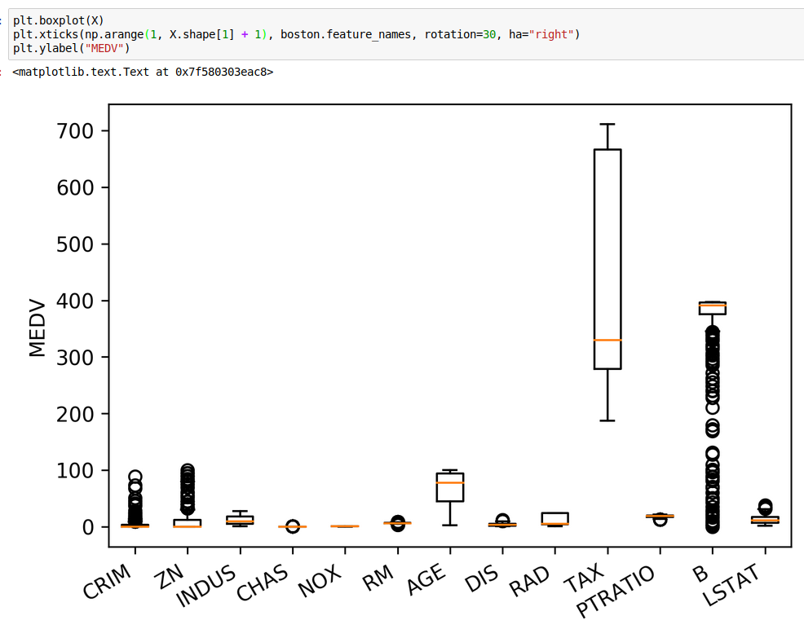

Slide 6
Sparse Data

Slide 7
A note on preprocessing (and pipelines)

Slide 8
Leaking information

Slide 9
Feature Distributions

Slide 10
Box-Cox Transform

Slide 11
Discrete Features

Slide 12
Models Supporting Discrete Features

Slide 13
One Hot Encoding

Slide 14
One-Hot vs statisticians

Slide 15
Count-Based Encoding

Slide 16
Feature Engineering

Slide 17
Interaction Features

Slide 18
Polynomial Features

Slide 19
Discretization and Binning

Slide 20
PCA

Slide 21
Missing Values

