Slide 1
W4995 Applied Machine Learning
Model evaluation and class imbalance
02/27/17
Andreas Müller

Slide 2
Metrics for Binary Classification

Slide 3
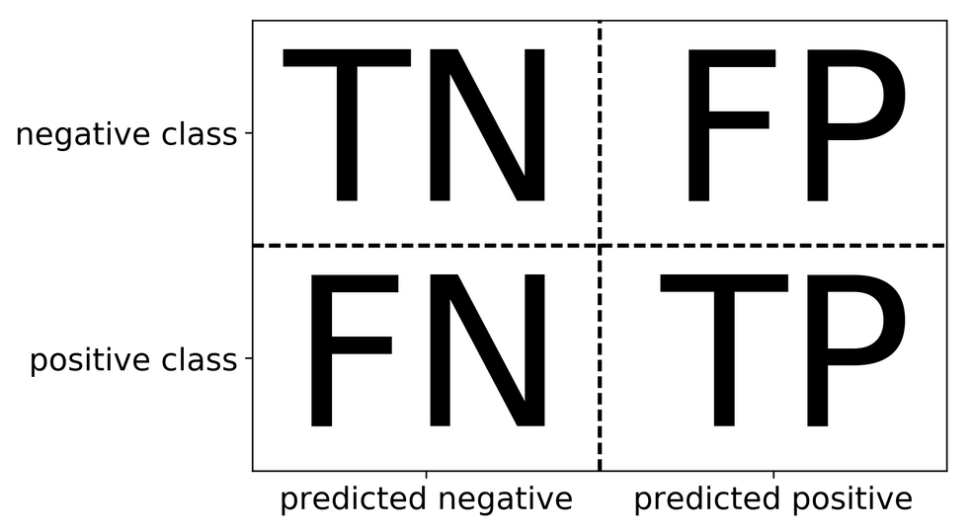
Review: confusion matrix
Diagonal divided by everything.

Slide 4
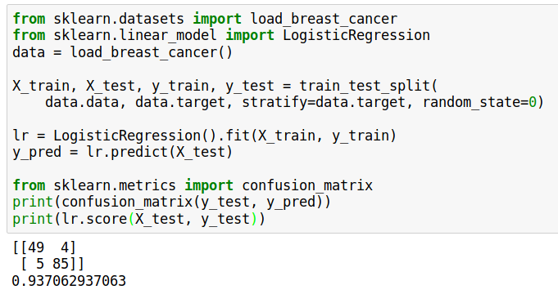

Slide 5
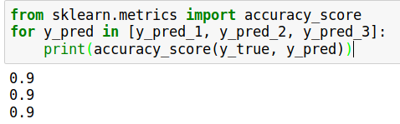
Problems with accuracy
Imbalanced classes lead to hard-to-interpret accuracy:
Data with 90% negatives

Slide 6
Precision, Recall, f-score
Positive Predicted Value (PPV)
Sensitivity, coverage, true positive rate.
All depend on definition of positive and negative!

Slide 7
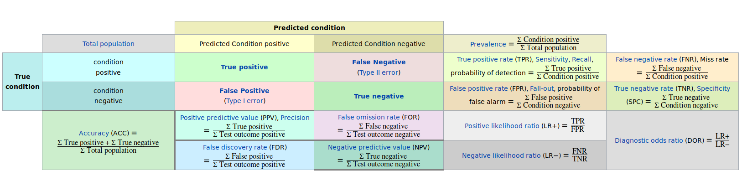
The zoo
https://en.wikipedia.org/wiki/Precision_and_recall

Slide 8
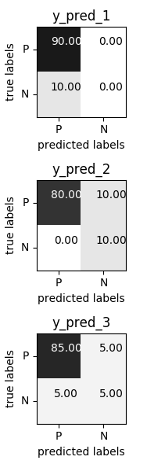
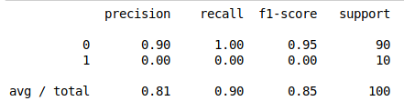
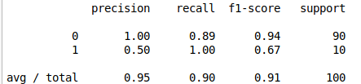
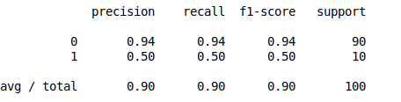

Slide 9
Goal setting!
What do I want? What do I care about?
(precision, recall, something else)
Can I assign costs to the confusion matrix?
(i.e. a false positive costs me $10, a false negative $100)
What guarantees do we want to give?

Slide 10
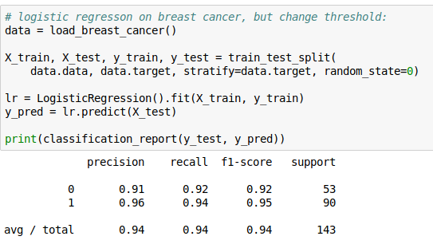
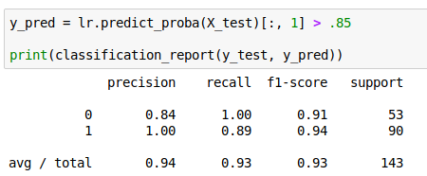
Changing Thresholds

Slide 11
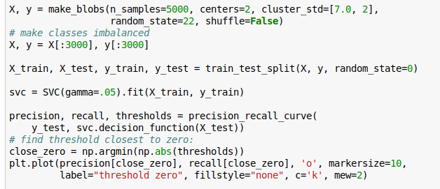
Precision-Recall Curve

Slide 12
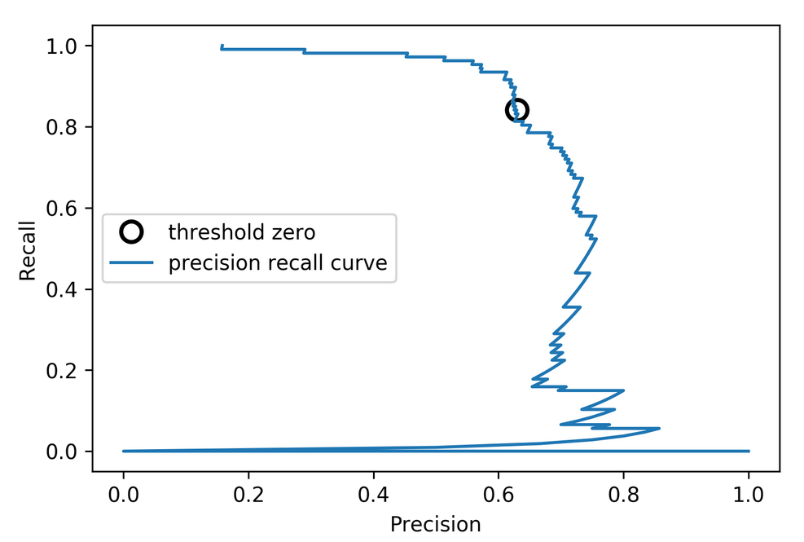
Precision-Recall Curve

Slide 13
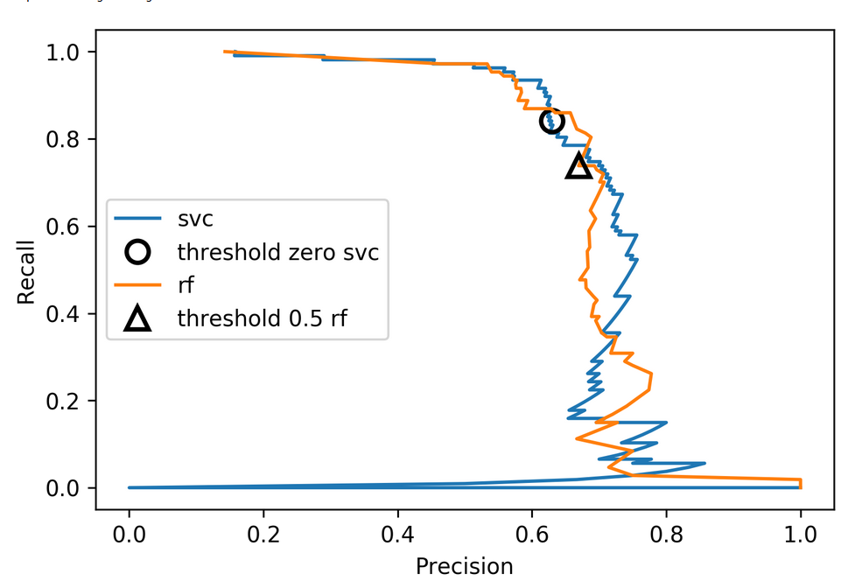
Comparing RF and SVC

Slide 14
Average Precision
Precision at threshold k
Change in recall
between k and k-1
Sum over data points, ranked by decision function
Same as area under the precision-recall curve
(depending on how you treat edge-cases)

Slide 15
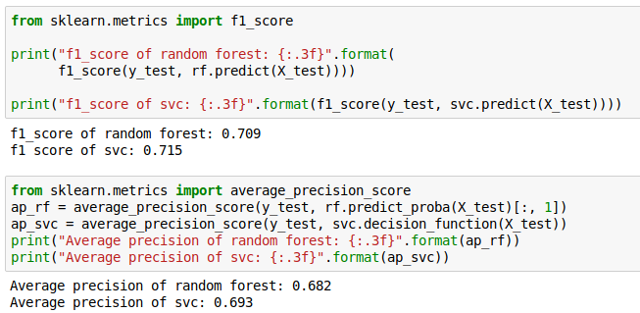
F1 vs average precision
AP only considers ranking!

Slide 16
ROC Curve
= recall

Slide 17
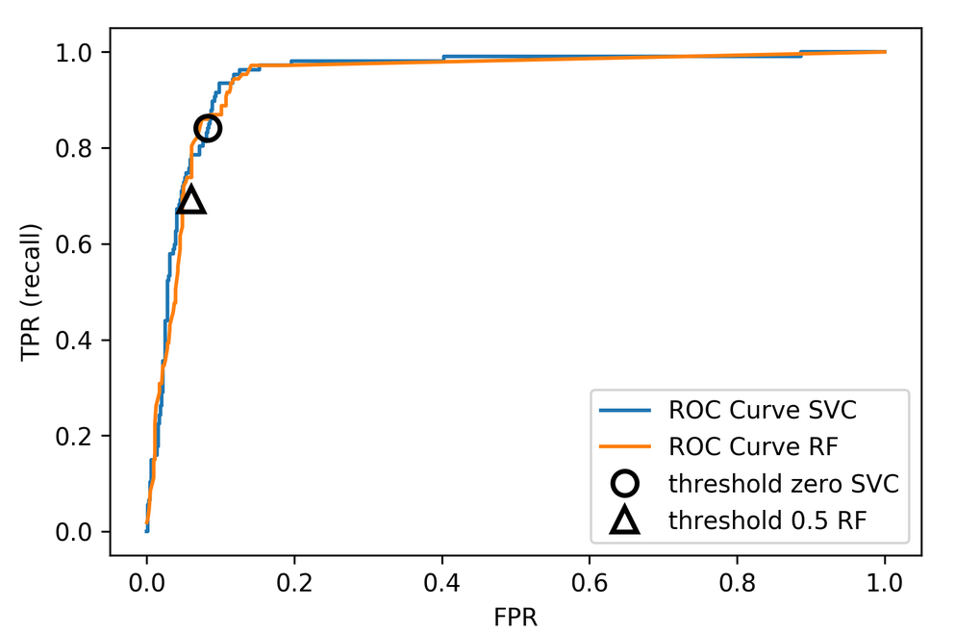

Slide 18
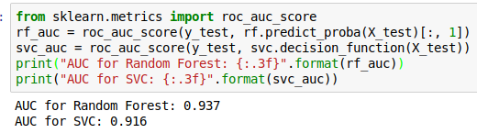
ROC AUC
Area under ROC Curve
Always .5 for random / constant prediction
The Relationship Between Precision-Recall and ROC Curves
https://www.biostat.wisc.edu/~page/rocpr.pdf

Slide 19
Multi-class classification

Slide 20
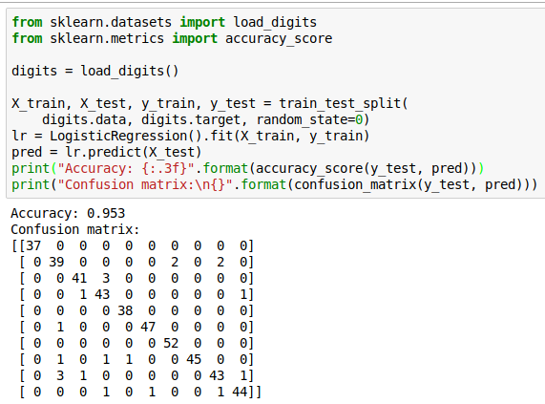
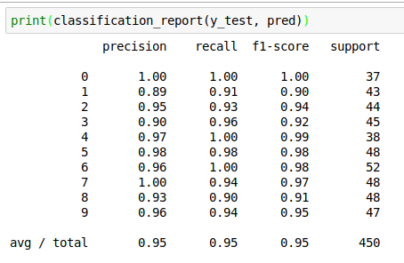
Confusion Matrix
Normalizing confusion matrix (by rows) can be helpful

Slide 21
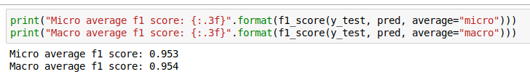
Micro and Macro F1
Macro-average f1: Average f1 scores over classes
Micro-average f1: Average binary confusion matrices, then compute recall, precision once
Macro: “all classes are equally important”
Micro: “all samples are equally important” - same for other metric averages

Slide 22
Multi-class ROC AUC
Hand & Till, 2001 one vs one
Provost & Domingo, 2000 one vs rest
https://github.com/scikit-learn/scikit-learn/pull/7663

Slide 23
Picking metrics?
Accuracy rarely what you want
Problems are rarely balanced
Find the right criterion for the task
OR pick one arbitrarily, but at least think about it
Emphasis on recall or precision?
Which classes are the important ones?

Slide 24
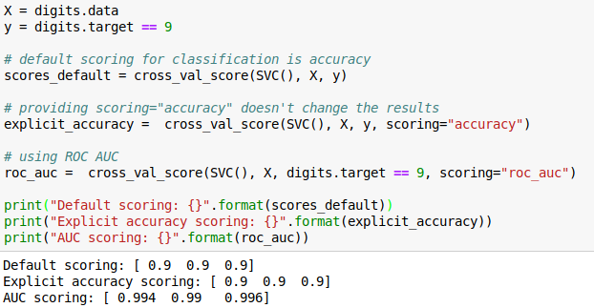
Using metrics in cross-validation
Same for GridSearchCV
Will make GridSearchCV.score use your metric!

Slide 25
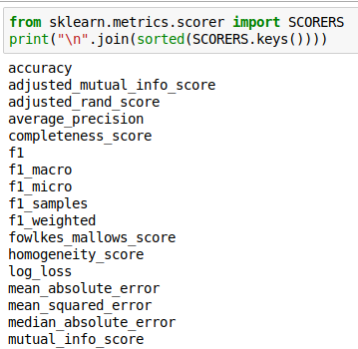
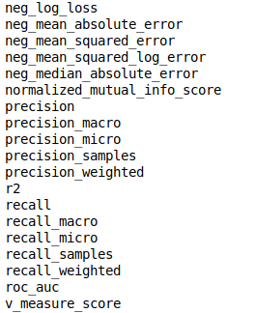
Built-in scoring
“scoring” can be string or callable.
Strings:

Slide 26
Providing your own callable
Takes estimator, X, y
Returns score – higher is better (always!)
def accuracy_scoring(est, X, y):
return (est.predict(X) == y).mean()

Slide 27
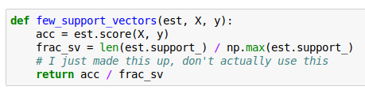
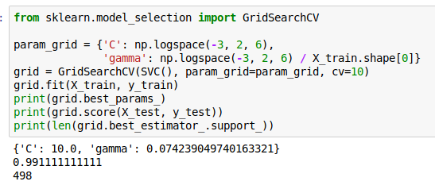
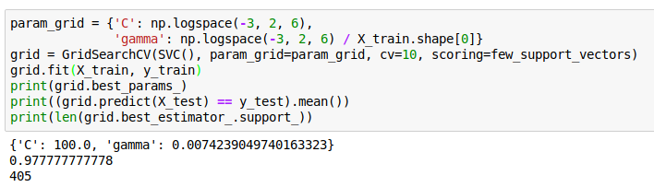
You can access the model!

Slide 28
Metrics for regression models

Slide 29
Build-in standard metrics
R^2 : easy to understand scale
MSE : easy to relate to input
Mean absolute error, median absolute error:
more robust.
When using “scoring” use “neg_mean_squared_error” etc

Slide 30
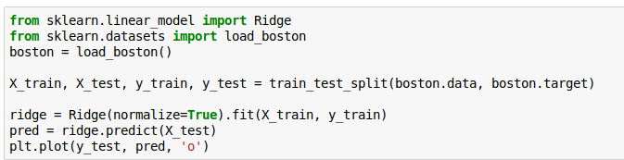
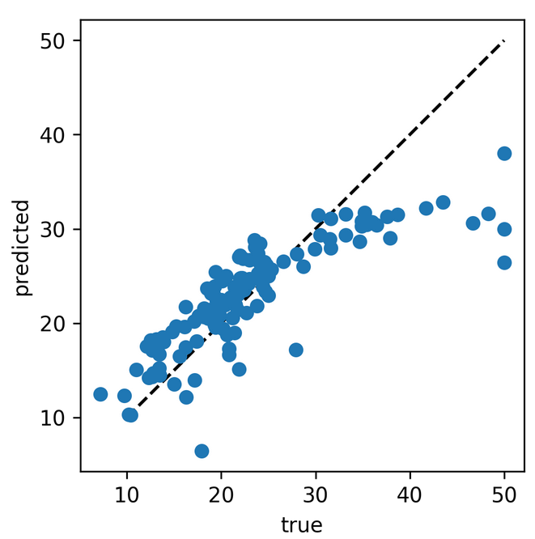
Prediction plots

Slide 31
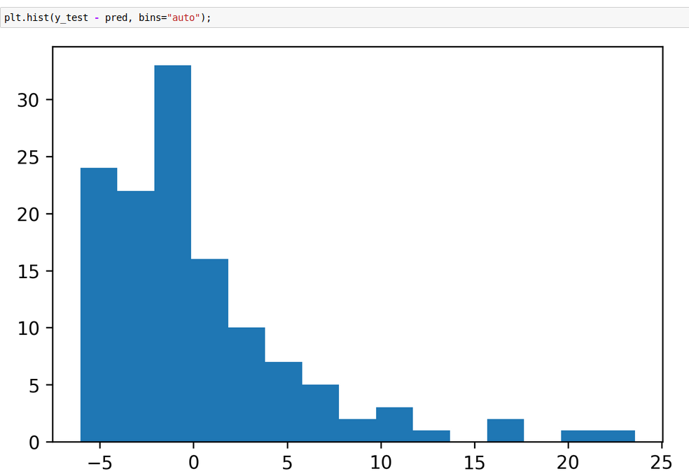
Residual Plots

Slide 32
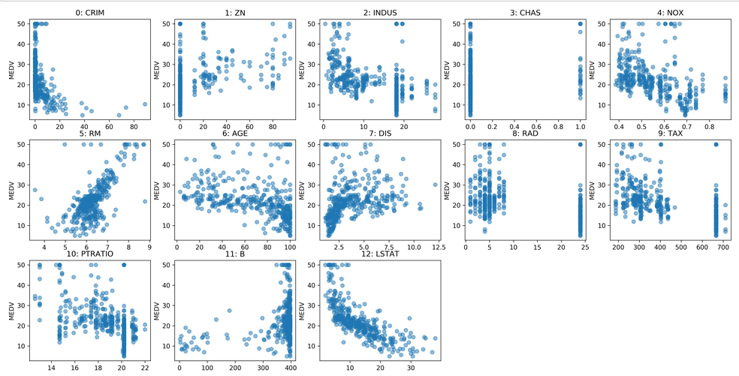
Residual vs Feature

Slide 33
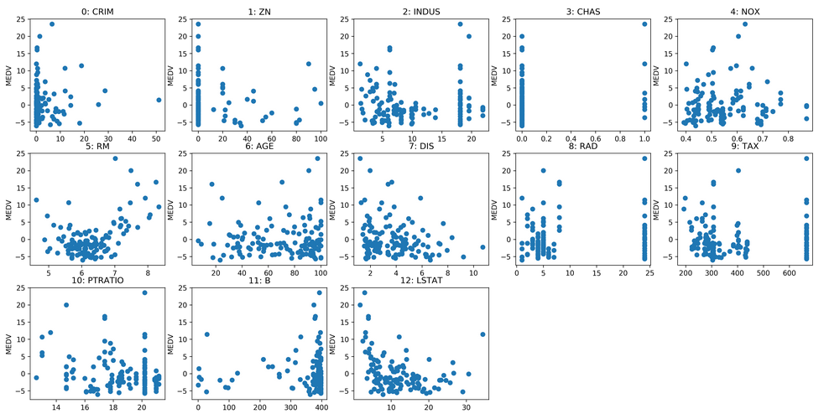
Residual vs Feature

Slide 34
Absolute vs relative: MAPE

Slide 35
Over vs under
Overprediction and underprediction can have different cost.
Try to create cost-matrix: how much does overprediction and underprediction cost?
Is it linear?

