Slide 1
W4995 Applied Machine Learning
NMF; Outlier detection
03/29/17
Andreas Müller

Slide 2
Non-Negative Matrix Factorization

Slide 3
Matrix Factorization
n x p
n x k k x p
P input features
B
k latent
dimensions
X
A
n samples
n samples
k latent dimensions
p input features

Slide 4
Matrix Factorization
n x p
n x k k x p
P input features
B
k latent
dimensions
X
A
n samples
n samples
Latent features
k latent dimensions
p input features
Latent representation

Slide 5
PCA
B
Principal components
X
A
Projected data

Slide 6
Other Matrix Factorizations
PCA: principal components orthogonal, minimize squared loss
Sparse PCA: components orthogonal & sparse
ICA: independent components
Non-negative matrix factorization (NMF):
latent representation and latent features are non-negative.

Slide 7
NMF
W
weights
X
H
Hidden representation

Slide 8
Why NMF?
Data points are composed into positive sums
Positive weights can be easier to interpret
No “cancellation” like in PCA
No sign ambiguity like in PCA
Can learn over-complete representation (n_components > n_features) by asking for sparsity (in either W or H)
Can be viewed as “soft clustering”: each point is positive linear combination of weights.

Slide 9
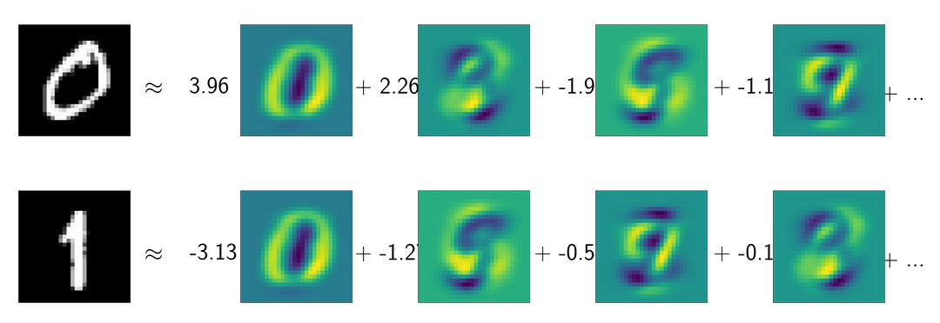
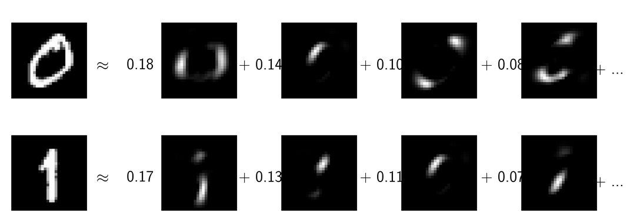
PCA (ordered by projection, not eigenvalue
NMF (ordered by hidden representation)

Slide 10
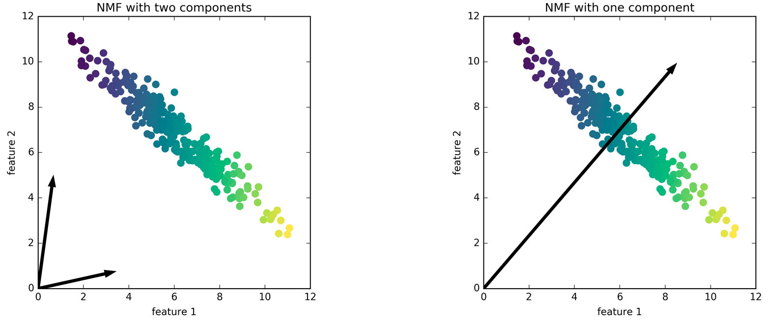
Downsides of NMF
Can only be applied to non-negative data
Whether components are interpretable is hit/miss
Non-convex optimization, requires initialization
Can be slow on large datasets
Not orthogonal

Slide 11
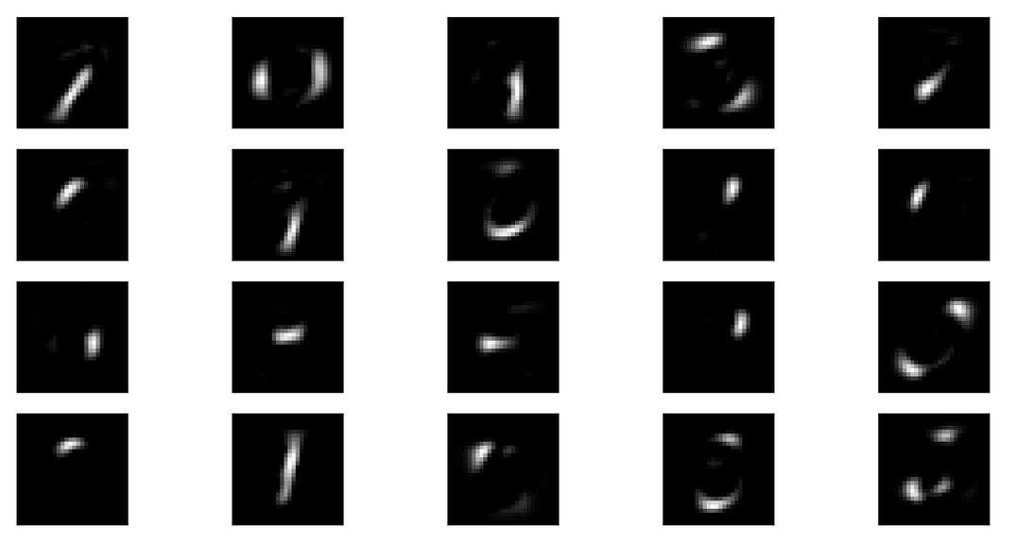
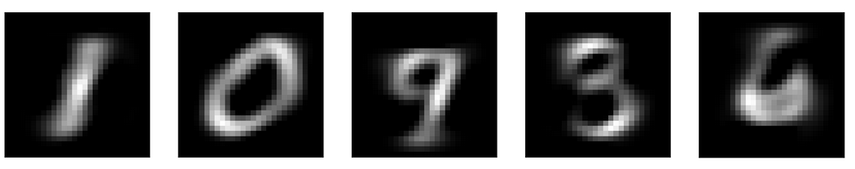
NMF with 20 components on MNIST
NMF with 5 components on MNIST

Slide 12
Applications of NMF
Text analysis (next week)
Signal processing
Speech and Audio (see https://librosa.github.io/librosa/generated/librosa.decompose.decompose.html#librosa.decompose.decompose)
Source separation
Gene expression analysis

Slide 13
Outlier Detection

Slide 14
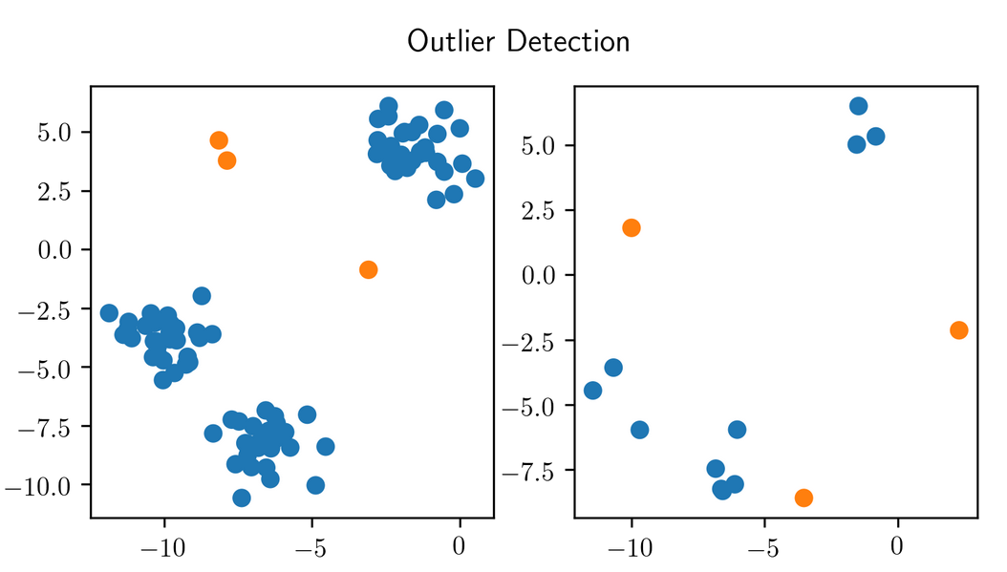
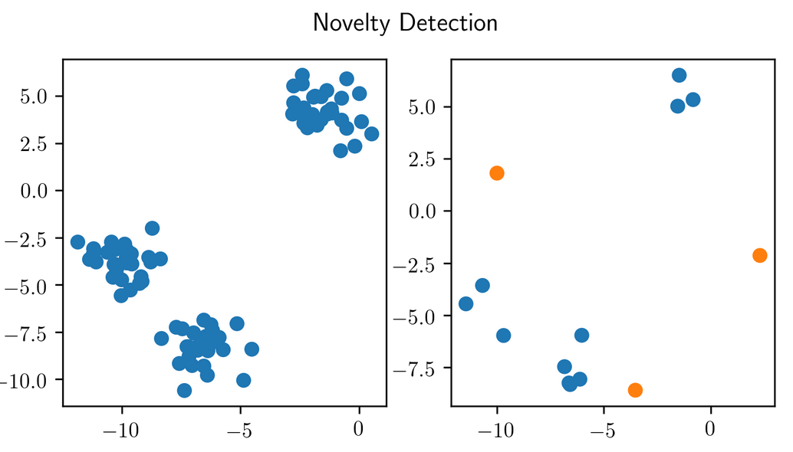
Motivation
Find points that are “different” within the training set (and in the future).
“Novelty detection” - no outliers in the training set.
Outliers are not labeled! (otherwise it’s just imbalanced classification)
Often used interchangeably in practice.

Slide 15
Applications
Fraud detection (credit cards, click fraud, ...)
Network failure detection
Intrusion detection in networks
Defect detection (engineering etc…)
News? Intelligence?

Slide 16
Basic idea
Model data distribution
For outlier detection: be robust in modelling
Nonparametric or parametric method
Apply at test-time, threshold likelihood.
Task is generally ill-defined (unless you know the real data distribution).

Slide 17
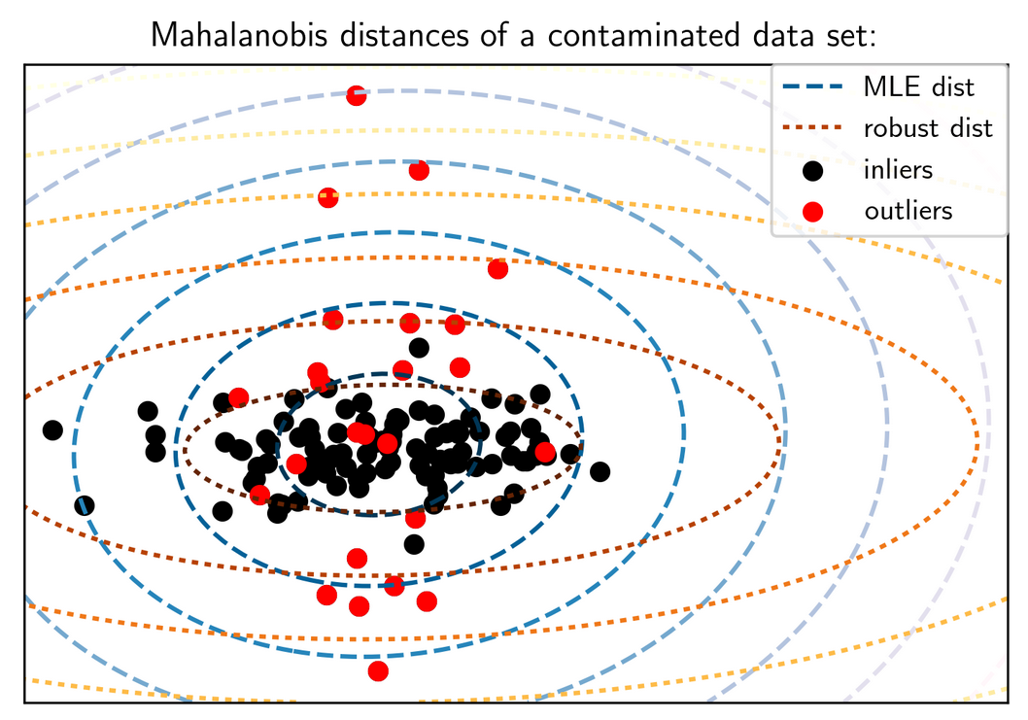
Elliptic Envelope
Gaussian model
Fit robust covariance matrix and mean

Slide 18
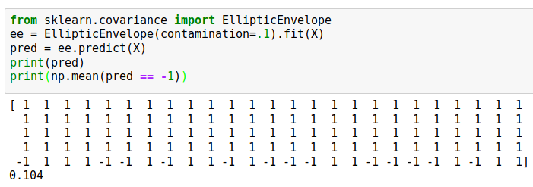
Elliptic Envelope
Only works if Gaussian assumption is reasonable
Preprocessing with PCA might help sometimes.

Slide 19
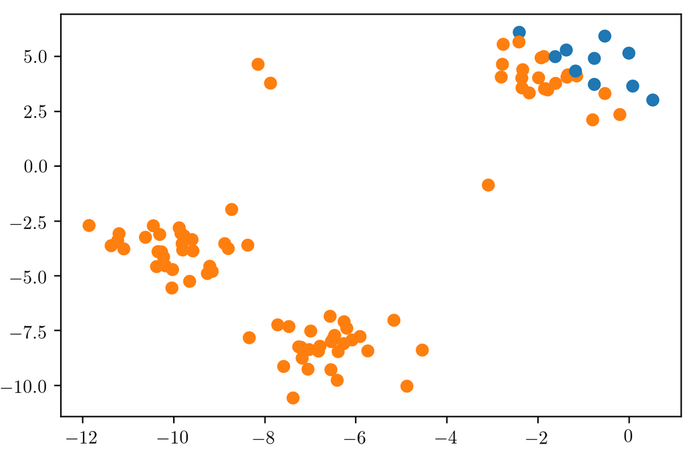

Slide 20
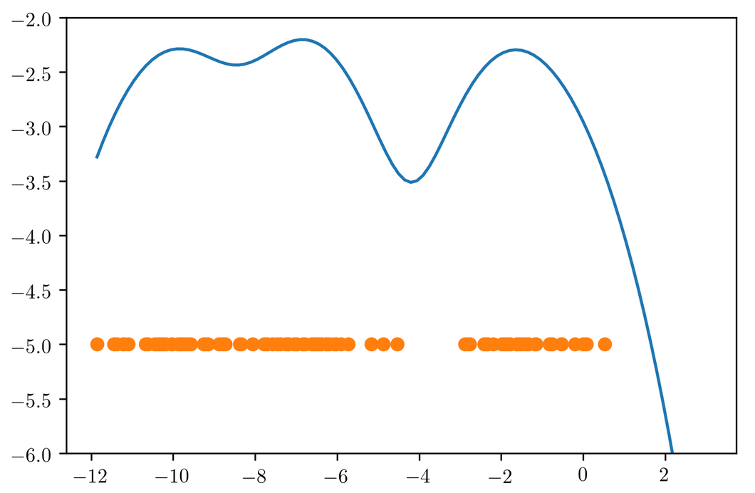
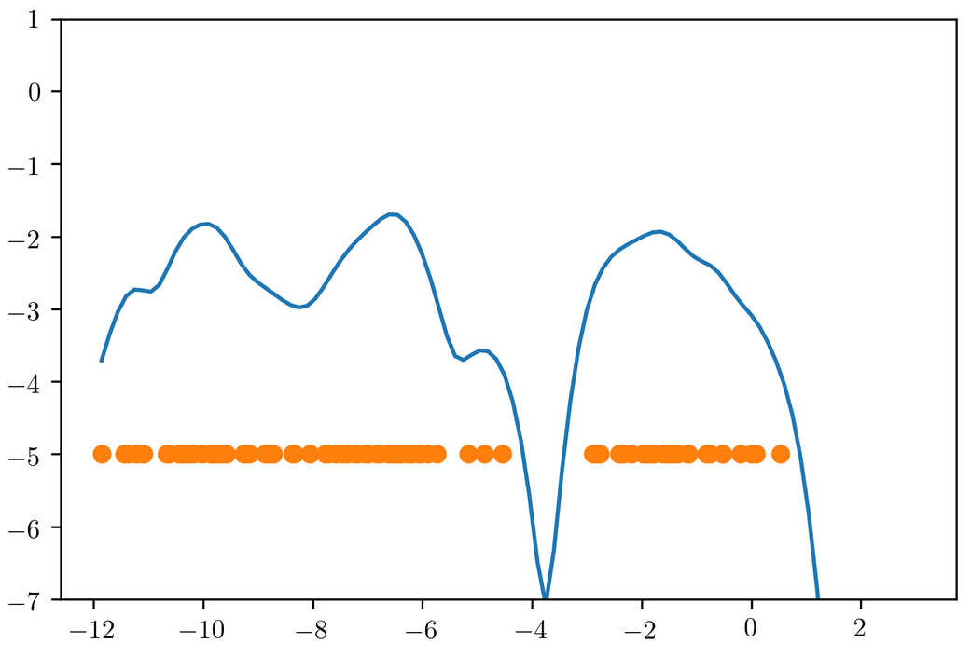
Kernel Density
Non-parametric density model
Gaussian blob on each data point
Need to adjust kernel bandwidth
Doesn’t work well in high dimensions
Unsupervised model, so how to pick?

Slide 21

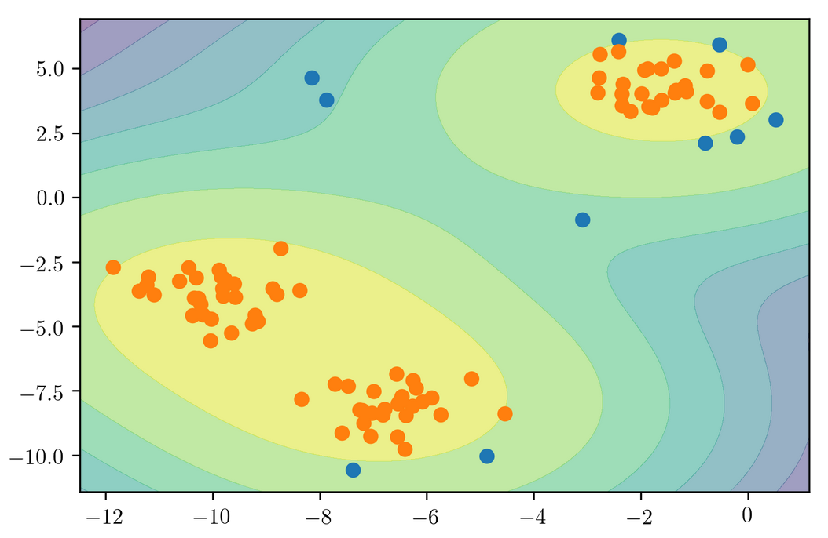

Slide 22
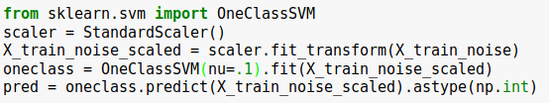
One Class SVM
Also uses Gaussian kernel to cover data.
Only select support vectors (not all points)
Need to select gamma
Specify outlier ratio (contamination) via nu (actually “fraction of training mistakes”)

Slide 23
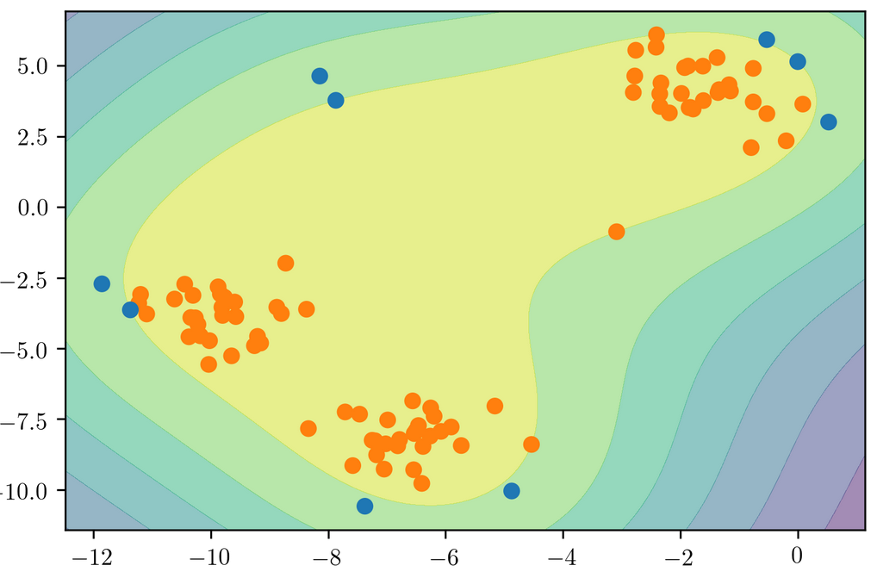

Slide 24
Isolation Forests

Slide 25
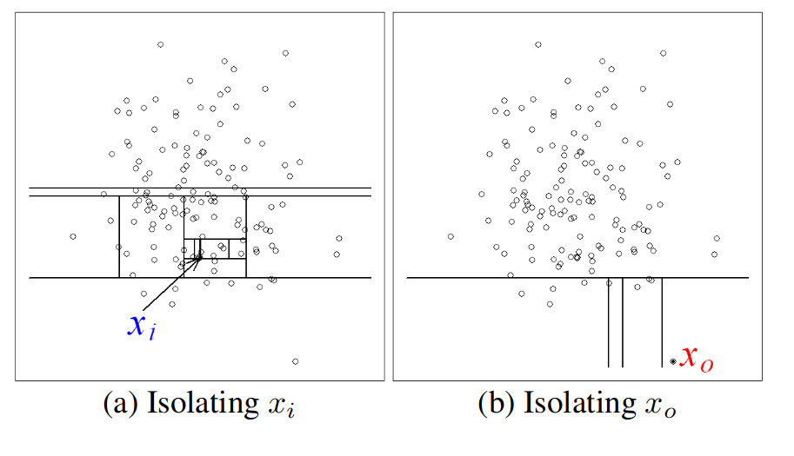
Idea
Build random trees
Outliers are easier to isolate from the rest
Measure as Path length!

Slide 26
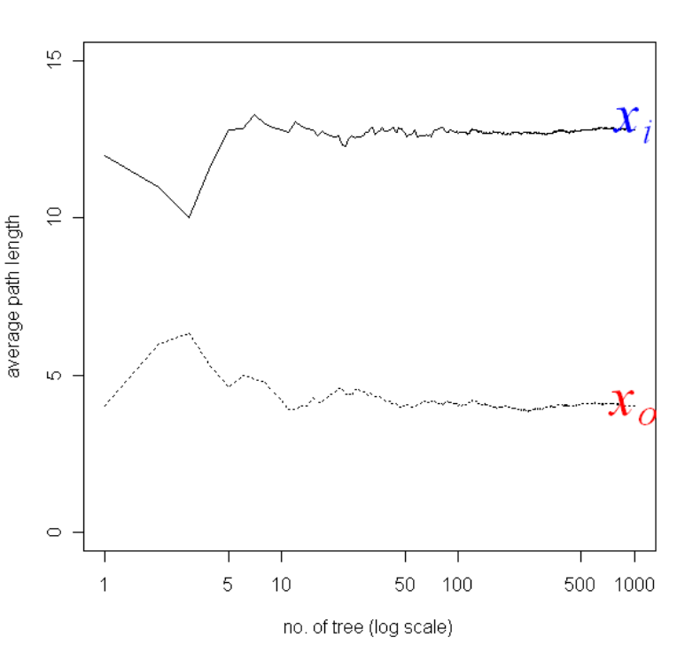

Slide 27

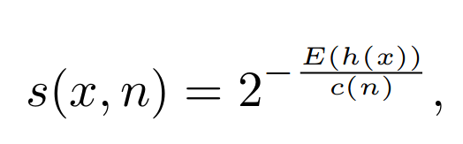
Normalizing the Path Length
Average path length of unsuccessful search in Binary Search Tree:
H = Harmonic number
h = depth in three
s < .5: definite inlier
s close to 1: outlier

Slide 28
Building the forest
Subsample dataset for each tree
Default sample size of 256 works surprisingly well
Stop growing tree at depth log_2(sample size) – so 8
No bootstrapping usually
More trees are better – default 100
Need to specify contamination rate

Slide 29
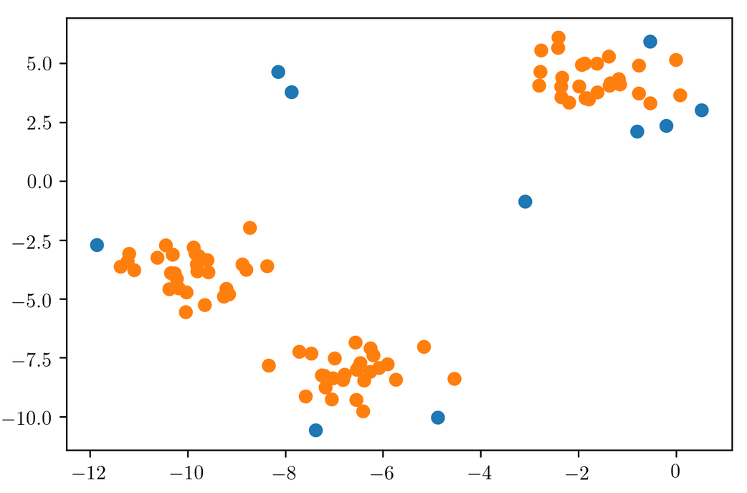

Slide 30
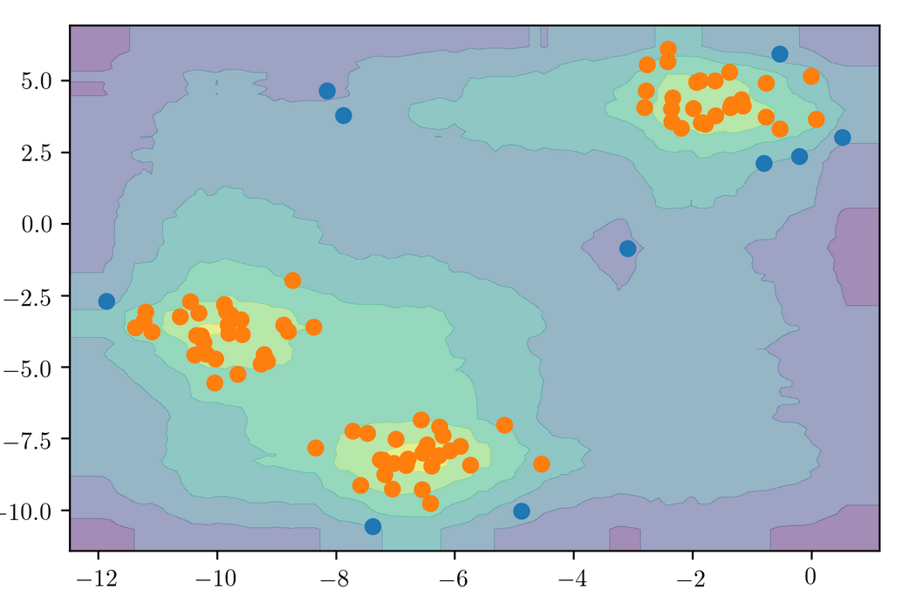

Slide 31
Other density based-models
PCA
GMMs
Robust PCA (not in sklearn :-()
Any other probabilistic model - “robust” is better.

Slide 32
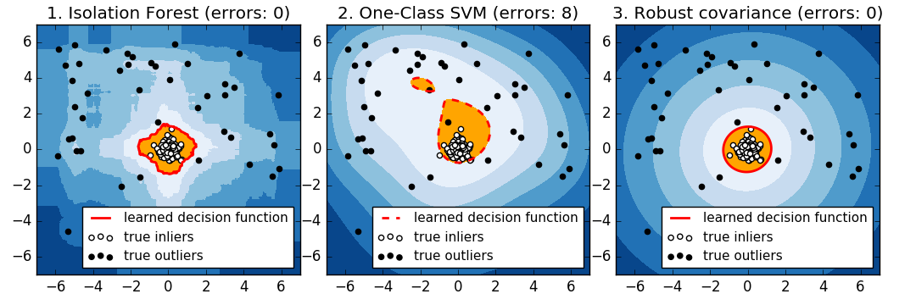
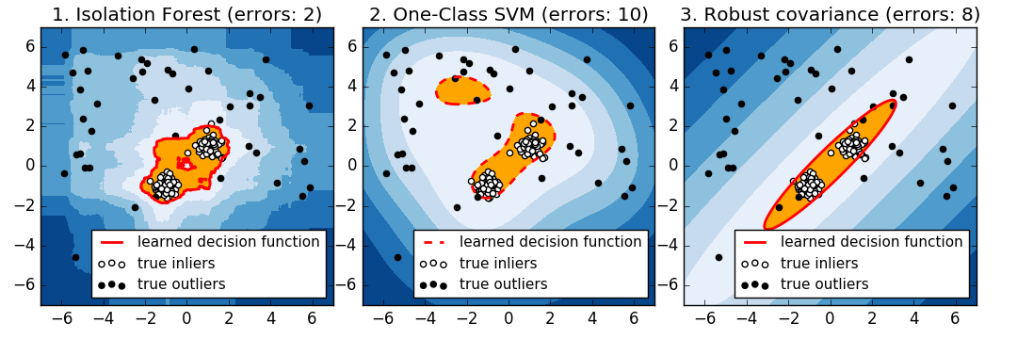
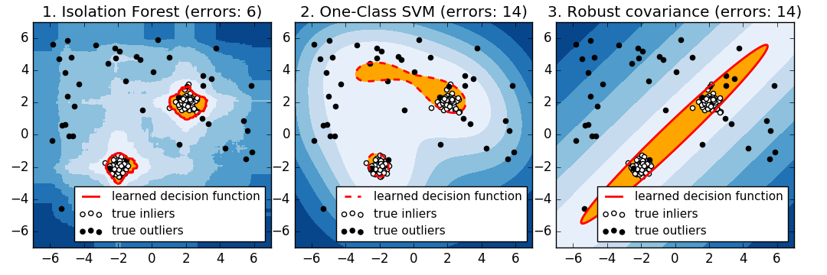

Slide 33
Summary
Isolation Forest works great!
Density models are great if they are correct.
Estimating bandwidth can be tricky in the unsupervised setting.
Validation of results requires manual inspection.

