Slide 1
W4995 Applied Machine Learning
Working with Text Data
04/03/17
Andreas Müller

Slide 2
More kinds of data
So far:
  Fixed number of features
  Continuous
  Categorical
Next up:
  No pre-defined features
  Free text
  Images
  (Audio: not this class)
  Need to create fixed-length description

Slide 3
Typical Text data
**May Contain Spoilers**<br /><br />A dude in a dopey-looking Kong suit (the same one used in KING KONG VS. GODZILLA in 1962) provides much of the laffs in this much-mocked monster flick. Kong is resurrected on Mondo Island and helps out the lunkhead hero and other good guys this time around. The vampire-like villain is named Dr. Who-funny, he doesn't look like Peter Cushing! Kong finally dukes it out with Who's pride and joy, a giant robot ape that looks like a bad metal sculpture of Magilla Gorilla. Like many of Honda's flicks this may have had some merit before American audiences diddled around with it and added new footage. The Rankin/Bass animation company had a hand in this mess. They should have stuck to superior children's programs like The Little Drummer Boy.
... than this ;-) What would happen if Terry Gilliam and Douglas Adams would have worked together on one movie? This movie starts with a touch of Brazil... when, at a certain point, the story moves straight into the twilight zone... bringing up nothing new, but just nothing... and nothing is great fun! When Dave and Andrew starts to explore their new environment the movie gets really enjoyable... bouncing heads? well... yes ;-) <br /><br />anyway... this movie was, imho, the biggest surprise at this year's FantasyFilmFest...<br /><br />Just like in Cube and Cypher Natali gave this one a minimalistic, weird but very special design, which makes it hard to locate the place of the story or its time... timeless somehow...

Slide 4
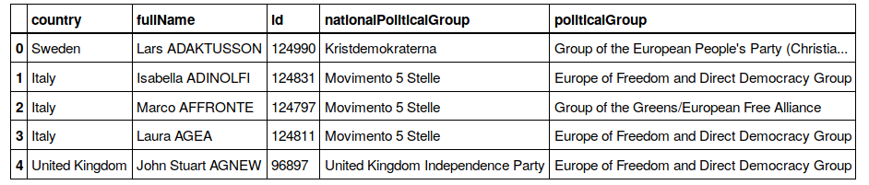
Other Types of text data
Free string – but not “words”
Named Entities
Categorical (If you’re lucky)

Slide 5
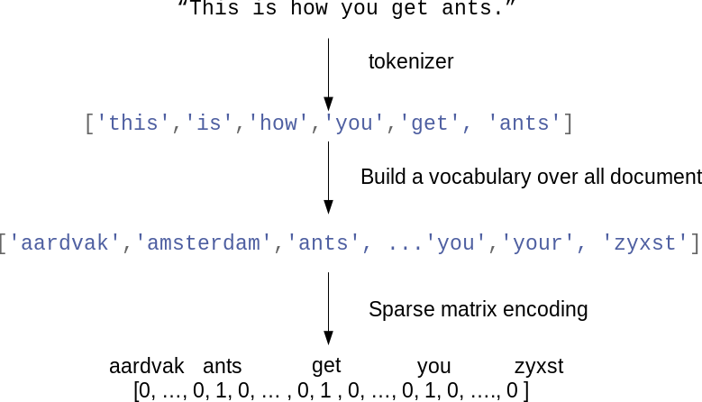
Features from Text:
Bag of Words

Slide 6

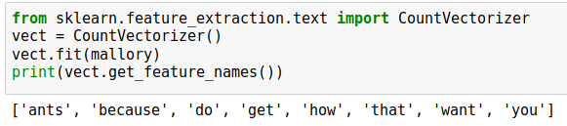
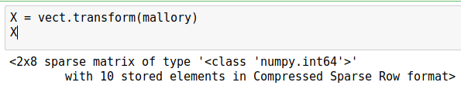

Toy Example
Two documents in datasets

Slide 7
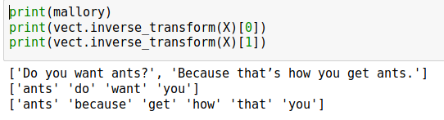
“bag”

Slide 8
Text classification example: IMDB Movie Reviews

Slide 9
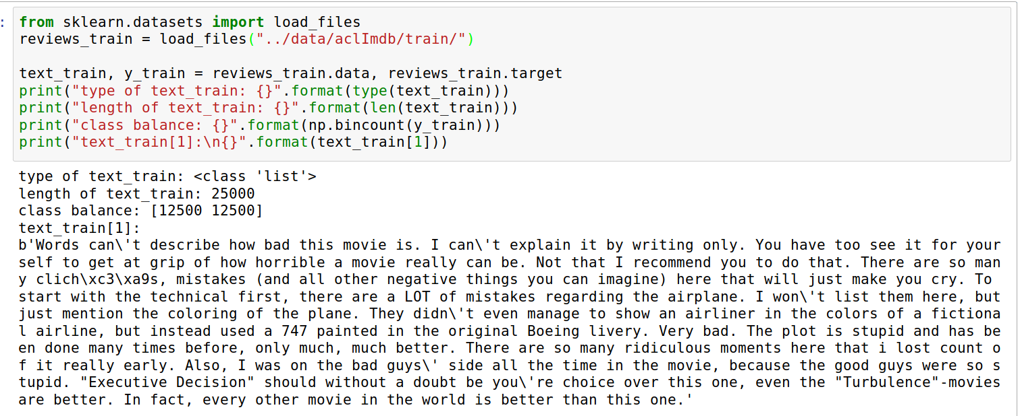
Data loading

Slide 10
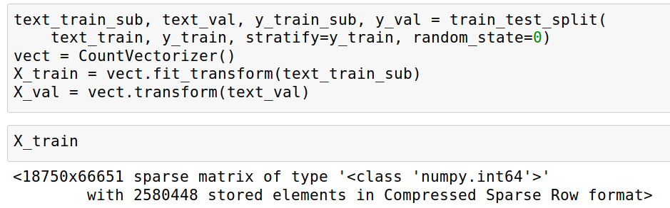
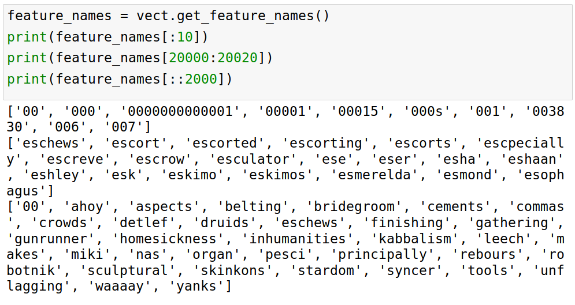
Vectorization

Slide 11
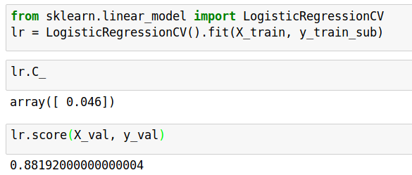
Once we have X, business as usual

Slide 12
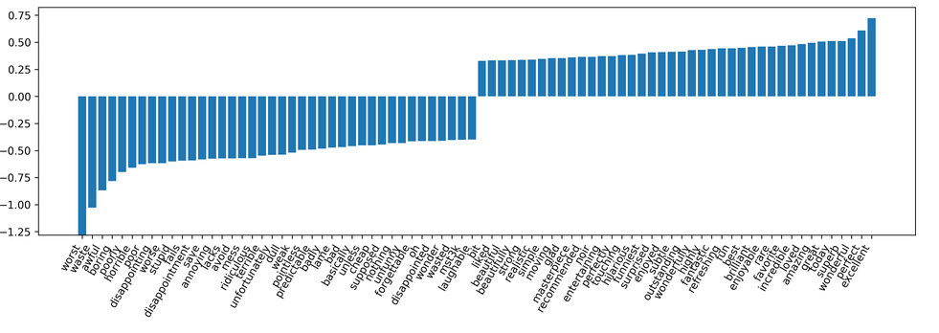

Slide 13
Soo many options!
How to tokenize?
How to normalize words?
What to include in vocabulary?

Slide 14
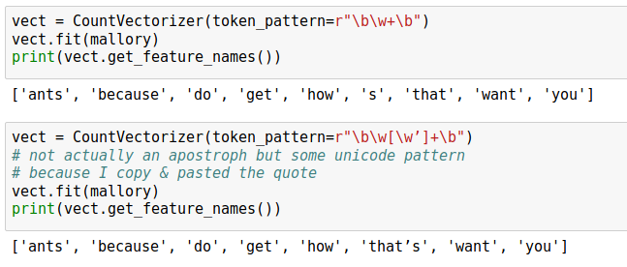
Tokenization
Scikit-learn (very simplistic):
  re.findall(r”\b\w\w+\b”)
  Includes numbers
  doesn’t include single-letter words
  doesn’t include – or ‘
Can change regular expression “token pattern”:

Slide 15
Normalization
Correct spelling?
Stemming: reduce to word stem
Lemmatization: reduce words to stem using curated dictionary and context
Scikit-learn:
Lower-case it.
Configurable, use nltk or spacy

Slide 16
Restricting the Vocabulary

Slide 17
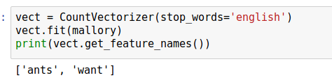
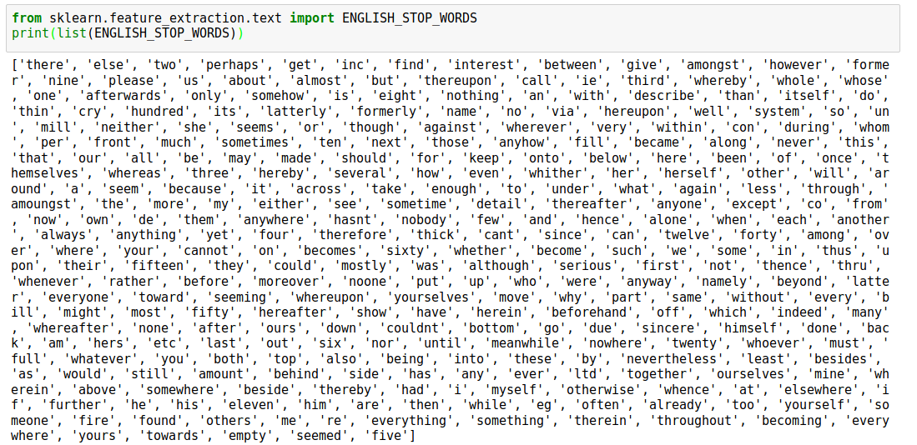
Stop Words
Also: max_df
For supervised learning often little effect on large corpuses (on small corpuses and for unsupervised learning it can help)

Slide 18
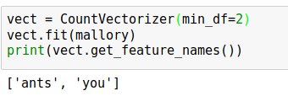
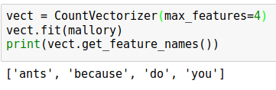
Infrequent Words
Words that appear only once or twice might not be helpful:
Restrict vocabulary size to only most frequent words (for less features):

Slide 19
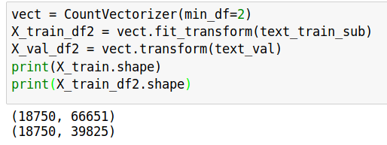
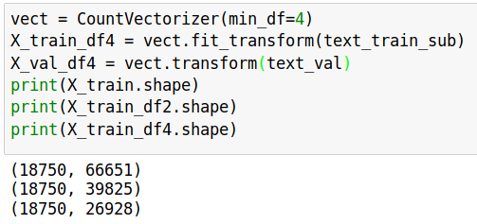
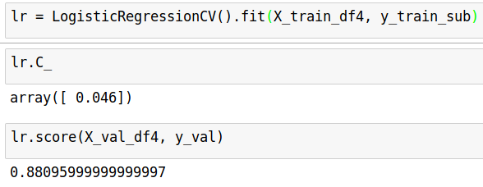
Removed nearly 1/3 of features!
As good as before

Slide 20
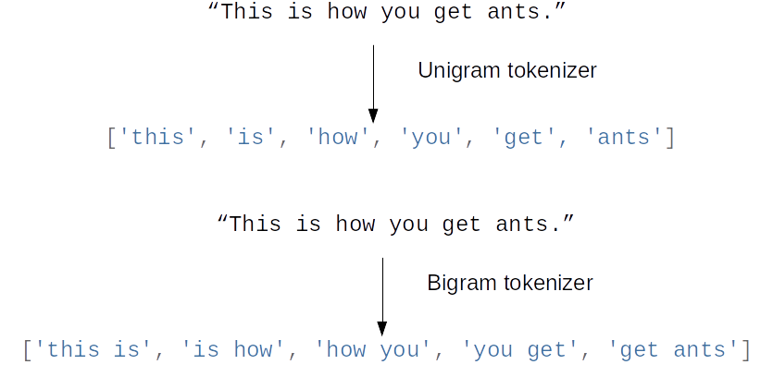
Beyond single words
Bag of words completely removes word order.
“didn’t love” and “love” are very different!
N-grams: tuples of consecutive words

Slide 21
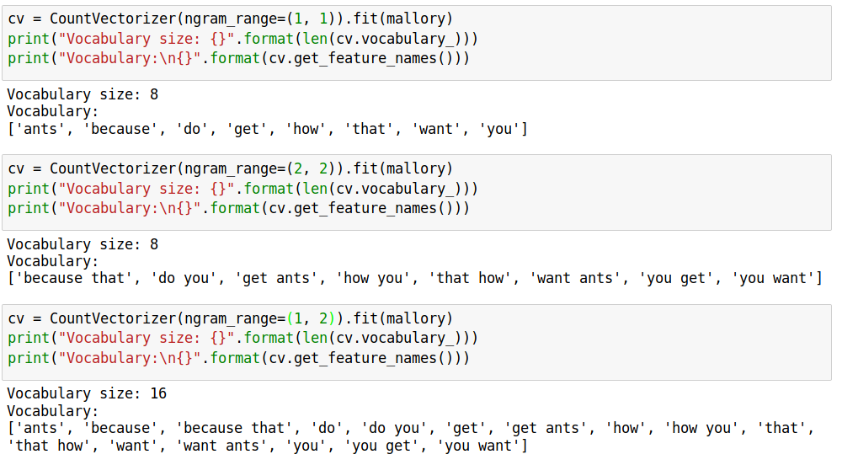
Bigrams toy example
Typically: higher n-grams lead to blow up of feature space!

Slide 22
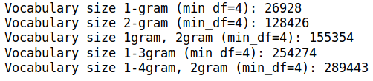
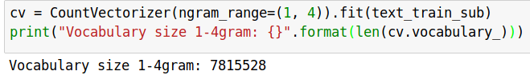
N-grams on IMDB data
More than 20x more 4-grams!

Slide 23
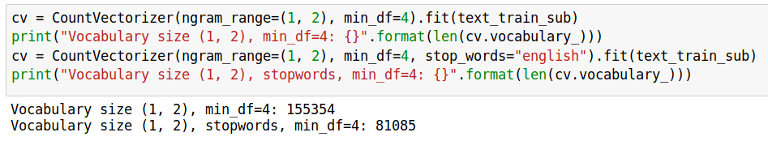
Stop-word impact on bi-grams

Slide 24
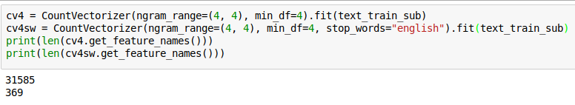
Stop words impact 4-gram

Slide 25
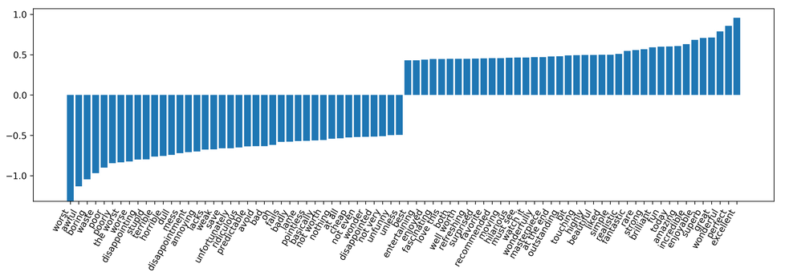
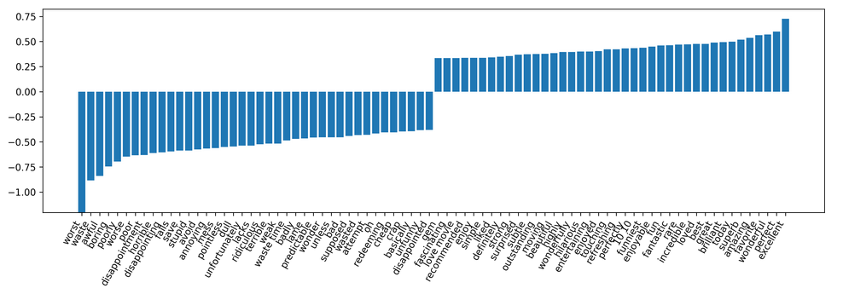
Stopwords included
Stopwords removed (slightly worse)

Slide 26
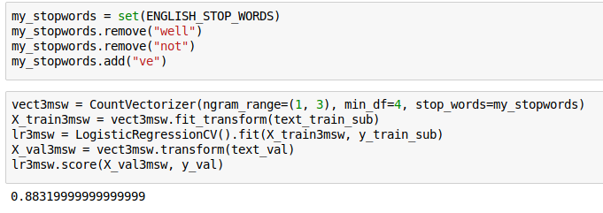
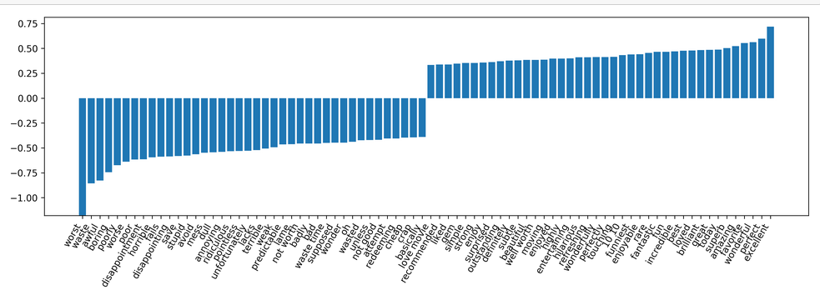

Slide 27
Tf-idf rescaling
Total number of documents
Number of documents containing term t
Emphasizes “rare” words - “soft stop word removal”
Slightly non-standard smoothing (many +1s)
By default also L2 normalization!

Slide 28
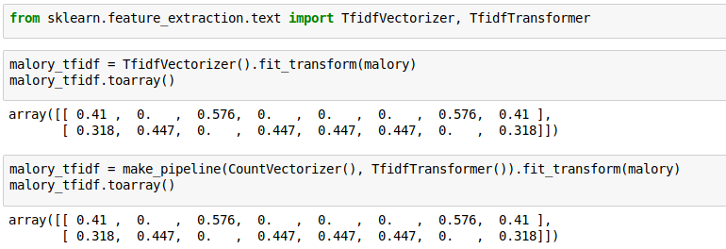
TfidfVectorizer, TfidfTransformer

Slide 29
Character n-grams

Slide 30
Principle
Do␣you␣want␣ants?

Slide 31
Applications
Be robust to misspelling / obfuscation
Language detection
Learn from Names / made-up words

Slide 32
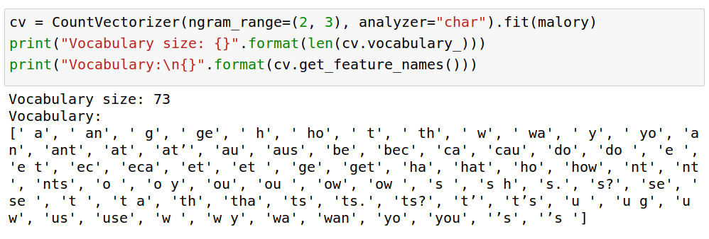
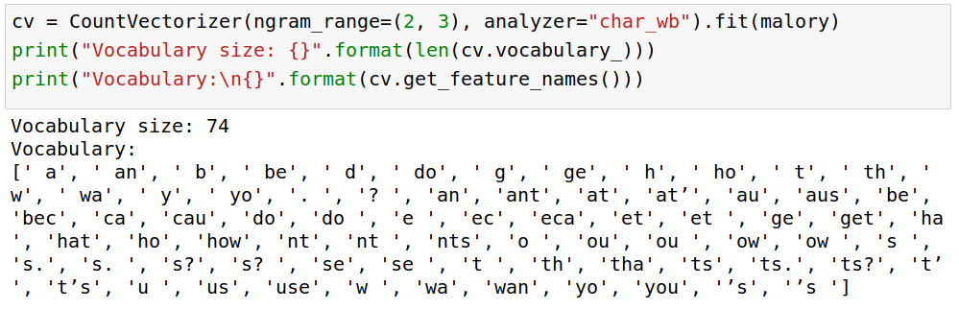
Toy Example
“Naive”
Respect word boundaries:

Slide 33
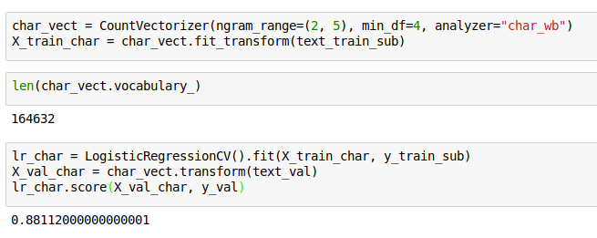
IMDB Data

Slide 34
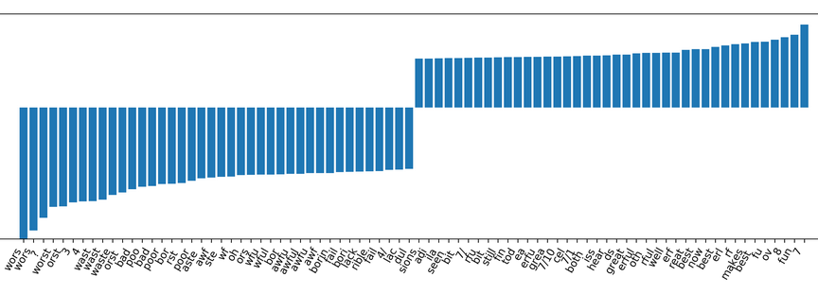

Slide 35
Predicting Nationality from Name

Slide 36
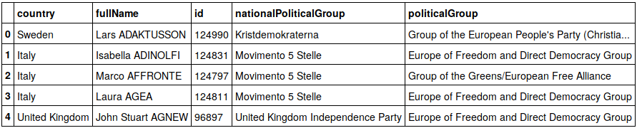
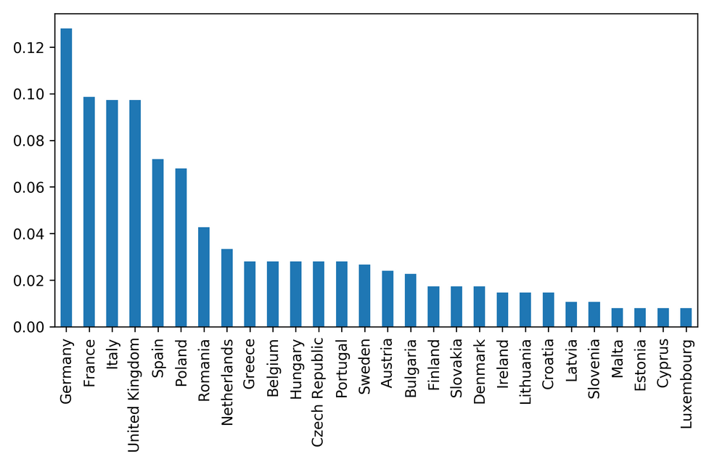

Slide 37
Comparing words vs chars

Slide 38
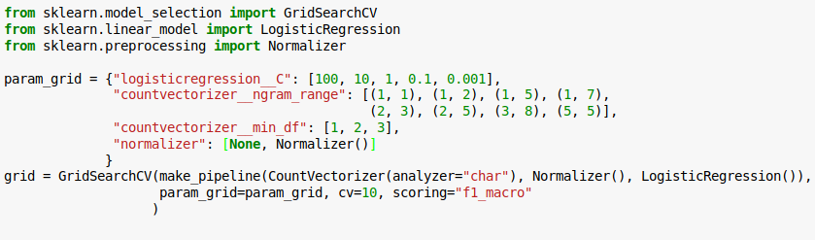
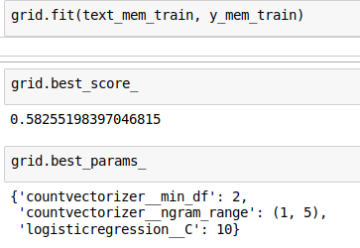
Grid-search parameters
Small dataset, makes grid-search faster! (less reliable)

Slide 39
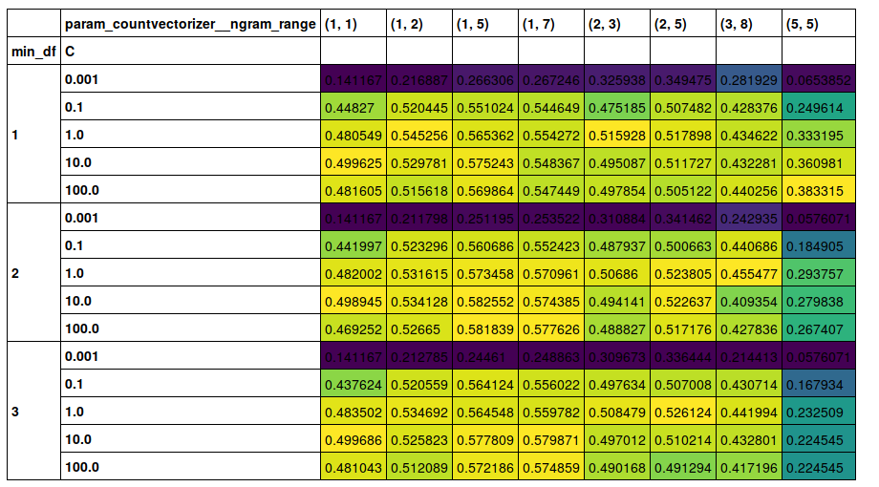

Slide 40
Other features
Length of text
Number of out-of-vocabularly words
Presence / frequency of ALL CAPS
Punctuation….!? (somewhat captured by char ngrams)
Sentiment words (good vs bad)
Whatever makes sense for the task!

Slide 41
Large Scale Text Vectorization

Slide 43
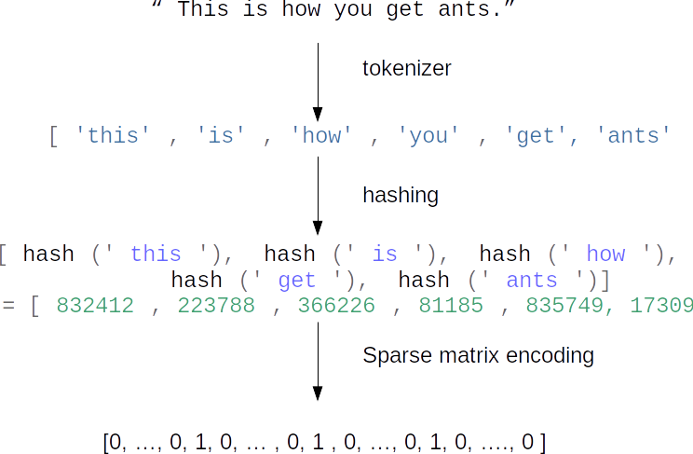

Slide 44
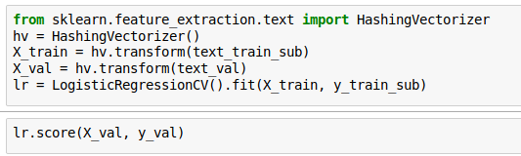
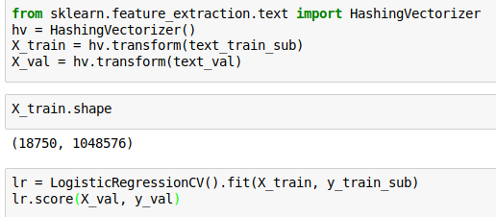
Near drop-in replacement
Careful: Uses l2 normalization by default!

Slide 45
Trade-offs
Pro:
Fast
Works for streaming data
Low memory footprint
Con:
Can’t interpret results
Hard to debug
(collisions are not a problem for performance)

