Slide 1
W4995 Applied Machine Learning
Trees, Forests and Boosting
02/20/17
Andreas Müller

Slide 2
Why trees?
Very powerful modeling method – non-linear!
Doesn’t care about scaling!
“Interpretable”
Basis of very powerful models!

Slide 3
Decision Trees for Classification

Slide 4
Idea: series of binary questions

Slide 5



Building trees
Continuous features:
“questions” are thresholds on single features.
[Other methods are possible but not as common]
For each split:
exhaustive search over all features and thresholds!
Minimize “impurity”
Notes:
The second family of models I want to talk about is decision-tree based models.
A decision tree is basically the same as a sequence of if-else branches, that ultimately lead to a decision. The point is that the question that are asked are learned, though.
A decision tree is build recursively by asking a series of questions of the form “is feature “i” greater than threshold t”. In each iteration, the question is chosen that yields the most information about the target variable. Then, the data is split according to this question, and we start again. This yields a hierarchical partitioning of the data, where each section of the partitioning becomes more and more “pure”, that is their content becomes more and more the same.
After you build the tree, you can make a prediction by checking which part of the partition a new point lies in and assigning the mean of the datapoints in this part.

Slide 6
Criteria (for classification)
Gini index:
Cross-entropy:
observations in node m
classes
distribution over classes in node m

Slide 7
Prediction
y=0
Traverse tree based on feature tests
Predict most common class in leaf

Slide 8
Regression trees
Impurity Criteria:
Mean Squared Error
Mean Absolute Error
Prediction:
Predict mean.
Without regularization / pruning:
Each leaf often contains a single point to be “pure”

Slide 9
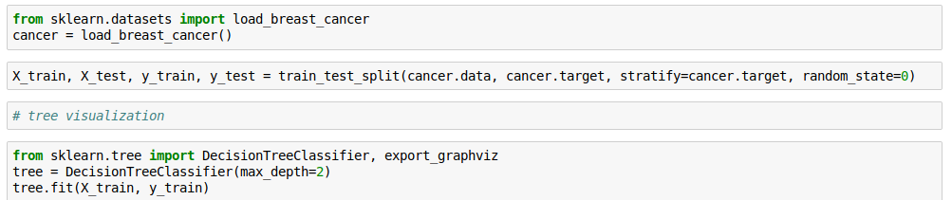
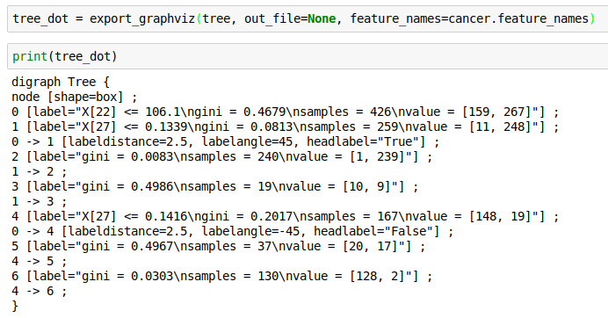
Visualizing trees with sklearn

Slide 10
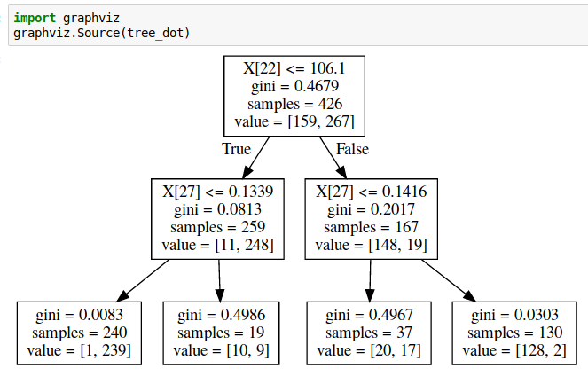
Showing dot files in Jupyter
First install graphvis C library:
conda install graphviz
Then install graphviz python library:
pip install graphviz

Slide 11
Parameter tuning
Pre-pruning and post-pruning (not in sklearn yet)
Limit tree size (pick one):
max_depth
max_leaf_nodes
min_samples_split
(and more)

Slide 12
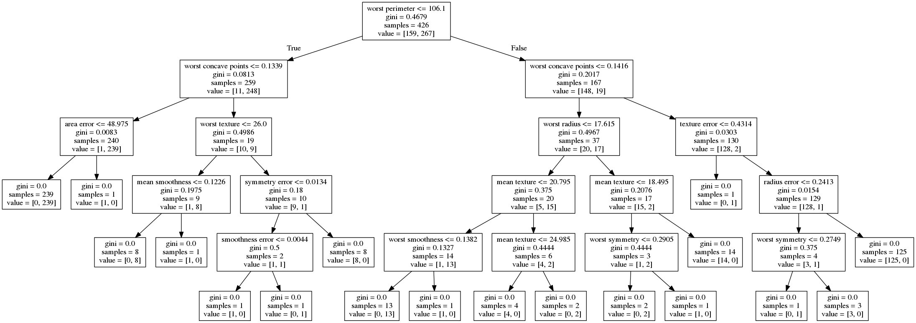
No pruning

Slide 13
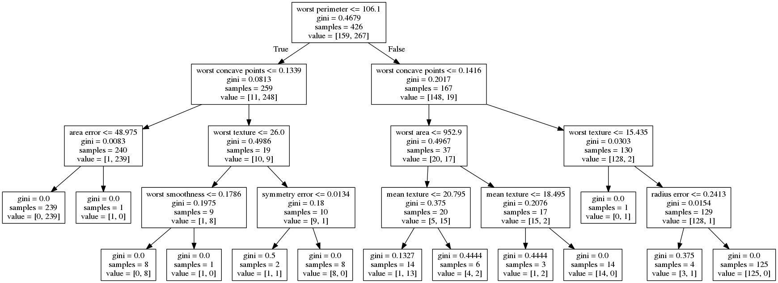
max_depth=4

Slide 14
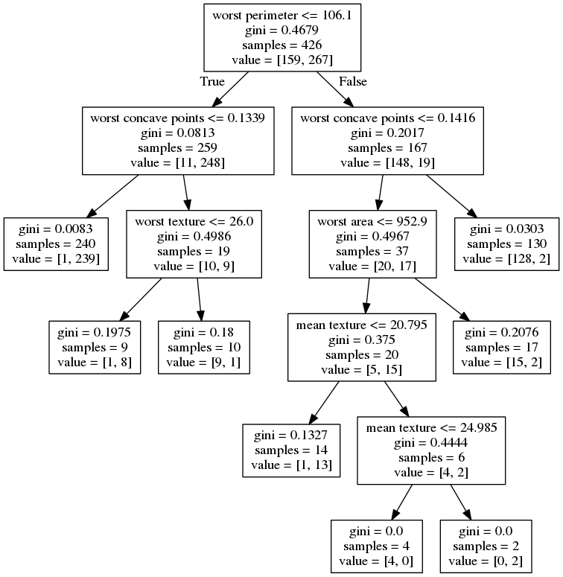
max_leaf_nodes=8

Slide 15
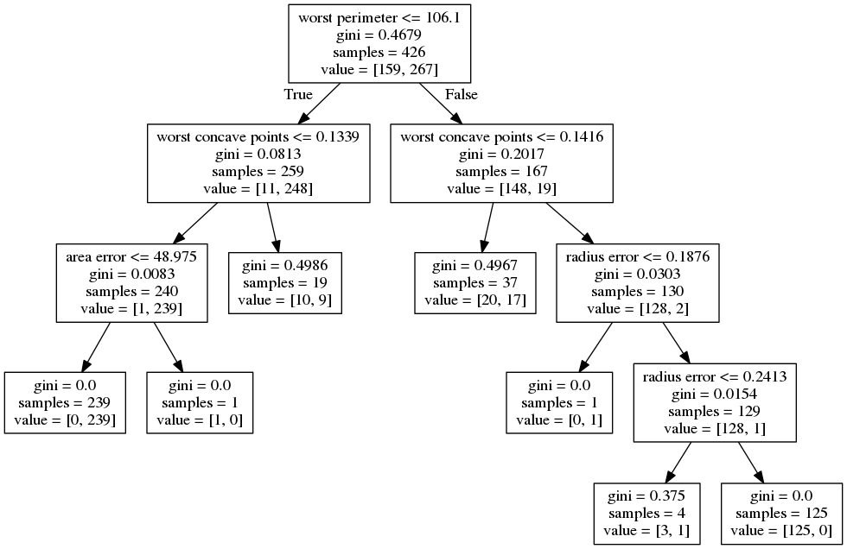
min_samples_split=50

Slide 16

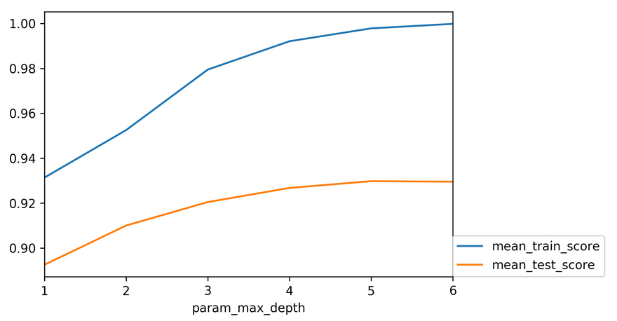

Slide 17
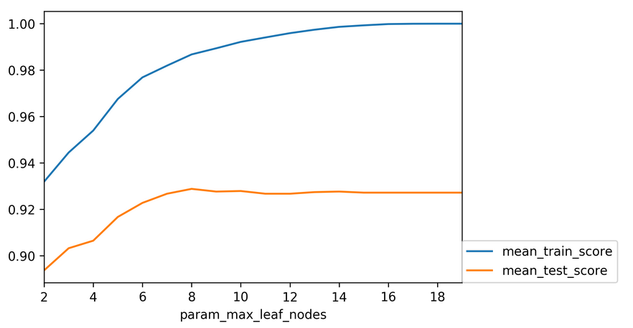

Slide 18
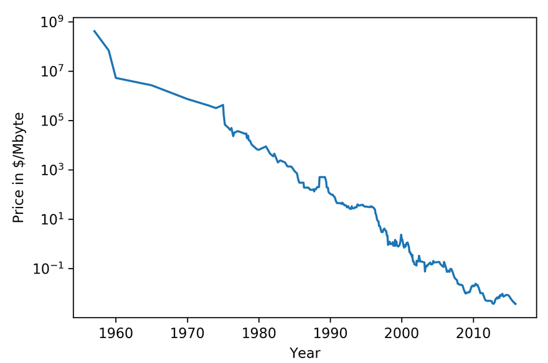

Slide 19
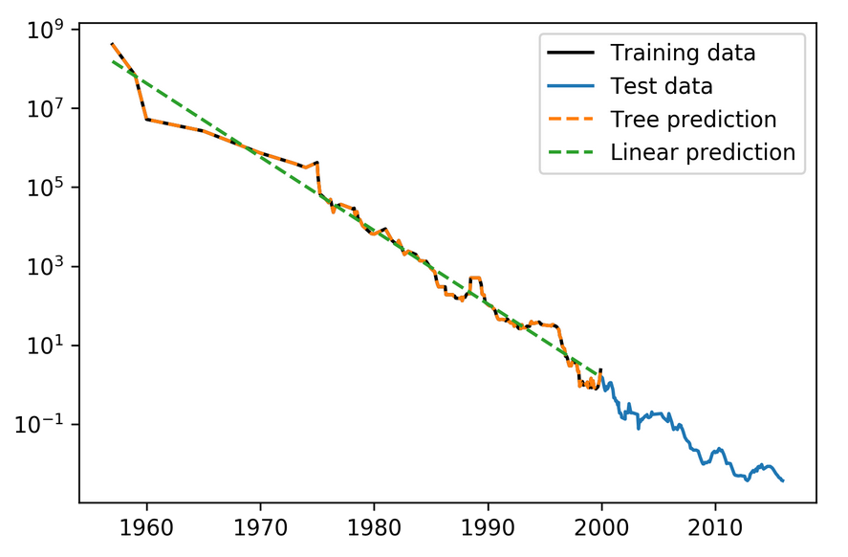

Slide 20
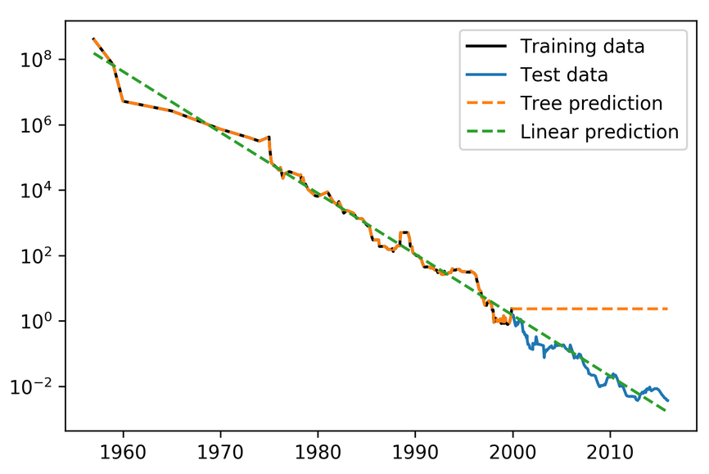
Extrapolation
Would be the same for nearest neighbor regression!

Slide 21
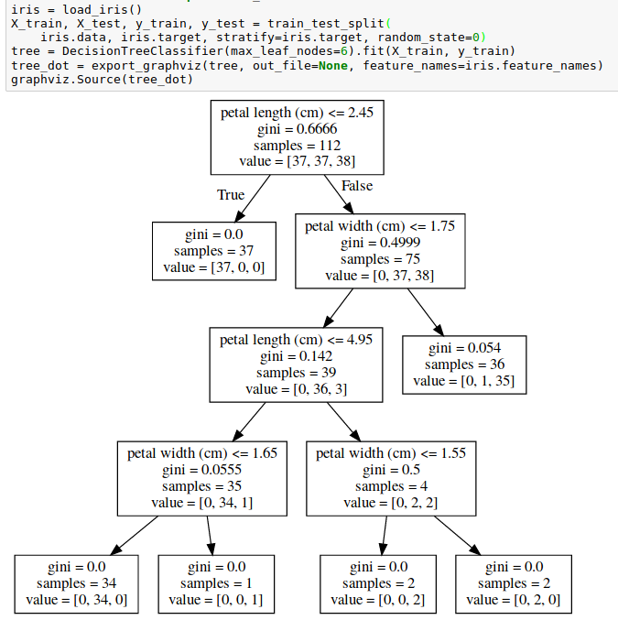
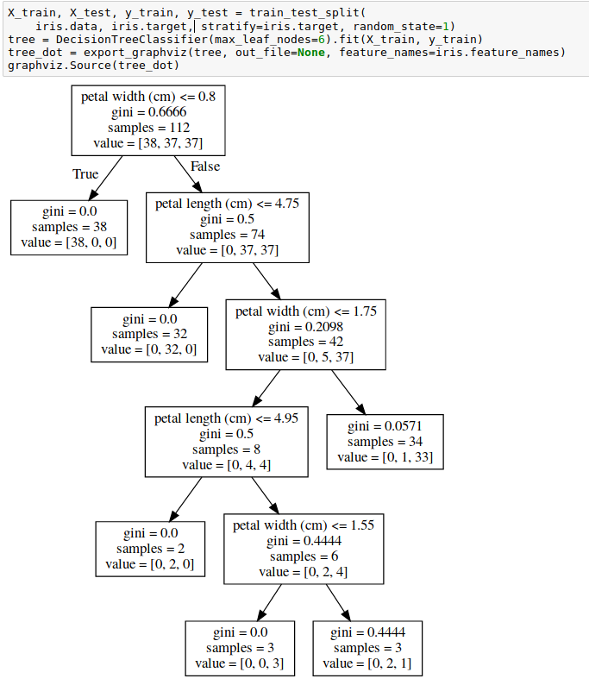
Instability

Slide 22

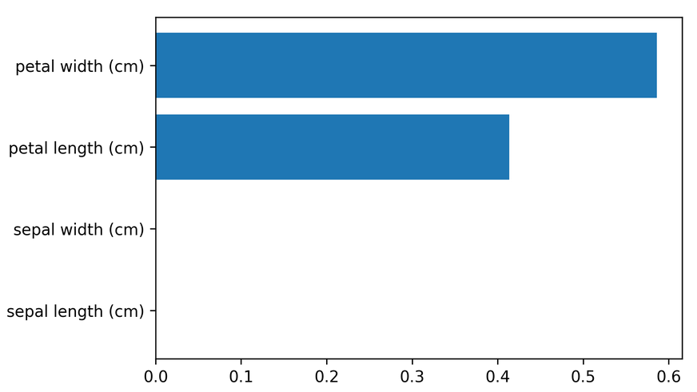
Feature importance
Unstable tree → unstable feature importances.
Might take one or multiple from a group of correlated features.

Slide 23
Categorical Data
Can split on categorical data directly
Intuitive way to split: split in two subsets
2 ^ n_values many possibilities
Possible to do in linear time exactly for gini index and binary classification.
Heuristics done in practice for multi-class.
Not in sklearn release version :(

Slide 24
Predicting probabilities
Fraction of class in leaf.
Without pruning: Always 100% certain!
Even with pruning might be too certain.

Slide 25
Conditional Inference Trees
Select “best” split with correcting for multiple-hypothesis testing.
More “fair” to categorical variables.
Only in R so far (party)

Slide 26
Relation to Nearest Neighbors
Predict average of neighbors – either by k, by epsilon ball or by leaf.
Trees are much faster to predict.
Both can’t extrapolate

Slide 27
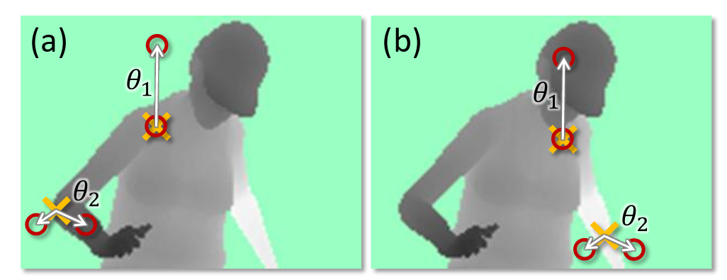
Different Splitting Methods
Could use anything as split candidate!
Linear models used if extrapolation is needed.
Computer vision: pixel comparisons
Kinect (first generation): depth comparison
(taken from Shotton et. al. Real-Time Human Pose Recognition ..)

Slide 28
Ensemble Models

Slide 29
Poor man’s ensembles
Build different models
Average the result
Owen Zhang (long time kaggle 1st): build XGBoosting models with different random seeds.
More models are better – if they are not correlated.
Also works with neural networks
You can average any models as long as they provide calibrated (“good”) probabilities.
Scikit-learn: VotingClassifier
hard and soft voting

Slide 30
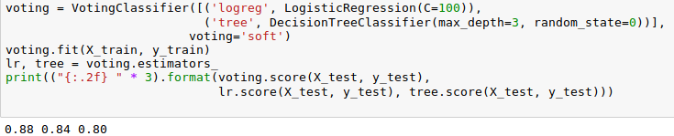
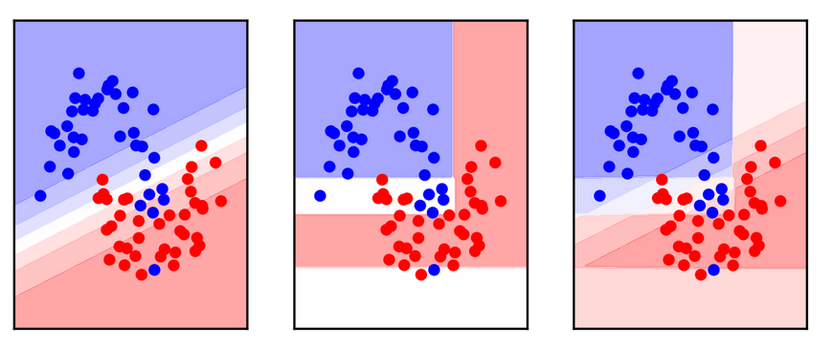
VotingClassifier

Slide 31
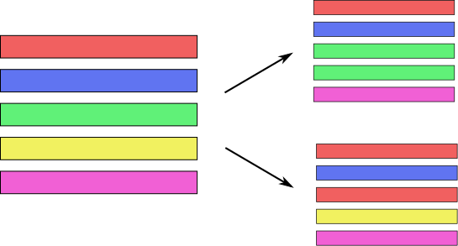
Bagging (Bootstrap AGGregation)
Generic way to build “slightly different” models
Draw bootstrap samples from dataset
(as many as there are in the dataset, with repetition)
Implemented in BaggingClassifier, BaggingRegressor

Slide 32
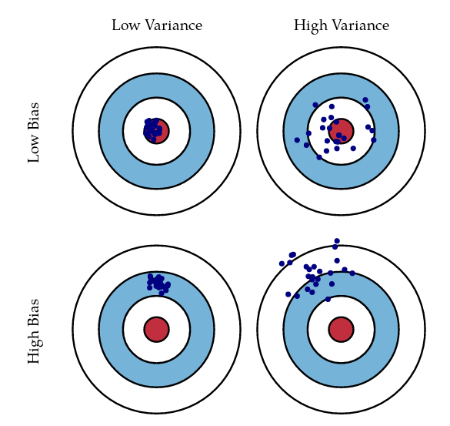
Bias and Variance
http://scott.fortmann-roe.com/docs/BiasVariance.html

Slide 33
Bias and Variance in Ensembles
Breiman showed that generalization depends on strength of the individual classifiers and (inversely) on their correlation
Uncorrelating them might help, even at the expense of strength

Slide 34

Random Forests
Smarter bagging for trees!
Notes:
So decision trees are a great idea, but unfortunately they don’t work that well in practice. However, there is a modification of the algorithm that works very well, called random forest.
The idea behind random forest is that we build many decision trees, but we inject some randomness into each tree, so that they are all different.
Then, to make a prediction, we look at the prediction of all the decision trees and take the average.

Slide 35
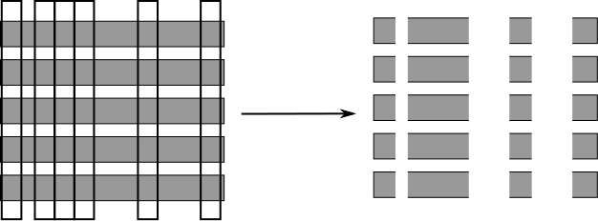
Randomize in two ways
For each tree:
Pick bootstrap sample of data
For each split:
Pick random sample of features
More tree are always better

Slide 36
Tuning Random Forests
Main parameter: max_features
  around sqrt(n_features) for classification
  Around n_features for regression
n_estimators > 100
Prepruning might help, definitely helps with model size!
max_depth, max_leaf_nodes, min_samples_split again

Slide 37
Extremely Randomized Trees
More randomness!
Randomly draw threshold for each feature!
Doesn’t use bootstrap
Faster because no sorting / searching
Can have smoother boundaries

Slide 38
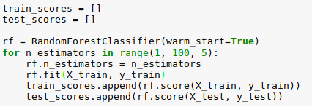
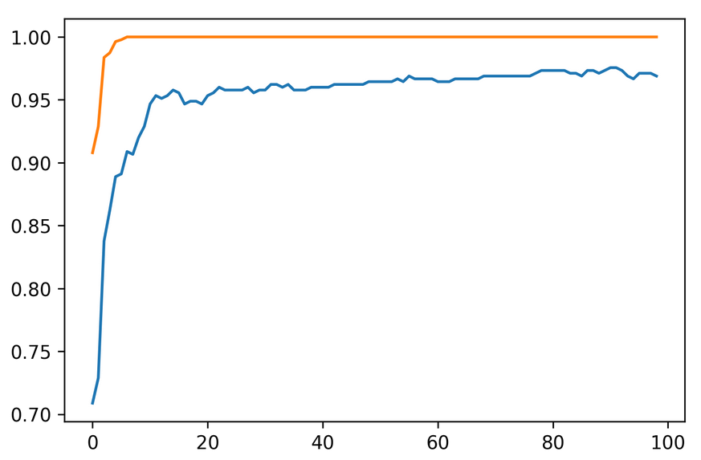
Warm-Starts

Slide 39
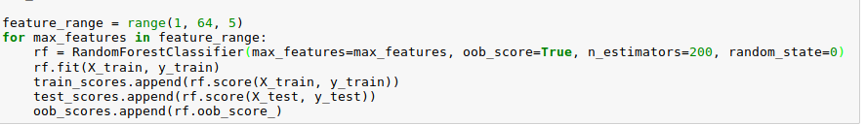
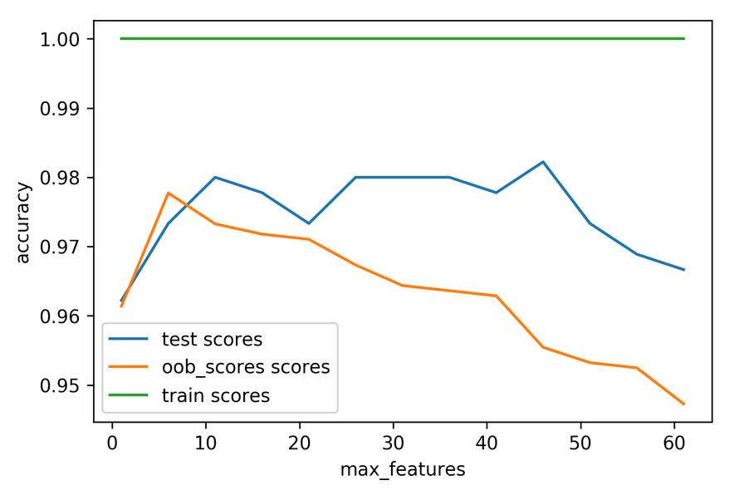
Out-of-bag estimates
Each tree only uses ~66% of data
Can evaluate it on the rest!
Make predictions for out-of-bag, average, score.
Each prediction is an average over different subset of trees

Slide 40
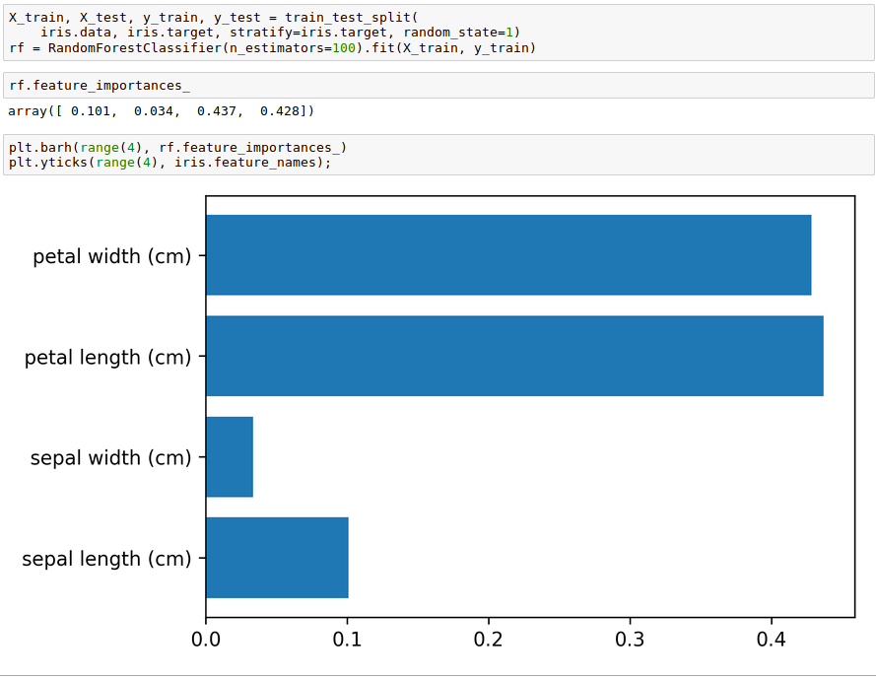
Variable Importance

Slide 41
Gradient Boosting

Slide 42



Gradient Boosting Algorithm
0.1 *
+ 0.1 *
+ 0.1 *
Iteratively add regression trees to model
Use log loss for classification
Discount update by learning rate

Slide 43
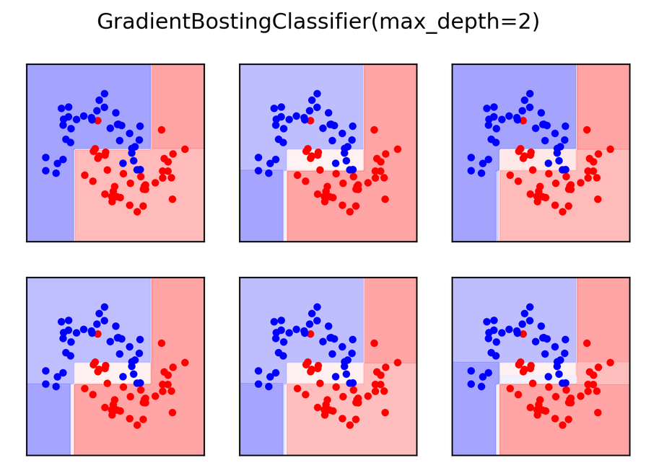

Slide 44
Gradient Boosting
Many shallow trees
learning_rate ↔ n_estimators
Slower to train than RF (serial), but much faster to predict
Small model size
Uses one-vs-rest for multi-class!

Slide 45
Tuning Gradient Boosting
Pick n_estimators, tune learning rate
Can also tune max_features
Typically strong pruning via max_depth

Slide 46
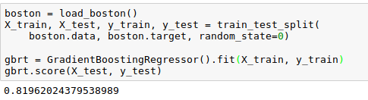
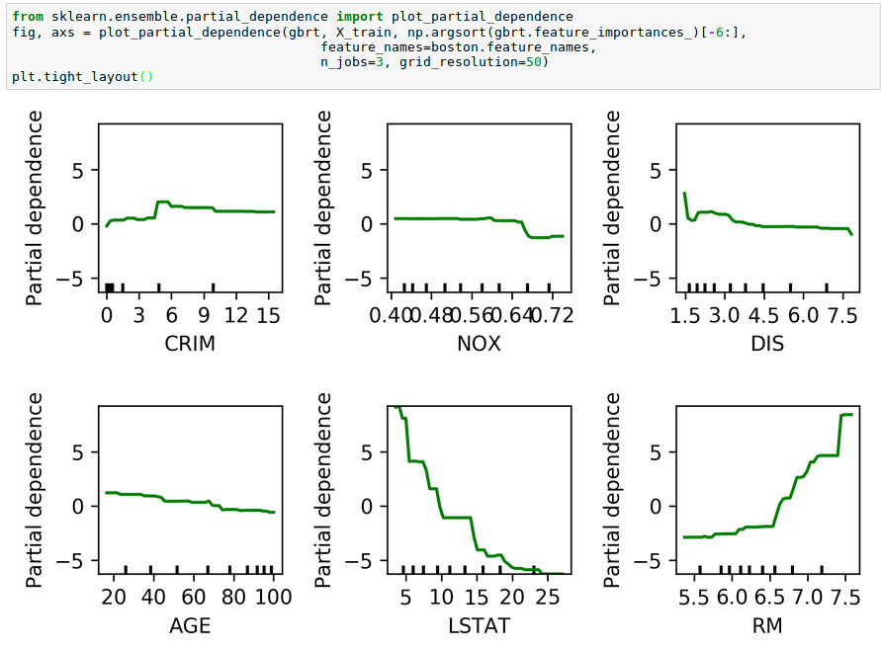
Partial Dependence Plots
Marginal dependence of prediction on one or two features

Slide 47
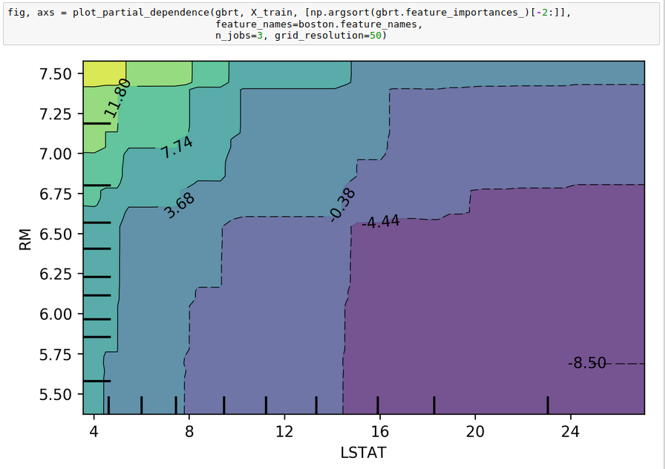

Slide 48
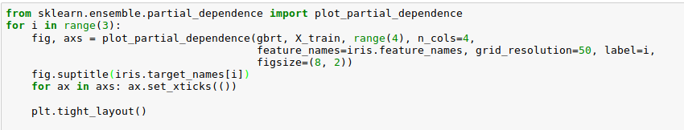
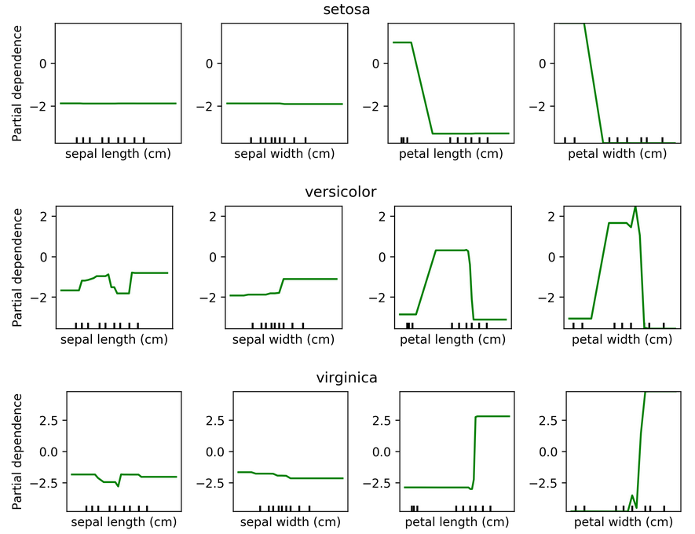
Partial Dependence for Classification

Slide 49
XGBoost
Efficient implementation of gradient boosting
Improvements on original algorithm
https://arxiv.org/abs/1603.02754
Adds l1 and l2 penalty on leaf-weights
Fast approximate split finding
Can pip-install
Scikit-learn compatible interface

Slide 50
Boosting in General
“Meta-algorithm” to create strong learners from weak learners.
AdaBoost, GentleBoost, …
Trees or stumps work best
Gradient Boosting often the best of the bunch
Many specialized algorithms (ranking etc)

Slide 51
When to use tree-based models
Model non-linear relationships
Single tree: very interpretable (if small)
Random forests very robust, good benchmark
Gradient boosting often best performance with careful tuning
Doesn’t care about scaling, no need for feature engineering!

Slide 52
More ensembles: Stacking

Slide 53
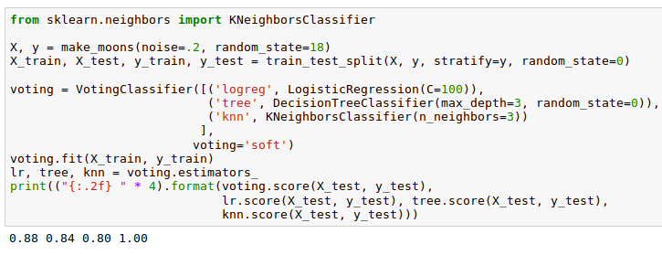
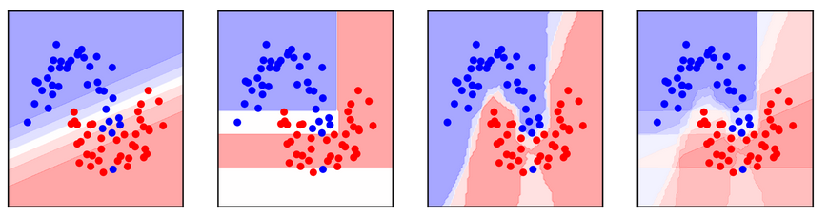
Poor man’s Stacking
Build multiple models
Train model on probabilities / scores produced

Slide 54
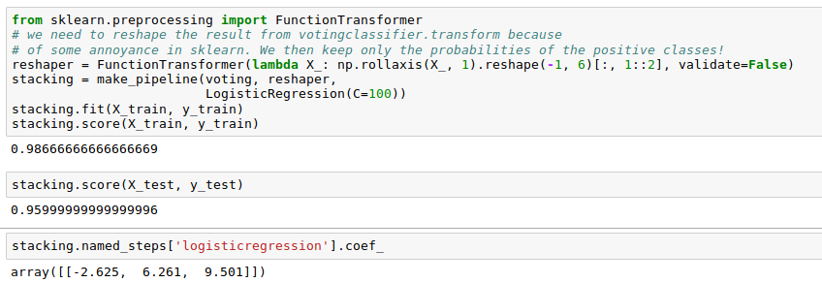
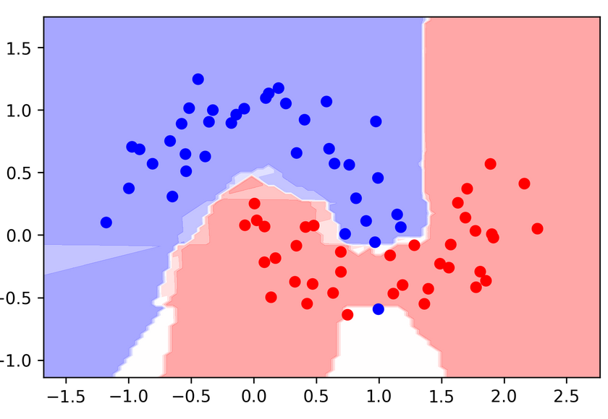
Poor man’s Stacking
Problem: Overfitting!

Slide 55
Stacking
Use cross-validation (even LOO!) to produce probability estimates on training set.
Train second step estimator on held-out estimates
No overfitting of second step!
For testing: as usual

Slide 56

Hold-out estimates of probabilities
Split 1 produces probabilities for Fold 1, split2 for Fold 2 etc.
Get a probability estimate for each data point!
Unbiased estimates (like on the test set) for the whole training set!
Without it: The best estimator is the one that memorized the training set.

Slide 57
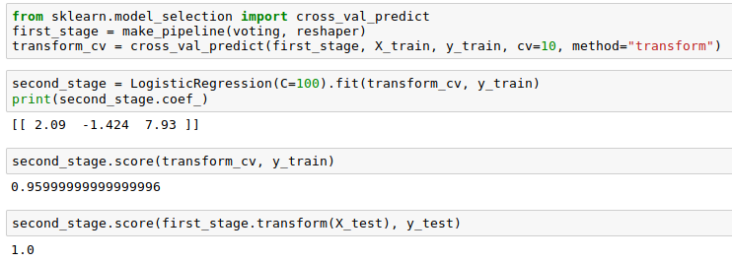
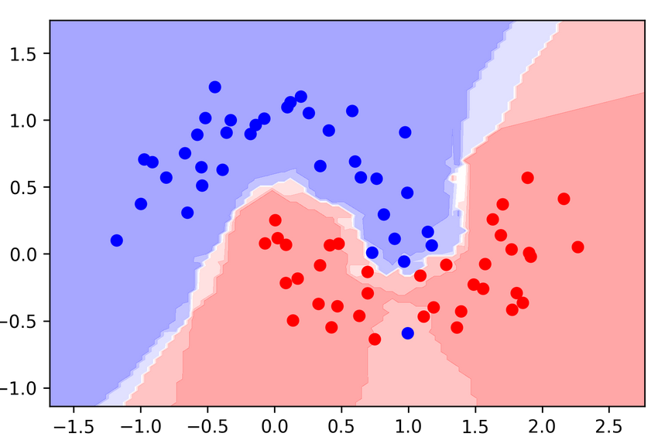
Stacking with Scikit-learn
Hold-out stacking
Naive stacking

Slide 58
Summary

