Slide 1
W4995 Applied Machine Learning
Imputation and Feature Selection
02/13/17
Andreas Müller

Slide 2
Dealing with missing values
Missing values can be encoded in many ways
Numpy has no standard format for it (often np.NaN)
Sometimes: 999, ???, ?, np.inf, “N/A”, “Unknown“ …
Not discussing “missing output” - that’s semi-supervised learning.

Slide 3
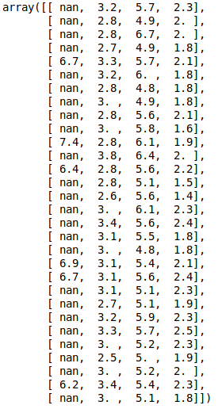
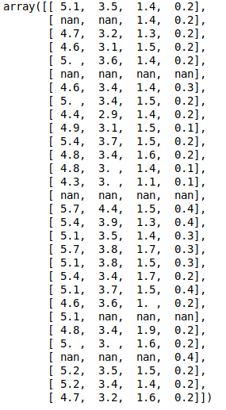
Problem:
prediction not for all samples! Accuracy might be biased!

Slide 4
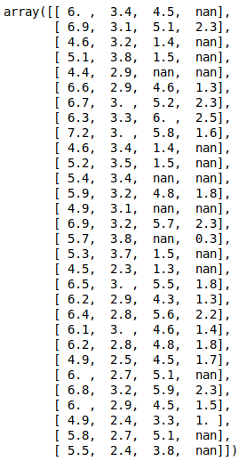
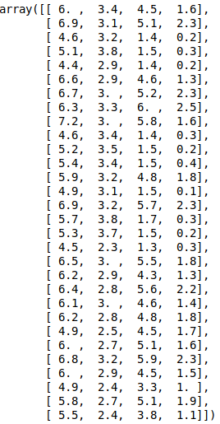
Imputation

Slide 5
Imputation methods
Mean / median
KNN
Model-driven
Iterative

Slide 6
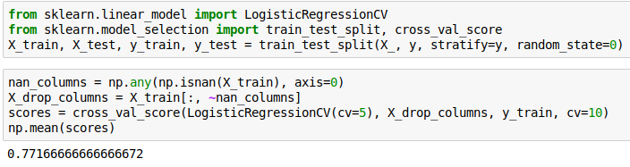

Slide 7
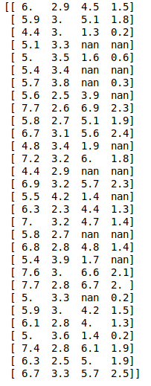
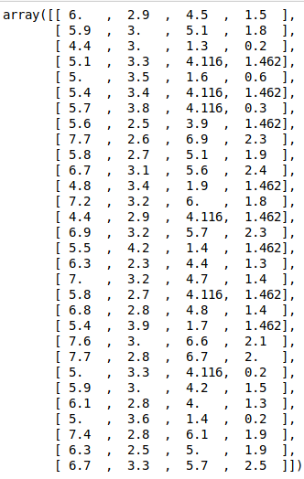

Mean and Median
Imputation

Slide 8
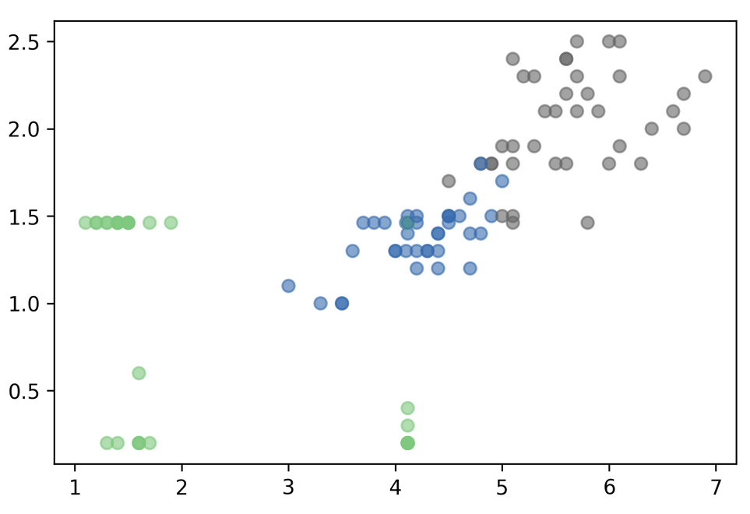

Slide 9
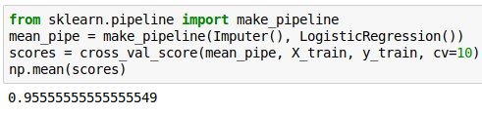

Slide 10
KNN imputation
Find k nearest neighbors that have non-missing values.
Fill in all missing values using the average of the neighbors.
Different strategies possible for finding neighbors that have missing values.
Tricky if there is no feature that is always non-missing.
PR in scikit-learn: https://github.com/scikit-learn/scikit-learn/pull/4844

Slide 11
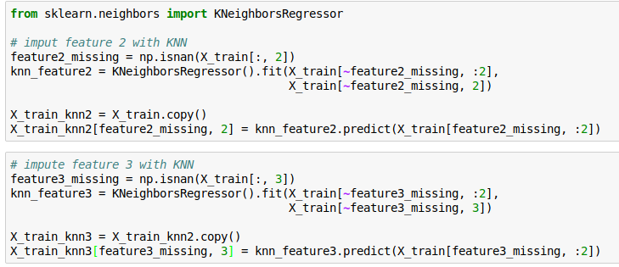
KNN imputation
An efficient implementation would find nearest neighbors only once!
This approach is quite naive as is requires the first two features to always be present!

Slide 12
Model-Driven Imputation
Train regression model for missing values
Possibly iterate: retrain after filling in
Very flexible!

Slide 13
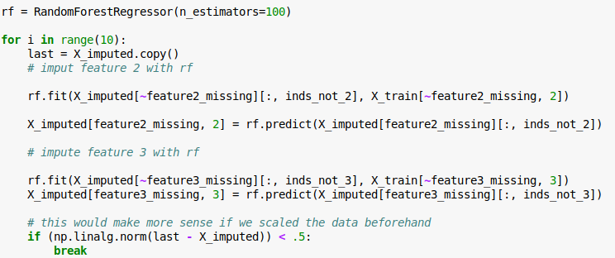
Model-driven Imputation w RF

Slide 14
Fanyimpute
pip install fancyimpute
Has many methods – but no fit-transform paradigm
MICE is iterative and works well often
Try different things in practice, MICE might be best

Slide 15
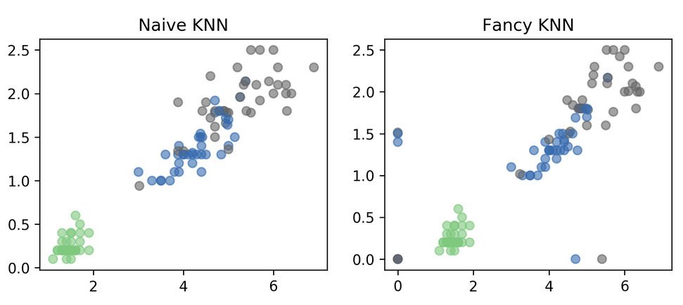

Slide 16
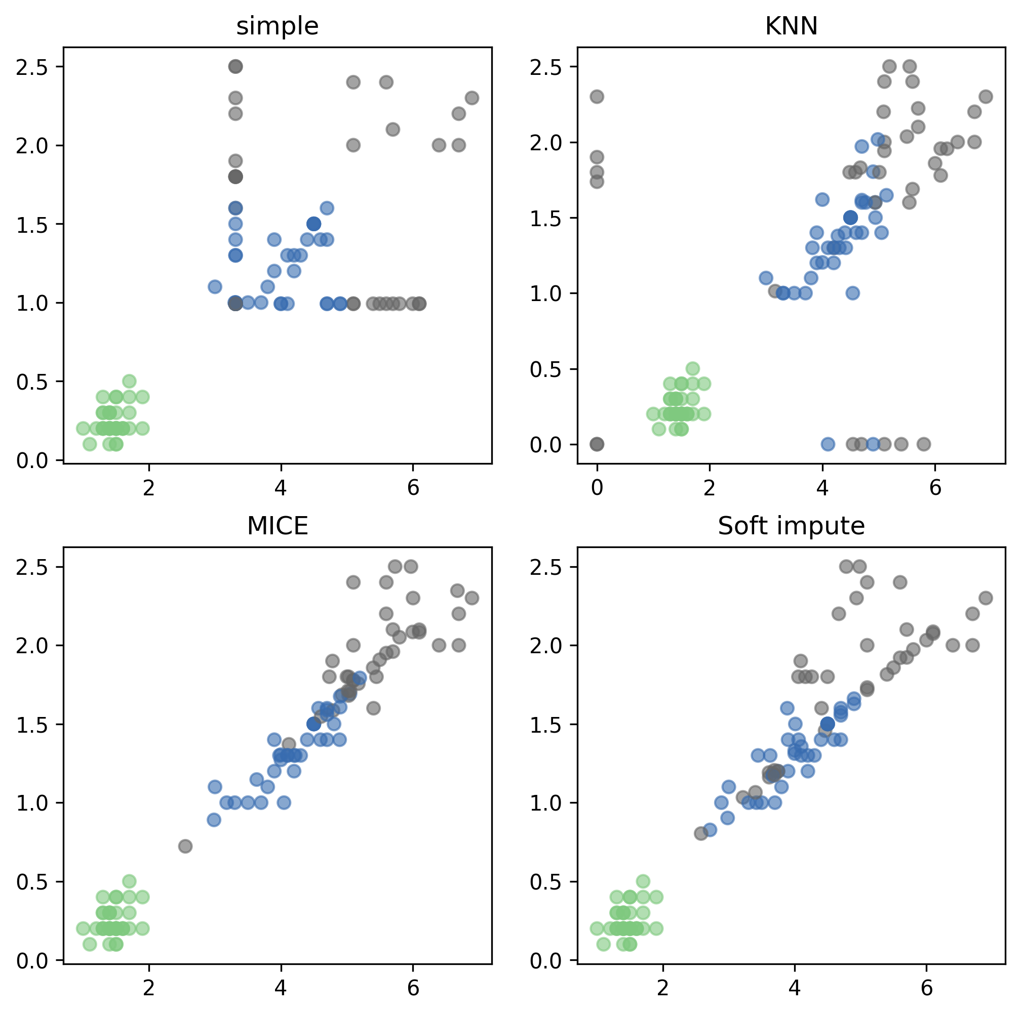

Slide 17
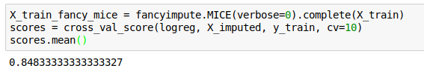
Applying fancyimpute
Again, cheating with the imputation :(
This is allowed for the homework because the current tools make it hard to do the right thing.

