Slide 1
W4995 Applied Machine Learning
LSA & Topic Models
04/05/17
Andreas Müller

Slide 2
Beyond Bags of Words
Limitations of bag of words:
Semantics of words not captured
Synonymous words not represented
Very distributed representation of documents

Slide 3
Latent Semantic Analysis (LSA)
Reduce dimensionality of data.
Can’t use PCA: can’t subtract the mean (sparse data)
Instead of PCA: Just do SVD, truncate.
“Semantic” features, dense representation.
Easy to compute – convex optimization

Slide 4
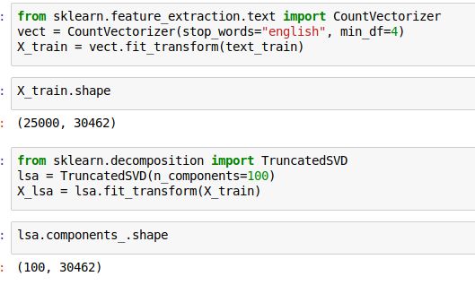
LSA with TruncatedSVD

Slide 5
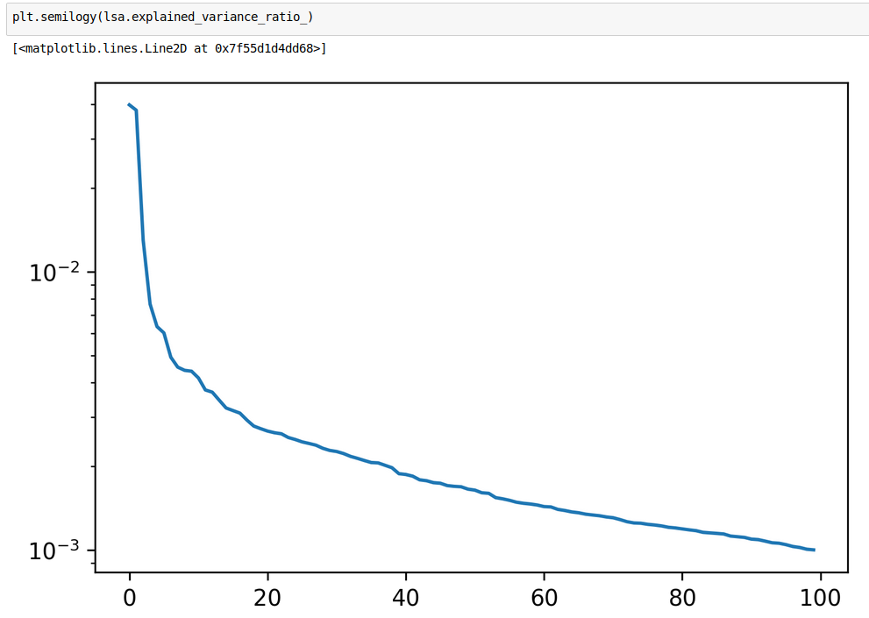

Slide 6
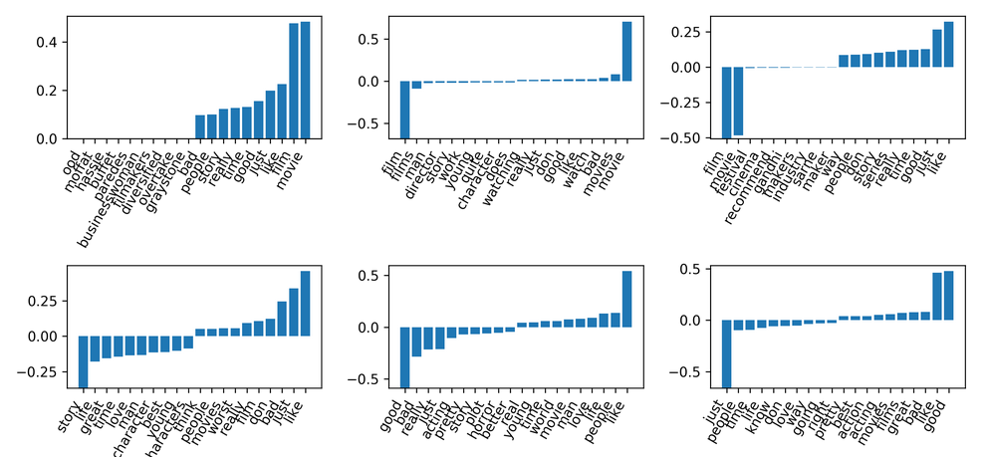
First Six eigenvectors
Points in direction of mean

Slide 7
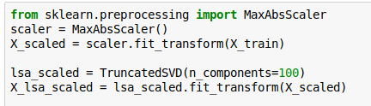
Scale before LSA
“Movie” and “Film” was dominating first couple of components.
Try to get rid of that effect.

Slide 8
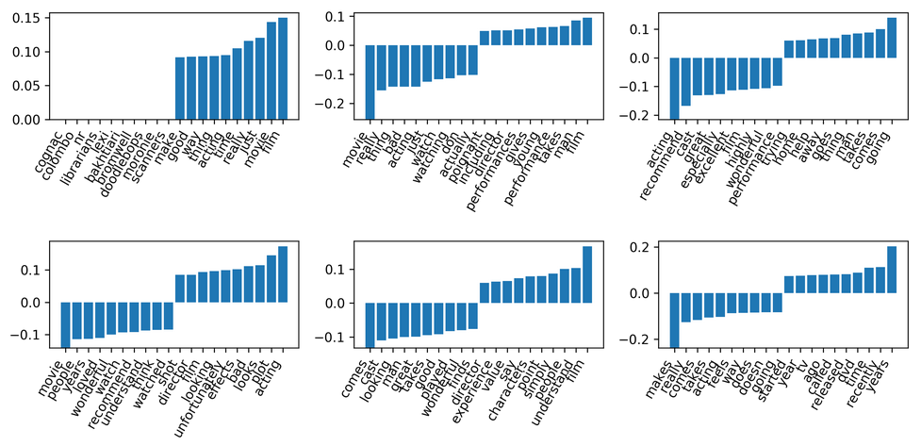
Eigenvectors after scaling
Movie and film still important, but not that dominant any more.

Slide 9
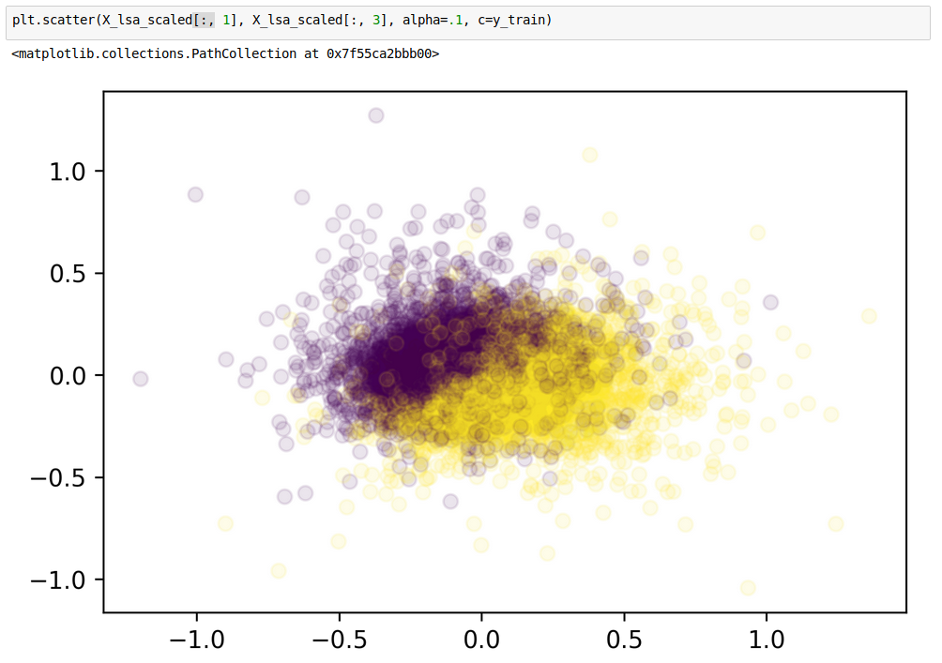
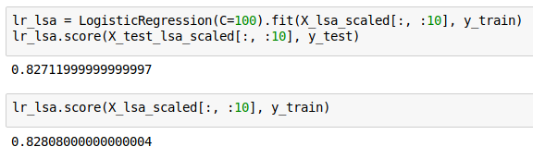
Some Components Capture Sentiment
Not competitive but reasonable with just 10 components!

Slide 10
Topic Models

Slide 11
Motivation
Each document is created as a mixture of topics
Topics are distributions over words
Learn topics and composition of documents simultaneously
Unsupervised (and possibly ill-defined)

Slide 12
NMF for topic models
W
weights
X
H
Hidden representation

Slide 13
NMF for topic models
W
Topics
X
H
documents
words
Topic proportions
per document
Each row of W corresponds to one “topic”

Slide 14

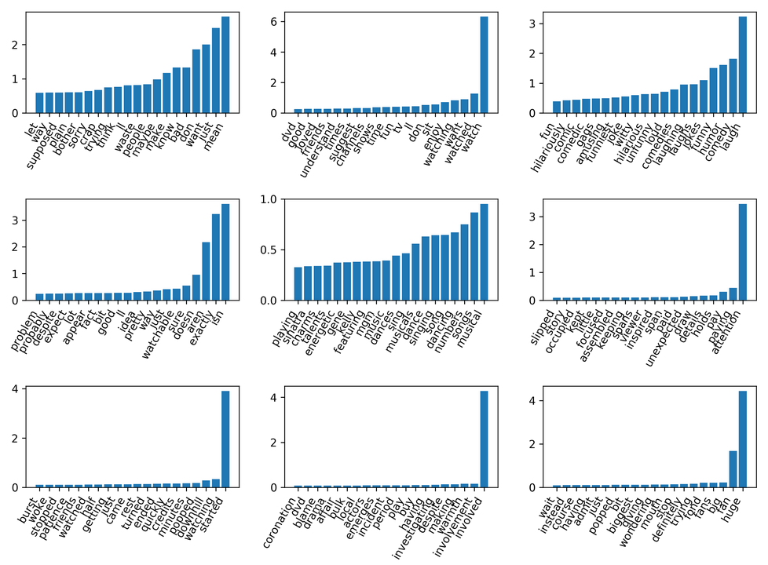
NMF on Scaled Data

Slide 15
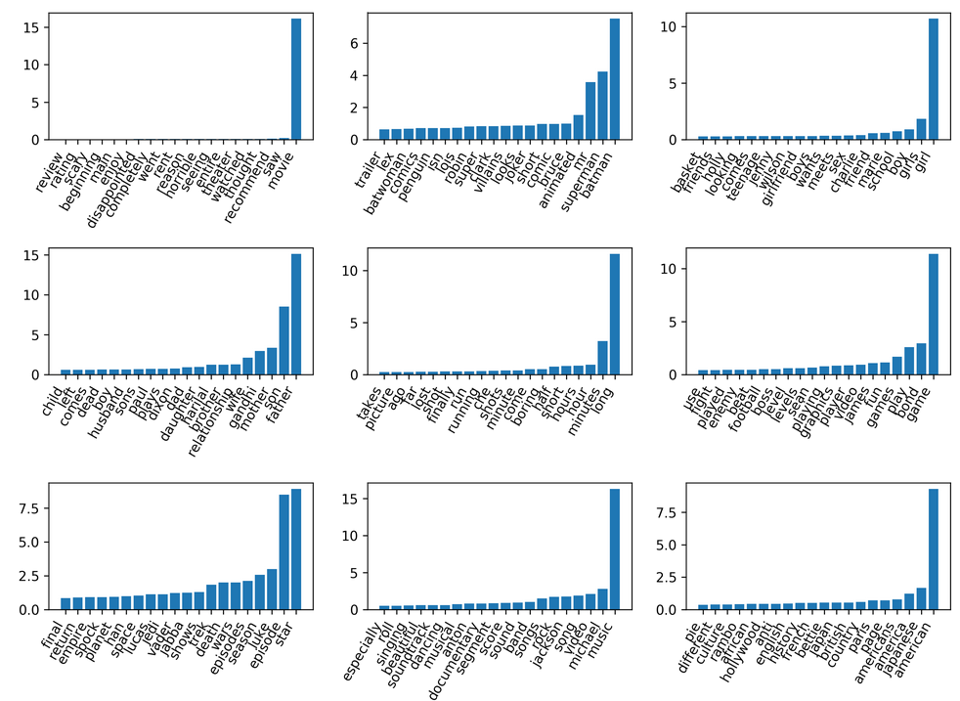
NMF components without scaling

Slide 16
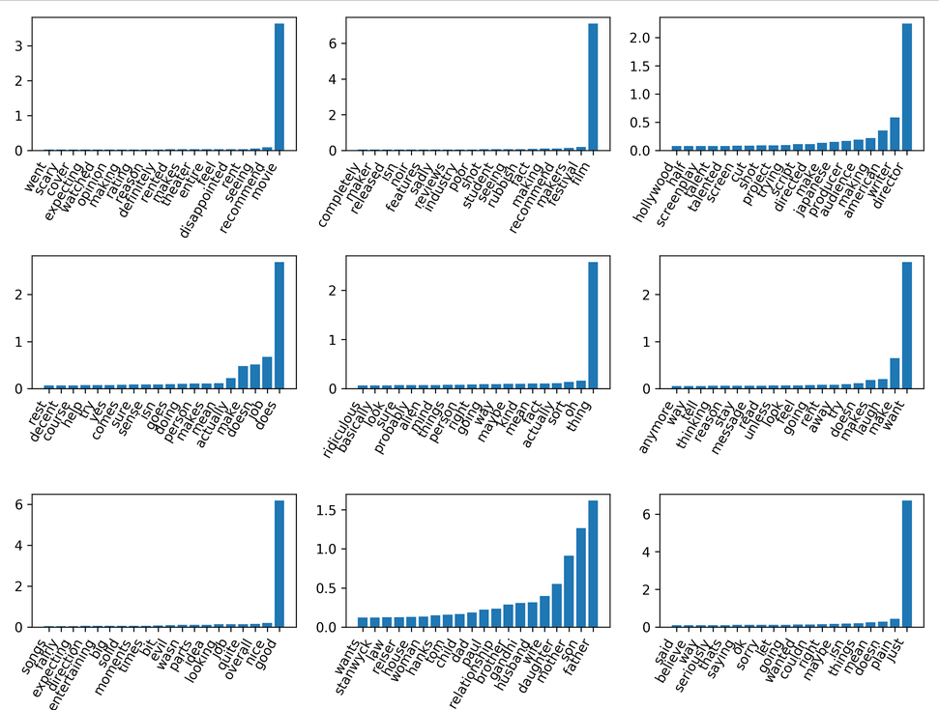
NMF with tfidf

Slide 17
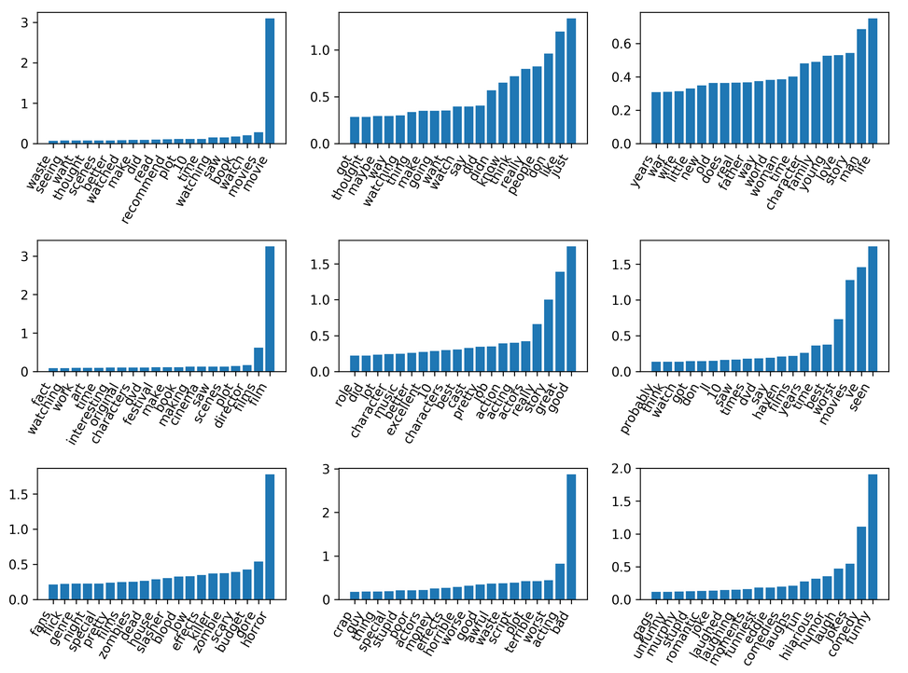
NMF with tfidf and 10 components

Slide 18
Latent Dirichlet Allocation (the other LDA)

Slide 19
LDA motivation
Generative probabilistic model (similar to mixture model)
Bayesian graphical model
Learning is probabilistic inference
Non-convex optimization (even harder than mixture models)

Slide 20
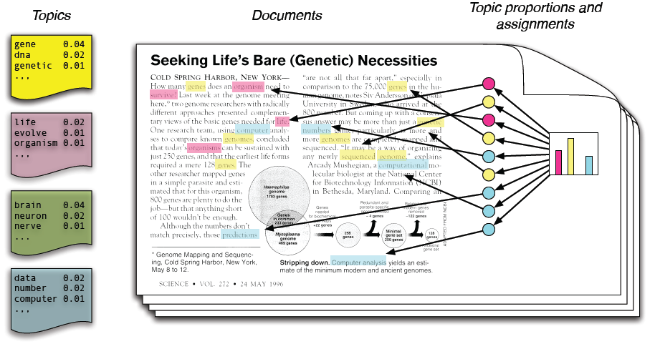
The LDA Model
(Stolen from Dave and John)

Slide 21
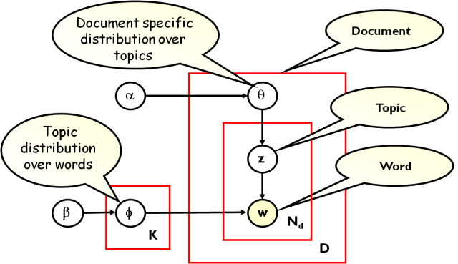
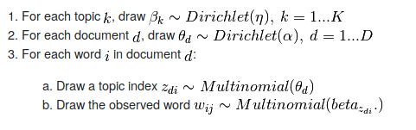
(taken from Yang Ruan, Changsi An http://salsahpc.indiana.edu/b649proj/proj3.html)

Slide 22
Estimated Parameters
K topics = multinomial distributions over words
“mixture weights” for each document:
  How important is each topic for this document
  Each document contains multiple topics!

Slide 23
Two Schools (of solvers)
Gibbs sampling
Implements MCMC
Standard procedure for any probabilistic model.
Very accurate
Very slow
Variational Inference
Extension of expectation-maximization algorithm
Deterministic
fast(er)
Less accurate solutions
Championed by Dave Blei

Slide 24
Pick a solver
“Small data” (<= 10k? Documents):
  Gibbs sampling (lda package, MALLET in Java!)
“Medium data” (<= 1M? Documents):
  Variational Inference (scikit-learn current default)
“Large Data” (>1M? Documents):
  Stochastic Variational Inference (scikit-learn future default)
  SVI allows online learning (partial_fit)
Remember SGD Lecture (and Leon Bottou):
More data beats better inference (often)
Edward by Dustin Tran: http://edwardlib.org/
Tensor-flow based framework for stochastic variational inference.

Slide 25
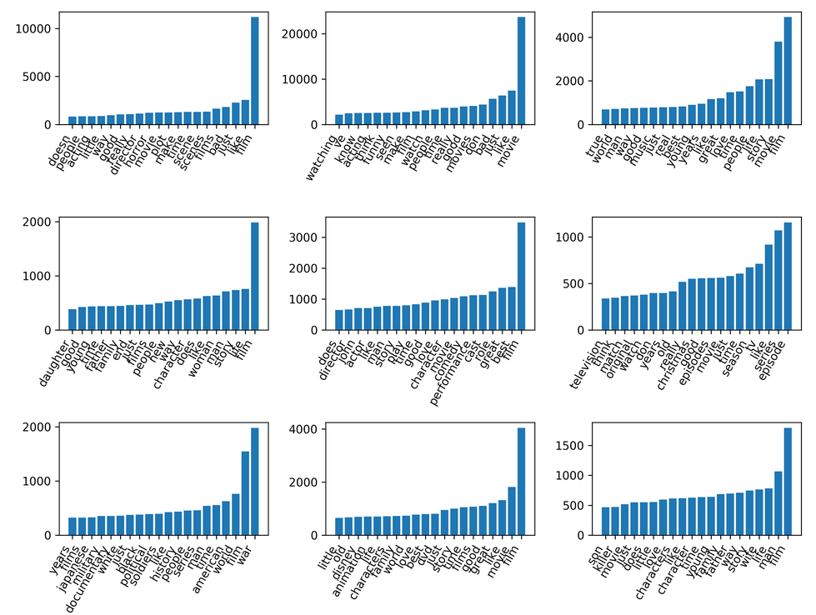

Notes:
Very generic, similar to NMF(n_components=10).
TV Series, “family drama”, and “history / war” topics

Slide 26
Hyper-Parameters
(or )= doc_topic_prior
(or ) = topic_word_prior
Both dirichlet distributions
Large value → more dispersed
Small value → more concentrated
Also see papers
“Rethinking LDA” & “LDA revisited”
They argue we need asymmetric priors

Slide 27


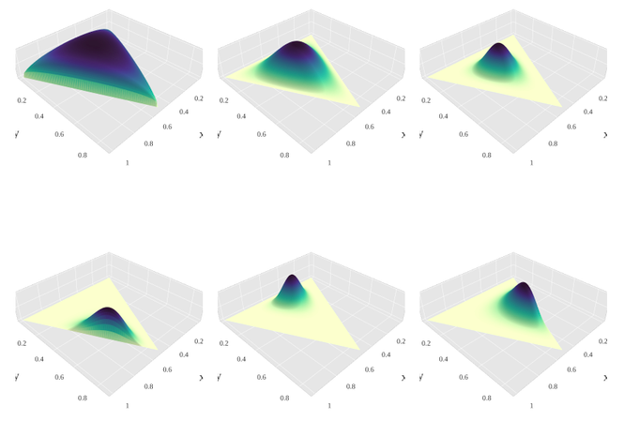
Dirichlet Distribution

Slide 28


Conjugate Prior
Prior is called “conjugate” if the posterior has the same form as prior.
If is multinomial (discrete distribution), then = Dirichlet(…) is a conjugate prior.
Multinomial:
Dirichlet

