Slide 1
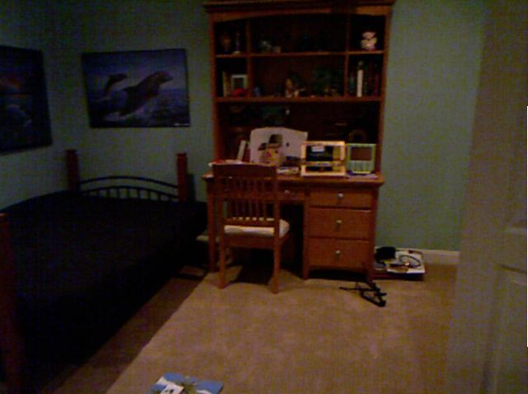
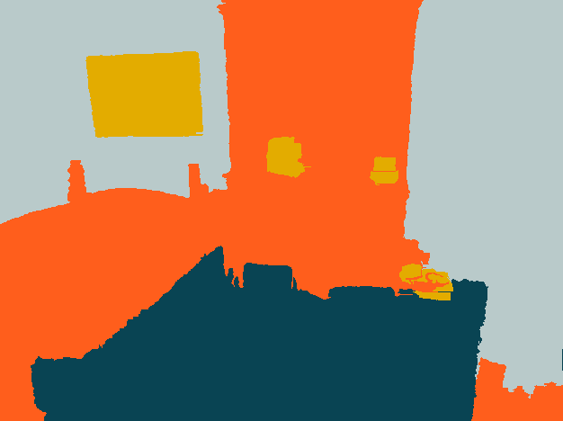
Learning Depth-Sensitive Conditional Random Fields for Semantic Segmentation of RGB-D Images
Andreas Christian Müller and Sven Behnke
Autonomous Intelligent Systems, University of Bonn, Germany
Objective: Structure class segmentation of RGB-D images
GPU-based Random Forest for classification of individual pixels
Segmentation of RGB-D images in superpixels
Conditional random field for modelling relations between superpixels
Unary and pair-wise potentials use depth
Structured SVM learning
State-of-the-art performance on large benchmark dataset (NYU V2 indoor scenes)

