Slide 1
Introduction to Machine Learning
(with Scikit-Learn)
Andreas Müller
(Columbia University, scikit-learn)
@amuellerml
Download Material: https://github.com/amueller/odsc-masterclass-2017-morning

Slide 2
What is machine learning?
Notes:
Machine learning is about extracting knowledge from data. It is closely related to statistics and optimization.
What distinguishes machine learning is that it is very focused on prediction.
We want to learn from a large dataset how to make decisions based on future observations.
You could say that the input to a machine learning program is the dataset, and the output is a program that can make decisions on future observations.
Machine learning is really widely used now, and I want to give you some examples that you probably all saw already today.

Slide 3
Types of machine learning:
- supervised
- unsupervised
- reinforcement
Notes:
There are three main branches of machine learning.
Who can name them?
They called supervised learning, unsupervised learning and reinforcement learning.
What are they?
This course will heavily focus on supervised learning, but you should be aware of the distinction. Supervised learning is also the most commonly used type in industry and research right now, though reinforcement learning becomes increasingly important.

Slide 4
Supervised Learning
i.i.d.
Notes:
In supervised learning, the dataset we learn form is input-output pairs (x_i, y_i), where x_i is some n_dimensional input, or feature vector, and y_i is the desired output we want to learn.
Generally, we assume these samples are drawn from some unknown joint distribution p(x, y).
What does iid mean?
We say they are drawn iid, which stands for independent identically distributed. In other words, the x_i, y_i pairs are independent and all come from the same distribution p.
You can think of this as there being some process that goes from x_i to y_i, but that we don’t know. We write this as a probability distribution and not as a function since even if there is a real process creating y from x, this process might not be deterministic.
The goal is to learn a function f so that for new inputs x for which we don’t observe y, f(x) is close to y.
This approach is very similar to function approximation.
The name supervised comes from the fact that during learning, a supervisor gives you the correct answers y_i.

Slide 5
Classification and Regression
Classification:
y discrete
Will you pass?
Regression:
y continuous
How many points will you get in the exam?
Notes:
So getting back to supervised learning, there are two basic kinds, called classification and regression.
The difference is quite simple, if y is continuous, then it’s regression, and if y is discrete, it’s classification.
That’s pretty simple, still let me give an example.
If I want to predict whether a student will pass the class, it’s a classification problem. There are two possible answers, “yes” and “no”.
If I want to predict how many points a student gets on an exam, it’s a regression problem, there is a continuous, gradual output space.
There are generalizations of this where we try to predict more than one variable, but we won’t go into that in this course. The main reason this distinction is important is because the way we measure how good a prediction is is very different for the two.

Slide 6
Generalization
Not only
Also for new data:
Notes:
For both regression and classification, it’s important to keep in mind the concept of generalization.
Let’s say we have a regression task. We have features, that is data vectors x_i and targets y_i drawn from a joint distribution.
We now want to learn a function f, such that f(x) is approximately y, not on this training data, but on new data drawn from this distribution. This is what’s called generalization, and this is a core distinction to function approximation. In principle we don’t care about how well we do on x_i, we only care how well we do on new samples from the distribution
We’ll go into much more detail about generalization in two weeks, when we dive into supervised learning.

Slide 7

Classification
Regression
Clustering
Semi-Supervised Learning
Feature Selection
Feature Extraction
Manifold Learning
Dimensionality Reduction
Kernel Approximation
Hyperparameter Optimization
Evaluation Metrics
Out-of-core learning
…...

Slide 8







Slide 9

Get the notebooks!
https://github.com/amueller/odsc-masterclass-2017-morning

Slide 10

http://scikit-learn.org/

Slide 11
Hi Andy,
I just received an email from the first tutorial speaker, presenting right before you, saying he's ill and won't be able to make it.
I know you have already committed yourself to two presentations, but is there anyway you could increase your tutorial time slot, maybe just offer time to try out what you've taught? Otherwise I have to do some kind of modern dance interpretation of Python in data :-)
-Leah
Hi Andreas,
I am very interested in your Machine Learning background. I work for X Recruiting who have been engaged by Z, a worldwide leading supplier of Y. We are expanding the core engineering team and we are looking for really passionate engineers who want to create their own story and help millions of people.
Can we find a time for a call to chat for a few minutes about this?
Thanks

Slide 12
Representing Data
one sample
1.1 | 2.2 | 3.4 | 5.6 | 1.0
6.7 | 0.5 | 0.4 | 2.6 | 1.6
2.4 | 9.3 | 7.3 | 6.4 | 2.8
1.5 | 0.0 | 4.3 | 8.3 | 3.4
0.5 | 3.5 | 8.1 | 3.6 | 4.6
5.1 | 9.7 | 3.5 | 7.9 | 5.1
3.7 | 7.8 | 2.6 | 3.2 | 6.3
1.6
2.7
4.4
0.5
0.2
5.6
6.7
X =
y =
one feature
outputs / labels

Slide 13
Training and Testing Data
training set
1.1 | 2.2 | 3.4 | 5.6 | 1.0
6.7 | 0.5 | 0.4 | 2.6 | 1.6
2.4 | 9.3 | 7.3 | 6.4 | 2.8
1.5 | 0.0 | 4.3 | 8.3 | 3.4
0.5 | 3.5 | 8.1 | 3.6 | 4.6
5.1 | 9.7 | 3.5 | 7.9 | 5.1
3.7 | 7.8 | 2.6 | 3.2 | 6.3
1.6
2.7
4.4
0.5
0.2
5.6
6.7
X =
y =
test set

Slide 14
IPython Notebook:
Part 0 – Data Loading

Slide 15
Supervised Machine Learning
Training Data
Model
Training
Training Labels
Test Data
Prediction
Generalization
Test Labels
Evaluation

Slide 16
clf = RandomForestClassifier()
clf.fit(X_train, y_train)
Training Data
Model
Training Labels
y_pred = clf.predict(X_test)
Test Data
Prediction
Test Labels
Evaluation
clf.score(X_test, y_test)

Slide 17
IPython Notebook:
Part 1 - Introduction to Scikit-learn

Slide 18
Unsupervised Machine Learning
Training Data
Model
Test Data
New View

Slide 19
Unsupervised Transformations
pca = PCA()
pca.fit(X_train)
X_new = pca.transform(X_test)
Training Data
Model
Test Data
Transformation

Slide 20
IPython Notebook:
Part 2 – Unsupervised Transformers

Slide 21
Basic API
estimator.fit(X, [y])
estimator.predict | estimator.transform
Classification | Preprocessing
Regression | Dimensionality reduction
Clustering | Feature selection
 | Feature extraction

Slide 22



Nearest neighbors
Notes:
Let’s say we have this two-class classification dataset here, with two features, one on the x axis and one on the y axis.
And we have three new points as marked by the stars here.
If I make a prediction using a one nearest neighbor classifier, what will it predict?
It will predict the label of the closest data point in the training set.
That is basically the simplest machine learning algorithm I can come up with.
Here’s the formula:
the prediction for a new x is the y_i so that x_i is the closest point in the training set.
Ok, so now how do we find out whether this model is any good?

Slide 23

Nearest neighbors
Notes:
So this was the predictions as made by one-nearest neighbor.
But we can also consider more neighbors, for example three. Here is the three nearest neighbors for each of the points and the corresponding labels.
We can then make a prediction by considering the majority among these three neighbors.
And as you can see, in this case all the points changed their labels! (I was actually quite surprised when I saw that, I just picked some points at random).
Clearly the number of neighbors that we consider matters a lot. But what is the right number?
The is a problem you’ll encounter a lot in machine learning, the problem of tuning parameters of the model, also called hyper-parameters, which can not be learned directly from the data.

Slide 24

Influence of n_neighbors
Notes:
Here’s an overview of how the classification changes if we consider different numbers of neighbors.
You can see as red and blue circles the training data. And the background is colored according to which class a datapoint would be assigned to for each location.
For one neighbor, you can see that each point in the training set has a little area around it that would be classified according to it’s label. This means all the training points would be classified correctly, but it leads to a very complex shape of the decision boundary.
If we increase the number of neighbors, the boundary between red and blue simplifies, and with 40 neighbors we mostly end up with a line.
This also means that now many of the training data points would be labeled incorrectly.

Slide 25

Model Complexity
Notes:
We can look at this in more detail by comparing training and test set scores for the different numbers of neighbors.
Here, I did a random 75%/25% split again. This is a very noisy plot as the dataset is very small and I only did a random split, but you can see a trend here.
You can see that for a single neighbor, the training score is 1 so perfect accuracy, but the test score is only 70%. If we increase the number of neighbors we consider, the training score goes down, but the test score goes up, with an optimum at 19 and 21, but then both go down again.
This is a very typical behavior, that I sketched in a schematic for you.

Slide 26
Overfitting and Underfitting
Training
Sweet spot
Accuracy
Generalization
Underfitting
Overfitting
Model complexity
Notes:
This chart has accuracy on the y axis, and an abstract concept of model complexity on the x axis.
If we make our machine learning models more complex, we will get better training set accuracy, as the model will be able to capture more of the variations in the data.
But if we look at the generalization performance, we get a different story. If the model complexity is too low, the model will not be able to capture the main trends, and a more complex model means better generalization.
However, if we make the model too complex, generalization performance drops again, because we basically learn to memorize the dataset.
If we use too simple a model, this is often called underfitting, while if we use to complex a model, this is called overfitting. And somewhere in the middle is a sweet spot.
Most models have some way to tune model complexity, and we’ll see many of them in the next couple of weeks.
So going back to nearest neighbors, what parameters correspond to high model complexity and what to low model complexity? high n_neighbors = low complexity!

Slide 27

Three-fold split
pro: fast, simple
con: high variance, bad use of data.
Notes:
The simplest way to combat this overfitting to the test set is by using a three-fold split of the data, into a training, a validation and a test set.
We use the training set for model building, the validation set for parameter selection and the test set for a final evaluation of the model.
So how many models should you try out on the test set? Only one! Ideally use use the test-set exactly once, otherwise you make a multiple hypothesis testing error!
What are downsides of this? We lose a lot of data for evaluation, and the results depend on the particular sampling.

Slide 28

Notes:
Here is an implementation of the three-fold split for selecting the number of neighbors.
For each number of neighbors that we want to try, we build a model on the training set, and evaluate it on the validation set.
We then pick the best validation set score, here that’s 97.2%, achieved when using three neighbors.
We then retrain the model with this parameter, and evaluate on the test set.
Do you have any idea how to make this more robust?

Slide 29

Cross-validation
Pro: more stable, more data
con: slower
Notes:
The answer is of course cross-validation. In cross-validation, you split your data into multiple folds, usually 5 or 10, and built multiple models.
You start by using fold1 as the test data, and the remaining ones as the training data. You build your model on the training data, and evaluate it on the test fold.
For each of the splits of the data, you get a model evaluation and a score. In the end, you can aggregate the scores, for example by taking the mean.
What are the pros and cons of this?
Each data point is in the test-set exactly once!
Takes 5 or 10 times longer!
Better data use (larger training sets).
Does that solve all problems? No, it replaces only one of the splits, usually the inner one!

Slide 30

Cross-validation + test-set
Notes:
Here is how the workflow looks like when we are using five-fold cross-validation together with a test-set split for adjusting parameters.
We start out by splitting of the test data, and then we perform cross-validation on the training set.
Once we found the right setting of the parameters, we retrain on the whole training set and evaluate on the test set.

Slide 31
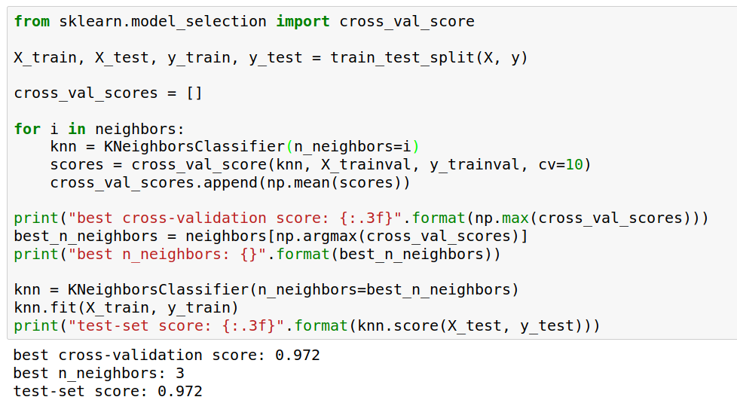
Notes:
Here is an implementation of this for k nearest neighbors.
We split the data, then we iterate over all parameters and for each of them we do cross-validation.
We had seven different values of n_neighbors, and we are running 10 fold cross-validation. How many models to we train in total?
10 * 7 + 1 = 71 (the one is the final model)

Slide 32

Notes:
Here is a conceptual overview of this way of tuning parameters, we start of with the dataset and a candidate set of parameters we want to try, labeled parameter grid, for example the number of neighbors.
We split the dataset in to training and test set. We use cross-validation and the parameter grid to find the best parameters.
We use the best parameters and the training set to build a model with the best parameters,
and finally evaluate it on the test set.

Slide 33
IPython Notebook:
Part 3 – Cross-validation and grid-search

Slide 34
Preprocessing

Slide 35

Notes:
Let’s go back to the boston housing dataset. The idea was to predict house prices. Here are the features on the x axis and the response, so price, on the y axis.
What are some thing you can notice? (concentrated distributions, skewed distibutions, discrete variable, linear and non-linear effects, different scales)

Slide 36
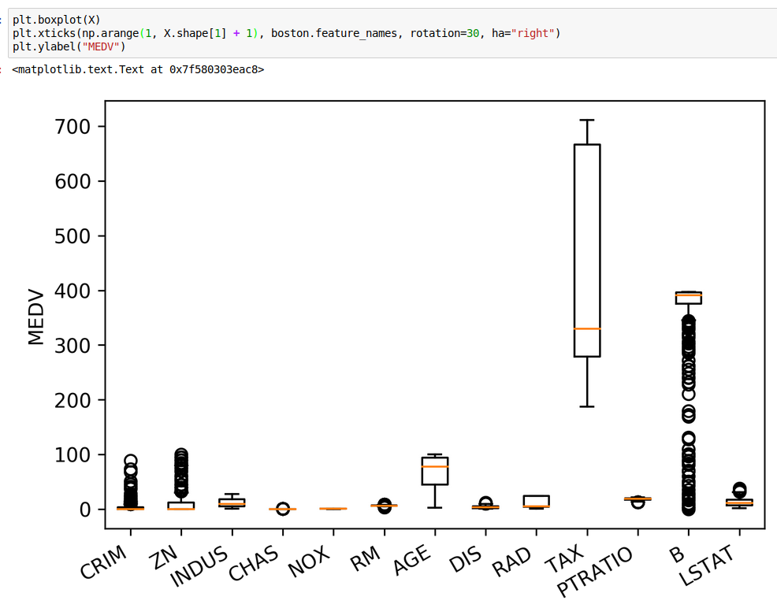
Notes:
Let’s start with the different scales.
Many model want data that is on the same scale. KNearestNeighbors: If the distance in TAX is between 300 and 400 then the distance difference in CHArS doesn’t matter!
Linear models: the different scales mean different penalty. L2 is the same for all!
We can also see non-gaussian distributions here btw!

Slide 37
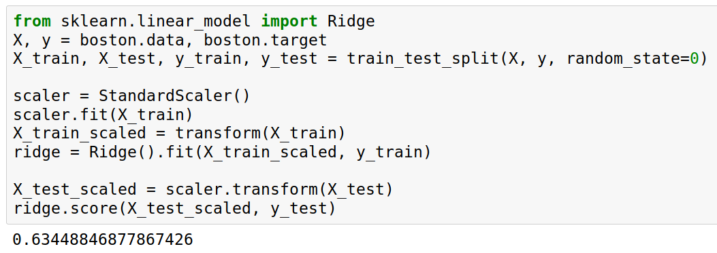
Notes:
Here’s how you do the scaling with StandardScaler in scikit-learn. Similar interface to models, but “transform” instead of “predict”. “transform” is always used when you want a new representation of the data.
Fit on training set, transform training set, fit ridge on scaled data, transform test data, score scaled test data.
The fit computes mean and standard deviation on the training set, transform subtracts the mean and the standard deviation.
We fit on the training set and apply transform on both the training and the test set. That means the training set mean gets subtracted from the test set, not the test-set mean. That’s quite important.

Slide 38
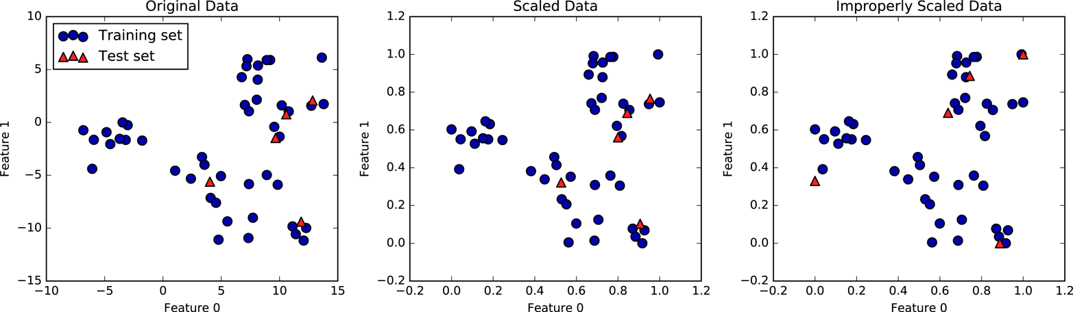
Notes:
Here’s an illustration why this is important using the min-max scaler. Left is the original data. Center is what happens when we fit on the training set and then transform the training and test set using this transformer. The data looks exactly the same, but the ticks changed. Now the data has a minimum of zero and a maximum of one on the training set. That’s not true for the test set, though. No particular range is ensured for the test-set. It could even be outside of 0 and 1. But the transformation is consistent with the transformation on the training set, so the data looks the same.
On the right you see what happens when you use the test-set minimum and maximum for scaling the test set. That’s what would happen if you’d fit again on the test set. Now the test set also has minimum at 0 and maximum at 1, but the data is totally distorted from what it was before. So don’t do that.

Slide 39
Categorical Features

Slide 40
Categorical Features
?
Notes:
Before we can apply a machine learning algorithm, we first need to think about how we represent our data.
Earlier, I said x \in R^n. That’s not how you usually get data. Often data has units, possibly different units for different sensors, it has a mixture of continuous values and discrete values, and different measurements might be on totally different scales.
First, let me explain how to deal with discrete input variables, also known as categorical features. They come up in nearly all applications.
Let’s say you have three possible values for a given measurement, whether you used setup1 setup2 or setup3. You could try to encode these into a single real number, say 0, 1 and 2, or e, \pi, \tau.
However, that would be a bad idea for algorithms like linear regression.

Slide 41
Categorical Variables
“red” “green” “blue”
1 0 0
0 1 0
0 0 1
Notes:
If you encode all three values using the same feature, then you are imposing a linear relation between them, and in particular you define an order between the categories. Usually, there is no semantic ordering of the categories, and so we shouldn’t introduce one in our representation of the data.
Instead, we add one new feature for each category,
And that feature encodes whether a sample belongs to this category or not.
That’s called a one-hot encoding, because only one of the three features in this example is active at a time.
You could actually get away with n-1 features, but in machine learning that usually doesn’t matter.

Slide 42
IPython Notebook:
Part 4 – Preprocessing

Slide 43
Linear Models for Regression

Slide 44

Linear Models for Regression

Slide 45
Linear Regression
Ordinary Least Squares
Unique solution if has full rank.

Slide 46
Ridge Regression
Always has a unique solution.
Has tuning parameter alpha

Slide 47
IPython Notebook:
Part 5 – Linear Models for Regression

Slide 48
Linear Models for Classification

Slide 49
Linear models for binary classfiication

Slide 50


Slide 51

Logistic Regression

Slide 52
Penalized Logistic Regression
C is inverse to alpha (or alpha / n_samples)

Slide 53
Multinomial Logistic Regression
Probabilistic multi-class model:

Slide 54


Slide 55
IPython Notebook:
Part 6 – Linear Models for Classification

Slide 56
Decision Trees and Tree-based Models

Slide 57
Idea: series of binary questions

Slide 58



Building trees
Continuous features:
“questions” are thresholds on single features.
[Other methods are possible but not as common]
For each split:
exhaustive search over all features and thresholds!
Minimize “impurity”
Notes:
The second family of models I want to talk about is decision-tree based models.
A decision tree is basically the same as a sequence of if-else branches, that ultimately lead to a decision. The point is that the question that are asked are learned, though.
A decision tree is build recursively by asking a series of questions of the form “is feature “i” greater than threshold t”. In each iteration, the question is chosen that yields the most information about the target variable. Then, the data is split according to this question, and we start again. This yields a hierarchical partitioning of the data, where each section of the partitioning becomes more and more “pure”, that is their content becomes more and more the same.
After you build the tree, you can make a prediction by checking which part of the partition a new point lies in and assigning the mean of the datapoints in this part.

Slide 59
Prediction
y=0
Traverse tree based on feature tests
Predict most common class in leaf

Slide 60
IPython Notebook:
Part 7 – Decision Trees

Slide 61




Random Forests

Slide 62
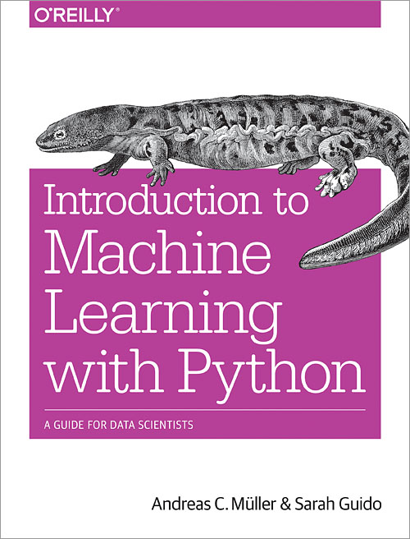

Slide 63




Thank you for your attention.
@amuellerml
@amueller
importamueller@gmail.com
http://amueller.github.io

