Slide 1
Large scale non-linear learning on a single CPU
Andreas Mueller

Slide 2
Large Scale – “Out of core: Fits on a hard disk but in RAM”
Non-linear – because real-world problems are not.
Single CPU – Because parallelization is hard
(and often unnecessary)

Slide 3
Three regimes of data
Fits in RAM
Fits on a Hard Drive
Doesn't fit on a single PC

Slide 4
Three regimes of data
Fits in RAM (up to 256 GB?)
Fits on a Hard Drive (up to 6TB?)
Doesn't fit on a single PC

Slide 5


Slide 6
Why not do to out of core learning.

Slide 7
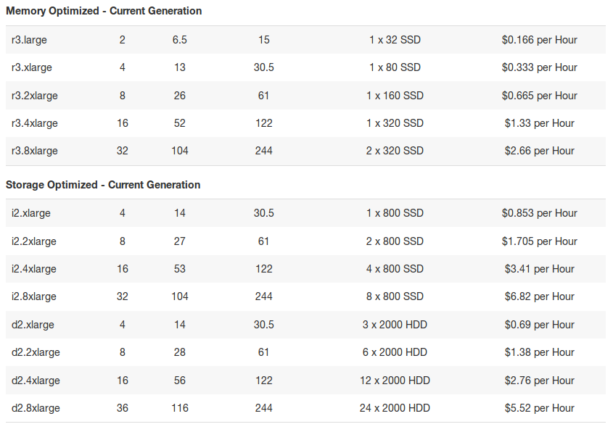

Slide 8
Your data is not that big!

Slide 10
"256Gb ought to be enough for anybody."
- me
(for machine learning)

Slide 11
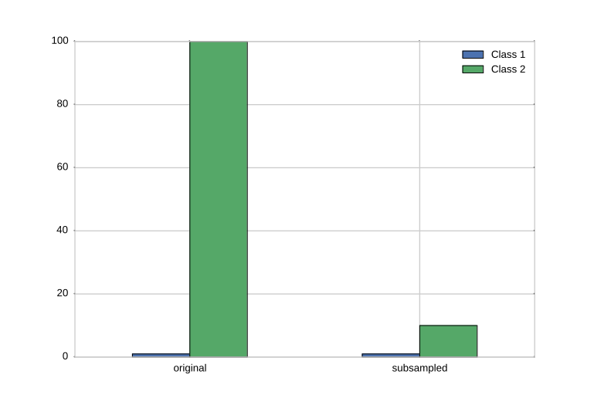
Subsample!

Slide 12
The scikit-learn way

Slide 13
HDD
Your for-loop / polling
estimator.partial_fit(X_batch, y_batch)
Trained
Scikit-learn
estimator
Network

Slide 14
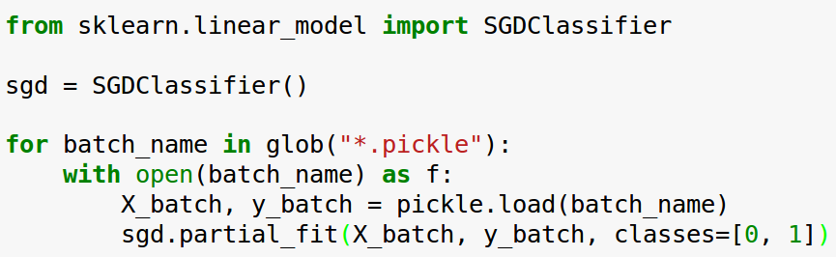
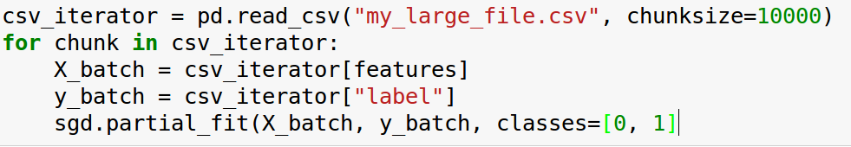
Linear Classification

Slide 15
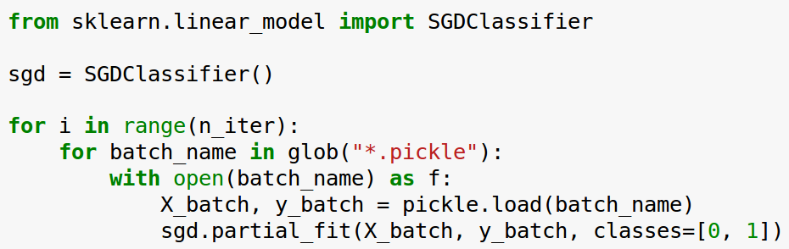
Linear Classification

Slide 16
1st nonlinear option:
Stateless Transformers

Slide 17
Text Classification: Bag Of Word
“This is how you get ants.”
tokenizer
['this', 'is', 'how', 'you', 'get', 'ants']
Build a vocabulary over all documents
['aardvak', 'amsterdam', 'ants', ... 'you', 'your', 'zyxst']
Sparse matrix encoding
aardvak
ants
get
you
zyxst
[0, …, 0, 1, 0, … , 0, 1 , 0, …, 0, 1, 0, …., 0 ]

Slide 18
Text Classification: Hashing Trick
“This is how you get ants.”
tokenizer
['this', 'is', 'how', 'you', 'get', 'ants']
hashing
[hash('this'), hash('is'), hash('how'), hash('you'), hash('get'), hash('ants')]
= [832412, 223788, 366226, 81185, 835749, 173092]
Sparse matrix encoding
[0, …, 0, 1, 0, … , 0, 1 , 0, …, 0, 1, 0, …., 0 ]

Slide 19
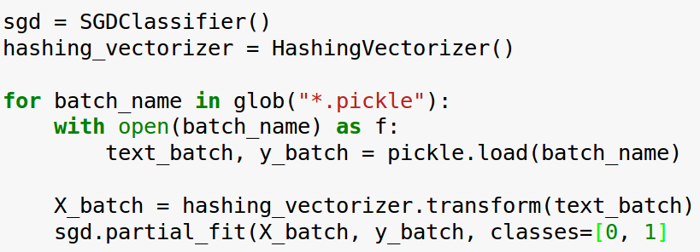
Text Classification: Hashing Trick

Slide 20
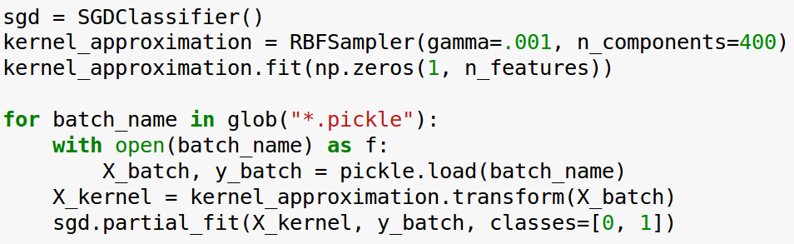
Kernel Approximation

Slide 21
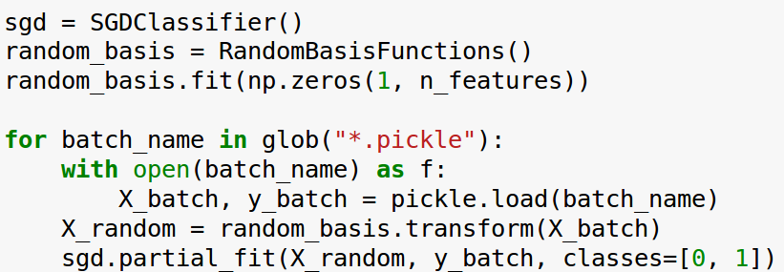
Random Neural Nets
(not merged yet)

Slide 22
2nd nonlinear option:
Learn Transformations on Subsets

Slide 23
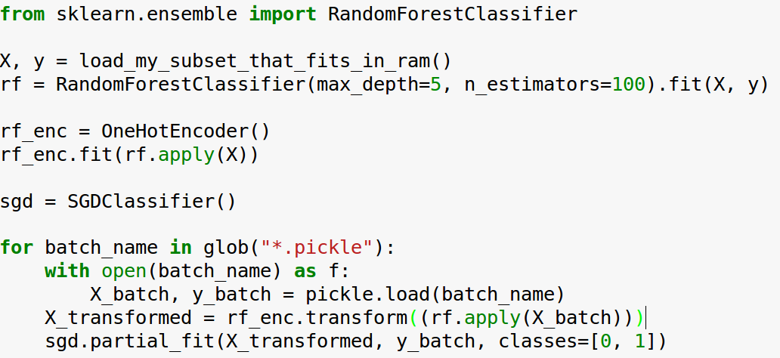
RandomForests

Slide 24
3rd nonlinear option:
Online Nonlinear Classification

Slide 25
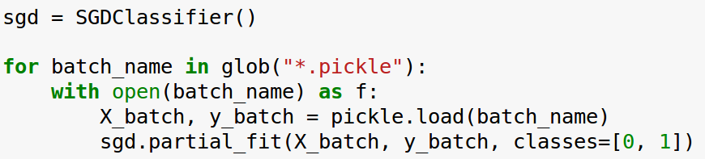
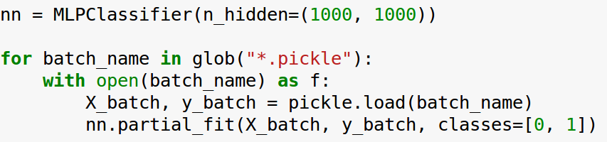
Neural Networks (MLPs)

Slide 26
Neural Networks (MLPs)

Slide 27
Other algorithms
Naive Bayes
MinibatchKMeans
Birch
IncrementalPCA
MiniBatchDictionaryLearning
Scalers
...

Slide 28
What Else is Out There?
Vowpal Wabbit (VW)
More deep learning
Hogwild!

