Slide 1

Machine Learning with Scikit-Learn
Andreas Mueller (NYU Center for Data Science, scikit-learn)

Slide 2



Me

Slide 3







Slide 4

Get the notebooks!
http://bit.ly/skCUNY

Slide 5
Hi Andy,
I just received an email from the first tutorial speaker, presenting right before you, saying he's ill and won't be able to make it.
I know you have already committed yourself to two presentations, but is there anyway you could increase your tutorial time slot, maybe just offer time to try out what you've taught? Otherwise I have to do some kind of modern dance interpretation of Python in data :-)
-Leah
Hi Andreas,
I am very interested in your Machine Learning background. I work for X Recruiting who have been engaged by Z, a worldwide leading supplier of Y. We are expanding the core engineering team and we are looking for really passionate engineers who want to create their own story and help millions of people.
Can we find a time for a call to chat for a few minutes about this?
Thanks

Slide 6


Hi Andy,
I just received an email from the first tutorial speaker, presenting right before you, saying he's ill and won't be able to make it.
I know you have already committed yourself to two presentations, but is there anyway you could increase your tutorial time slot, maybe just offer time to try out what you've taught? Otherwise I have to do some kind of modern dance interpretation of Python in data :-)
-Leah
Hi Andreas,
I am very interested in your Machine Learning background. I work for X Recruiting who have been engaged by Z, a worldwide leading supplier of Y. We are expanding the core engineering team and we are looking for really passionate engineers who want to create their own story and help millions of people.
Can we find a time for a call to chat for a few minutes about this?
Thanks

Slide 7
Supervised Machine Learning
Training Data
Model
Training
Training Labels
Test Data
Prediction
Generalization
Test Labels
Evaluation

Slide 8
clf = RandomForestClassifier()
clf.fit(X_train, y_train)
y_pred = clf.predict(X_test)
Training Data
Model
Training Labels
Test Data
Prediction
Test Labels
Evaluation
clf.score(X_test, y_test)

Slide 9
IPython Notebook:
Chapter 1 - Introduction to Scikit-learn

Slide 10
Unsupervised Machine Learning
Training Data
Model
Training
Test Data
New View
Generalization

Slide 11
All Data
Training data
Test data
Fold 1
Fold 2
Fold 3
Fold 4
Fold 5
Split 1
Fold 1
Fold 2
Fold 3
Fold 4
Fold 5
Split 2
Fold 1
Fold 2
Fold 3
Fold 4
Fold 5
Split 3
Fold 1
Fold 2
Fold 3
Fold 4
Fold 5
Split 4
Fold 1
Fold 2
Fold 3
Fold 4
Fold 5
Split 5
Fold 1
Fold 2
Fold 3
Fold 4
Fold 5

Slide 12
IPython Notebook:
Chapter 2 - Cross-validation

Slide 13



Slide 14
All Data
Training data
Test data
Fold 1
Fold 2
Fold 3
Fold 4
Fold 5
Split 1
Fold 1
Fold 2
Fold 3
Fold 4
Fold 5
Split 2
Fold 1
Fold 2
Fold 3
Fold 4
Fold 5
Finding Parameters
Split 3
Fold 1
Fold 2
Fold 3
Fold 4
Fold 5
Split 4
Fold 1
Fold 2
Fold 3
Fold 4
Fold 5
Split 5
Fold 1
Fold 2
Fold 3
Fold 4
Fold 5
Final evaluation
Test data

Slide 15
SVC(C=0.001, gamma=0.001)
SVC(C=0.01, gamma=0.001)
SVC(C=0.1, gamma=0.001)
SVC(C=1, gamma=0.001)
SVC(C=10, gamma=0.001)
SVC(C=0.001, gamma=0.01)
SVC(C=0.01, gamma=0.01)
SVC(C=0.1, gamma=0.01)
SVC(C=1, gamma=0.01)
SVC(C=10, gamma=0.01)
SVC(C=0.001, gamma=0.1)
SVC(C=0.01, gamma=0.1)
SVC(C=0.1, gamma=0.1)
SVC(C=1, gamma=0.1)
SVC(C=10, gamma=0.1)
SVC(C=0.001, gamma=1)
SVC(C=0.01, gamma=1)
SVC(C=0.1, gamma=1)
SVC(C=1, gamma=1)
SVC(C=10, gamma=1)
SVC(C=0.001, gamma=10)
SVC(C=0.01, gamma=10)
SVC(C=0.1, gamma=10)
SVC(C=1, gamma=10)
SVC(C=10, gamma=10)

Slide 16
IPython Notebook:
Chapter 3 – Grid Searches

Slide 17
Training Labels
Training Data
Model

Slide 18
Training Labels
Training Data
Feature
Extraction
Scaling
Feature
Selection
Model
Cross Validation

Slide 19
IPython Notebook:
Chapter 4 - Preprocessing and Pipelines

Slide 20
Do cross-validation over all steps.
Keep a separate test set until the very end.

Slide 21

Source: Bergstra and Bengio

Slide 22
IPython Notebook:
Chapter 4 - Randomized Parameter Search

Slide 23
Bag Of Word Representations
CountVectorizer / TfidfVectorizer
“You better call Kenny Loggins”
tokenizer
['you', 'better', 'call', 'kenny', 'loggins']
Sparse matrix encoding
aardvak
better
call
you
zyxst
[0, …, 0, 1, 0, … , 0, 1 , 0, …, 0, 1, 0, …., 0 ]

Slide 24
IPython Notebook:
Chapter 5 - Working With Text Data

Slide 25
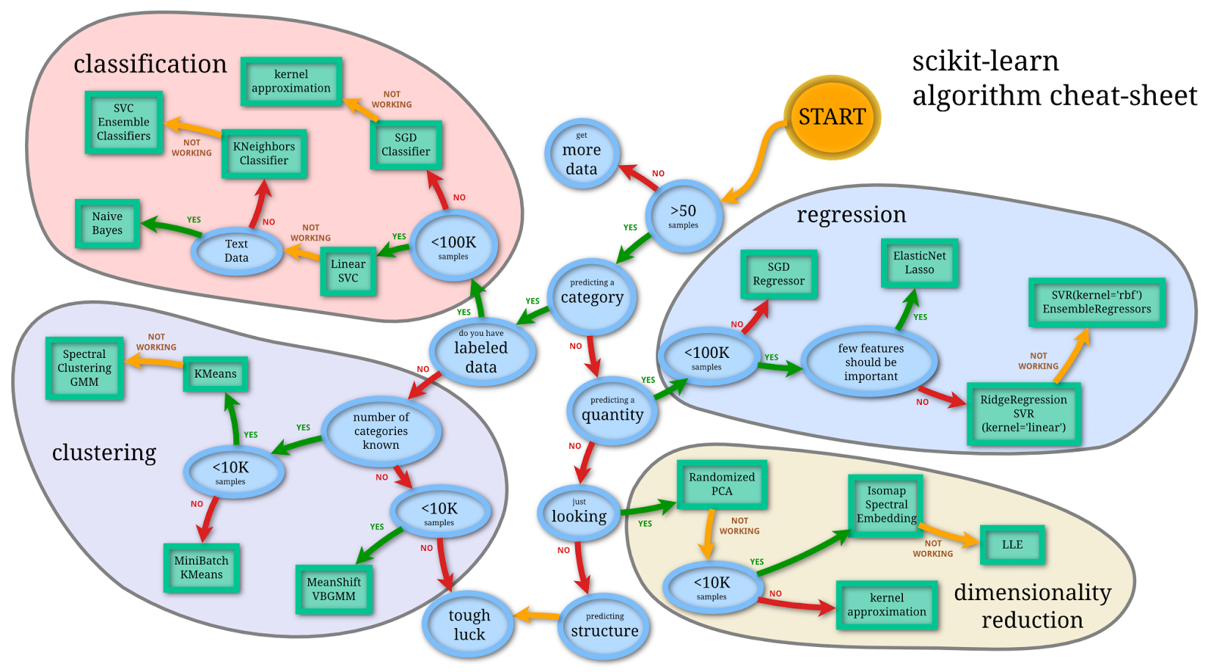

Slide 26



Thank you for your attention.
@t3kcit
@amueller
importamueller@gmail.com

