Slide 1


Multi-Instance Kernels for Partially Supervised Object Class Segmentation
Andreas Mueller and Sven Behnke

Slide 2
Overview
What is Multi-Instance Learning
Multi-Instance Kernels
Partially Supervised Object Class Segmentation as Multi-Instance Learning
Results on Graz02 Dataset

Slide 3
Multiple Instance Learning

Slide 4
Supervised Learning
-
-
+
+
-
-
+
-
+
-
+
Given (x_{i}, y_{i}) in

Slide 5
Supervised Learning
-
-
+
+
-
-
+
-
+
-
+
Given (x_{i}, y_{i}) in
Find such that sign(f(x_{i})) = y_{i}

Slide 6
Supervised Learning
-
-
+
+
-
-
+
-
+
-
+
For new x

Slide 7
Supervised Learning
-
-
-
+
+
-
+
-
-
+
-
+
-
-
+
+
-
+
+
For new x predict y as sign(f(x))

Slide 8
Multiple Instance Learning
-
+
-
+
-
+
-
-
+
+
-
-
Given and y_{i} in {+1, -1}
Find such that
Given and y_{i} in {+1, -1}
-
-
-
-
-

Slide 9
Multiple Instance Learning
-
+
-
+
-
-
+
-
-
+
+
-
-
-
-
-
-
-
For new

Slide 10
Multiple Instance Learning
+
-
+
-
-
+
+
-
-
+
-
-
-
+
+
-
-
-
-
-
-
-
-
-
-
For new , predict y as

Slide 11
Multiple Instance Learning
+
-
+
-
-
+
+
-
-
+
+
-
-
-
+
+
-
-
-
-
-
-
-
-
-
-
-
For new , predict y as

Slide 12
Multiple Instance Kernels

Slide 13
Multi-Instance Kernel
(Gaertner 2003)
y₁
x1
y₁
x1
KMI( , )
x3
x3
y₂
x2
y₂
x2

Slide 14
Multi-Instance Kernel
(Gaertner 2003)
y₁
x1
y₁
x1
KMI( , )
k( , )^{p} + k( , )^{p} + k( , )^{p} + k( , )^{p} + k( , )^{p} + k( , )^{p}
x3
x3
y₂
x2
y₂
x2
=
x1
y₁
x1
y₂
x2
y₁
x2
y₂
x3
y₁
x3
y₂

Slide 15
Multi-Instance Kernel
(Gaertner 2003)
y₁
x1
y₁
x1
KMI( , )
k( , )^{p} + k( , )^{p} + k( , )^{p} + k( , )^{p} + k( , )^{p} + k( , )^{p}
x3
x3
y₂
x2
y₂
x2
=
x1
y₁
x1
y₂
x2
y₁
x2
y₂
x3
y₁
x3
y₂
Theorem
If k can separate underlying concept, kMI can separate concepts on bags.

Slide 16
Multi-Instance Kernel
(Gaertner 2003)
y₁
x1
y₁
x1
KMI( , )
k( , )^{p} + k( , )^{p} + k( , )^{p} + k( , )^{p} + k( , )^{p} + k( , )^{p}
x3
x3
y₂
x2
y₂
x2
=
x1
y₁
x1
y₂
x2
y₁
x2
y₂
x3
y₁
x3
y₂
Theorem
If k can separate underlying concept, kMI can separate concepts on bags.
If k is a Gaussian kernel, k^{p} is also a Gaussian kernel.

Slide 17
Using MI Kernel
Can use MI Kernel to train SVM

Slide 18
Using MI Kernel
Can use MI Kernel to train SVM
Gram matrix scales with number of bags
→ Very efficient training/recall

Slide 19
Using MI Kernel
Can use MI Kernel to train SVM
Gram matrix scales with number of bags
→ Very efficient training/recall
Yields bag-level classifier:
x1
x2
x3

Slide 20
Multi-Instance Kernel for Instance Level Prediction
Construct instance level classifier by x → {x}:
f( ) = f_{MI}( )

Slide 21
Multi-Instance Kernel for Instance Level Prediction
Construct Instance Level classifier by x → {x}:
f( ) = f_{MI}( )
Training as MIKernel

Slide 22
Multi-Instance Kernel for Instance Level Prediction
Construct Instance Level classifier by x → {x}:
f( ) = f_{MI}( )
Training as MIKernel
Gram matrix still independent of number of instances
→ fast recall

Slide 23
Multi-Instance Kernel for Instance Level Prediction
Problem:
f_{MI}( ) ≠ max { f( ) , f( ), f( ) }
Since we only have f_{MI} at training time and we are only
interested in f at test time, not really a problem.
x1
x3
x1
x2
x3
x2

Slide 24
Partially Supervised
Object Class Segmentation

Slide 25
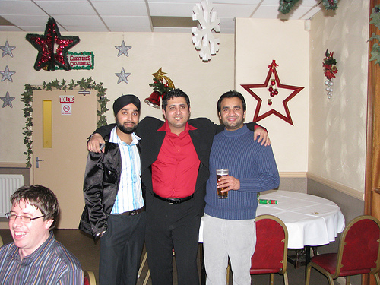
Object Class Segmentation
Which object categories are present?
Which pixel belongs to
which object category?

Slide 26

Object Class Segmentation

Slide 27
Object Class Segmentation
Object Class Segmentation = “Give every pixel a class label.”
i.e. “person”, “table”, “chair”

Slide 28
Weak Supervision for
Object Class Segmentation
Full Supervision:
Input Teacher Output

Slide 29
Weak Supervision for
Object Class Segmentation
Full Supervision:
Input Teacher Output
Weak Supervision:
Input Teacher Output
contains:
people, table,
chair

Slide 30
Object Class Segmentation as Multi Instance Learning

Slide 31
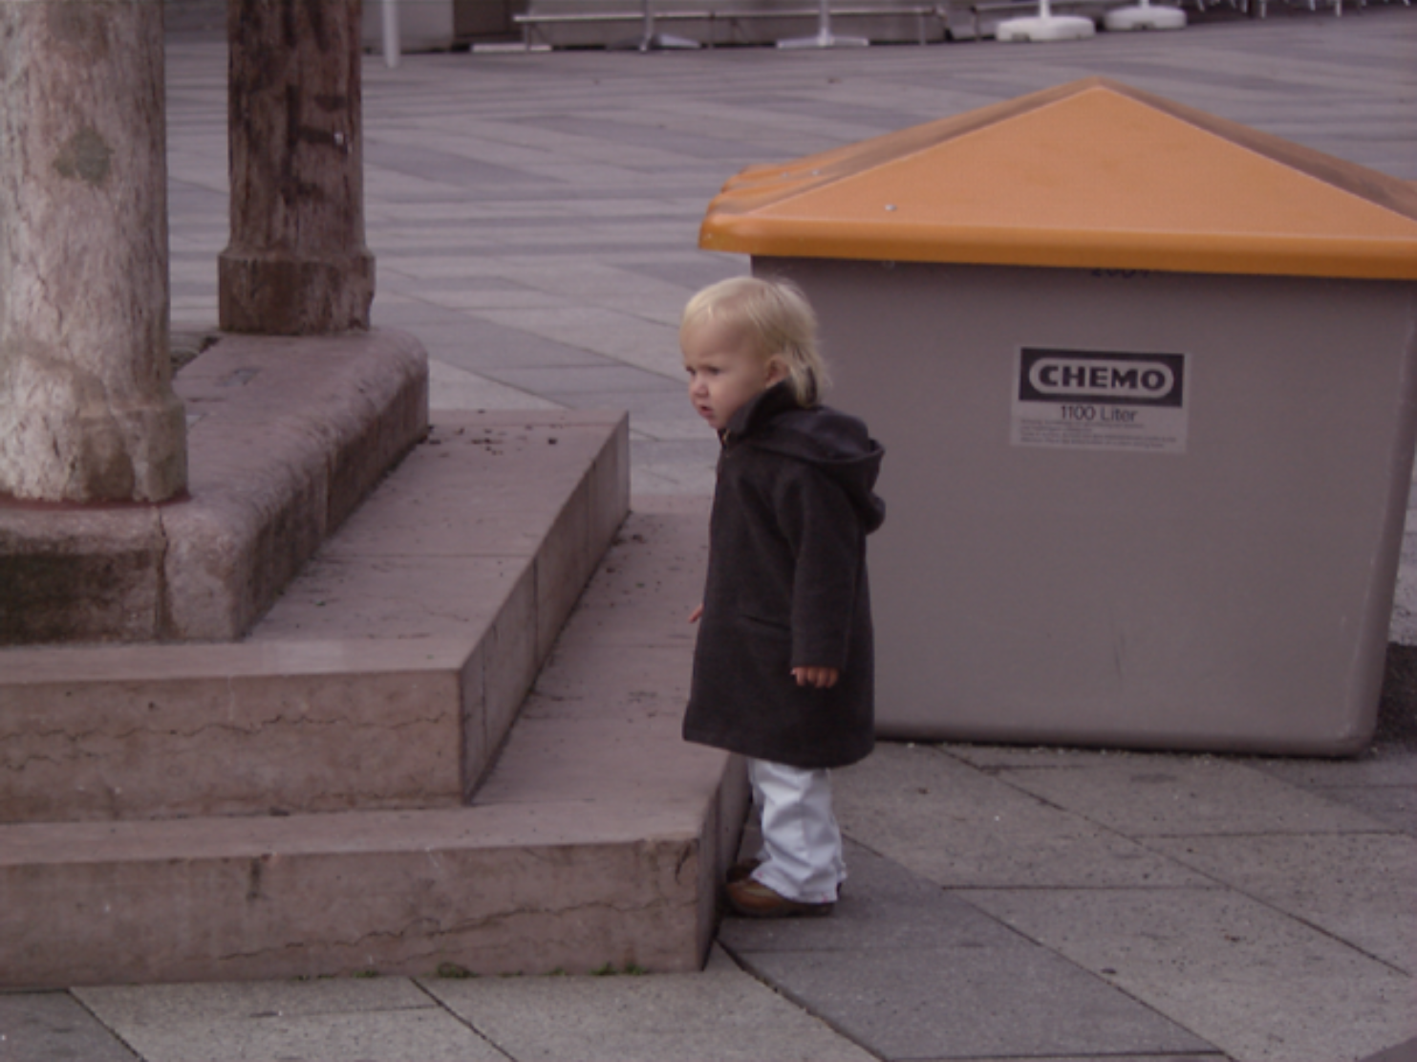
Images as Bags of Segments

Slide 32
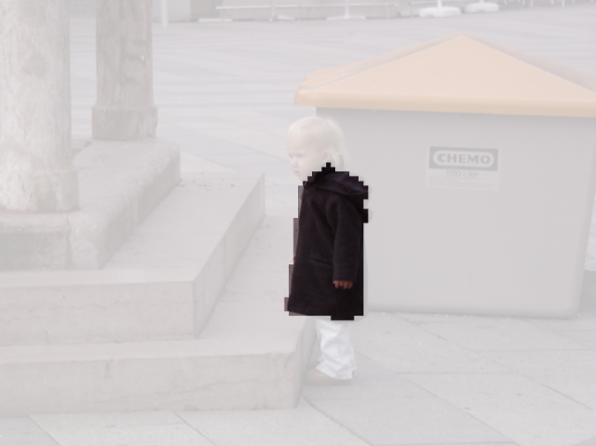
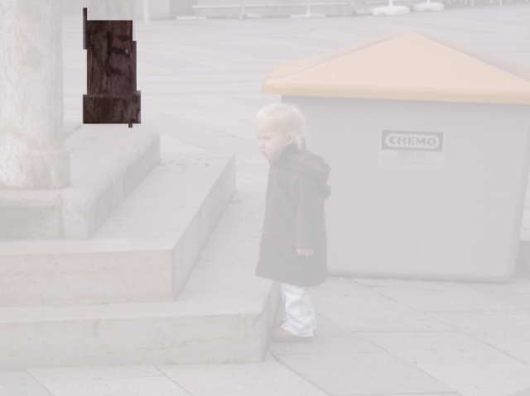
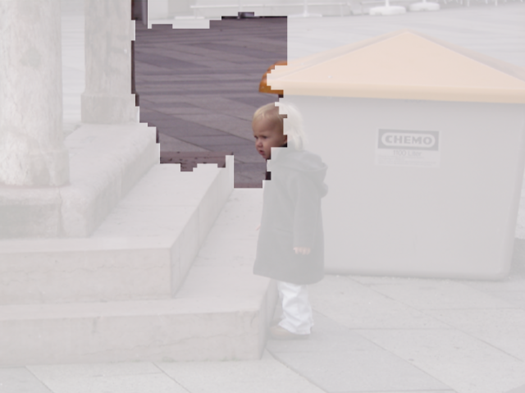
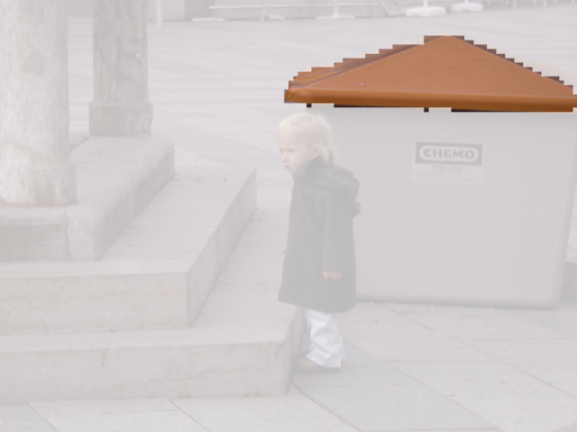
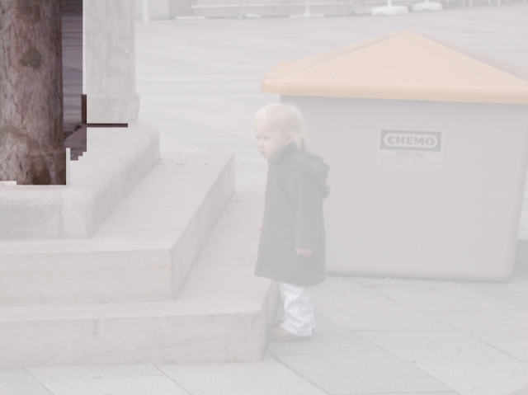
Images as Bags of Segments

Slide 33
Constraint Parametric Min-Cuts (Carreira 2010)
Generates overlapping object-like segments

Slide 34
Constraint Parametric Min-Cuts (Carreira 2010)
Generates overlapping object-like segments
Around 700 segments per image
Ranked according to object-ness

Slide 35
Constraint Parametric Min-Cuts (Carreira 2010)
Generates overlapping object-like segments
Around 700 segments per image
Ranked according to object-ness
Uses graph cuts between foreground and background seeds
Pairwise potentials given by gPb

Slide 36
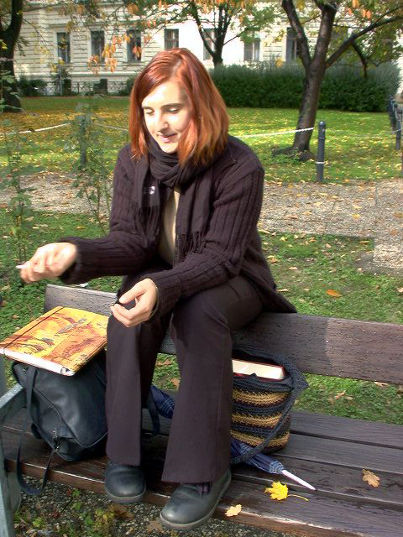
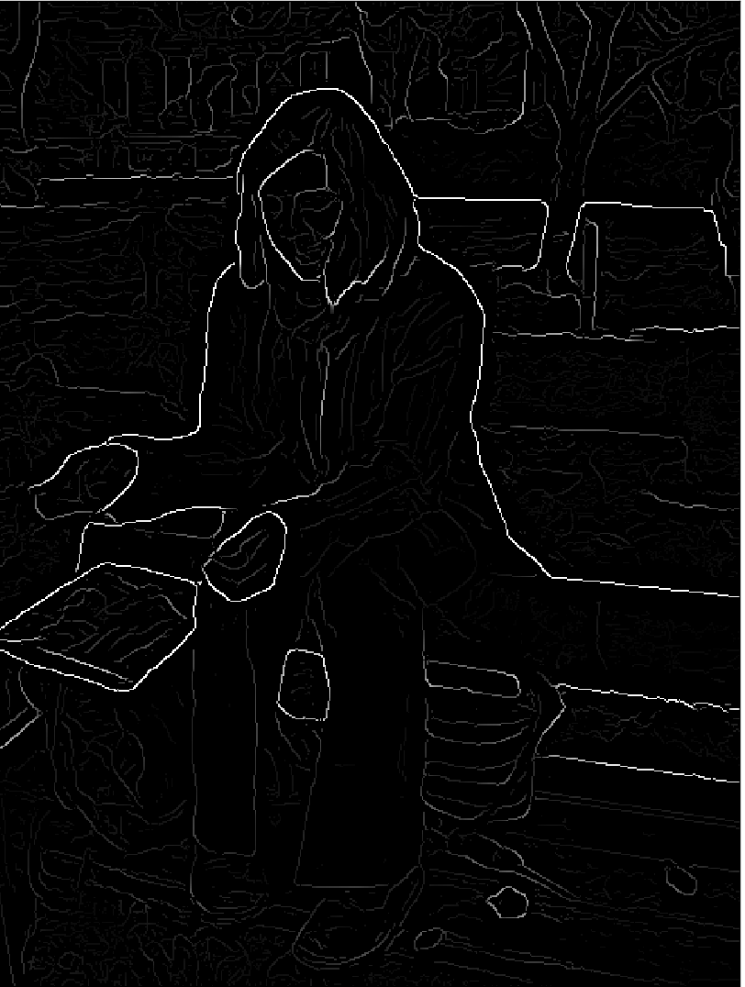
Constraint Parametric Min-Cuts (Carreira 2010)
Generates overlapping object-like segments
Around 700 segments per image
Ranked according to object-ness
Uses graph cuts between foreground and background seeds
Pairwise potentials given by gPb

Slide 37
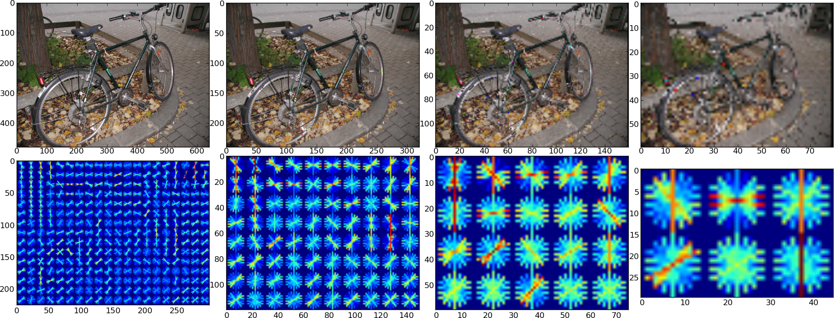
Segment Descriptors
Pyramid histogram of oriented gradients
Bag of multi-scale dense Sift-features
Bag of multi-scale dense ColorSift-features

Slide 38
Images Segmentation as
Multi Instance Learning

Slide 39
Images Segmentation as
Multi Instance Learning
Image represented as bag of segments
Each segment might represent an object
segmentation

Slide 40
Images Segmentation as
Multi Instance Learning
Image represented as bag of segments
Each segment might represent an object
During training, image-level labels are available
training
segmentation
f(x)
“person”

Slide 41
Images Segmentation as
Multi Instance Learning
Image represented as bag of segments
Each segment might represent an object
During training, image-level labels are available
During recall, we can infer segment-level labels
training
recall
segmentation
f(x)
“person”
“person”

Slide 42
Images Segmentation as
Multi Instance Learning
Image represented as bag of segments
Each segment might represent an object
During training, image-level labels are available
During recall, we can infer segment-level labels
Obtain pixel-level labels by voting
training
recall
segmentation
f(x)
“person”
“person”

Slide 43
Experiments

Slide 44
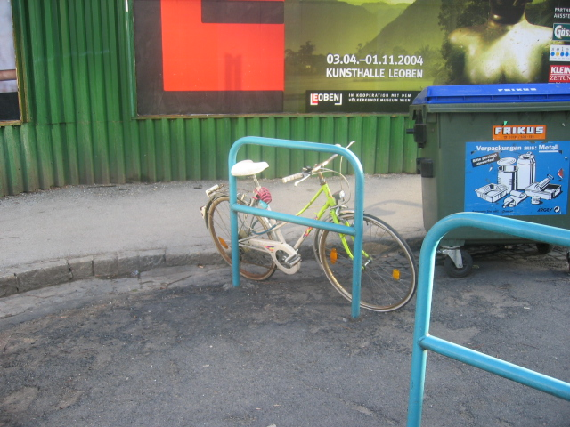
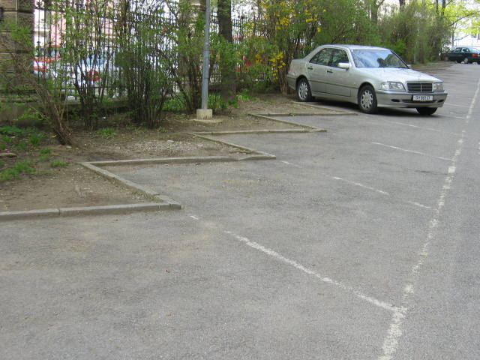
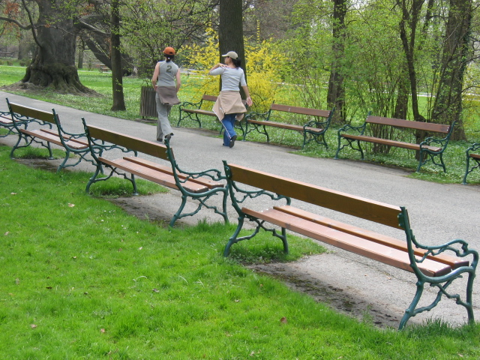
Experiments on Graz02 Dataset
Only one class per image
High variability of size, viewpoint, scene
bike
car
person
Class | Test/train images | Objects
Bike | 162 | 511
Car | 177 | 770
Person | 140 | 785

Slide 45



Implementation
CPMC implementation by Carreira
SVM Optimization using Shogun / SVMLight
MI-Kernel computation using CUDA
CUV Library for easy CUDA coding and
Python-Cuda interaction
Available from www.ais.uni-bonn.de/deep_learning/

Slide 46
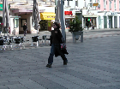
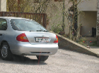
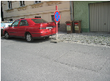
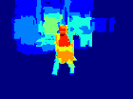
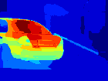
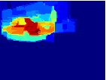
Results

Slide 47
Results
Pixel level precision at precision = recall point:
 | Car | Bike | Person
This work | 0.30 | 0.45 | 0.43
Strong supervision | 0.72 | 0.72 | 0.66
Image level accuracy: 90%

Slide 48
Future Work
More Classes ( Pascal VOC)
More Data (Flickr? ImageNet ?)
Superpixels vs Segments
Can we get f_{MI}(X) = max f(x_{i}) efficiently?

Slide 49
Questions?

