Slide 1

Advanced Scikit-Learn
Andreas Mueller (NYU Center for Data Science, scikit-learn)

Slide 2
Overview
Reminder: Basic sklearn concepts
Model building and evaluation:
  Pipelines and Feature Unions
  Randomized Parameter Search
  Scoring Interface
  Bias Variance Tradeoff
Out of Core learning
  Feature Hashing
  Kernel Approximation
PyStruct – Structured Prediction in Python

Slide 3

Get the notebooks!
https://github.com/amueller/pydata-nyc-advanced-sklearnhttp://nbviewer.ipython.org/github/amueller/pydata-nyc-advanced-sklearn

Slide 4
Reminder: Estimators
Classification / Regression
from sklearn.svm import SVC
clf = SVC()
clf.fit(X_train, y_train)
y_pred = clf.predict(X_test)

Slide 5
Reminder: Estimators
Classification / Regression
from sklearn.svm import SVC # import
clf = SVC() # instantiate
clf.fit(X_train, y_train) # fit
y_pred = clf.predict(X_test) # apply

Slide 6
Reminder: Estimators
Classification / Regression
from sklearn.svm import SVC # import
clf = SVC() # instantiate
clf.fit(X_train, y_train) # fit
y_pred = clf.predict(X_test) # apply
Transformations
from sklearn.decomposition import PCA # import
trans = PCA(n_components=2) # instantiate
trans.fit(X) # fit
X_pca = clf.transform(X) # apply

Slide 7
Reminder: Tools
Cross -Validation
from sklearn.cross_validation import cross_val_score
scores = cross_val_score(SVC(), X_train, y_train, cv=5)
print(scores)
>> [ 0.92 1. 1. 1. 1. ]

Slide 8
Reminder: Tools
Cross -Validation
from sklearn.cross_validation import cross_val_score
scores = cross_val_score(SVC(), X_train, y_train, cv=5)
print(scores)
>> [ 0.92 1. 1. 1. 1. ]
cv_ss = ShuffleSplit(len(X_train))
scores_shuffle_split = cross_val_score(SVC(), X_train, y_train, cv=cv_ss)

Slide 9
Reminder: Tools
Cross -Validation
from sklearn.cross_validation import cross_val_score
scores = cross_val_score(SVC(), X_train, y_train, cv=5)
print(scores)
>> [ 0.92 1. 1. 1. 1. ]
cv_ss = ShuffleSplit(len(X_train))
scores_shuffle_split = cross_val_score(SVC(), X_train, y_train, cv=cv_ss)
cv_labels = LeaveOneLabelOut(labels)
scores_pout = cross_val_score(SVC(), X_train, y_train, cv=cv_labels)

Slide 10
Reminder: Tools
Cross -Validated Grid Search
from sklearn.grid_search import GridSearchCV
param_grid = {'C': 10. ** np.arange(-3, 3),
'gamma': 10. ** np.arange(-3, 3)}
grid = GridSearchCV(SVC(), param_grid=param_grid)
grid.fit(X_train, y_train)
grid.predict(X_test)

Slide 11
Reminder: Tools
Pipelines
from sklearn.pipeline import make_pipeline
pipe = make_pipeline(StandardScaler(), SVC())
pipe.fit(X_train, y_train)
pipe.predict(X_test)

Slide 12
Combining Pipelines and
Grid Search
Proper cross-validation
param_grid = {'svc__C': 10. ** np.arange(-3, 3), 'svc__gamma': 10. ** np.arange(-3, 3)}
scaler_pipe = make_pipeline(StandardScaler(), SVC())
grid = GridSearchCV(scaler_pipe, param_grid=param_grid, cv=5)
grid.fit(X_train, y_train)

Slide 13
Do cross-validation over all steps.
Keep a separate test set till the very end.

Slide 14
Combining Pipelines and
Grid Search II
Searching over parameters of the preprocessing step
param_grid = {'selectkbest__k': [1, 2, 3, 4],
'svc__C': 10. ** np.arange(-3, 3),
'svc__gamma': 10. ** np.arange(-3, 3)}
scaler_pipe = make_pipeline(SelectKBest(), SVC())
grid = GridSearchCV(scaler_pipe, param_grid=param_grid, cv=5)
grid.fit(X_train, y_train)

Slide 15
Feature Union
char_and_word = make_union(TfidfVectorizer(analyzer="char"), TfidfVectorizer(analyzer="word"))
text_pipe = make_pipeline(char_and_word, LinearSVC(dual=False))
param_grid = {'linearsvc__C': 10. ** np.arange(-3, 3)}
grid = GridSearchCV(text_pipe, param_grid=param_grid, cv=5)
param_grid2 = {'featureunion__tfidfvectorizer-1__ngram_range':
[(1, 3), (1, 5), (2, 5)],
'featureunion__tfidfvectorizer-2__ngram_range':
[(1, 1), (1, 2), (2, 2)],
'linearsvc__C': 10. ** np.arange(-3, 3)}

Slide 16
Randomized Parameter Search

Slide 17
Randomized Parameter Search
params = {'featureunion__tfidfvectorizer-1__ngram_range':
[(1, 3), (1, 5), (2, 5)],
'featureunion__tfidfvectorizer-2__ngram_range':
[(1, 1), (1, 2), (2, 2)],
'linearsvc__C': 10. ** np.arange(-3, 3)}

Slide 18
Randomized Parameter Search
params = {'featureunion__tfidfvectorizer-1__ngram_range':
[(1, 3), (1, 5), (2, 5)],
'featureunion__tfidfvectorizer-2__ngram_range':
[(1, 1), (1, 2), (2, 2)],
'linearsvc__C': expon()}

Slide 19

Randomized Parameter Search
params = {'featureunion__tfidfvectorizer-1__ngram_range':
[(1, 3), (1, 5), (2, 5)],
'featureunion__tfidfvectorizer-2__ngram_range':
[(1, 1), (1, 2), (2, 2)],
'linearsvc__C': expon()}
rs = RandomizedSearchCV(text_pipe,
param_distributions=param_distributins, n_iter=50)

Slide 20
Randomized Parameter Search
params = {'featureunion__tfidfvectorizer-1__ngram_range':
[(1, 3), (1, 5), (2, 5)],
'featureunion__tfidfvectorizer-2__ngram_range':
[(1, 1), (1, 2), (2, 2)],
'linearsvc__C': expon()}
rs = RandomizedSearchCV(text_pipe,
param_distributions=param_distributins, n_iter=50)
Step-size free for continuous parameters
Decouples runtime from search-space size
Robust against irrelevant parameters

Slide 21
Randomized Parameter Search
params = {'featureunion__tfidfvectorizer-1__ngram_range':
[(1, 3), (1, 5), (2, 5)],
'featureunion__tfidfvectorizer-2__ngram_range':
[(1, 1), (1, 2), (2, 2)],
'linearsvc__C': expon()}
rs = RandomizedSearchCV(text_pipe,
param_distributions=param_distributins, n_iter=50)
Step-size free for continuous parameters
Decouples runtime from search-space size
Robust against irrelevant parameters

Slide 22
Randomized Parameter Search
params = {'featureunion__tfidfvectorizer-1__ngram_range':
[(1, 3), (1, 5), (2, 5)],
'featureunion__tfidfvectorizer-2__ngram_range':
[(1, 1), (1, 2), (2, 2)],
'linearsvc__C': expon()}
rs = RandomizedSearchCV(text_pipe,
param_distributions=param_distributins, n_iter=50)
Step-size free for continuous parameters
Decouples runtime from search-space size
Robust against irrelevant parameters

Slide 23
Randomized Parameter Search
params = {'featureunion__tfidfvectorizer-1__ngram_range':
[(1, 3), (1, 5), (2, 5)],
'featureunion__tfidfvectorizer-2__ngram_range':
[(1, 1), (1, 2), (2, 2)],
'linearsvc__C': expon(), 'linearsvc__tol': expon(scale=0.001)}
rs = RandomizedSearchCV(text_pipe,
param_distributions=param_distributins, n_iter=50)
Step-size free for continuous parameters
Decouples runtime from search-space size
Robust against irrelevant parameters

Slide 24
Randomized Parameter Search
params = {'featureunion__tfidfvectorizer-1__ngram_range':
[(1, 3), (1, 5), (2, 5)],
'featureunion__tfidfvectorizer-2__ngram_range':
[(1, 1), (1, 2), (2, 2)],
'linearsvc__C': expon(), 'linearsvc__tol': expon(scale=0.001)}
rs = RandomizedSearchCV(text_pipe,
param_distributions=param_distributins, n_iter=50)
Step-size free for continuous parameters
Decouples runtime from search-space size
Robust against irrelevant parameters

Slide 25

Randomized Parameter Search
Step-size free for continuous parameters
Decouples runtime from search-space size
Robust against irrelevant parameters
Source: Bergstra and Bengio

Slide 26
Randomized Parameter Search
Always use distributions for continuous variables.
Don't use Randomized search with n_iter close to the full discrete grid.
Don't use for low dimensional spaces.
Future: Bayesian optimization based search.

Slide 27
Bias Variance Tradeoff
(why we do cross validation and grid searches)

Slide 28
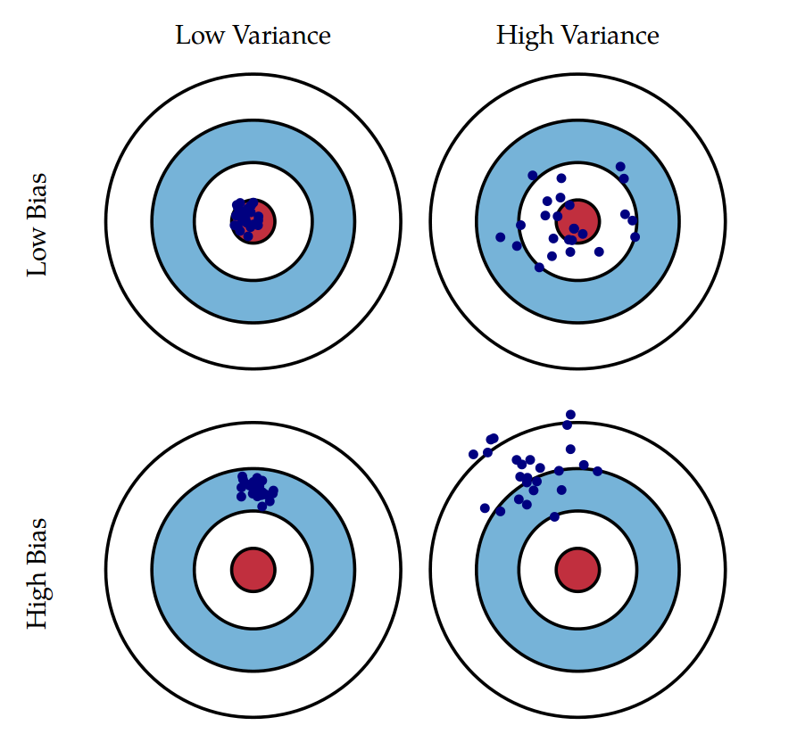
Bias and Variance
Illustration: Scott Fortmann-Roe

Slide 29
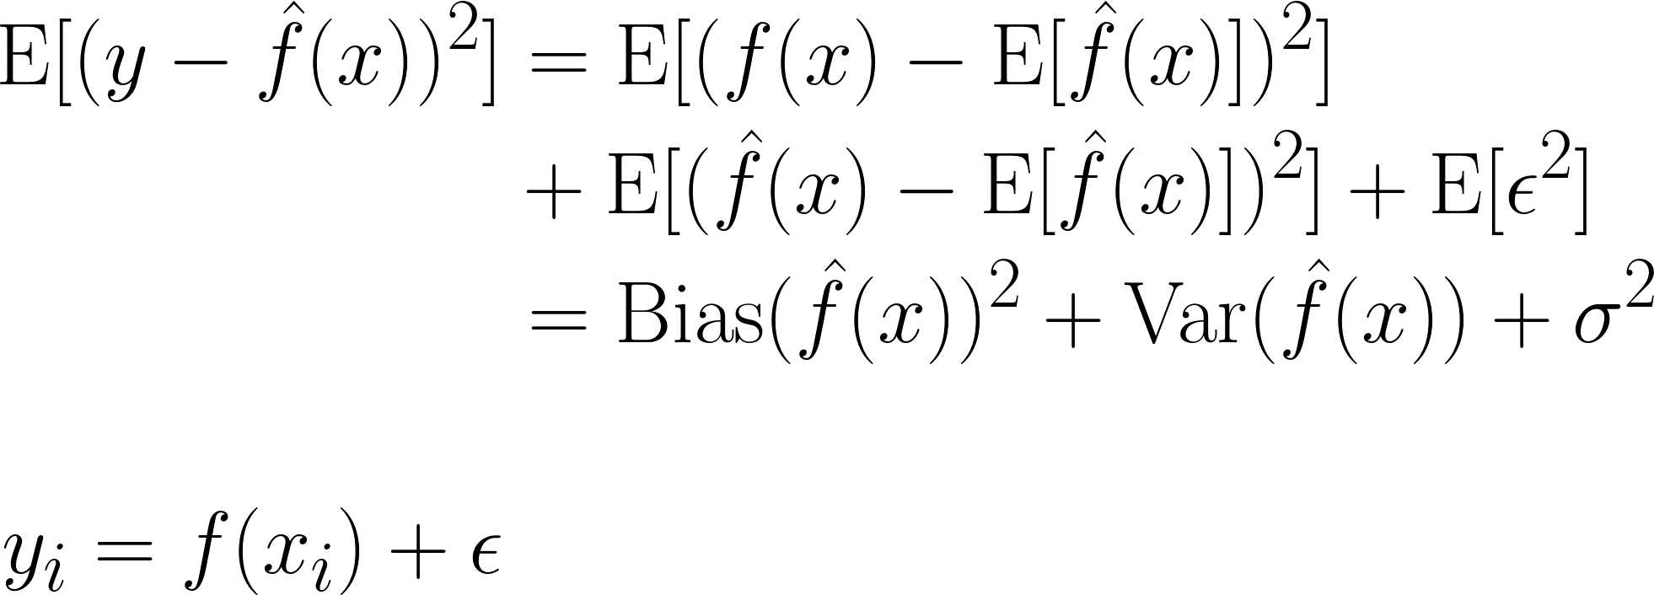
Bias and Variance

Slide 30
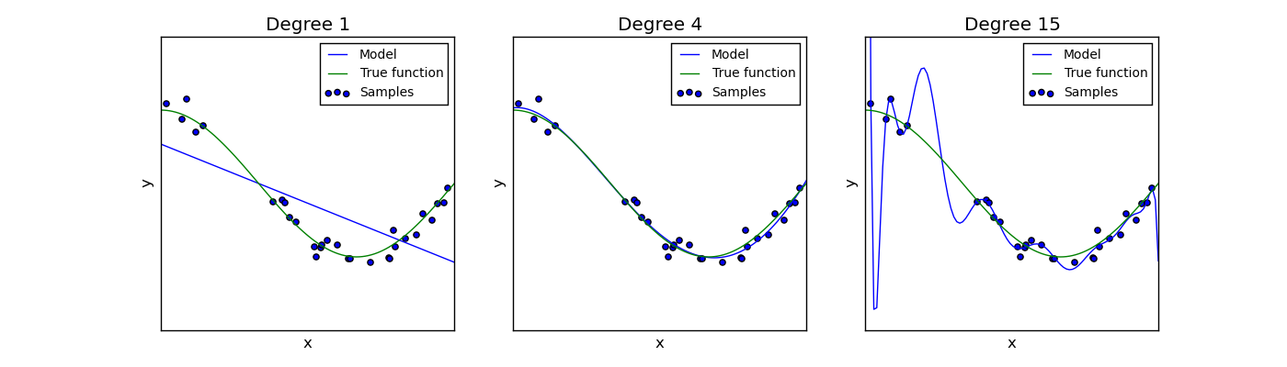
Curve (over and under) fitting

Slide 31
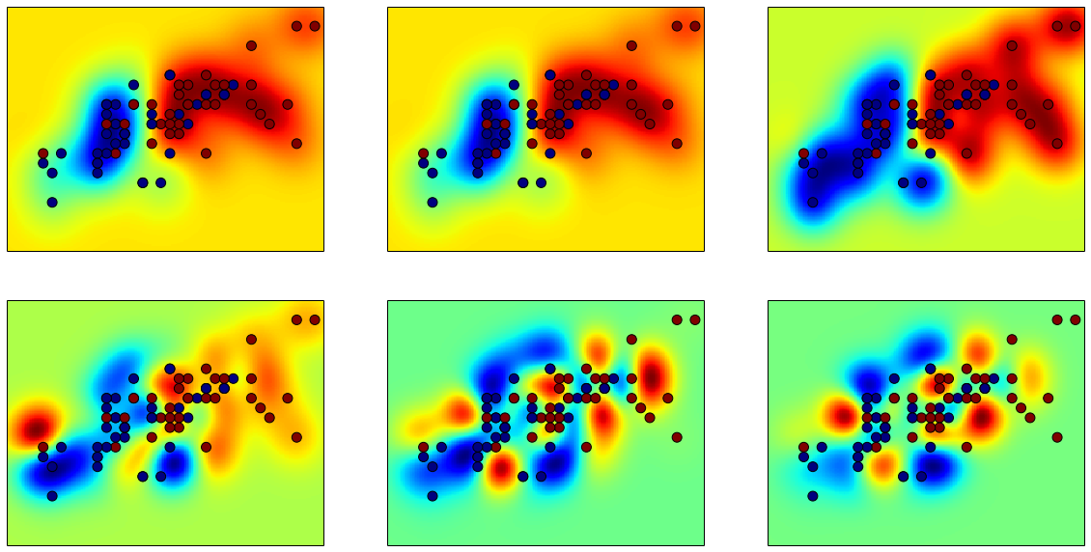
RBF-SVM wigglyness

Slide 32
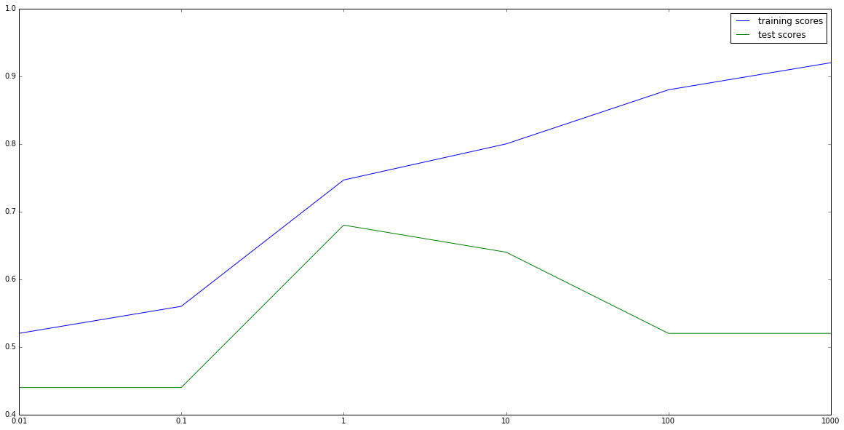
Bias Variance Tradeoff aka overfitting vs underfitting

Slide 33
Know where you are on the bias-variance tradeoff

Slide 34

Validation Curves
train_scores, test_scores = validation_curve(SVC(), X, y, param_name="gamma", param_range=param_range)

Slide 35

Learning Curves
train_sizes, train_scores, test_scores = learning_curve(
estimator, X, y,train_sizes=train_sizes)

Slide 36
Scoring Functions

Slide 37
GridSeachCV
cross_val_score
validation_curve
Default:
Accuracy (classification)
R2 (regression)
For GridSeachCV
cross_val_score
validation_curve
Typical: accuracy

Slide 38
Scoring
Motivation: Imbalanced data 1:9
cross_val_score(SVC(), X_train, y_train)
>>> array([ 0.9, 0.9, 0.9])

Slide 39
Scoring
Motivation: Imbalanced data 1:9
cross_val_score(SVC(), X_train, y_train)
>>> array([ 0.9, 0.9, 0.9])
cross_val_score(DummyClassifier("most_frequent"), X_train, y_train)
>>> array([ 0.9, 0.9, 0.9])

Slide 40

Scoring
Motivation: Imbalanced data 1:9
cross_val_score(SVC(), X_train, y_train)
>>> array([ 0.9, 0.9, 0.9])
cross_val_score(SVC(), X_train, y_train, scoring="roc_auc")
array([ 0.99961591, 0.99983498, 0.99966247])

Slide 41
Available metrics
print(SCORERS.keys())
>> ['adjusted_rand_score',
'f1',
'mean_absolute_error',
'r2',
'recall',
'median_absolute_error',
'precision',
'log_loss',
'mean_squared_error',
'roc_auc',
'average_precision',
'accuracy']

Slide 42
Defining your own scoring
def my_super_scoring(est, X, y):
return accuracy_scorer(est, X, y) - np.sum(est.coef_ != 0)

Slide 43
Defining your own scoring
def my_super_scoring(est, X, y):
return accuracy_scorer(est, X, y) - np.sum(est.coef_ != 0)
def scoring_function(y_true, y_pred):
return (np.abs(y_true – y_pred) < 2).mean()
tolerant_scoring = make_scorer(scoring_function)

Slide 44
Out of Core Learning

Slide 45

Or: save ourself the effort

Slide 46
Think twice!
Old laptop: 4GB Ram
1073741824 float32
Or 1mio data points with 1000 features
EC2 : 256 GB Ram
68719476736 float32
Or 68mio data points with 1000 features

Slide 47
Supported Algorithms
All SGDClassifier derivatives
Naive Bayes
MinibatchKMeans
IncrementalPCA
MiniBatchDictionaryLearning

Slide 48
Out of Core Learning
sgd = SGDClassifier()
for i in range(9):
X_batch, y_batch = cPickle.load(open("batch_%02d" % i))
sgd.partial_fit(X_batch, y_batch, classes=range(10))
Possibly go over the data multiple times.

Slide 49
Stateless Transformers
Normalizer
HashingVectorizer
RBFSampler (and other kernel approx)

Slide 50
Text data and the hashing trick

Slide 51
Bag Of Word Representations
CountVectorizer / TfidfVectorizer
“You better call Kenny Loggins”

Slide 52
Bag Of Word Representations
CountVectorizer / TfidfVectorizer
“You better call Kenny Loggins”
tokenizer
['you', 'better', 'call', 'kenny', 'loggins']

Slide 53
Bag Of Word Representations
CountVectorizer / TfidfVectorizer
“You better call Kenny Loggins”
tokenizer
['you', 'better', 'call', 'kenny', 'loggins']
Sparse matrix encoding
aardvak
better
call
you
zyxst
[0, …, 0, 1, 0, … , 0, 1 , 0, …, 0, 1, 0, …., 0 ]

Slide 54
Hacking Trick
HashingVectorizer
“You better call Kenny Loggins”
tokenizer
['you', 'better', 'call', 'kenny', 'loggins']
hashing
[hash('you'), hash('better'), hash('call'), hash('kenny'), hash('loggins')]
= [832412, 223788, 366226, 81185, 835749]
Sparse matrix encoding
[0, …, 0, 1, 0, … , 0, 1 , 0, …, 0, 1, 0, ... 0 ]

Slide 55
Out of Core Text Classification
sgd = SGDClassifier()
hashing_vectorizer = HashingVectorizer()
for i in range(9):
text_batch, y_batch = cPickle.load(open("batch_%02d" % I))
X_batch = hashing_vectorizer.transform(text_batch)
sgd.partial_fit(X_batch, y_batch, classes=range(10))

Slide 56
Kernel Approximations

Slide 57

Reminder: Kernel Trick
x

Slide 58

Reminder: Kernel Trick

Slide 59
Reminder: Kernel Trick
Classifier linear → need only

Slide 60
Reminder: Kernel Trick
Classifier linear → need only
Linear:
Polynomial:
RBF:
Sigmoid:

Slide 61
Complexity
Solving kernelized SVM:
~O(n_samples ** 3)
Solving linear (primal) SVM:
~O(n_samples * n_features)
n_samples large? Go primal!

Slide 62
Undoing the Kernel Trick
Kernel approximation:
k = exp(-\gamma |x-x'|^2)
f' = RBFSampler

Slide 63
Usage
sgd = SGDClassifier()
kernel_approximation = RBFSampler()
for i in range(9):
X_batch, y_batch = cPickle.load(open("digit_batch_%02d" % I))
X_transformed = kernel_approximation.transform(X_batch)
sgd.partial_fit(X_transformed, y_batch, classes=range(10))

Slide 64
Questions so far?

Slide 65
PyStruct – Structured Prediction in Python

Slide 66
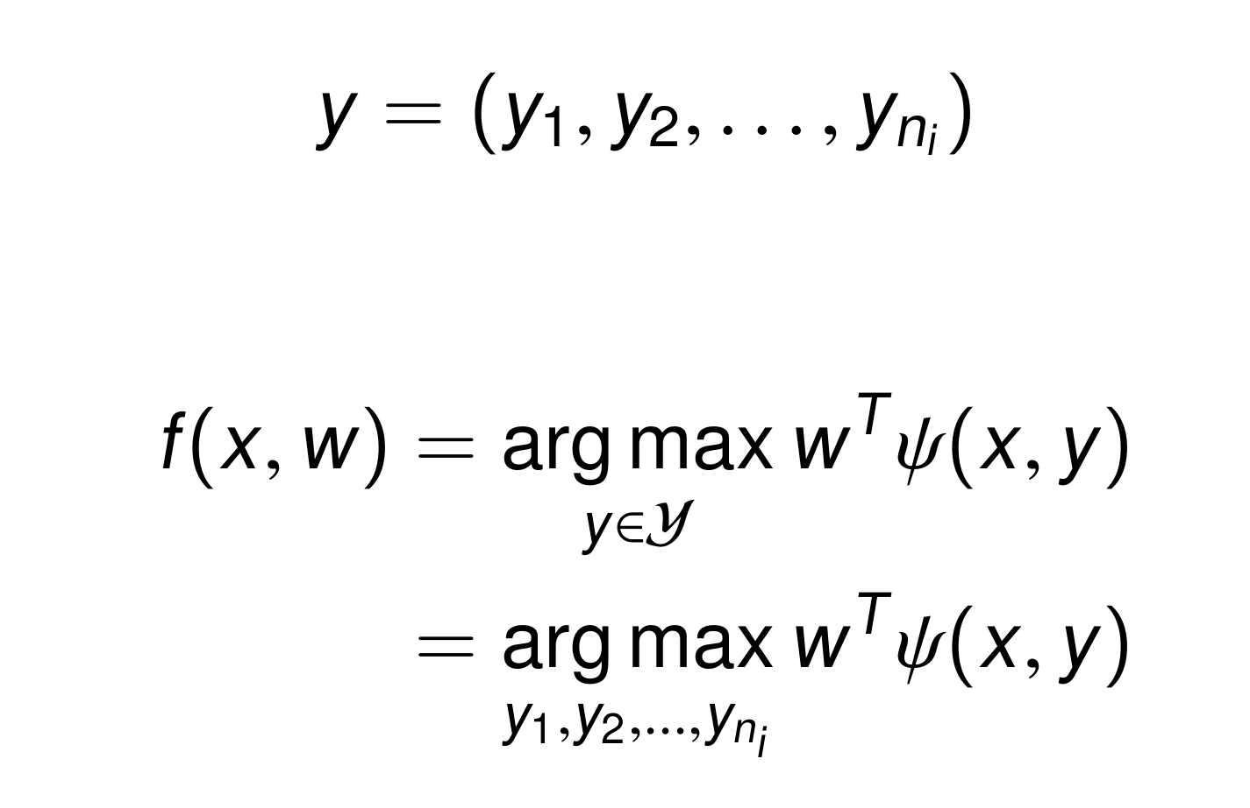
Structured Prediction

Slide 67
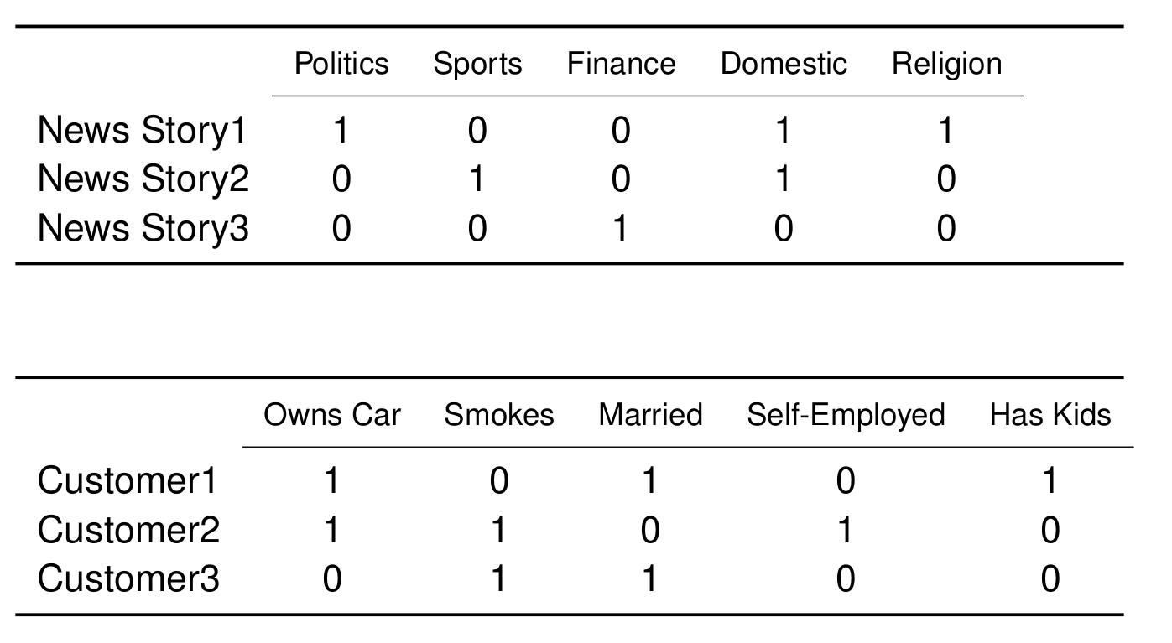
Applications: Multi-Label Classification

Slide 68
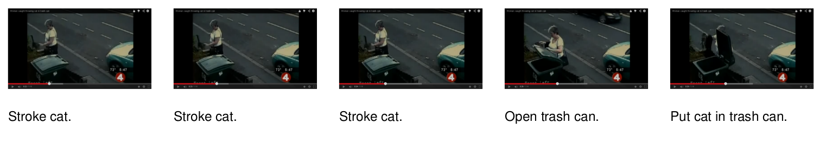
Applications: Sequence Tagging

Slide 69
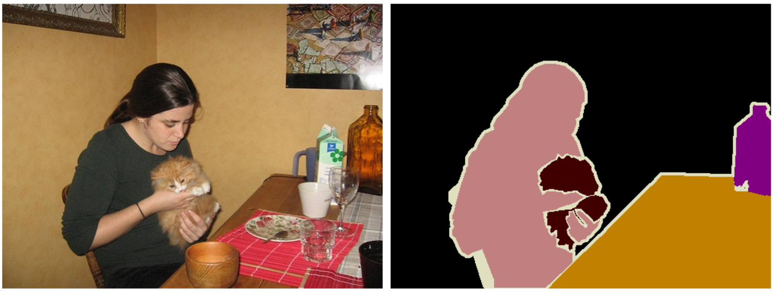
Applications: Image Segmentation

Slide 70
PyStruct Architecture
Estimator = Learner + Model + Inference
model = ChainCRF(inference="max_product")
ssvm = OneSlackSSVM(model=model, C=.1, inference_cache=50,, tol=0.1, verbose=3)
ssvm.fit(X_train, y_train)

Slide 71
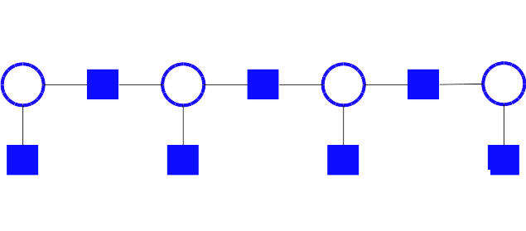
The Devil is in the Inference
Easy: Dynamic Programming

Slide 72
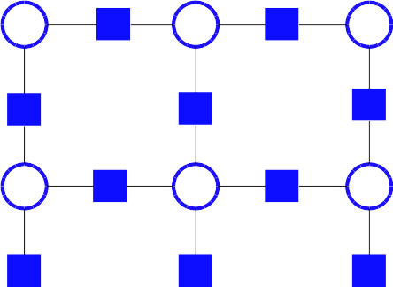
The Devil is in the Inference
HARD!
AD3, QPBO, LP, Loopy BP, ….

Slide 73
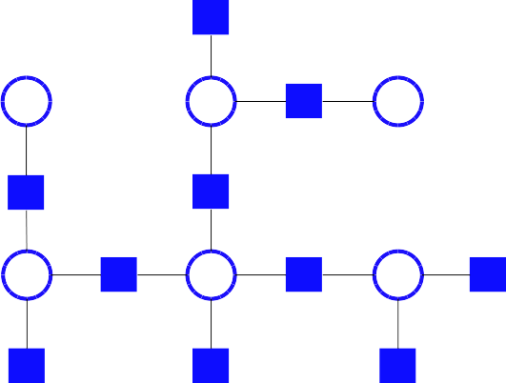
The Devil is in the Inference
Easy: Dynamic Programming

Slide 74
PyStruct Architecture
Estimator = Learner + Model + Inference
model = ChainCRF(inference="max_product")
ssvm = OneSlackSSVM(model=model, C=.1, inference_cache=50,, tol=0.1, verbose=3)
ssvm.fit(X_train, y_train)

Slide 75
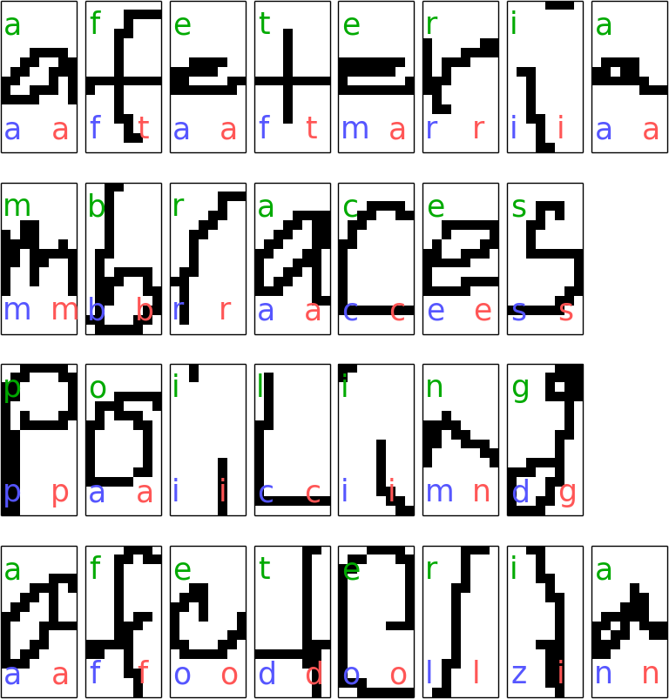
Sequence Tagging example

Slide 76
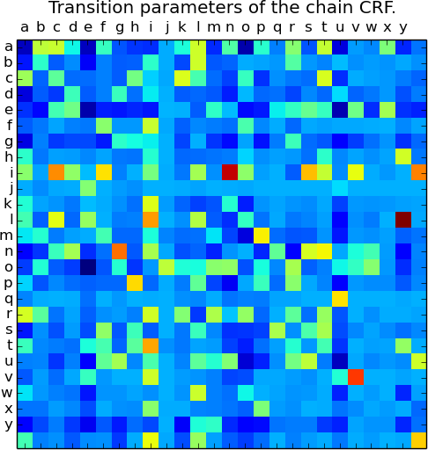
Sequence Tagging example

Slide 77
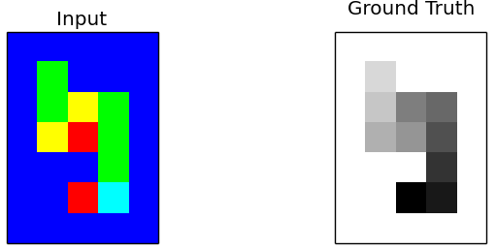
Grid Graphs: Snakes

Slide 78
Grid Graphs: Snakes
crf = EdgeFeatureGraphCRF(inference_method='qpbo')
ssvm = OneSlackSSVM(crf, inference_cache=50, C=.1, tol=.1,
switch_to='ad3', n_jobs=1)
ssvm.fit(X_train_edge_features, Y_train_flat)

Slide 79
Grid Graphs: Snakes
crf = EdgeFeatureGraphCRF(inference_method='qpbo')
ssvm = OneSlackSSVM(crf, inference_cache=50, C=.1, tol=.1,
switch_to='ad3', n_jobs=1)
ssvm.fit(X_train_edge_features, Y_train_flat)

Slide 80
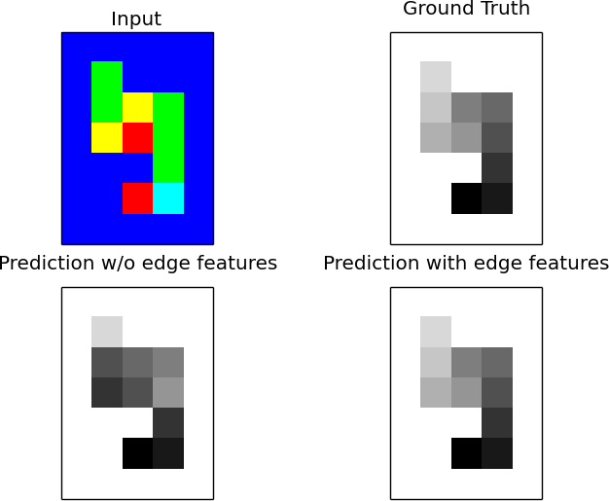
Grid Graphs: Snakes

Slide 81
Classes of Inference Algorithms
Exact Algorithms
Max-Product (Chains, Trees) 'max-product'
Exhaustive (usually too expensive)
Relaxed algorithms + branch & bound
('ad3', {'branch_and_bound': True})
Relaxed
Linear Programming (slooow) 'lp'
Dual Decomposition 'ad3'
Approximate / heuristics
Loopy message passing 'max-product'
QPBO 'qpbo'

Slide 82
Classes of Inference Algorithms
Exact Algorithms
Max-Product (Chains, Trees) 'max-product'
Exhaustive (usually too expensive)
Relaxed algorithms + branch & bound
('ad3', {'branch_and_bound': True})
Relaxed
Linear Programming (slooow) 'lp'
Dual Decomposition 'ad3'
Approximate / heuristics
Loopy message passing 'max-product'
QPBO 'qpbo'
Install OpenGM for many more!

Slide 83
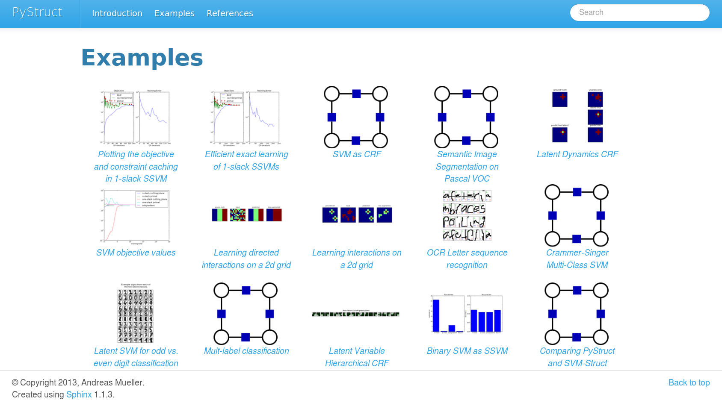

Slide 84
Thank you for your attention.

