Slide 1


Introduction to
Machine Learning
with Python
Andreas Müller
Columbia University, scikit-learn
https://github.com/amueller/quick-ml-intro
Notes:
Hey and welcome to my talk on machine learning and how to do it with python.
My goal for the next 45 minutes is to convince you that machine learning can help you in your research, make your life easier, and allow you to process much more data than you could before – and that it’s all pretty easy to do.
I’m andy, I work at Columbia and I’ve been contributing to the scikit-learn project for a couple of years now. Scikit-learn is the main machine learning tool in python and I’ll tell you a bit more about it later.

Slide 2
What is machine learning?
Notes:
Machine learning is about extracting knowledge from data. It is closely related to statistics and optimization.
What distinguishes machine learning is that it is very focused on prediction.
We want to learn from a large dataset how to make decisions based on future observations.
You could say that the input to a machine learning program is the dataset, and the output is a program that can make decisions on future observations.
Machine learning is really widely used now, and I want to give you some examples that you probably all saw already today.

Slide 3
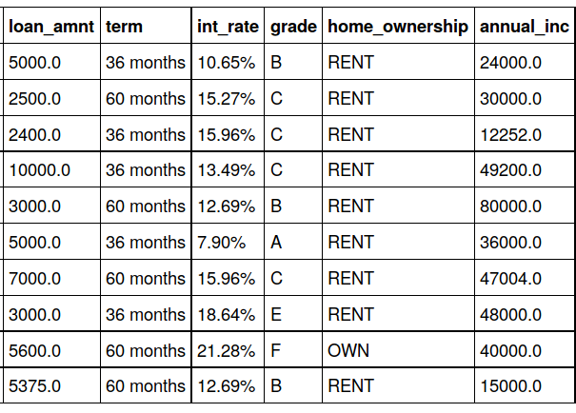
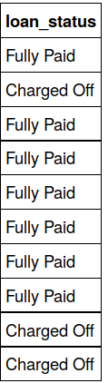

Slide 4
Supervised Learning
i.i.d.
Most common applications:
- Automate a manual task
- Predict the future
Notes:
In supervised learning, the dataset we learn form is input-output pairs (x_i, y_i), where x_i is some n_dimensional input, or feature vector, and y_i is the desired output we want to learn.
Generally, we assume these samples are drawn from some unknown joint distribution p(x, y).
What does iid mean?
We say they are drawn iid, which stands for independent identically distributed. In other words, the x_i, y_i pairs are independent and all come from the same distribution p.
You can think of this as there being some process that goes from x_i to y_i, but that we don’t know. We write this as a probability distribution and not as a function since even if there is a real process creating y from x, this process might not be deterministic.
The goal is to learn a function f so that for new inputs x for which we don’t observe y, f(x) is close to y.
This approach is very similar to function approximation.
The name supervised comes from the fact that during learning, a supervisor gives you the correct answers y_i.

Slide 5
Classification and Regression
Classification:
y discrete
Will they subscribe?
Regression:
y continuous
How much will the returns be?
Notes:
So getting back to supervised learning, there are two basic kinds, called classification and regression.
The difference is quite simple, if y is continuous, then it’s regression, and if y is discrete, it’s classification.
That’s pretty simple, still let me give an example.
If I want to predict whether a student will pass the class, it’s a classification problem. There are two possible answers, “yes” and “no”.
If I want to predict how many points a student gets on an exam, it’s a regression problem, there is a continuous, gradual output space.
There are generalizations of this where we try to predict more than one variable, but we won’t go into that in this course. The main reason this distinction is important is because the way we measure how good a prediction is is very different for the two.

Slide 6
Generalization
Not only
Also for new data:
Notes:
For both regression and classification, it’s important to keep in mind the concept of generalization.
Let’s say we have a regression task. We have features, that is data vectors x_i and targets y_i drawn from a joint distribution.
We now want to learn a function f, such that f(x) is approximately y, not on this training data, but on new data drawn from this distribution. This is what’s called generalization, and this is a core distinction to function approximation. In principle we don’t care about how well we do on x_i, we only care how well we do on new samples from the distribution
We’ll go into much more detail about generalization in two weeks, when we dive into supervised learning.

Slide 7

http://scikit-learn.org/

Slide 8
Representing Data
one sample
1.1 | 2.2 | 3.4 | 5.6 | 1.0
6.7 | 0.5 | 0.4 | 2.6 | 1.6
2.4 | 9.3 | 7.3 | 6.4 | 2.8
1.5 | 0.0 | 4.3 | 8.3 | 3.4
0.5 | 3.5 | 8.1 | 3.6 | 4.6
5.1 | 9.7 | 3.5 | 7.9 | 5.1
3.7 | 7.8 | 2.6 | 3.2 | 6.3
1.6
2.7
4.4
0.5
0.2
5.6
6.7
X =
y =
one feature
outputs / labels

Slide 9
Training and Testing Data
training set
1.1 | 2.2 | 3.4 | 5.6 | 1.0
6.7 | 0.5 | 0.4 | 2.6 | 1.6
2.4 | 9.3 | 7.3 | 6.4 | 2.8
1.5 | 0.0 | 4.3 | 8.3 | 3.4
0.5 | 3.5 | 8.1 | 3.6 | 4.6
5.1 | 9.7 | 3.5 | 7.9 | 5.1
3.7 | 7.8 | 2.6 | 3.2 | 6.3
1.6
2.7
4.4
0.5
0.2
5.6
6.7
X =
y =
test set

Slide 10
IPython Notebook:
Part 1 – Data Loading

Slide 11
Preprocessing

Slide 12
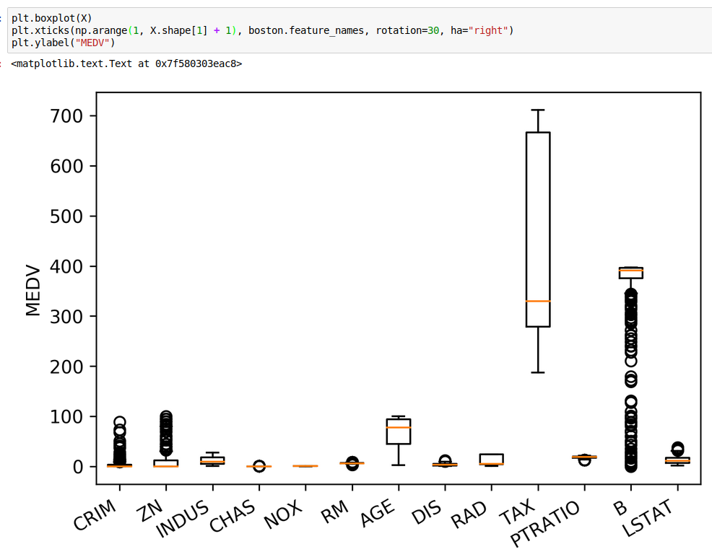
Notes:
Let’s start with the different scales.
Many model want data that is on the same scale. KNearestNeighbors: If the distance in TAX is between 300 and 400 then the distance difference in CHArS doesn’t matter!
Linear models: the different scales mean different penalty. L2 is the same for all!
We can also see non-gaussian distributions here btw!

Slide 13
Categorical Features

Slide 14
Categorical Features
?
Notes:
Before we can apply a machine learning algorithm, we first need to think about how we represent our data.
Earlier, I said x \in R^n. That’s not how you usually get data. Often data has units, possibly different units for different sensors, it has a mixture of continuous values and discrete values, and different measurements might be on totally different scales.
First, let me explain how to deal with discrete input variables, also known as categorical features. They come up in nearly all applications.
Let’s say you have three possible values for a given measurement, whether you used setup1 setup2 or setup3. You could try to encode these into a single real number, say 0, 1 and 2, or e, \pi, \tau.
However, that would be a bad idea for algorithms like linear regression.

Slide 15
Categorical Variables
“red” “green” “blue”
1 0 0
0 1 0
0 0 1
Notes:
If you encode all three values using the same feature, then you are imposing a linear relation between them, and in particular you define an order between the categories. Usually, there is no semantic ordering of the categories, and so we shouldn’t introduce one in our representation of the data.
Instead, we add one new feature for each category,
And that feature encodes whether a sample belongs to this category or not.
That’s called a one-hot encoding, because only one of the three features in this example is active at a time.
You could actually get away with n-1 features, but in machine learning that usually doesn’t matter.

Slide 16
IPython Notebook:
Part 2 – Preprocessing

Slide 17
Supervised Machine Learning
Training Data
Model
Training
Training Labels
Test Data
Prediction
Generalization
Test Labels
Evaluation

Slide 18
clf = RandomForestClassifier()
clf.fit(X_train, y_train)
Training Data
Model
Training Labels
y_pred = clf.predict(X_test)
Test Data
Prediction
Test Labels
Evaluation
clf.score(X_test, y_test)

Slide 19
IPython Notebook:
Part 3 – Supervised Learning

Slide 20



Nearest neighbors
Notes:
Let’s say we have this two-class classification dataset here, with two features, one on the x axis and one on the y axis.
And we have three new points as marked by the stars here.
If I make a prediction using a one nearest neighbor classifier, what will it predict?
It will predict the label of the closest data point in the training set.
That is basically the simplest machine learning algorithm I can come up with.
Here’s the formula:
the prediction for a new x is the y_i so that x_i is the closest point in the training set.
Ok, so now how do we find out whether this model is any good?

Slide 21

Nearest neighbors
Notes:
So this was the predictions as made by one-nearest neighbor.
But we can also consider more neighbors, for example three. Here is the three nearest neighbors for each of the points and the corresponding labels.
We can then make a prediction by considering the majority among these three neighbors.
And as you can see, in this case all the points changed their labels! (I was actually quite surprised when I saw that, I just picked some points at random).
Clearly the number of neighbors that we consider matters a lot. But what is the right number?
The is a problem you’ll encounter a lot in machine learning, the problem of tuning parameters of the model, also called hyper-parameters, which can not be learned directly from the data.

Slide 22

Influence of n_neighbors
Notes:
Here’s an overview of how the classification changes if we consider different numbers of neighbors.
You can see as red and blue circles the training data. And the background is colored according to which class a datapoint would be assigned to for each location.
For one neighbor, you can see that each point in the training set has a little area around it that would be classified according to it’s label. This means all the training points would be classified correctly, but it leads to a very complex shape of the decision boundary.
If we increase the number of neighbors, the boundary between red and blue simplifies, and with 40 neighbors we mostly end up with a line.
This also means that now many of the training data points would be labeled incorrectly.

Slide 23

Model Complexity
Notes:
We can look at this in more detail by comparing training and test set scores for the different numbers of neighbors.
Here, I did a random 75%/25% split again. This is a very noisy plot as the dataset is very small and I only did a random split, but you can see a trend here.
You can see that for a single neighbor, the training score is 1 so perfect accuracy, but the test score is only 70%. If we increase the number of neighbors we consider, the training score goes down, but the test score goes up, with an optimum at 19 and 21, but then both go down again.
This is a very typical behavior, that I sketched in a schematic for you.

Slide 24
Overfitting and Underfitting
Training
Sweet spot
Accuracy
Generalization
Underfitting
Overfitting
Model complexity
Notes:
This chart has accuracy on the y axis, and an abstract concept of model complexity on the x axis.
If we make our machine learning models more complex, we will get better training set accuracy, as the model will be able to capture more of the variations in the data.
But if we look at the generalization performance, we get a different story. If the model complexity is too low, the model will not be able to capture the main trends, and a more complex model means better generalization.
However, if we make the model too complex, generalization performance drops again, because we basically learn to memorize the dataset.
If we use too simple a model, this is often called underfitting, while if we use to complex a model, this is called overfitting. And somewhere in the middle is a sweet spot.
Most models have some way to tune model complexity, and we’ll see many of them in the next couple of weeks.
So going back to nearest neighbors, what parameters correspond to high model complexity and what to low model complexity? high n_neighbors = low complexity!

Slide 25

Three-fold split
pro: fast, simple
con: high variance, bad use of data.
Notes:
The simplest way to combat this overfitting to the test set is by using a three-fold split of the data, into a training, a validation and a test set.
We use the training set for model building, the validation set for parameter selection and the test set for a final evaluation of the model.
So how many models should you try out on the test set? Only one! Ideally use use the test-set exactly once, otherwise you make a multiple hypothesis testing error!
What are downsides of this? We lose a lot of data for evaluation, and the results depend on the particular sampling.

Slide 26

Notes:
Here is an implementation of the three-fold split for selecting the number of neighbors.
For each number of neighbors that we want to try, we build a model on the training set, and evaluate it on the validation set.
We then pick the best validation set score, here that’s 97.2%, achieved when using three neighbors.
We then retrain the model with this parameter, and evaluate on the test set.
Do you have any idea how to make this more robust?

Slide 27
Linear Models for Regression

Slide 28

Linear Models for Regression

Slide 29
Linear Regression
& Ridge Regression
Unique solution if has full column rank.
Always has a unique solution.
Tuning parameter alpha.

Slide 30
Linear Models for Classification

Slide 31


Slide 32


Slide 33
IPython Notebook:
Part 4 – Linear Models for Regression

Slide 34
Basic API
estimator.fit(X, [y])
estimator.predict | estimator.transform
Classification | Preprocessing
Regression | Dimensionality reduction
Clustering | Feature selection
 | Feature extraction

Slide 35
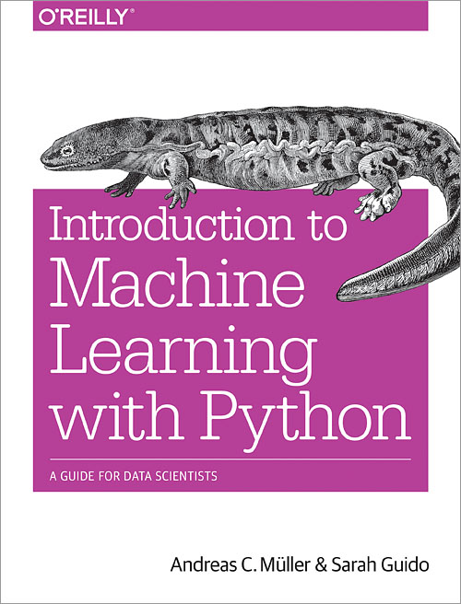

Slide 36




Thank you for your attention.
@amuellerml
@amueller
importamueller@gmail.com
http://amueller.github.io

