Slide 1






Building
scikit-learn
amueller@nyu.edu
@amuellerml
@amueller
Amueller.io
Andreas Müller
NYU, scikit-learn
Notes:
Hi and thank you for coming to my talk today.
I’m andreas mueller, I work at the NYU center for data science, and I’ll talk a bit about the scikit-learn project I’ve been working on in the last couple of years, and my recent work at NYU.
Let me start by giving you first a bit of background on my self, and then on scikit-learn.

Slide 2



Me
Notes:
So my career is not entirely run-of-the-mill for academia.
I did my masters and PhD at the University of Bonn in Germany, where I studied first pure math, and then moved to machine learning and computer vision for my PhD. During my PhD, I started contributing to open source, in particular scikit-learn.
After my PhD I spend a year at Amazon Machine Learning in Berlin and Seattle, where I worked on computer vision applications and time series forecasting. In the last two years, I have been a Research Engineer at the NYU Center for Data Science. At NYU, I’ve continued working on scikit-learn and creating instructional materials for machine learning and scikit-learn, but I also worked with students and researchers on ML related problems.
So let me tell you a bit more about scikit-learn.

Slide 3

Classification
Regression
Clustering
Semi-Supervised Learning
Feature Selection
Feature Extraction
Manifold Learning
Dimensionality Reduction
Kernel Approximation
Hyperparameter Optimization
Evaluation Metrics
Out-of-core learning
…...
Notes:
Scikit-learn is a machine learning library for python that implements many different algorithms, as well as tools to tune and evaluate machine learning models.
You’ll find all the standard text-book algorithms like linear models, random forest, SVMs, neural networks, PCA, NMF, ICA, t-SNE, K-Means, and so on. In addition, scikit-learn also contains tools to build machine learning pipelines and tools for cross-validation and parameter searches.
Scikit-learn is a library, and there’s no official graphical interface or command line interface, so to use it, you need to write python code. Though not very much as I’ll show you in a bit.

Slide 4
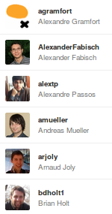
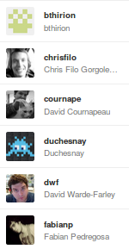
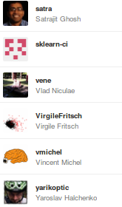
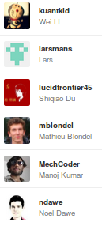
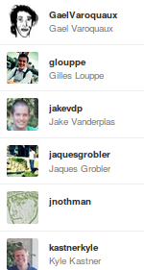
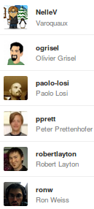
Notes:
Scikit-learn is an open source project that was started in 2011 at INRIA in Paris by Gael Varoquax and Alex Gramfort, and quickly grew to an community driven project with contributors from around the world. I’ve been on the project since 2012 and I’ve been managing the releases and a lot of the maintenance and API since then.
The project has around 20.000 commits, 700 contributors and 200.000 lines of code. Everything is managed by a team of 36 core developers, of which around 20 are still active.

Slide 5
Mission
Commoditize and Democratize Machine Learning
Notes:
So why this project? To me, and I think to many others in the project, the mission of scikit-learn is to create effective and easy to use machine learning solutions, and make them accessible to everybody. In other words, we want to commoditize and democratize machine learning.
That is quite different from just putting a collection of algorithms out there, and I think it’s one of the reasons why the project has been so successful.

Slide 6
Simplicity
lr = LogisticRegression()
lr.fit(X_train, y_train)
lr.score(X_test, y_test)
Notes:
To make scikit-learn usable, we really focus on simplicity. You can build really powerful machine learning experiments and pipelines with scikit-learn with just a couple of lines of code. And doing a standard supervised machine learning task boils down to just these three lines: instantiate a model, fit the model on the training data, evaluate it on the test data. We want to keep simple things simple.
Here, I used the logistic regression classifier, but I could replace that first line with any other algorithm and the code would be exactly the same.

Slide 7
Consistency
grid = GridSearchCV(svm,param_grid)
grid.fit(X_train, y_train)
grid.score(X_test, y_test)
Notes:
And not only is the scikit-learn api designed to be simple, it’s also designed to be consistent, and only have a few basic building blocks. The grid-search for example acts as a model (which we call estimator), and has exactly the same interface as any other model.

Slide 8
Flat Class Hierarchy, Few Types
Numpy arrays / sparse matrices
Estimators
[Cross-validation objects]
[Scorers]
Notes:
But the simplicity goes further. There are very few types of objects in scikit-learn. Data is always numpy arrays, and basically every building block in scikit-learn is an “Estimator”. And that’s it. That’s more or less the only two types of objects you have to deal with in scikit-learn. There is no dataset object, for example. There also two kinds of object for model evaluation, but these are only interesting to expert users.
Having few types and a flat class hierarchy not only makes the project easier to use, it also makes it easier for new contributors to join the project, and simplifies maintaining the project.

Slide 9
Maintainability
Notes:
Which brings us to the next point, which is particularly important for an open source project: maintainability. Scikit-learn was built with maintainability in mind from the start, to make this a sustainable project. If me, or the people in Paris, would stop working on the project, it would still live on. Creating software that can be taken over by someone else is quite challenging, and you should ask yourself how much of your research software holds up to that bar.
Maintainability helps us create a thriving ecosystem of contributors, even though the barrier of entry inevitably keeps rising over time.

Slide 10
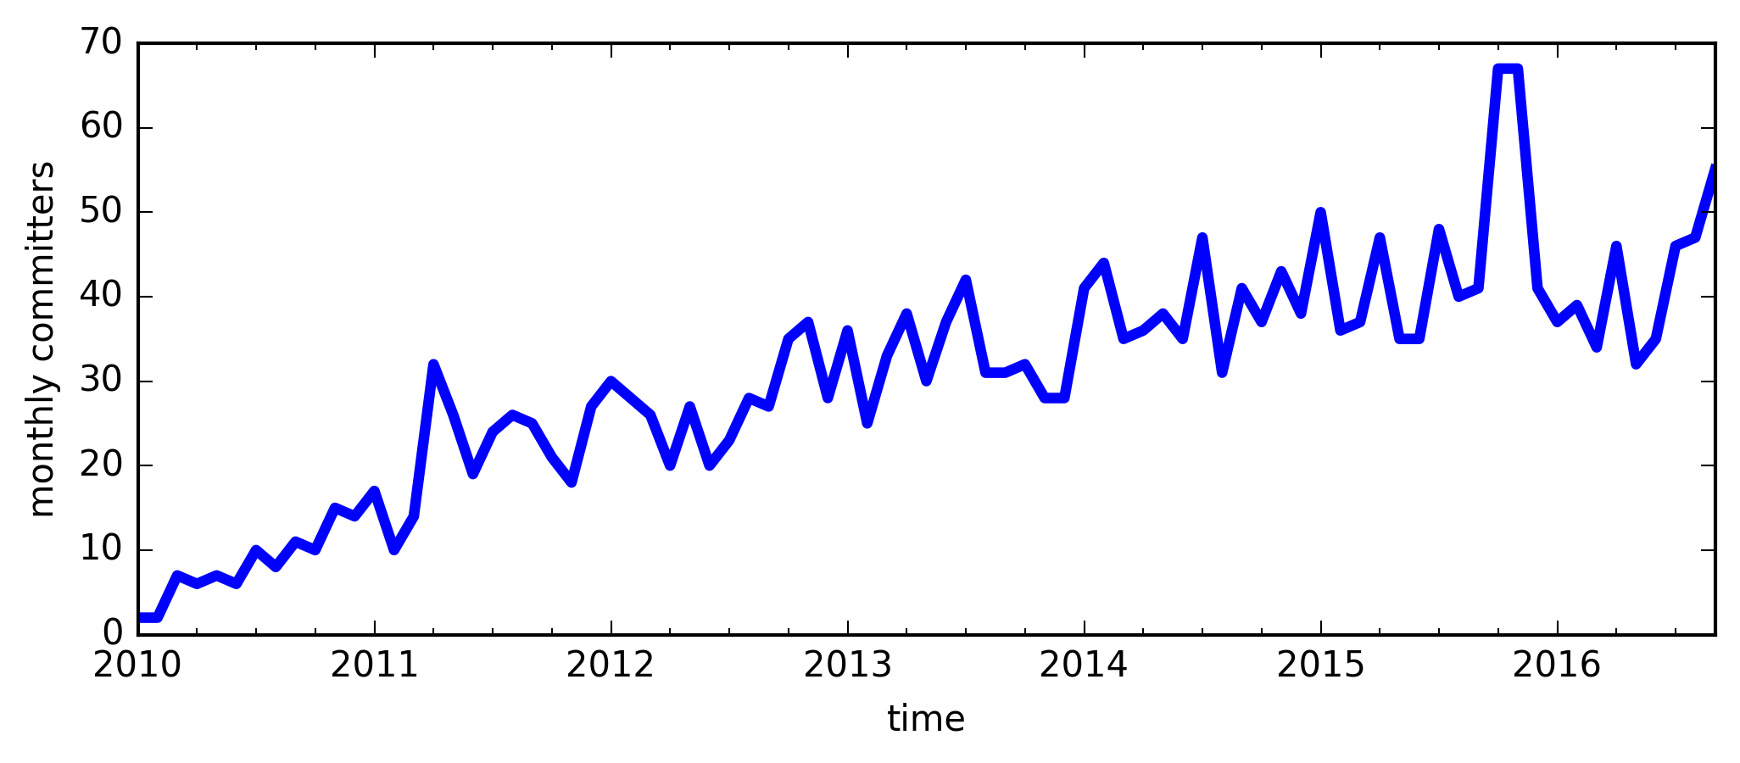
Code Contributors Over Time
Notes:
Just to emphasize why maintainability is important: this project really involves a lot of people. Here you can see how many people contributed to the project in each month since the project started. As you can see, there is about 40 to 50 people contributing to the project each month! We could never grow that big if we didn’t keep the barrier of entry as low as possible. Keep in mind is that nearly all of this is volunteer effort. There are only very few people on the project for whom this is actually part of their day-to-day job. Many contributors are students from around the world that we mentor as part of their contributions.
That means though we need to review hundreds of contributions and bug reports.
If I wanted to use hyperbole, I could say I’m trying to manage a team of 50 people, that changes every month, and that I have basically no power over.

Slide 11
Scoping
Well established
Widely
useful
sklearn
Matrix in,
matrix out
Notes:
One of the most important tools to help with maintainability is scoping. We only include methods that are well established and widely useful. We don’t have methods that are only good in biology, or that are only good for financial data. We aim to have a very broad spectrum. We also limit ourselves to well-established methods. One of the reasons we don’t want to implement the cutting edge is that the field of Machine learning is very fast moving, and what looked promising half a year ago might no longer be any good. Basically everything in scikit-learn stood the test of time. Another very important restriction to scope is that we only have algorithms that work on a fixed matrix of data, and produce some matrix or array of results. This basically excludes active learning, reinforcement learning and collaborative filtering. It also excludes working on structured data, and allows us to have such a simple interface.

Slide 12
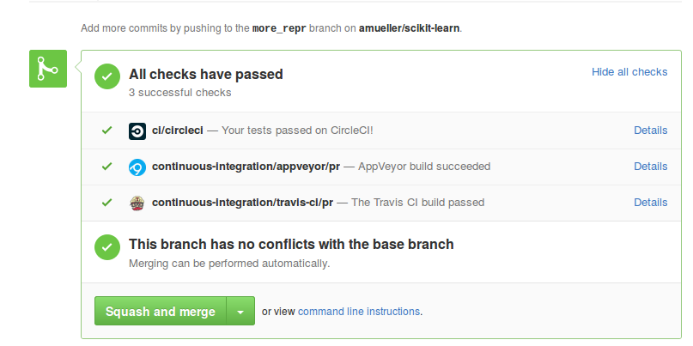
Testing & Continuous Integration
Notes:
Another tool that helps with maintainability and usability is extensive testing. We have tests for everything. Every option is tested, every edge case.
We also have automatic tests to check that everything has the same interface and all parts play nicely together.
What I mean by testing here might be slightly unfamiliar for the people without an software engineering background. Often when I asked researchers if they test their code they answer with “yes, I tried it”. That’s not what testing is about.
I’m talking about continuous integration and unit tests.
Whenever anyone suggests a change to the package, an automated service starts and runs all our tests against the changed version, and makes sure they all pass. That ensures that all additions are sane.

Slide 13



Three way documentation
Notes:
Another thing that’s very important, both for maintainability and usability is extensive documentation. We document each feature in three ways: we have a user guide that explains algorithms in a text-book style and provides references. We also have an API documentation that explains all the parameters, and finally we have examples that illustrate particular properties of the algorithms and compare their strength and weaknesses.

Slide 14
Additions in the 0.18 release
Notes:
But enough on the project in general, I wanted to tell you a bit more about what happened within the last year, which is how long we’ve been working on the 0.18 release.

Slide 15
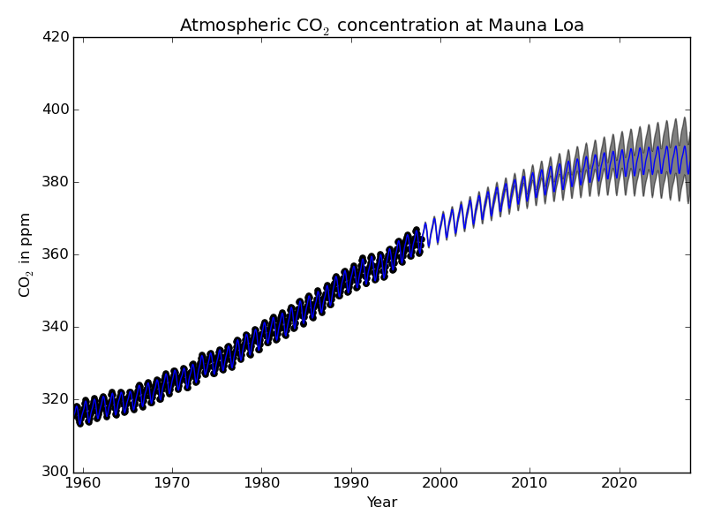
Gaussian Process Rewrite
34.4**2 * RBF(length_scale=41.8)
+ 3.27**2 * RBF(length_scale=180)
* ExpSineSquared(length_scale=1.44, periodicity=1)
+ 0.446**2 * RationalQuadratic(alpha=17.7, length_scale=0.957)
+ 0.197**2 * RBF(length_scale=0.138) + WhiteKernel(noise_level=0.0336)
Notes:
One thing thats really great and that some of you might be interested in is a complete rewrite of the Gaussian Process, which now has a very extensive language to specify and learn kernels. Here you can see the classical example of the Mauna Loa C02 concentration and the kernel parameters that were learned.
The user can specify any form of parametric kernel which can then be learned by maximum likelihood.

Slide 16
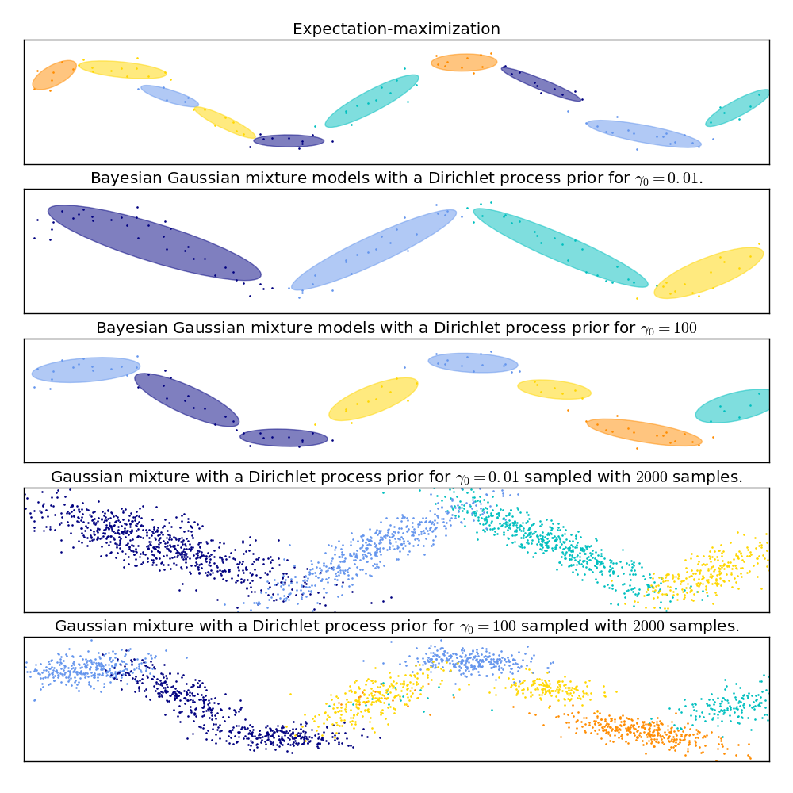
from sklearn.mixture import GaussianMixture
from sklearn.mixture import BayesianGaussianMixture
Notes:
Another addition are two new classes for Gaussian Mixture models, called GaussianMixture and BayesianGaussianMixture. We had Gaussian mixture models before, but the new classes have a simpler interface and are numerically much more stable. Gaussian Mixture is a standard model build with expectation-maximization, and BayesianGaussianMixture model using variational inference either with a finite dirichlet prior or a dirichlet process prior.

Slide 17
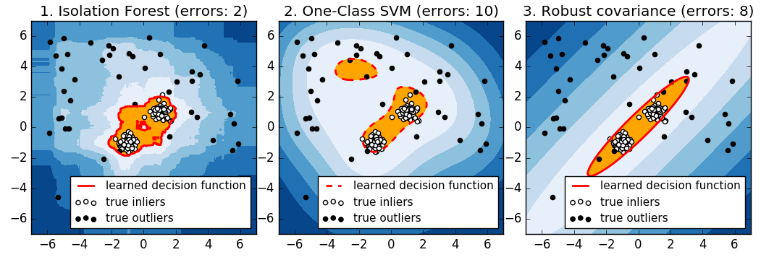
Isolation Forests
Notes:
Another great new addition are Isolation Forests. Isolation Forests are an outlier detection method. In case you’re unfamiliar, outlier detection tries to find data that looks different from “normal”. This can be used, for example, for fraud detection in finance or for intrusion or failure detection in distributed systems.
Here you can see Isolation forest compared to two methods that we had previously, one-class SVM and robust covariance.
Isolation forests are great because they work very well without a lot of parameter tuning, and they are very flexible, in that they allow for completely non-parametric densities models of the data.

Slide 18
pipe = Pipeline([('preprocessing', StandardScaler()),
('classifier', SVC())])
param_grid = {'preprocessing': [StandardScaler(), None]}
grid = GridSearchCV(pipe, param_grid)
Notes:
Another change that I want to mention is that we improved how algorithm pipelines and grid-search interact. You can now directly run gird-search over what kind of preprocessing you might want to do, and what kind of classifier you want to use. To me, this is a step towards fully automatic model selection.

Slide 19
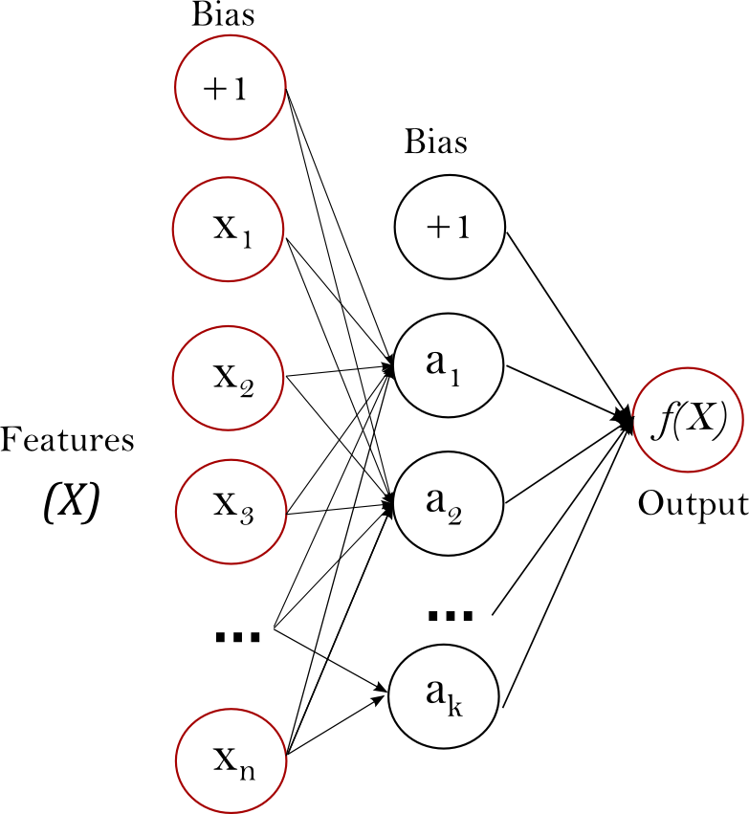
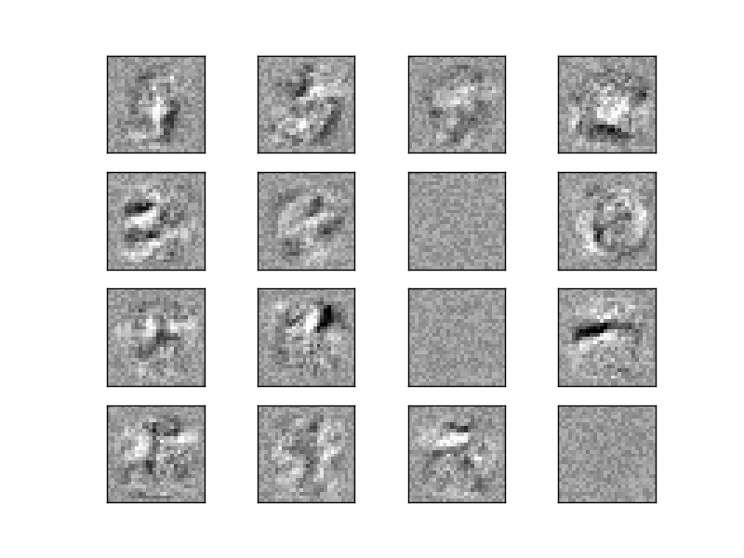
Neural Networks
Notes:
We also added a simple feed forward neural network, which took us a bit longer than we hoped. We have several optimization procedures, including stochastic gradient descent, l-BFGS and Adam.
We don’t have GPU support, so this is more for quickly trying out a neural net and not for deep learning research.

Slide 20
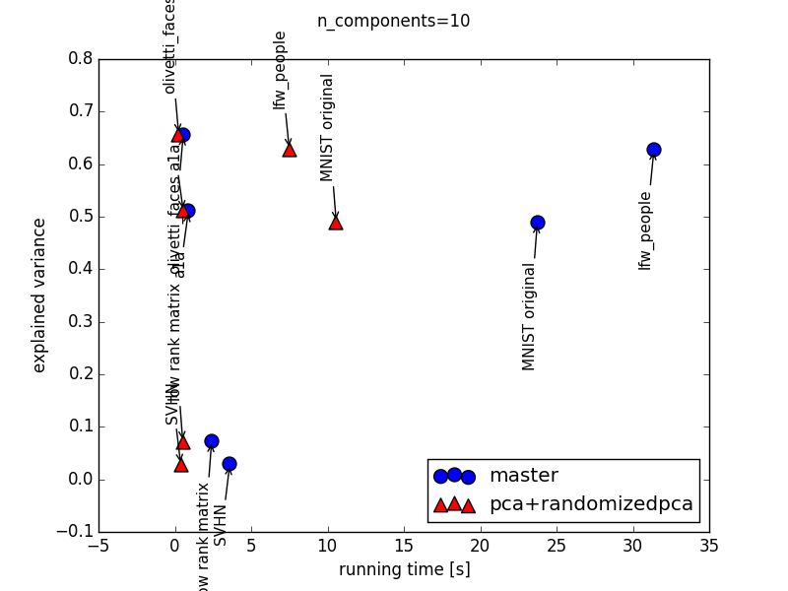
Faster Principal Component Analysis
Notes:
Another thing that goes more into the direction of usability is that we now automatically detect what the best algorithms for PCA is dependent on the data and the number of components you want to extract.
This list of additions is not exhaustive and there’s a lot more changes, some of them quite technical, but I feel this should give you a good overview.

Slide 21
Other software projects
Notes:
I think this was enough about scikit-learn, I now want to talk about some of my personal projects that I did while at NYU.

Slide 22
Patsy-sklearn
y ~ x_1 + x_2 + x_3
log(y) ~ x_1 + x_2 + x_3
log(y) ~ x_1:x_2 + x_3
log(y) ~ x_1:x_2 + log(x_3)
model = PatsyModel(LogisticRegression(),
"species ~ sepal_length + petal_length")
transformer = PatsyTransformer(
"sepal_length + log(petal_length) + petal_length:sepal_width")
Notes:
In terms of software, I created a library called patsy-learn. This is basically glue between two existing libraries, scikit-learn and patsy. Patsy is a python library to allow you to specify linear models using a formula, as you might be familiar with from R.
Patsy-sklearn allows you to create scikit-learn compatible models using formulas by using patsy in the background. My hope is that this will bring some of the things that people like about R more into the Python world.

Slide 23
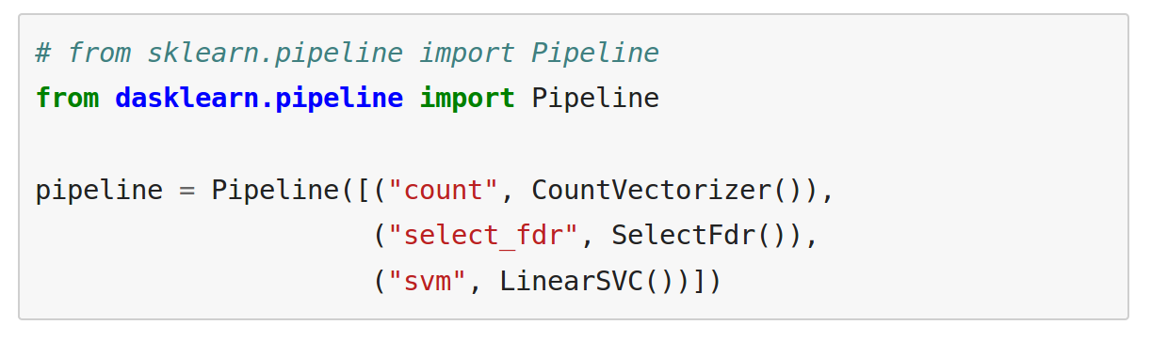
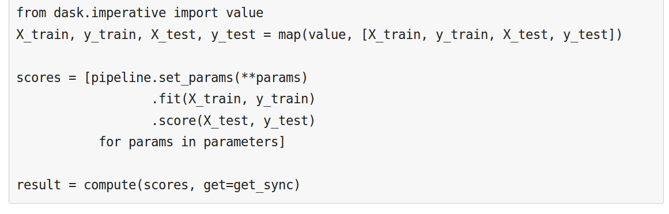
Dask-learn (with Matt Rocklin)
Notes:
Another software project is Dask-learn on which I worked with Matt Rocklin from Continuum.
Dask is a distributed graph execution engine. Dask-learn implements some of the elements of scikit-learn like pipelines and grid-search using dask computation primitives.
This allows the dask scheduler to parallelize and distribute the computations, but also cache and reuse intermediate results, while observing memory constraints.

Slide 24
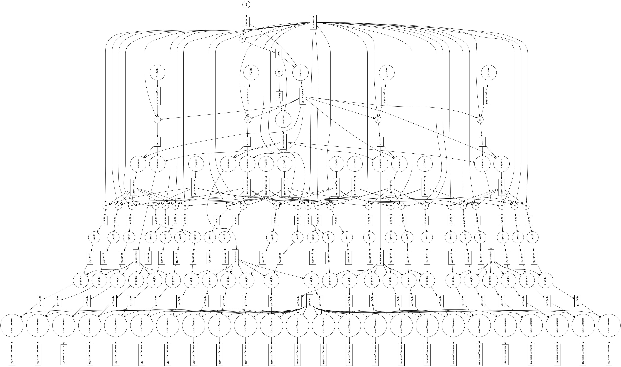
Dask-learn (with Matt Rocklin)
Notes:
Here is the computation graph generated by a standard grid-search with cross-validation and you can see that can get quite hairy quickly, so it’s good that we don’t have to handle intermediate results manually. This is somewhat similar to what tensorflow does, in that a user specifies a computational graph and then simply passes it to the backend for execution.

Slide 25
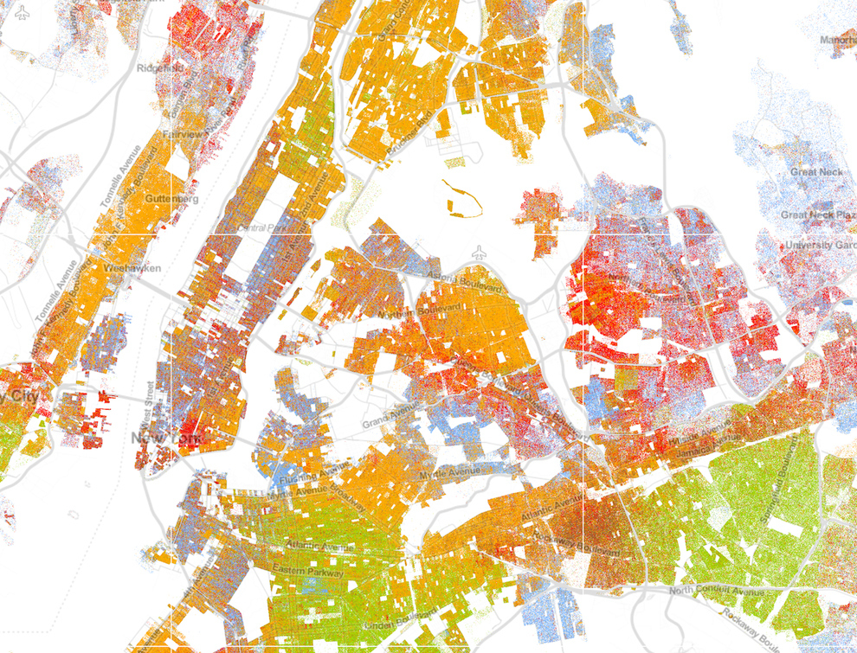
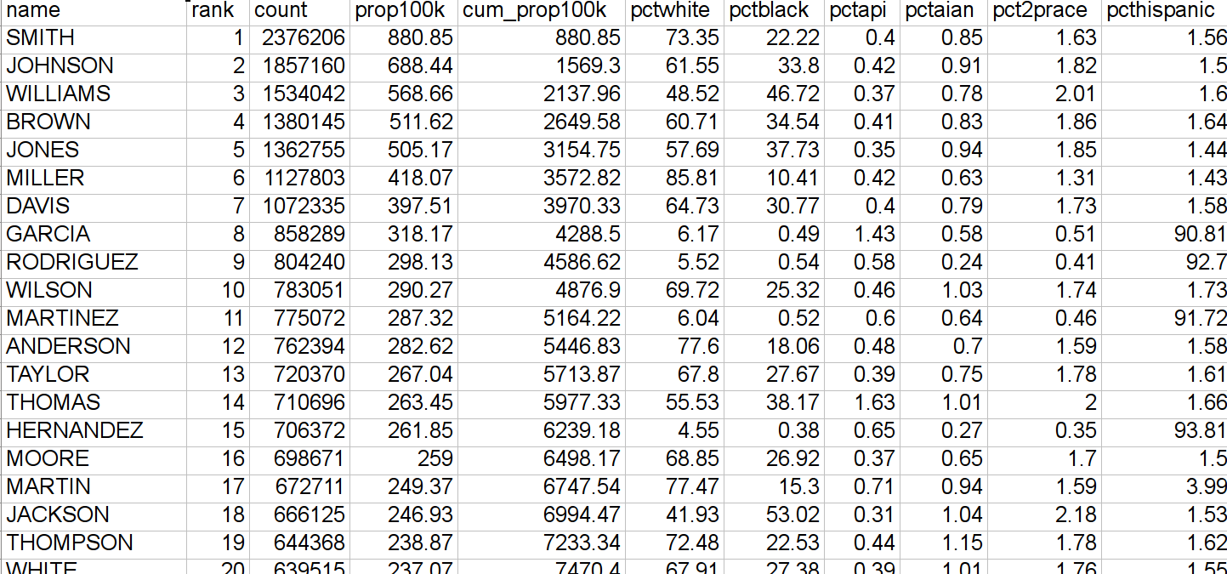
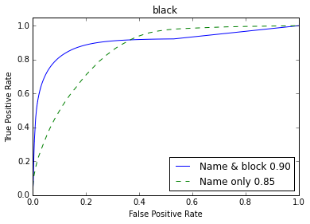
Voter Ethnicity Prediction
(Tian Wang)
Census block ethnical distribution x Last name ethnical distribution
~ Voter ethnicity
Notes:
I also did several student projects. This one has a nice picture so I’m showing it. I worked with one of our master students, Tian Wang, and Chris Dawes from the politics department.
The goal was to predict ethnicities for each voter in New York City voting records to discover trends. We did this based on previous research that used known US-wide name-ethnicity distributions. There is quite a long public list of last names and corresponding ethnicity distributions that you can see on the right. We also know census block level ethnicity distributions from the census.
We combined these using a naive independence assumption and tested on data from states where the voter record includes ethnicity, and confirmed that the system was working well.
We then extended the method to last names beyond the list using a character n-gram model trained on the known name distributions to fully cover all voters.

Slide 26
In-Hospital Transmitions
(with Anna Stachel)
Data from Langone Medical Center
Estimate number of in-hospital transmissions
Find sources of transmissions (shared room, equipment, health care providers)
Use antibiotic-resistance as fingerprint
Notes:
Another project that I did was with Anna Stachel from NYU Langone medical research. Her group was trying to investigate in-hospital transmissions of pathogens. Apparently, many people get additional illnesses while in the hospital via transmissions from other patients. This project is more a cautionary tale than anything else.
There was a plan for a large-scale study to find out how many transmissions there are, and how transmissions happen. The idea was to use large scale genetic fingerprinting of bacteria, however, the data for that never arrived.
Instead, we used bacteria’s resistance against several antibiotics as a fingerprint to identify whether patients might have the same strands. Similar strands indicate candidates for transmissions. While DNA tests are very certain transmissions, these antibiotic resistance patterns are only plausible transmissions.

Slide 27
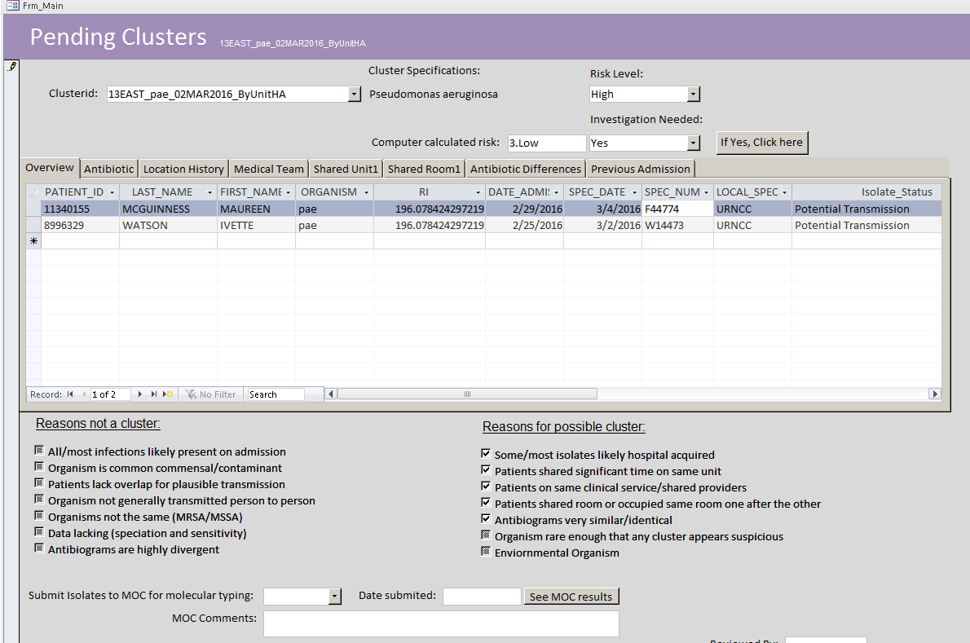
Their approach: SatScan
Notes:
What they did before was they used their large databases of patients, rooms and resistances, loaded it into SAS and used a tool called SatScan to find spatio-temporal clusters.
This took into account admission dates, and where patients staid in the hospital. There is also data on all the staff and equipment they interacted with, like X-Ray or dialysis machines, but that wasn’t used.
Then this software spit out some clusters. Unfortunately these clusters were very hard to interpret, which is why they came to the CDS for help.
We spend a lot of time sorting through the data, extracted the antibiotic fingerprints, admission and discharge dates etc to see what’s going on.

Slide 28
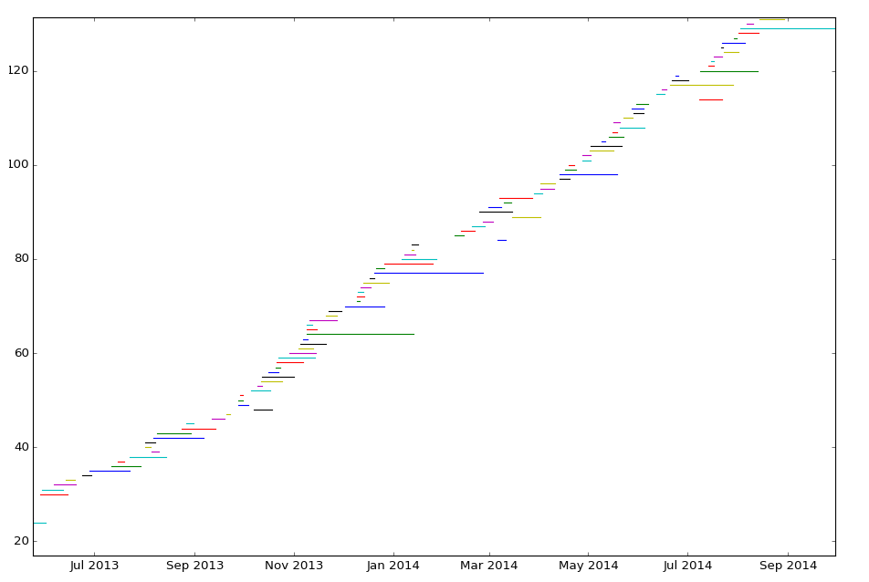
Digging in
Notes:
Here is a visualization of a selection of patients from one particular building. Each row is one patient, and the x-axis shows the dates of admission and discharge. The colors are just for contrasts. You can see that stays vary greatly in length. The really interesting part though is to see how often patients overlap in this data. This is only a small subset of all the patients in the hospital, namely the ones for which the antibiotic tests were done. And you can see that each patient only overlaps with three or four other patients! If patients are not there on the same day, we assume a transmission can not occur.
That means that finding a transmission in this data is quite unlikely.

Slide 29
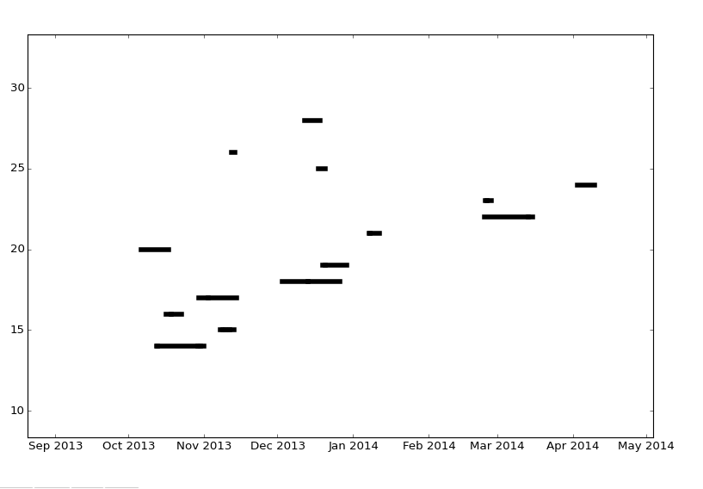
Patient overlap
Notes:
We zoomed in on a particular unit, and here is one period where we actually had quite a lot overlap. And we checked all the fingerprints and they didn’t match at all, even with very generous metrics. Not all tests were done on all patients. If a particular test wasn’t done on a patient, we assumed that the result would match the other patient that we compared against.
We ran a query over the whole dataset, and found not one overlap with matching fingerprint. That was quite disappointing, but I also thought it was a valuable lesson. Don’t run clustering, or any other fancy machine learning, without looking at your data first.

Slide 30

X-Ray Binaries
(Daniela Huttenkoppen, Nicolas Goix)
Notes:
The last project I wanted to talk about is probably the biggest science project, or maybe rather two projects. I worked on this with Daniela Huttenkoppen who is a data science fellow working in astronomy, and part of this was done by a student intern from INRIA, Nicolas Goix.
The goal of these projects, is to study black-hole x-ray binaries. I’m not an astronomer, so I might get some of the astronomy parts wrong, but I’ll try to do my best.
An x-ray binary is a gravity bound binary system consisting of a black hole and a star emitting light in the x-ray range.
The star loses mass into the black hole and is slowly absorbed, as you can see in this fancyful illustration here.

Slide 31
X-Ray Binaries
(Daniela Huttenkoppen, Nicolas Goix)
Notes:
We are trying to learn about the physics of the black hole by observing the light that is emitted in the process.
These X-Ray binaries are particularly interesting as they allow physicists to study general relativity in the context of very strong gravity, here in form of the black hole. That’s something that can’t be studied easily elsewhere.
As you can see in the depiction, the mass from the star doesn’t fall into the black hole directly, because of a phenomenon called angular momentum. Instead, it settles on a circular orbit and slowly falls into the black hole, forming what’s called an accretion disc.

Slide 32
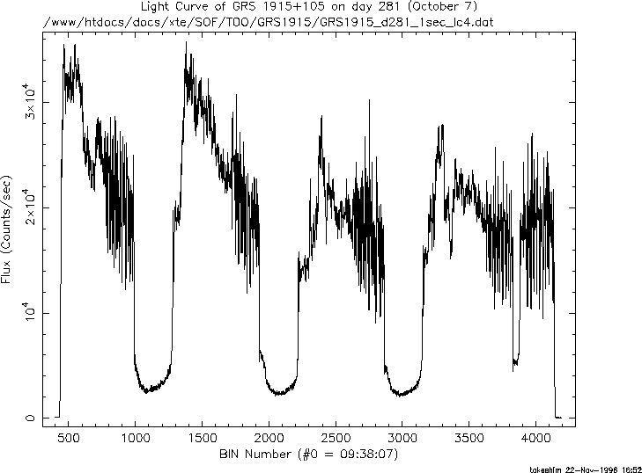
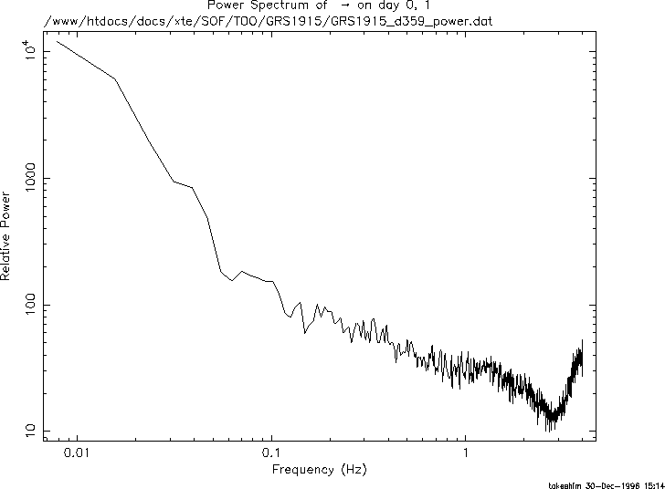
Measurements and Observations
Notes:
I want to talk about two different systems here, the first one being GRS 1915+105, the second one cyg-x1.
Astronomers categorized the possible emissions coming from these sources into several discrete states, and these states are what we are interested in applying machine learning to.
We have several different instruments that observe these sources, which all provide us with time series of photon counts. These sources are far away so we are actually counting individual photons, and measure the energy associated with the photons.
Each observation is a photon count over a particular time frame, like .1 second or 1 second,
There is interruptions between the time-series, when the instruments are pointed at other sources.
On the left you can see a time-series of photon counts, with each point in the curve one observation. On the right, you can see the spectrum of photons in one particular observation.

Slide 33
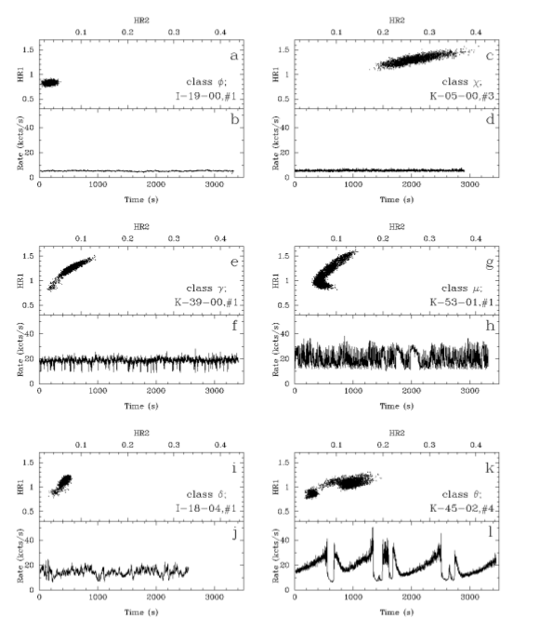
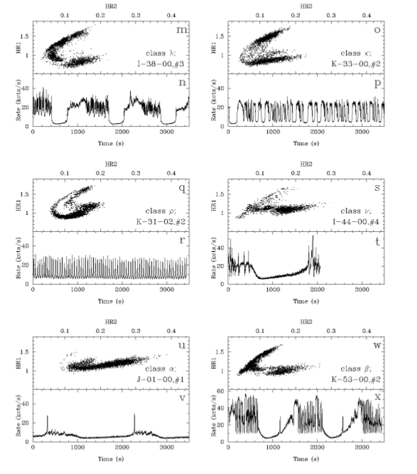
Black Hole States and Transitions
GRS 1915+105
(Huppenkothen, Heil, Hogg, Mueller)
Belloni et. al. 2000
Notes:
The work on GRS 1915+105 is together with Lucy Heil and David Hogg and is submitted for publication
This source is known to exhibit at least 14 known patterns or states which were annotated manually in data ranging from 1996 – 1999. These states are empirical distinctions and it’s not clear if they correspond to qualitatively different physical phenomena. The distinction is made based on physically meaningful features, but there are no clear written down definition and annotation is done “by eye”. You can see a representation of 12 of these 14 states above. The top of each plot shows a 2d scatter plot of properties of the spectrum known as the hardness ratio, while the bottom shows a time-series of the total photon counts.
There is additional data that wasn’t annotated, ranging from 2000 to 2012, so the vast majority of data is not annotated with states. The telescope that was used to gather the data stopped working in 2012.

Slide 34
Black Hole States and Transitions
GRS 1915+105
Belloni et. al. 2000
Notes:
We want to automatically label this remaining data to learn more about the frequency of the 14 states, the average length of each state and transitions between states.
In this paper, we cast this as a supervised learning task on time windows. In other words we slice the data into overlapping windows of fixed length and classify them independently. There is a natural extension to using a time-series model, but that is future work.

Slide 35
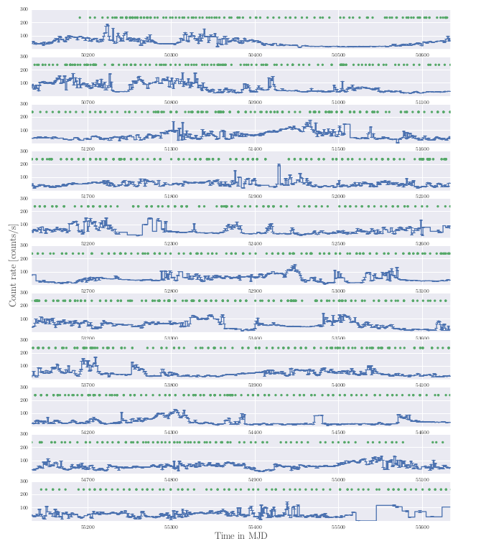
Black Hole States and Transitions
Notes:
Here is a summary of the data over the whole period. In blue is a low resolution sensor. There are more precise measurements from another instrument where you see the green dots, which contains four energy bands, which is the data we are using. So our input consists of pieces of four-dimensional time-series. In other words, the spectrum associated with each observation has four bins.
We tried several models, including random forests, but ended up using a simple logistic regression.
As features, we used the coefficients from an auto-regressive model, the principal components of power spectra, and quotients of particular frequency bins that measure the slope of the power spectrum. These are the harness ratios.

Slide 36
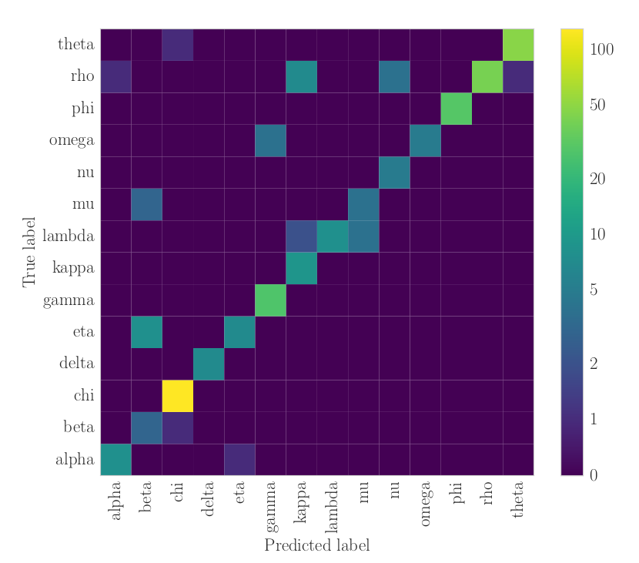
State Classification Results
Notes:
Here is the resulting confusion matrix, which shows pretty good performance, with an overall accuracy of 90%. The classes are quite imbalanced, but other metrics that take the imbalance into account are also quite good.
There is quite a clear pattern of confusions, so we could investigate the types of errors that are made manually. Some of them are classifier failures, which would require more expressive features to actually distinguish the states, but some of them are also clearly labeling errors.

Slide 37
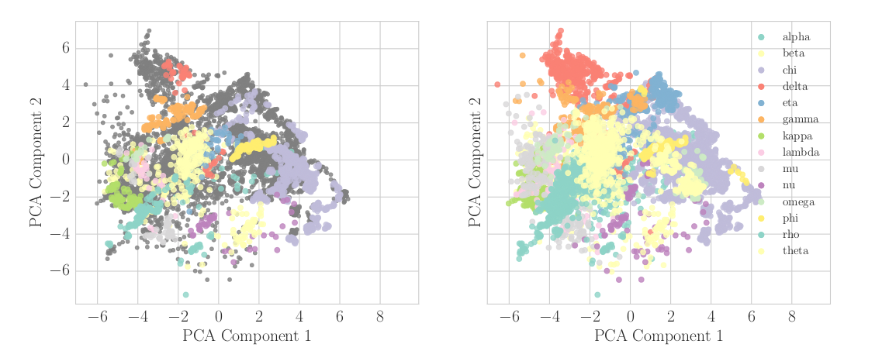
Validation of Inferred States
Notes:
After convincing ourselves that the model performs well, we apply it to the remaining unlabeled data.
Here you can see a visual sanity test. We projected the 11 dimensional feature space that I described before down to two features for visualization using the t-SNE algorithm. we used the whole data for building the t-SNE mapping, only a part of which is labeled. You can see the manual labeling on the left.
On the right, you can see the labels predicted by the model for all data points. This looks reasonable, in that most classes are well located. However the embedding and the classification are based on the same features, so it’s not that surprising that the embedding confirms the classification by the logistic regression.

Slide 38
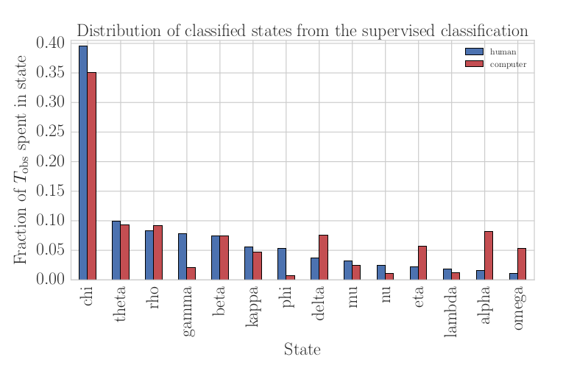
State Frequency Comparison
Notes:
Here is one of the astronomical statements we can derive from the model. This is the frequency of different states in the human-annotated span before the year 2000 in red and the machine-annotated span after 2000 in blue.
In general, the frequencies of the states are quite similar.
there are some interesting differences, though. the alpha and omega states are much more common in the later part of the data. We take this as an actual change in the physics, as we observed few false positives in these classes on the human-annotated set.
This is just a very simple analysis of the prediction, the paper also discusses state transitions, and in the future we might use these annotations for more elaborate analysis of the states.

Slide 39
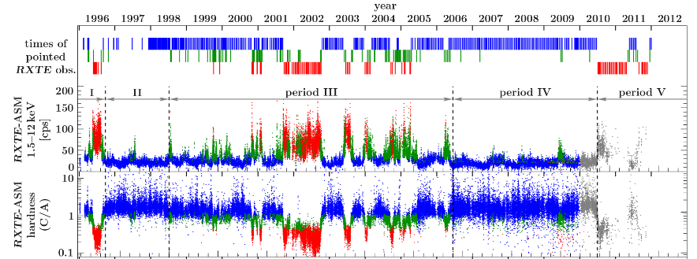
Finding States for CYG-X1
Notes:
So let’s talk about the second source, cyg-x1. This one is much simpler in some regards, as the literature only distinguishes two or three states, depending on the publication.
Here, we ask a somewhat more ambitious question, which is whether we can confirm the existence of theses states using machine learning. We want to use unsupervised models to see if there are actually clear boundaries, and whether they correspond to the expert-drawn boundaries.
We did quite a bit of exploration for this, though unfortunately we don’t have any good quantitative results yet.

Slide 40
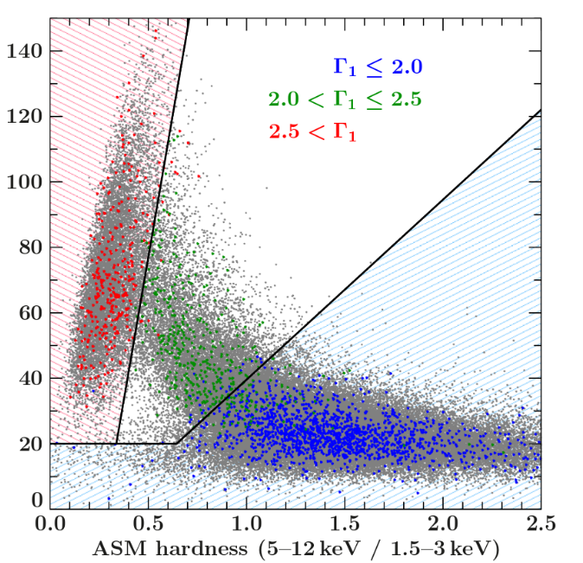
Human Annotations
Notes:
The publication we are basing our work on used a distinction into three categories. The original data is three energy bands, from which several hardness ratios are derived. The human classification can be reduced to boundaries in a 2-dimensional projection that you can see above.
Using the two-dimensional space shown here, or the full 5-dimensional space consisting of the three bands and two ratios allows for very easy supervised classification of the states.
But the question we are asking here is: do these lines makes sense? Can we recover them from the data.
We applied several models, most notably gaussian mixture models and hidden markov models with gaussian emissions. The problem is that the states are not very Gaussian, neither in the original measurements nor in the space including the ratios.

Slide 41
Demo
(Nicolas Goix)
Notes:
We created some interactive websites to illustrate our qualitative results and allow other researchers to interact with the data more easily.
Let’s start with a video of the time series, showing the human classification and groups of ten consecutive measurements on a subset of the data. You can see the data moving from the red state, which is known as the hard state, through the blue state, the intermediate state, to the yellow state, called the soft state. Looking at the video, at least I feel the boundaries are somewhat arbitrary. There are certainly some regions where the state remains longer, but they don’t entirely correspond to the human lines.

Slide 42

Notes:
Because I have been talking about what I’ve been up to within the last year or so, I also wanted to mention this book that I wrote with Sarah Guido that just came out. It’s a guide to practical machine learning in python. It doesn’t contain any math, but a lot of code examples with scikit-learn.

Slide 43

Thank you.
@amuellerml
@amueller
amueller@nyu.edu
http://amueller.io
Notes:
That’s it from my side, than you for your attention.

