Slide 1

Advanced Scikit-Learn
Andreas Mueller (NYU Center for Data Science, scikit-learn)

Slide 2



Me

Slide 3
Classification
Regression
Clustering
Semi-Supervised Learning
Feature Selection
Feature Extraction
Manifold Learning
Dimensionality Reduction
Kernel Approximation
Hyperparameter Optimization
Evaluation Metrics
Out-of-core learning
…...

Slide 4







Slide 5
Overview
Reminder: Basic scikit-learn concepts
Working with text data
Model building and evaluation:
  Pipelines
  Randomized Parameter Search
  Scoring Interface
Out of Core learning
  Feature Hashing
  Kernel Approximation
New stuff in 0.17 and 0.18-dev
  Overview
  Calibration

Slide 6

http://scikit-learn.org/

Slide 7
Representing Data
one sample
1.1 | 2.2 | 3.4 | 5.6 | 1.0
6.7 | 0.5 | 0.4 | 2.6 | 1.6
2.4 | 9.3 | 7.3 | 6.4 | 2.8
1.5 | 0.0 | 4.3 | 8.3 | 3.4
0.5 | 3.5 | 8.1 | 3.6 | 4.6
5.1 | 9.7 | 3.5 | 7.9 | 5.1
3.7 | 7.8 | 2.6 | 3.2 | 6.3
1.6
2.7
4.4
0.5
0.2
5.6
6.7
X =
y =
one feature
outputs / labels

Slide 8
Supervised Machine Learning
clf = RandomForestClassifier()
clf.fit(X_train, y_train)
y_pred = clf.predict(X_test)
Training Data
Model
Training Labels
Test Data
Prediction
Test Labels
Evaluation
clf.score(X_test, y_test)

Slide 9
Unsupervised Transformations
pca = PCA(n_components=3)
pca.fit(X_train)
X_new = pca.transform(X_test)
Training Data
Model
Test Data
Transformation

Slide 10
Basic API
estimator.fit(X, [y])
estimator.predict | estimator.transform
Classification | Preprocessing
Regression | Dimensionality reduction
Clustering | Feature selection
 | Feature extraction

Slide 11
Model selection and model complexity
(aka bias-variance tradeoff)

Slide 12
Overfitting and Underfitting
Training
Sweet spot
Accuracy
Generalization
Underfitting
Overfitting
Model complexity

Slide 13
Cross-Validation
from sklearn.cross_validation import cross_val_score
scores = cross_val_score(SVC(), X, y, cv=5)
print(scores)
>> [ 0.92 1. 1. 1. 1. ]

Slide 14
Cross-Validation
from sklearn.cross_validation import cross_val_score
scores = cross_val_score(SVC(), X, y, cv=5)
print(scores)
>> [ 0.92 1. 1. 1. 1. ]
cv_ss = ShuffleSplit(len(X_train), test_size=.3,
n_iter=10)
scores_shuffle_split = cross_val_score(SVC(), X, y,
cv=cv_ss)

Slide 15
Cross-Validation
from sklearn.cross_validation import cross_val_score
scores = cross_val_score(SVC(), X, y, cv=5)
print(scores)
>> [ 0.92 1. 1. 1. 1. ]
cv_ss = ShuffleSplit(len(X_train), test_size=.3,
n_iter=10)
scores_shuffle_split = cross_val_score(SVC(), X, y,
cv=cv_ss)
cv_labels = LeaveOneLabelOut(labels)
scores_pout = cross_val_score(SVC(), X, y, cv=cv_labels)

Slide 16

Cross -Validated Grid Search

Slide 17
All Data
Training data
Test data
Fold 1
Fold 2
Fold 3
Fold 4
Fold 5
Split 1
Fold 1
Fold 2
Fold 3
Fold 4
Fold 5
Split 2
Fold 1
Fold 2
Fold 3
Fold 4
Fold 5
Finding Parameters
Split 3
Fold 1
Fold 2
Fold 3
Fold 4
Fold 5
Split 4
Fold 1
Fold 2
Fold 3
Fold 4
Fold 5
Split 5
Fold 1
Fold 2
Fold 3
Fold 4
Fold 5
Final evaluation
Test data

Slide 18
Cross -Validated Grid Search
from sklearn.grid_search import GridSearchCV
from sklearn.cross_validation import train_test_split
X_train, X_test, y_train, y_test = train_test_split(X, y)
param_grid = {'C': 10. ** np.arange(-3, 3),
'gamma': 10. ** np.arange(-3, 3)}
grid = GridSearchCV(SVC(), param_grid=param_grid)
grid.fit(X_train, y_train)
grid.predict(X_test)
grid.score(X_test, y_test)

Slide 19
Sample application: Sentiment Analysis

Slide 20
IMDB Movie Reviews Data
Review:
One of the worst movies I've ever rented. Sorry it had one of my favorite actors on it (Travolta) in a nonsense role. In fact, anything made sense in this movie.
Who can say there was true love between Eddy and Maureen? Don't you remember the beginning of the movie ?
Is she so lovely? Ask her daughters. I don't think so.
Label: negative
Training data: 12500 positive, 12500 negative

Slide 21
Bag Of Word Representations
CountVectorizer / TfidfVectorizer
“This is how you get ants.”
tokenizer
['this', 'is', 'how', 'you', 'get', 'ants']
Build a vocabulary over all documents
['aardvak', 'amsterdam', 'ants', ... 'you', 'your', 'zyxst']
Sparse matrix encoding
aardvak
ants
get
you
zyxst
[0, …, 0, 1, 0, … , 0, 1 , 0, …, 0, 1, 0, …., 0 ]

Slide 22
N-grams (unigrams and bigrams)
CountVectorizer / TfidfVectorizer
“This is how you get ants.”
Unigram tokenizer
['this', 'is', 'how', 'you', 'get', 'ants']
“This is how you get ants.”
Bigram tokenizer
['this is', 'is how', 'how you', 'you get', 'get ants']

Slide 23
Notebook Working With Text Data

Slide 24
Pipelines

Slide 25
Training Labels
Training Data
Model

Slide 26
Training Labels
Training Data
Feature
Extraction
Scaling
Feature
Selection
Model
Cross Validation

Slide 27

Pipelines

Slide 28
Pipelines
from sklearn.pipeline import make_pipeline
pipe = make_pipeline(StandardScaler(), SVC())
pipe.fit(X_train, y_train)
pipe.predict(X_test)

Slide 29
Continue Notebook Working with Text Data

Slide 30
Randomized Parameter Search

Slide 31

Randomized Parameter Search
Step-size free for continuous parameters
Decouples runtime from search-space size
Robust against irrelevant parameters
Source: Bergstra and Bengio

Slide 32
Randomized Parameter Search
params = {'featureunion__countvectorizer-1__ngram_range':
[(1, 3), (1, 5), (2, 5)],
'featureunion__countvectorizer-2__ngram_range':
[(1, 1), (1, 2), (2, 2)],
'linearsvc__C': 10. ** np.arange(-3, 3)}

Slide 33
Randomized Parameter Search
params = {'featureunion__countvectorizer-1__ngram_range':
[(1, 3), (1, 5), (2, 5)],
'featureunion__countvectorizer-2__ngram_range':
[(1, 1), (1, 2), (2, 2)],
'linearsvc__C': expon()}

Slide 34

Randomized Parameter Search
params = {'featureunion__countvectorizer-1__ngram_range':
[(1, 3), (1, 5), (2, 5)],
'featureunion__countvectorizer-2__ngram_range':
[(1, 1), (1, 2), (2, 2)],
'linearsvc__C': expon()}
rs = RandomizedSearchCV(text_pipe,
param_distributions=param_distributins, n_iter=50)

Slide 35
Randomized Parameter Search
Always use distributions for continuous variables.
Don't use for low dimensional spaces.

Slide 36
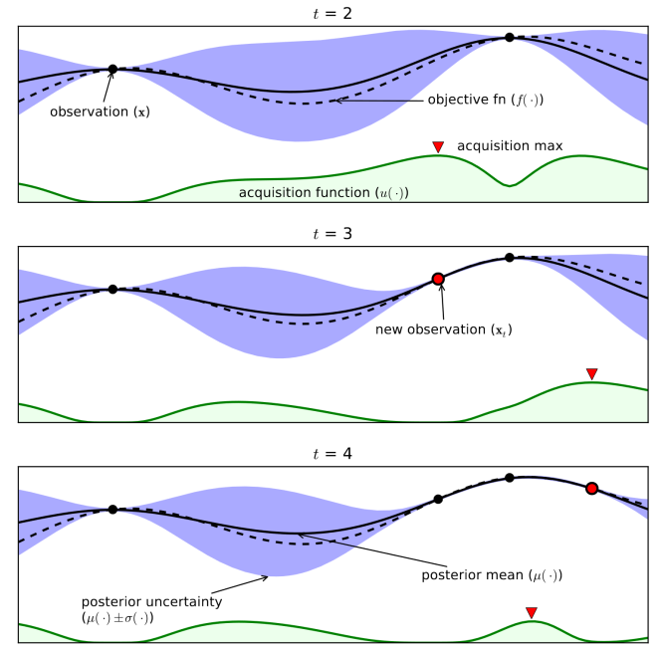
GP based parameter optimization
(coming soon)
From Eric Brochu, Vlad M. Cora and Nando de Freitas

Slide 37
Efficient Parameter Search and Path Algorithms

Slide 38
rfe = RFE(LogisticRegression())
param_grid = {'n_features_to_select': range(1, n_features)}
gridsearch = GridSearchCV(rfe, param_grid)
grid.fit(X, y)
rfecv = RFECV(LogisticRegression())
rfecv.fit(X, y)

Slide 39
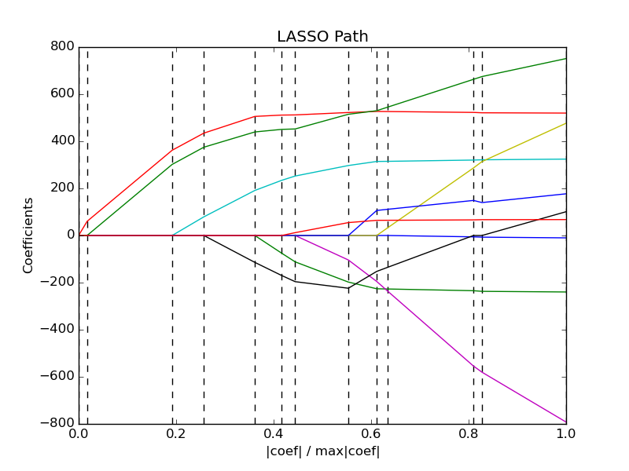

Slide 40
Linear Models | Feature Selection | Tree-Based models [possible]
LogisticRegressionCV [new] | RFECV | [DecisionTreeCV]
RidgeCV |  | [RandomForestClassifierCV]
RidgeClassifierCV |  | [GradientBoostingClassifierCV]
LarsCV
ElasticNetCV ...

Slide 41
Notebook Efficient Parameter Search

Slide 42
Scoring Functions

Slide 43
GridSeachCV
RandomizedSearchCV
cross_val_score
...CV
Default:
Accuracy (classification)
R2 (regression)
For GridSeachCV
cross_val_score
validation_curve
Typical: accuracy

Slide 44
Notebook scoring metrics

Slide 45
Out of Core Learning

Slide 46
Large Scale – “Out of core: Fits on a hard disk but in RAM”
Non-linear – because real-world problems are not.
Single CPU – Because parallelization is hard
(and often unnecessary)

Slide 47
Think twice!
Old laptop: 4GB Ram
1073741824 float32
Or 1mio data points with 1000 features
EC2 : 256 GB Ram
68719476736 float32
Or 68mio data points with 1000 features

Slide 48


Slide 49
HDD
Your for-loop / polling
estimator.partial_fit(X_batch, y_batch)
Trained
Scikit-learn
estimator
Network

Slide 50
Supported Algorithms
All SGDClassifier derivatives
Naive Bayes
MinibatchKMeans
IncrementalPCA
MiniBatchDictionaryLearning
MultilayerPerceptron (dev branch)
Scalers

Slide 51
Out of Core Learning
sgd = SGDClassifier()
for i in range(9):
X_batch, y_batch = cPickle.load(open("batch_%02d" % i))
sgd.partial_fit(X_batch, y_batch, classes=range(10))
Possibly go over the data multiple times.

Slide 52
The hashing trick for text data

Slide 53
Text Classification: Bag Of Word
“This is how you get ants.”
tokenizer
['this', 'is', 'how', 'you', 'get', 'ants']
Build a vocabulary over all documents
['aardvak', 'amsterdam', 'ants', ... 'you', 'your', 'zyxst']
Sparse matrix encoding
aardvak
ants
get
you
zyxst
[0, …, 0, 1, 0, … , 0, 1 , 0, …, 0, 1, 0, …., 0 ]

Slide 54
Text Classification: Hashing Trick
“This is how you get ants.”
tokenizer
['this', 'is', 'how', 'you', 'get', 'ants']
hashing
[hash('this'), hash('is'), hash('how'), hash('you'), hash('get'), hash('ants')]
= [832412, 223788, 366226, 81185, 835749, 173092]
Sparse matrix encoding
[0, …, 0, 1, 0, … , 0, 1 , 0, …, 0, 1, 0, …., 0 ]

Slide 55
Kernel Approximations

Slide 56

Reminder: Kernel Trick
x

Slide 57

Reminder: Kernel Trick

Slide 58
Reminder: Kernel Trick
Classifier linear → need only

Slide 59
Reminder: Kernel Trick
Classifier linear → need only
Linear:
Polynomial:
RBF:
Sigmoid:

Slide 60
Complexity
Solving kernelized SVM:
~O(n_samples ** 3)
Solving linear (primal) SVM:
~O(n_samples * n_features)
n_samples large? Go primal!

Slide 61
Undoing the Kernel Trick
Kernel approximation:
k =
= RBFSampler

Slide 62
Usage
sgd = SGDClassifier()
kernel_approximation = RBFSampler(gamma=.001, n_components=400)
for i in range(9):
X_batch, y_batch = cPickle.load(open("batch_%02d" % i))
if i == 0:
kernel_approximation.fit(X_batch)
X_transformed = kernel_approximation.transform(X_batch)
sgd.partial_fit(X_transformed, y_batch, classes=range(10))

Slide 63
How (and why) to build your own estimator

Slide 64
Why?
GridSearchCV
cross_val_score
Pipeline

Slide 65
How
“fit” method
set_params and get_params (or inherit)
Run check_estimator
See the “build your own estimator” docs!

Slide 66
Notebook Building your own estimator

Slide 67
What's new in 0.17

Slide 68
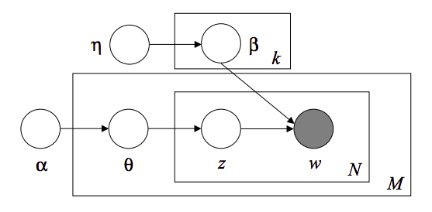
Latent Dirichlet Allocation
using online variational inference
Topic #0:
government people mr law gun state president states public use right rights national new control american security encryption health united
Topic #1:
drive card disk bit scsi use mac memory thanks pc does video hard speed apple problem used data monitor software
Topic #2:
said people armenian armenians turkish did saw went came women killed children turkey told dead didn left started greek war
Topic #3:
year good just time game car team years like think don got new play games ago did season better ll
Topic #4:
10 00 15 25 12 11 20 14 17 16 db 13 18 24 30 19 27 50 21 40
Topic #5:
windows window program version file dos use files available display server using application set edu motif package code ms software
Topic #6:
edu file space com information mail data send available program ftp email entry info list output nasa address anonymous internet
Topic #7:
ax max b8f g9v a86 pl 145 1d9 0t 34u 1t 3t giz bhj wm 2di 75u 2tm bxn 7ey
Topic #8:
god people jesus believe does say think israel christian true life jews did bible don just know world way church
Topic #9:
don know like just think ve want does use good people key time way make problem really work say need
By Chyi-Kwei Yau, based on code by Matt Hoffman

Slide 69
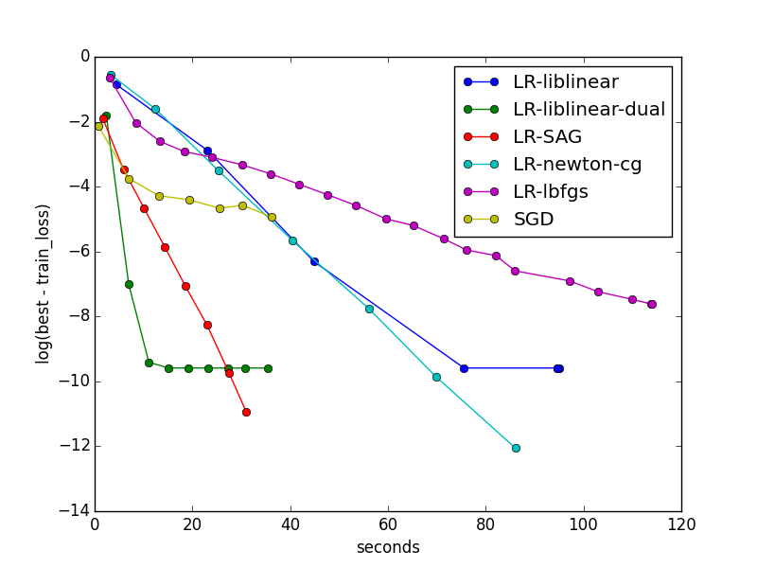
SAG for Logistic Regression and Ridge Regression
By Danny Sullivan and Tom Dupre la Tour

Slide 70
Coordinate Descent Solver for Non-Negative Matrix Factorization
Topics in NMF model:
Topic #0:
don people just like think know time good right ve make say want did really way new use going said
Topic #1:
windows file dos files window program use running using version ms problem server pc screen ftp run application os software
Topic #2:
god jesus bible christ faith believe christians christian heaven sin hell life church truth lord say belief does existence man
Topic #3:
geb dsl n3jxp chastity cadre shameful pitt intellect skepticism surrender gordon banks soon edu lyme blood weight patients medical probably
Topic #4:
key chip encryption clipper keys escrow government algorithm secure security encrypted public des nsa enforcement bit privacy law secret use
Topic #5:
drive scsi ide drives disk hard controller floppy hd cd mac boot rom cable internal tape bus seagate bios quantum
Topic #6:
game team games players year hockey season play win league teams nhl baseball player detroit toronto runs pitching best playoffs
Topic #7:
thanks mail does know advance hi info looking anybody address appreciated help email information send ftp post interested list appreciate
Topic #8:
card video monitor vga bus drivers cards color driver ram ati mode memory isa graphics vesa pc vlb diamond bit
Topic #9:
00 sale 50 shipping 20 10 price 15 new 25 30 dos offer condition 40 cover asking 75 interested 01
By Tom Dupre la Tour and Mathieu Blondel

Slide 71
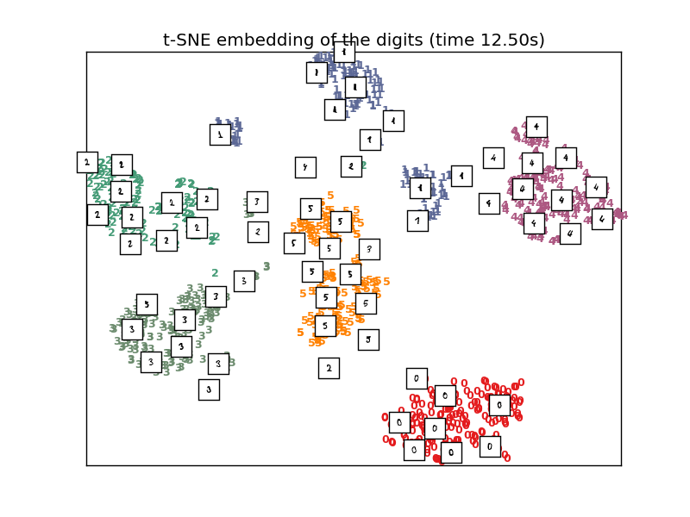
Barnes-Hut Approximation for
T-SNE manifold learning

Slide 72
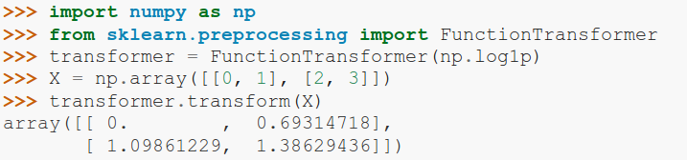
FunctionTransformer

Slide 73
VotingClassifier
clf1 = LogisticRegression()
clf2 = RandomForestClassifier()
clf3 = GaussianNB()
eclf = VotingClassifier(
estimators=[('lr', clf1), ('rf', clf2), ('gbn', clf3)],
voting=”hard”)

Slide 74
Scalers
RobustScaler
MaxAbsScaler
By Thomas Unterthiner.

Slide 75
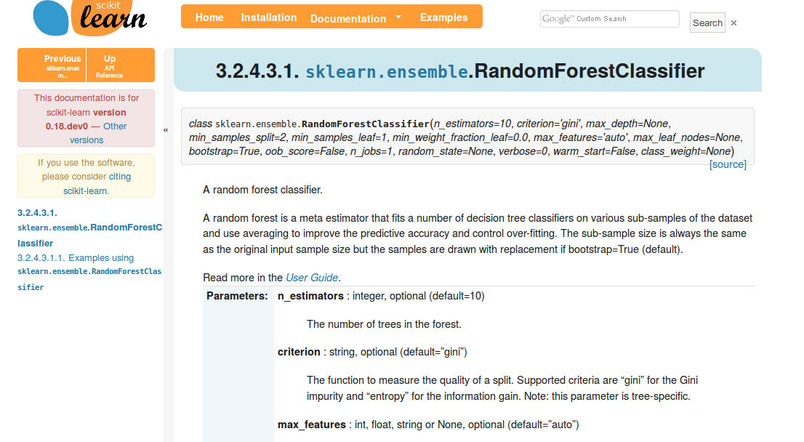
Add Backlinks to Docs

Slide 76
What the future will bring (0.18)

Slide 77

Gaussian Process Rewrite
34.4**2 * RBF(length_scale=41.8)
+ 3.27**2 * RBF(length_scale=180)
* ExpSineSquared(length_scale=1.44, periodicity=1)
+ 0.446**2 * RationalQuadratic(alpha=17.7, length_scale=0.957)
+ 0.197**2 * RBF(length_scale=0.138) + WhiteKernel(noise_level=0.0336)
By Jan Hendrik Metzen.

Slide 78
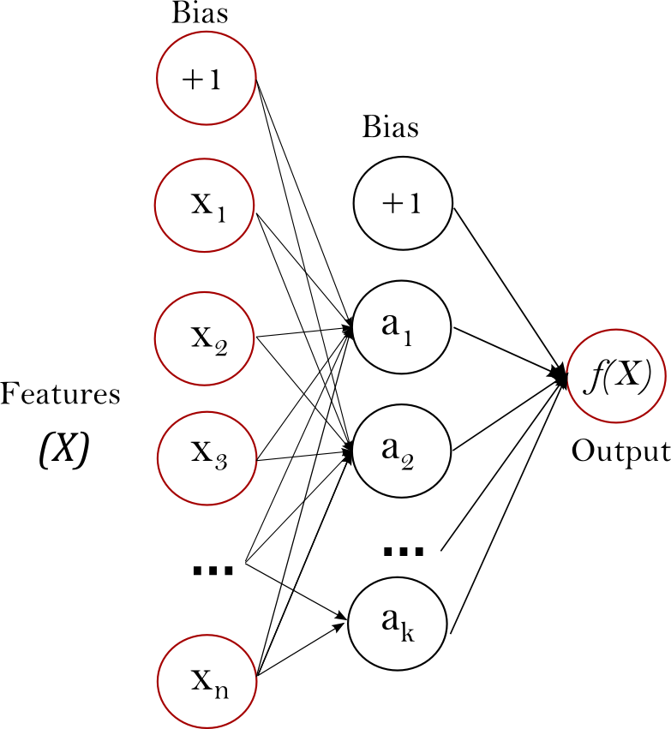
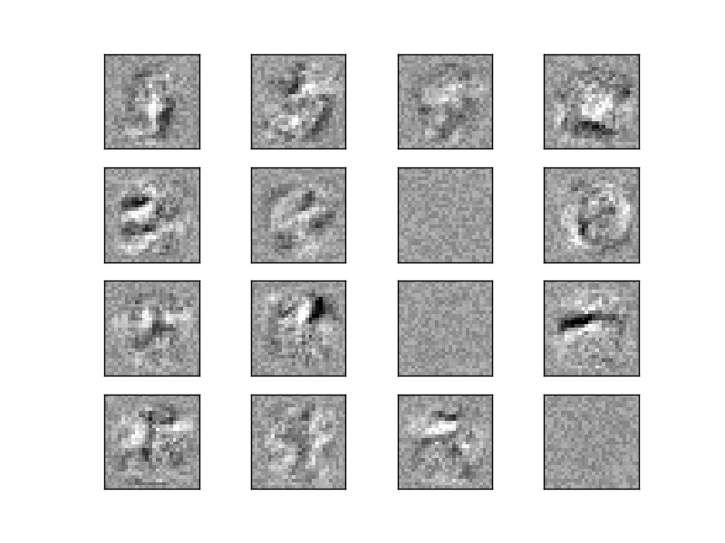
Neural Networks
By Jiyuan Qian and Issam Laradji

Slide 79
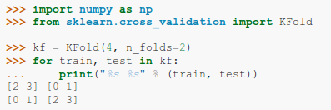
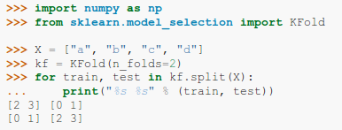

Improved Cross-Validation
current
future
By Raghav RV

Slide 80
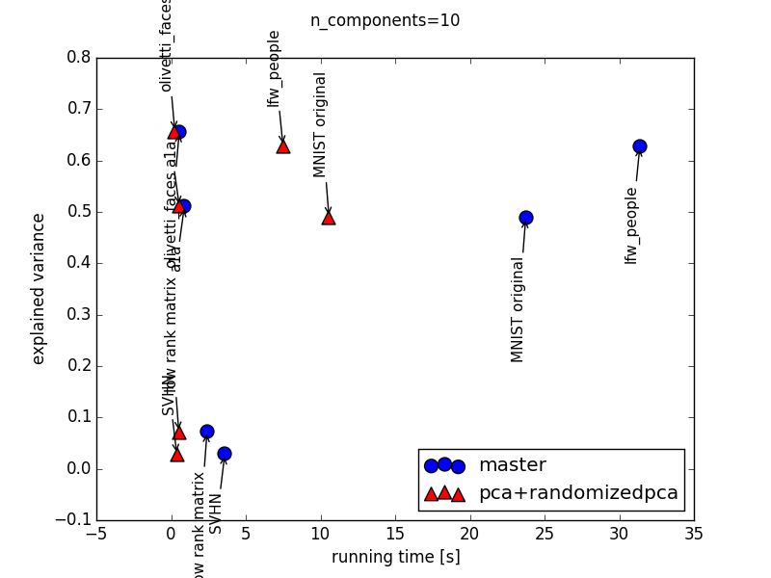
Faster PCA
By Giorgio Patrini

Slide 81

Hellbender
Release June 2016

Slide 82




Thank you!
@amuellerml
@amueller
importamueller@gmail.com
http://amueller.github.io

