Slide 1
Simple Word Clouds in Python
Andreas Mueller

Slide 2
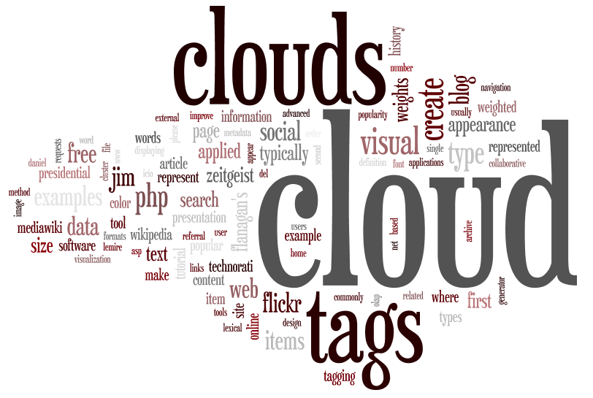

Slide 3
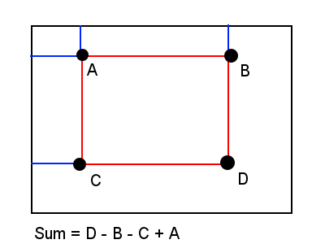
integral_image = np.cumsum(np.cumsum(image, axis=0), axis=1)
area = integral_image[i, j] + integral_image[i + size_x, j + size_y]
- integral_image[i + size_x, j] + integral_image[i, j + size_y

Slide 4
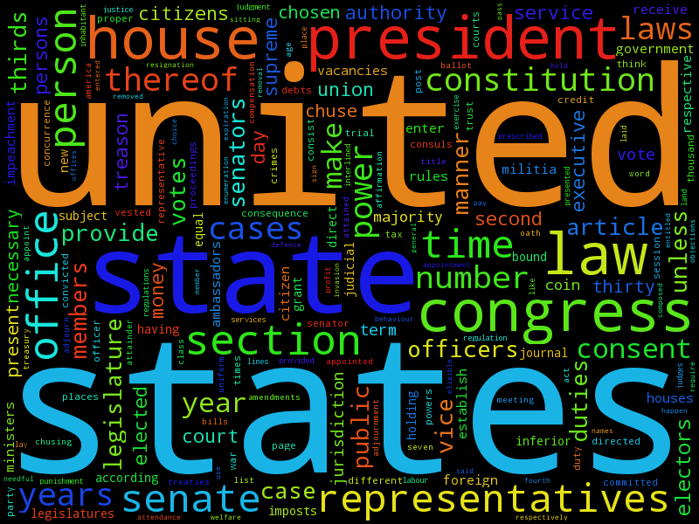

Slide 5
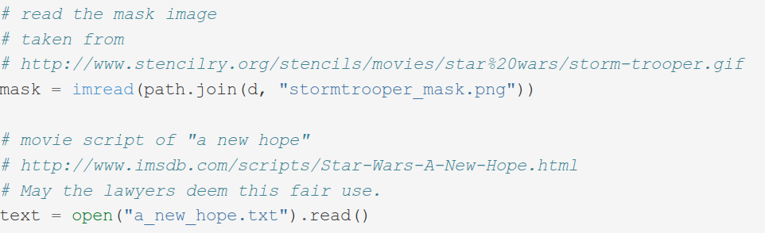

Slide 6
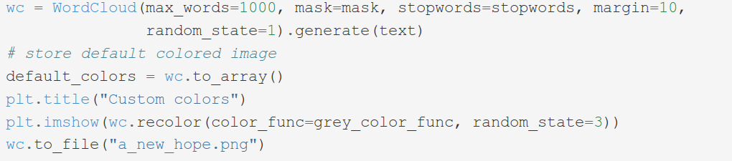

Slide 7
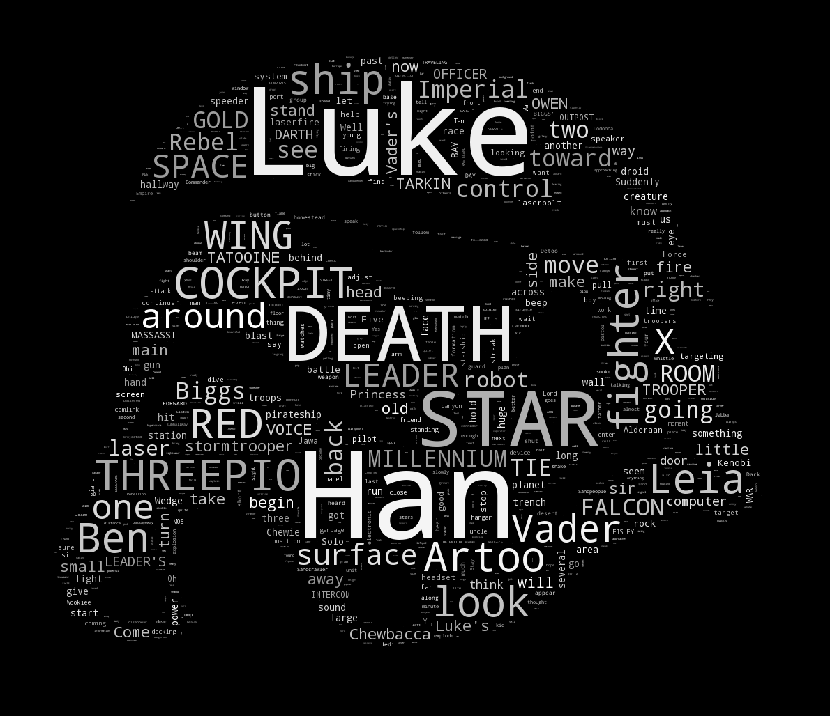

Slide 8
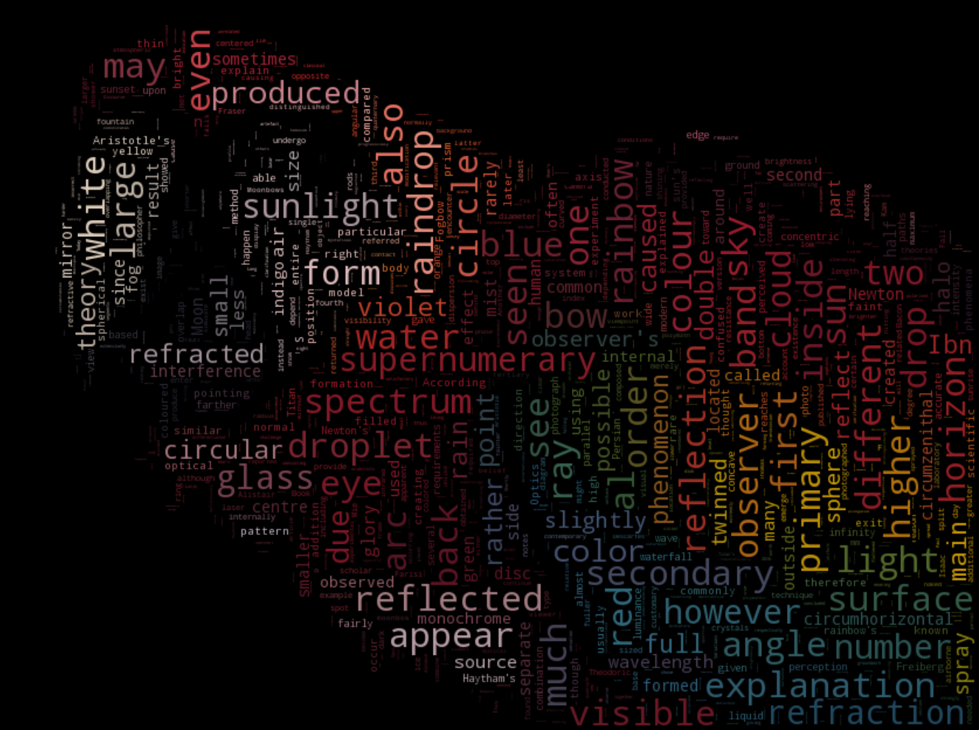

Slide 9
My new game

Slide 10
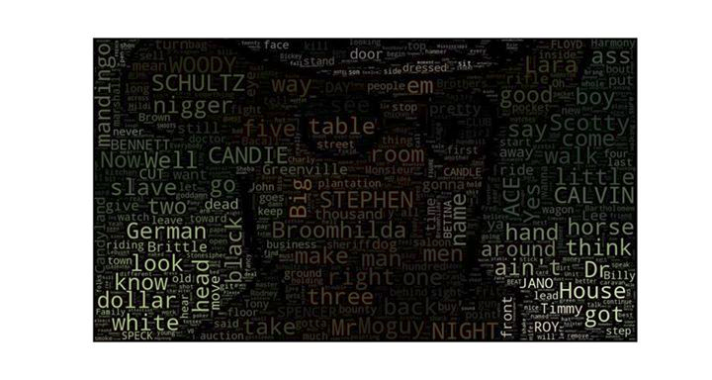

Slide 11
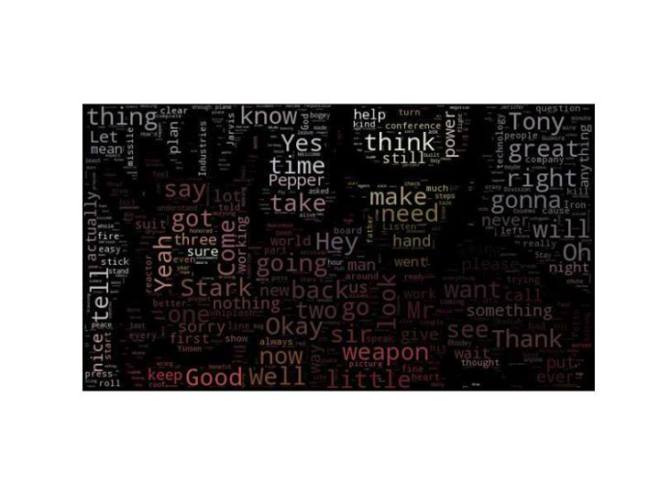

Slide 12
Bored?
Web service!
Command line interface!
PDF parsing!

Slide 13
$ pip install wordcloud
http://amueller.github.io/word_cloud

