Slide 1
Basic API review

Slide 2
Representing Data
one sample
1.1 | 2.2 | 3.4 | 5.6 | 1.0
6.7 | 0.5 | 0.4 | 2.6 | 1.6
2.4 | 9.3 | 7.3 | 6.4 | 2.8
1.5 | 0.0 | 4.3 | 8.3 | 3.4
0.5 | 3.5 | 8.1 | 3.6 | 4.6
5.1 | 9.7 | 3.5 | 7.9 | 5.1
3.7 | 7.8 | 2.6 | 3.2 | 6.3
1.6
2.7
4.4
0.5
0.2
5.6
6.7
X =
y =
one feature
outputs / labels

Slide 3
clf = RandomForestClassifier()
clf.fit(X_train, y_train)
Training Data
Model
Training Labels
y_pred = clf.predict(X_test)
Test Data
Prediction
Test Labels
Evaluation
clf.score(X_test, y_test)

Slide 4
Basic API
estimator.fit(X, [y])
estimator.predict | estimator.transform
Classification | Preprocessing
Regression | Dimensionality reduction
Clustering | Feature selection
 | Feature extraction

Slide 5
Cross -Validated Grid Search
from sklearn.grid_search import GridSearchCV
from sklearn.cross_validation import train_test_split
X_train, X_test, y_train, y_test = train_test_split(X, y)
param_grid = {'C': 10. ** np.arange(-3, 3),
'gamma': 10. ** np.arange(-3, 3)}
grid = GridSearchCV(SVC(), param_grid=param_grid)
grid.fit(X_train, y_train)
grid.predict(X_test)
grid.score(X_test, y_test)

Slide 6
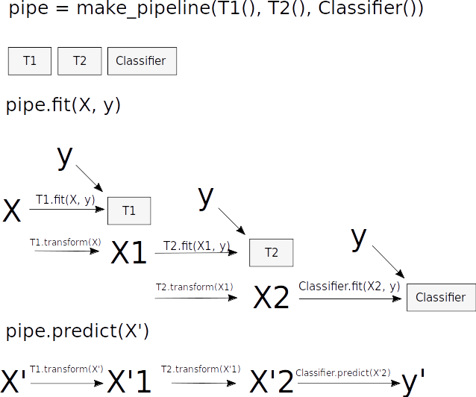
Pipelines

Slide 7
Pipelines
from sklearn.pipeline import make_pipeline
pipe = make_pipeline(StandardScaler(), SVC())
pipe.fit(X_train, y_train)
pipe.predict(X_test)
param_grid = {'svc__C': 10. ** np.arange(-3, 3),
'svc__gamma': 10. ** np.arange(-3, 3)}
scaler_pipe = make_pipeline(StandardScaler(), SVC())
grid = GridSearchCV(scaler_pipe, param_grid=param_grid, cv=5)
grid.fit(X_train, y_train)

Slide 8
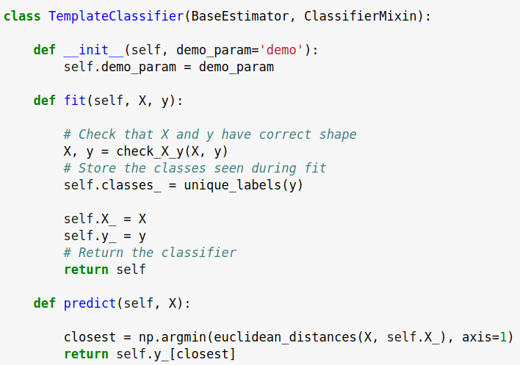
check_estimator
AssertionError: Error message does not include the expected string: 'fit'.
Observed error message: "'TemplateClassifier' object has no attribute 'X_'"

Slide 9
Scikit-Learn 0.19
(August 2017)

Slide 10
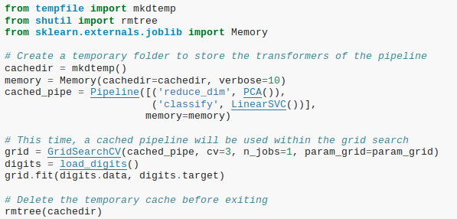
Caching Pipeline

Slide 11
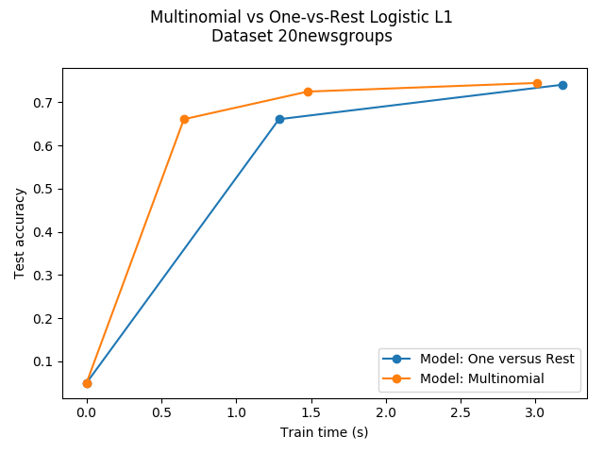
SAGA

Slide 12
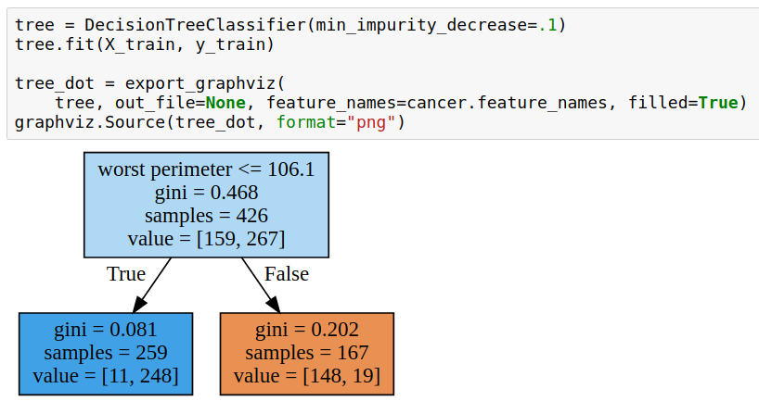
More Tree Regularization

Slide 13
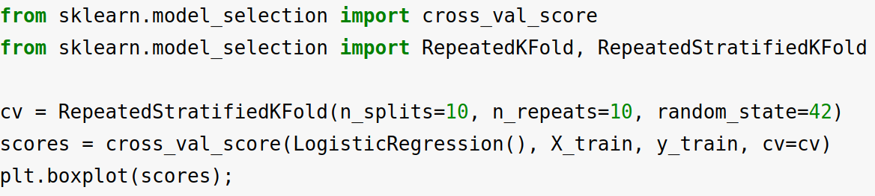
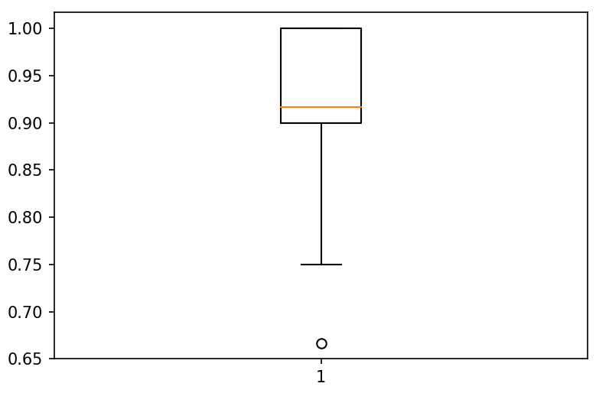
Repeated KFold

Slide 14
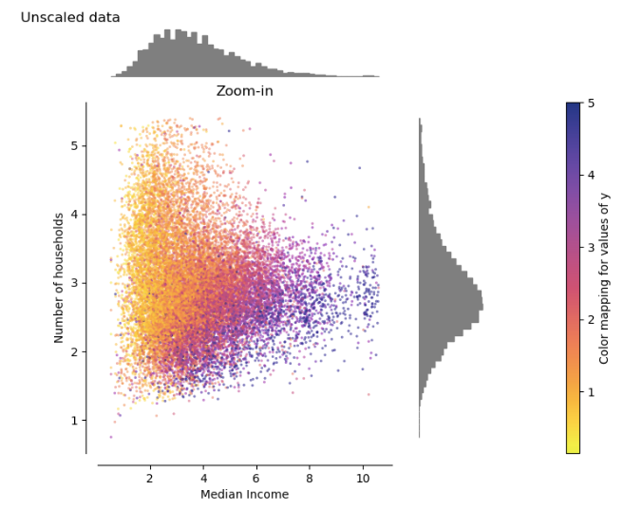
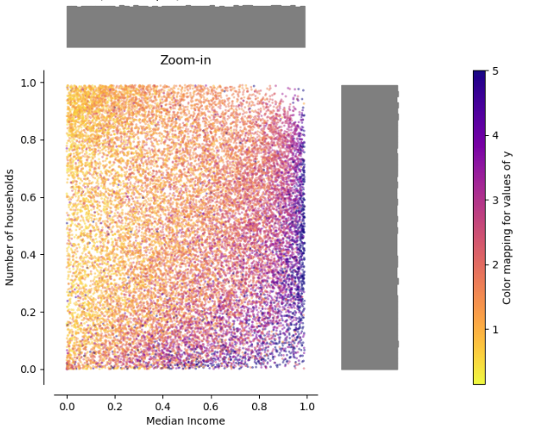
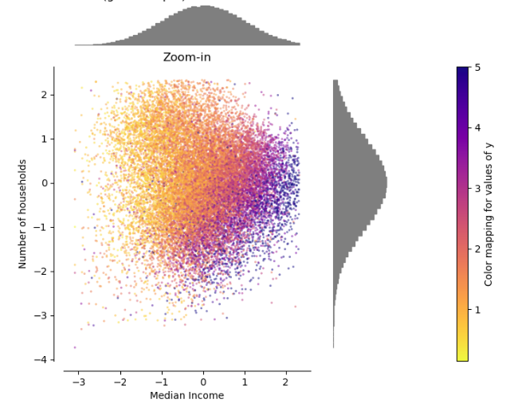
QuantileTransformer

Slide 15
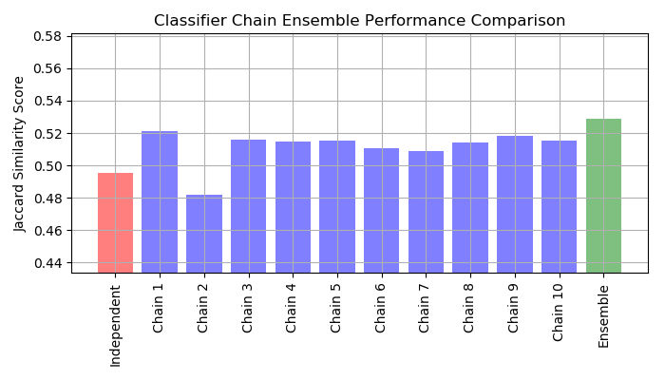
ClassifierChain

Slide 16
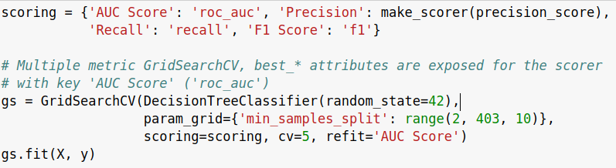
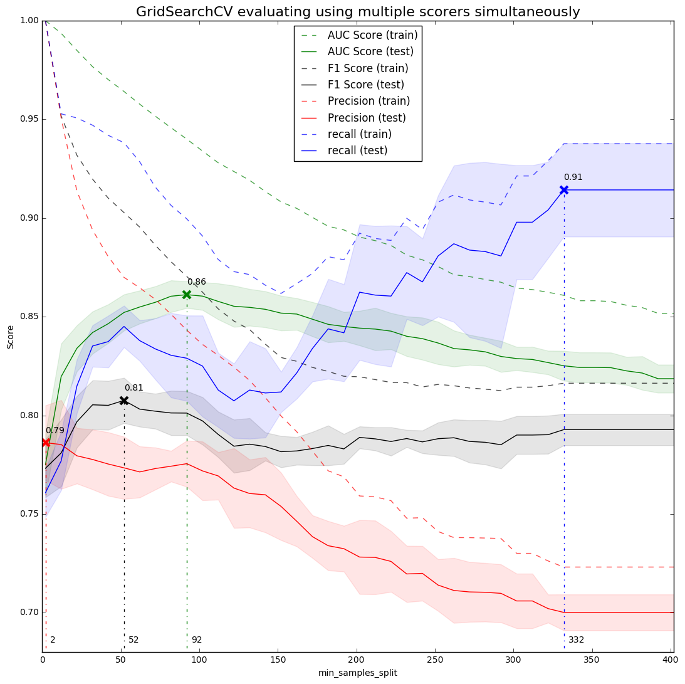
Multiple Metric Search

Slide 17
Testing Meta-Estimators
check_estimator(
  make_pipeline(NMF(), LogisticRegression()))
  Can pass instances now!

Slide 18
Around Scikit-learn

Slide 19
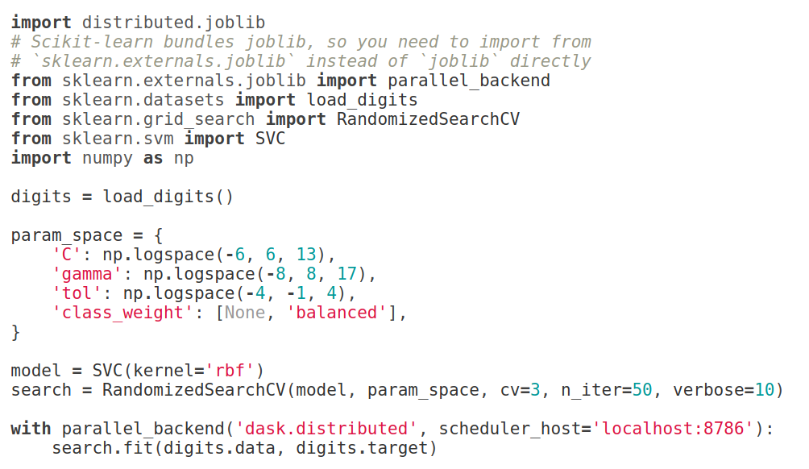
Joblib Distributed Backend

Slide 20
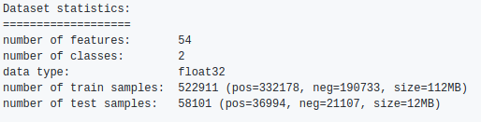
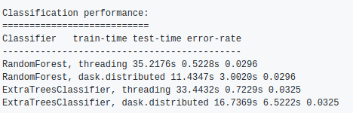
Distributed Random Forests
Uses scatter!
https://github.com/dask/distributed/pull/1022#issuecomment-297550998

Slide 21
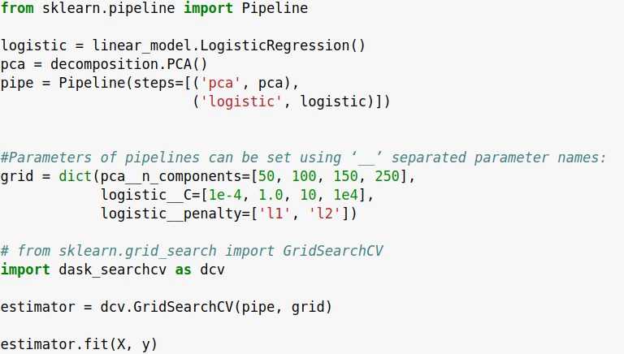
dask_searchcv – lazy pipelines!

Slide 22
Scikit-Learn 0.20
(“early” 2018)

Slide 23
Merged Already!

Slide 24
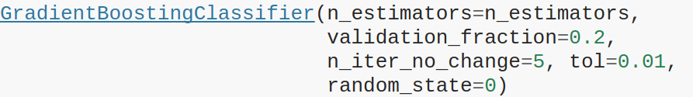
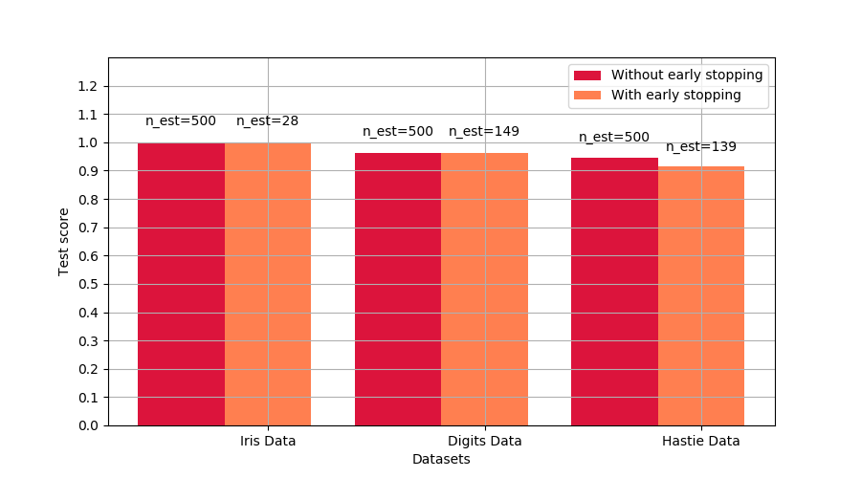
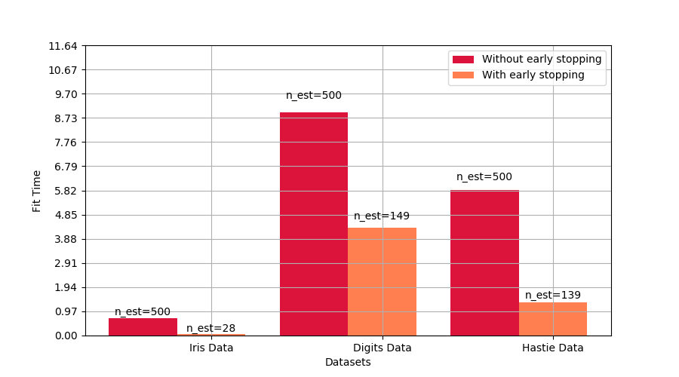
Gradient Boosting Early Stopping
Activated by “n_iter_no_change”

Slide 25
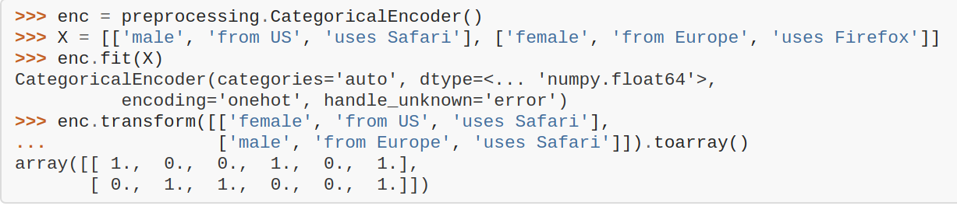
CategoricalEncoder
Extends / replaces OneHotEncoder
to work on text and integer data!

Slide 26
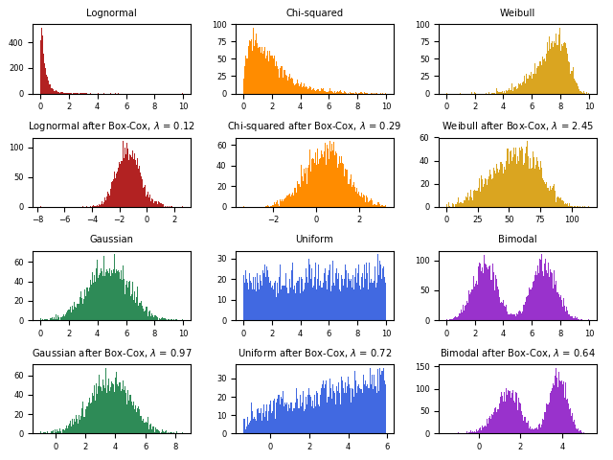

PowerTransformer
Right now: Box-Cox transform
before release: also Yeo-Johnson

Slide 27
Work In Progress
Notes:
So now, lets talk to the somewhat further-out future.
What are the plans and ideas we have?

Slide 28
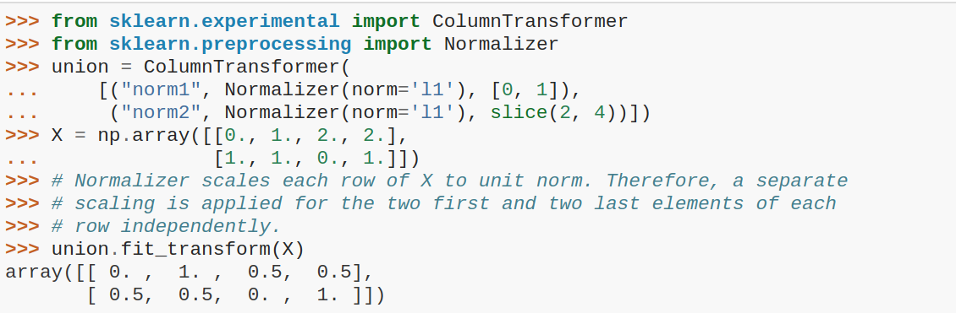
ColumnTransformer
Particularly userful to treat different types of data within the same dataset
(continuous, categorical, text, ...)

Slide 29
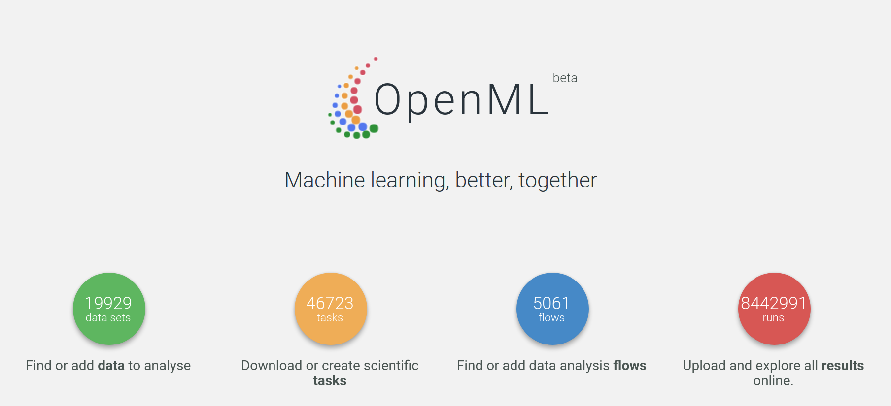
OpenML Dataset Loader

Slide 30
Estimator Tags
est._get_tags()
input_validation
multioutput
multilabel
stateless
missing_values
...

Slide 31
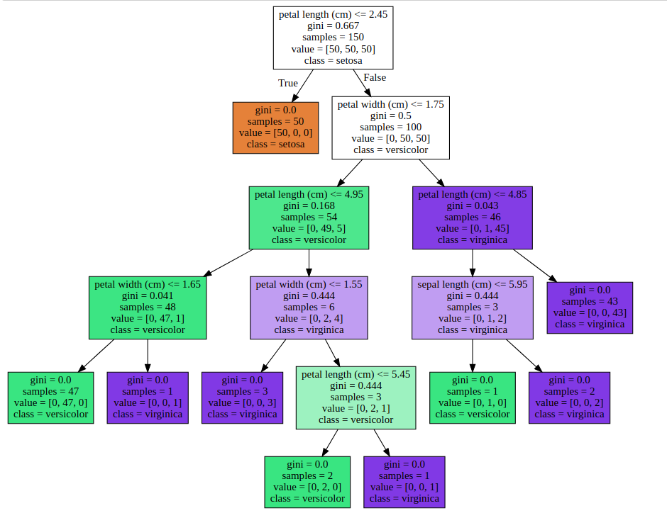
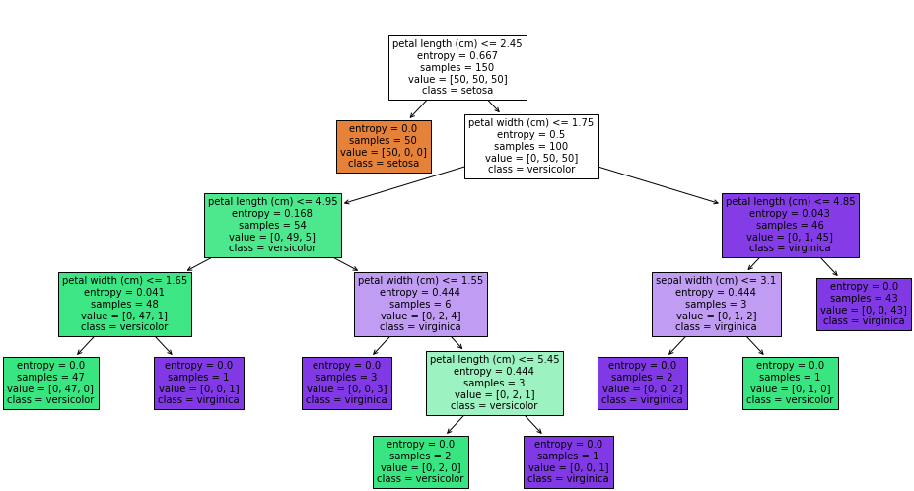
Matplotlib based tree plotting
Graphviz
Our own!

Slide 32





amueller.github.io
@amuellerml
@amueller
t3kcit@gmail.com
Notes:
Alright, as I said, buy my book.
You can also find a lot of free videos and notebooks about machine learning and scikit-learn on my website. All the code from the book is BSD-licensed and on github.
I’ll hang around for the rest of the day if you want to chat about machine learning.
Or if you want to take a selfie, that seems to be even more popular than machine learning these days.
Alright, thank you for your attention.

