Slide 1




An update on
scikit-learn
0.20 and beyond
Andreas Müller
Columbia University, scikit-learn
Notes:
Hey and welcome to my talk on machine learning and how to do it with python.
My goal for the next 45 minutes is to convince you that machine learning can help you in your research, make your life easier, and allow you to process much more data than you could before – and that it’s all pretty easy to do.
I’m andy, I work at Columbia and I’ve been contributing to the scikit-learn project for a couple of years now. Scikit-learn is the main machine learning tool in python and I’ll tell you a bit more about it later.

Slide 2
What is scikit-learn?

Slide 3




Slide 4
Basic API review

Slide 5
Representing Data
one sample
1.1 | 2.2 | 3.4 | 5.6 | 1.0
6.7 | 0.5 | 0.4 | 2.6 | 1.6
2.4 | 9.3 | 7.3 | 6.4 | 2.8
1.5 | 0.0 | 4.3 | 8.3 | 3.4
0.5 | 3.5 | 8.1 | 3.6 | 4.6
5.1 | 9.7 | 3.5 | 7.9 | 5.1
3.7 | 7.8 | 2.6 | 3.2 | 6.3
1.6
2.7
4.4
0.5
0.2
5.6
6.7
X =
y =
one feature
outputs / labels

Slide 6
clf = RandomForestClassifier()
clf.fit(X_train, y_train)
Training Data
Model
Training Labels
y_pred = clf.predict(X_test)
Test Data
Prediction
Test Labels
Evaluation
clf.score(X_test, y_test)

Slide 7
Basic API
estimator.fit(X, [y])
estimator.predict | estimator.transform
Classification | Preprocessing
Regression | Dimensionality reduction
Clustering | Feature selection
 | Feature extraction

Slide 8
Cross -Validated Grid Search
from sklearn.grid_search import GridSearchCV
from sklearn.cross_validation import train_test_split
X_train, X_test, y_train, y_test = train_test_split(X, y)
param_grid = {'C': 10. ** np.arange(-3, 3),
'gamma': 10. ** np.arange(-3, 3)}
grid = GridSearchCV(SVC(), param_grid=param_grid)
grid.fit(X_train, y_train)
grid.predict(X_test)
grid.score(X_test, y_test)

Slide 9
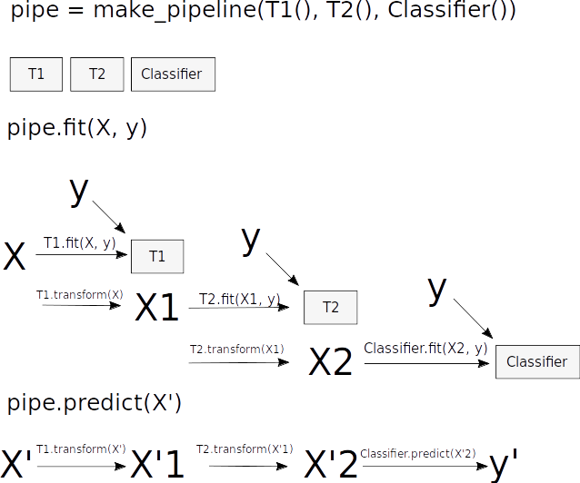
Pipelines

Slide 10
Pipelines
from sklearn.pipeline import make_pipeline
pipe = make_pipeline(StandardScaler(), SVC())
pipe.fit(X_train, y_train)
pipe.predict(X_test)
param_grid = {'svc__C': 10. ** np.arange(-3, 3),
'svc__gamma': 10. ** np.arange(-3, 3)}
scaler_pipe = make_pipeline(StandardScaler(), SVC())
grid = GridSearchCV(scaler_pipe, param_grid=param_grid, cv=5)
grid.fit(X_train, y_train)

Slide 11

0.20
conda install scikit-learn=0.20rc1 -c conda-forge/label/rc -c conda-forge
pip install --pre scikit-learn

Slide 12
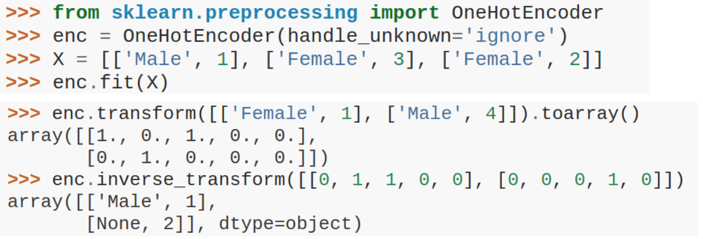
OneHotEncoder for Strings

Slide 13
Ordinal Encoder?

Slide 14
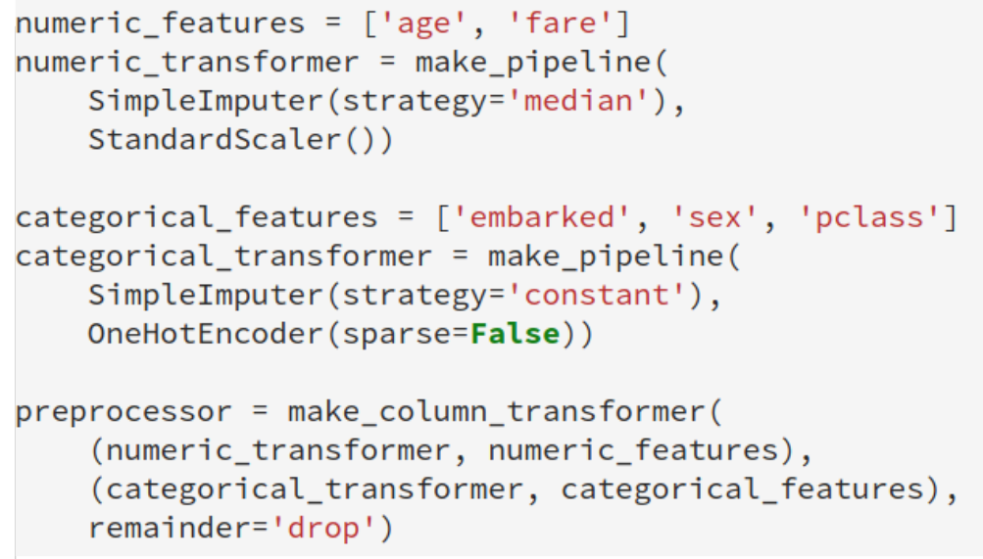
ColumnTransformer

Slide 15
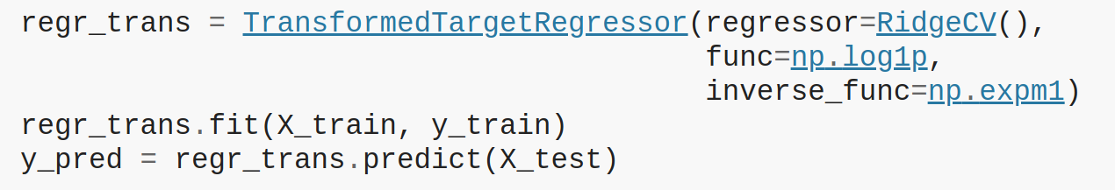
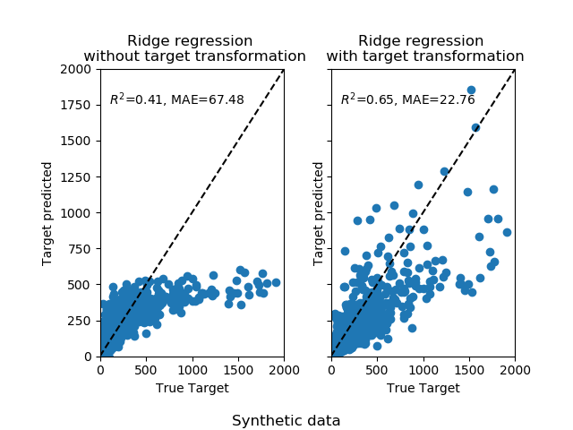
TransformedTargetRegressor

Slide 16
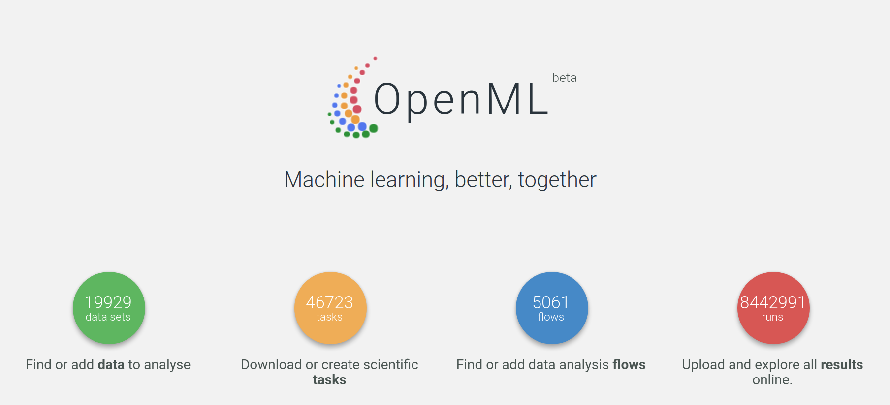
OpenML Dataset Loader

Slide 17
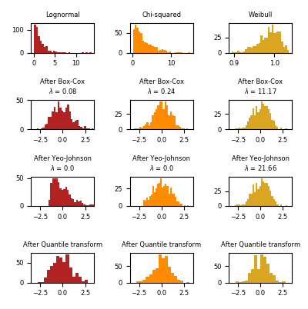

PowerTransformer

Slide 18
Missing Value treatment
Scalers
SimpleImputer
MissingIndicator

Slide 19
Loky

Slide 21
Working memory

Slide 22
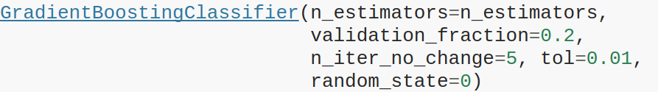
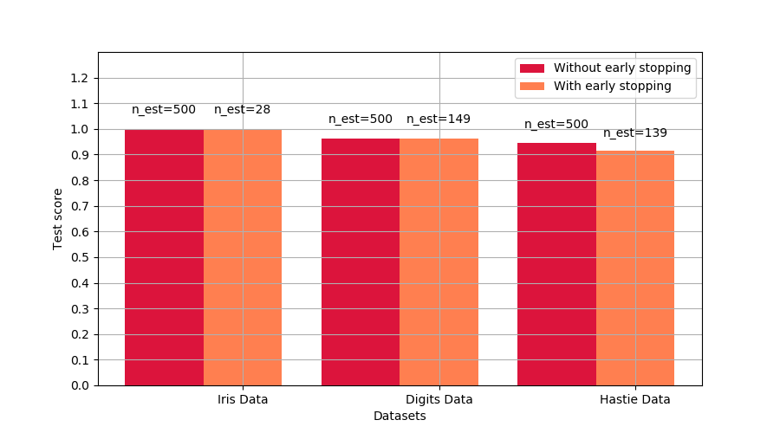
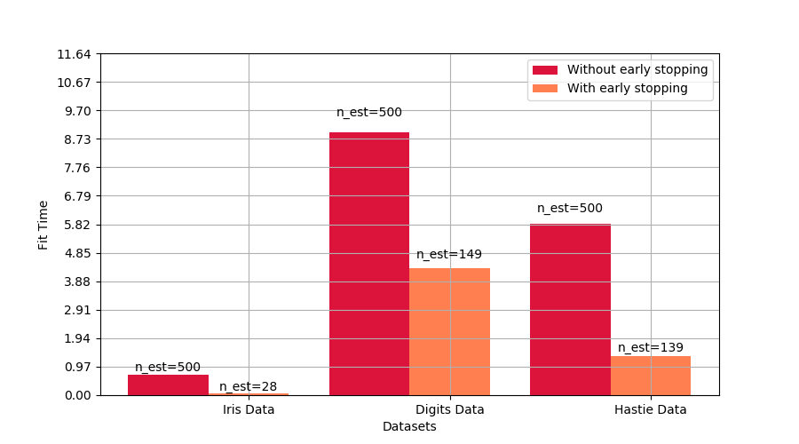
Gradient Boosting Early Stopping
Activated by “n_iter_no_change”

Slide 23
SGD et al early stopping

Slide 24
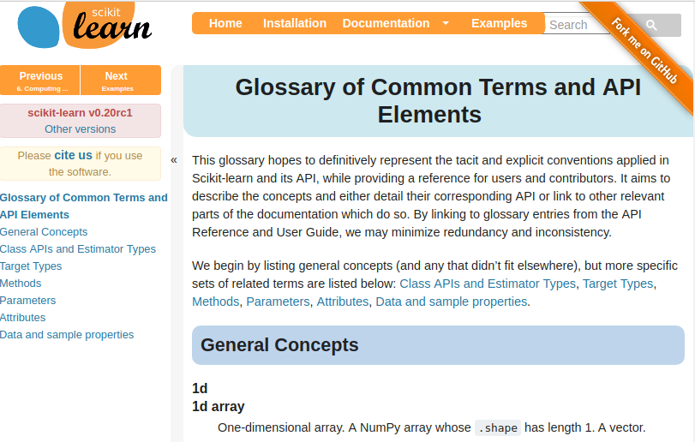

Slide 25
Better defaults
All random forests:
n_estimators from 10 to 100 (in 0.22)
Cross-validation:
cv from 3 to 5 (in 0.22)
Grid-Search:
iid to False (in 0.22)
Remove iid (in 0.24)

Slide 26
LogisticRegression defaults

Slide 27
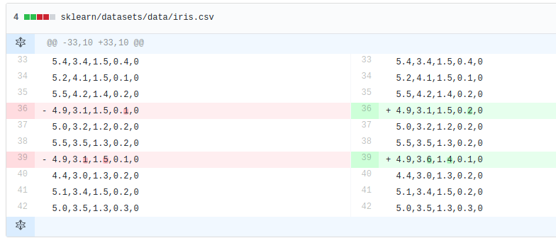
“Fixed” iris

Slide 28

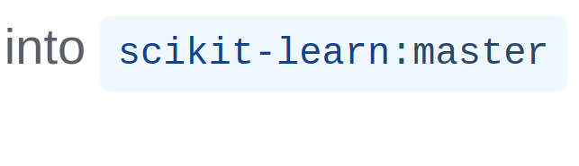

Slide 29

Work In Progress
Notes:
So now, lets talk to the somewhat further-out future.
What are the plans and ideas we have?

Slide 30
Dropping 2.7 (and 3.4!)

Slide 31
Loky / OpenMP

Slide 32
Imbalance-Learn integration

Slide 33
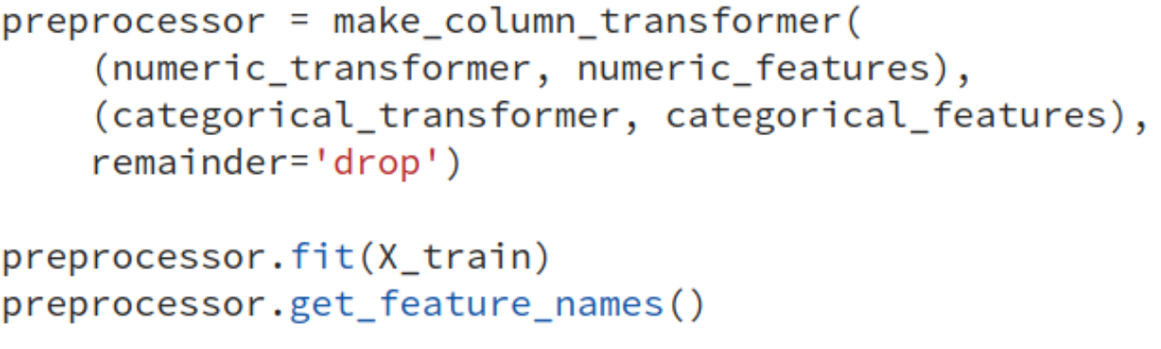
Pandas & Feature Names

Slide 34





amueller.github.io
@amuellerml
@amueller
t3kcit@gmail.com
Notes:
Alright, as I said, buy my book.
You can also find a lot of free videos and notebooks about machine learning and scikit-learn on my website. All the code from the book is BSD-licensed and on github.
I’ll hang around for the rest of the day if you want to chat about machine learning.
Or if you want to take a selfie, that seems to be even more popular than machine learning these days.
Alright, thank you for your attention.

