Slide 1

Engineering
Andreas Mueller (NYU Center for Data Science, scikit-learn)

Slide 2
Goals
Achievements
Methods
Challenges

Slide 3
Goals

Slide 4
Goal:
High quality, easy to use machine learning library.

Slide 5
Goal:
High quality, easy to use machine learning library.
Keep it usable, keep it maintainable.

Slide 6
Interoperability
X = pd.read_csv(“data.csv”).values
X_2d = PCA(n_components=2).fit_transform(X)
plt.scatter(X_2d[:, 0], X_2d[:, 1])

Slide 7
Simple things should be simple, complex things should be possible.
Alan Kay

Slide 8
Non-Goals
Non-programmatic interfaces
Algorithm development
Cutting edge algorithms
Structured, online, or reinforcement learning.
“I thought it was more like CRAN”

Slide 9
Achievements

Slide 10


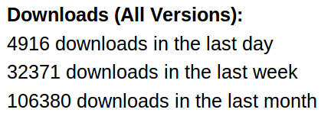
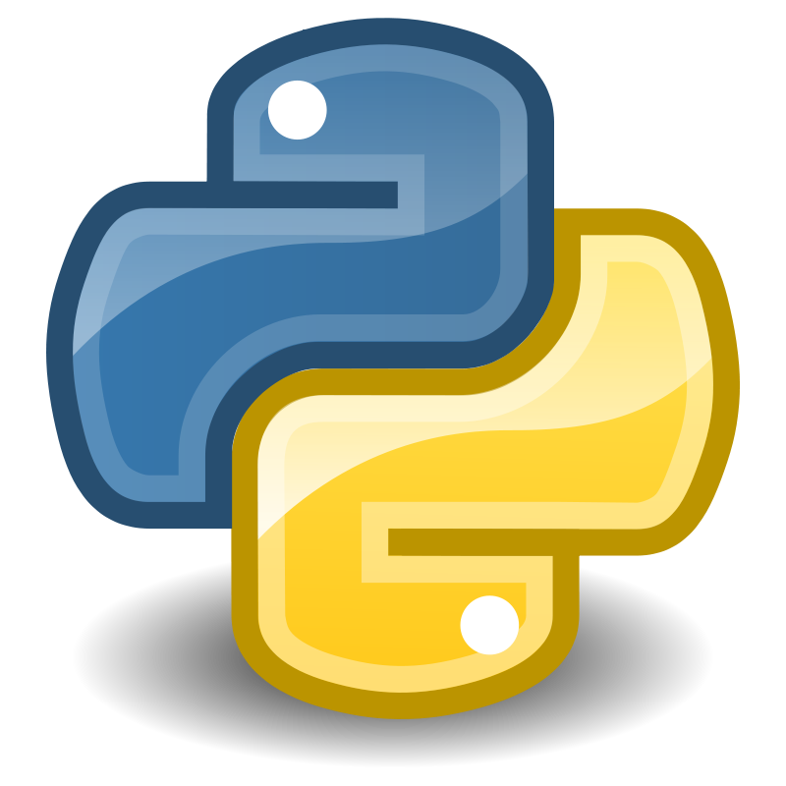



Slide 11
We’ve been using it quite a lot for music recommendations at Spotify and I think it’s the most well-designed ML package I’ve seen so far.
- spotify
scikit-learn in one word: Awesome.
- machinalis
I’m constantly recommending that more developers and scientists try scikit-learn.
- lovely
The documentation is really thorough, as well, which makes the library quite easy to use.
- OkCupid
scikit-learn makes doing advanced analysis in Python accessible to anyone.
- yhat

Slide 12
Methods

Slide 13
Scoping
Well established
Widely
useful
sklearn
Matrix in,
matrix out

Slide 14
Simplicity
est = Est()
est.fit(X_train, y_train)
est.score(X_test, y_test)

Slide 15
Consistency
grid = GridSearchCV(svm,param_grid)
grid.fit(X_train, y_train)
grid.score(X_test, y_test)

Slide 16
Sensible Defaults
Everything is default constructible!
for clf in [KneighborsClassifier(),
SVC(),
DecisionTreeClassifier(),
RandomForestClassifier(),
AdaBoostClassifier(),
GaussianNB(),
LDA(),
QDA()]:
clf.fit(X_train, y_train)
print(clf.score(X_test, y_test))

Slide 17
Common Tests
classifiers = all_estimators(type_filter='classifier')
for name, Classifier in classifiers:
# test classfiers can handle non-array data
yield check_classifier_data_not_an_array, name, Classifier
# test classifiers trained on a single label
# always return this label
yield check_classifiers_one_label, name, Classifier
yield check_classifiers_classes, name, Classifier
yield check_classifiers_pickle, name, Classifier
yield check_estimators_partial_fit_n_features, name, Classifier

Slide 18
Flat Class Hierarchy, Few Types
Numpy arrays / sparse matrices
Estimators
[Cross-validation objects]
[Scorers]

Slide 19
No Framework
“This looks frameworkish.” means “try again.”

Slide 20

Avoid Code
Code rots!
Hail all code deleters!

Slide 21



Three-Way Documentation

Slide 22
Challenges

Slide 23

Feature Creep

Slide 24
Multi-Platform Support
Linux / Mac / Windows / Solaris (no kidding)
32bit / 64bit
Python2.6 / Python2.7 / Python 3.4
GCC, Clang, MSVC
Blas dependency...
And we want “one click” install

Slide 25


Two Language Problem

Slide 26
Two Language Problem
C / C++

Slide 27
Backward compatibility
from sklearn.cross_validation import Bootstrap
Bootstrap(10)
sklearn/cross_validation.py:685:
DeprecationWarning: Bootstrap will no longer
be supported as a cross-validation method as of
version 0.15 and will be removed in 0.17.

Slide 28
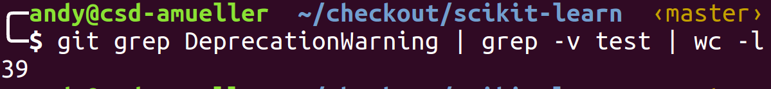
Backward compatibility

Slide 29
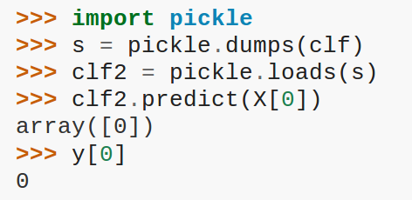
Backward compatibility

Slide 30
Correctness Testing
?

Slide 31


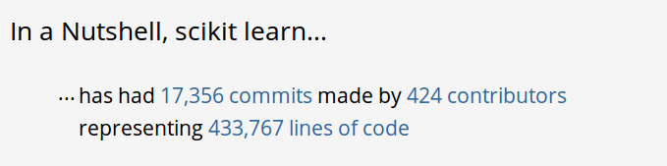
Project Size

Slide 32



@t3kcit
@amueller
amueller@nyu.edu

